Slide 1

Report to the RA VI MG-5
Regional Office for Europe
WMO DRA Department

Slide 2
UNHCR work
USAID project (South-East Europe)
Activity re: connecting EUMETNET Roshydromet, under the RA VI umbrella
PRO NEWS Project “Programme for Improving National Early warning System and flood prevention in Albania”
WMO Eurasian Office in Minsk
Preliminary plan for fund raising
Preparations for the RA VI Session

Slide 3
UNHCR work

Slide 4


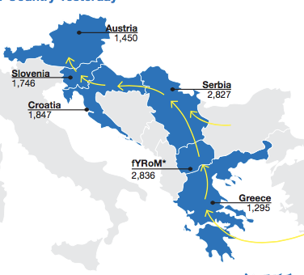
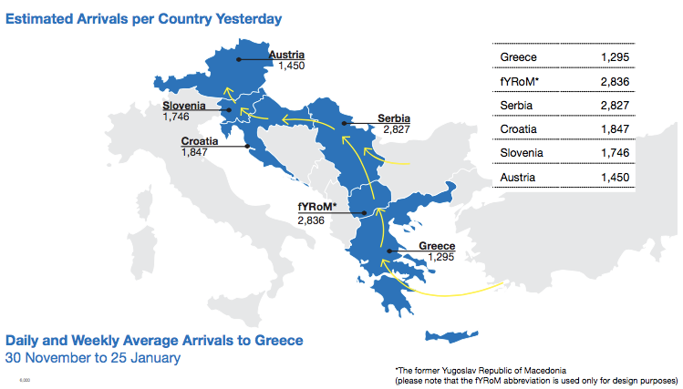

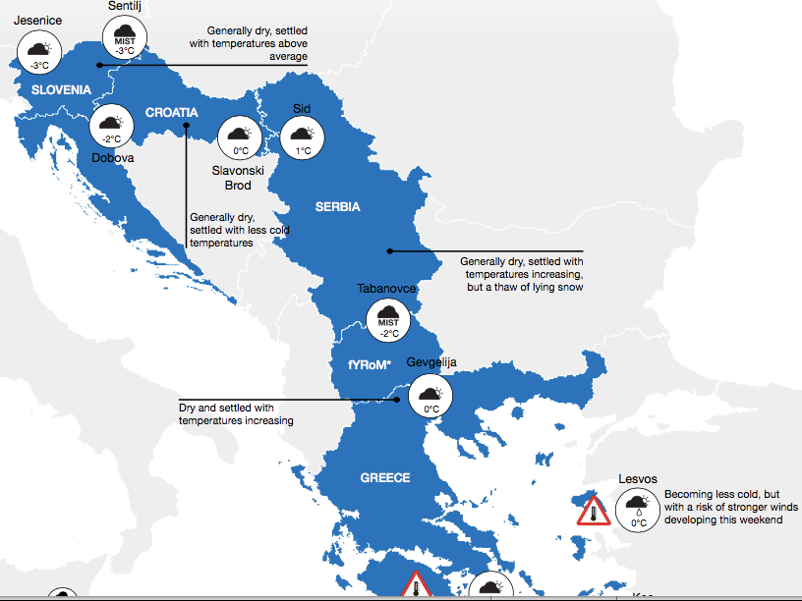
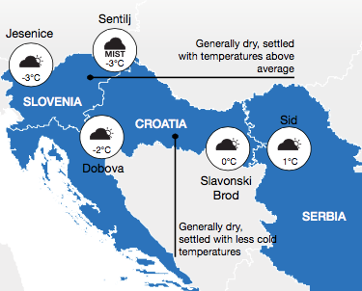
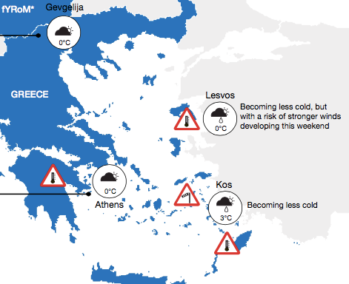
CONTRIBUTION OF SOUTH EAST EUROPE NMHS TO
WMO-UK MET OFFICE COORDINATION OF MET SUPPORT TO
UNHCR DURING THE REFUGEE CRISIS IN EUROPE
In 2015 more than 3,400 people lost their lives or had been reported missing as they were seeking to reach Europe. At least 200 have died making the hazardous sea crossing to Greece from Turkey.
http://www.politika.rs/scc/clanak/351110/Hiljade-migranata-napusta-Idomeni
UNHCR approached WMO for MET support. Jointly with UK, WMO responded and organized the MET support to UNHCR ‘Winter Cell’ for their planning of field operations and logistics in humanitarian activities on route of refugees. WDS/DRR and DRA/ROE offices took lead in WMO Secretariat to coordinate the action amongst the South East European NMHSs with the
UK Met Office operational forecasters embedded in Winter Cell in Geneva.

Slide 5
CONTRIBUTION OF SOUTH EAST EUROPE NMHS TO
WMO-UK MET OFFICE COORDINATION OF MET SUPPORT TO
UNHCR DURING THE REFUGEE CRISIS IN EUROPE
NMHS 24/7 Offices: Turkey, Greece, former Yugoslav Republic of Macedonia, Serbia, Croatia, Slovenia
Coordination: WMO Secretariat and UK Met Office
UNHCR Winter Cell: UK Met Office forecasters preparing jointly with 24/7 forecasters from SEE the daily reports for identified spots on route of refugees of particular concern of UNHCR
Video Conferencing: Blue Jeans – e.g. 18 and more participants becoming regular activity
ZAMG Involvement: Developing collaboration platform to ease(speed-up) the work of the shift forecasters in contributing to the UNHCR MET Report

Slide 6
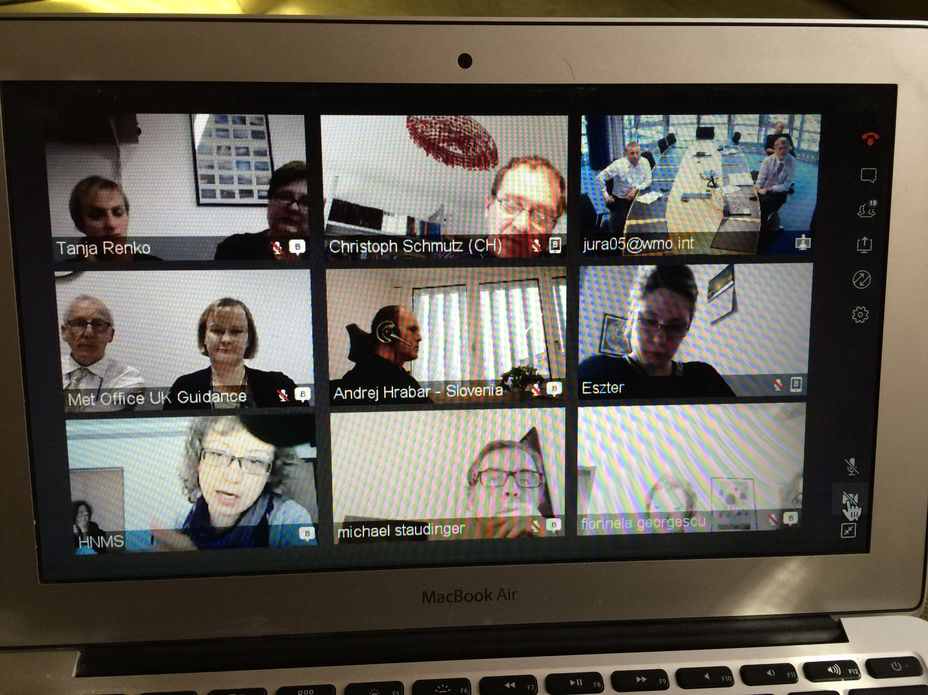
CONTRIBUTION OF SOUTH EAST EUROPE NMHS TO
WMO-UK MET OFFICE COORDINATION OF MET SUPPORT TO
UNHCR DURING THE REFUGEE CRISIS IN EUROPE

Slide 7
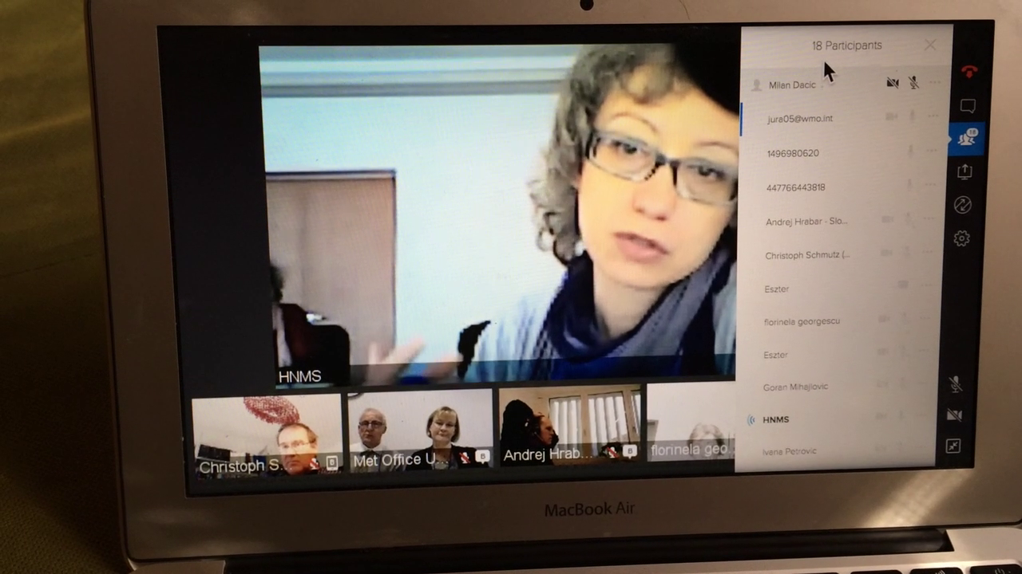
CONTRIBUTION OF SOUTH EAST EUROPE NMHS TO
WMO-UK MET OFFICE COORDINATION OF MET SUPPORT TO
UNHCR DURING THE REFUGEE CRISIS IN EUROPE
18 participants

Slide 8
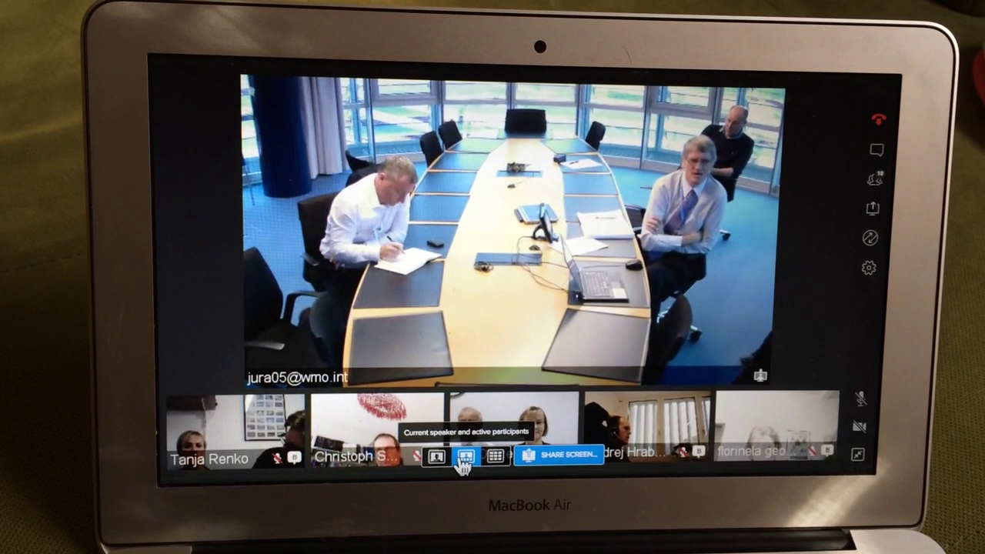
CONTRIBUTION OF SOUTH EAST EUROPE NMHS TO
WMO-UK MET OFFICE COORDINATION OF MET SUPPORT TO
UNHCR DURING THE REFUGEE CRISIS IN EUROPE
Coordination

Slide 9
Communication: Blue Jeans http://bluejeans.com/

Slide 10
COMMUNICATION: ZAMG DEVELOPING A PLATFORM FOR QUICK EXCHANGE OF SUB-REGIONAL INFO

Slide 11
LESSONS LEARNET
MET support to UNHCR activity thought us a lesson on which we should capitalize. Namely, if this kind of situation appears again - not necessarily in this part of the world - WMO should have in place a ready procedure on how we respond.
Which entities are responsible on different levels?
(Global, Regional, and Sub-regional)
Which existing or new cooperation mechanisms should be engaged without delay?
WMO should play proactive role in any future situation of this kind.

Slide 12
USAID project (South-East Europe)

Slide 13

Project highlights
- Overall Objective: Achieved better collaboration between the NMHS, which will contribute to improved protection of life and property in South-East Europe.
- Main outputs:
Detailed implementation plan for a regionally owned Multi-Hazard Early Warning Advisory System (SEE-MHEWS-A) prepared and adopted by NMHS directors.
Consensus of Directors of participating NMHS on the scope and technical content of the SEE-MHEWS-A;
- Implementing organization: WMO, project coordination by FMI
- Funding: USAID, 580 000 USD
- Implementation period: 12 months, September 2016 – August 2017

Slide 14
Project partners
Participating NMHSs:
Albania, Bosnia and Herzegovina, Croatia, Montenegro, Serbia, Kosovo (UNSCR 1244/99), the former Yugoslav Republic of Macedonia, Turkey, Slovenia, Bulgaria, Greece, Cyprus, Hungary, Romania, Moldova, Ukraine, Israel, Jordan and Lebanon.
Collaborators:
ECMWF, EUMETSAT, EUMETNET, ESSL, JRC, ISRBC, SEE-DMC, SEE-VCCCC, Euro-Mediterranean Center on Climate Change, NWP consortiums, European and global NMHSs etc.

Slide 15
PROJECT ACTIVITIES
Regional Conference on South-East European Multi-Hazard Early Warning Systems
Introduction to the vision of SEE-MHEWS-A and the Phase 1 on the project implementation;
Discuss of the willingness and interest of the NMHSs to participate in the SEE-MHEWS-A project and actively cooperate with other project partners and stakeholders;
Preliminary agreement of the scope of the project, geographical coverage and roles of different stakeholders;
Establishment of the cooperative foundation for project implementation;
Provision of training on CAP implementation.
OCTOBER 2016

Slide 16
PROJECT ACTIVITIES
Development of the implementation plan
Global, regional and sub-regional modelling and observing capabilities that could be leveraged for the region.
Observation network enhancements that would strengthen meteorological and hydrological modeling outputs.
Communications and collaboration framework that facilitates exchange of data and information and harmonization of forecasts among the participating parties.
NMHS requirements for training and capacity development to maximize their utilization of the new sub-regional tools.
NMHS partnerships to be strengthened at the sub-regional, regional and global levels.
Technical specifications for the needed solutions.
OCTOBER 2016- JUNE 2017

Slide 17
PROJECT ACTIVITIES
Thematic workshops
Three workshops will organized with the aim on identification of the needs and potential solutions relevant to the development of the SEE-MHEWS-A including topics on:
Workshop on Forecasting requirements (7-9 February 2017, Skopje).
Workshop on Numerical modelling (8-9 March 2017, Budapest).
Workshop on ICT technologies and Observational requirements for Advisory system (4-6 April 2017, Athens).
FEBRUARY-APRIL 2017

Slide 18
PROJECT ACTIVITIES
Final Regional Conference
Acceptance of Implementation Plan and the technical specifications.
Memorandum of Understanding on collaborative work towards the regionally owned MHEWS-A approved by Directors of the NMHS.
Discussions with potential donors (WB, USAID, EU, GCF, JICA etc).
Dates 14-15 June 2017, Ljubljana, Slovenia.
JUNE 2016

Slide 19
Preliminary plan for fund raising
JICA
Green Climate Fund (GCF)
GTZ
Austrian Aid Agency
Swiss Aid Agency,
USAID
World Bank
European Commission
GCF and EU for the major implementation of
SEE-MHEWS
Other components of the SEE-MHEWS Implementation Plan supported by WB, USAID, bilateral assistance through ODA

Slide 20
PROJECT CONTACTS
WMO/FMI Project Office, Skopje
Sari Lappi
slappi@wmo.int
WMO Regional Office for Europe
Milan Dacic
mdacic@wmo.int
Project email address:
see-mhews-a@wmo.int
Project Website:
http://public.wmo.int/en/projects/see-mhews-a

Slide 21
Connecting EUMETNET, Roshydromet, under the RA VI umbrella
Visit of President RA VI, EUMETNET ED, EMMA/Meteoalarm Project Director, and WMO Rep EUR
to Roshydromet and PR of Russian Federation
Title: Preliminary discussions on establishment of cooperation between the WMO-Roshydromet-EUMETNET
Report to SG from the visit to Roshydromet

Slide 22
PRO NEWS Project “Programme for Improving National Early warning System and flood prevention in Albania” – PRO NEWS
Grant Contract: EuropeAid/151-248/DD/ACT/AL
Contract number: 2016/382-775
Coordinator: Presidenza del Consiglio dei Ministri, Dipartamento della Protezione Civile”- Italian Presidency of the Council of Ministers, National Civil Protection Department
Partners: Fondazione CIMA - Savona Italy - CIMA Foundation,
Croatian Meteorological and Hydrological Service (DHMZ)
European Centre for Medium-range Weather Forecasts (ECMWF)
Regional Environmental Center (REC), Country Office Albania
World Meteorological Organization (WMO – DRA/ROE)

Slide 23








Steering Committee Meeting
10-11 April 2017
Milan Dacić
WMO Representative for Europe

Slide 24
WMO activities
B.1: Assessment of EWS regulatory framework and protocols currently in force (part relevant to the activities of IGEWE)
  Fact finding mission(s)
  Update of previous assessments
  Assessment report on the EWS in Albania comprising of: legal and institutional framework, existence of SOPs, communication protocols, data management, regional and International agreements, list of needed legal acts
  Stakeholders workshop
  WMO, DHMZ, CIMA, DPC (and GIZ)

Slide 25
WMO activities
D.1: Assessment of EWS Capacities, identification of needs, prioritization based on Cost-Benefit analysis and preparation of procurement files
  Fact finding mission(s)
  Analysis and recommendations focusing on recognized urgent needs and priorities relevant to observations, forecasting, data management, ICT and telecommunications
  Update of previous assessments
  Preparation of procurement files
  WMO and DHMZ

Slide 26
WMO activities
D.2: Improve the National meteorological forecasting system in a Regional context
  Evaluation of which existing limited area NWP models, operated by different national meteorological and hydrological services in the South-Eastern Europe (DHMZ, RHMSS, IHSM, HNMS), can be available and suitable to support forecasting of extreme weather events in Albania.
  Evaluation of availability of suitable and affordable software tools to improve utilization of available data and products for meteorological forecasting
  Improved utilization of other data and products (such as satellite data) for weather forecasting
  Training of staff
  Detailed planning during the first reporting period together with IGEWE
  WMO and DHMZ

Slide 27
Action plan
Output | Activity | Inception phase (month 1-3) | First Reporting Period (month 3-9) | Second Reporting Period (month 9-15) | Third Reporting Period (month 15-21) | Role of Consortium Partners and Beneficiary Partners
Op B.1 assessment report on National EWS in Albania comprising Legal and institutional framework, communication protocols, regional and international agreements | Activity B.2.1 elaboration of recommendations for improving Early Warning System and hydro-meteorological emergency management in Albania based on initial assessment mission and desktop analysis of current existing assessments |  |  |  |  | CoPs: WMO DHMZ, CIMA, DPC BP: IGEWE
 | Activity B.2.2 organization of Stakeholders workshop for the presentation of the assessment to Albanian authorities

Slide 28
Action plan
Output | Activity | Inception phase (month 1-3) | First Reporting Period (month 3-9) | Second Reporting Period (month 9-15) | Third Reporting Period (month 15-21) | Role of Consortium Partners and Beneficiary Partners
Op D.1 Assessment and recommendations for improvement of EWS capacities and preparation of procurement files | Activity D.1.1 – Assessment of the functioning of the existing observation network, forecasting system, telecommunications, ICT system and data management, relevant for development of EWS in Albania, including recommendations for improvement |  |  |  |  | CoPs: WMO DHMZ
 | Activity D.1.2 - Rehabilitation and maintenance plan for existing stations and radar, including cost-benefit analysis and prioritization of interventions for EWS flood management both for non-structural intervention and for investments; Activity D.1.3 - Development of plan for improvement of current observations system, procurement files for at least 4 priorities |  |  |  |  | CoPs: WMO, DHMZ BP: IGEWE
OP D.2 Provision of available ready to share operational weather forecasts with a footprint on Albania and improved utilization of other data and products (such as satellite data) for weather forecasting and training of staff | Activity D.2.1 Evaluation of which existing limited area NWP models, operated by different national meteorological and hydrological services in the South-Eastern Europe (DHMZ, RHMSS, IHSM, HNMS), can be available and suitable to support forecasting of extreme weather events in Albania. |  |  |  |  | CoPs: WMO, DHMZ BP: IGEWE
 | Activity D.2.2 Evaluation of availability of suitable and affordable software tools to improve utilization of available data and products for meteorological forecasting, consultation with IGEWE and development of PRO-NEWS work plan for the second and third reporting period |  |  |  |  | CoPs: WMO, DHMZ BP: IGEWE
D.3.3 Evaluation of possibility to utilize the model HYPROM for hydrological models intercomparison for selected flooding episodes. | Activity D.3.3.1 Consultation with IGEWE and development of PRO-NEWS work plan for the second and third reporting period |  |  |  |  | CoPs: WMO BP: IGEWE

Slide 29
WMO Eurasian Office in Minsk

Slide 30

RA VI Collaboration in Eastern Europe
WMO Eurasian Office in Minsk, Belarus

Slide 31
Driving facts:
1- Needs for collaboration in whole RA VI and beyond
2- EUMETNET as a driving engine of RA VI collaboration
3- Congress deliberations on Regional Programm (cooperation, partnership)
4- Cg-17 Decision on WMO Eurasian Office in Minsk; EC-66 Decision
5- CIS/ICH Decision
6- Need to think in Broader sense then CIS domain – Russian speaking countries
7- Fundraising attempts with the World Bank Grant for Belarus, with a focus on methodological issues for Eurasia, and case study on Belarus (Combined approach).
8- Vision:
a) Broadened EUMETNET Programs coverage towards the East;
e.g. OPERA, EMMA
b) RA VI benefit the broader data exchange, e.g. AMDAR data
c) participation of east European countries in RA VI pilot-RWC implementation

Slide 32
Executive Council Sixty-sixth session, Geneva, 18–27 June 2014: Abridged final report with resolutions, Page 20
Paragraph 2.4.43 The Council was informed of the progress on the establishment of a new office for the Commonwealth
of Independent States (CIS) region covering 10 countries in RA II (Asia) and RA VI (Europe), which was initiated by the Interstate Council on Hydrometeorology of the countries of CIS (ICH/CIS). The Council was pleased to note that the Government of the Republic of Belarus has indicated its willingness to host the office in Minsk. The Council agreed that a closer liaison among the ICH/CIS, the Government of Republic of Belarus and WMO would be mutually beneficial and supported the on-going consultations that should find an appropriate format and related funding mechanism for a sustainable solution.

Slide 33
Seventeenth World Meteorological Congress, Geneva, 25 May–12 June 2015: Abridged final report with resolutions, Page 172
Decision 5.4.16 Congress noted with appreciation the ongoing process towards establishment of an Eurasian Office in Minsk, Belarus based on the initiative of the Interstate Council on Hydrometeorology of the Commonwealth of Independent States (CIS/ICH). Congress was further encouraged by RA VI and RA II consultations on the support for WMO activities that this Office could provide for Members in RA VI and RA II, noting that these consultations were supported by EC-66 (para. 2.4.43). Congress welcomed the readiness of Belarus to provide in-kind support for a WMO Eurasian office and requested the Secretary-General to pursue with Belarus and CIS, without delay, the possible arrangements for this cooperation, with the understanding that no regular budget funding would be provided during the seventeenth financial period.

Slide 34
Status:
Russian and English versions of the DRAFT Agreement:
Agreement between the government of the Republic of Belarus and the World
Meteorological Organization on establishment in the Republic of Belarus Eurasian Office of World Meteorological Organization
and
СОГЛАШЕНИЕ МЕЖДУ ПРАВИТЕЛЬСТВОМ РЕСПУБЛИКИ БЕЛАРУСЬ И ВСЕМИРНОЙ МЕТЕОРОЛОГИЧЕСКОЙ ОРГАНИЗАЦИЕЙ О СОЗДАНИИ В РЕСПУБЛИКЕ БЕЛАРУСЬ ЕВРАЗИЙСКОГО ОФИСА ВСЕМИРНОЙ МЕТЕОРОЛОГИЧЕСКОЙ ОРГАНИЗАЦИИ
Status at present: Russian version taken as a Master copy. English version officially checked to make it identical to Russian version. English version preliminary looked at Belarus MOFA for consistency with Russian (it is OK). English version will be officially sent to Belarus to agree on the English version of the text. Once done, English version will be taken in the internal procedure of WMO (DRA Department, Legal Counsel, Cabinet of External Relations) to prepare for the signature of Secretary-General.
Signature possibly before the end of the year (?)
President RA VI, EUMETNET Executive Director and WMO Rep for EUR visit to Belarus
Outcome: Belarus committed to work towards operationalization of the future Office in Minsk. NMHS of Belarus dedicated two staff members for this work. Office space with furniture secured, equipment and telecom. Belarus would like to join EUMETNET, to start with particular program e.g. EMMA/Meteoalarm.

Slide 35
Preparations for the RA VI Session
Discussion at the MG-5:
  Dates of the RA VI Session
  TECO Agenda
  Duration of the Session
  Future Priorities of the RA VI
  Documentation
  Cg-17 and EC-68 Decisions (Consolidated)
  ….

Slide 36

Thank you

