Slide 1
RA VI Management Group 5th Meeting (Vilnius, Lithuania, 26 – 27 April 2017) Report of the RA VI President
Achievements, Challenges, Perspectives
Towards 17th RA VI Session
Ivan Čačić

Slide 2
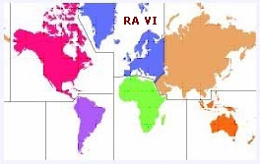
CONTENTS
Follow ups of the MG-4
Some of the Major Achievements
Challenges – Benefits – Priorities
----
How to cope with Priorities ? – Rob Varley slide
----
WMO Strategic Priorities 2017-2023 – SG slides
WMO Priorities 2016-19
How to cope with WMO complexity ?
How to cope with more and more meetings ?
----
How to plan inputs for the RAVI 17th Session ?
Results of Meeting of ROP TT, Geneva, 3 March 2017
Lessons learned – filling the gaps

Slide 3
Follow ups of the MG-4
Status on implementation – on going
 | Decision/Action | Responsible | Deadline | Notes/Remarks
MG 4/12 | Request the guidance from the SG on relation to the Copernicus | RA VI President | May 2016 | Continuous verbal consultations
MG 4/14 | MG endorses the decision of EC WG DRR to establish a WMO Inter-Programme TT on Cataloguing Extreme Weather, Water and Climate Events (IPTT - CWWCE) as an organization-wide coordination mechanism for the implementation of Cg-17 Resolution 9. MG further tasks RA VI WGs and their relevant TTa to actively contribute to the work of the above IPTT-CWWCE | RA VI President All WG Chairs/Co-chairs | On-going | Established 1st Phase of SEE MHEWS-A GMAS initiative - charing of the GMAS Advisory Group
MG 4/16 | MG has considered the Cg-17 Decision (paragraph 5.4.16) on establishment of the WMO Eurasian Office in Minsk and welcomes the kind offer of Belarus to host the future WMO Eurasian Office in Minsk and support it with two staff members, which could be regarded as a secondment to the Regional Office for Europe. MG requests the WMO Secretary-General to inform on the progress on implementation of Decision 5.4.16. MG invites the PR of Belarus to participate at the next MG-5 meeting and present the plan and work progress of the Office, including the coordination with the RA II | RA VI President WMO Secretariat / ROE | Before EC-68 | PR of Belarus, Maria Germenchuk acted as the PRA VI Advisor at the EC-68

Slide 4
Follow ups of the MG-4
Status on implementation – on going
 | Decision/Action | Responsible | Deadline | Notes/Remarks
MG 4/17 | MG supported the efforts of SEE through President and ROE to create the MHEWS Advisory system for South East Europe. MG recommended to explore the use of WMO Regional Specialized Meteorological Centres (RSMC) in this endeavor. MG requested President RA VI to report on its implementation at the next MG meeting. | RA VI President | By MG-5 | Regional Conference on SEE MHEWS project Project kick-off meeting Workshop on CAP 2016 ICSEED 1st Phase of the Project ends in June 2017 Project funding: USAID, WB Presentation at MG-5
Status on implementation – completed
 | Decision/Action | Responsible | Deadline | Notes/Remarks
MG 4/19 | The MG endorsed the proposal to replace the outgoing co-chair of the WG CH, and Hydrological Adviser to the President RA VI, Dr Dominique Berod with Mrs Cristina Alionte Eklund for both functions. Letter will be sent to the WMO Secretary-General with this regard. | RA VI President | ASAP | Mrs Cristina Alionte Eklund has been appointed as co-chair of the WG CH, and Hydrological Adviser to the PRA VI

Slide 5
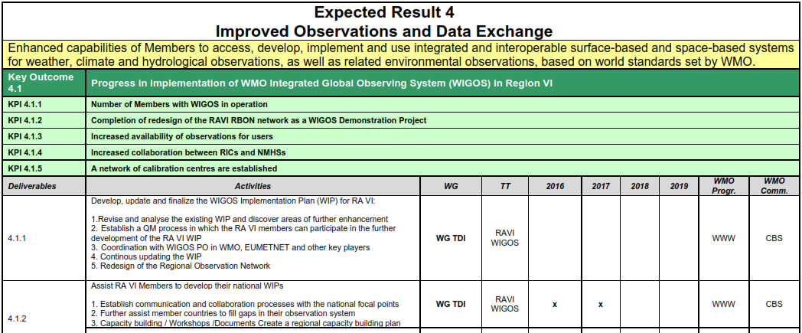
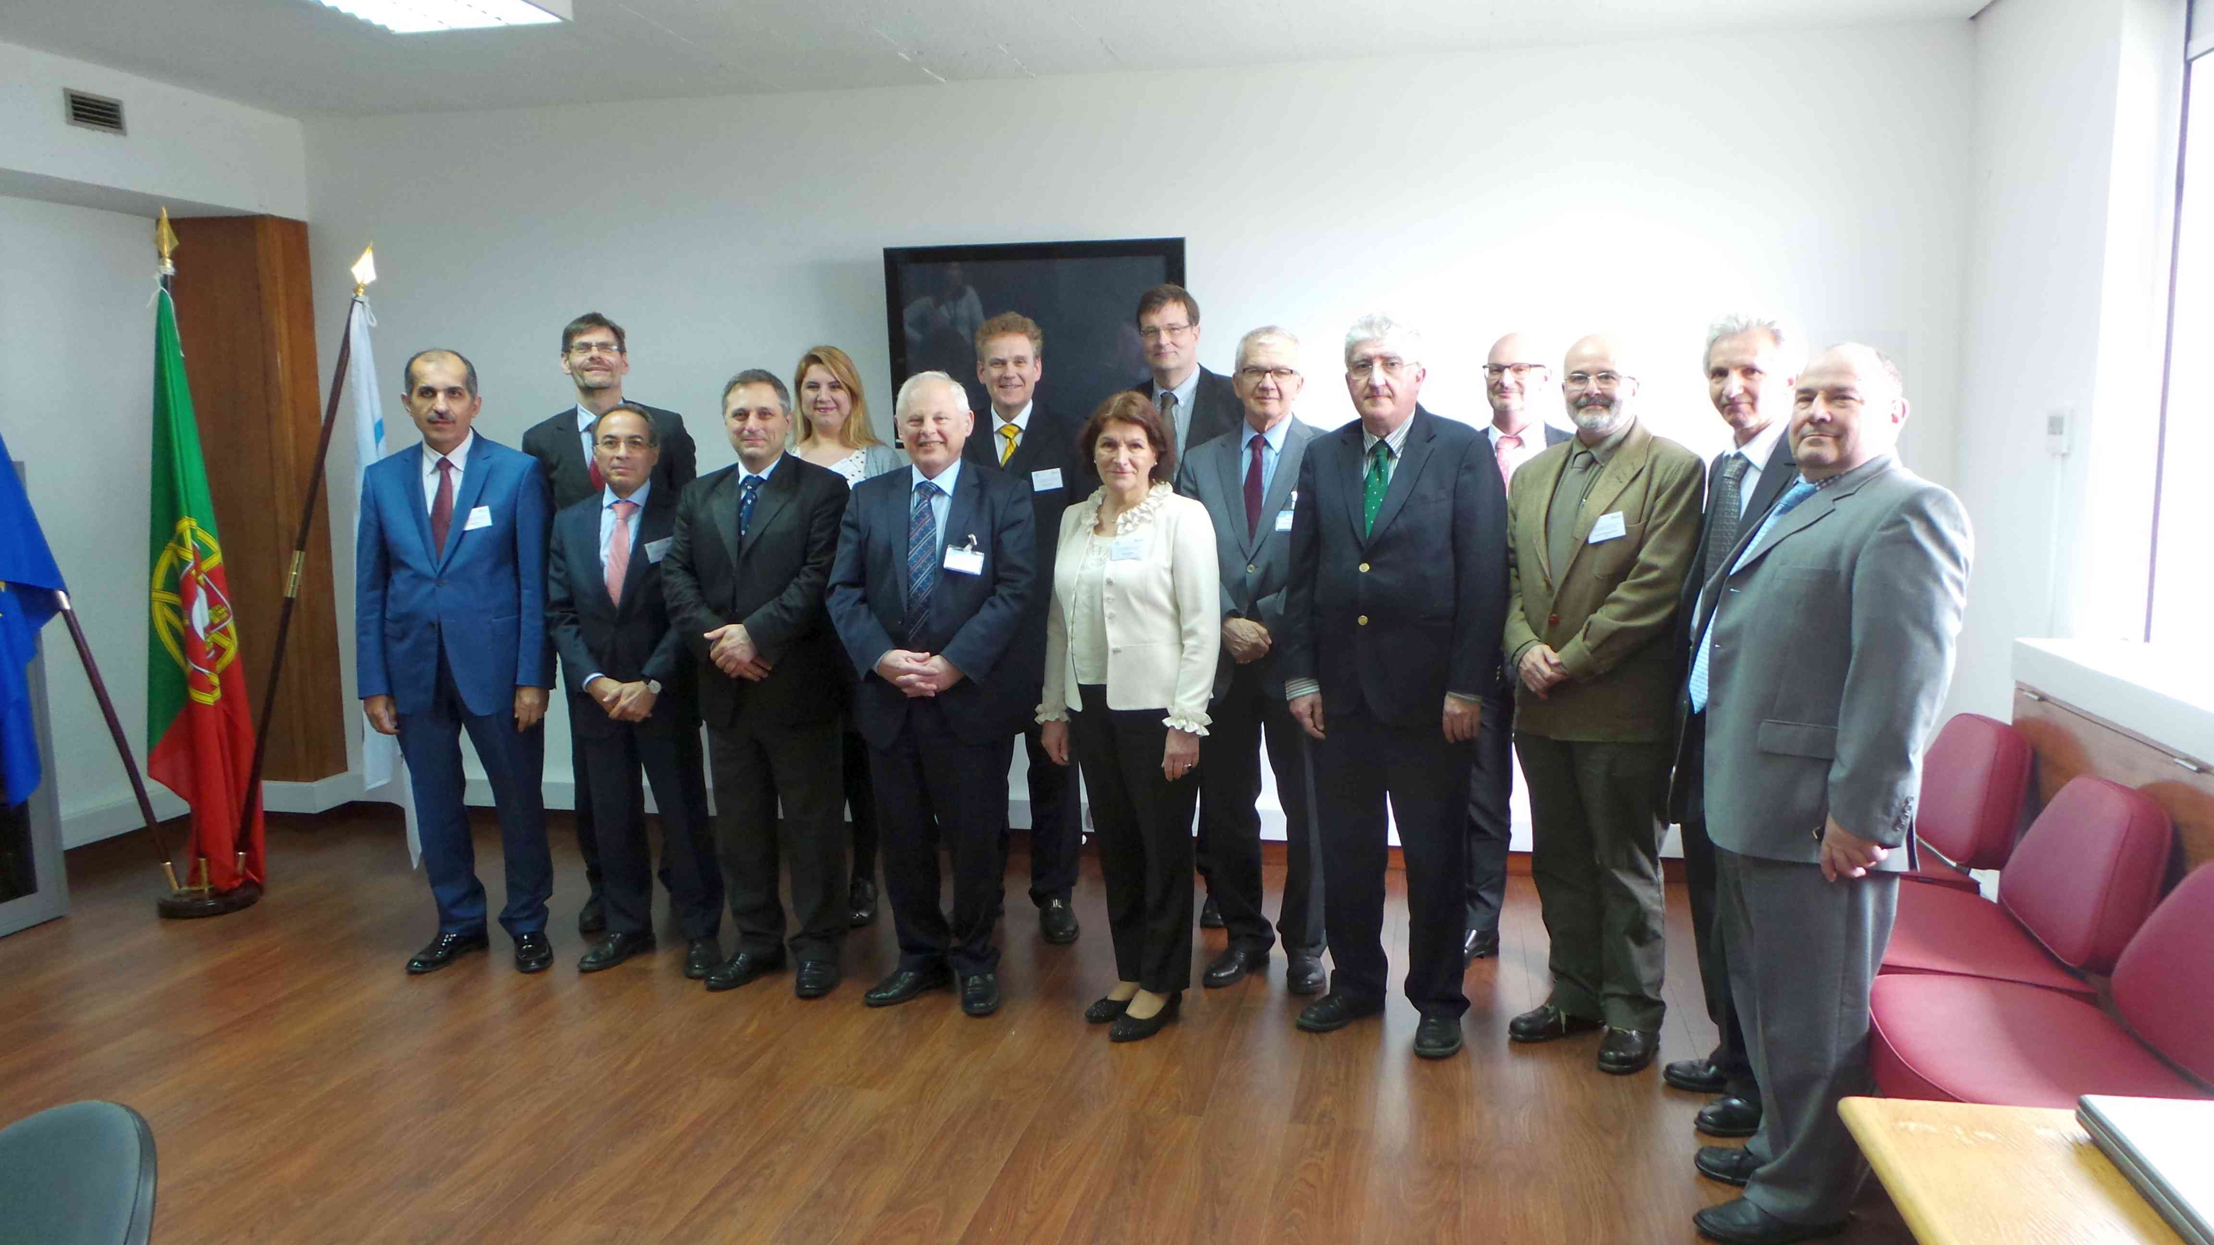
Some of the Major Achievements
Support WIGOS Implementation Plan
Decision of the 4th RA VI MG Meeting, Lisbon, Portugal, 21 – 22 April 2016
RA VI Regional WIGOS Centers (RWC) should be established as a network of contributing NMHSs (virtual center structure)
- Draft Concept document on RWC-Network, including the Terms of Reference
for the modules of RWC Network
Establish a “proof of concept” phase in setting-up of RWC-Network
- assign the roles of virtual RWC that will start to work as a “nut shell RWC”
- initiate assignment process after the RA VI Session in 2017

Slide 6
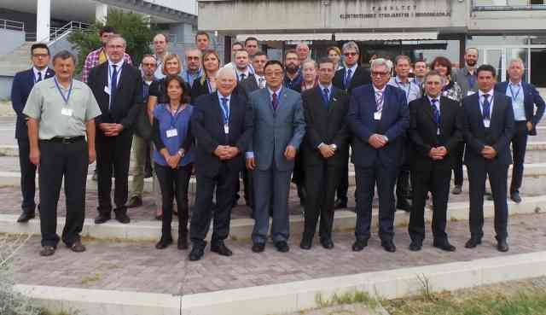
Some of the Major Achievements
Support WIGOS Implementation Plan
“WMO RA VI WIGOS Workshop with focus on marine observations”, Split, Croatia, 5-7 September 2016
The RA VI WIGOS / Marine - Ocean workshop recommendations
Establish a RWC for the Adriatic Sea area as a virtual centre and refine the functionalities of this centre. The proposed RWC will complement existing WIS DCPC for the Adriatic Sea area; Croatia will be leading in this regard
Explore possibilities to establish an WMO-IOC Regional Marine Instrument Centre (RMIC) for the Adriatic Sea as a distributed centre where service for instruments and measurements would provide
oceanographic institute(s) - for oceanografic part
NMHS(s) – for marine meteorological part

Slide 7
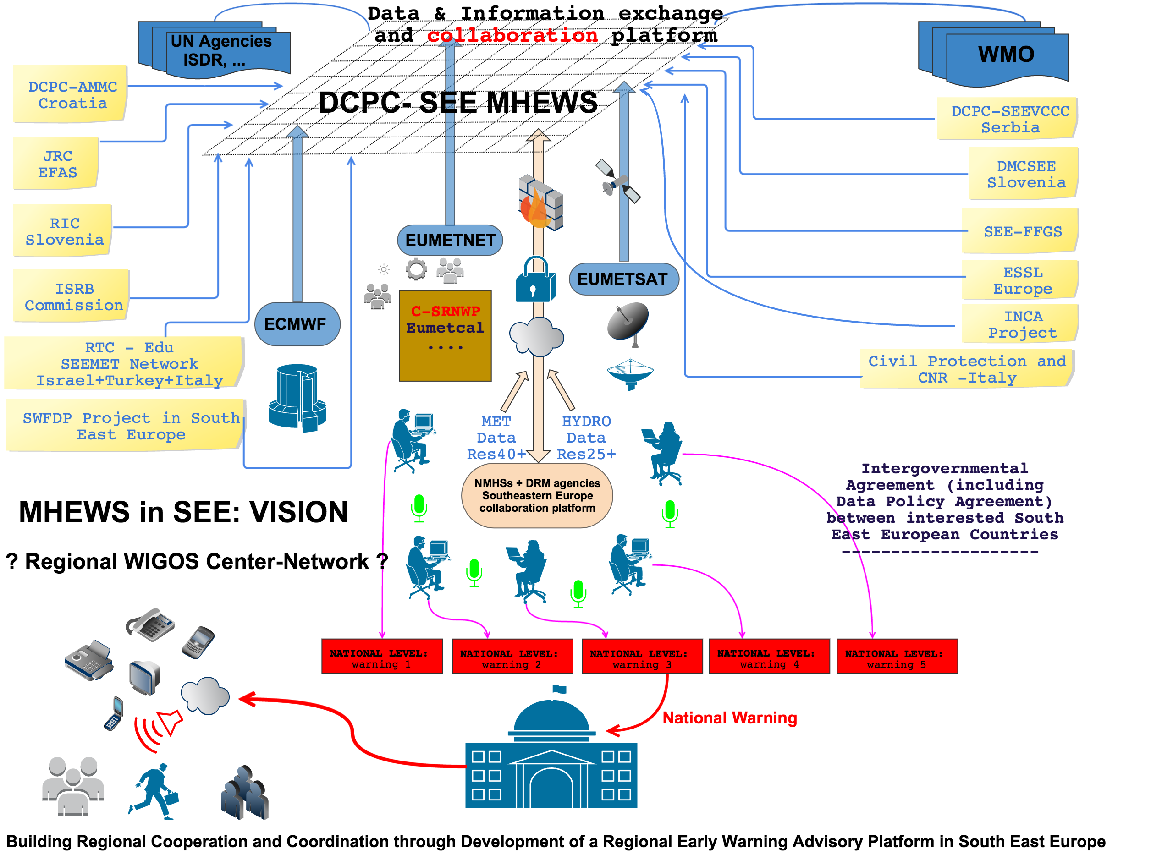
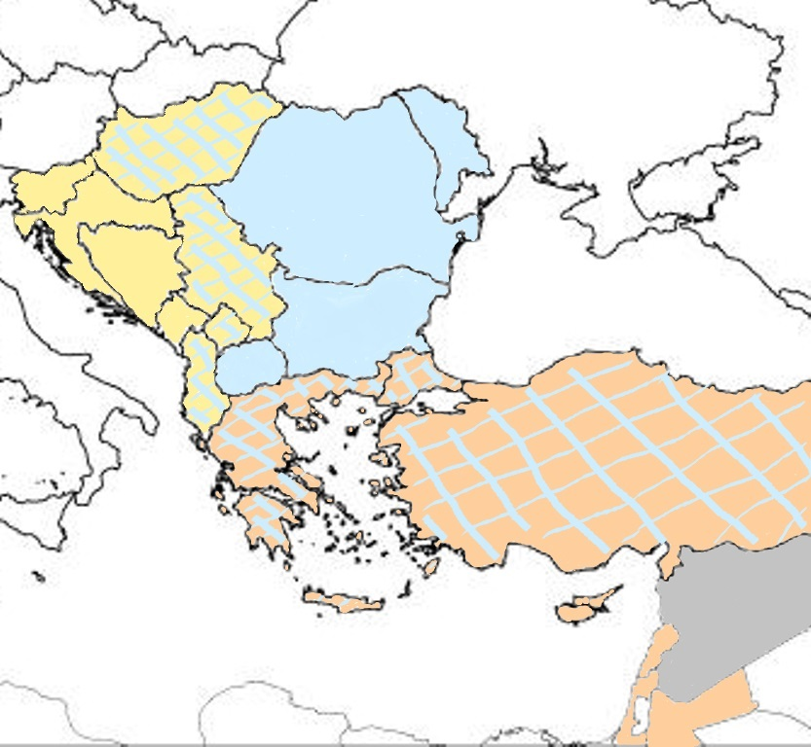
Some of the Major Achievements
EC WG DRR recommendation on developing new projects such as a South-East European Multi-Hazard Early Warning Advisory System project with a perspective to collaborate with other regional projects
Project has perspective to build up
common technical platform including a virtual
Regional WIGOS Center in SEE to ensure data
and products availability for MHEWS in line
with the DRM requirements
common organizational platform
to ensure cros-boarder collaboration / SOP
trough distributed structure
SEE Consortium of Collaboration
3 Clusters of Collaboration
Ad-Hoc Claster / Clusters of Collaboration
what could serve as a template
SEE-MHEWS – topic under next presentation

Slide 8
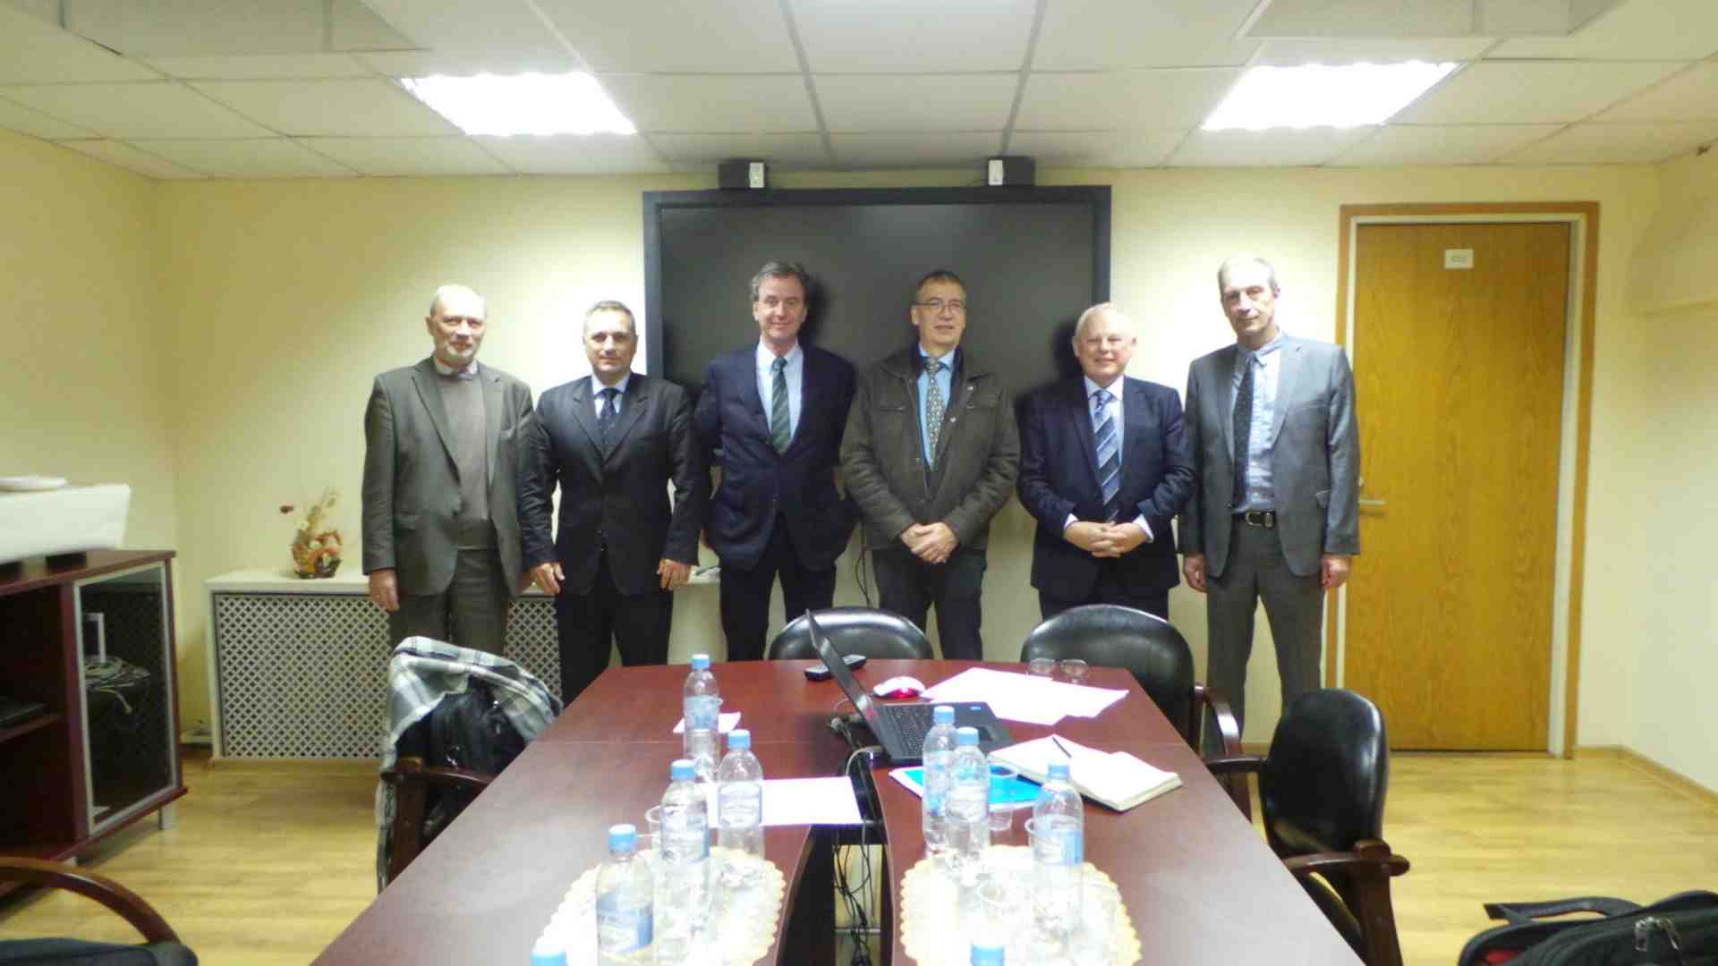
Some of the Major Achievements
Based on the initiative during Cg-17 and EC-68 an exploratory mission of WMO and EUMETNET to Roshydromet, was organized to explore the ways of potential collaboration related to
hydrometeorological early warning systems
in the framework of wider
DRR agenda and the WMO priorities
Roshydromet Meteo-Alert and
EUMETNET MeteoAlarm systems
It was agreed to
facilitate cooperation between EUMETNET and Roshydromet under the WMO umbrella
consider draft additional Annex to the existing WMO-EUMETNET MoU
It was envisaged that the above collaboration may have implications in setting-up of a WMO driven cross-regional meteo-alerting system
Meeting acted as an initial building block towards Global Meteo Alarm System
31st October 2016, Moscow, Russian Federarion

Slide 9
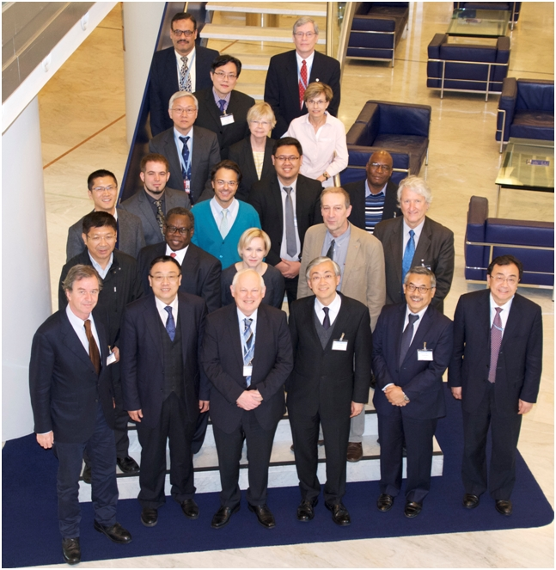
Some of the Major Achievements
Moscow meeting was strongly supported by the WMO SG who launched initiative on GMAS
SG initiative was strongly supported by the
CBS-16 and its MG meeting, Guangzhou, China, November 2016
Joint meeting PRAs and PTCs, Geneva, Switzerland, January 2017
RA II-16 session, Abu Dhabi, United Arab Emirates, February 2017
RA IV-16 session, San Jose, Costa Rica, March 2017
SG established GMAS Advisory Team to assist in the
development of the initiative and provide guidance
on the content of an EC-69 document
work arrangements on how to develop
concept note
work plan
implementation plan
First Meeting of the Advisory Group
and Technical Team on WMO GMAS
Geneva, 13-15 March 2017

Slide 10
Challenges – Benefits - Priorities
Outcomes from the Management Group teleconference on 4th November 2016
Various views was expressed about the
challenges and needs in the region
importance of the Regional Association VI for the RA VI Members
Draft priorities
Enhancing the NMHSs visibility
Ensuring the relevance and value of the NMHS services for society,
including also ocean and climate services
This is important due to the budget cuts - many of the NMHSs are facing
while at the same time
the complexity of the required services are growing and there are many new service providers from the private sector
Sub-regional approach in the implementation of WIGOS taking into account the vision of WIGOS 2040 including also the fast development on
crowd sourcing
the internet of things
new commercial data providers
Notes:
3 questions:
1.
2.
3.

Slide 11
Challenges – Benefits - Priorities
Outcomes from the Management Group teleconference on 4th November 2016
Draft priorities
Integration of the meteorological, oceanographic and climate communities in Multihazard Early Warning Systems and the role of the NMHSs
The weather rooms are transformed into multi-hazard early warning centers
Important to have a clear focus on
what are of most relevance to the various sub-regional areas of RAVI
how knowledge could be shared between the sub-regions / regions
Advancing the European Meteorological Infrastructure (EMI) in RAVI through the 2016 – 2025 Strategy for the European NMHSs
Aviation
Improvement of monitoring, prediction and services in the Arctic and high mountain areas
Notes:
3 questions:
1.
2.
3.

Slide 12
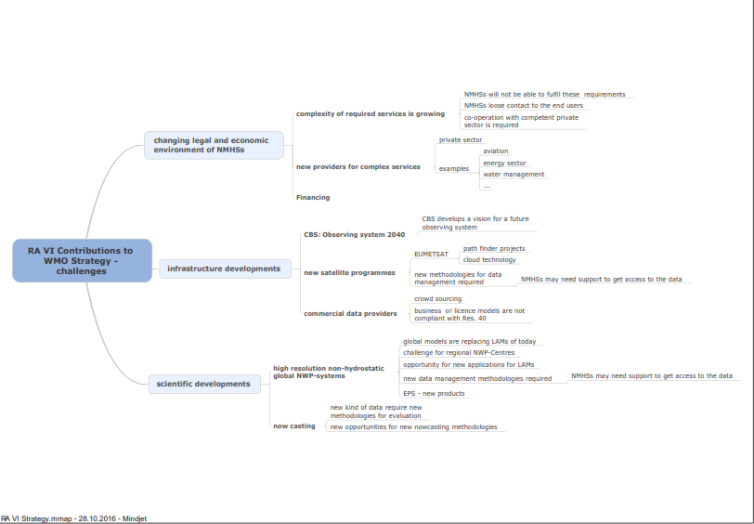
Challenges – Benefits - Priorities
Gerhard Adrians diagram
Notes:
3 questions:
1.
2.
3.

Slide 13
How to cope with Priorities ?
Setting priorities for WMO strategy 2020-2023 by Rob Varley
Problem to be addressed is how to direct the prioritization of limited resources
The diverse nature of NMHSs means there are divergent views on how to prioritize, which tends to result in
long list of priorities
lack of clear focus within the strategy
Why to prioritise?
reference to the priorities set by the WMO Congress
within the Purpose of WMO as defined in the WMO Convention
allocate budget and greater Secretariat resources for planning and enagbling RAs and TCs activities
There are a number of “lenses” through which one can consider the question of prioritization (e.g.):
Geographical – polar, mountain, Small Island States
User-based – aviation, public weather services, health, energy, DRR
Input-based – WIGOS, training, capacity building, science
Internally-focused – governance, efficiency, organizational transformation
Externally focused – relationship with the private sector, other UN Agencies, development banks
Notes:
3 questions:
1.
2.
3.

Slide 14
WMO Strategic Priorities 2017-2023
WMO SG - slide
WMO strategic priorities for 2017-23 Member / regional level
Enhanced service capability
High quality of observation/operational systems
Enhanced cooperation between countries
Enhanced cooperation within countries: met-hydro-marine-R&D
Optimization of WMO constituent body activities
Interaction with the private sector
Notes:
3 questions:
1.
2.
3.

Slide 15
WMO Priorities 2016-19
WMO SG - slide
WMO Priorities 2016-19 (Target examples)
Disaster Risk Reduction Indicators
e.g. # of countries with MHEWS, range of services at NMHSs
Global Framework for Climate Services
# of countries with climate services
WMO Integrated Global Observing System
# of WIGOS compliant countries
Aviation meteorological services
# of countries with QMS
Polar and high mountains regions
Implementation of YOPP (YearOfPolarPrediction), improved observing systems
Capacity Development
# of projects & their volume, improved service capacity
Governance
Efficiency and validity of constituent body structure, administrative
processes, efficiency of meetings, working practices
Notes:
3 questions:
1.
2.
3.

Slide 16
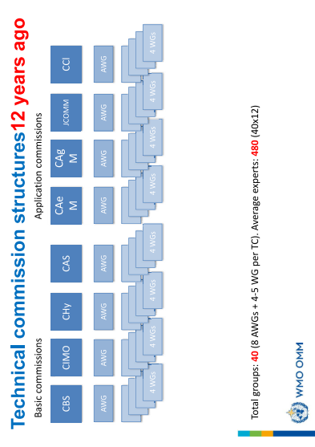
How to cope with WMO complexity ?
WMO SG - slide
Notes:
3 questions:
1.
2.
3.

Slide 17
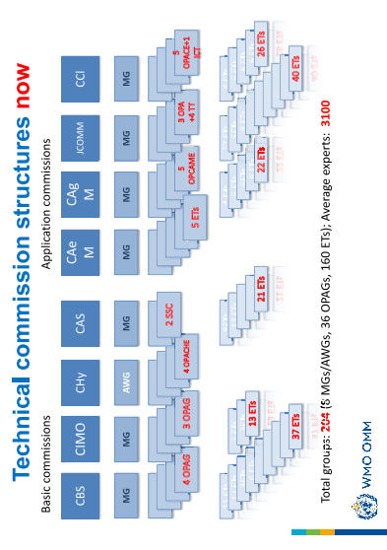
How to cope with WMO complexity ?
WMO SG - slide
Notes:
3 questions:
1.
2.
3.

Slide 18
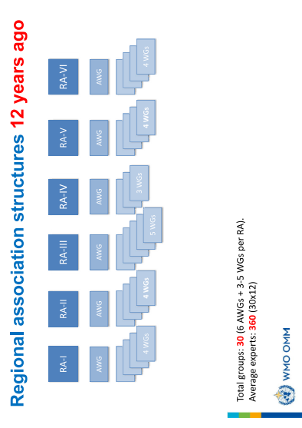
How to cope with WMO complexity ?
WMO SG - slide
Notes:
3 questions:
1.
2.
3.

Slide 19
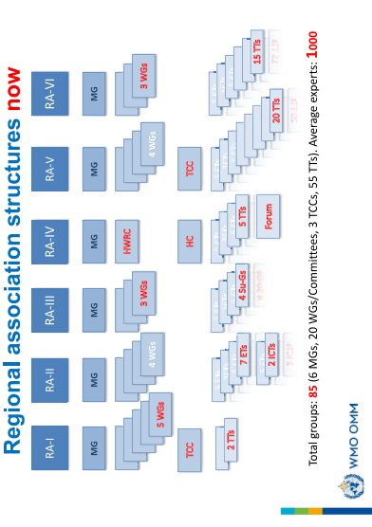
How to cope with WMO complexity ?
WMO SG - slide
Notes:
3 questions:
1.
2.
3.

Slide 20
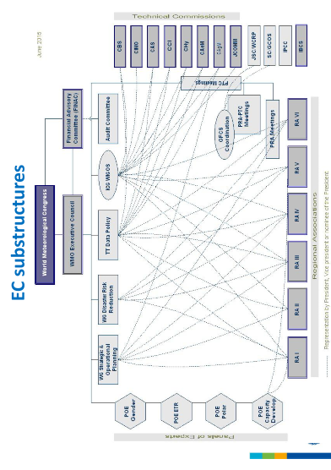
How to cope with WMO complexity ?
WMO SG - slide
Structure / interactions - too complex
Notes:
3 questions:
1.
2.
3.

Slide 21
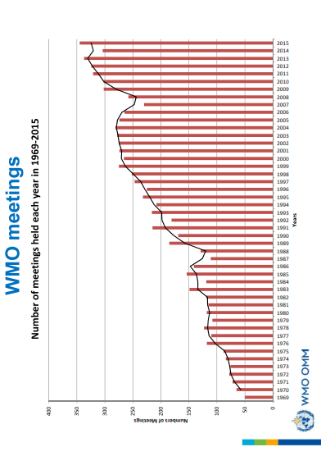
How to cope with more and more meetings ?
WMO SG - slide
WMO – World Meeting Organization
Notes:
3 questions:
1.
2.
3.

Slide 22
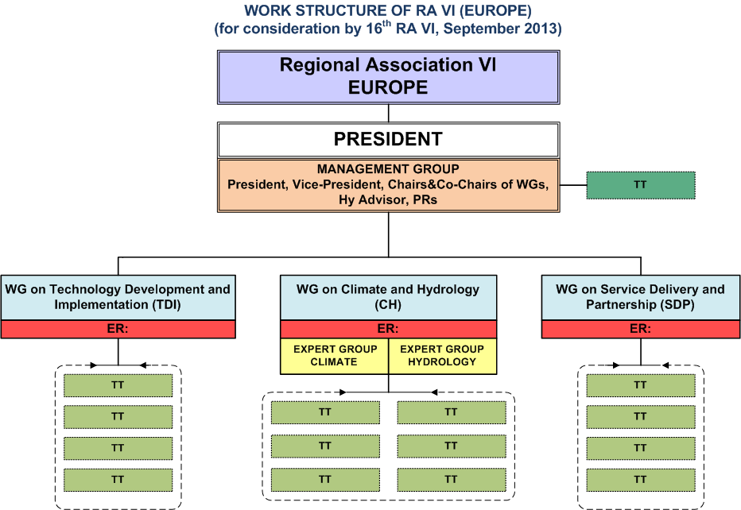
How to plan Inputs for the RAVI 17th Session ?
Mechanism of RA VI Activities (2013 – 2017)
RA VI Management Group
RA VI Activities are based o
Operational plan 2016 – 2017
Management Group decisions that are followed up by the appropriate actions
RA VI Working Groups / Task Teams activities
RA VI President activities
Notes:
3 questions:
1.
2.
3.

Slide 23
How to plan inputs for the RAVI 17th Session ?
Meeting of RAVI TT on Regional and Operational Planning, Geneva, 3 March 2017
Outcomes from Regional Conference - RECO should be vital inputs for the RA VI session
The following questions were suggested as setting the base for possible themes for RECO
Does the current form of RAVI serve its Members in the best way?
What is the future role of RAVI in light of the WMO governance reform?
What benefit(s) and where RA VI provided to their Members during the RA VI MG
mandate
What are the lacking areas in supporting Members as needed / percept by the
Members?
What are the key activities which will need to be implemented over the next 6 years
(2018-2019, 2020-2023)?
How should Members best plan and structure itself to effectively deliver these
(e.g. regrouping based on language, hazards, other organizations etc)?
How can the region increase the efficiency and effectiveness of delivering its
WMO/RA VI priorities through aligning work plans with other established regional
entities /associations?
The future working structure of RAVI
Should there be a sub-regional working structure?
Notes:
3 questions:
1.
2.
3.

Slide 24
How to plan inputs for the RAVI 17th Session ?
Meeting of RAVI TT on Regional and Operational Planning, Geneva, 3 March 2017
Private Public Partnership
Should Members aim to coordinate RA VI activities with non-NMHS organizations, to
ensure they’re aligned where possible. If so, how?
Which are the main priorities / emerging issues for RAVI
for focusing its resources on during 2018 – 2019
for inputs to the new WMO SP 2020 – 2023
indicated differences in the sub-regions
It is important to find speakers for the RECO triggering a real/productive discussion on
issues of importance (e.g. WMO Strategic and Operational Plan)
RAVI session including RECO could be carried out as two days of RECO and
two or three days of the RAVI session
RECO + 17th RAVI Session will be held from 27th November to 1st December 2017
Venue of the Session is still opened
Notes:
3 questions:
1.
2.
3.

Slide 25
How to plan inputs for the RAVI 17th Session ?
Lessons learned – filling the gaps – WAY OF DOING BUSSINES
WHAT
RA VI-17 session has opportunity to progress in its performance (smaller session period
and optimal effectivenes) by avoiding Congress stile session
HOW
not processing copy-paste Cg-17 / RA II / RA IV session documents
compile Cg-17 decision relevant for RA VI and present in condensed (table ) format
more comprehensive documents related to decisions - tailor in Inf format that are not
expected to be discussed (except if a Mamber explicitly express wish to be done so)
Tailor optimal structures and activities / plans / ToRs of constituent and subsidiary bodies
Preliminary work by the Secretariat: compile Congress Decisions List soon after
ending of the Congress session and send it to EC / RAs / TCs for their joint
adjustment of their ToRs and activities
budget alocation / support
inclusion to the WMO Operational Plan
in a project oriented format
Up to now there was no request by anyone (exception PRA VI one month ago)
Notes:
3 questions:
1.
2.
3.

Slide 26
How to plan inputs for the RAVI 17th Session ?
Lessons learned – filling the gaps – WAY OF DOING BUSSINES
Urgent need to fill all communication gaps toward RA VI Members related to the
Cg-17 decisions
Operating plan
WMO / RA VI priorities
executed and ongoing activities
current needs and requirements
perception of the RA VI performance / structure in the next PRA VI, RA VI MG mandate
EC SOP working paper / draft Strategic Plan (2020-30)
Is higly beneficial to articulate by TECO
Request Secretariat for Inf document with all abreviations
Urgent request to define the RA VI – 17 dates
Notes:
3 questions:
1.
2.
3.

Slide 27
Thank you

