Slide 1
NWP Modelling systems at NCMRWF
V.S. Prasad
vsprasad@ncmrwf.gov.in

Slide 2
Models & Data Assimilation Systems at NCMRWF
T1534L64 GSI - T574 ENKF hybrid Global Data Assimilation system.
3D- Var (GSI) DA
80 ensemble member ENKF
T1534-L64 (SL) GFS model
Operational from 1 June 2016
Unified Model for seamless prediction at 17 km (Global)
4D –Var DA
Nested 1.5 km regional model
Probabilistic Forecast at 33 km with 44 members
4D-Var hybrid system is getting ready
Notes:
NGFS is our legacy system and also present operational system; and working on developing NCUM as a seamless system; responsible for NGFS analysis for India

Slide 3
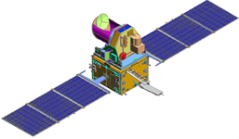
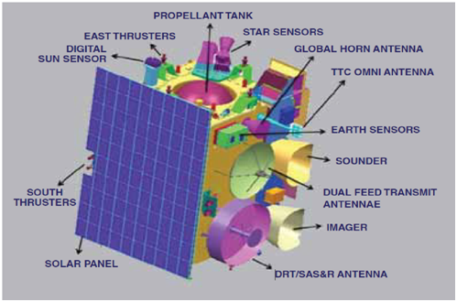
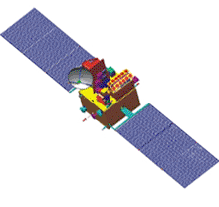
Robust Satellite Data Handling system
Meghatropiques
Circular orbiting
Oceansat -2
Polar orbiting
INSAT- 3D Geostationary
Notes:
Apart from developments in model and assimilation systems; the augmentation of data handling system in recent times helped NCMRWF to increase reliability of its forecasts

Slide 4
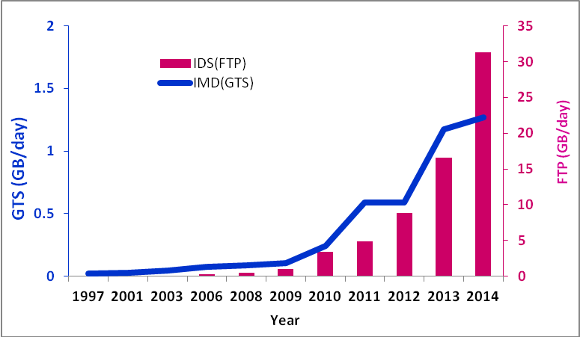
Utilisation of Satellite Observations
Mainly satellite observations are downloaded through FTP
Volume of data reception (Gb/day) at NCMRWF via GTS & IDS
Receives satellite observations from various geostationary and polar orbiting satellites from different national and international sources viz. GTS, NOAA/NESDIS, EUMETCAST via MOSDAC, NRSC, ISSDC, IMD, etc. in real time.

Slide 5
Types of observations Assimilated at NCMRWF
Observation category | Name of Observation.
Surface | Surface, Mobile, Ship, Buoy (SYNOPs)
Upper air | TEMP (land and marine), PILOT (land and marine), Dropsonde, Wind profiler, VAD winds from IMD DWR network
Aircraft | AIREP, AMDAR, ACARS, KAMDAR
Atmospheric Motion Vectors from Geo-Stationary Satellites | AMV from Meteosat-7, Meteosat-9, GOES-11, GOES-13, MTSAT-1R, MODIS (TERRA and AQUA), POLAR WINDS (NOAA, MODIS, METOP), INSAT 3D
Scatterometer winds &Soil Moisture | ASCAT winds from METOP-A & Metop-B satellite,
NESDIS / POES ATOVS radiance data | 1bamua, 1bmhs,1bhirs3, 1bhirs4, CrIS and ATMS
Satellite derived Ozone data | NESDIS/POES, METOP-2 and AURA orbital ozone data
Precipitation Rates | GPM and SSM/I precip. rates
Bending angles from GPSRO | Atmospheric profiles from radio occultation data using GPS satellites (COSMIC series, GRACE etc), MT-ROSA
MeghaTropique | SAPHIR radiance
AQUA AIRS & METOP/ IASI brightness temperature | IASI,AIRS brightness temperatures
GPSIPW | GNSS IPW (including INCOIS GNSS network )
Geostat. Satellite Radiances | GOES, Meteosat , INSAT-3D

Slide 6
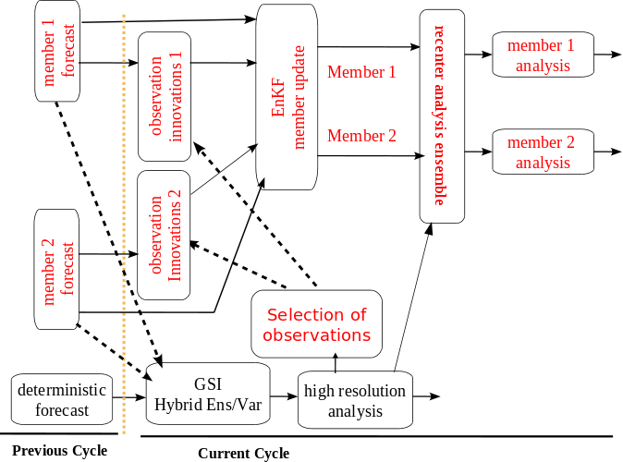
Flow chart

Slide 7
Utilisation of Hybrid-GSI Analysis
IMD-GFS
T574 Ensembles
IITM-GEFS
INCOIS- LEKF
T574 (EL)
T1534 (SL) ICs
T
3
8
2
IMD-extended
IITM-seasonal

Slide 8
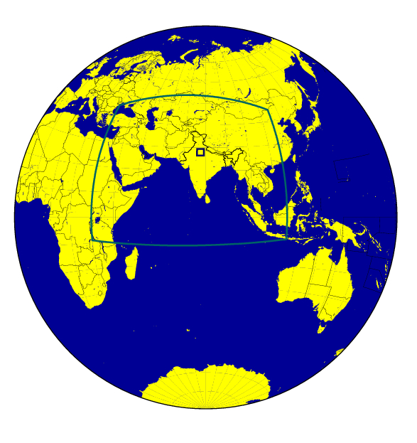
Unified Model at NCMRWF
Same Model for Global/Regional/Mesoscale – seamless model
4 km/1.5 km grid
up to 48 hr forecast
12 km grid
up to 72 hr forecast
25 km global grid
up to 10 Days hr forecast
Ensemble Prediction System
N400L70(33 km) 44 members
Coupled ocean atmosphere system
Notes:
8
8
8
Plan for seamless weather prediction system at NCMRWF ; red ones are under development ; black ones are in place ; new HPC

Slide 9
BIMSTEC
RIMES
Regional Specific forecasts
(EPS, Meteograms, forecast charts)

