Slide 1
Flash Flood in Addu City on 24 November 2015 (Worst situation in 40 years)

Slide 2
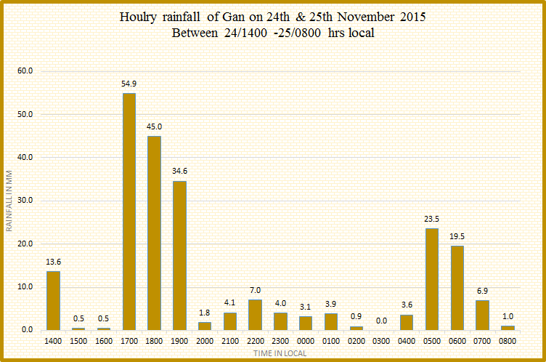

Slide 3
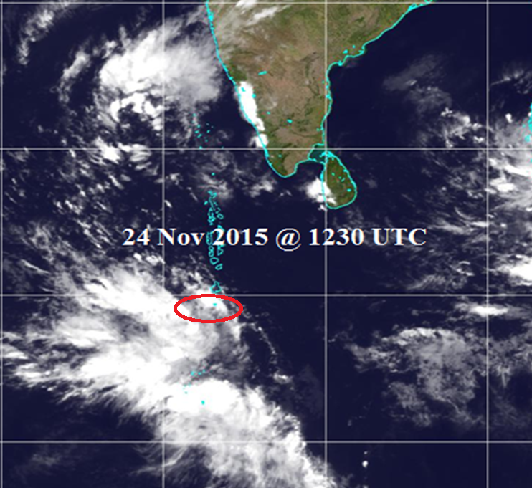

Slide 4
An intensive cloud band south of Addu atoll since 0900 hrs in the morning.
Later in the afternoon, it intensified further and few isolated cloud cells moved out in different direction including over Addu atoll.
Weather models estimated heavy rain to south of Maldives but not southern atolls.
Extremely heavy rainfall occurred over southern-most area within 3-4 hours.
228.4 millimeters of rain

Slide 5
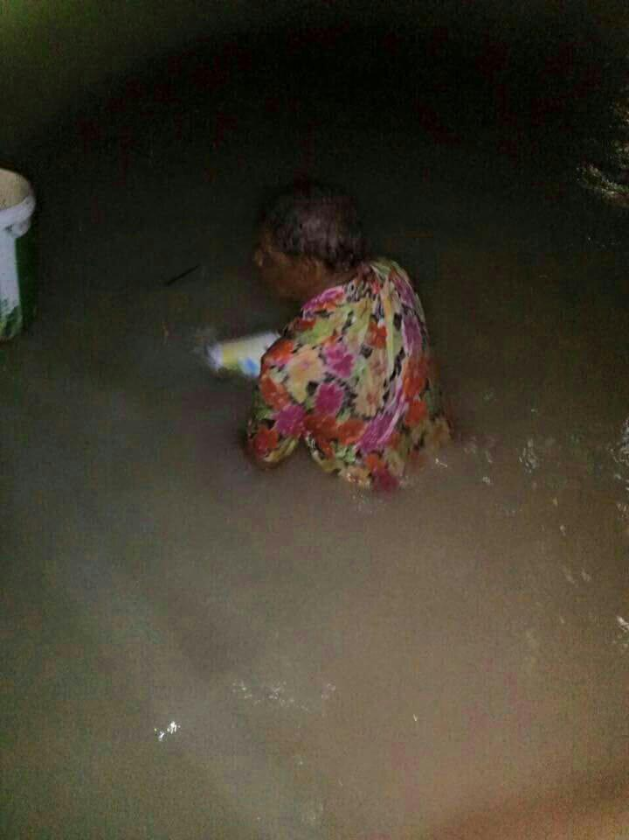
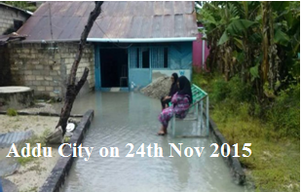
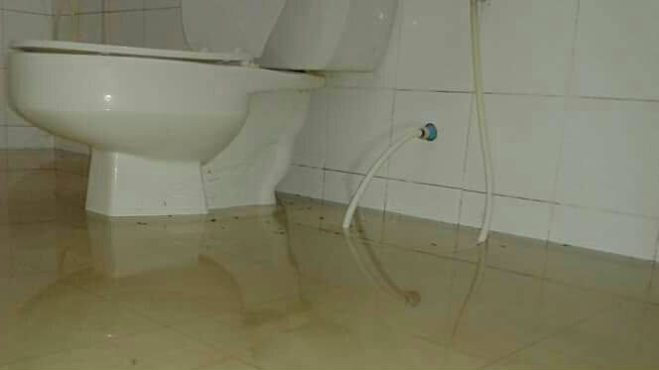
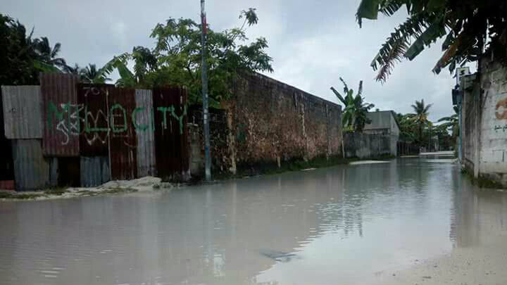

Slide 6
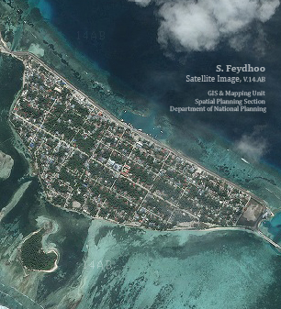
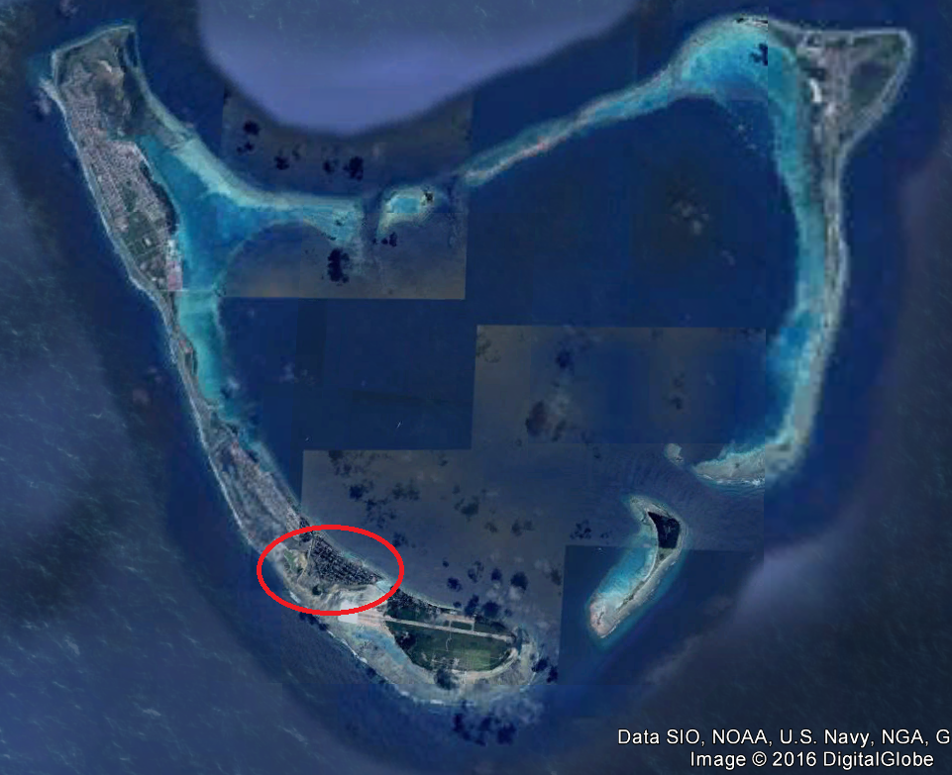

Slide 7
Streets inundated.
200 households affected including 32 houses in Feydhoo, 11 houses in Maradhoofeudhoo severely affected.
Water contaminated

Slide 8
Thank you

