Slide 1
CRISIS MANAGEMENT SYSTEM IN THE REPUBLIC OF MACEDONIA
Notes:
<number>
<number>

Slide 2
LEGAL BASIS
The Constitution
Crisis Management Law
Defence Law
Protection and Rescue Law
Police Law
Law on Classified Information
Law on Electronic Communication
Law on Local Government
Low on Civil Service
Notes:
<number>
CMS function according the next legal basic

Slide 3
Law on Crisis Management (“Official Gazette of RM” No. 29/2005)‏ make operationalisation of Crisis management system over
Organization and functioning
Government bodies for decision-making
Engage for national resources
Communication, coordination and cooperation
Risk ant security assessment
The Others activities relating to the system for crisis management
Notes:
<number>

Slide 4
GOALS OF THE CRISIS MANAGEMENT SYSTEM:
1. PREVENTION
2. MITIGATION
3. RECOVERY
Notes:
<number>
The Mein functions of CMS are

Slide 5
Risks and threats according to the Law on Crisis Management
National security threats ( terrorism, org. crime, corruption, proliferation, WMD, etc.);
Natural catastrophes (floats, earthquakes, land sliding, Intensive snow falls, other disasters like thunder strikes, strong winds, extremely low or high temperatures, high scale fire etc.);
Technical accident and ecological disasters (explosive crashing. disasters in the mines and production establishments. radiological, chemical, or biological contamination , damages and larger defects in the plants, rraffic accident in the road, railway or air traffic, massive poisoning with food, chemicals and toxic materials etc.); Here is climate changes disaster
Epidemics, episodes, epiphytes;
Other threats and risks who may be threat for citizens and their owners
Notes:
<number>
According the low next Risks and threats may be threat for citizens and their owners
ScaleРазмер

Slide 6
Subjects in the Crisis Management System
Crisis Management Centre;
Rescue and Protection Directorate;
Ministry of Interior;
Ministry of Foreign Affairs;
Ministry of Defence;
Ministry of Finance;
Ministry of Transport and Communication;
Ministry of Health;
Ministry of Agriculture, Forestry and Water Management;
Ministry of Environment and Planning;
Ministry of Economy;
Ministry of Local Government;
Ministry of Labour and Social Affairs
Intelligence Agency;
Macedonian Army;
Education and Academic institution
Municipalities;
Public and private enterprises and agencies engaged in Crisis Management;
Notes:
<number>
The following subjects are participate or representatives in CMS

Slide 7
ORGANIZATION AND FUNCTIONING
OF THE CRISIS MANAGEMENT SYSTEM:
The Government
1. Steering Committee,
2. Assessment Group,
3. Crisis Management Centre
- Joint HQ
4. Subjects in the Crisis Management System
Government
Steering Committee
Assessment Group
Crisis Management Centre
Joint HQ
Subjects
Notes:
<number>
According the low CMS I R. of Macedonia are building next government bodies

Slide 8
The Steering Committee
Governmental body for coordination and management of the crisis management system.
The Steering Committee-is composed of:
Ministers of Interior, Health, Transport and communications, Defence, Foreign affairs, Director of the CMC;
Representative from Security and Defence Commission of the Parliament ;
Representative from the Cabinet of the President;
Other officials and experts may be invited (if is necessary).
Minister of Interior is Chairman of the Steering Committee
Notes:
<number>

Slide 9
Steering Committee
Minister of Health
Minister of Transport and Communication
Minister of interior
Minister of Foreign Affairs
Minister of Defense
Head od Assessment Group
Assembly’s Defense and Security Commission

Slide 10
The Assessment Group
Governmental body that performs constant assessment of the risks and dangers to the security of the Republic and proposes measures and activities for their prevention, early warning and handling a crisis situation.
The Assessment Group is composed of:
Directors of the Public Security Bureau and Security and Counter Intelligence Department in the Ministry for Interior;
Directors of the Intelligence Agency;
Director and Deputy director of the CMC;
Director and Deputy director of the Protection and Rescue directorate;
Head of Security and Intelligence Department in Ministry of Defence;
Other officials and experts may be invited (if is necessary).
Notes:
<number>
Is govermental bodi tat performs konstant asesment of de risk and denxers

Slide 11
Assessment Group
Public Security Bureau Director
Director of Security and Counter-Intelligence Directorate
DCOD
MoD Security and Intelligence Service Head
Intelligence Agency Director
Governmental body for assessment of the risk and dangers to the security of the Republic/proposes measures and activities for their prevention, early warning, handling and recovering a crisis situation
Director and the Deputy Director of the Protection and Rescue Directorate
Director and Deputy Director of the Crisis Management Center

Slide 12
Headquarters ( HQ)
Is formed in the CMC, as an operational and professional body that handles the activities for prevention and management of crisis situations;
HQ (headed by director of the CMC), is composed of representatives from Ministries for Interior, Health, Transport and Communications, Defence, Foreign affairs, also Head of First Aid Service, Director of the Protection and Rescue Directorate, Macedonian Army, Intelligence Agency, Directorate for Classified Information, Macedonian Red Cross;
Other officials and experts may be invited (if is necessary).
Notes:
<number>

Slide 14
Crisis Management Centre
Independent state administrative subject;
Having the status and function of a directorate
Notes:
<number>

Slide 15
Main function - measures and activities for:
Prevention ( assessment, education end exercise for the all subjects );
Early Warning (public alert);
Mitigation - handling a crisis situation, management and make the all coordination between all subjects in CMS;
Recovery – sanation of all crisis effects;
International coordination ( in the case in decelerated crisis situation).
Notes:
The mein functioh who CMC provide are Mitigation ( ublazuvanje, namaluvanje ) obviation- otstranuvanje
<number>

Slide 16
Total number of Regional Centers in CMC
35 Regional Crises Management Centers (RCMC) for local level - 8 main RCMC and 27 smaller RCMC
8 Main RCMC and smaller 27 RCMC covert 85 municipalities
Notes:
IN the CMC exist
<number>

Slide 17
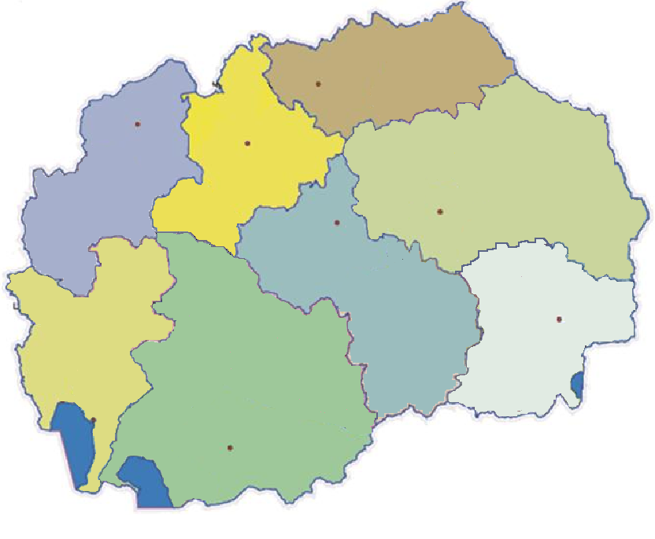
Head Regional Centers in CMC
Kumanovo
Tetovo
Skopje
Stip
Veles
Strumica
Ohrid
Bitola
Notes:
This is teritory whu Mein RCMC cover
<number>

Slide 18
8 main RCMC working time 24/7 365 days;
Emergency number 195;
In the future telephone number 195 will change with E-112 (Skopje, Bitola end Stip it will coverage all territory of R. of Macedonia)
Notes:
8 RCMC work 24 ours non stop and in this mien RCMC funcionate Emergence call number 195. In the future this number will be chenced whit emergency call number 112. This number will funcionate in 3 centers and will coverage all state territory
<number>

Slide 19
For function on CMS CMC organize own systems for communications and system for public alert:
IT connection;
Radio (VHF conventional radio connections, One state level radio connection, 34 independent local radio networks, More than 1000 radio devices);
Telephone and fax communications;
Mobile (GSM) lines;
Special telephone and fax communications ( Army, police, Macedonian railway and other states institution );
System for crypto protection;
Public alert (The existing of the Public Alert System in Republic of Macedonia is regulated by articles 38 and 39 of the Crisis Management Law; Around 250 electrical, pneumatic, electronic sirens are grouped in 30 independent Public Alert Systems)
Notes:
This is special telephone and fax communication which owner are subjects who are participate In CMS
<number>

Slide 20
Thank You
for your attention
MSc. Dusko Petrovski,
Head of Department for Operation
and Coordination in CMC – R. Macedonia
Notes:
<number>

