Slide 1
MANDATE AND ACTIVITIES OF RHMS RS in providing information in regular and hazardous situation Republic Hydro-Meteorological Service of Republika Srpska (one of two entity hidrometeorological services in Bosnia and Herzegovina)
WMO STRATEGY FOR SERVICE DELIVERY FOR NMHSs IN SOUTH-EAST EUROPE
REGIONAL STAKEHOLDERS
WORKSHOP TO IMPLEMENT
THE WMO STRATEGY FOR
SERVICE DELIVERY
FOR NMHSs IN
SOUTH-EAST EUROPE
World Bank Group (WBG)
Global Facility for Disaster
Reduction and Recovery
(GFDRR)
TIRANA, ALBANIA,
17-21 OCTOBER 2016
rhmz@teol.net Republic Hydro-Meteorological Service of Republika Srpska, B&H www.rhmzrs.com

Slide 2
WMO STRATEGY FOR SERVICE DELIVERY FOR NMHSs IN SOUTH-EAST EUROPE
ORGANIZATION OF RHMZ RS
REPUBLIC HYDRO METEOROLOGICAL SERVICE OF REPUBLIKA SRPSKA
DIRECTOR
SECTOR OF
METEOROLOGY
SECTOR OF
HYDROLOGY
AND ECOLOGY
SECTOR OF
SEIZMOLOGY
DEPARTMENT OF
FINANCIAL AND
LEGAL AFFAIRS
Department of
Weather Watch
Department of
Hydrology
Division for
Seismological
observation
in this sense, identify products that are distributed to users:
depend on the capacity of: human and technical, where the most important meteorological, hydrological and ecological tools;
Division for forecast
Department of
Ecology
Division for
Seizmological
engeneering
Network of stations
Department of
Climatology and
Agrometeorology
function and responsibilities RHMS RS done according to the law
rhmz@teol.net Republic Hydro-Meteorological Service of Republika Srpska, B&H www.rhmzrs.com

Slide 3
WMO STRATEGY FOR SERVICE DELIVERY FOR NMHSs IN SOUTH-EAST EUROPE
MANDATE OF RHMZ RS
FOCUS ON LEGISLATION
LEGAL FRAMEWORK:
Law of hydrological and meteorological services, Official Gazette of the Republic of SRPSKA, no. 20/2000.
Law on seizmological activities, Official Gazette of the Republic of SRPSKA, no. 20/1997.
Law on Air Protection, Official Gazette of the Republic of SRPSKA, no. 28/2007
The Law on Environmental Protection, Official Gazette of the Republic of SRPSKA, no. 28/2007.
Water Law, Official Gazette of the Republic of SRPSKA, no. 53/2006.
rhmz@teol.net Republic Hydro-Meteorological Service of Republika Srpska, B&H www.rhmzrs.com

Slide 4
WMO STRATEGY FOR SERVICE DELIVERY FOR NMHSs IN SOUTH-EAST EUROPE
MANDATE OF RHMZ RS
FOCUS ON LEGISLATION
LEGAL FRAMEWORK:
Regulations on air quality, Official Gazette of the Republic of SRPSKA, no. 39/2005
Law regulation is in process of harmonization with
EU legislation: (According to Law on Air Protection (Official Gazzete 124/11)
rhmz@teol.net Republic Hydro-Meteorological Service of Republika Srpska, B&H www.rhmzrs.com

Slide 5
WMO STRATEGY FOR SERVICE DELIVERY FOR NMHSs IN SOUTH-EAST EUROPE
SERVICE DELIVERY
SECTOR OF METEOROLOGY
Department of Weather Watch: Division for forecast
issued daily three diferent meteorological bulletins for all users
-weather condition in hole teritory, measured parametars and forecast for
today; second with forecast for tomorow; third with forecast for next 3 days
editing forecasts for a web application and for two televisions
bio prognosis
forecast for heating and organizations for maintenance of roads and highways
Ministry for Agroculture, Forestry and Water Management and Ministry Spatial Planning, Civil Engineering and Ecology
electric power industry, hydroelectric power plants and heating plants
regular reporting to the media: radio, television newspapers…
METEOALARM
rhmz@teol.net Republic Hydro-Meteorological Service of Republika Srpska, B&H www.rhmzrs.com

Slide 6
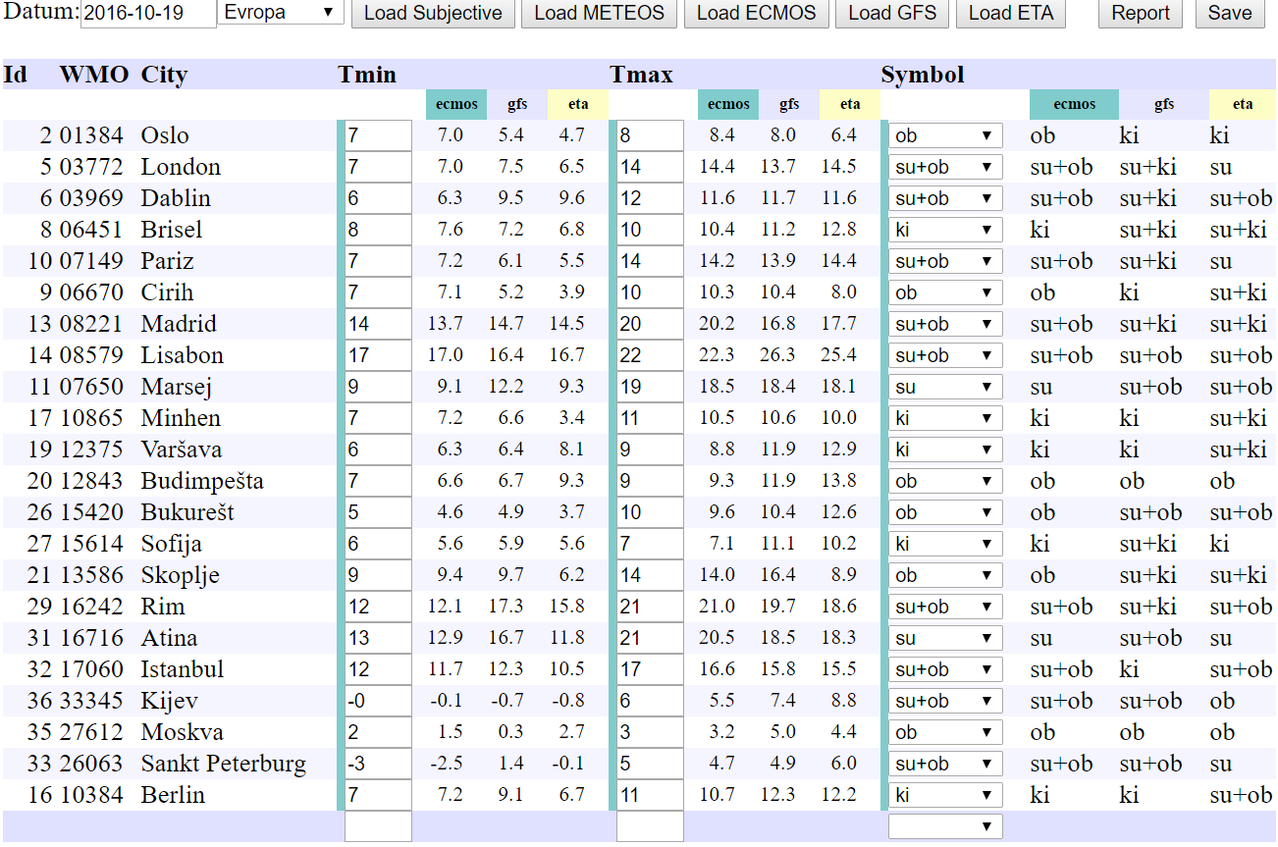
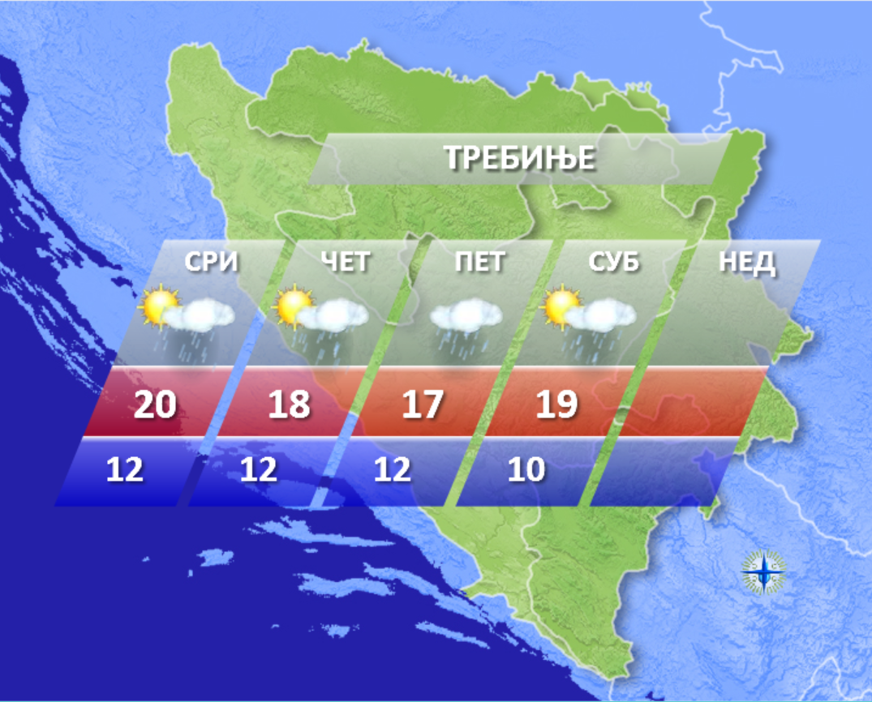
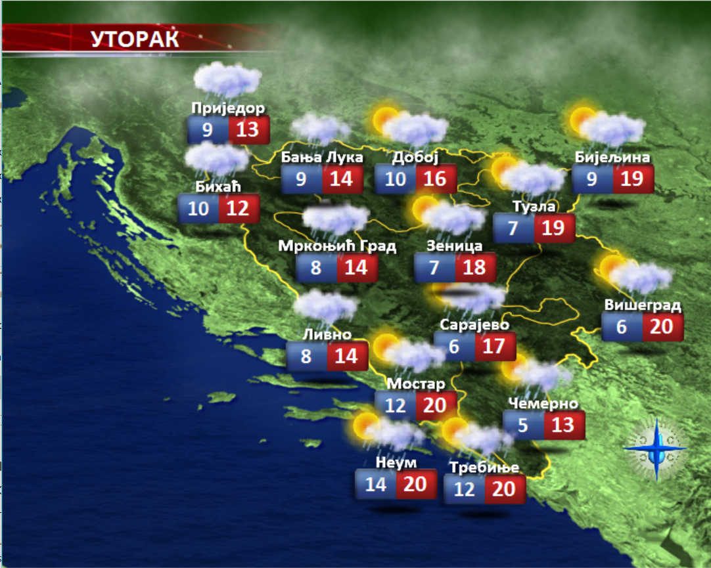
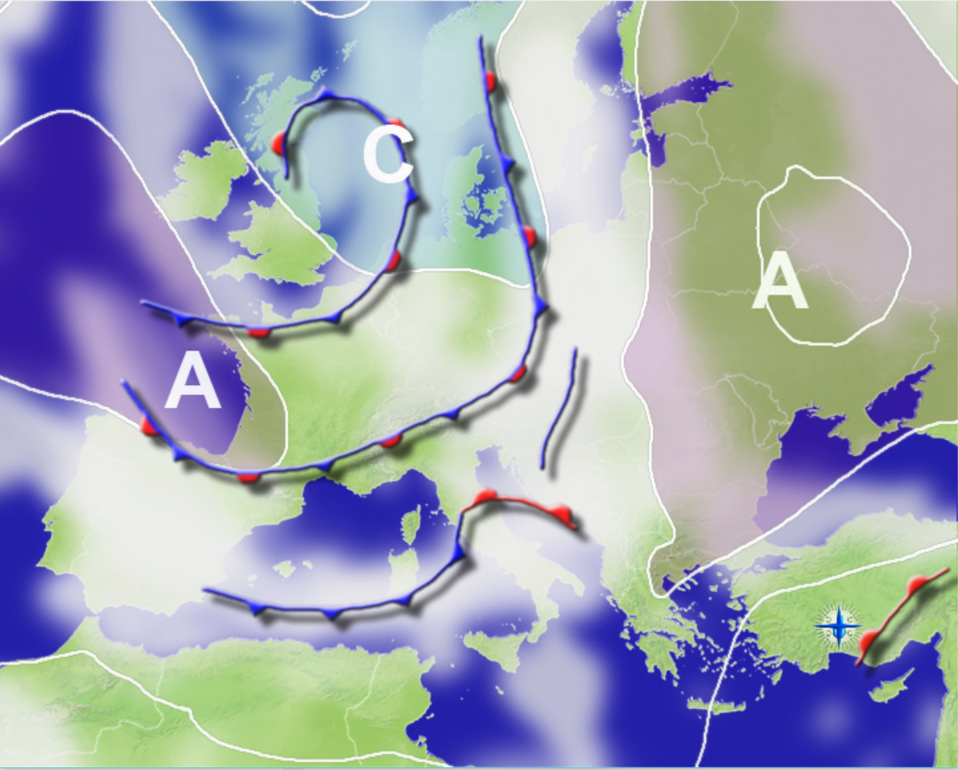
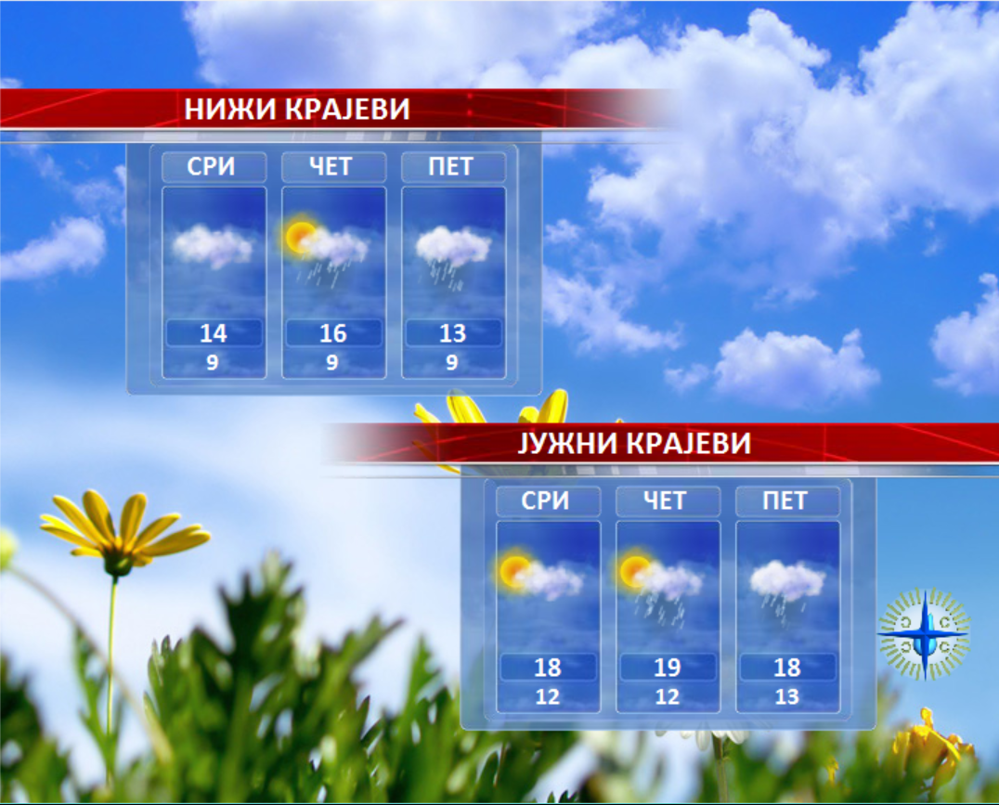
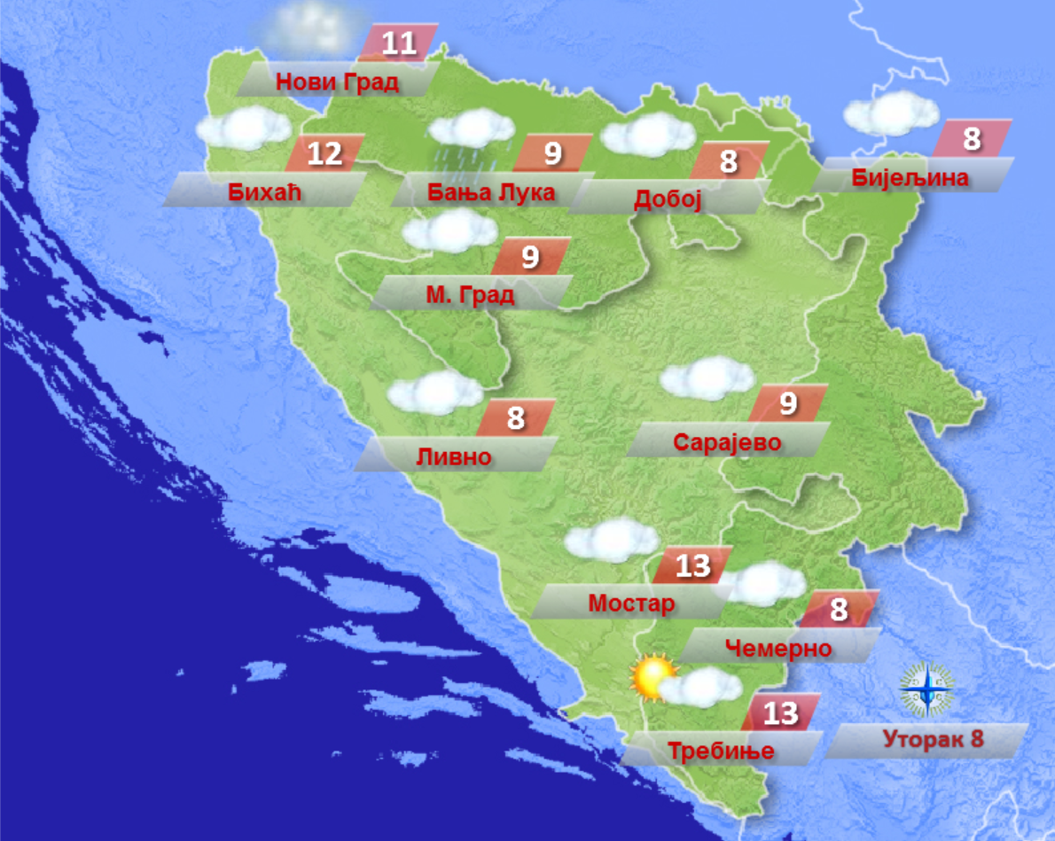
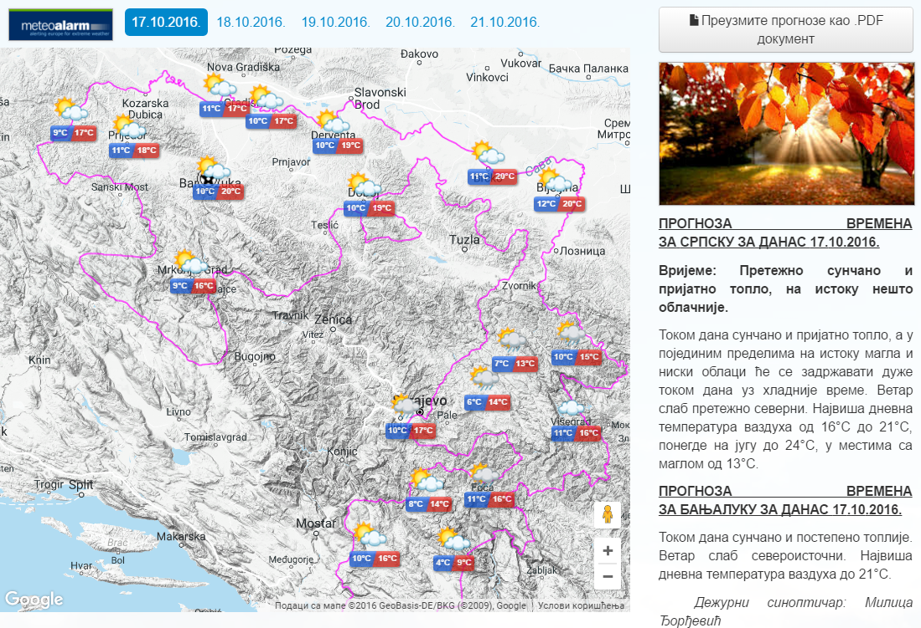
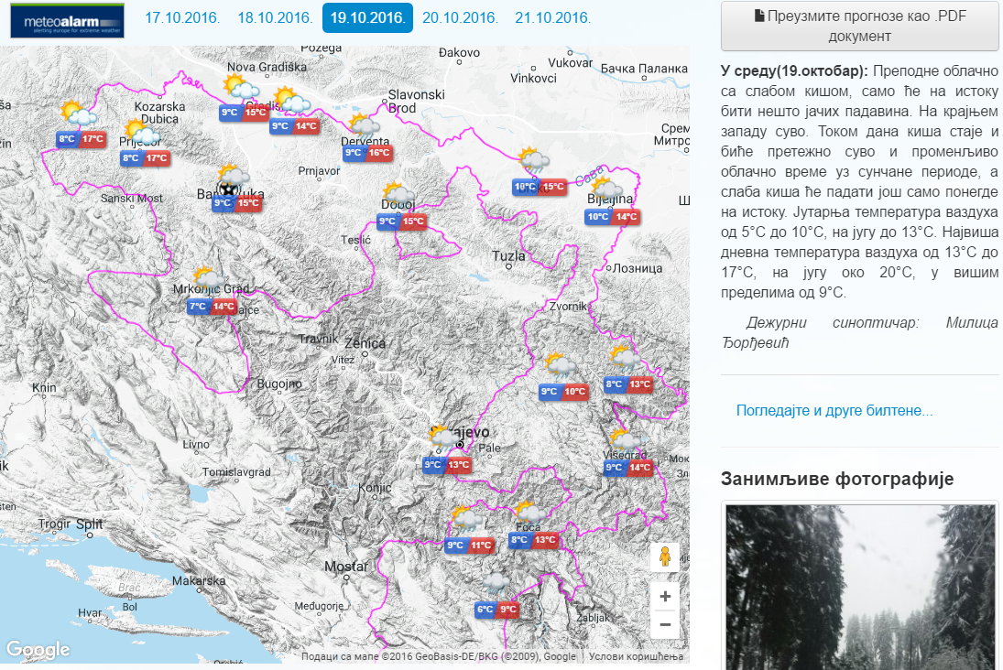
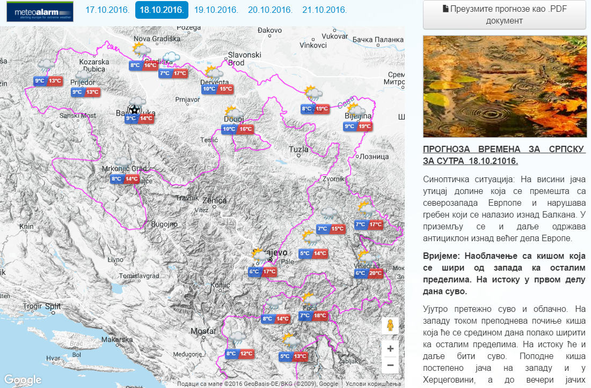
WMO STRATEGY FOR SERVICE DELIVERY FOR NMHSs IN SOUTH-EAST EUROPE
SERVICE DELIVERY
SECTOR OF METEOROLOGY
Department of Weather Watch: Division for forecast
rhmz@teol.net Republic Hydro-Meteorological Service of Republika Srpska, B&H www.rhmzrs.com

Slide 7
WMO STRATEGY FOR SERVICE DELIVERY FOR NMHSs IN SOUTH-EAST EUROPE
SERVICE DELIVERY
SECTOR OF METEOROLOGY
Department of Climatology and Agrometeorology
Climatology issued monthly and annual reports
-climatological analysis for different clients and purposes: spatial planning,
construction of facilities, insurance companies, healthcare organizations,
national reports on the state of climate ...
Agrometeorology issued regular weekly bulitens and forecast
-monthly and annual reports
- other information for users related to the soil temperature, humidity leaves
-phenological reports on current and medium dates appearances phenophases
of the leaves and flowering and beginning of ripening
-concentration of pollen
-SPI index
rhmz@teol.net Republic Hydro-Meteorological Service of Republika Srpska, B&H www.rhmzrs.com

Slide 8
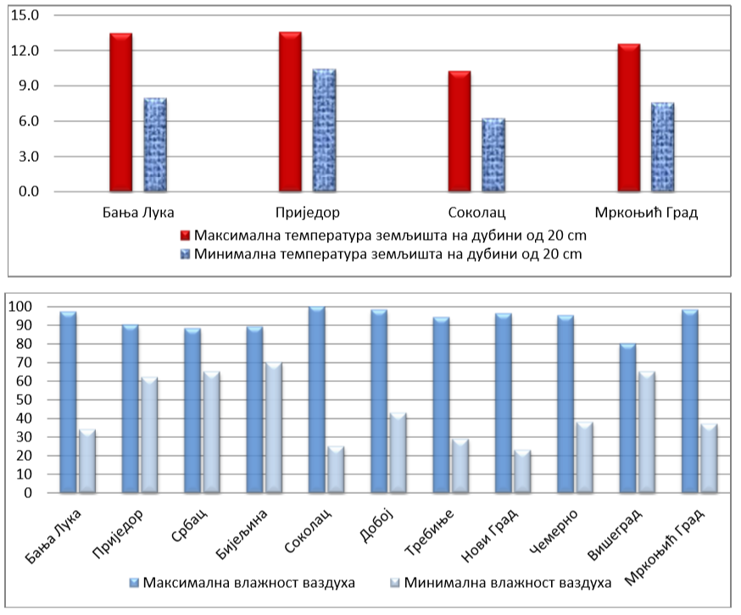
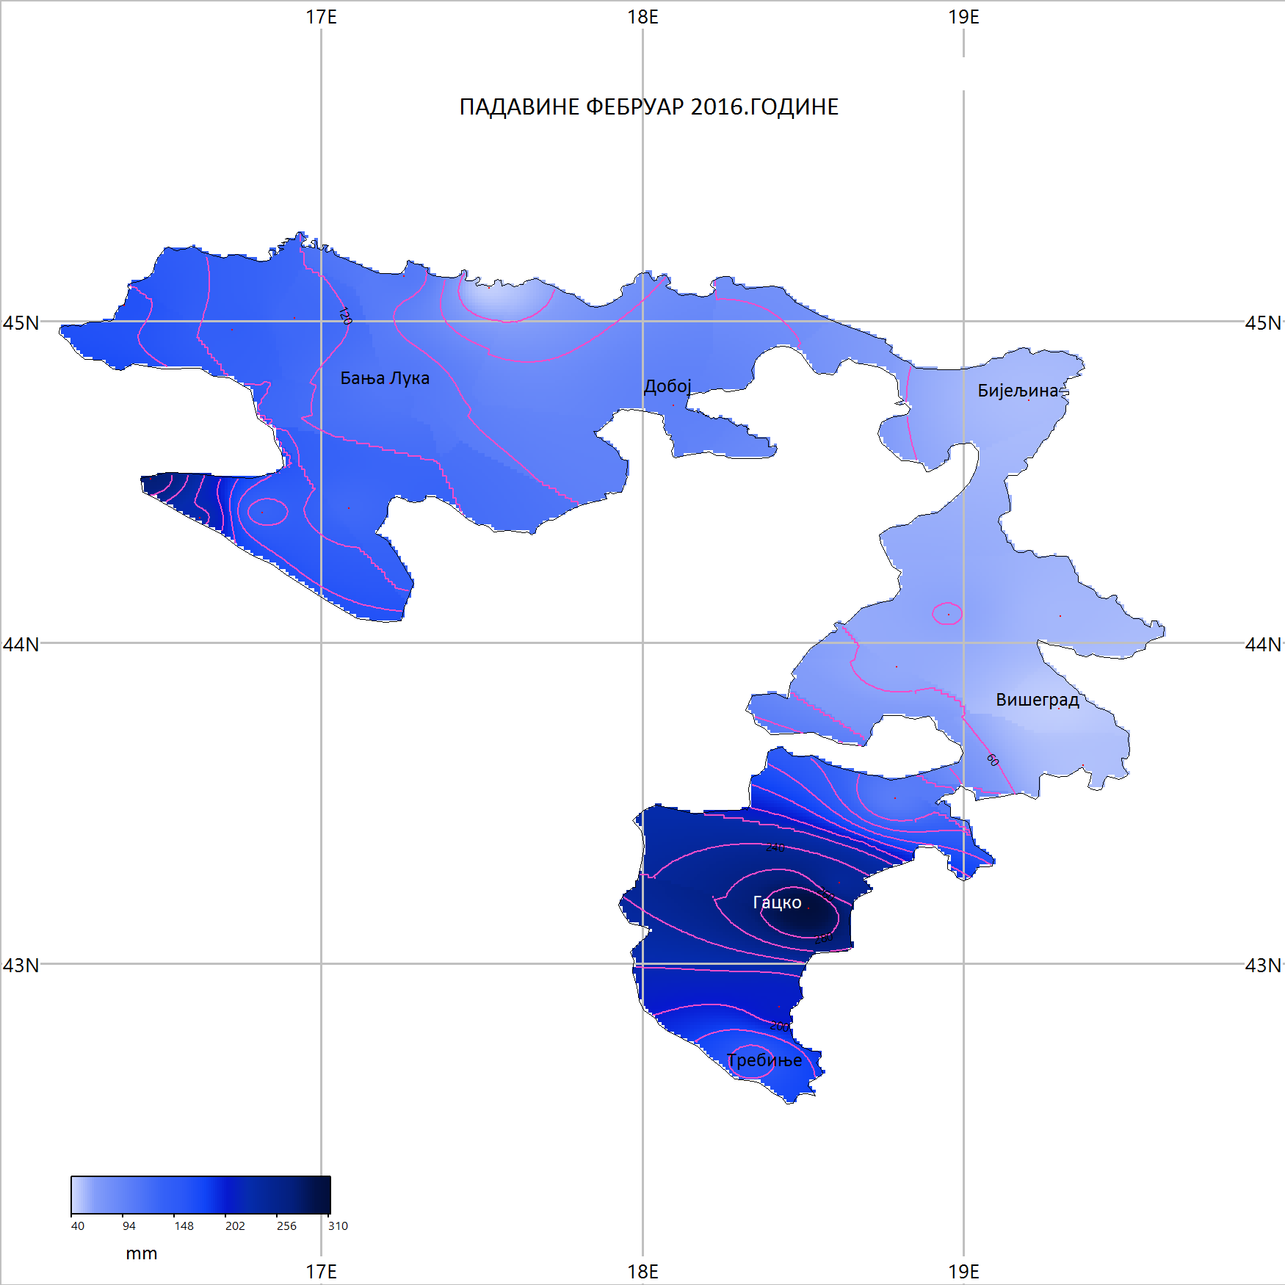
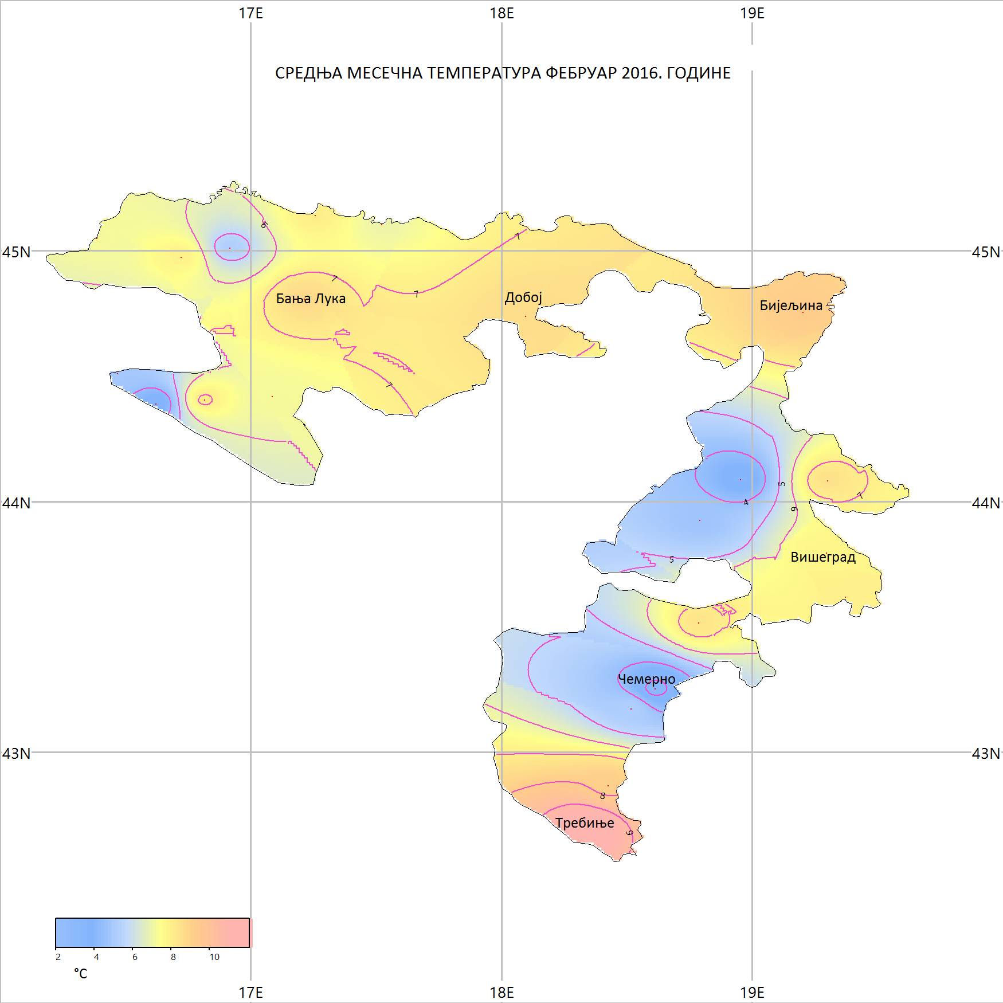
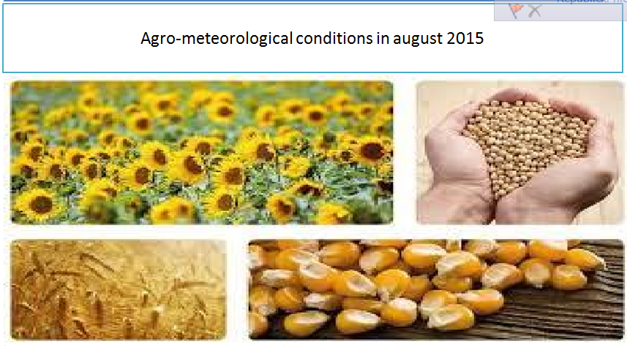
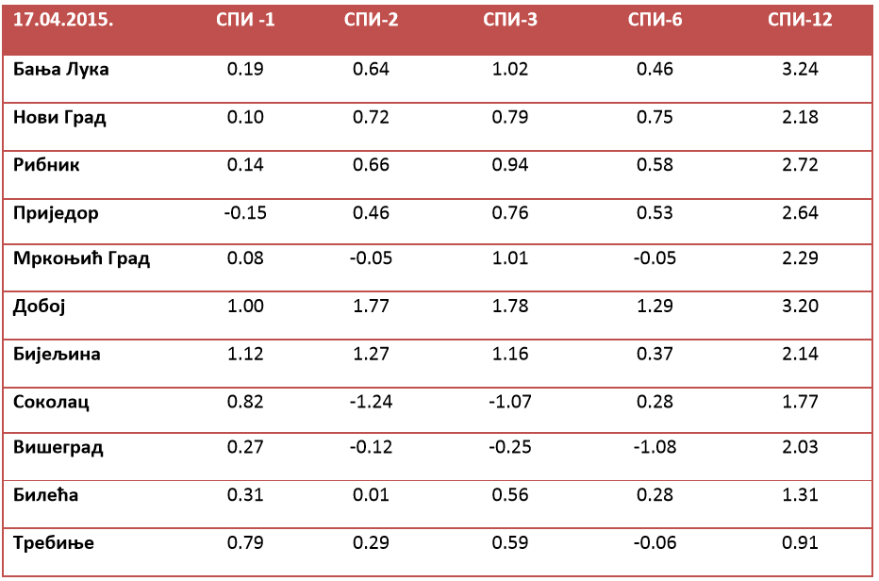
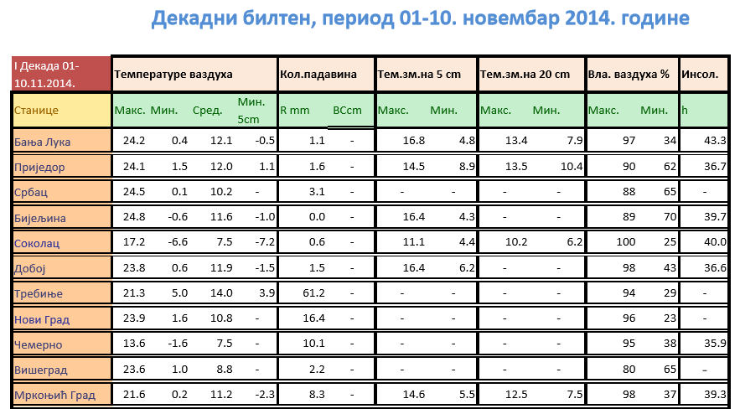
WMO STRATEGY FOR SERVICE DELIVERY FOR NMHSs IN SOUTH-EAST EUROPE
SERVICE DELIVERY
SECTOR OF METEOROLOGY_Climatology and Agrometeorology
Department of Climatology and Agrometeorology
rhmz@teol.net Republic Hydro-Meteorological Service of Republika Srpska, B&H www.rhmzrs.com

Slide 9
WMO STRATEGY FOR SERVICE DELIVERY FOR NMHSs IN SOUTH-EAST EUROPE
SERVICE DELIVERY
SECTOR OF HYDROLOGY AND ECOLOGY
Department of Hydrology
issued daily one hydrological bulletin for all users
-state watercourses: level, water flow and temperature
-in the case of watercourses crossing height above the level of flood defense
emergency bulletins are issued every hour
does not exist a hydrological forecast
temporary reporting to the media: radio, television newspapers…
rhmz@teol.net Republic Hydro-Meteorological Service of Republika Srpska, B&H www.rhmzrs.com

Slide 10
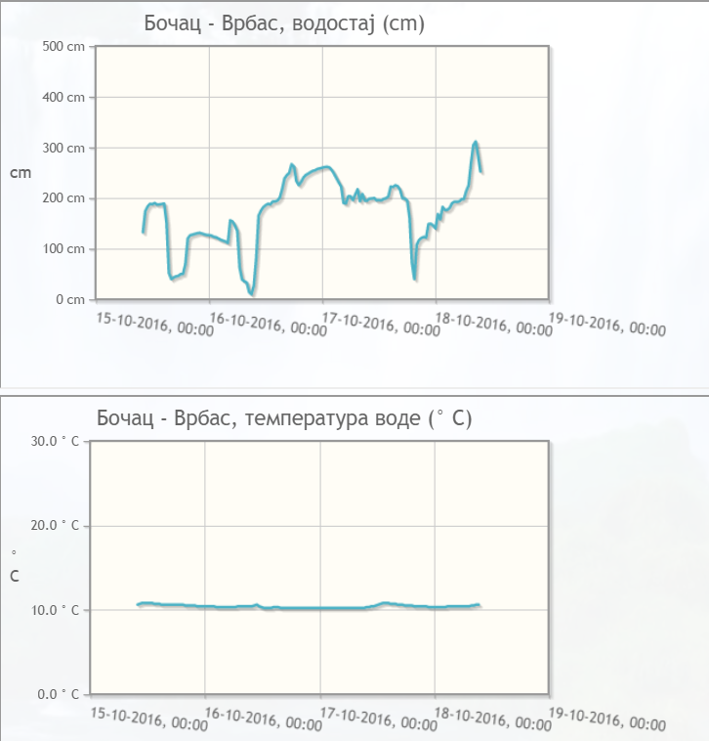
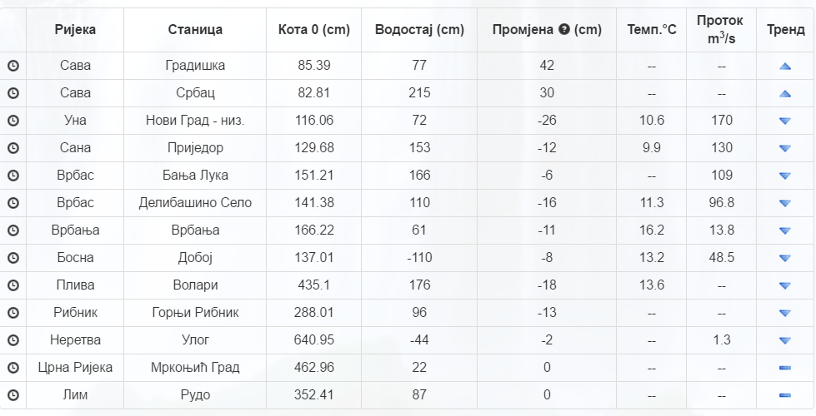
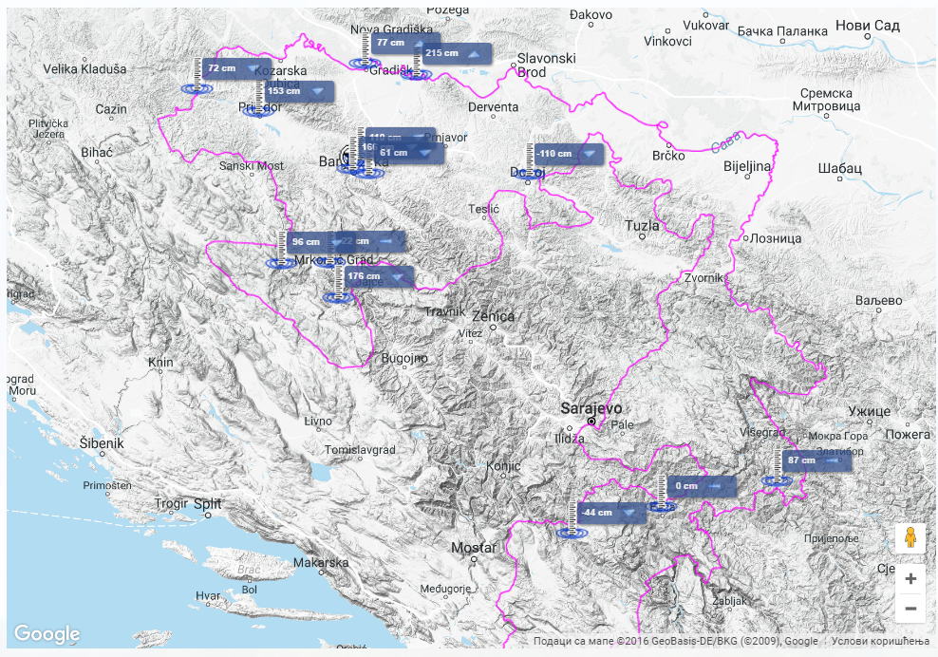
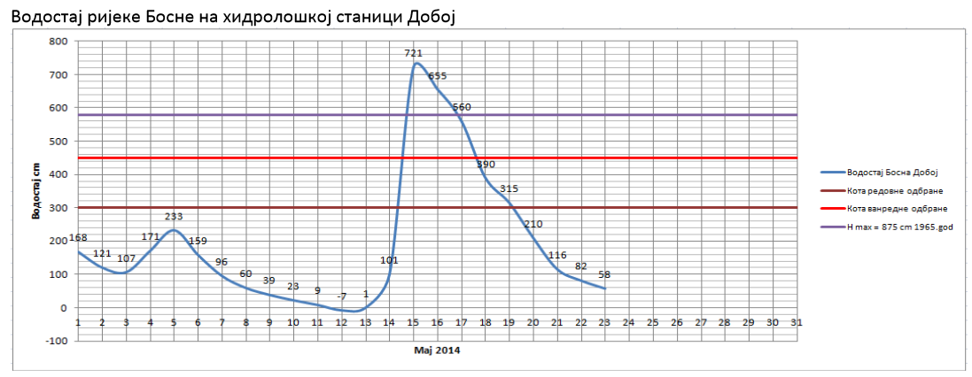
WMO STRATEGY FOR SERVICE DELIVERY FOR NMHSs IN SOUTH-EAST EUROPE
SERVICE DELIVERY
SECTOR OF HYDROLOGY AND ECOLOGY
Department of Hydrology
rhmz@teol.net Republic Hydro-Meteorological Service of Republika Srpska, B&H www.rhmzrs.com

Slide 11
WMO STRATEGY FOR SERVICE DELIVERY FOR NMHSs IN SOUTH-EAST EUROPE
SERVICE DELIVERY
SECTOR OF HYDROLOGY AND ECOLOGY
Department of Ecology
Daily Report on Air Quality
Common online reporting with FHMS of Federation of B&H automatic station for Air Quality http://www.hidrometeo.ba/rs/bluka.html
Monthly and annual report
GHG Inventory (UNFCCC)
PRTR In process of establishing
Air quality Inventory (LRTAP) In process of establishing
Monitoring of air and water quality of the surface, ground and offshore water
Systematic monitoring air and precipitation radioactivity
Sending of data to EIONET
rhmz@teol.net Republic Hydro-Meteorological Service of Republika Srpska, B&H www.rhmzrs.com

Slide 12
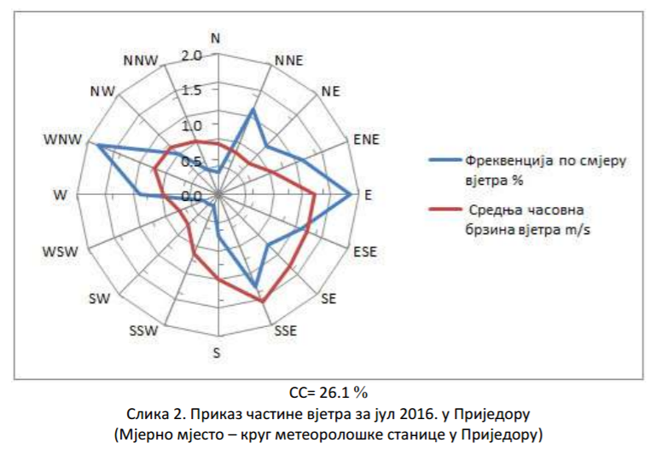
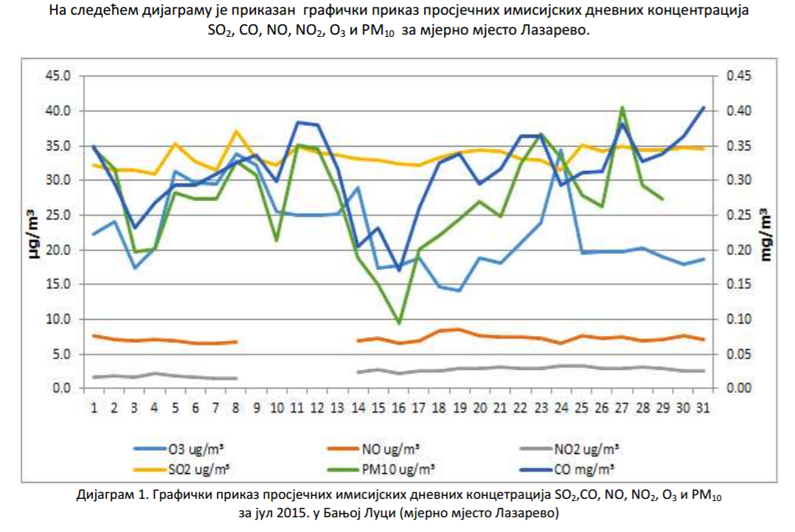
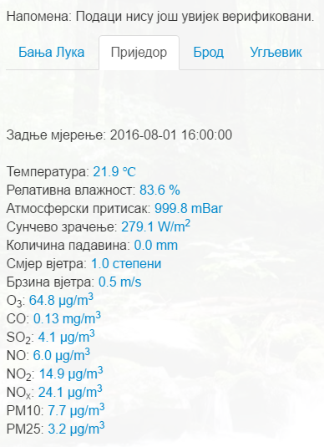
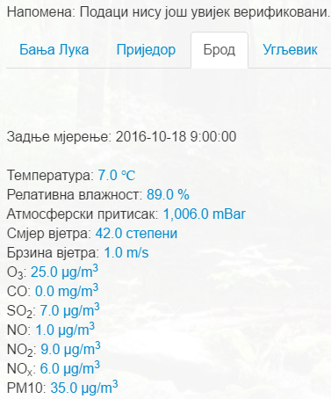
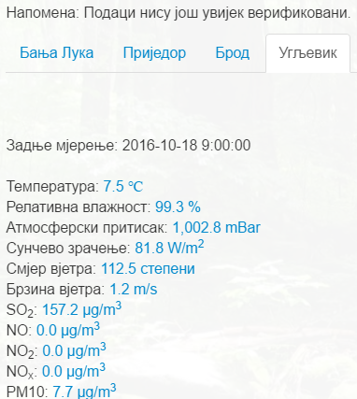
WMO STRATEGY FOR SERVICE DELIVERY FOR NMHSs IN SOUTH-EAST EUROPE
SERVICE DELIVERY
SECTOR OF HYDROLOGY AND ECOLOGY
Department of Ecology
rhmz@teol.net Republic Hydro-Meteorological Service of Republika Srpska, B&H www.rhmzrs.com

Slide 13
WMO STRATEGY FOR SERVICE DELIVERY FOR NMHSs IN SOUTH-EAST EUROPE
SERVICE DELIVERY
end users according to their priority
VIP end users: Civil Protection, Ministry, Govermnet in special situation
agricultural users, electricity authorities, hydroelectric power plants, heating plants
Environment Agency, Water Agency
media, turistic organizations, Public company, citizens...
ways of delivery of reports, forecasts and warnings
E-mail
sms
web
Phone aplication in testing phase
rhmz@teol.net Republic Hydro-Meteorological Service of Republika Srpska, B&H www.rhmzrs.com

Slide 14
WMO STRATEGY FOR SERVICE DELIVERY FOR NMHSs IN SOUTH-EAST EUROPE
SERVICE DELIVERY in emergency situations
RHMS,RS hydrological department-monitoring results:
Spcial bulletins with announcement and warning are distribute to
RHMS RS
Special bulletins with announcement and warning are distribute to
Ministry of Internal Affairs
-
Goverment
Republic administration for Civil Protection –
Municipal Civil Protection Headquarters
Operating center 121
112
rhmz@teol.net Republic Hydro-Meteorological Service of Republika Srpska, B&H www.rhmzrs.com

Slide 15
WMO STRATEGY FOR SERVICE DELIVERY FOR NMHSs IN SOUTH-EAST EUROPE
MANDATE OF RHMZ RS
FOCUS ON DRR ACTIVITIES
DOCUMENTS and ACTION:
Republika Srpska Strategy (platform) for natural disaster reduction (two session made)
Risk assessment of natural disasters in Republika Srpska (adopted 2014)
Projects (INC ,SNC, TNC): Initial, Second and Third National Communication (UNFCCC)
New and additional legislative acts
rhmz@teol.net Republic Hydro-Meteorological Service of Republika Srpska, B&H www.rhmzrs.com

Slide 16
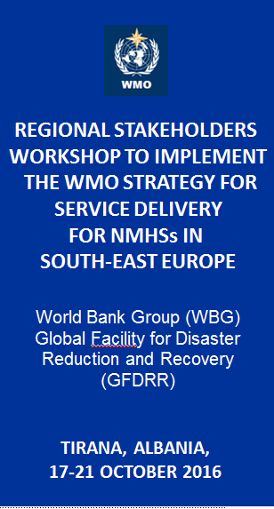
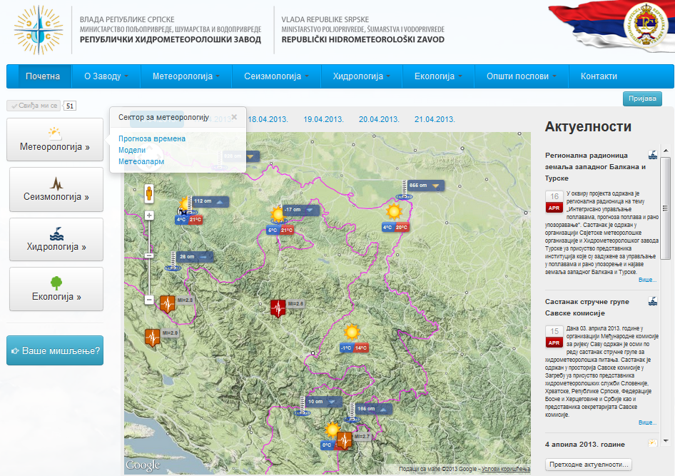
THANK YOU FOR YOUR ATTENTION Republic Hydro-Meteorological Service of Republika Srpska
WMO STRATEGY FOR SERVICE DELIVERY FOR NMHSs IN SOUTH-EAST EUROPE
rhmz@teol.net Republic Hydro-Meteorological Service of Republika Srpska, B&H www.rhmzrs.com

