Slide 1
Hydrometeorological institutE of kosovo
Dr. Sc. Bashkim KASTRATI – hydrologist
Contact:
Email: bashkim.kastrati@rks-gov.net
Mob: +377 (0) 44 25 65 52
Promotion of the Albanian Strategy for Service Development of NMH
Regional Stakeholders Workshop to Implement the World Meteorological Organization Strategy for Service Delivery for National Meteorological and Hydrological Services in South-East Europe
Tirana, Albania, 18-21 October 2016

Slide 2
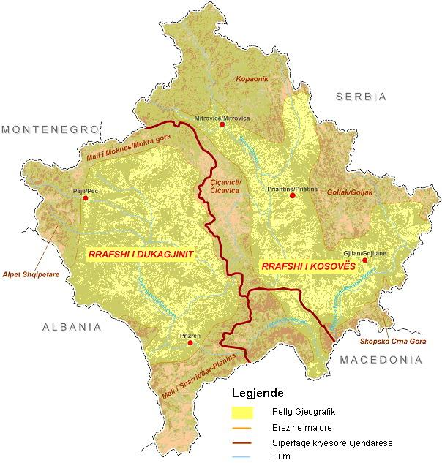
Kosovo consists of two hollows (Dukagjini in the west and Kosovo in the east) surrounded by Albanian Alps in west (Gjeravica 2656 m), Sharri Mountains in the south and Kopaonik in north.
2
1
3
4
Kosovo is divided into 5 hydrogeographical river basins: 1. Drini i Bardhë, 2. Ibri, 3. Morava e Binçës, 4. Lepeneci and 5 Plava.
5

Slide 3
ORGANISATION CHART OF HMIK
DIRECTORAT OF HMIK
SECTOR OF HYDROLOGY
SECTOR OF METEOROLOGY
SECTOR OF
LABORATORY (AIR,WATER SOIL)

Slide 4
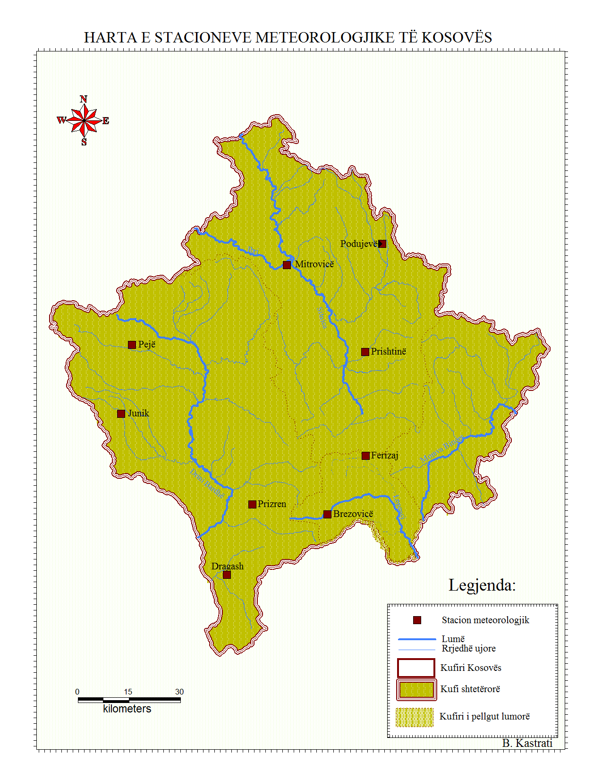
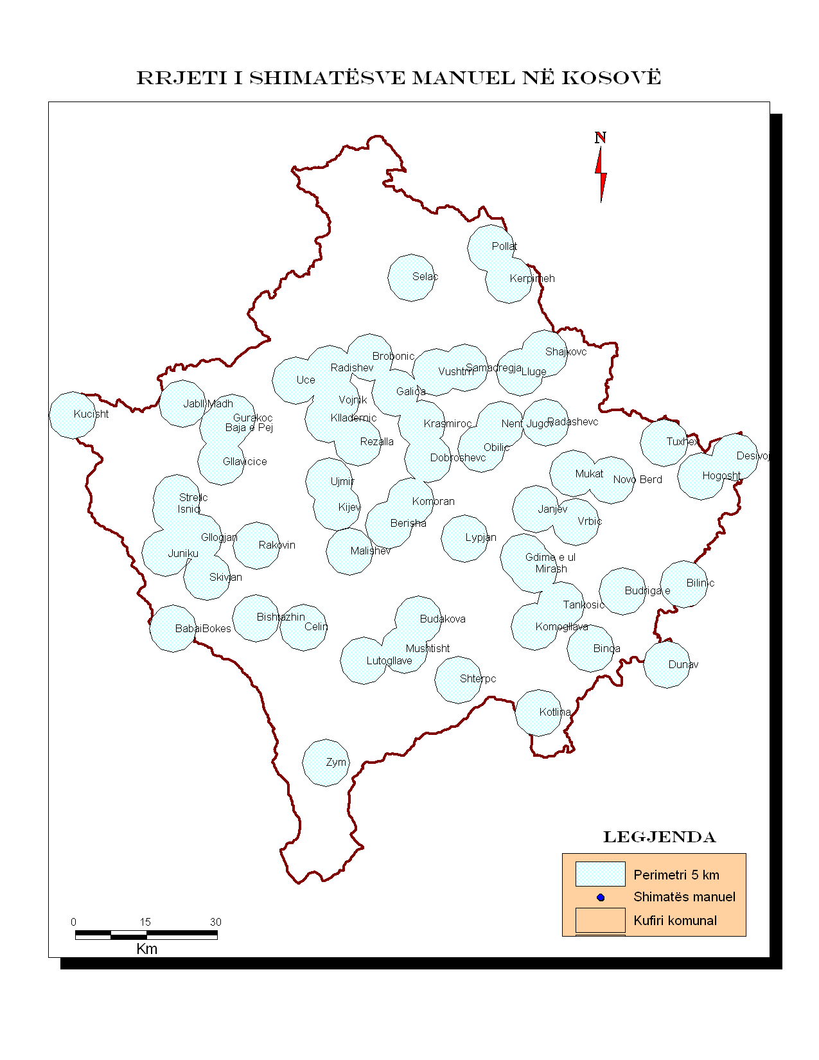
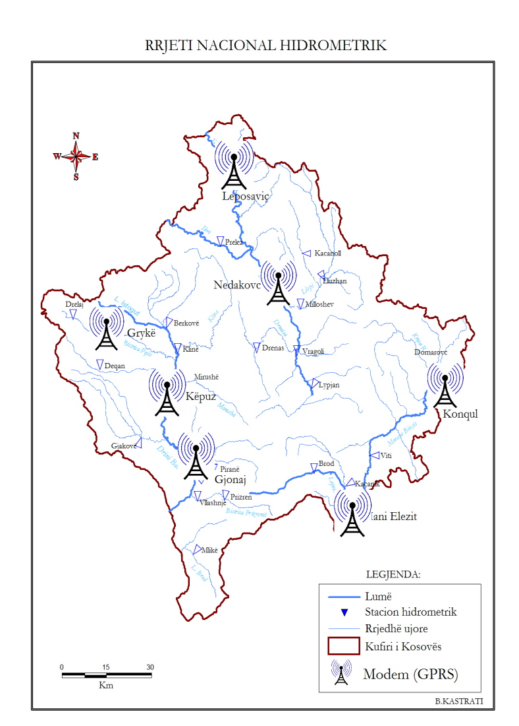
Hydrometeorological Stations Network of Kosovo

Slide 5
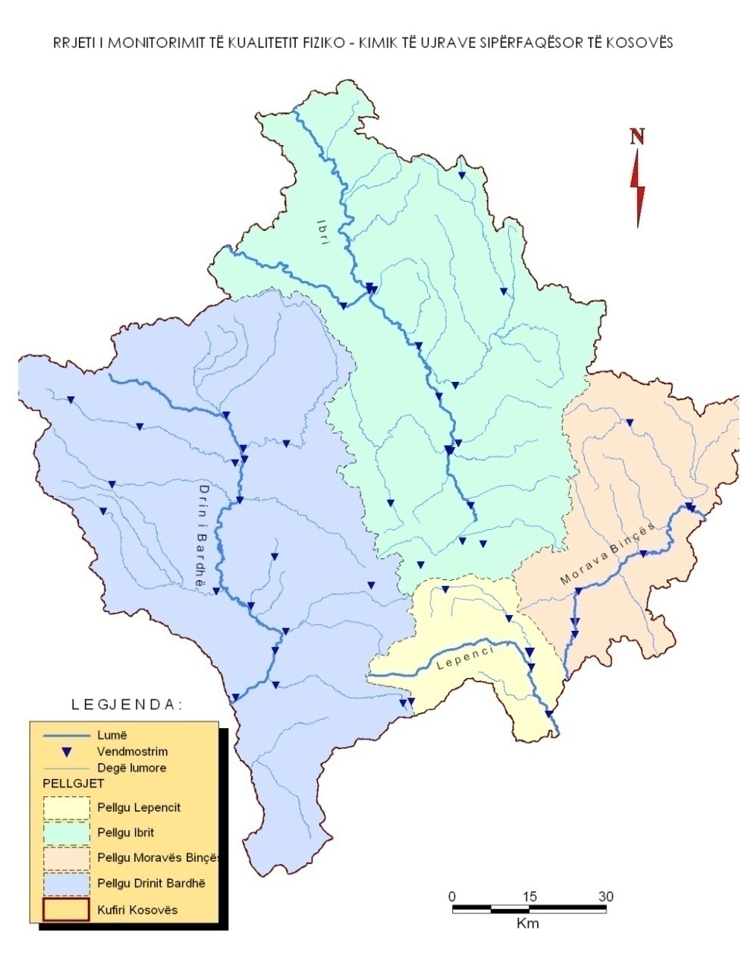
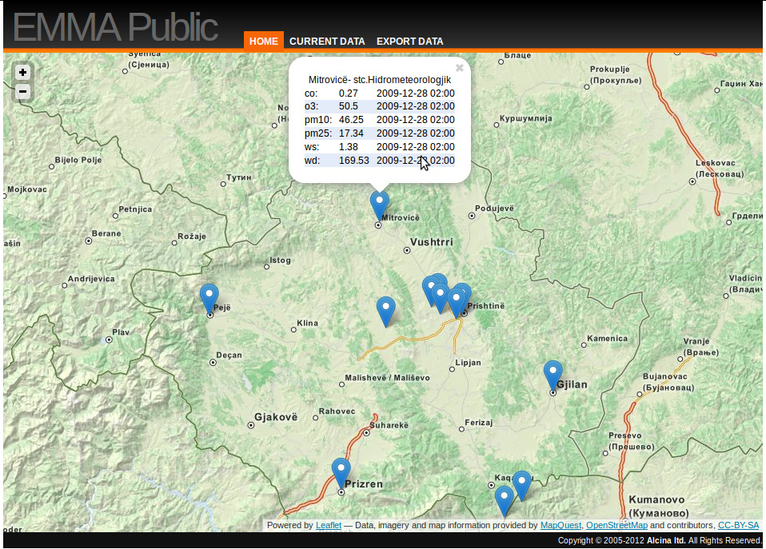
Water quality stations
Air quality stations

Slide 6
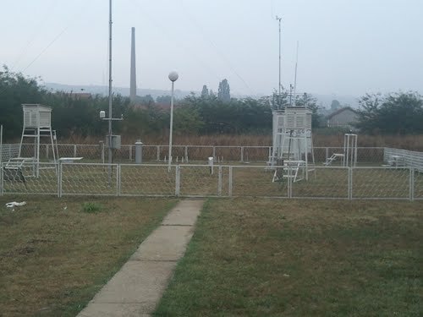
MONITORING NETWORKS
River basin | Drini Bardhë | Ibri | Morava Binçës |  | Lepenci | Total
Hydrometric stations | 13 | 8 | 3 |  | 3 | 27
Meteorological stations | 1 | 1 | - |  | 1 | 3
Climatological stations | 2 | 2 | - |  | - | 6
Wells RBD | - | 1 | 10 |  | 6 | 17
Rain gauge RBD | 23 | 28 | 9 |  | 1 | 61
Rezervoir RBD | 1 | 3 | 1 |  | - | 5

Slide 7
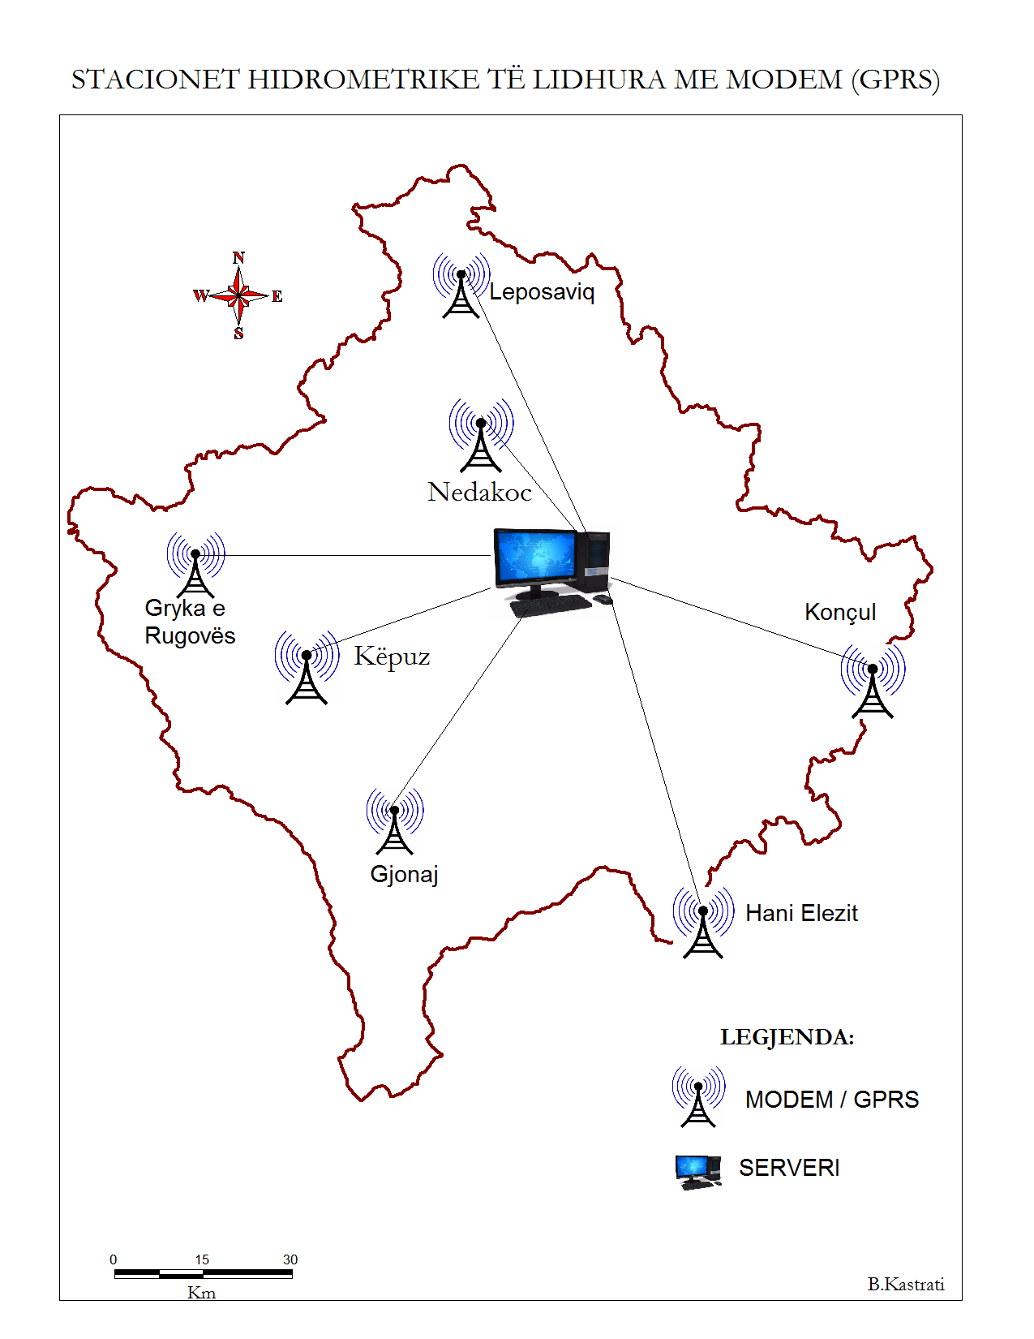

STATIONS CONNECTED BY
GPRS MODEM
I. Hydrometric stations
All number - 27
Drini Bardhë/Gjonaj
Drini Bardhë/Këpuz
Bistrica Pejës/ Grykë e R.
Ibri/Leposaviq
Sitnica/Nedakoc
Lepenci/Hani Elezit
Mrava Binçës/Konçul
II. Meteo Stations
Prishtinë
Pejë
Ferizaj
Junik
Prizren
Dragash
Mitrovicë
Brezovicë
Podujeva
Pejë
Server/KHMI
PRISHTINË
Junik
Prizren
Hydro GPRS
Meteo GPRS

Slide 8
- 2 Hydro stations
- 3 Meteo connected by (GPRS)
Involved: (Kosovo, Albania, Macedonia, Montenegro)
Its implemented the project: "Adapting to climate change in the Western Balkans Drini / Buna Basin - GIZ. "
Meteo stations
Pejë (Precip, temp,)
Junik (Precip, temp,)
Prizren (Precip, temp,
lhumidity, preasure)
Hidro stations
Bistrica Pejës (Grykë R.) level
Drini Bardhë (Gjonaj) level

Slide 9
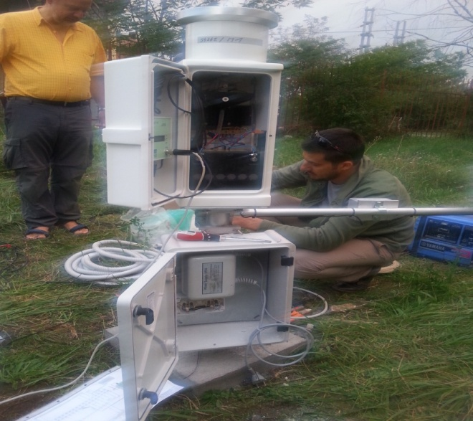
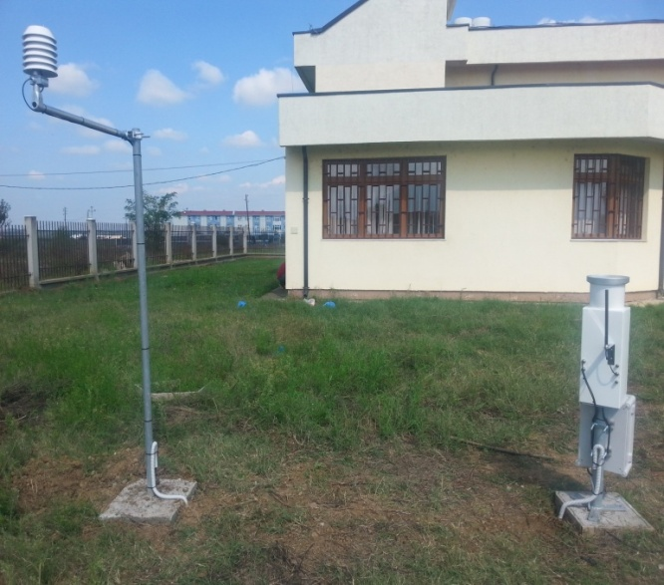
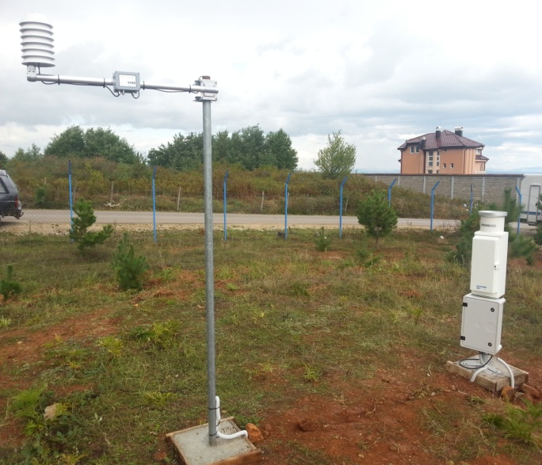
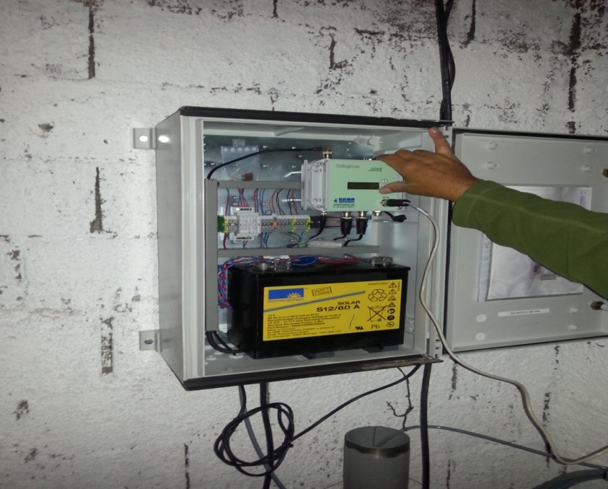
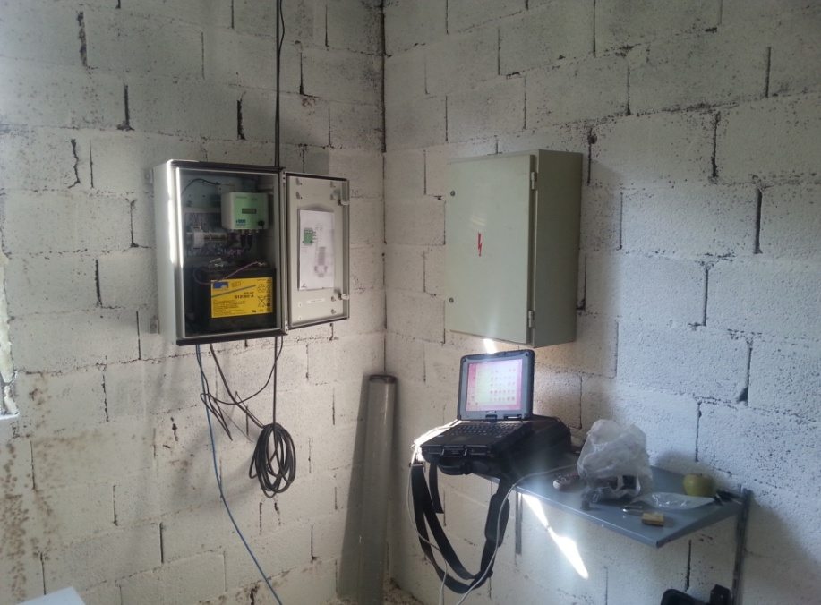
Meteo & HYDRO staTIONS
Pejë
Prizren
Junik
Bistrica e P – Gryka e Rugovës
Drini i Bardh – Gjonaj

Slide 10
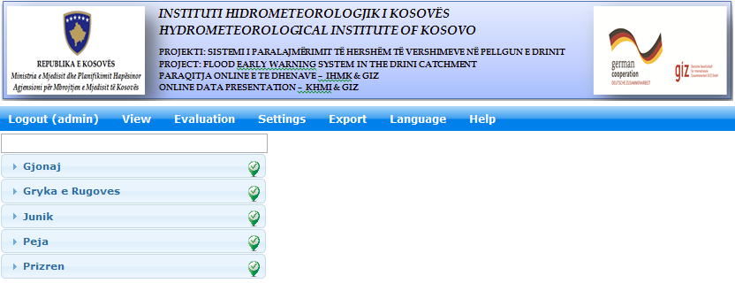
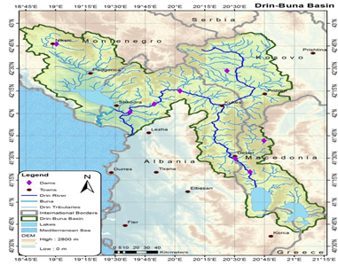
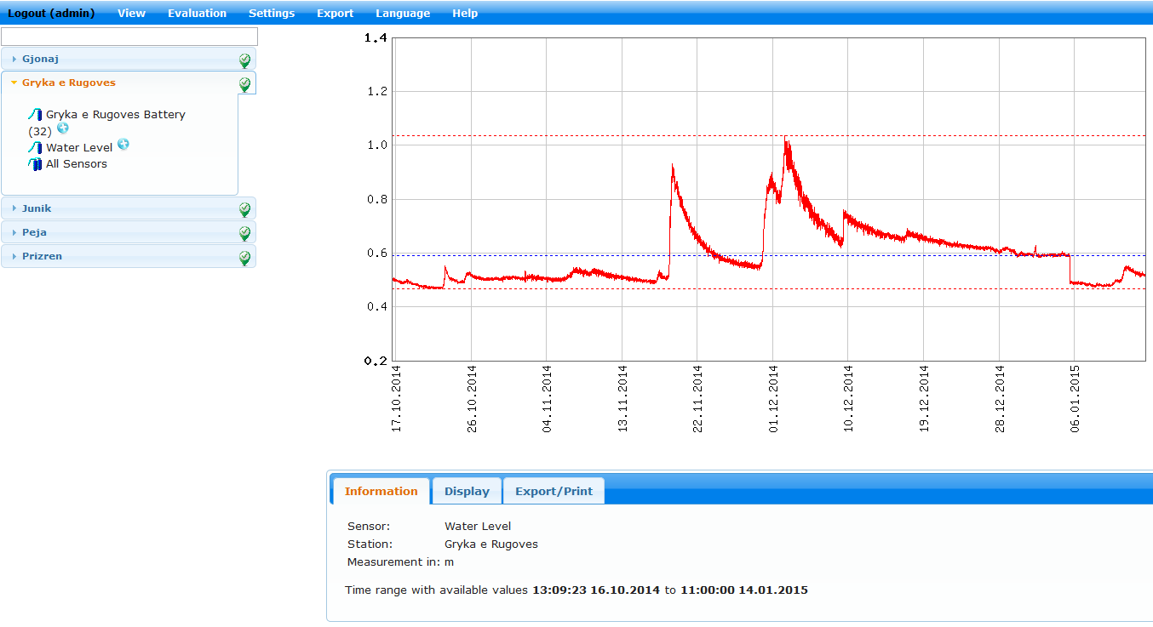
Internet module access

Slide 11
DATABASE
Database &
server
demasDp
MCH
hydrological
Climatological
Environmental data
(water, soil-air)
Meteorological

Slide 12
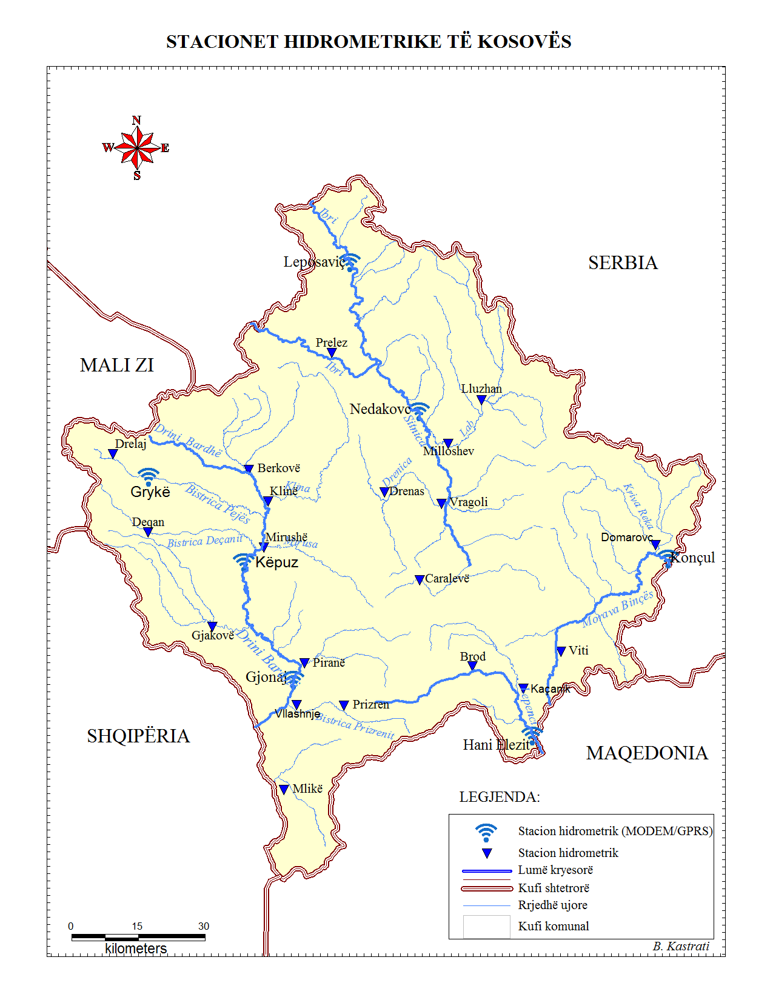
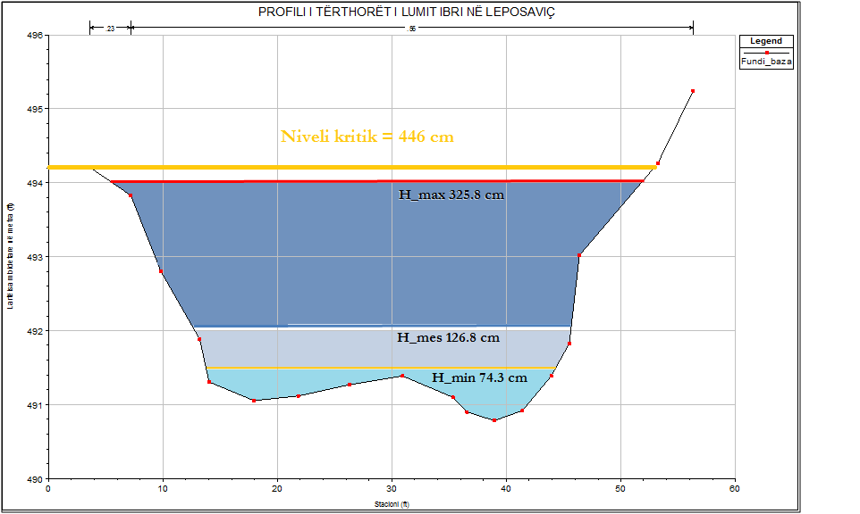
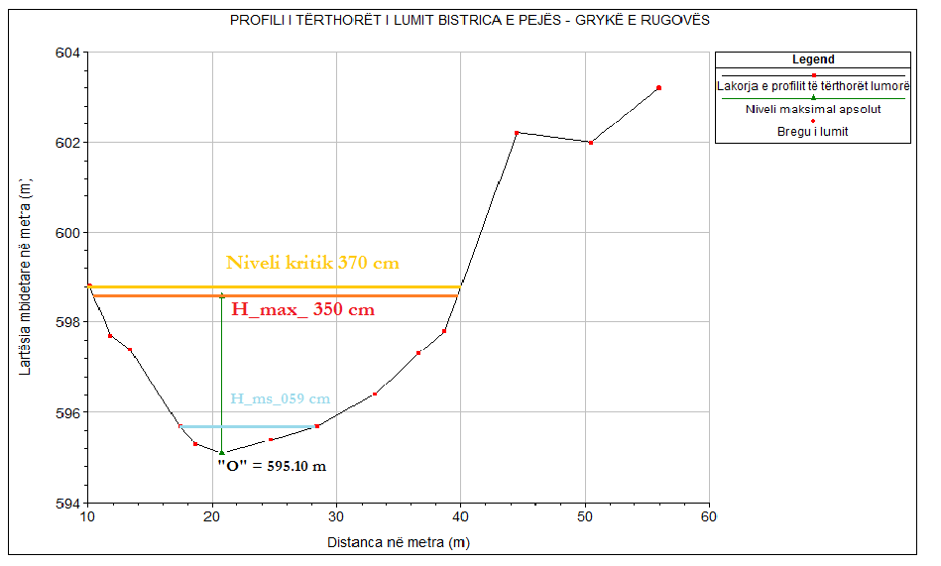
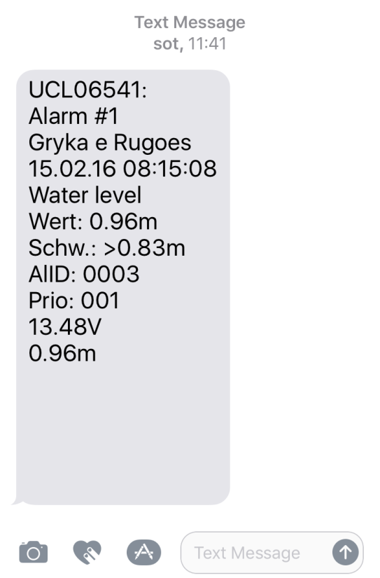
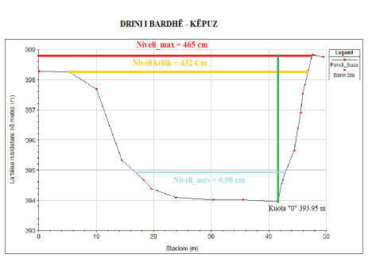
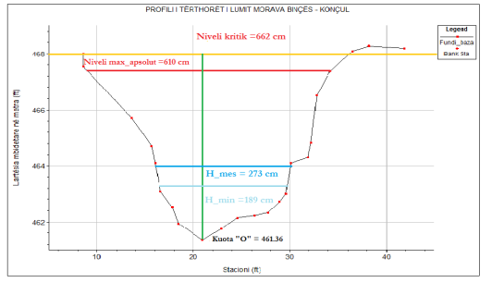
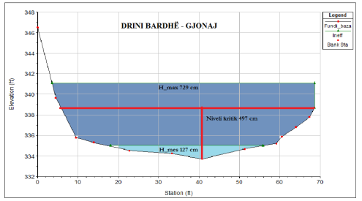
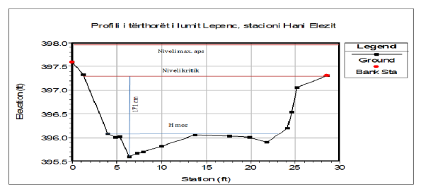

Slide 13
HYDRO – CLIMATIC disasters
METEOROLOGICAL & CLIMATOLOGICAL:
Extreme temperatures (minimum and maximum)
Heavy precipitation (rain, snow, avalanches, ice, frost)
Strong winds (direction, speed)
2. HYDROLOGICAL:
Floods
Flash floods
Land slide
Droughts

Slide 14
Advances in climate modeling and forecasting, offer Opportunities in Disaster Risk Management
Shorter and mid-term weather forecast period
Annual and seasonal weather forecast
Analysis of climate trends by decades
Climate Change Scenario
Next 10 hours, until 10 days
Seasonal - annual
decades
Long-term climate change
Short-term planning
emergency Preparedness
- Sectoral Operational Planning
Mid-term assessment and risk management
Long-term strategic planning
Infrastructure planning, land zoning
International negotiations with national political implications
Deadlines decision

Slide 15
The public Information
Daily weather data and forecast for 3-5 days (temperature, precipitation rain –snow etc.),
Hydrological data (Current Water Levels & temperature in Rivers –tendency)
Preparation of reports for warning of floods
Hydro-climatological three monthly Bulletin
Hydro Climatological Yearbook

Slide 16
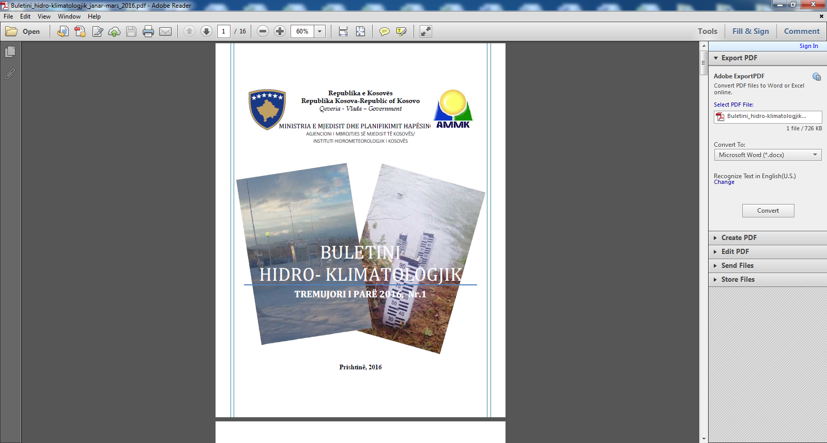
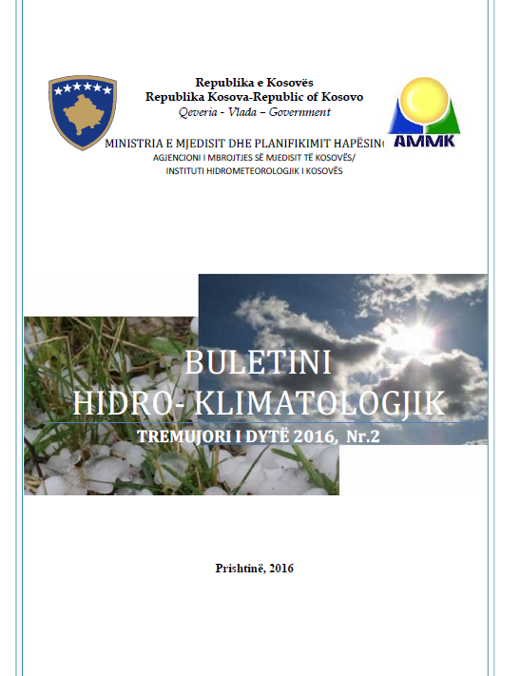

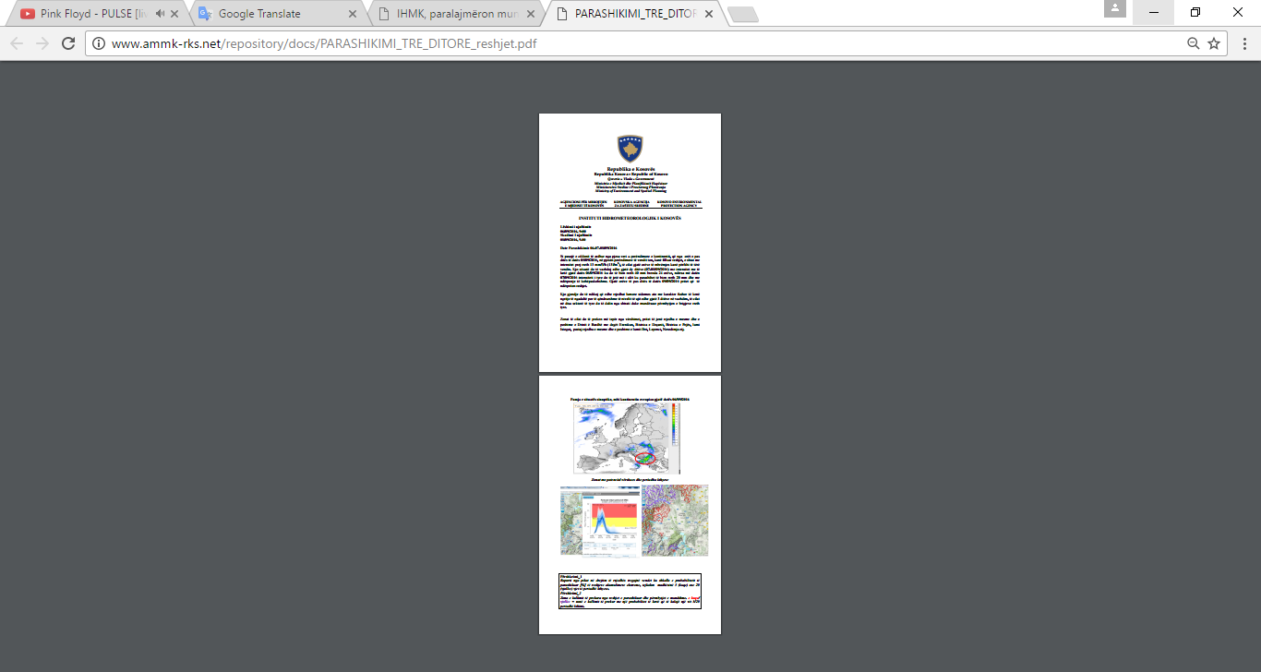
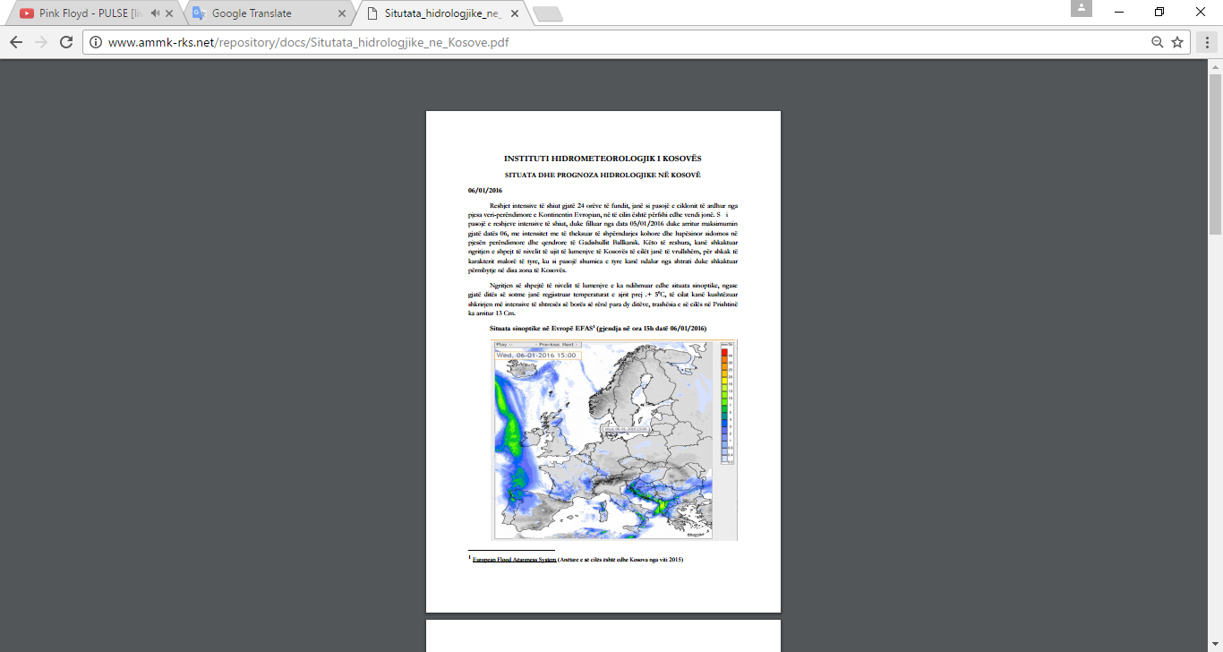
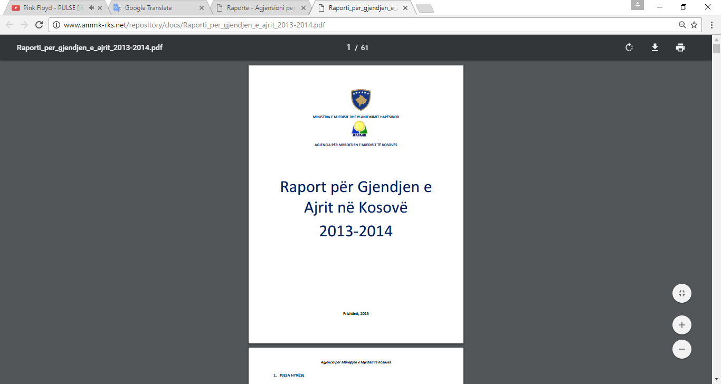
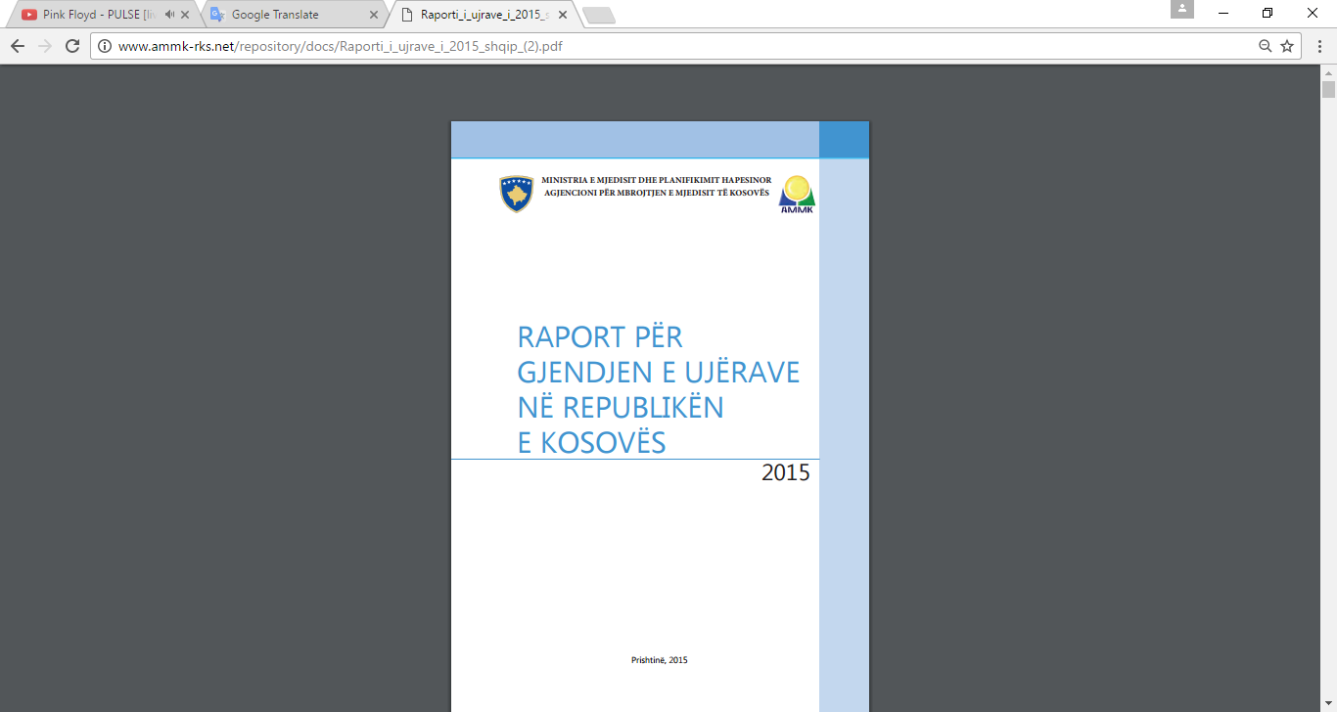

Slide 17








INFORMATION OF PUBLIC and STAKEHOLDERS
Ministry of Environment and Spatial Planning – MESP
http://mmph-rks.org/
OTHERS…………..
Kosovo Environment AND Protection Agency (KEPA)
http://www.ammk-rks.net/
EMERGENCY MANAGEMENT AGENCY OF KOSOVA (EMA)
https://ame.rks-gov.net/al/
MUNICIPALITIES
http://kk.rks-gov.net/
PUBLIC
Insurance companies
MEDIA (Public & Private TV, Radio, Newspaper etc.)
Ministry of Environment and Spatial Planning – MESP
http://mmph-rks.org/
OTHERS…………..
Kosovo Environment AND Protection Agency (KEPA)
http://www.ammk-rks.net/
EMERGENCY MANAGEMENT AGENCY OF KOSOVA (EMA)
https://ame.rks-gov.net/al/
MUNICIPALITIES
http://kk.rks-gov.net/
PUBLIC
Insurance companies
MEDIA (Public & Private TV, Radio, Newspaper etc.)

Slide 18






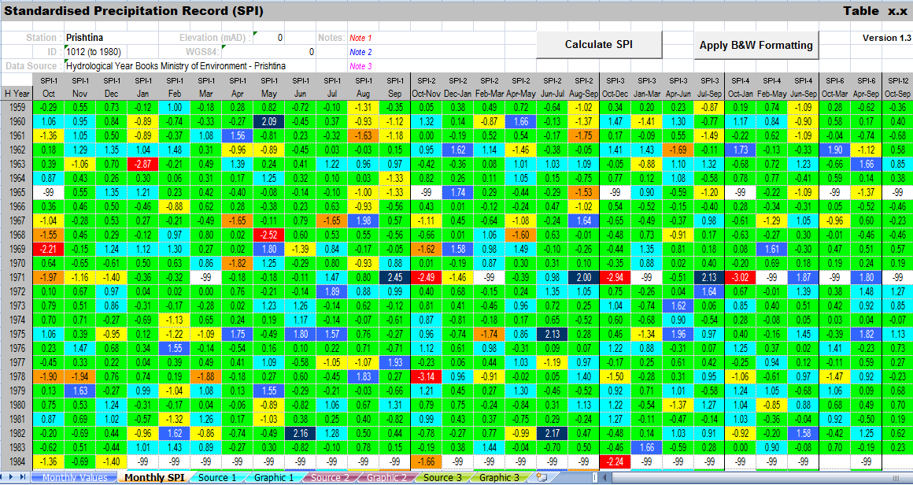
Standard Precipitation Index (SPI)
Informing the water companies

Slide 19


MEBER & PARTNERS

Slide 20
CAPACITY:
Hydrometeorological Institut of Kosova
It is still not well covered by monitoring systems, especially meteorological, climatological, agro- climatological etc.
There is insufficient technical capacity and professional (meteorologist, weather forecast, synoptic etc.
No radar system for prediction and prognosis.

Slide 21
PLANS
Increase and modernization of Hydro -Meteorological stations.
Membership and cooperation with international organizations and institutions.

Slide 22
HEAT INDEX
 |  |  |  |  |  | Temperature ºC
 |  | 27 | 28 | 29 | 30 | 31 | 32 | 33 | 34 | 36 | 37 | 38 | 39 | 40 | 41 | 42 | 43
 | 40 | 27 | 27 | 28 | 29 | 31 | 33 | 34 | 36 | 38 | 41 | 43 | 46 | 48 | 51 | 54 | 58
 | 45 | 27 | 28 | 29 | 31 | 32 | 34 | 36 | 38 | 40 | 43 | 46 | 48 | 51 | 54 | 58
Relative humidity % | 50 | 27 | 28 | 29 | 31 | 33 | 35 | 37 | 39 | 42 | 45 | 48 | 51 | 55 | 58
 | 55 | 27 | 29 | 30 | 32 | 34 | 36 | 38 | 41 | 44 | 47 | 51 | 54 | 58
 | 60 | 28 | 29 | 31 | 33 | 35 | 38 | 41 | 43 | 47 | 51 | 54 | 58
 | 65 | 28 | 29 | 32 | 34 | 37 | 39 | 42 | 46 | 49 | 53 | 58
 | 70 | 28 | 30 | 32 | 35 | 38 | 41 | 44 | 48 | 52 | 57
 | 75 | 29 | 31 | 33 | 36 | 39 | 43 | 47 | 51 | 56
 | 80 | 29 | 32 | 34 | 38 | 41 | 45 | 49 | 54
 | 85 | 29 | 32 | 36 | 39 | 43 | 47 | 52 | 57
 | 90 | 30 | 33 | 37 | 41 | 45 | 50 | 55
 | 95 | 30 | 34 | 38 | 42 | 47 | 53
 | 100 | 31 | 35 | 39 | 44 | 49 | 56
(Possibility of disorders as a result of activities and prolonged exposure)
Attention
Extreme care
Danger
Extreme risk

Slide 23
Heat Index, GUIDE FOR EMPLOYERS
Heat IndexºC | LEVEL OF RISK | PROTECTIVE MEASURES
< 32 | Low Attention | Basic Heating safety and planning
32 - 39 | Average | Implement measures to raise awareness
39 - 46 | High | Ndditional measures to protect workers
>46 | Very High to extreme | It causes even more aggressive defensive measures
Classification | Heat Index | Effects on the body (Organism)
Carefully | 26 - 32 | Fatigue possible with prolonged exposure and / or physical activity
Extreme care | 32 - 39 | Heat stroke, heat cramps or heat exhaustion possible with prolonged exposure and / or physical activity
Risk | 39 - 51 | Heat cramps or heat exhaustion likely, and heat stroke possible with prolonged exposure and / or physical activity
Extrem risk | <51 | Heat stroke likely

Slide 24
Thank you

