Slide 1
Socio Economic Benefits Workshop
Edson NKONDE
Kalisto KHUMALO
Zambia Meteorological Department

Slide 2
Contents
Location & Map
Climate of Zambia
Weather Related Hazards
Population, Land-cover & GDP
ZMD
Product & services
Expectations

Slide 3
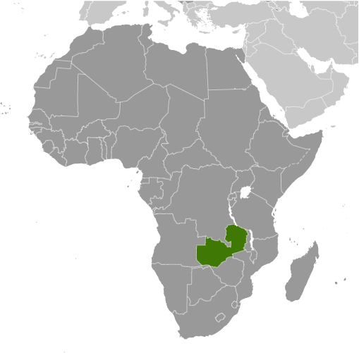
Location and Map of Zambia

Slide 4
Climate of Zambia
Two main seasons,
the rainy season (November to April) – summer
the dry season(May to October/November) - winter.
The dry season is subdivided into the cool dry season (May to August) & the hot dry season (September to October/November).

Slide 5
Weather Related Hazards
Droughts- Droughts occur every several years in Zambia
Floods - Zambia experiences floods on average every other year

Slide 6
Population, Land cover & GDP
752,618 km²
Population: 14.54 Million
Land cover: 752,618km squared
Gross domestic product: 26.82 billion USD ‎(2013)
Break down of GDP
Agriculture: 10.8%
Industries: 32.9%
Services: 56.3%
Main Industries: Mining and Agriculture

Slide 7
Zambia Meteorological Department
The Zambia Meteorological Department (ZMD) was established on 1st January 1967
Prior to this Meteorological Service in Zambia were administered by the Federal Meteorological Services (Nyasaland, Northern Rhodesia and Southern Rhodesia) in Salisbury, (Harare) Zimbabwe.
became a member of the World Meteorological Organisation (WMO) in 1964.
Current staff levels - 207

Slide 8
Our Mandate
A National Meteorological Service (NMS) anywhere in the world is a key institution charged with the responsibility of weather observation, analysis and prediction, for purposes of protecting life and property, safeguarding the environment, provision of advice and assessment for policy formulation as well as contribution to sustainable development.
In Zambia, ZMD is the National Meteorological Service and the primary provider of meteorological services. It has offices in every Province and some districts, and it is responsible for providing weather and climate information to the public and various sectors of the economy. ZMD is also the custodian of the official records of Zambian Weather and Climate.

Slide 9
Our Mission Statement
The Mission Statement of ZMD is:
To monitor, predict and provide reliable, timely accurate and user-friendly weather and climate products and services for sustainable socio-economic development through collaboration with other stakeholders.
In support of this mission statement, the goal of ZMD is “to improve its products and services to its clients by restoring its human resource base, observation network, communications infrastructure, data analysis and dissemination as well as its linkages with reputable regional and international climate centres.

Slide 10
Products and Services
Products and Services | Frequency
Seasonal Rainfall Forecast | Issued September/October
Seven-Day Weather Forecasts | Issued on Mondays and Fridays
Zambia Evening Weather Forecast | Issued daily
T.V. Weather Report and Forecast | Mondays, Wednesdays & Fridays (ZNBC)
Ten-Day Crop-Weather Bulletin | Every 10 days, during rainy season
Aviation Forecasts | Daily
Severe Weather Warnings | Occasional
Technical Reports/Publications | Occasional
Climate Databank Service | Data supplied on request

Slide 11
Sectors Benefiting from Products & Services
Aviation
Agriculture
Power Generation
Construction
Research

Slide 12
Current Projects
Southern Africa Science Service Centre for Climate Change and Adaptive Land Management- SASSCAL
Climate Information and Early Warning System-CIEWS

Slide 13
Expectations from SEB workshop
We expect to:
Design SEB study for ZMD products & services

Slide 14
THANK YOU

