Slide 1
Training Workshop on Severe Weather and Impact Based Forecasting and Warning Services
Workshop on Public Weather Services
“Weather Warning Dissemination, Challenges and Gaps”
Vientiane, Lao PDR
19 February-01 March 2019
Presented by:
Ms. Angelina S. Galang
PHILIPPINES

Slide 2
Outline:
Introduction
1
The Philippines, its geographical circumstances
The NMHS of the Philippines-PAGASA
Products and Services
2
End-to-end Early Warning System
3
Multi-Hazard Early Warning System
4
Gaps/Challenges
5
Current Initiatives and Way Forward
Notes:
Intro
End to end early warning
Lessons learned from notable weather hazards
Multi-hazard EWS
Warning Commm and dissemination
Gaps

Slide 3
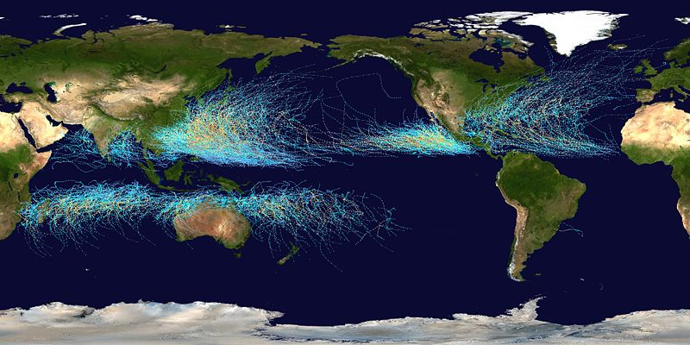
1
Introduction
The Philippines, its geographical circumstances
Philippines is 3rd in the world as the country’s most exposed and at risk to natural hazards (World Risk Report 2017).
20 Tropical Cyclones in a year with the following associated hazards:
- Strong Winds
- Heavy Rainfall Thunderstorms
- Floods
- Landslides/Mudflows
- Storm Surges
- Tornado
Affected by ITCZ and monsoons that result to floods and landslides
Tracks of tropical cyclones that formed in the Western North Pacific (WNW) during the period 1948-2010 (data used : JMA Data set) (Source : Cinco, et. al.,2011)
Notes:
The Philippines is one of the most natural hazard-prone countries in the world.
Reducing the risk of disasters will be key to achieving the development goals in the Philippines. (world bank)

Slide 4
1
Introduction
PAGASA, the NMHS of the Philippines
Philippine Atmospheric, Geophysical & Astronomical Services Administration
NMHS of the Philippines

Slide 5
PAGASA Mandate:
PAGASA Modernization Act of 2015
Provide adequate, up-to-date data, and timely information on atmospheric, astronomical and other weather-related phenomena using the advances achieved in the realm of science to help government and the people prepare for calamities caused by typhoons, floods, landslides, storm surges, extreme climatic events, and climate change, among others, to afford greater protection to the people;
Provide science and technology-based assessments pertinent to decision-making in relevant areas of concern such as in disaster risk reduction, climate change adaptation and integrated water resources management, as well as capacity building, and;
Ensure that the country fulfills its commitments to international meteorological and climate change agreements.
Notes:
The enactment of the PAGASA Modernization Act of 2015 is a a conscious recognition of the Philippine government ‘s of the need to improve PAGASA not only in the present time but also in the immediate and foreseeable future.

Slide 6
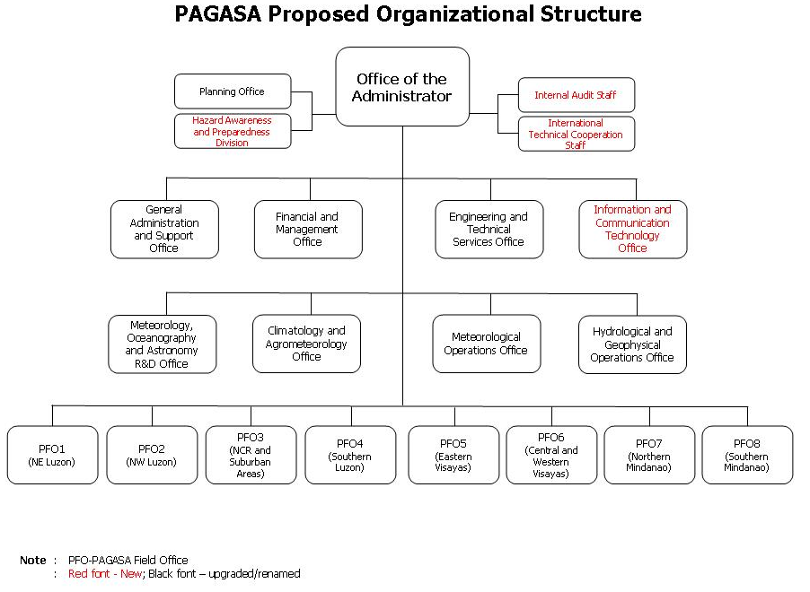
PAGASA Modernization Act of 2015
Notes:
PMP has 7 components and in order to attain the specific objectives of those components
PAGASA needs Organizational restructuring which will emphasize on streamlining the PAGASA's operational capability, reinforcing the regional service divisions to account for local climatic variabilities and needs. This decentralized approach will enable a swifter issuance of specific forecasts over a limited area of interest. The special focus will also open up an important feedback and coordination system that the Agency can use to cater to its local clients, especially during times of meteorological hazards when time is of utmost importance.
In the long run, an investment in resources, whether they be human or technical, will provide PAGASA with better knowledge of the intricacies of the atmosphere and produce the necessary warnings against weather and climate-related risks and hazards.

Slide 7

1
Introduction
Products and Services
1. Public Weather Forecasts
2. Shipping Forecast
3. Aviation Forecasts:
Airways and Terminal Forecast
SIGMET: TC & Volcanic Ash
4. Weather Bulletins
Weather Advisory
Tropical Cyclone Alert,
Tropical Cyclone Warning
Tropical Cyclone Warning for Shipping
5. Special Weather Forecast/Outlook
6. Forecast for Selected Local and Asian Cities and Tourist Destination
7. Gale Warning
8. Rainfall Warning
9. Flood Warning & Advisory
10. Seasonal/Climate Forecast
11. Climate Projections
12. Farm Weather Forecast

Slide 8
2
End-to-end Early Warning System
24/7 Observations Data Collection/ Transmission
Reception/ Integration/ Processing/ Analyses
Customization/Tailor-fitting of Warnings, Advisories, Info
Dissemination/Utilization
RESPONSE

Slide 9

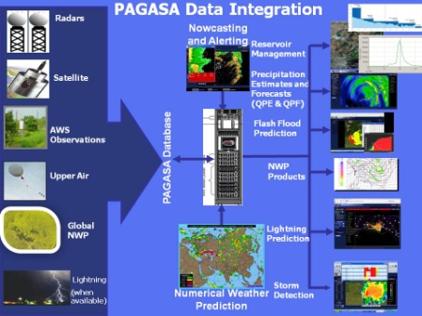
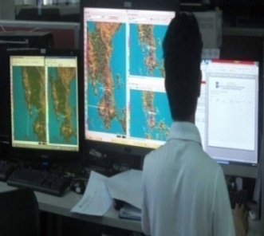
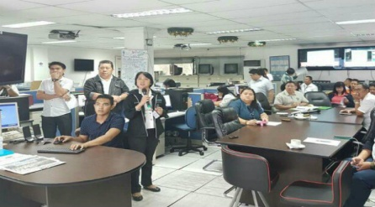
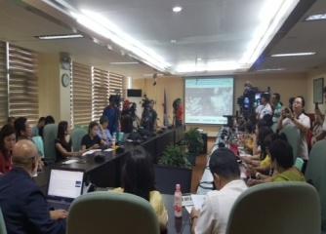



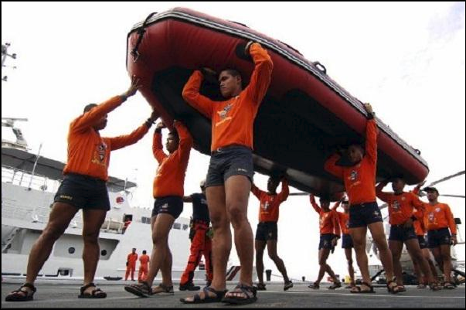

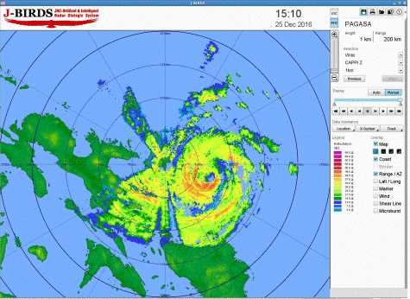

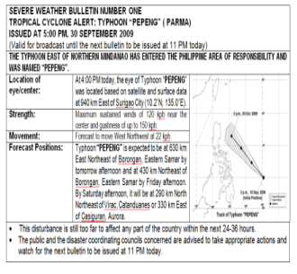




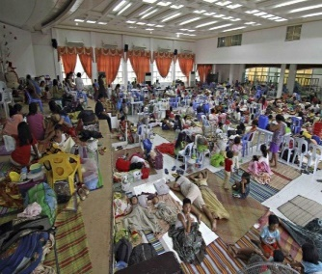


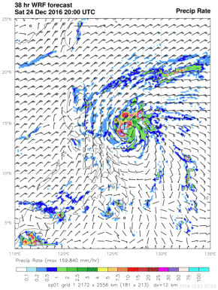
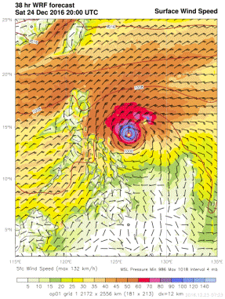

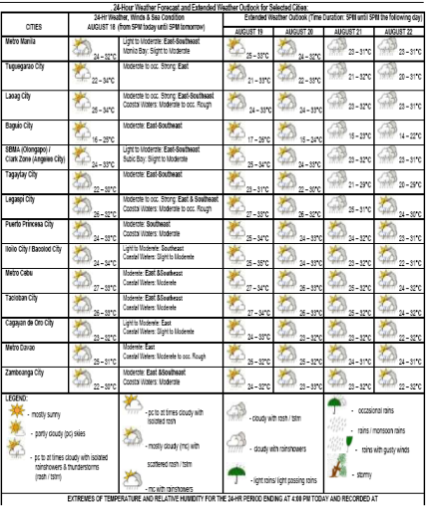







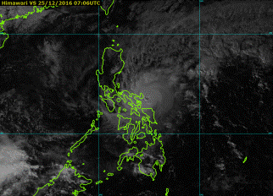
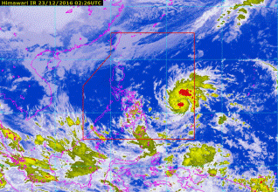
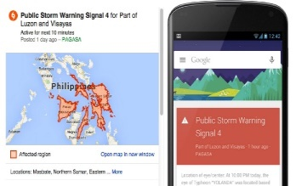


End-to-end Early Warning System
24/7 Observations Data Collection/ Transmission
Reception/ Integration/ Processing/ Analyses
Customization/ Tailor-fitting of Warnings, Advisories, Info
Dissemination/Utilization
RESPONSE
Field
Stations
Met. Satellites
Upper-air
Stations
Weather
Radars
Automatic
Stations
Ocean Buoys
Wind Profiler
Aviation Obs.
Stations-LIDARS
Lightning Detection
System
Wave Glider
Global
Observations
GTS
Coastal Radars

Slide 10
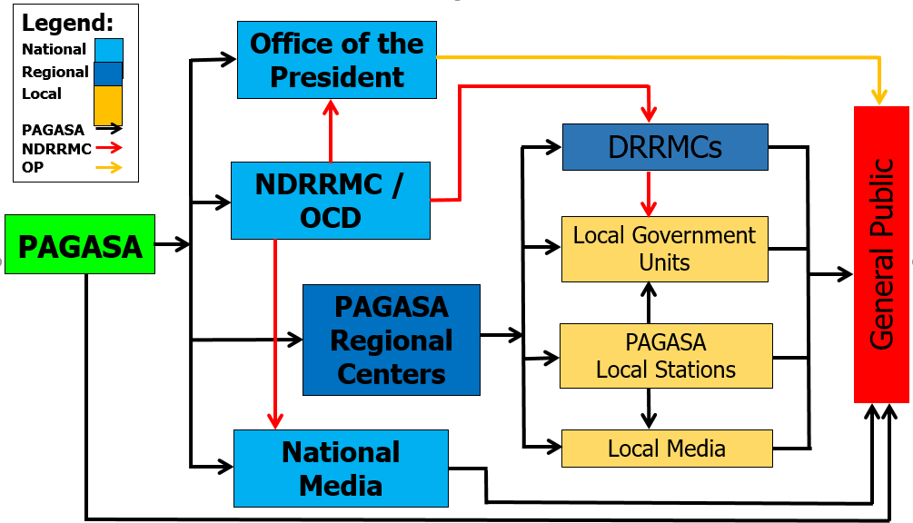
Warning Communication and Dissemination

Slide 11
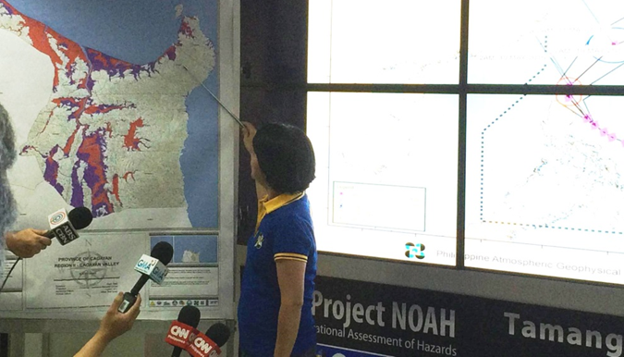
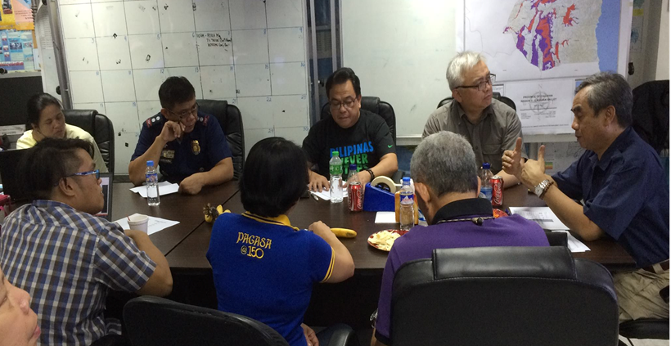
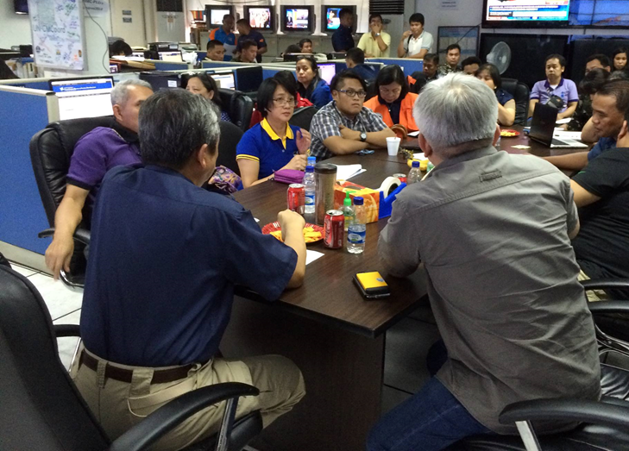
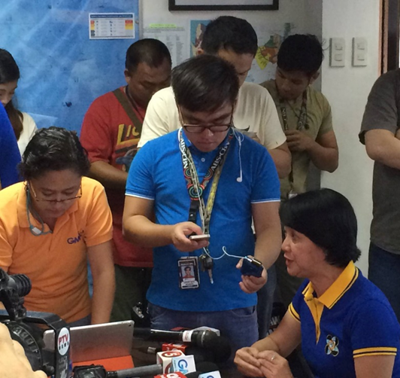
Warning Communication and Dissemination
Pre-Disaster Risk Assessment (PDRA)
assessing the possible impacts of the hazard to the community and is used to determine the appropriate level of response/action from the national to the local government. HAZARD SPECIFIC, AREA FOCUS & TIME BOUND

Slide 12
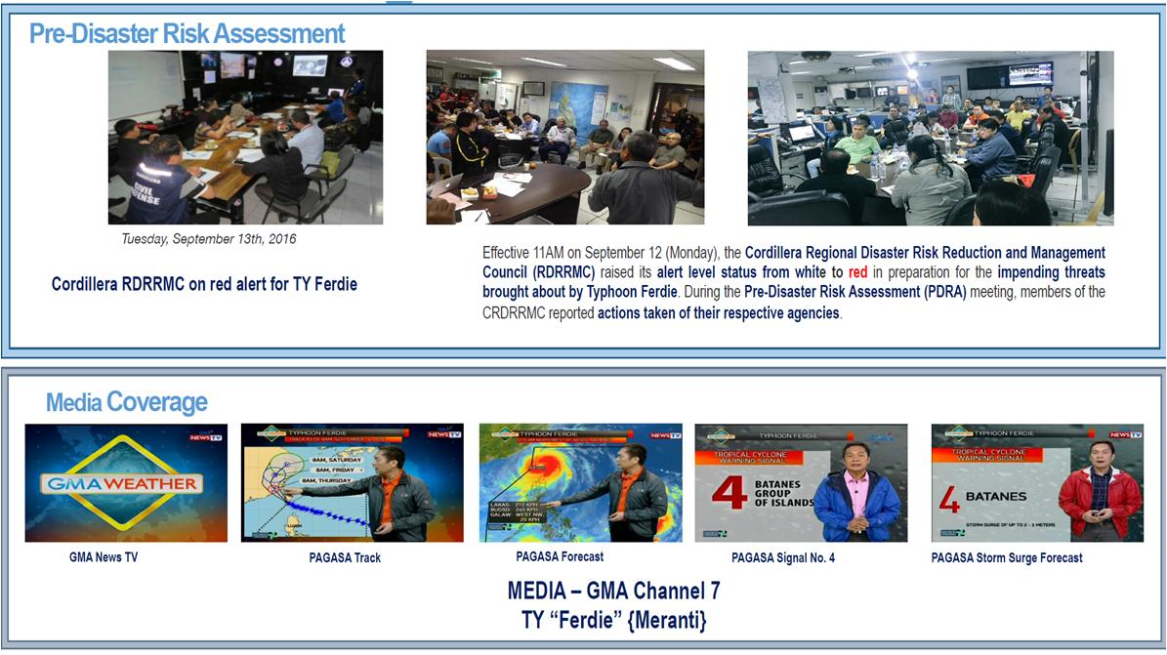
Warning Communication and Dissemination

Slide 13
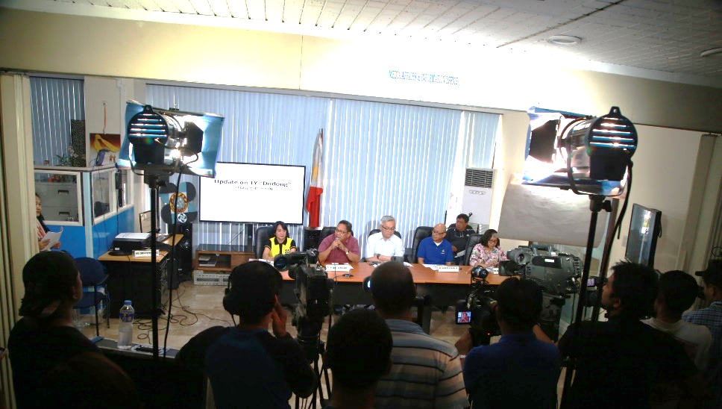
Warning Communication and Dissemination
Conduct Press Conferences and press briefing in PAGASA
Media Coverage

Slide 14
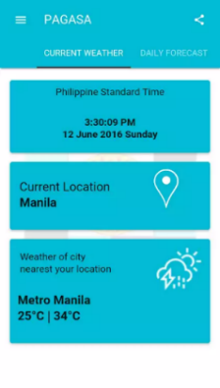
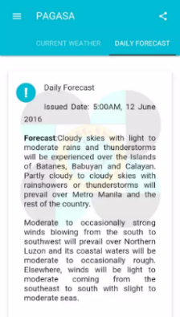
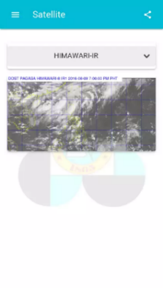
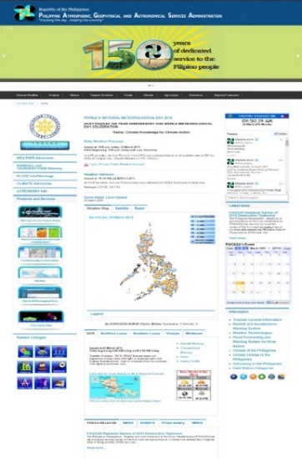
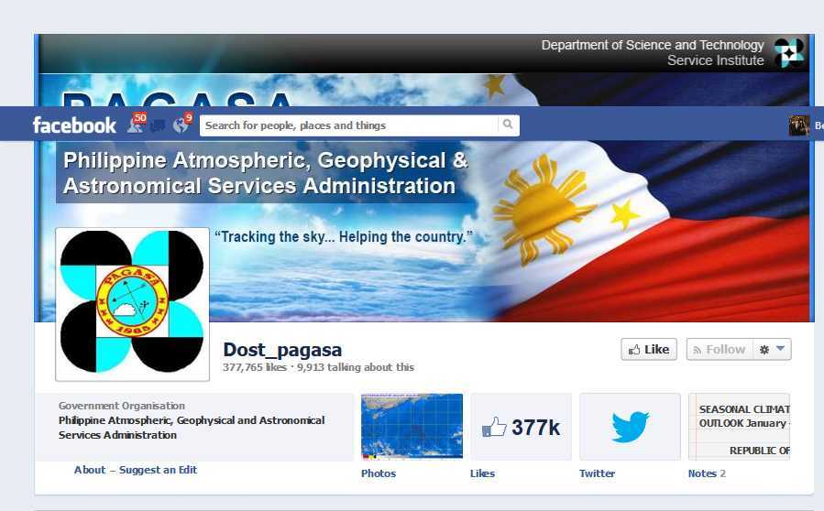
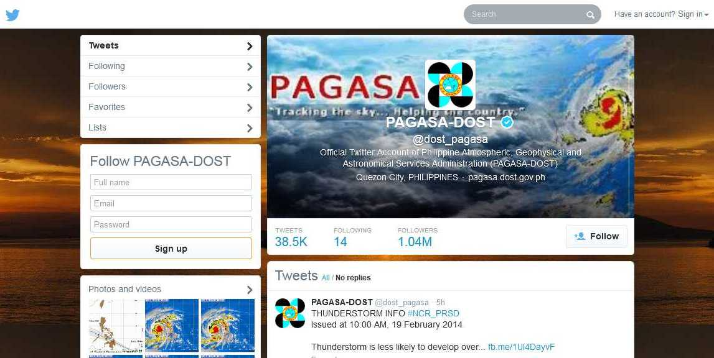
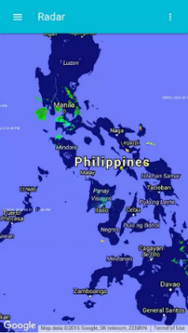
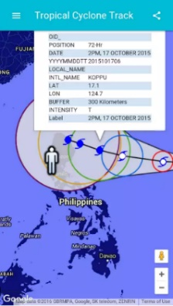
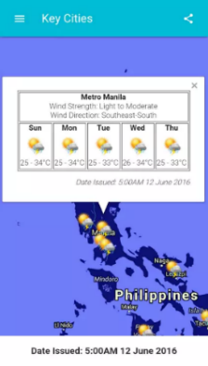
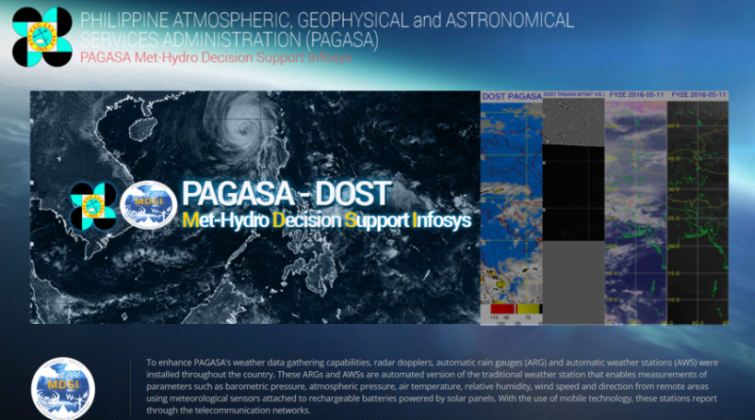


Warning Communication and Dissemination
PAGASA Mobile Application
Social Media Networks

Slide 15
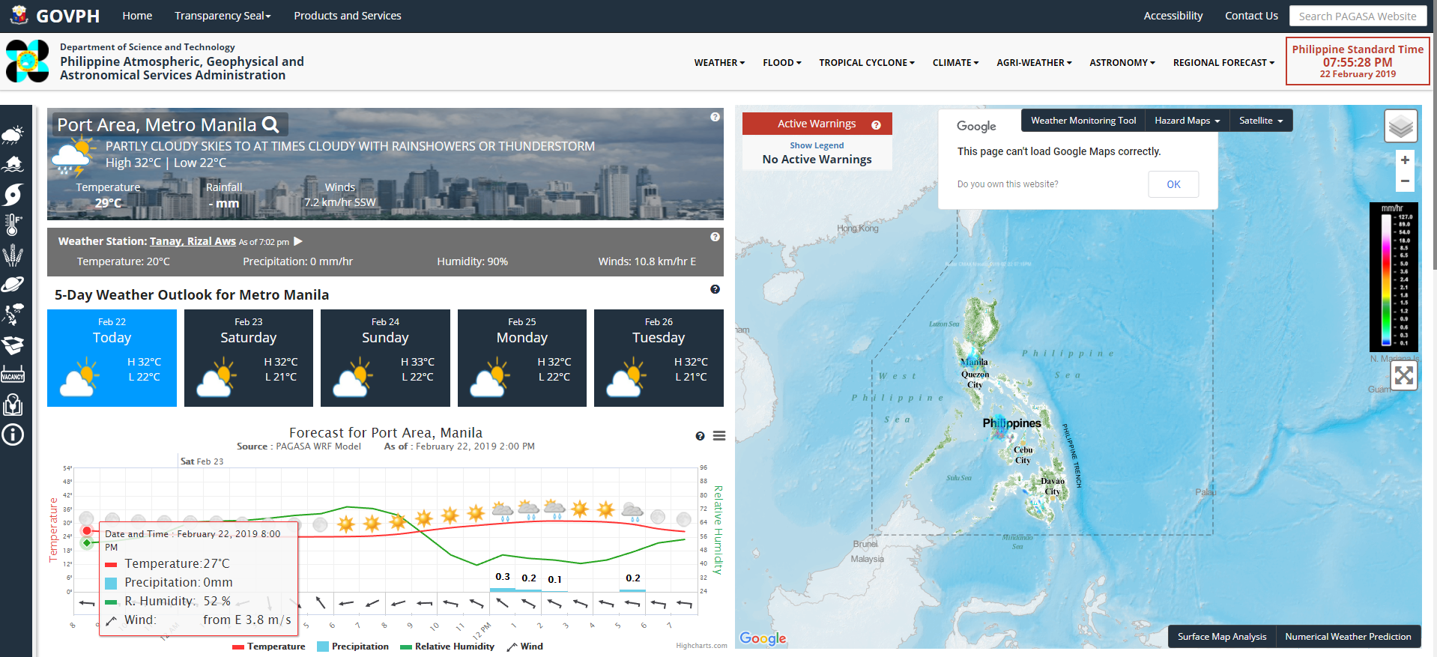
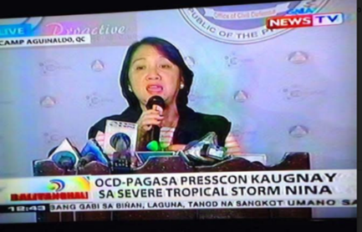
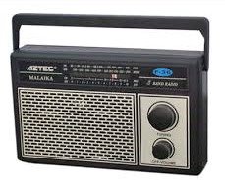

Warning Communication and Dissemination
http://www.bagong.pagasa.dost.gov.ph

Slide 16
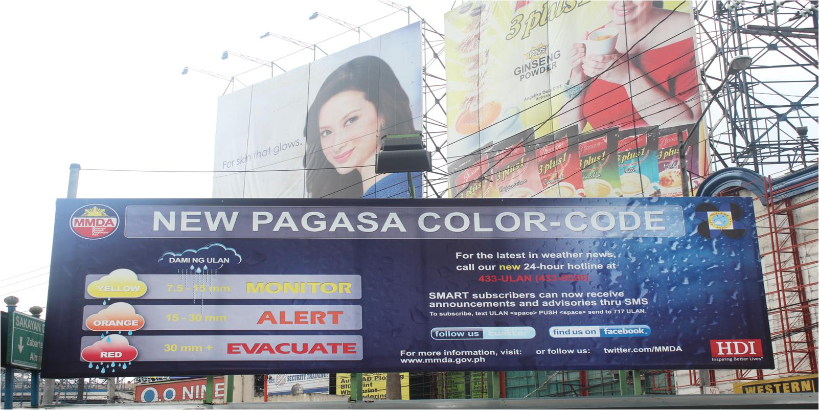
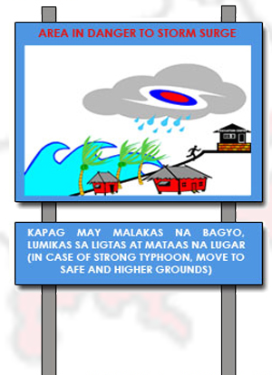
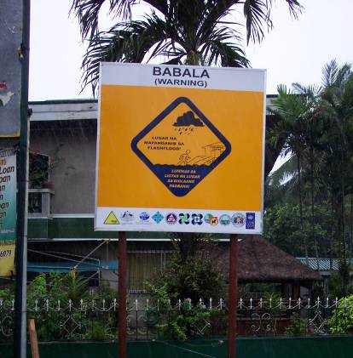
Warning Communication and Dissemination
Heavy Rainfall
Storm Surge Signage
Flood Signage

Slide 17
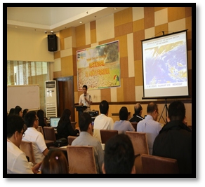

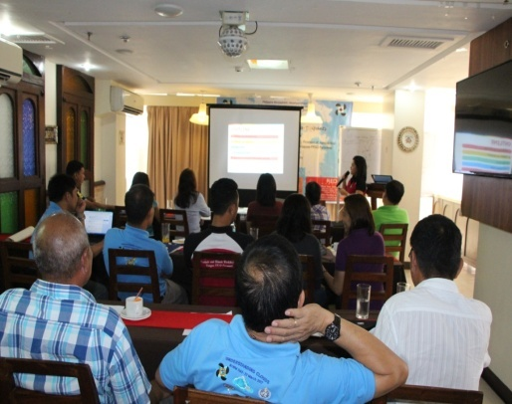

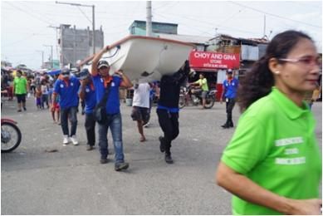
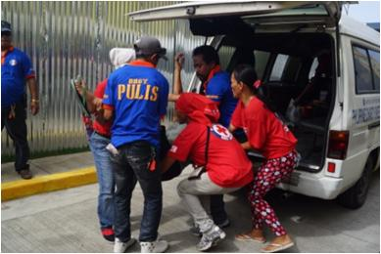
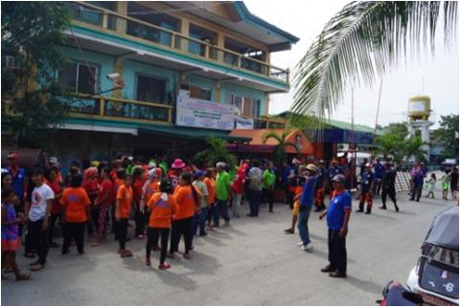
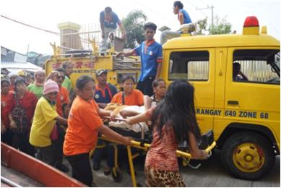
Warning Communication and Dissemination
Information, Education and Communication Campaign
Mock Simulation/Drill

Slide 18
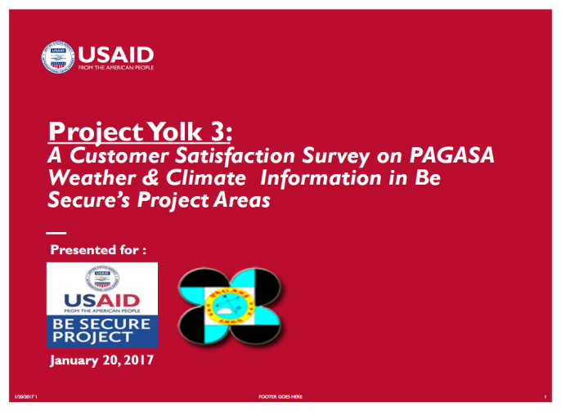
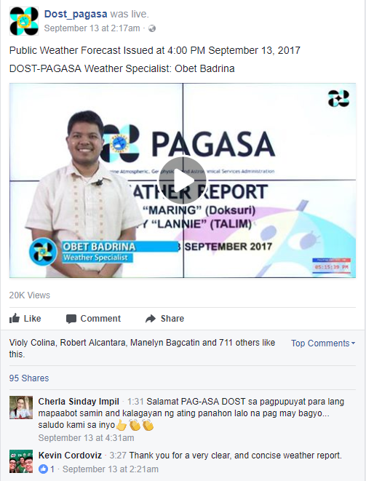
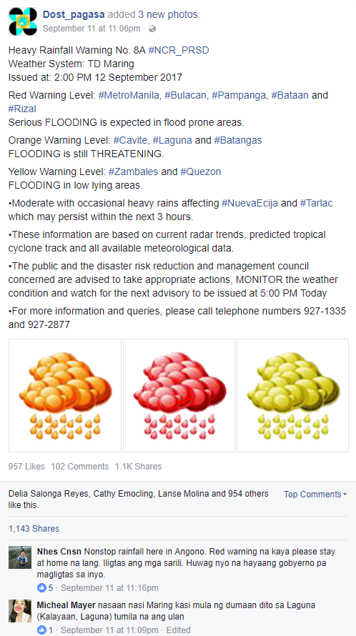
Feedback Mechanism
Customer Satisfaction Survey
Social Media Responses
This study aims to ascertain ease of access, comprehension and relevance of PAGASA alerts, and warnings by end users.
On the overall, awareness of PAGASA programs and services have improved over time in both areas covered, Iloilo and Tacloban. This may mean that numerous sources and channels that PAGASA utilizes such as seminars/trainings, social media/FB, websites, etc. are working in favor of the organization. In fact, word-of-mouth has helped them more.

Slide 19
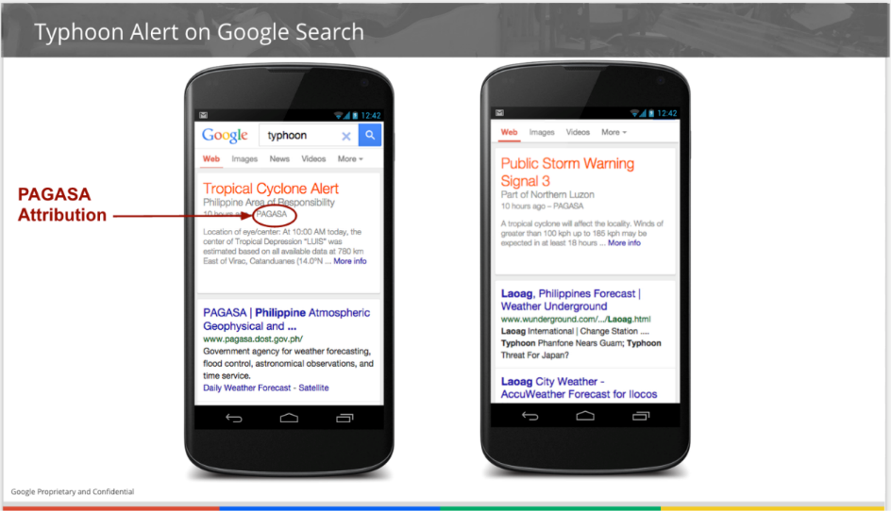

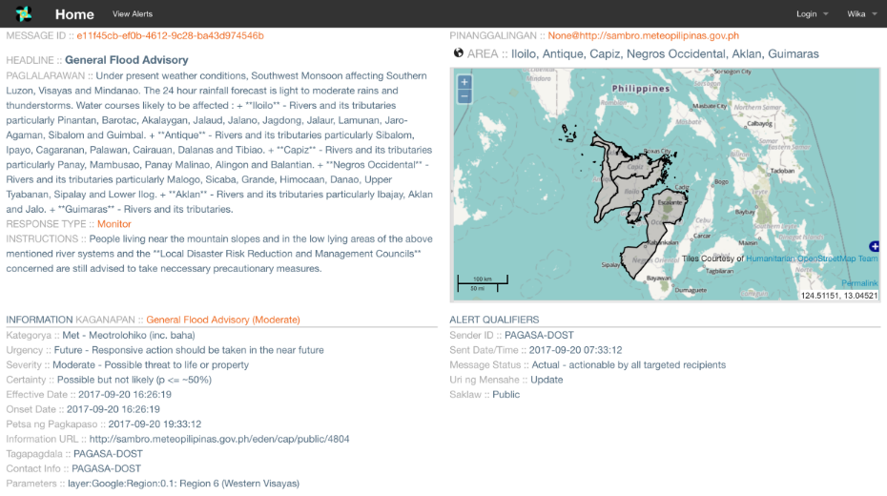
Alerting the Public
Google Public Alerts
Typhoon Alert on Google Search

Slide 20
Alerting the Public
OUTPUT OF THE EMERGENCY ALERT AND WARNING MESSAGES
(EAWM)
Templates
TC LANDFALL:
“TY NINA will make landfall over Tingloy, Batangas this afternoon. Evacuate to safer area.”
“TY NINA (1 of 2): TY NINA made landfall over Tingloy, Batangas at 10 AM.”
“TY NINA (2 of 2): The next possible landfall over Calatagan, Batangas before 12NN today. Evacuate.”
TCWS:
“TCWS 5: TY NINA catastrophic danger over Leyte in 12 hours. Very heavy to widespread damage. Evacuate
to safer area.”
“TCWS 4: TY NINA extreme danger over Leyte in 12 hours. Heavy to very heavy damage. Evacuate to safer area.”
“TCWS 3: TY NINA severe danger over Leyte in 18 hours. Heavy damage. Evacuate to safer area.”
Republic Act (RA) No. 10639 or the Free Mobile Disaster Alerts Act
Telephone Companies (Telcos) are required to send out advisories, alerts, and other vital information during typhoons or other disasters. Failure to do so may merit legal action and fines.
Parameters:
Heavy Rainfall Warnings: ORANGE or RED
Tropical Cyclone: Tropical Cyclone Warning Signal No.
4 and 5, and expected LANDFALL
Monsoon Rains / LPA: forecasted more than 100 mm
HEAVY RAINFALL WARNING (Severe Thunderstorm, TECF, LPA):
For RED:
OPTION 1: “RED RAINFALL (1 of 2): Serious flooding in low lying areas and near river. Evacuate.”
“RED RAINFALL (2 of 2): possible landslides in mountainous areas. Evacuate.”
OPTION 2: “RED RAINFALL IN QUEZON: FLOODING IS SERIOUS. LANDSLIDE IS POSSIBLE. EVACUATE ASAP.”
For ORANGE:
OPTION 1: “ORANGE RAINFALL (1 of 2): Flood is alarming in low lying areas and near river. Prepare to evacuate.”
“ORANGE RAINFALL (2 of 2): Possible landslides in mountainous areas. Prepare to evacuate.”
OPTION 2: “ORANGE RAINFALL IN QUEZON: FLOOD IS ALARMING. LANDSLIDE IS POSSIBLE. PREPARE TO EVACUATE.”
FLOOD BULLETIN: (for Rivers/Dams)
“CRITICAL LEVEL: Upper Pampanga River, Serious flooding. Evacuate.”
“ALARM LEVEL: Upper Pampanga River, Flood is alarming. Prepare to Evacuate.”

Slide 21
For any early warning system to succeed, several components are necessary:
Technology to detect and monitor the hazard;
Communication systems to alert the public;
Local leaders trained to make the right decisions;
A public that is educated to react appropriately to warnings; and
Response protocols - such as evacuation plans, prepared and rehearsed well in advance of the threat.
All these elements must work well, both individually and in harmony.
Failure in any one of these elements can mean failure of the whole early warning system.

Slide 22


Typhoon “YOLANDA” (Haiyan)
06-09 November 2013
Gustiness : 275 kph

Slide 23


Typhoon “YOLANDA” (Haiyan)
06-09 November 2013
7 meter wave height

Slide 24
When Typhoon Yolanda/Haiyan hit the Philippines, over 6,300 people were killed despite consistent forecasts of a severe threat to the region for several days before the event.
Otto, et. Al, 2016
It was one of the strongest typhoons in this country’s history, if not the world’s. We thank the experts from PAGASA, the Mines and Geosciences Bureau, Phivolcs, and DOST, who gathered together and gave us the right, detailed information, which allowed our countrymen to prepare for the coming storm.
In spite of all this, we all witnessed the vast destruction that this typhoon wrought in Leyte and Samar.
Statement of His Excellency Benigno S. Aquino III
Former President of the Philippines on Typhoon Yolanda

Slide 25

FACTS:
RESULT:
Accurate warnings were issued in advance
6,201 dead; 28,626 injured and 1,785 missing.
The potentials for associated hazards (heavy rainfall, severe wind and storm surges) were explicitly stated in the warnings.
More than 16M people were affected and more than US$827 million estimated damage to infrastructure and agriculture

Slide 26
Strength:
Weakness:
Accurate track and intensity forecasts
Warnings issued in advance and at the provincial level
Close coordination (national and local government)
Policies and guiding laws in placed
Warnings not fully understood hence, did not trigger life-saving actions (evacuation).
Risk not fully understood
Local Government Units received same information but act differently.
Lack of scientific and technical capacity to translate hazard information into impacts – therefore, impacts underestimated.
Lack of appreciation and utilization of available hazard maps
Inconsistency in interpretation of information from different sources delivered through multiple channels contributed to public and responder confusion.

Slide 27
End-to-end Early Warning System
?
24/7 Observations Data Collection/ Transmission
Reception/ Integration/ Processing/ Analyses
Customization/Tailor-fitting of Warnings, Advisories, Info
Dissemination/Utilization
RESPONSE




Would lives have been saved with better knowledge of the specific impacts of Typhoon Haiyan particularly, the risks of storm surge?
- WMO(2015)
Guidelines on Multi-hazard Impact-based Forecast and Warning Services
Most likely, yes.

Slide 28
End-to-end Early Warning System
Internal
External
24/7 Observations Data Collection/ Transmission
Reception/ Integration/ Processing/ Analyses
Customization/Tailor-fitting of Warnings, Advisories, Info
Dissemination/Utilization
Communication Interpretation
RESPONSE





Slide 29
3
Multi-Hazard Early Warning System in PAGASA
Introduced the color-coded warning categories:
Alert/Advisory/Warning relating to specific hazard thresholds and lead-times
Standardized content of message

Slide 30












3
Multi-Hazard Early Warning System in PAGASA
Hazards | Signal/Warning
Tropical Cyclone
Heavy Rainfall
Thunderstorm
Floods (riverine)
Storm Surge (height)
TCWS 1
TCWS 2
TCWS 3
TCWS 4
TCWS 5
Advisory
Alert
Emergency
Information
Watch
Advisory
< 1m
1-2m
2-3m
3-4m

Slide 31

Tropical Cyclone Warning System
TC Information
TC Advisory
Severe Weather Bulletin

Slide 32
Updated Tropical Cyclone Classification
3
Multi-Hazard Early Warning System in PAGASA
Category | Intensity
 | kph | kt
Tropical Depression (TD) | 61 or less | 33 or less
Tropical Storm (TS) | 62 - 88 | 34 - 47
Severe Tropical Storm (STS) | 89 - 117 | 48 - 63
Typhoon (TY) | 118 - 220 | 64 - 120
Super Typhoon (STY) | more than 220 | more than 120
Based on the classification of tropical cyclones being used in the warning systems intended for international users and exchanges among the Typhoon Committee Members (Category 1-4, from Chapter 4, Typhoon Committee Operational Manual, Meteorological Component, 2015 Ed.)

Slide 33

Tropical Cyclone Warning Signal
TCWS # 1
30-60 kph winds in 36 hrs
TCWS # 2
61-120 kph winds in 24 hrs
TCWS # 3
121-170 kph winds in 18 hrs
TCWS # 4
171-220 kph winds in 12 hrs
Color-code TC Warning
TCWS # 5
171-220 kph winds in 12 hrs

Slide 34
Tropical Cyclone Warning Signals (TCWS)
TCWS | LEAD TIME (hrs) on 1st issuance | WINDS (kph) | IMPACTS
#1 | 36 | 30 - 60 | Very light or no damage to high risk structures Light to medium and low risk structures Slight damage to some houses of very light materials or makeshift structures in exposed communities Some banana plants are tilted, a few downed and leaves are generally damaged. Twigs of small trees may be broken. Rice crops, however, may suffer significant damage when it is in its flowering stage. Cancellation of sea travel
#2 | 24 | 61-120 | Unshielded, old dilapidated schoolhouses, makeshift shanties, and other structures of light materials are partially damaged or unroofed. Some old galvanized iron (G.I.) roofs may be peeled or blown off. Some wooden, old electric posts are tilted or downed. Some damage to poorly constructed signs/billboards.

Slide 35


Tropical Cyclone Warning Signals (TCWS)
TCWS | LEAD TIME (hrs) on 1st issuance | WINDS (kph) | IMPACTS
#3 | 18 | 121-170 | Widespread disruption of power & communication Road closure due to uprooted trees and fallen transmission line Houses of medium strength materials (old, timber or mixed timber-CHB structures, usually with G.I. roofings), some warehouses or bodega-type structures are unroofed Dwarf-type or hybrid coconut trees are tilted or downed. Considerable damage to shrubbery and trees with heavy foliage blown off; some large trees blown down.
#4 | 12 | 171-220 | Roads closed due to fallen trees & collapsed bridges Total power disruption All signs/billboards are blown down.
#5 | 12 | more than 220 | Catastrophic damages (Delubyo)
http://bagong.pagasa.dost.gov.ph/learnings/legend

Slide 36


24-hour Public Weather Forecast
2010
2015

Slide 37

3
Multi-Hazard Early Warning System in PAGASA

Slide 38

3
Multi-Hazard Early Warning System in PAGASA

Slide 39


3
Multi-Hazard Early Warning System in PAGASA
Storm Surge Warning

Slide 40

4
Gaps
impact
use of easily understandable language
meets end user needs (i.e. thresholds, inundation)
forecast uncertainty
Further enhancement of IEC campaign

Slide 41
The tendency for citizens to respond to risk information and ultimately survive the threat is influenced by many factors that go beyond receiving accurate and timely information (Morrow and Lazo, 2015).
- Morrow and Lazo, 2015
It is no longer enough to provide a good weather forecast or warning – people are now demanding information about what to do to ensure their safety and protect their property
- WMO(2015), Guidelines on Multi-hazard Impact-based Forecast and Warning Services

Slide 42
5
Current Initiatives
R&D Development of Improved Impact-based Forecasting Approaches- Newton Agham project with UKMO (on going)
R&D project on Weather and Climate Science for Service Partnership for Southeast Asia (recently started)
Develop user-oriented Impact Based Forecast through building partnership (High Impact Weather and Climate Extremes-ENSO)
Close engagement and interaction with Stakeholders to further refine current impact warnings

Slide 43
5
Way Forward
Conduct survey on replacing hazard description forecast
  Need to develop a unified format and language describing impacts of a particular hazard (i.e. storm surge, flooding, heavy rainfall, etc)
  Feedback on the efficiency of the Impact-based Warning System
Conduct Information Education Campaign (IEC) to prepare users with the new warning system
  Lectures, Campaign materials (flyers, comics, posters, video presentations)
  Conduct mock simulation drills

Slide 44
“First, it should be understood that forecasts possess no intrinsic value.
They acquire value through their ability to influence the decisions made by users of the forecasts.”
Allan H. Murphy
Weather and Forecasting (June 1993)

Slide 45
Public:
What is wind chill?
Forecaster:
It will freeze your skin in 15 minutes.
News: US Midwest Winter Freeze

Slide 46

FOR YOUR ATTENTION

