Slide 2
CONCEPTUAL MODEL
Impact on a user of
weather and climate events
Critical Locations:
Geographic features, city infrastructure, weather-sensitive sectors
Predisposition of a person or group to be adversely affected
Vulnerability
Shanghai, a Mega-city
Marine and coastal area
East China region
Lake Tai basin
Weather and climate events
Disaster Risk
Exposure
High Impact Weather in Shanghai:
Typhoon, severe thunderstorm, thick fog, heat waves, haze,
light rain/snow
Typhoon, severe thunderstorm, thick fog, heat waves, haze, even light snow
Users:
People life and property safety, public health;
User-related events
Highly sensitive sectors
Exposure to weather
Exposure and vulnerability are the drivers of risk and disaster losses;
Meteorology-related disaster risk is a result of high impact weather, exposure, and vulnerability.
* From Professor Gordon McBean

Slide 3
To meet the requirements of the social and economic development,
To improve the refined weather forecast for the mega-city of Shanghai,
To provide the useful weather impact forecast to various users,
1. Focus on high impact weather systems, to enhance an integrated and seamless weather forecasting procedure from long term to short-range, and to nowcasting;
2. Focus on weather impact on critical locations, to enhance refined forecast of weather impact for specific places;
3. Focus on weather impact on sensitive users, to enhance specialized (individual) forecast and service and weather-related health forecasts (public and some social vulnerable groups).
Dialogue with the weather + Dialogue with the people

Slide 4


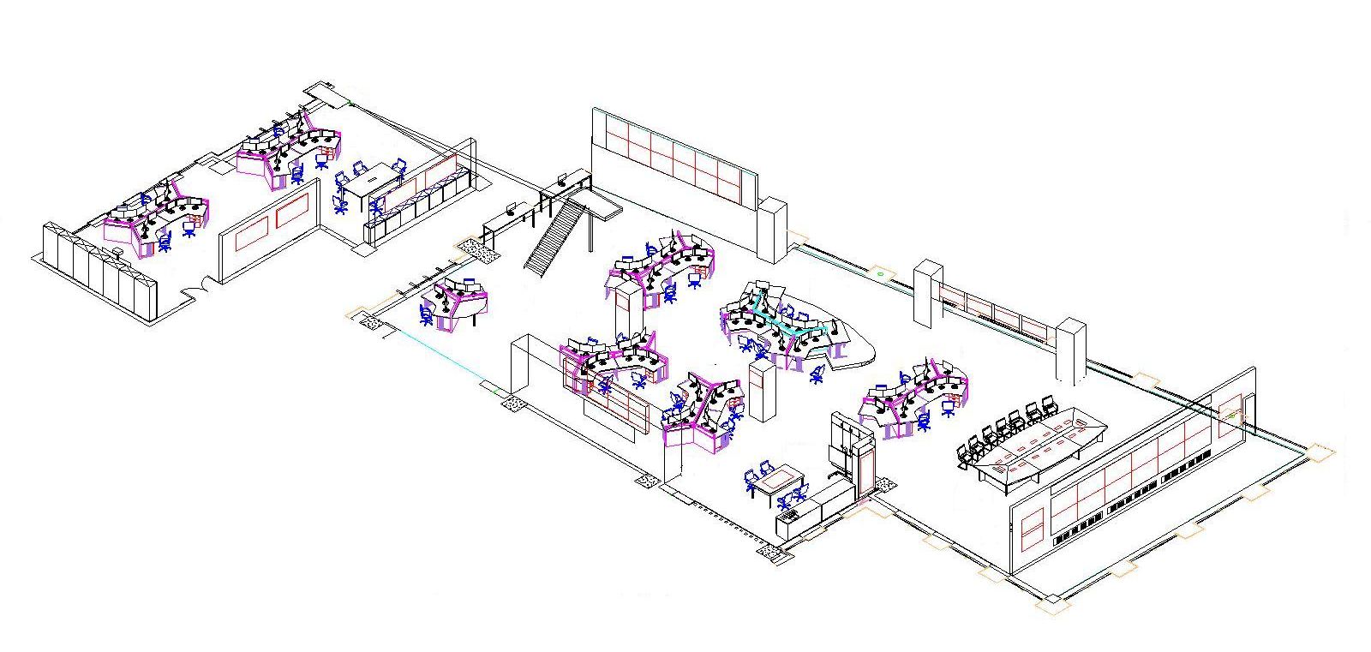










Layout
F-1: Forecast Planning & Organization
Focus on high impact weather:
F-2: Multi-scale Weather Analysis and Forecast
F-3: Refined Urban Weather Forecast and Early Warning based on Vulnerability
F-7: Typhoon Early Warning
Focus on weather impact on critical locations:
F-3: Refined Urban Weather Forecast and Early Warning based on Vulnerability
F-5: Regional Weather Forecast, Warning and Joint Preparedness
F-7: Refined Marine Weather Forecast
Weather Briefing
Supporting sub-sections:
F-6: Weather and Environment Analysis based on Satellite Remote Sensing
F-8: Regional NWP Application
F-9: Subtropical Circulation & Abnormal Characteristic Analysis
Focus on weather impact on users:
F-4: Weather Impact Forecast Based on Ensemble NWP Analysis

Slide 5
Operation Organization
Typhoon, Severe Convection, Haze / Fog…
F-1: Forecast Planning & Organizing (Chief Forecaster)
F-3: Refined Urban Weather Forecast and Early Warning based on Vulnerability
F-4: Weather Impact Forecast Based on Ensemble NWP Analysis
F-8: NWP Application
F-2: Multi-scale Weather Analysis & Forecast
F-5: Regional Weather Forecast, Warning and Joint Preparedness
F-6:Satellite Remote Sensing
F-9: Subtropical Circulation Analysis
F-7: Typhoon Early Warning & Refined Marine Weather Forecast
Nowcasting
(0-6h)
Short Range
(<3 d)
Medium Range
(3d - 10d)
Long Range
(>10d)
Weather Impact Forecast
CMA data and products
(NMC, NSMC,
NCC, CAMS, MOC…)
Local observations
(satellite, radar,
AWS, GPS,lightning , …)
Data shared with
Others ( e.g.,
Hydrological
Bureau, etc.)

Slide 6
Operation Organization
Typhoon, Severe Convection, Haze / Fog…
F-7: Typhoon Early Warning & Refined Marine Weather Forecast
F-1: Forecast Planning & Organization
Typhoon
F-1: Forecast Planning & Organizing (Chief Forecaster)
F-3: Refined Urban Weather Forecast and Early Warning based on Vulnerability
F-4: Weather Impact Forecast Based on Ensemble NWP Analysis
F-8: NWP Application
F-2: Multi-scale Weather Analysis & Forecast
F-5: Regional Weather Forecast, Warning and Joint Preparedness
F6:Satellite Remote Sensing
F-9: Subtropical Circulation Analysis
F-7: Typhoon Early Warning & Refined Marine Weather Forecast
F-7: Typhoon Early Warning & Refined Marine Weather Forecast
Nowcasting
(0-6h)
Short Range
(<3 d)
Medium Range
(3d - 10d)
Long Range
(>10d)
Weather Impact Forecast
CMA data and products
(NMC, NSMC,
NCC, CAMS, MOC…)
Local observations
(satellite, radar,
AWS, GPS,lightning , …)
Data shared with
Others ( e.g.,
Hydrological
Bureau, etc.)

Slide 7
Subtropical Circulation & Abnormal Characteristic Analysis
Focus on High Impact Weather System
1 ) Basic Weather System
2 ) Severe Convective Weather
3 ) Tropical Cyclone
NWP products
Uncertainty and maximum possibility analysis of NWP
Sensitivity parallel run
TC Location and Intensity Estimation
Weather system dynamic analysis
Tropical Early Warning
Multi-scale Wea Analysis & Fcst
Severe Convective Weather
F-2: Multi-scale Weather Analysis and Forecast
F-3: Refined Urban Weather Forecast and Early Warning based on Vulnerability
F-7: Typhoon Early Warning & Refined Marine Weather Forecast

Slide 8
Techniques and products focus on high impact weather
Multi-scale weather system analysis and seamless forecast procedure
Uncertainty and maximum probability analysis based on ensemble NWP
Multi-specialty and integrated weather consultation
Severe convection meso-β scale analysis based on dense observation networks and high-resolution rapid refresh model
Step-by-step typhoon forecasting and early warning procedure and techniques
Refined forecast product generation and verification

Slide 9
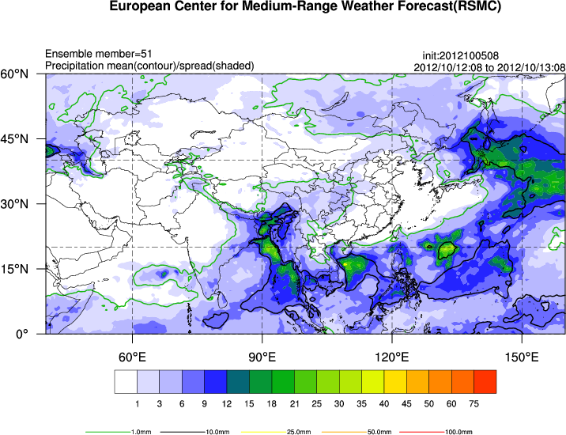
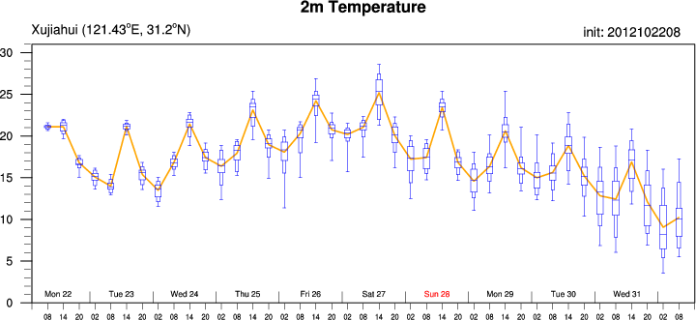
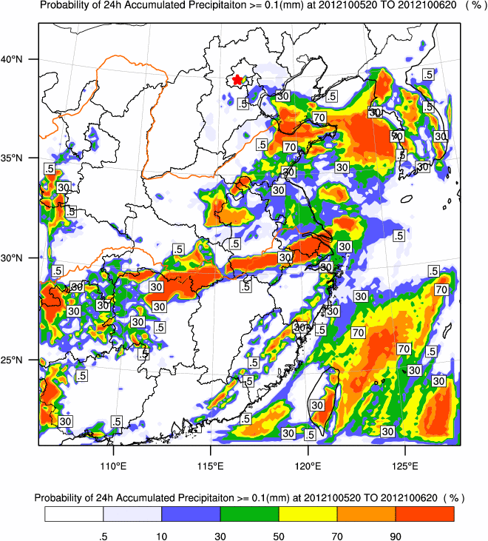
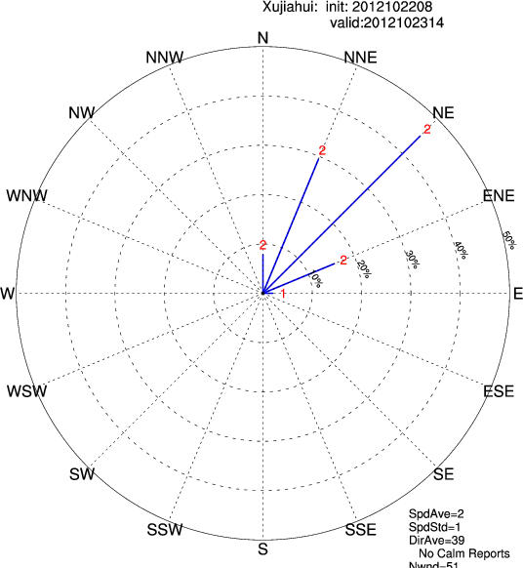
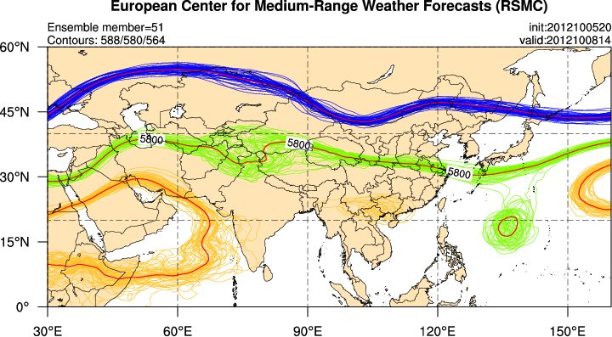
Weather Forecast Area
Ensemble forecast products

Slide 10
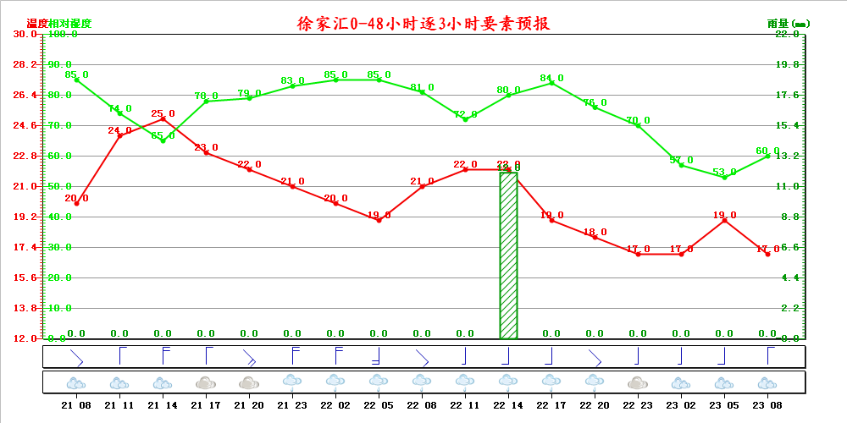
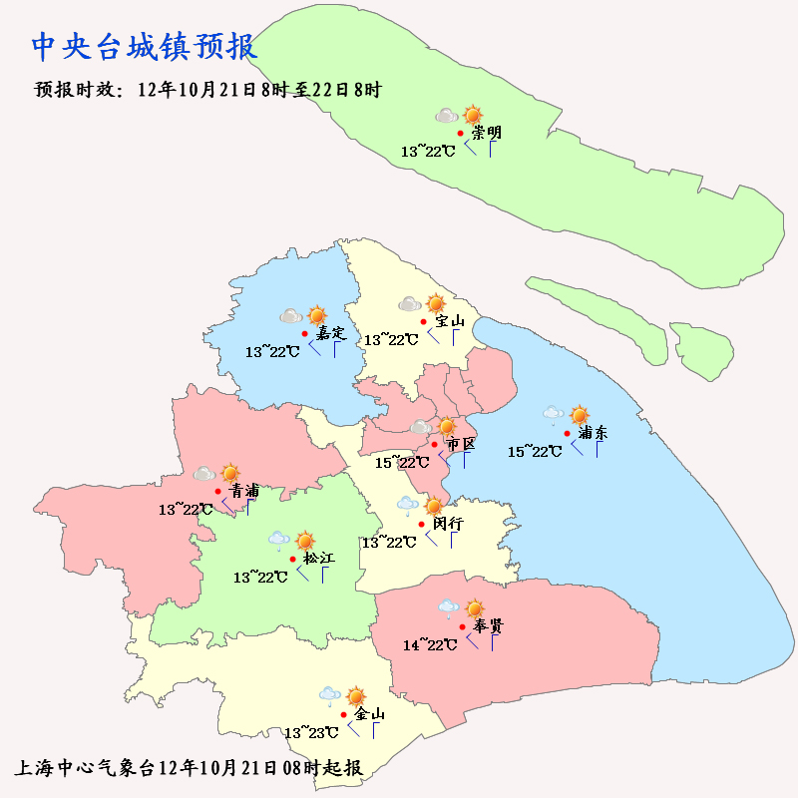

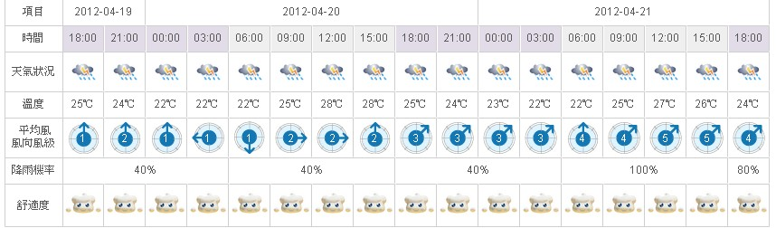
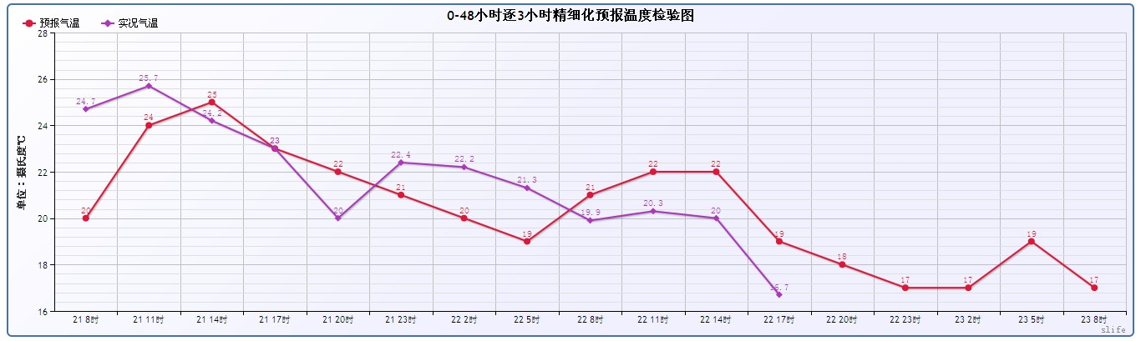
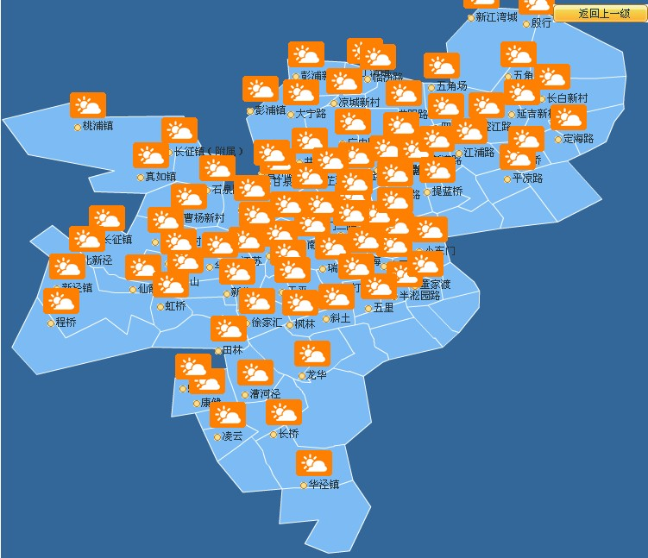
Automatic Product Generator
Refined forecast product generation and verification
Text Forecast
Model Grid Output
2011年08月16日14时起报，
今天和明天上海市和长江口
区天气预报:
多云到阴，东部、南部等地
区有短时小雨，明天多云到
阴有短时小雨。南到西南风4-
5级，今天夜里起长江口区西
部5-6级。今天最高温度35.8
度，明天最低温度23.4度。
Objective & Subjective
Revision
Table forecast
Graphical forecast

Slide 11
Environmental Remote Sensing Monitoring and Analysis
Weather system dynamic analysis
Focus on critical locations
1) Shanghai, a megacity
2 ) Marine and costal areas
3 ) East China Region
Ensemble PoP
Sea wave model product
Hydro-meteorological coupled model
Multi-scale weather analysis and Seamless Forecast
Refined marine weather forecast
1.Urban Refined Forecast
2.Early warning based on Vulnerability
Lake Taihu basin hydro-meteorology
regional weather guidance & jointly preparedness
F-3: Refined Urban Weather Forecast and Early Warning based on Vulnerability
F-5: Regional Weather Forecast，Warning and Joint Preparedness
F-7: Typhoon Early Warning & Refined Marine Weather Forecast

Slide 13
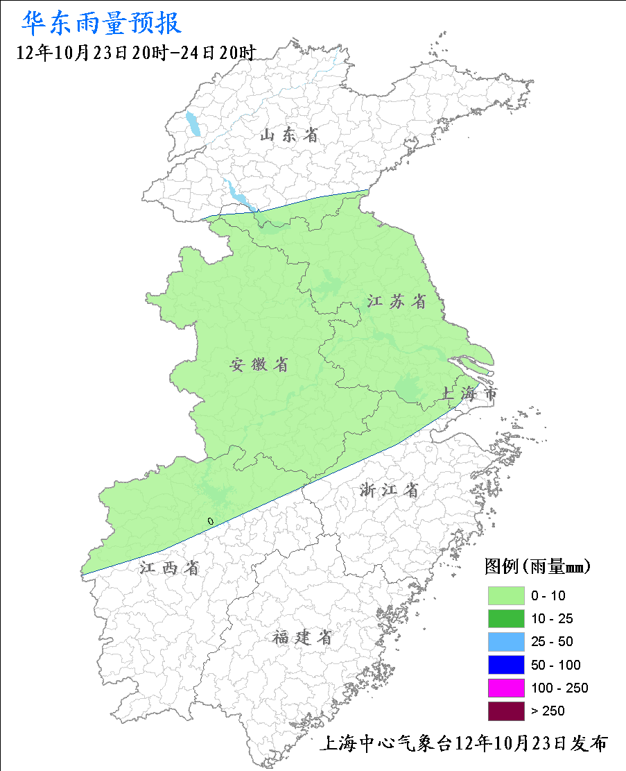
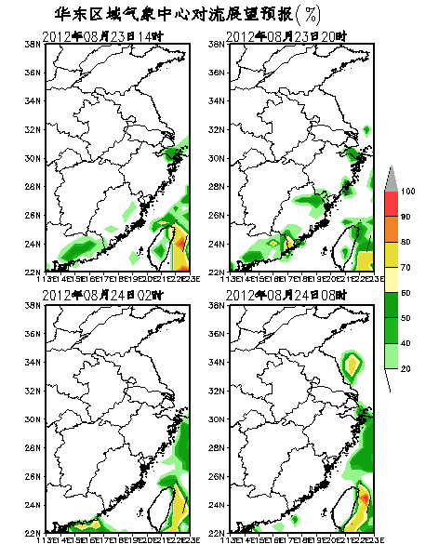
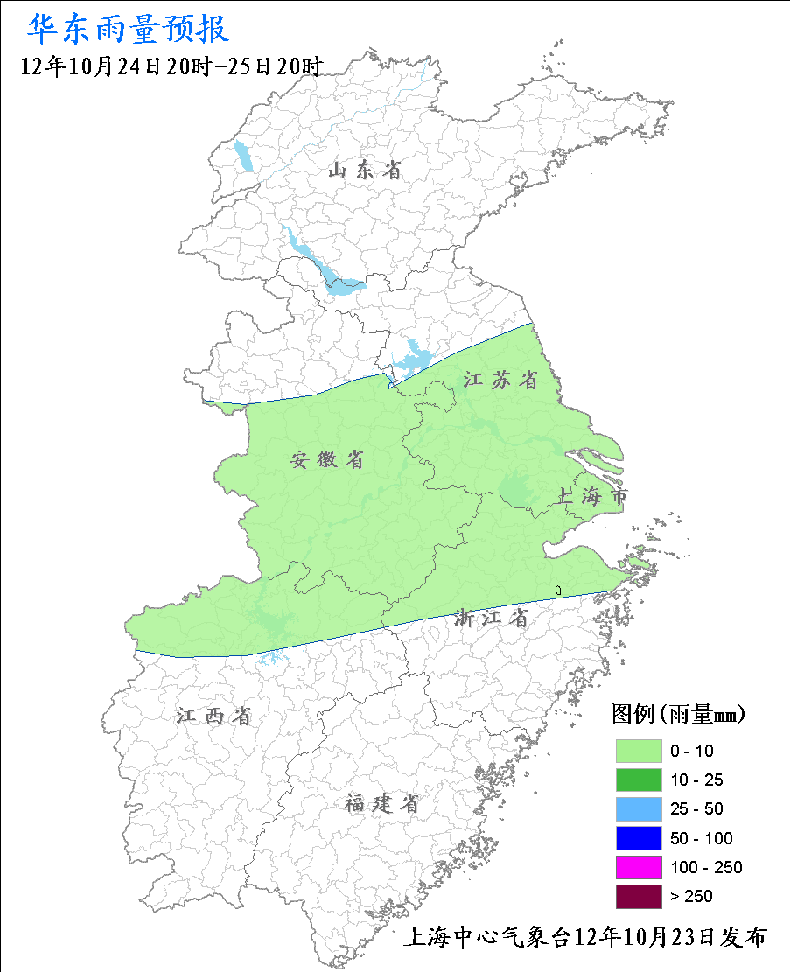
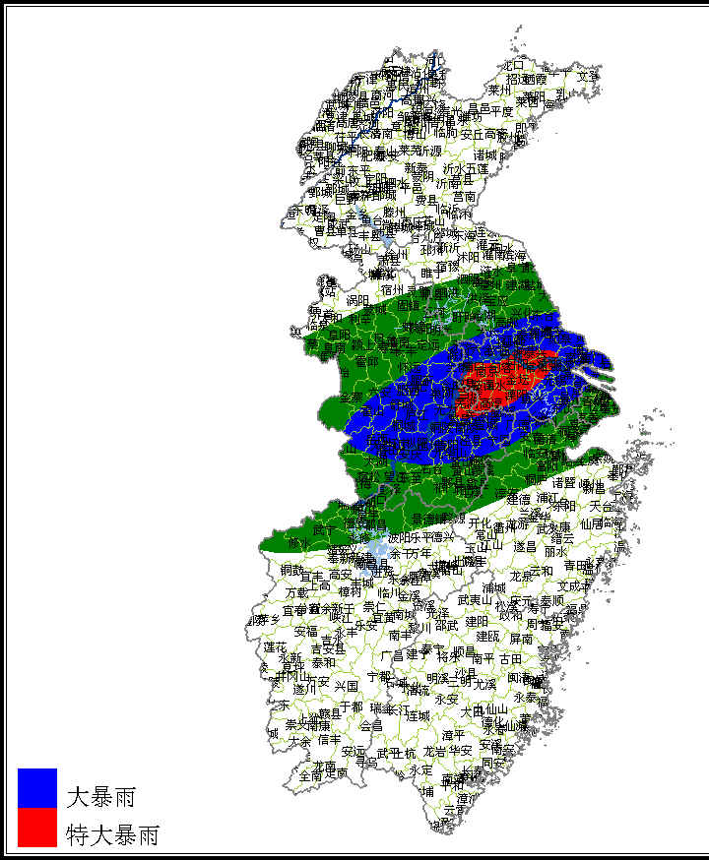
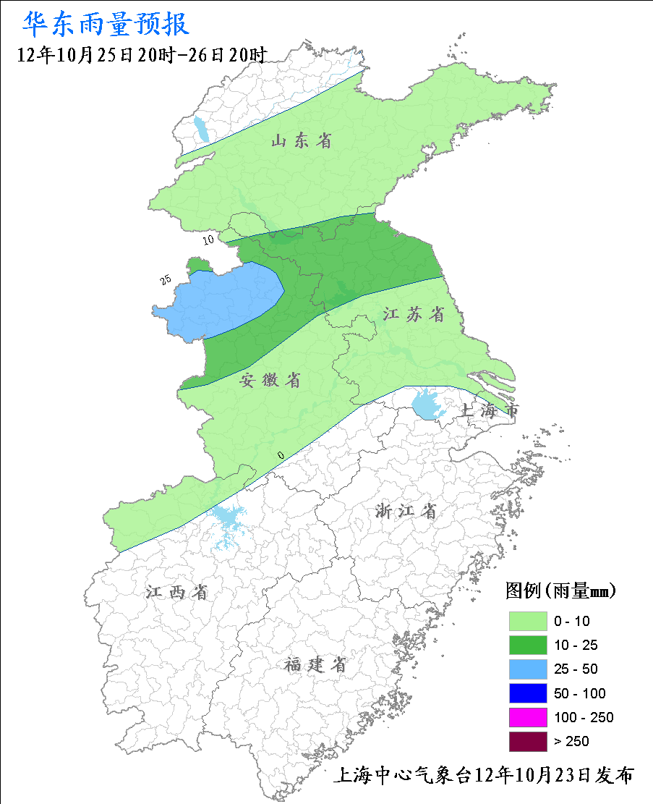
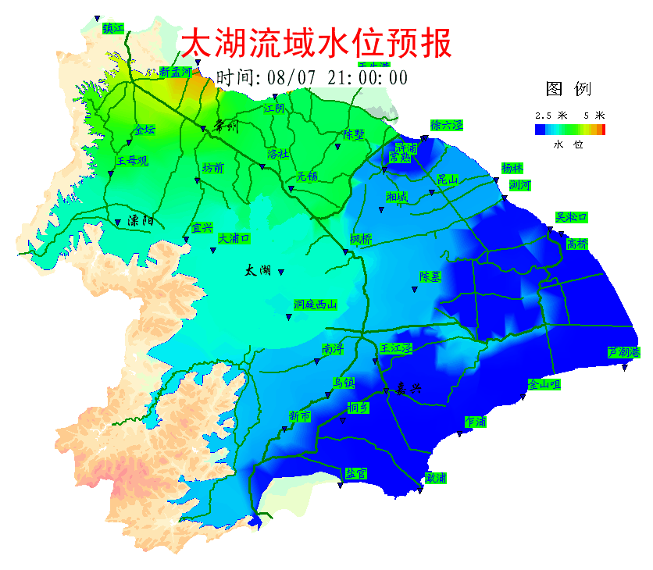
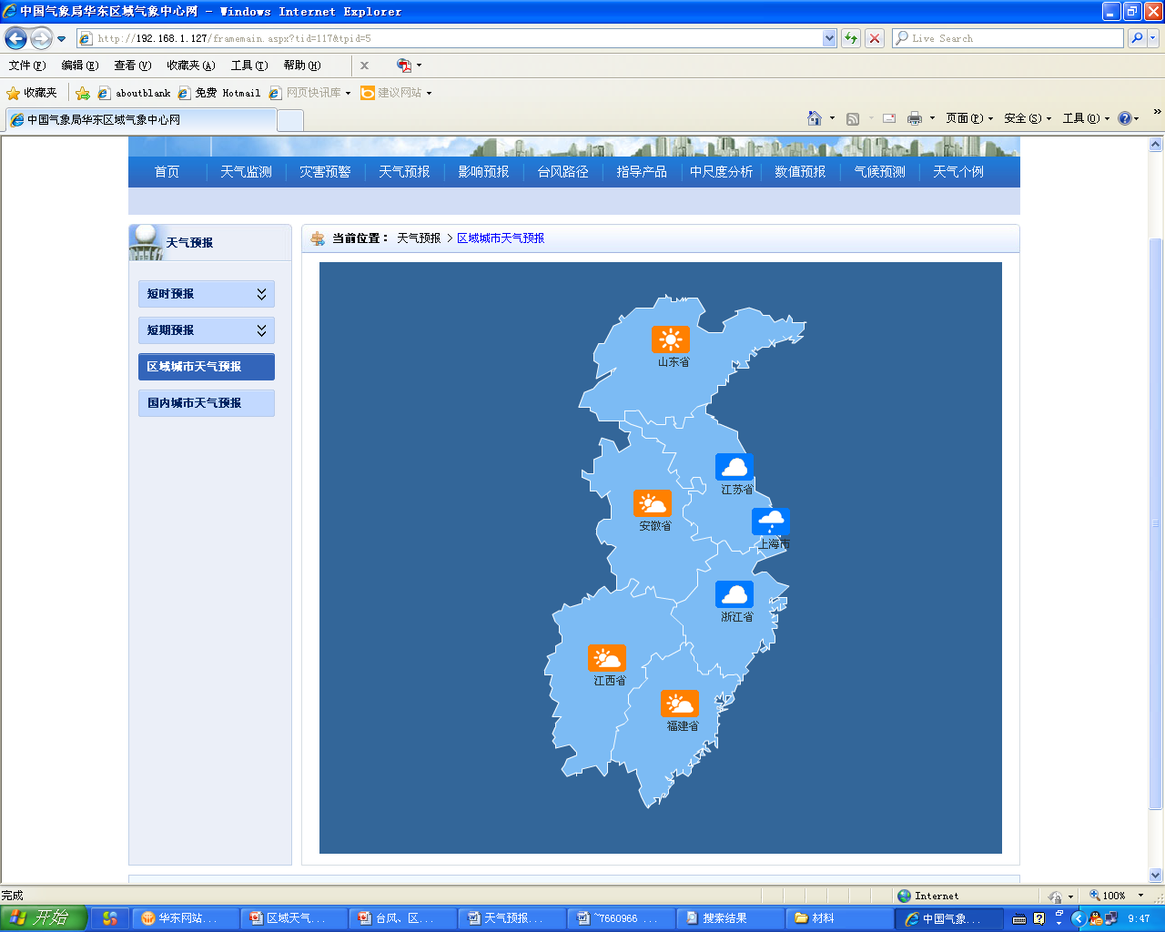
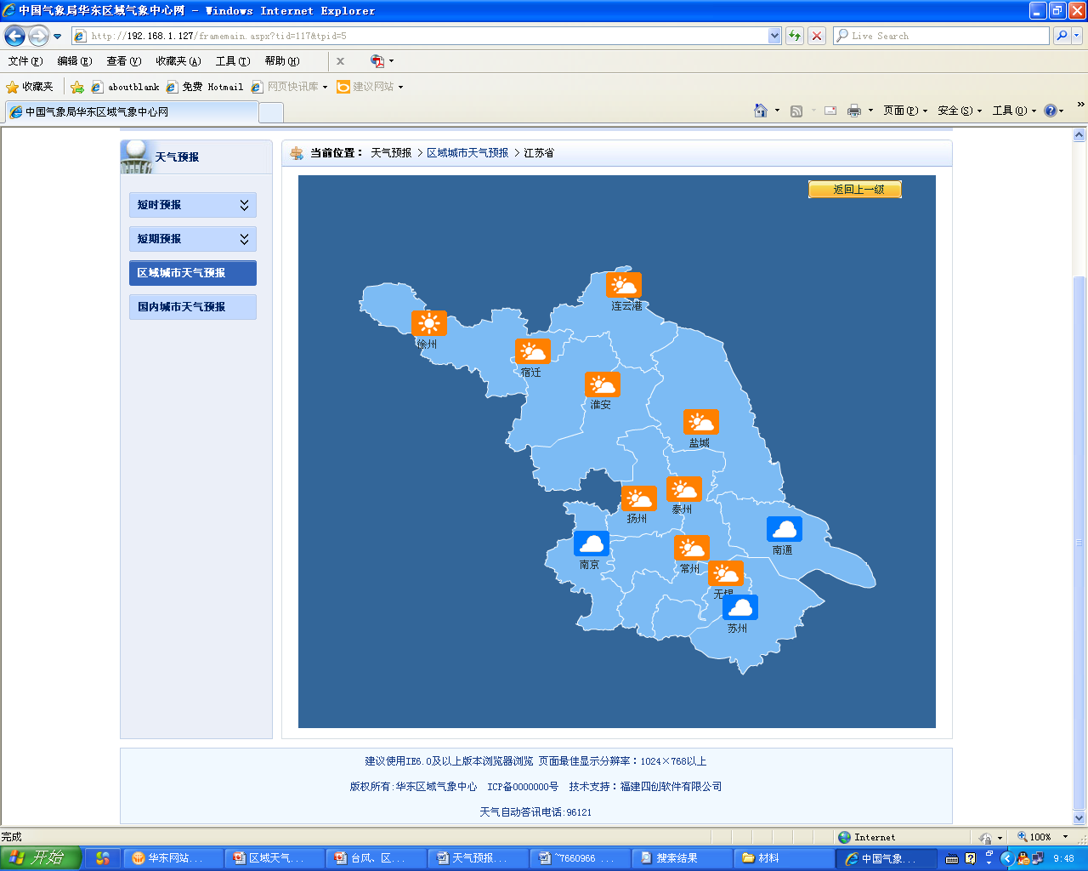
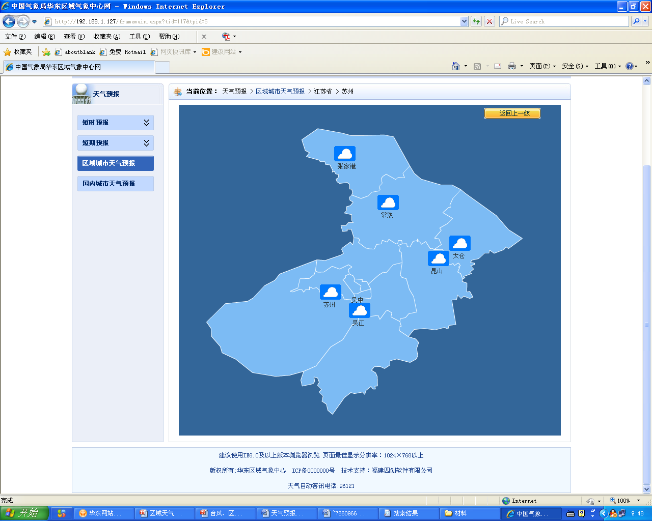
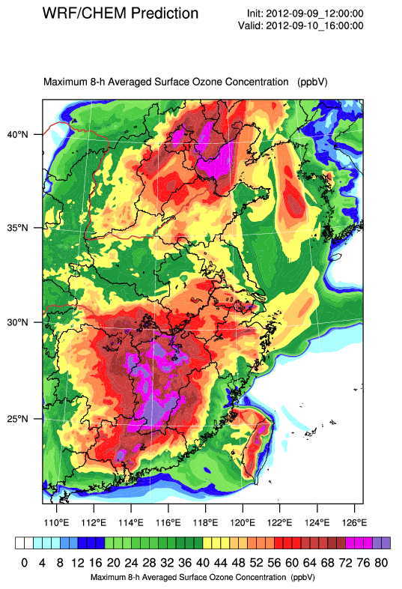
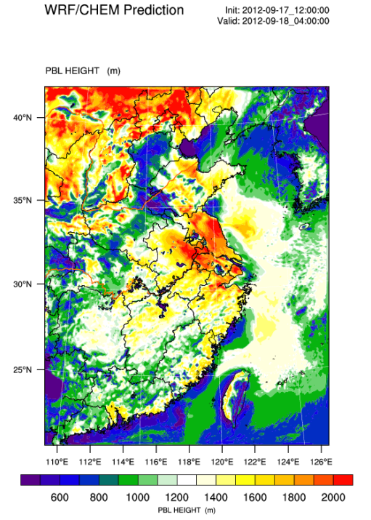
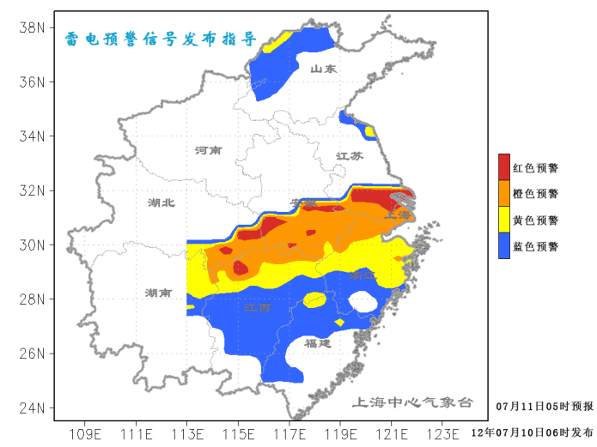
Regional guidance of county-town forecast, severe convection potential, heavy rain, hydro-meteorology, geologic hazards, and environmental factors
Outlook
Water level forecast
regional 24-h rainfall forecast
region
province
county-town
Warning
Signal
Environmental parameter forecast
Outlook

Slide 14
Environmental Remote Sensing Monitoring and Analysis
Weather system dynamic analysis
Focus on high sensitive users
1) Impact on natural environment
2) Impact on urban infrastructure
3) Impact on Public health
Reliability analysis and verification of NWP
Ensemble NWP products and analysis
TC wind and rain fcst
Multi-scale weather analysis and Seamless Forecast
Urban refined forecast
F-4: Weather Impact Forecast Based on Ensemble NWP Analysis

Slide 15
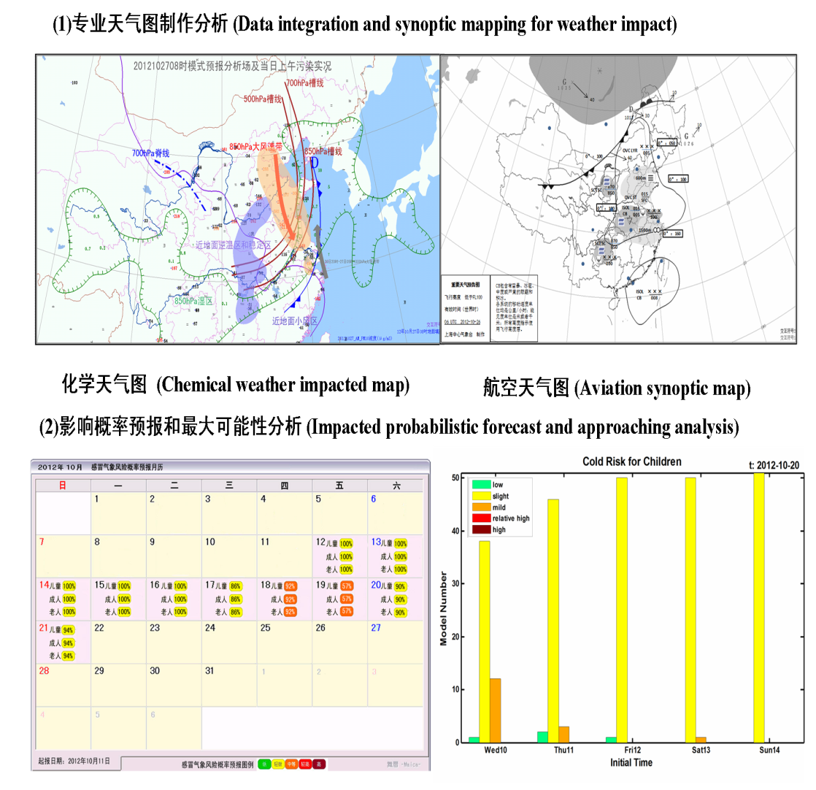
Weather Impact Forecast Based on Ensemble NWP Analysis
To deploy weather impacted analysis and forecasting operations aiming at urban community and public health.
Responsibilities:
  to develop more specific forecasts and advisories for individuals, industries and government
  in the fields of weather impacted application, management and decision making at urban activities and issues of air quality, human health, aviation, transportation, as well as urban flood and power et al

Slide 16
Organization
F-1: Forecast Planning & Organization
Weather Briefing
Supporting sub-sections:
F-6: Weather and Environment Analysis based on Satellite Remote Sensing
F-8: Regional NWP Application
F-9: Subtropical Circulation & Abnormal Characteristic Analysis

Slide 17

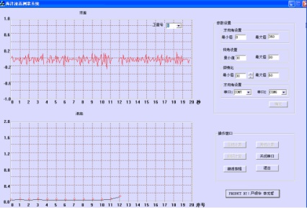
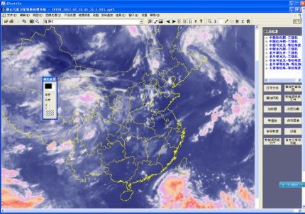
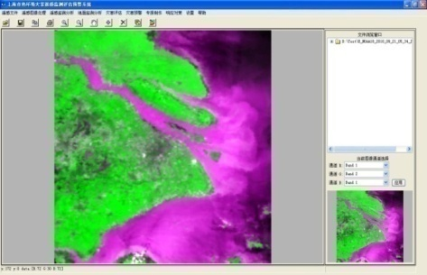
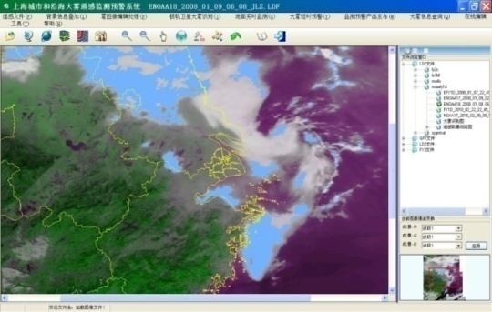
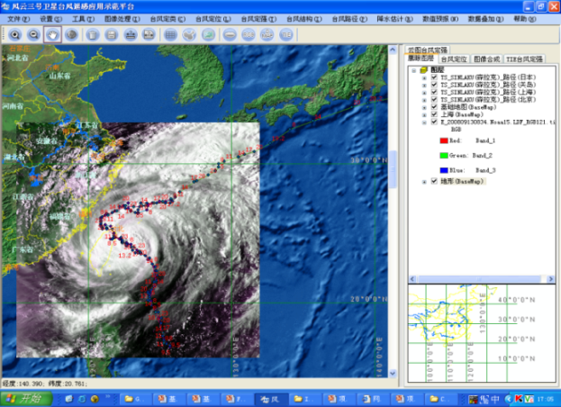
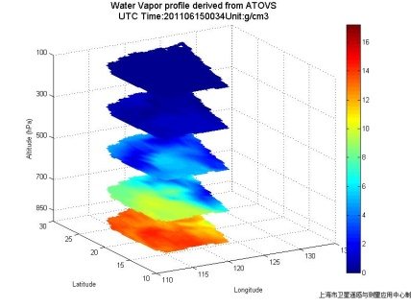
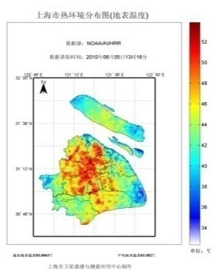
Supporting from Satellite Remote Sensing
Positions:
  remote sensing monitoring and dynamic analysis of East China regional weather and environment
  meteorological remote sensing analysis and environmental remote sensing analysis.
Thermal condition monitoring
Fog monitoring
Typhoon monitoring

Slide 18
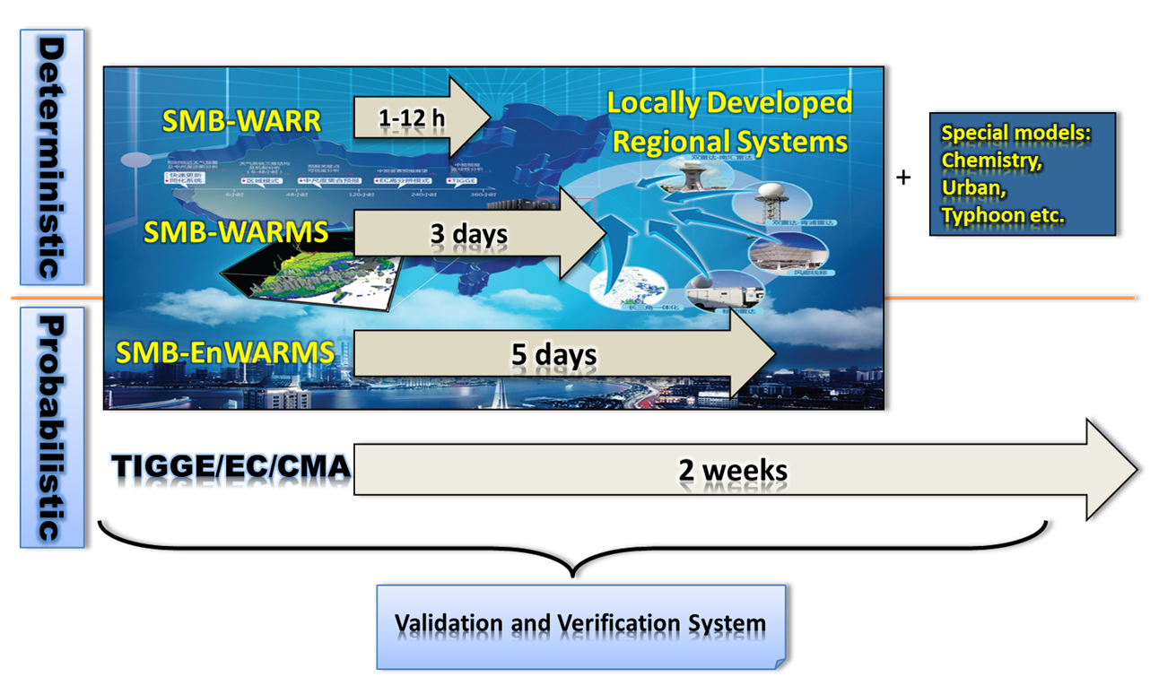
Regional NWP Application
Regional Ensemble → Regional Deterministic → Rapid Refresh

Slide 19
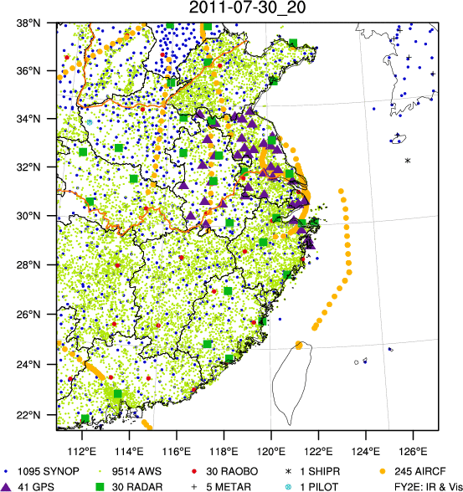
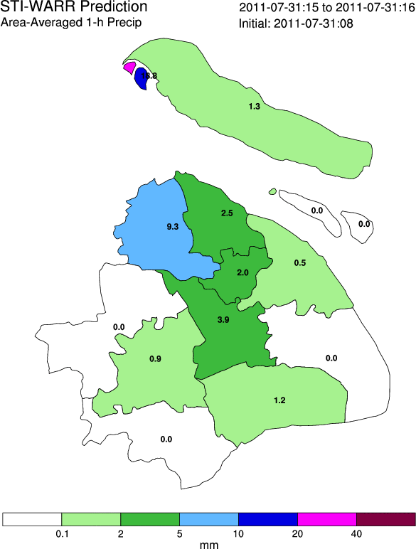

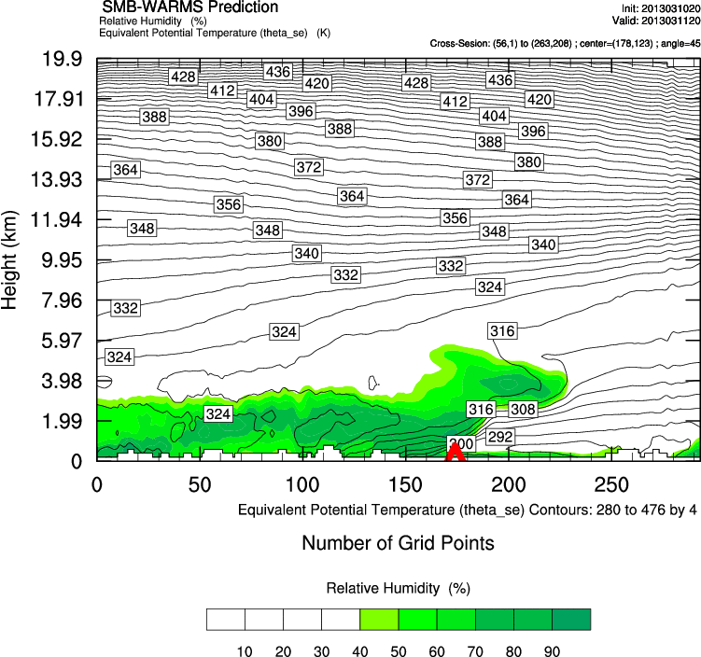
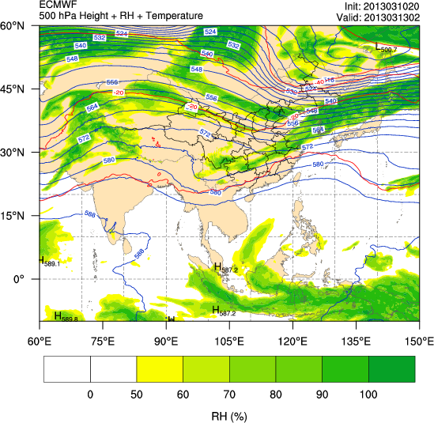
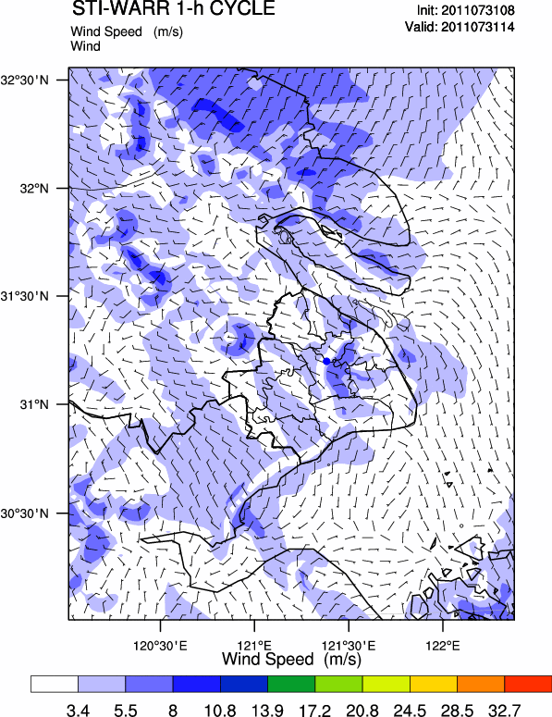
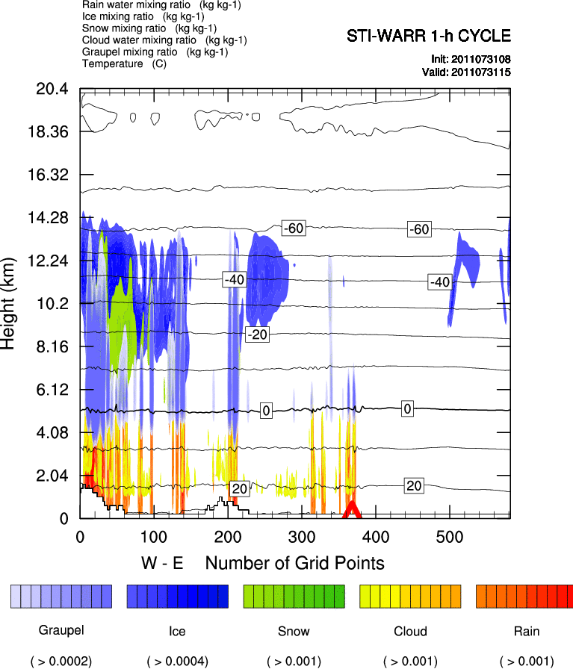
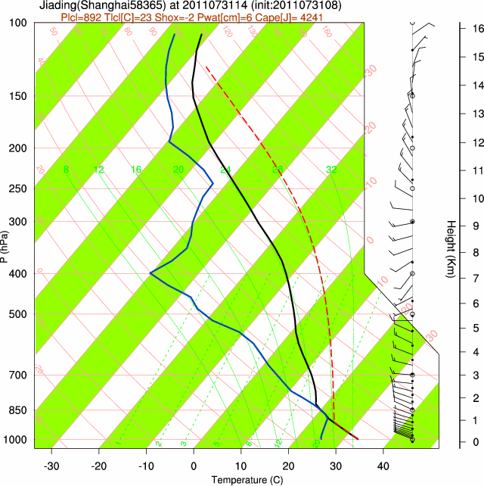
To build up a NWP application and supporting platform
To provide information of uncertainty, most likelihood of weather systems
To carry out real-time parallel run by modifying sensitive parameters and to give guidance for better use of the results

Slide 20
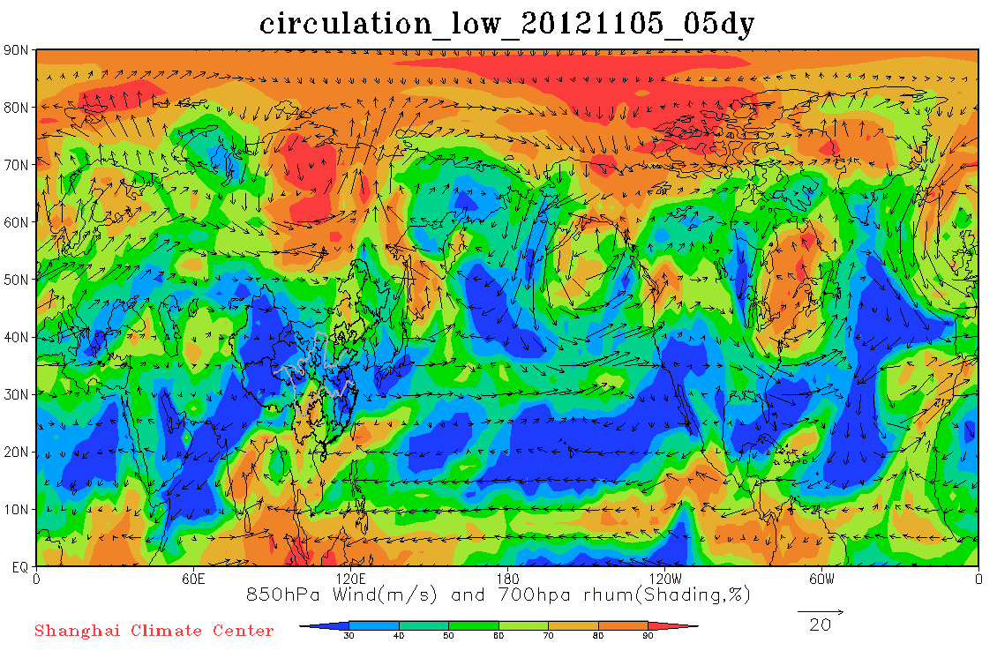
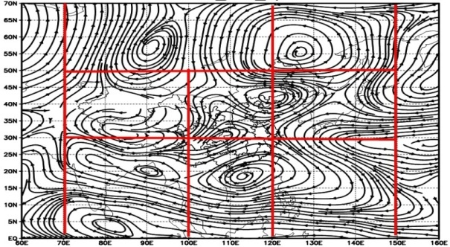
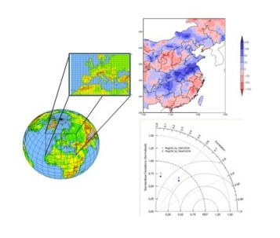
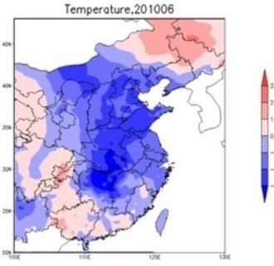
F9: Subtropical Circulation & Abnormal Characteristic Analysis
9-1
Subtropical Monitoring
9-2
Long-Range Weather Forecast
9-3
Extended-Range Weather Forecast
9-4
Extreme Events Pre-assessment
Northeast cold vortex index monitoring
Air circulation monitoring for last 5 days
Forecast system of dynamical and analogous skills(FODAS)
to provide technical supports to short-middle range forecast and make dialogs among forecasters more effective in long-middle-short range integration forecast consultation.
Regional climate forecast
Low-frequency synoptic weather chart

Slide 21
Thank you for your attention!

