Slide 1
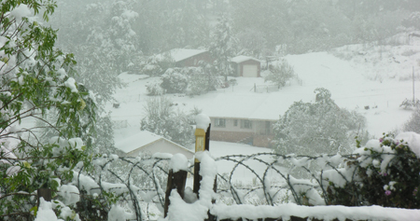
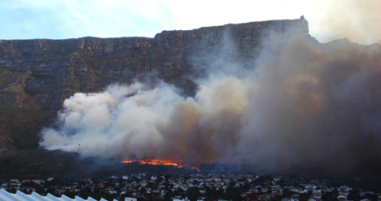
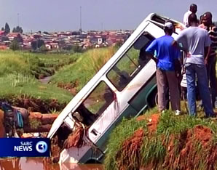
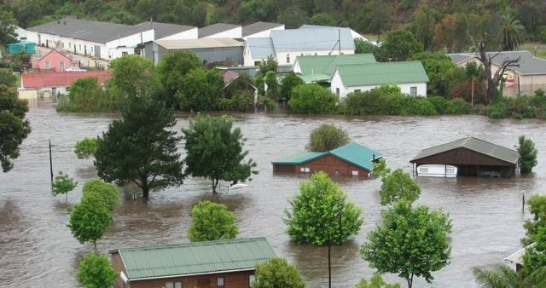



Introduction to Weather Ready Nations Program
Dr. Elizabeth Page

Slide 2
Weather Ready Nations Projects
South Africa Weather Service
Myanmar
Barbados
El Salvador
Costa Rica
Guatemala
Indonesia
Croatia

Slide 3
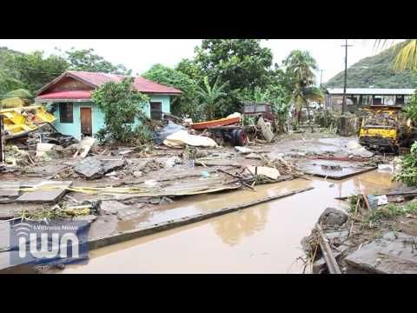
Phase One:
Collect Data and Develop Hazard, Risk and Response Matrices
Analyze available data and tools for developing matrices
Draft Hazard and Response Matrices
Finalize Hazard and Response Matrices

Slide 4
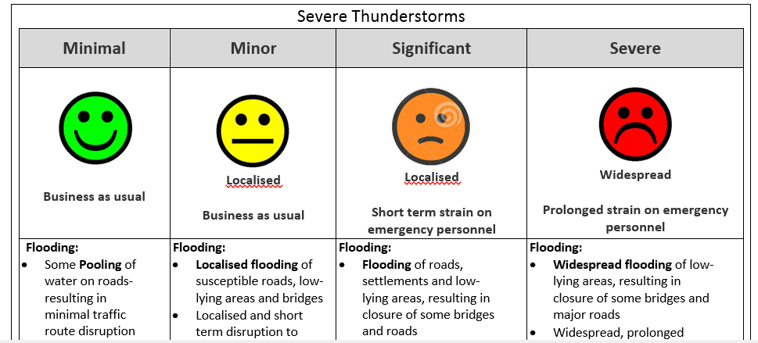
Example of combined Heavy Rainfall: Impact, Hazard and Response Matrix developed by forecasters, hydrologists, and disaster managers
Minimal | Minor | Significant | Severe
Business as Usual | Localized = Single District Municipality affected Business as usual | Localized = Single District Municipality affected Short term strain on emergency personnel | Widespread = Multiple Districts affected Prolonged strain on emergency personnel
Some pooling of water on roads or in informal settlements Day to day activities not disturbed Wet roads Minimal traffic congestion Isolated mudslides and rock falls | Localized flooding of susceptible informal settlements or roads, low lying areas and bridges Localized and short term disruption to municipal services (water, electricity, etc.) Major roads affected but can be used, increased travel times Minor motor vehicle accidents due to slippery roads Closure of roads crossing low water bridges Localized mudslides and rock falls | Flooding of roads and settlements (formal and informal) Disruption to municipal services (water, electricity, etc.) Major disruption of traffic flow due to major roads being flooded or closed Possible damage to roads and bridges Danger to life (fast flowing streams I deep water) Some communities temporarily not accessible/ cut-off Displacement of affected communities Damage to property, infrastructure and loss of livelihood Mudslides and rock falls | Widespread flooding of roads and settlements Widespread, prolonged disruption to municipal services (water, electricity, etc.) Widespread transport routes and travel services severely affected Major roads and bridges damaged or washed away Danger to life (fast flowing streams I deep water) Large communities not accessible/cut-off for a prolonged period Widespread displacement of affected communities Widespread damage to property, buildings and loss of livelihoods Widespread mudslides and rock falls

Slide 5
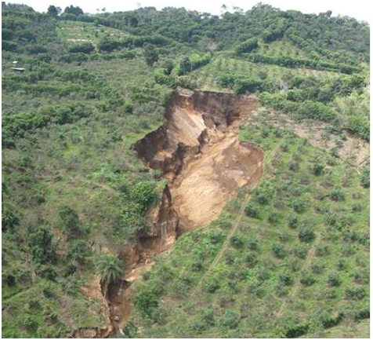
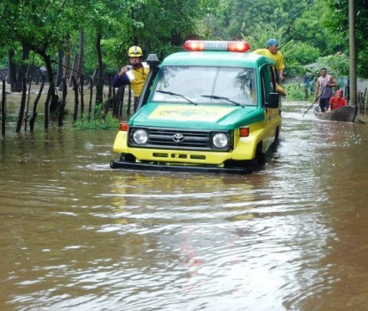
Phase Two: Expand Stakeholder Participation
Draft sector specific matrices (e.g. health, public works, transportation and other key partners)
Finalize sector specific matrices

Slide 6
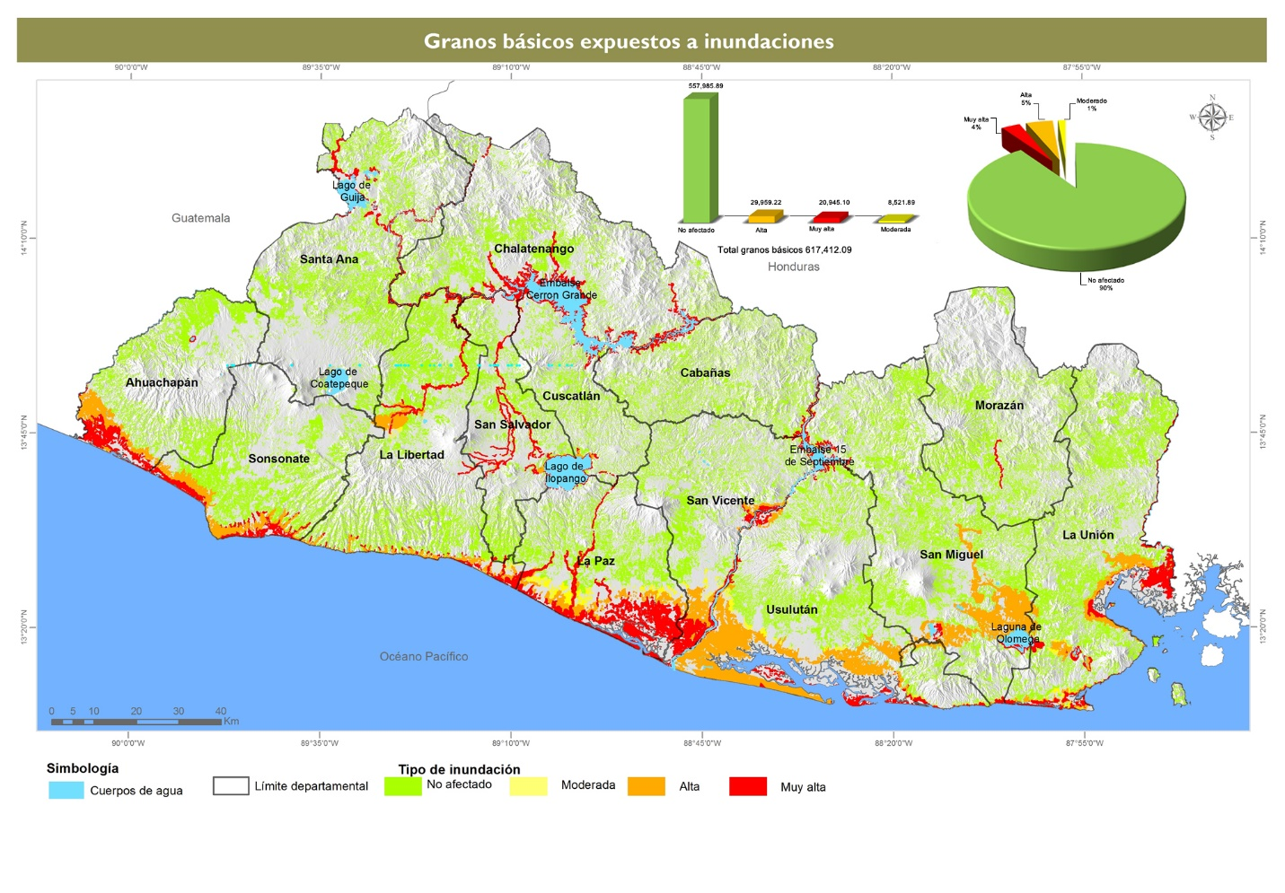
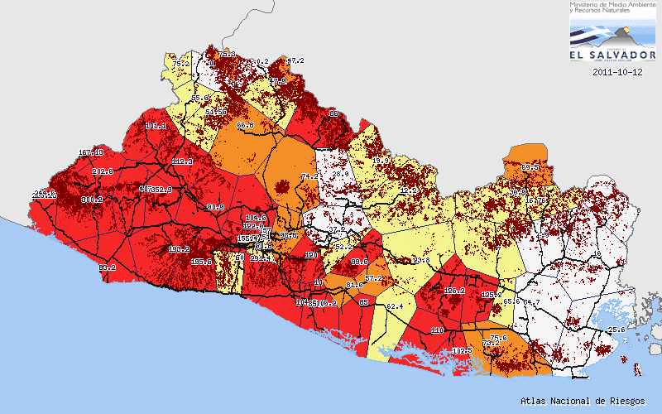
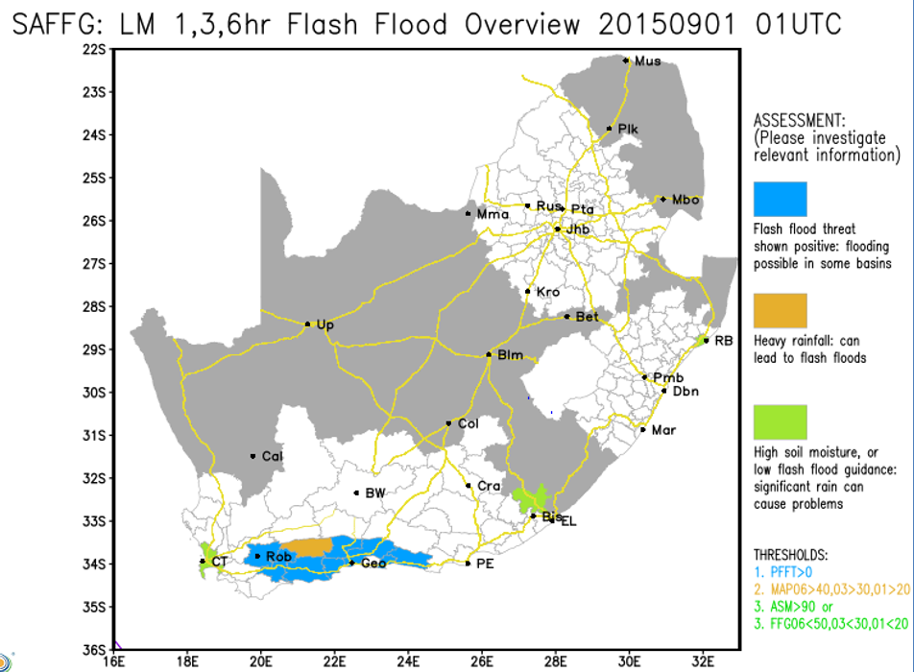
Phase Three: Forecaster and Disaster Management Interface
Develop display system to share information between forecasters and disaster managers

Slide 7
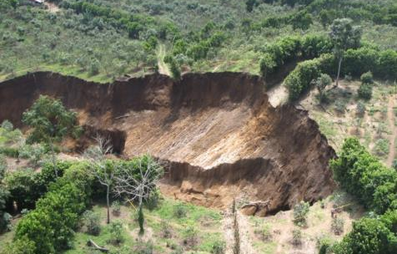
Phase Four: Standard Operating Procedures (SOP)
Draft the Standard Operating Procedures
Finalize Standard Operating Procedures

Slide 8
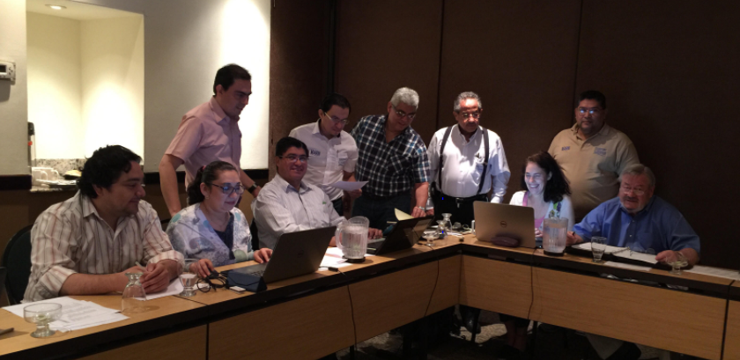
Phase Five: Demonstration Test
Train Forecast and Civil Protection Staff
Train the media and other stakeholders
Simulation test in conjunction with civil protection and NMHSs

Slide 9
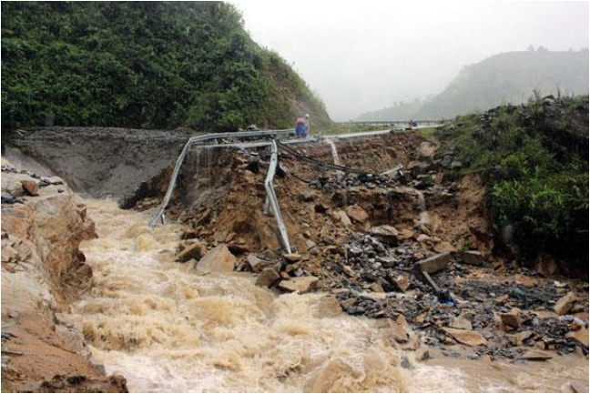
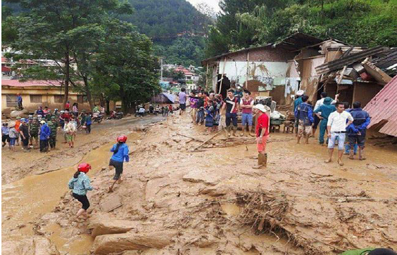
Phase Six: Public Awareness and Outreach
Develop outreach material and raise public awareness to recruit volunteers to assist with communication and mitigation efforts.

Slide 10
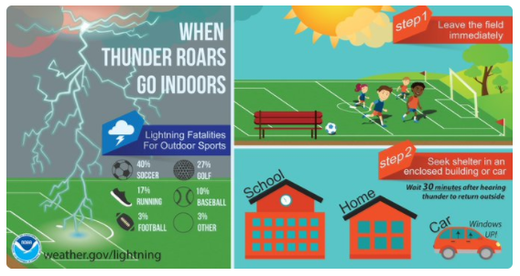
Challenges
  NMHS forecasters and civil protection commit to paradigm shift to impact-based forecasts and warnings
  NMHS and civil protection needs to build staffing skills to create and use impact-based forecasts
  NMHS and civil protection needs to incorporate social science principles in operations
  NMHS and civil protection collect and analyse data to develop the impacts, hazard and response catalog (for the matrices)

Slide 11
Warning Template Example
Date Issued | 18-Oct-2017
Date Valid | 18-Oct-2017 to 19-Oct-2017
Time Valid | 1100hr 18-Oct to 23oohr 19-Oct
Warning (SMS) | Yellow Warning of Rain Be aware that some low level disruption looks likely to occur
Discussion | High rain fall amounts have already been recorded therefore the ground is likely saturated. Flooding has already been reported in flood prone areas. Any further rainfall could result in previous areas flooding again. There is a higher likelihood of minor impacts occurring over central San Salvador due to the amount of rainfall expected to occur over the area.
Date Issued | 18-Oct-2017
Date Valid | 18-Oct-2017 to 19-Oct-2017
Time Valid | 1100hr 18-Oct to 23oohr 19-Oct
Warning (SMS) | Orange Warning of Rain Be prepared for moderate level disruption to normal daily life
Discussion | Rain fall already occurring with rainfall amounts already recorded across San Salvador causing flooding. There is an indication that ore than 100mm more rainfall is possible. Areas prone to flooding need to be closely monitored over this period. Please be aware that flooding of roads is possible, disruption of municipal services, disruptions of traffic on major roads because of flooded roads and significant reduced visibility due to rainfall, possible damage to roads and bridges due to flooding.

Slide 12
Partnerships and Collaboration
1. Main challenge: NMHSs and Civil protection need to work in partnership with other government agencies and stakeholders (emergency response, mapping agencies, transport, public, etc..)
2. Development of Information and Services - data sharing among different agencies and departments vital (demographic, GIS and mapping, economic etc.)

Slide 13
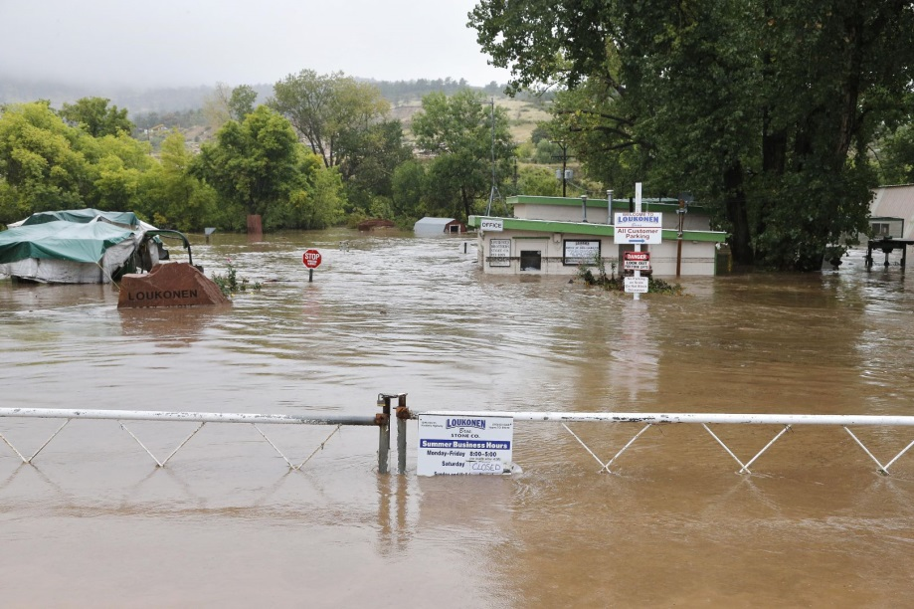
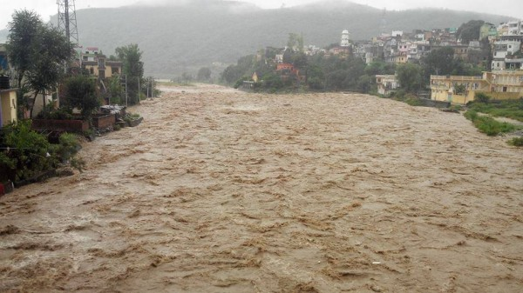
Thank you
Questions?

