Slide 1
ADPC Support in Enhancing
Technical and Human Capacity of DMH-Myanmar

Slide 2
Background
1986
  Originally a training agency at AIT, established in partnership with United Nations Office for the Coordination of Humanitarian Affairs (UNOCHA), UNDP and World Meteorological Organization (WMO)
1999
  Kick-started project implementation and advisory services
Pioneering programs in 90’s
  Asian Urban Disaster Mitigation Program: started ‘urban’ focus
  Extreme Climate Events Program: led to establishment of ADPC’s Climate Risk Management team
Notes:
1986: ADPC was established as a training agency in partnership with 3 agencies, UNDP, UNOCHA, WMO. It was established to answer to the need to have a regional agency focusing on disaster preparedness whereas previously the focus of most actors in the region had been mostly on disaster relief. [click]
In the 1990s, because of the onset of severe disasters, ADPC wanted to extend its work to technical services adding project implementation and technical advisory to its work. [click]
Pioneering Programs:
Asian Urban Disaster Mitigation Program: It is the longest running program (10 years), and it started the urban focus of DRR working at mega cities in 10 countries in the region. ADPC for example worked to mitigate the impact of urban hazards such as typhoons and floods in the Philippines. This project also started ADPC’s cooperation with governments on the ground. [click]
With funding from USAID, the pioneering on program on Extreme Climate Events started ADPC’s Climate Risk Management team in 1996. At that time, climate risk management was a very forward-thinking component of disaster risk management. ADPC took a lead to lay the foundations for this work in the region.
These two programs were the start of ADPC’s program implementation work

Slide 3







Our Locations
ADPC currently works in 23 countries in the South and Southeast Asian region.
Offices:
Bangkok, Thailand
Dhaka, Bangladesh
Yangon, Myanmar
Notes:
We maximize our regional presence through two country offices in Bangladesh and Myanmar. Our headquarters is in Bangkok.

Slide 4
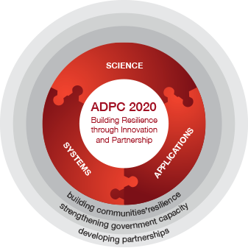
Programmatic Approach
Science
Enhanced capacity of countries in the utilization of science-based information to understand risk.
Systems
Strengthened systems for effective management of risk at all levels, especially at sub-national and local levels.
Applications
Improved and grounded application of risk reduction measures in development.

Slide 5

Thematic areas
Climate Change and Climate Risk Management
Disaster Risk Assessment and Monitoring
Disaster Risk Management Systems
Public Health in Emergencies
Safer Development Planning and Implementation
Resilient Cities and Urban Risk Management

Slide 6
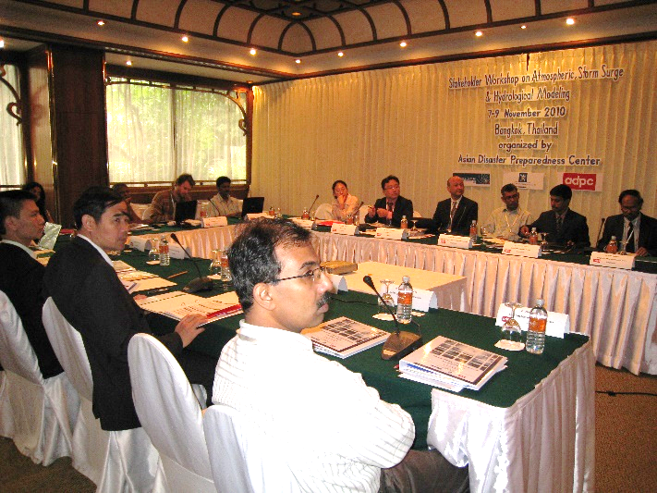
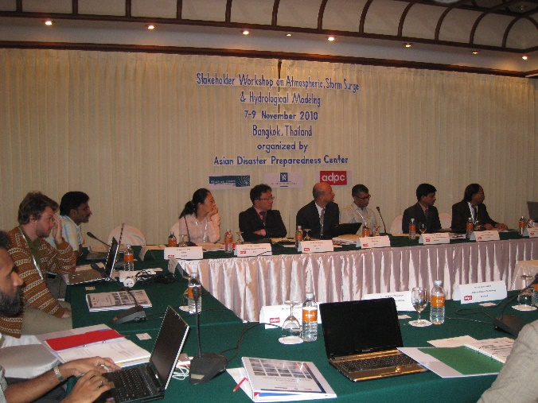
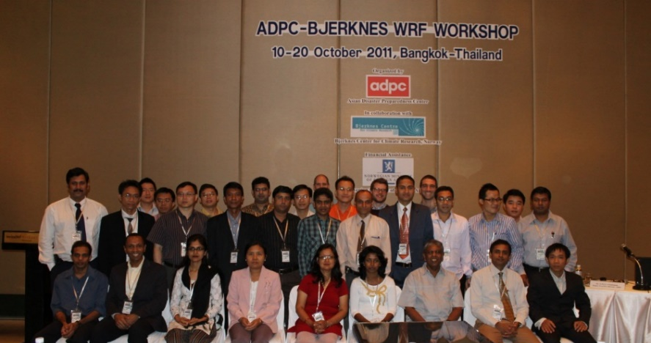
Regional Initiatives of NWP Modeling
In collaboration with NCAR-USA
and BCCR-Norway - Funded by MoFA- Norway
Stakeholder Workshop on Atmospheric Modeling: Bangkok in 2010
Regional Workshop on WRF Modeling: Bangkok in 2011

Slide 7






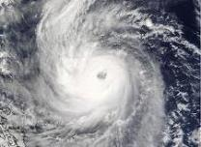
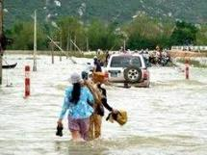
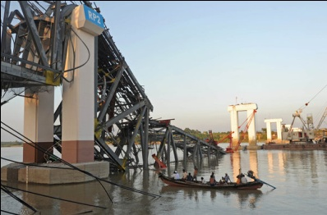
Technical support to Myanmar for strengthening of human resources and institutional capacity to deal with the threat from natural disasters
Duration: Jun 2012 – Dec 2017
Meteorology
Overview of the Project and
Progress / future activities
Hydrology
Seismology

Slide 8
Goal:
Enhanced capacity of Department of Meteorology and Hydrology (DMH) on meteorological, hydrological, and seismological services for disaster risk management in the country.
Meteorology
Hydrology
Seismology

Slide 9
Key Objectives:
3
2
1
  To improve customized forecasting and early warning products for different sectors
  To improve human and technical capacity through Trainings, workshops, discussions and Secondment for DMH professionals
  To assess gaps and capacity needs for strengthening Weather / Climate / Hydrology services of DMH.

Slide 10
Activities Conducted
Regional Workshop on WRF Modeling: Vietnam Sep 2012: In collaboration with NCAR-USA and BCCR-Norway; Follow up workshops in NPT during Nov 2012, Aug 2013, Apr/Nov 2014, Mar 2016.
Regional Training Workshop on Storm Surge Modeling: BKK Jun 2013: In collaboration with JMA-Japan; Follow up workshop in NPT in Aug 2013.
Training and Capacity Building on CLIMSOFT (v2.7) data archiving system: Jun 2013 and Mar/Jul 2014
Training and Capacity Building on Climate Modeling: Jul 2013, Oct 2015 and Jul 2016
Training and Capacity Building on Climate Data Analyzing Tools (SURFER, ANUSPLIN, RClimdex): Aug 2014
Development of "Myanmar Climate Data Portal” :- Nov 2014 (www.dhm-cdp.wowspace.org)
Secondment Programmes (Weather and Climate Modeling) : ADPC, Apr 2013 & Aug 2014

Slide 11
Activities Conducted
Regional Courses on EWS and CRM : BKK Oct/ Nov 2013 and 2014.
Supported Training workshops on DIANA, R & RClimDex : Oct 2013 to Mar 2016 (by MET-Norway)
El Nino Forum: in NPT Feb 2016

Slide 12
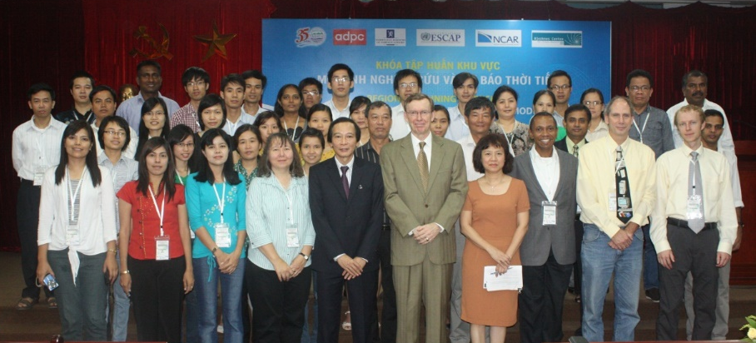
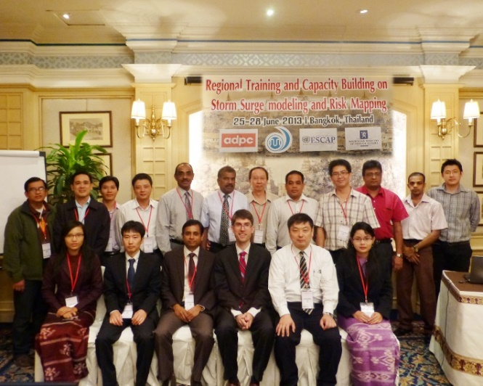
Regional Workshop on WRF Modeling: Vietnam 2012
- In collaboration with NCAR-USA and BCCR-Norway
Funded by MoFA- Norway and UNESCAP
Regional Training Workshop on Storm Surge Modeling: Bangkok 2013
- In collaboration with JMA-Japan
Funded by MoFA- Norway and UNESCAP

Slide 13
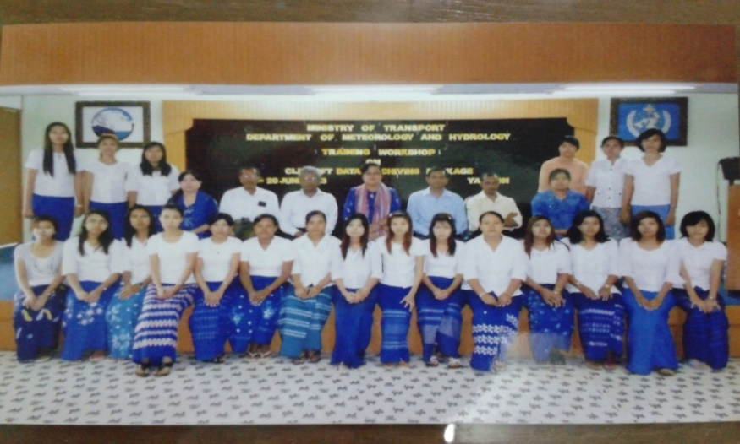
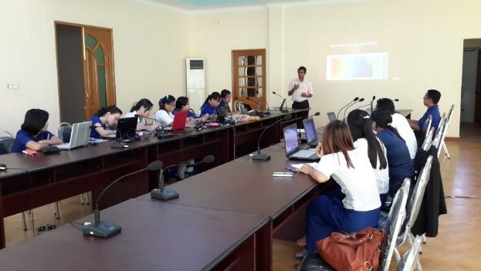
Training and Capacity building on;
1. CLIMSOFT (v2.7) data archiving system
2. Climate modeling and climate data analyzing tools (SURFER, ANUSPLIN, RClimdex)
1
2

Slide 14
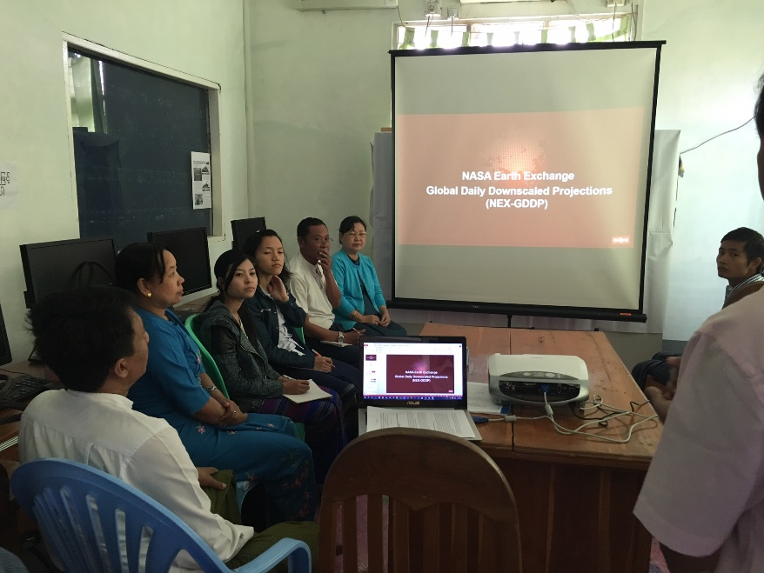
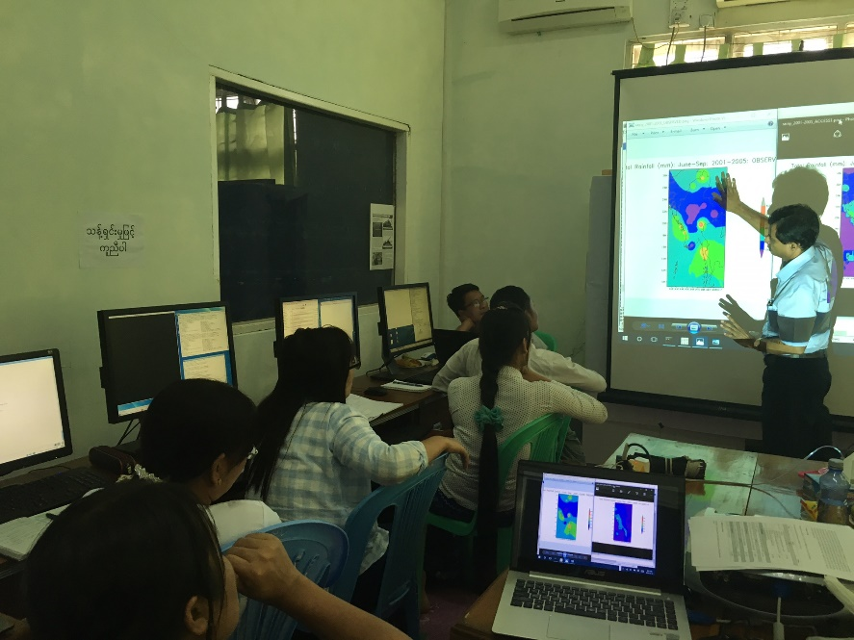
3. Workshop on Climate Change Scenario Development for Myanmar using NASA Earth Exchange Global Daily Downscaled Projections (NEX-GDDP) in July 2016

Slide 15
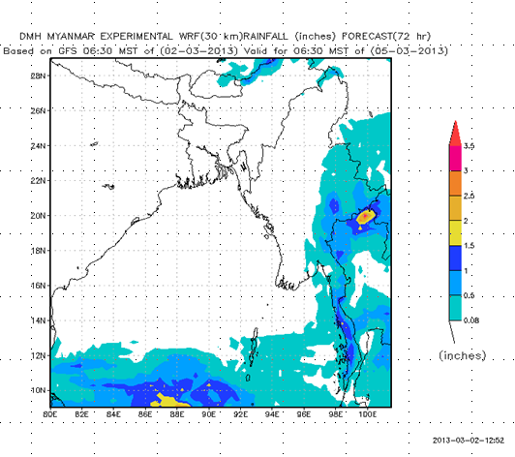
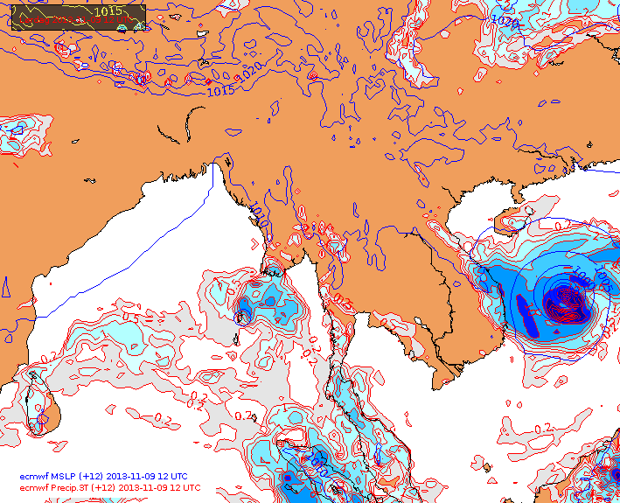
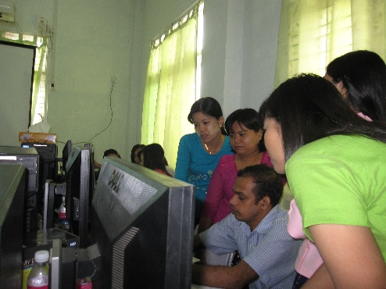
Progress on WRF modeling at DMH
Research and Development: Deploying the model in 4-5 PCs and training 15-20 staff in 2012
            Forecast Verification (with MET-Norway support)
Operationalizing: In 2013 onwards: 30 and (10 km resolutions), 3 day forecast with 3 hourly outputs.
        Publishing WRF forecast products in the web site
        Integrating with DIANA visualization tool (introduced by MET-Norway)
        Scripting/Semi automation of executing

Slide 16
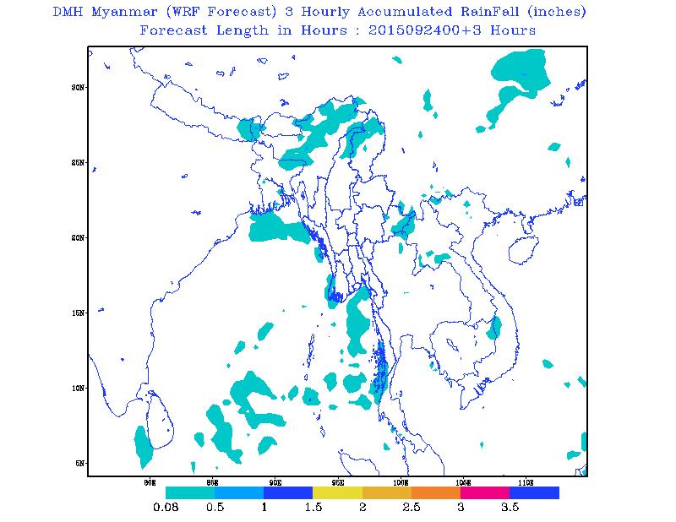
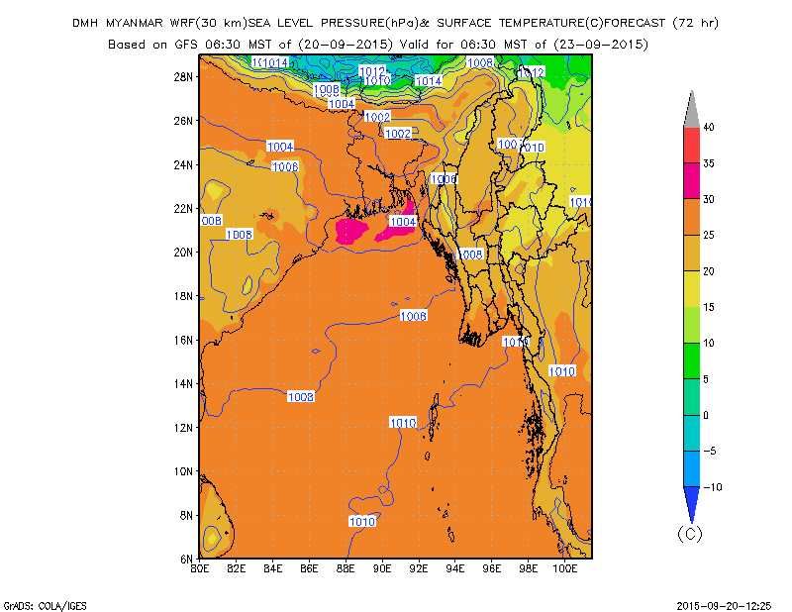
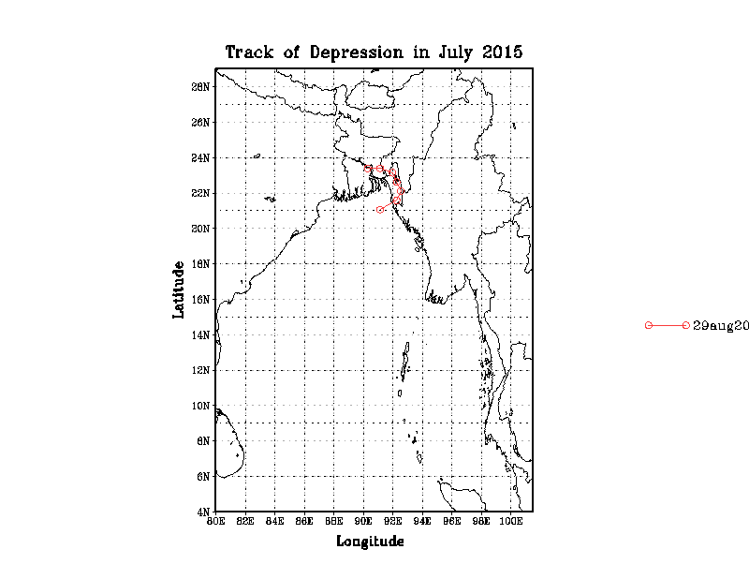
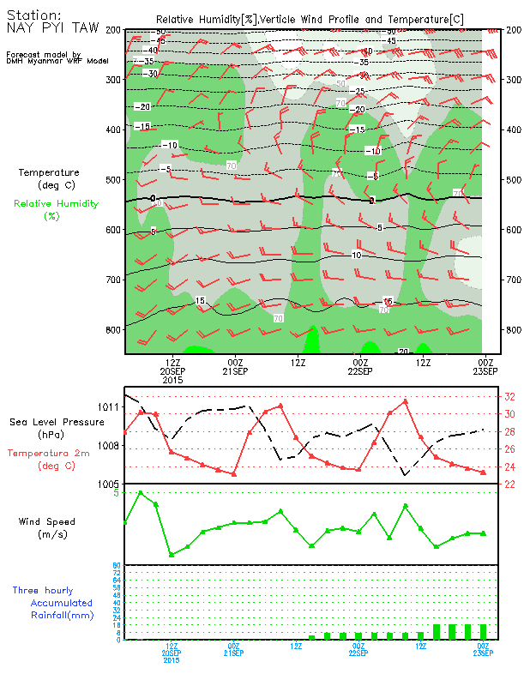
Storm Track
WRF products generated by DMH
Source: DMH

Slide 17
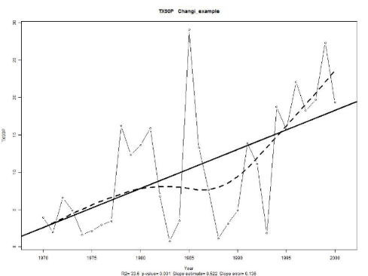
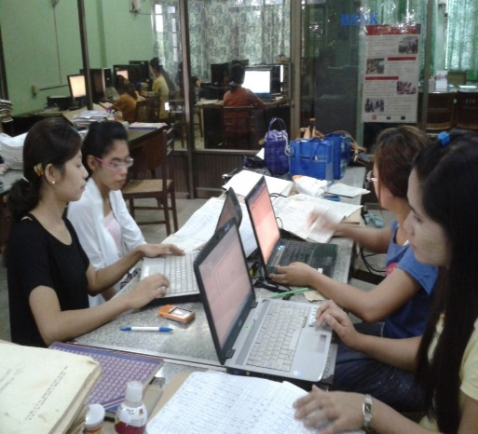
Progress on climate services at DMH
1. CLIMSOFT (v2.7) data archiving system
2. Climate data analyzing tools (SURFER, ANUSPLIN, RClimdex)
Digitized data of 2001-2016 period for 32 stations was uploaded to CLIMSOFT main data base system
State wise main data bases
Data QCing
2
Different interpolation techniques
Climatological map preparation
Indices calculation
Dynamic maps with GEE.
1

Slide 18
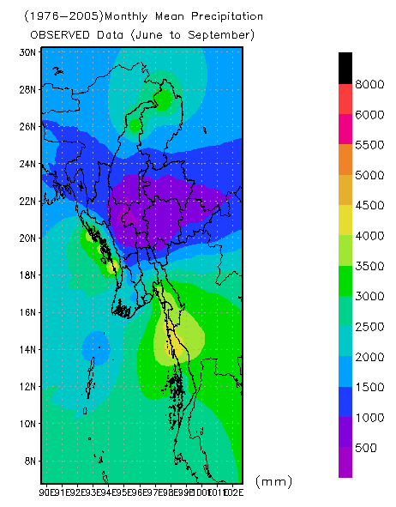
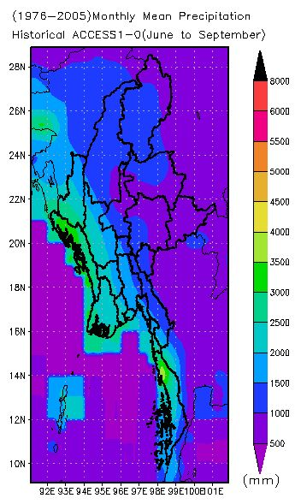

3. Climate Change Scenario Development
RCP-Scenarios
  4.5 and 8.5
  21 GCMs
Selection of best perform models
Local bias correction
  SD ratio
  Gamma Dist.
Observed gridded data preparation
Easy data handling and visualization
  CDO
  Grads
Selection of best perform models

Slide 19
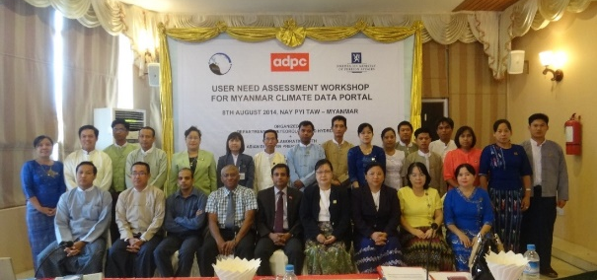
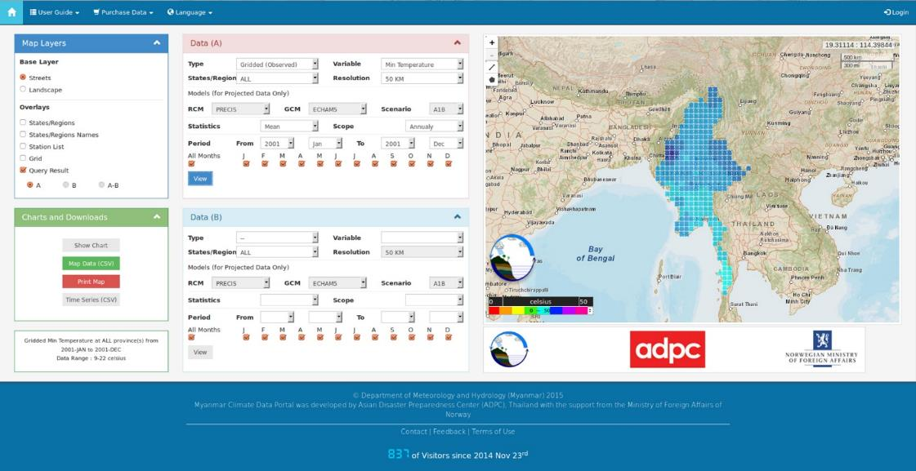
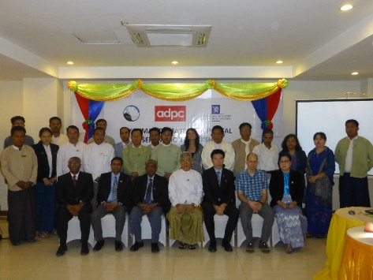
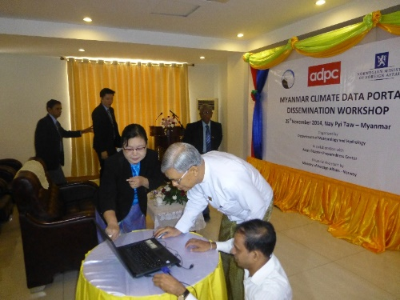
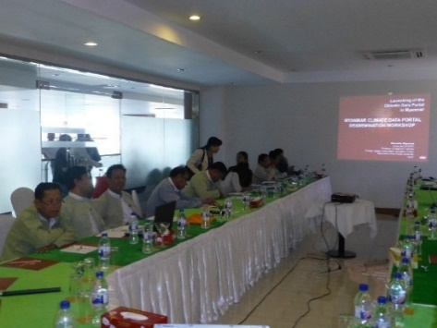
Myanmar Climate Data Portal
www.dhm-cdp.wowspace.org
Easy accessing historical station data, historical gridded data and projected future climate change scenarios, Statistical calculation, Map & graphs generation, Data purchasing

Slide 20
Planned Activities for 2016-2017:
Improve day-to-day weather forecasting capacity with the state-of-the-art numerical models / tools for strengthening Early Warning Systems (EWSs) for hydro-meteorological hazards
  WRF data assimilation
  NWP course curriculum development
Strengthen coastal hazard early warning system with the state-of-the-art numerical models / tools for securing life and property
  Storm surge modeling (follow up)
  Climate inclusive coastal hazard mapping
Strengthen drought forecasting system with the state-of-the-art techniques / tools for effective decision making and sector specific planning
  Seasonal forecasting (NMME)
  Introducing and capacity building on Regional Drought and Crop Yields Information Service

Slide 21
Planned Activities for 2016-2017:
Improve climate services with user-friendly tools / models to support sector specific panning and sustainable development
  Upgrading Myanmar Climate Data Portal
  Upgrading Climate Data Archiving System

Slide 22
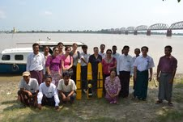
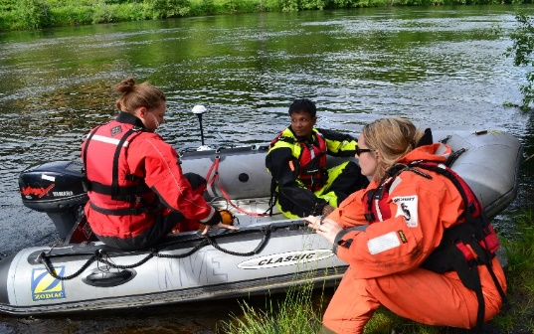
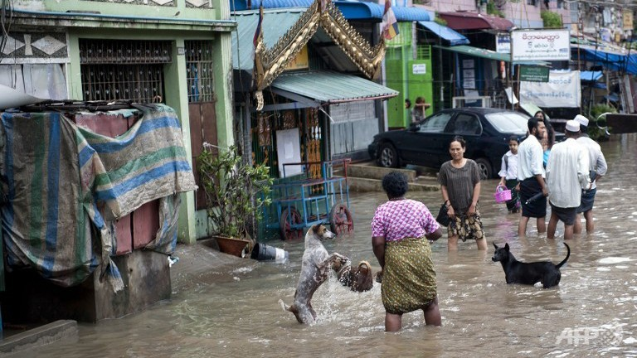
Progress on Hydrological Service at DMH

Slide 23
Activities Conducted
Field visit and investigate the representative water basin for hydrological data and flood monitoring: Myanmar, Oct 2012 (with NVE).
Training of relevant key personnel of DMH in use of "river surveyor" type of equipment; Norway Jun 2013 (by NVE)
Field training on “river surveyor” type of equipment; Mandalay, Myanmar Oct 2013 (with NVE)
Advanced field training on “river surveyor” type of equipment; Yangon, Myanmar Jan 2014 (by NVE)
Training workshop on Hydrological Modeling using HEC-RAS; NPT, Myanmar Dec 2015 and June 2016 (by ADPC)

Slide 24
Planned Activities for 2016-2017
Develop flood hazard maps (climate induced) for Chindwin river basin in Myanmar
Training on GIS for hazard mapping (ADPC regional course)
Strengthening local EWSs for floods in selected communities in Chindwin river basin (conduct drills, simulation exercises, etc)

Slide 25


Technical assistance for Enhancing the Capacity of End-to-end Multi-hazard Early Warning Systems (EWS) for Coastal hazards
Duration: Jul 2012 – Jun 2014
Overview of the Project and
Progress / future activities

Slide 28
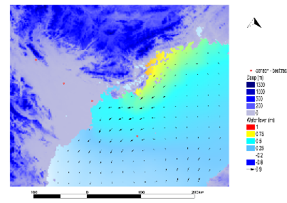
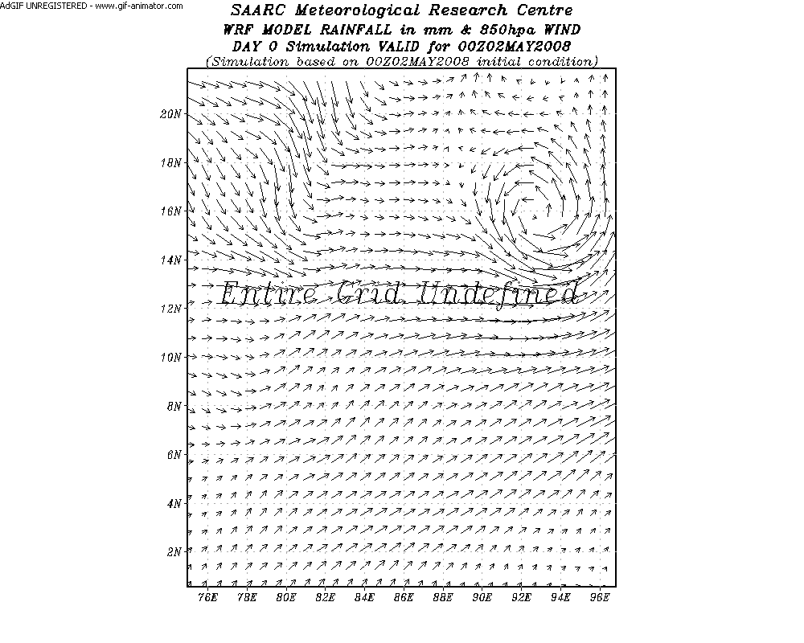
Activities Conducted
Myanmar Inception and national consultation workshop
Formation of the Project Working Group
Regional training for the meteorological services professionals on WRF held in Vietnam
Hand-on training workshop at DMH on WRF for meteorological coastal hazards
Storm surge training in Bangkok

Slide 29
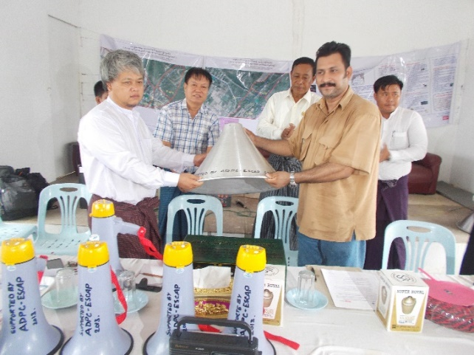
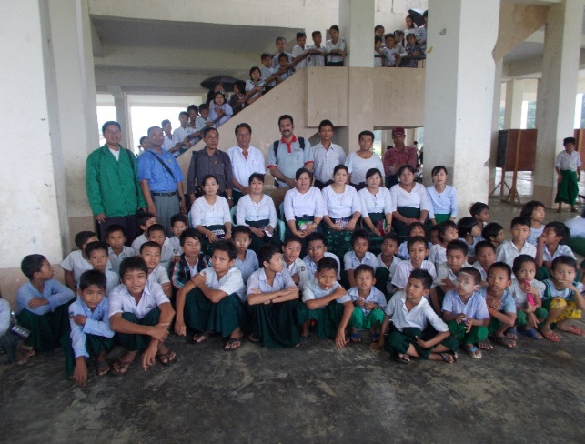
Activities Conducted
EWS Situation and Gap Assessment (both at national level and at local level)
Field Level Mapping and Training Workshop in Chauntha-Pathine
Field Level Mapping and Training Workshop in Paypon
Pre-End to End Simulation Workshop in Yangon
End to End Early Warning Simulations in all three pilot sites with local awareness program (1 site in Chauntha-Pathine, 2 sites in Paypon)

Slide 30

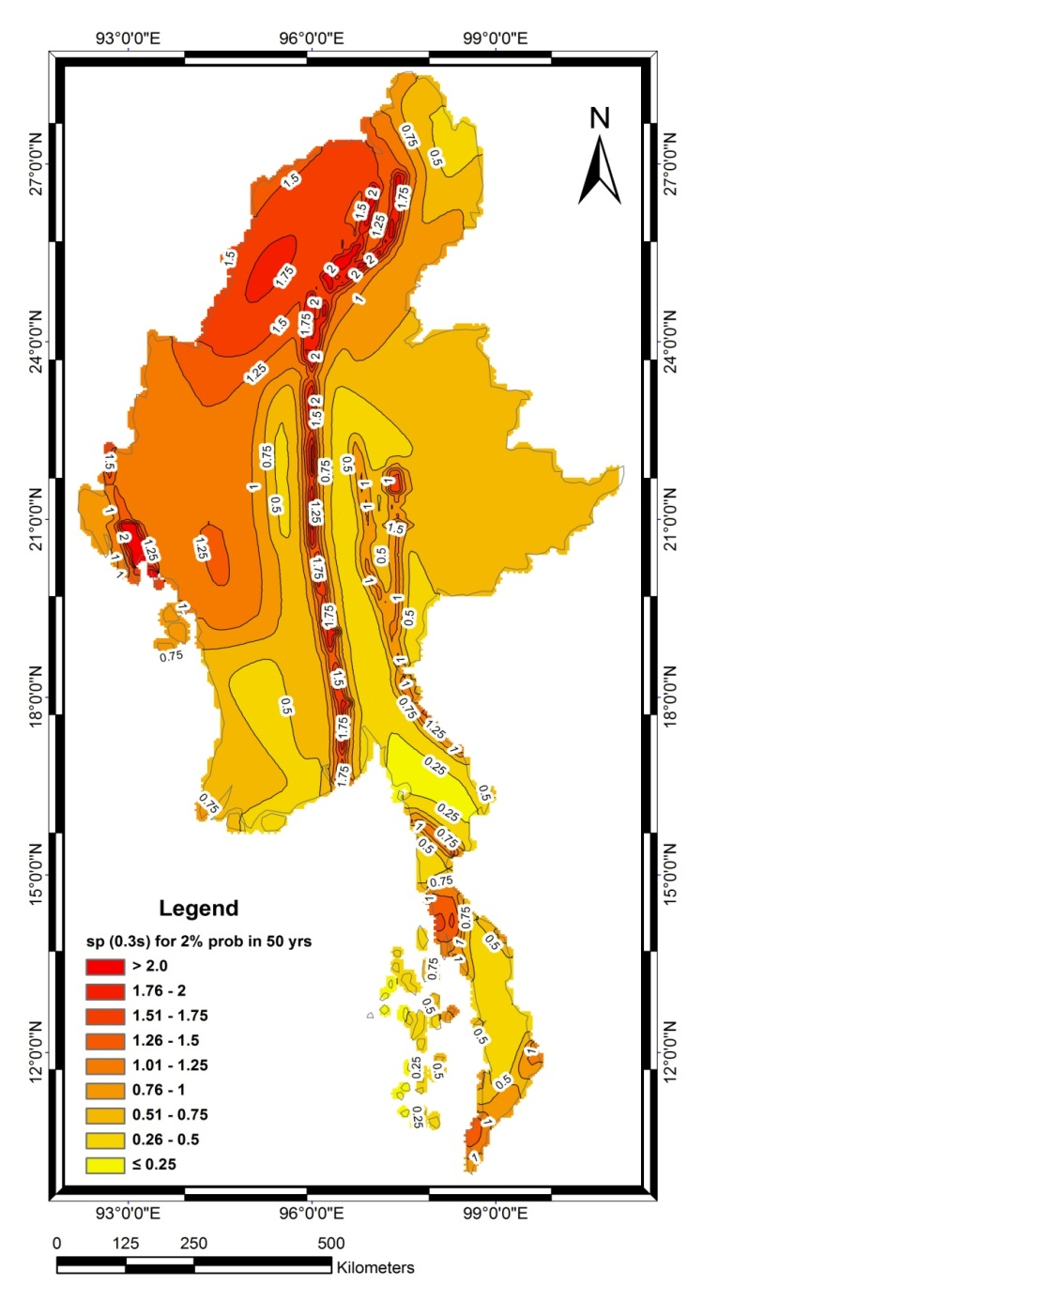
Outcome 1: Capacity for risk assessment and sharing of risk information increased and institutionalized at national and sub-national levels in Myanmar
Activity 3: Facilitate local-level application of disaster risk and Climate Change information in Early Warning System enhancement for better preparedness to extreme Hydro-met events
Strengthening DRR Capacity in Selected ASEAN Country:
Duration: Oct 2013 – Dec 2015
Overview of the Project and
Progress / future activities

Slide 31
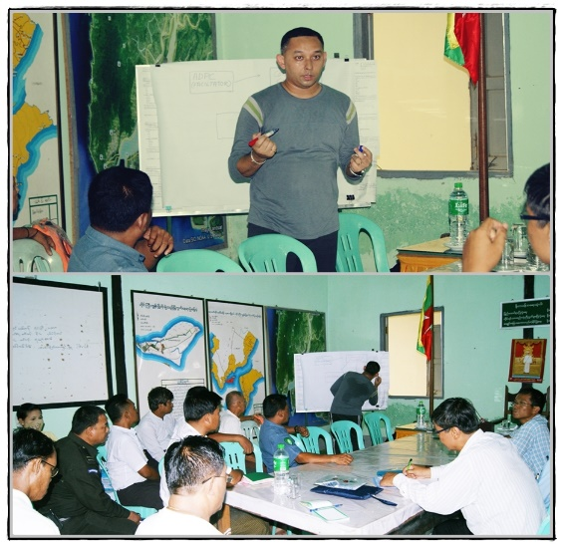
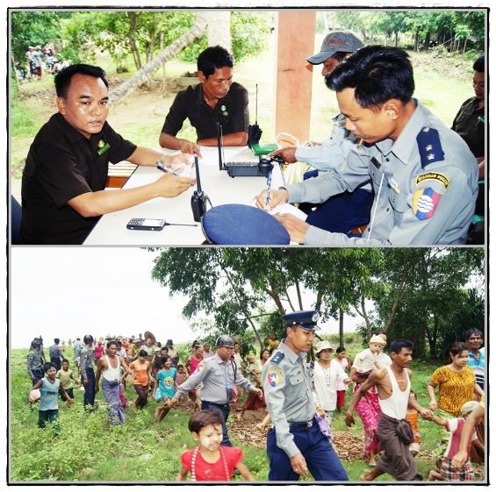
Activities conducted:
Collaboration with State level Meteorological Offices
EWS gap assessment and Social Mapping in Toungoo Township
EWS assessment and Social Mapping in Heingyikyun Township
National workshop on integrating disaster and climate risk information for improved flood hazard early warning system in Myanmar
Simulations and drills for coastal floods in Heingyikyun Township
Simulations and drills for coastal floods in Toungoo Township
Develop detailed risk, resources and evacuation maps

Slide 32



Geospatial Tools for Decision Making in Lower Mekong Countries

Slide 33
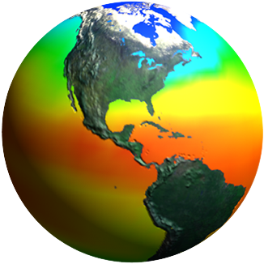
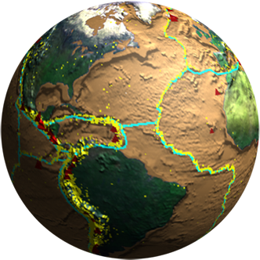



What is SERVIR-Mekong ?
Partnership between USAID and NASA. Utilizes the strengths of each agency.
Establishes long-term regional hubs at ADPC to cooperate to get geo-spatial information and tools into the hands of decision-makers to address development challenges.
Identifies, addresses, resolves data & information challenges and build capacity.
Focuses on climate change and implications for agriculture, biodiversity, disasters, forests, land use, water and weather.

Slide 34
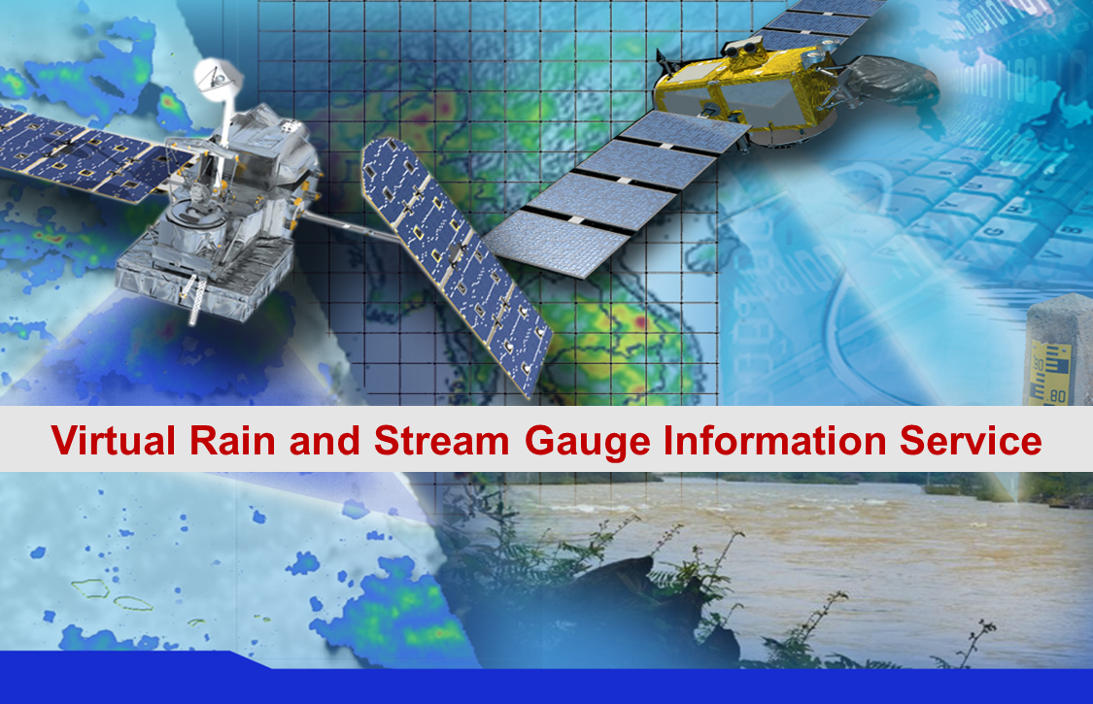
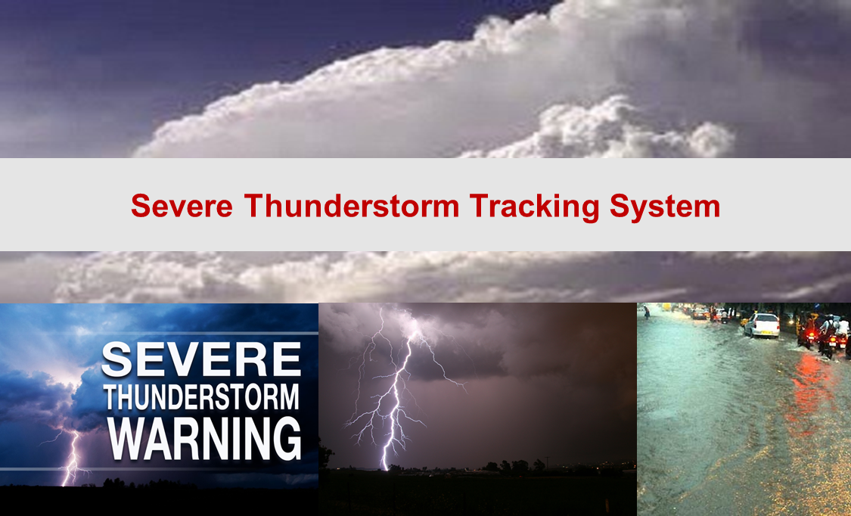
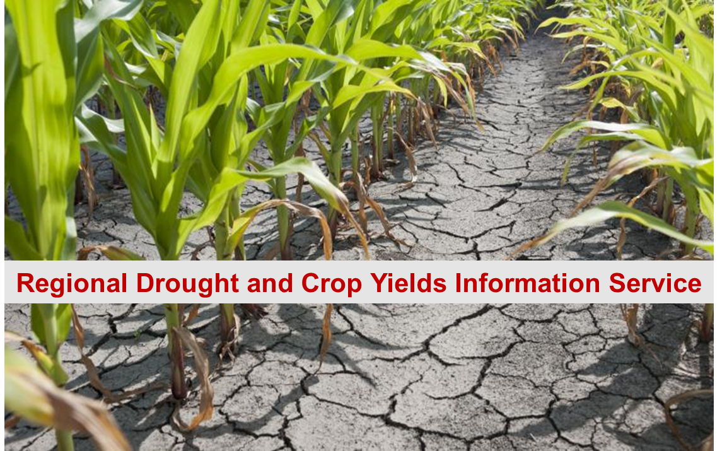
Proposed Collaboration with DMH
Collaborative works to produce the following geospatial tools:
  Virtual Rain and Stream Gauge Information Service
  Severe Thunderstorm Tracking System
  Regional Drought and Crop Yields Information Service
Benefits to DMH
Accessing near-real time high resolution calibrated data streams
Building capacity to create own database and to run algorithms for developing own products
Participating capacity building training workshops
Engaging with NASA experts
State-of-the-art technology transferring

