Slide 1
Olena Hryhorova
Operative weather forecaster
of Ukrainian Hydrometeorological Center
nattfodd04@ukr.net

Slide 2
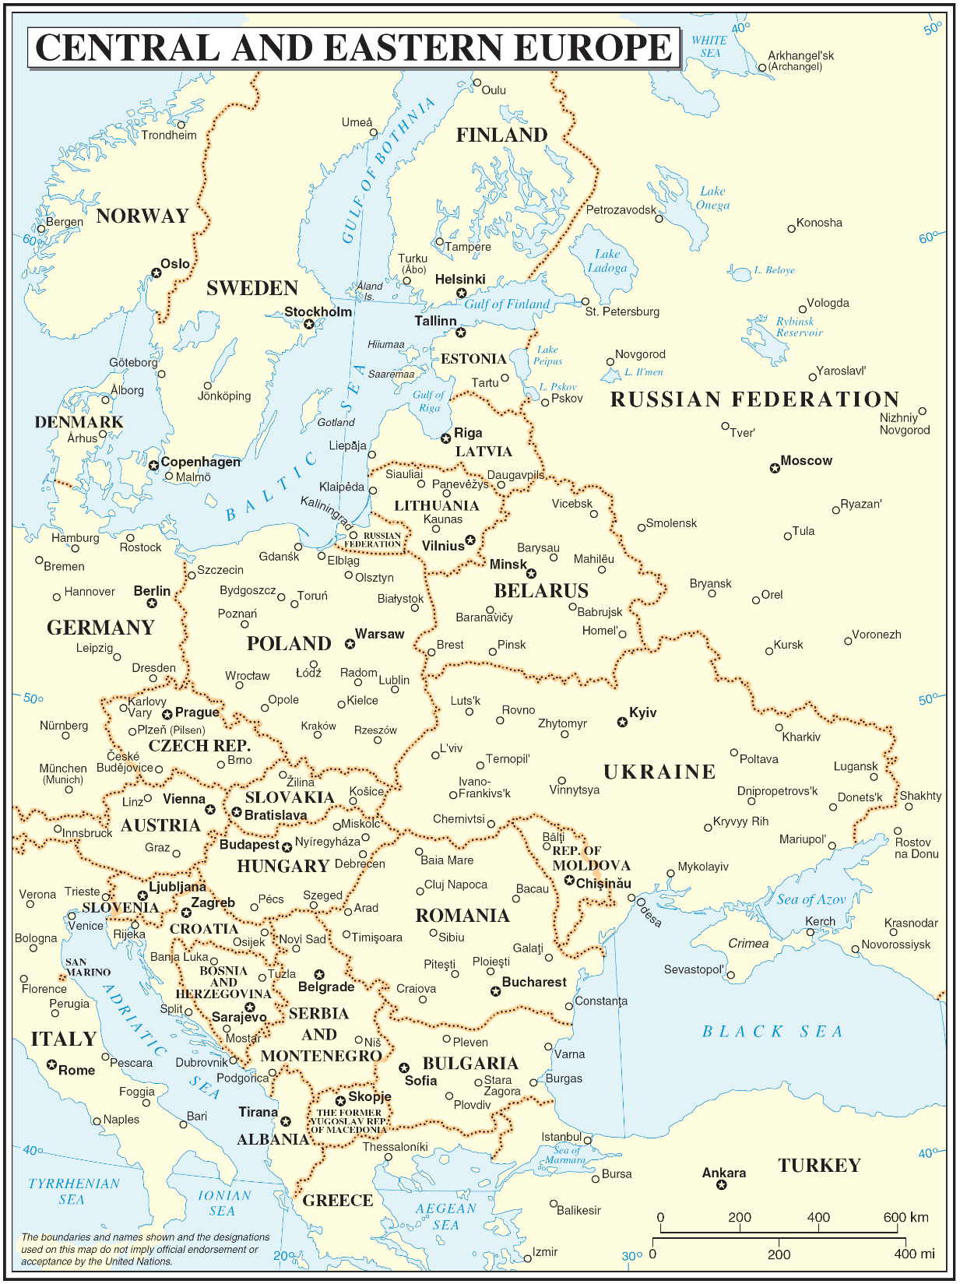
Ukraine is situated in eastern Europe and it borders with Poland, Slovakia, Hungary, Romania and Moldova at west, with Belarus at north and with Russia at east. The population of Ukraine as of 2014 is 44,3 millions. Latest annual Gross Domestic Product (GDP) is $176.6 billion. The part of industry include 30%, agriculture 8%, services 62%. The main industries in Ukraine is metallurgy, engineering, power, chemical and food industry. In Ukraine never been so horrible weather hazards such like tsunami and large scale tornado, but after snowly winters we usually have flooding in Carpathian region. Also worth noting such dangerous phenomenas as freezing, heavy rains and snowfall, extreme cold and heat, hurricanes, hail and squalls.

Slide 3
There are three main met-hydro organization in Ukraine:
Ukrainian Hydrometeorological Center (UkrHMC)
Ukrainian Hydrometeorological Institute (UkrHMI)
Central Geophysical Observatory (CGO)

Slide 4
Ukrainian Hydrometeorological Institute (UkrHMI) | Central Geophysical Observatory (CGO)
scientific base of practice work in UkrHMC | laboratory analysis of atmospheric pollution, state water cadastre, climatic cadastre, meteo and hydro data archive.

Slide 5
Ukrainian Hydrometeorological Center (UkrHMC)
Ukrainian Hydrometeorological Center – government institution in the State Service of Ukraine of Emergencies, which carries meteorological observations on the territory of Ukraine. There are works around 500 staffs. The range of products and services provided include: met/hydro forecasts and storm warning, forecasts and storm warning for Black and Azov seas, warning about chemical and radioactive pollution, agriculture forecasts. Of course, the most useful sectors is meteorological forecasts. If this sector is the most useful – it is the stronger. But, not enough. Also, we need better computers, improve innovations in different areas of our work and more young dedicated staffs. Unfortunately we have dig problem with funding. For example, wary important is modern ways to provide information. Of course, we have web-side, e-mail and communities in social networks, but nowadays it’s not enough. Government don’t want to give funding for providing applications for smartphones and iphones. Our meteorological stations need new equipment and etc.

Slide 6
Expectation from workshop
As workshop has social-economic character, I would start to seriously develop the work in this direction. Getting new knowledge, information and tips can significantly help in introducing innovations in the Ukrainian Hydrometeorological Center work and improve it’s performance. This means - increasing trust of our clients, because for us it is very important that all were satisfied.

Slide 7
Thank you for your attention!
Zagreb, Croatia
29 June – 3 July 2015

