Slide 1
Translating weather forecasts into impact-relevant information:
Practice of impact-based forecast in weather forecast operation
Alice Soares
Scientific Officer
Data-Processing and Forecasting Systems (DPFS) Division
asoares@wmo.int
Curaçao, 10-13 October 2016
WMO; WDS

Slide 2
Background & Introduction
National Meteorological and Hydrological Services (primary responsibility): to provide timely and accurate forecasts and warnings of hydrometeorological hazards and events.
  Governments and Public: to use forecasting and warning information and take effective action.
BUT even good forecasts are not always well used because they do not respond to the requirements of the users (e.g., emergency managers) in way that they can be of real use in decision-making and actions.
Notes:
In general, the primary responsibility of a NMHS (National Meteorological and hydrological services） is to provide timely and accurate forecasts and warnings of hazards and events, governments and public will use forecasting and warning information, and take actions.
However, even good forecasts are not always well used .
Because they are not well responding to the requirement of users, usually, in a way that they can not be of real use in decision-making and actions.

Slide 3

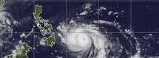
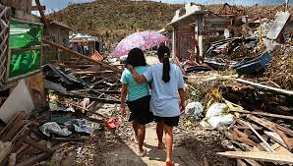
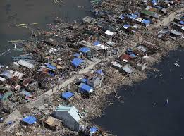
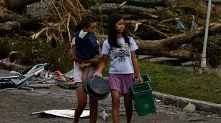
Why do good weather forecasts result in a poor response?
Example 1
Tropical Cyclone Haiyan (Yolanda), which struck the Philippines as a Category 5 storm on November 7 2013, as of 14 January 2014:
6,201 dead, 28,626 injured and 1,785 missing.
More than sixteen million affected and more than US$827 million estimated for the damage of infrastructure and agriculture (NDRRMC 2014).
1. Accurate warnings were issued by the meteorological agency – PAGASA – for heavy rain and winds in time.
2. The government deployed planes and helicopters to the regions most likely to be affected.
Many of the deaths were caused by the storm surge that resulted from the wind, which reached a maximum ten-minute sustained velocity of 275 km per hour.
Accurate warnings issued
Good indication of storm surge
Not enough knowledge of storm surge impacts
Notes:
Here is an example of why good weather forecasts result in a poor response
Tropical cyclone Haiyan of 2013, struck Philippines, a lot damage and enormous lost of life and property
Like Paul’s talk yesterday, there were pretty accurate forecasts for wind and rainfall, also warnings issued, but many of deaths resulted from storm surge caused by high wind. Unfortunately, there was not enough knowledge of storm surge impacts

Slide 4
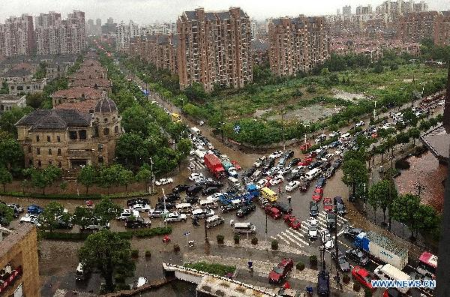




Example 2
Tropical cyclone Fitow: Shanghai, China
Many roads and communities flooded, rivers overflowed, 1.2 million people directly impacted, direct economic loss 890 million RMB (app. US$ 150 million), one death
Good weather forecasts of TC
Highly developed multi hazard warning system
Well prepared emergency management and first responders
Good public communication using multiple channels
Good rules and regulations for warnings and response
Good standard operating procedures
Over 18 million people alerted
  But, gridlock and many people exposed to the hazard; flooded cars, buses, etc. 1,240,000 people directly affected
The actions recommended to take are usually quite general and do not provide specific guidance for a particular circumstance.
The forecaster does not usually consider the vulnerability and exposure of the population to the hazard.
The highest level of warning was not issued until well into the morning rush hour when the appropriate meteorological thresholds were exceeded.
Notes:
Here is another example, tropical cyclone, Fitow which effected Shanghai, last year
Shanghai Meteorological Service is arguably one of the most advanced meter service in the world.
There was good forecast for TC
Highly developed multi hazards warning system
Well prepared emergency management and first responders
Good public communication using multiple channels
Good rules and regulations for warnings and response
Good standard operating procedures
Over 18 million people alerted
But, gridlock occurred and many people exposed to the hazard; flooded cars, buses, etc. 1,24 million people directly affected
WHY
The actions recommended to take are usually quite general and do not provide specific guidance for a particular circumstance.
The forecaster does not usually consider the vulnerability and exposure of the population to the hazard.
The highest level of warning was not issued until well into the morning rush hour when the appropriate meteorological thresholds were exceeded
causes

Slide 5
An accurate and timely warning does not guarantee safety of life or prevent major economic disruption

Slide 6
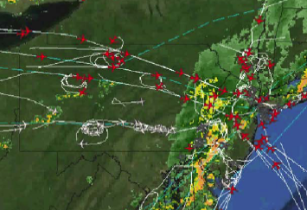
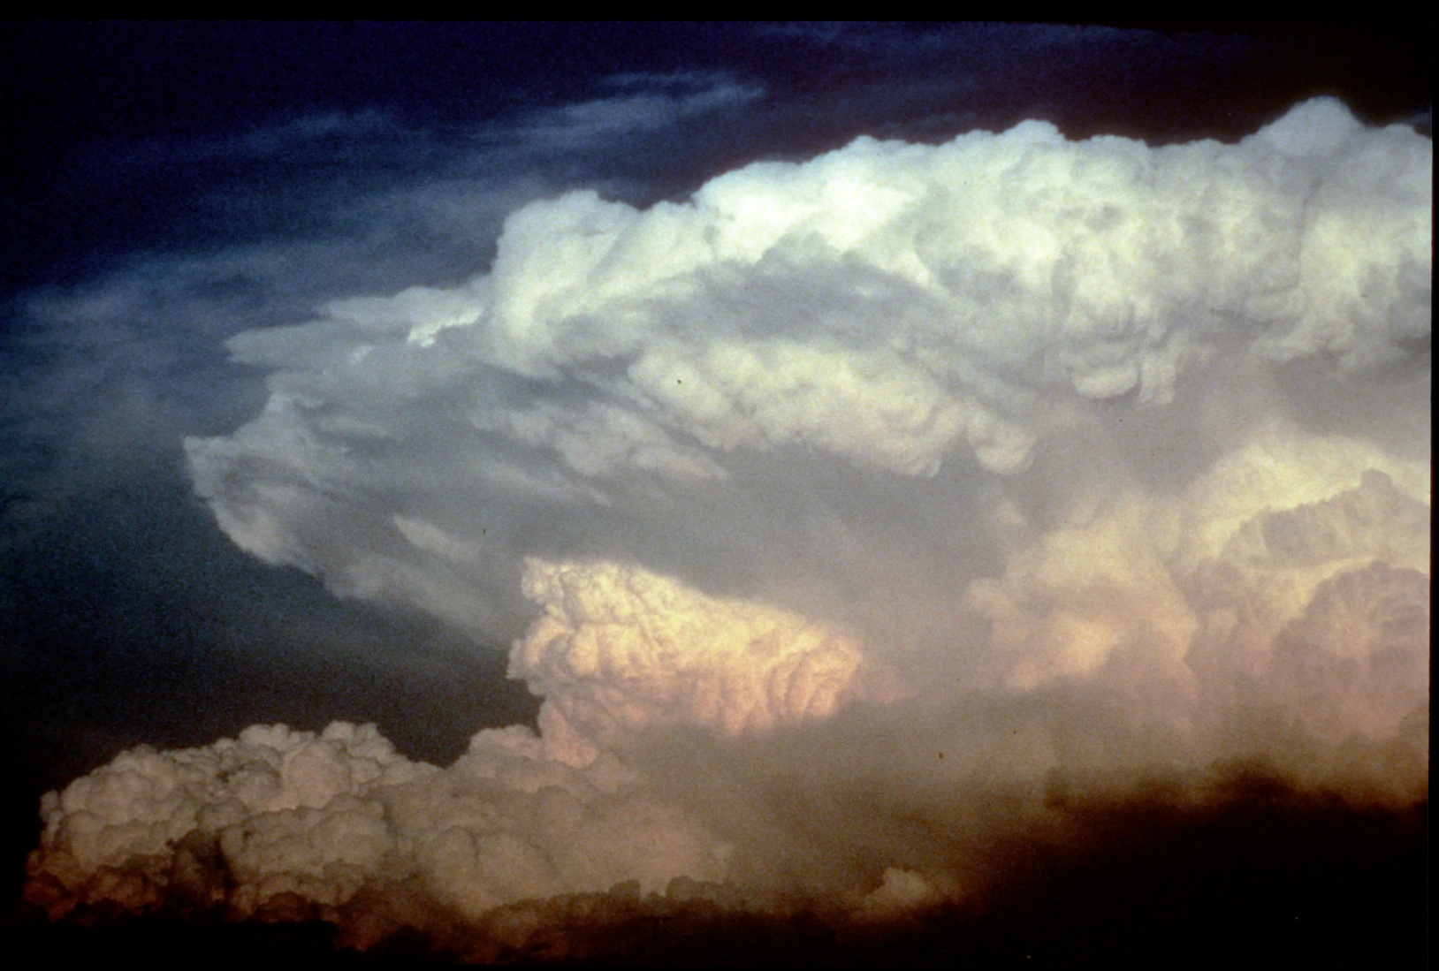

Impact of Weather Forecasts
high
It’s about sensitivity of a user or sector
to aspects of weather, assessment of risks,
& readiness to cope with weather impacts!
Air Traffic Manager:
How many airplanes
can airport handle?
Risk of delays &
diversions
Consequences of Bad Decision
medium
Public User:
Do I take umbrella
today – yes/no?
Risk of getting
soaked
CAUTION: It’s not just about weather,
there are many other factors that
influence a user’s decision!
low
low
medium
high
Degree of User Requirements & Sophistication
Notes:
Broad range of weather information users, with various degrees of sensitivity to weather, requirements regarding space & time scales, what weather aspects matter, forecast lead time need to be able to respond, etc.
Even for similar users, readiness to cope with impacts vary significantly (e.g., 1 inch of snow for DIA is no big deal but would be shutting airport down for ATL)
Other factors that affect aviation may be runway construction, president flying into that location, etc.

Slide 7
Operation Shifts needed
Phenomenon-Based Forecasts
Impact-Based Forecasts
Products-Based Services
Decision Support Services
Meteorological Threshold-Based Warning
Impact Threshold-Based Warning (Risk based warning)
Deterministic (best forecast)
Probabilistic (uncertainty range)
underway
Notes:
So , we need some operation shifts：
That is,
Phenomenon-based forecast to impacted-based forecast
Product-based service to decision support services
Meteorological threshold based warning to impact threshold based warning or risk-based warning
Currently, in the operational community, more and more probabilistic forecasts products are generated,
There is a transition from deterministic (best guess) to probabilistic forecasts (ensemble forecast) taking place.
This provides a good opportunity to generate impact-related information by using ensemble forecasts.

Slide 8
Users want to know – as precisely and as early as possible – the future course of the weather
Our main goal is to fulfill this task as best as we can…
…but we will never be perfect!
The knowledge about shortcomings / uncertainties can be of great value
To know what you know and to know what you do not know, that is real knowledge, Confucius (The Analects)
The communication of uncertainties can mitigate negative impacts…
…but only if users know how to incorporate this information!
A big gap between potential and actual value of forecast information, and an even bigger gap between potential and actual value of uncertainty information

Slide 9
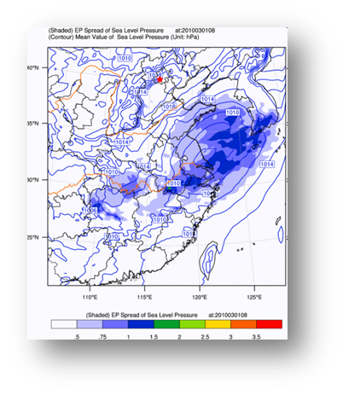
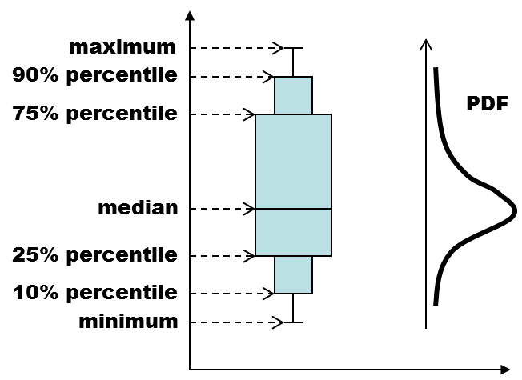
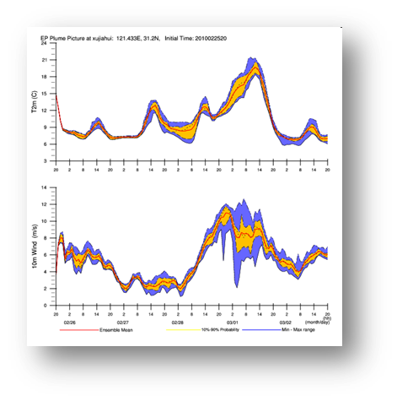
Translating weather forecasts (ensemble forecast) into impact-relevant information
We live in an uncertain world, and uncertainty information is extremely important for decision making.
The growth of inevitable uncertainties and errors in making forecast is flow-dependent because of the atmosphere being a nonlinear dynamical system. Ensemble Prediction Systems (EPSs) have been developed to estimate such ‘flow-dependent’ forecast uncertainty.
The real values of ensemble prediction are not only the probability forecasts per se, but also their ability to influence decisions across a range of applications sectors.
The economic value of ensemble forecasts as a tool for risk assessment: From days to decades，By T. N. Palmer of European Centre for Medium-Range Weather Forecasts, UK, Q. J. R. Meteorol. Soc. (2002), 128, pp. 747–774
Notes:
The Ensemble forecast systems have been developed to estimate so-called flow-dependent forecast uncertainty.

Slide 10
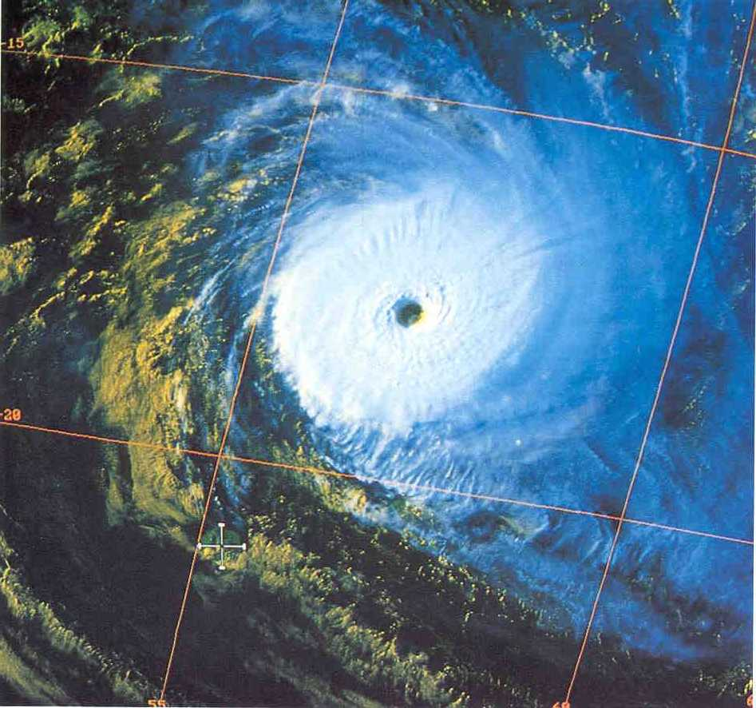
Small Islands: « All or Nothing » syndrome
Réunion

Slide 11
Small Islands: « All or Nothing » syndrome
« ALL »
i.e. catastrophic conditions
Réunion

Slide 12
Small Islands: « All or Nothing » syndrome
20°
With a velocity of 10 kt (18,5 km/h),
Inflexion of 20° in the trajectory,
corresponds to a delay of 24h,
a distance of 158 km…
158 km
Réunion

Slide 13
Small Islands: « All or Nothing » syndrome
« NOTHING »
… or nearly nothing
(minimal consequences)
Réunion

Slide 14
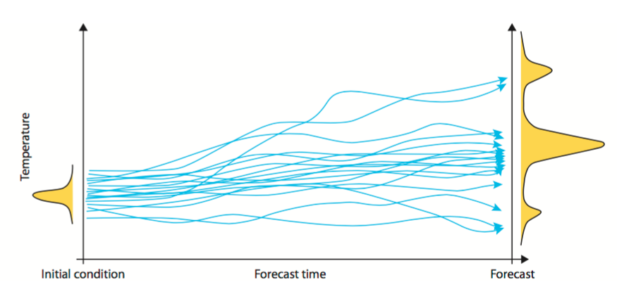
Ensemble forecasts:

Slide 15
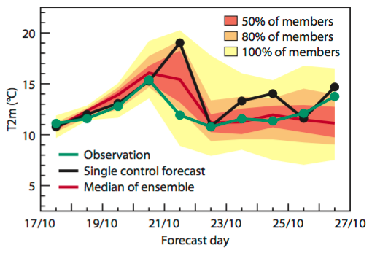
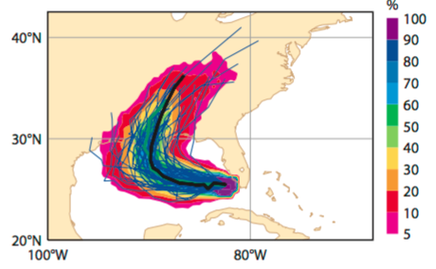
Ensemble forecasts:

Slide 16
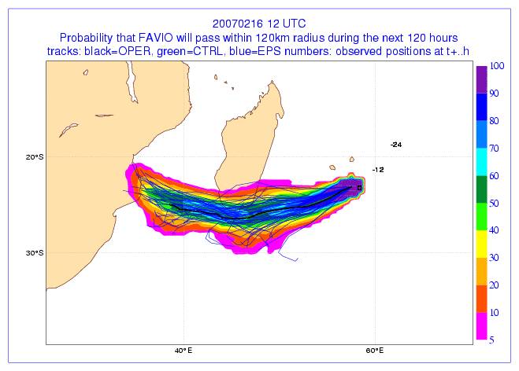
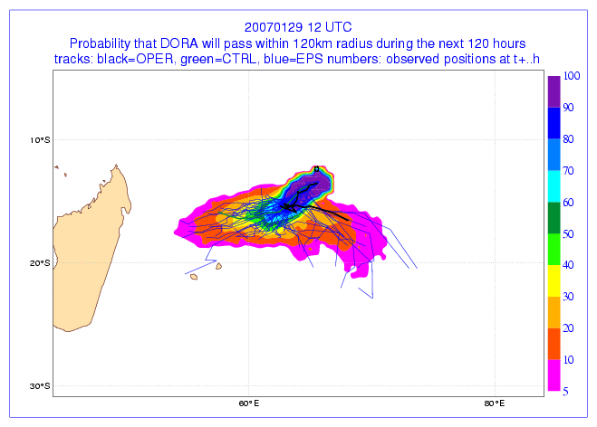
Ensemble forecasts: Useful to estimate uncertainty
EPS are useful and used
  In the weather system forecast / evolution
  Confirm the information provided by the RSMC
  Propagate into impact-related forecasts: waves, storm surges
  Communicate uncertainty to user community
Probability of TDS crosses within 120 km
from Fort Dauphin
In the next 120h is about 60 to 70%.

Slide 17
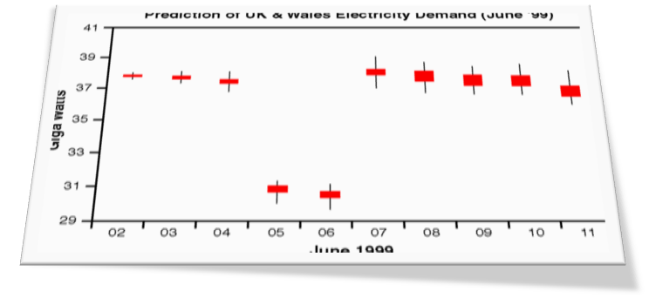
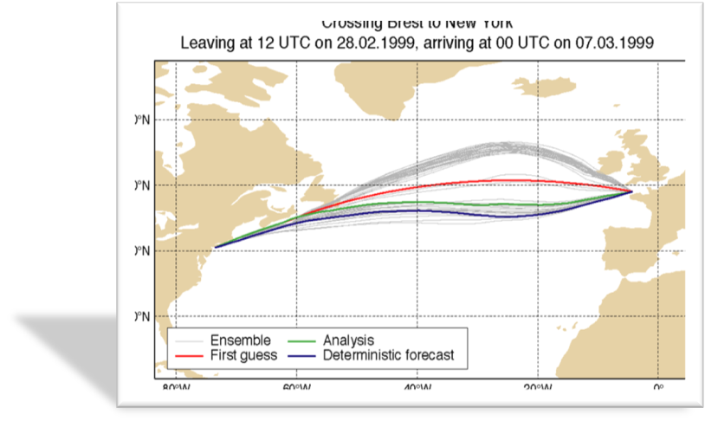
End-to End Outcome Forecasting
An EPS forecast can be used to drive an ensemble of outcome models, e.g.:
  Tidal surge
  Ocean waves
  Wind power output
  Energy demand
  Hydrology – flood risk
  Ship or aircraft routes
  Public Health
Notes:
Using ensemble forecast to drive other models

Slide 18
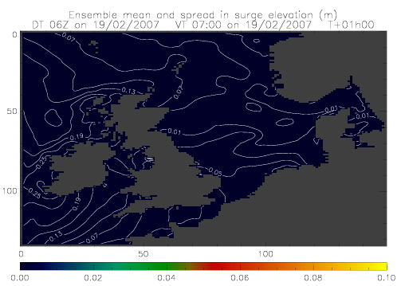

Storm surge Ensemble
Storm surge model coupled to EPS
Mean/spread of surge
Probability of surge >1m
Notes:
These plots are from UK met office, it is storm surge ensemble driven by Ensemble forecast, left is mean & spread of surge, and right is the probability of surge larger than 1m.

Slide 19
Aviation Example
Translation
Meteorology way
User (aviation) way
Most likely, hazard occurs
Most likely, 2 air lines open
Curtesy of Dr. Matthias Steiner of NCAR
Notes:
There are different ways to look at the ensemble forecast, This is an example.
Three ensembles give different location of hazards, in a meteorological way, we look at where, most likely, hazard occurred
in user’s way, each ensemble can have 2 flight lines open, so most likely, two lines open.
So question is how to translate meteorological way to user’s way

Slide 20
Weather Translation & Integration Concept
Weather Information
Weather Translation
Impact Estimation
Response Scenarios
Weather analysis
& forecast data
Extraction of relevant information
Placing into situational context
Mitigation strategies
Weather-impacted user
Weather Information provider
Some examples:
Airport operation | Ceiling & visibility (flight categories) | Reduced capacity (arrival rates) | Ground delay programs
Dam operation | Precipitation & runoff (water level) | Overflow or breaking, minimal discharge | Controlled release of water
Power plant operation | Winds below/above critical thresholds | Reduced power generation | Balancing grid with other power sources
Curtesy of Dr. Matthias Steiner of NCAR
Notes:
This shows a schematic plot of weather translation & integration concept proposed by Dr. Steiner.
First of all, you have weather information such as analysis and ensemble forecast data
Then extract relevant information from each ensemble (for example, ceiling & visibility for airport operation,
Precipitation and runoff for Dam operation, winds below/above critical thresholds for power plant operation )
Third, put the relevant information into situational context to estimate impact (for example reduced fight arrival capacity in terms of percentage),
Last, carry out mitigation strategies based on estimated impact information (e.g., ground delay programs etc.)
During whole process, as indicated by these two triangles, the impact of weather information provider becomes smaller and smaller, and the one of user becomes larger and larger, but the most of part is a jointed effort of both forecasters and users.

Slide 21
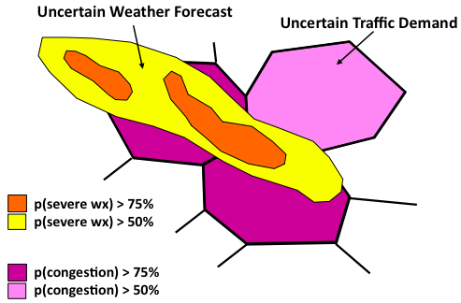
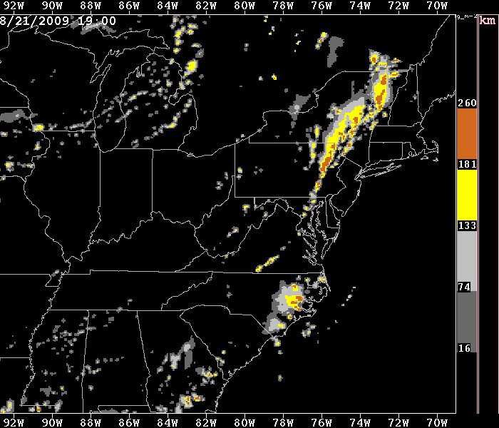
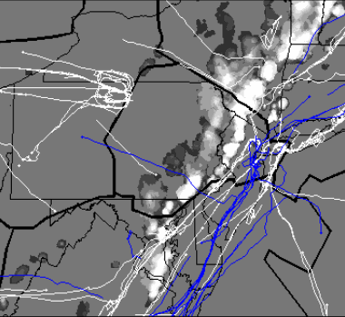
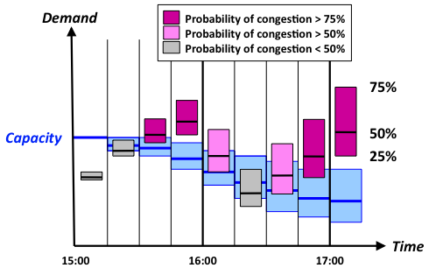
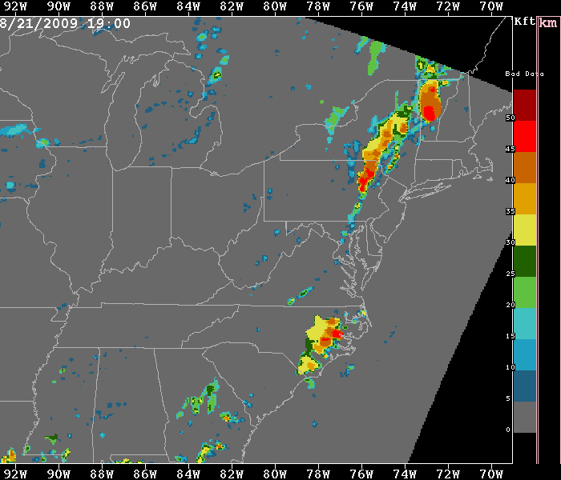
Sector: Air Traffic Management
Weather
Information
Weather
Translation
Impact
Estimation
Response
Scenarios
Weather analyses
& forecast data
Extraction of
relevant information
Placing into
situational context
Mitigation strategies
Strategic traffic flow
management initiatives
& tactical programs
Aviation constraints
or threshold events
Storm intensity
& echo tops
Sector capacity &
workload impact
Notes:
The following sides show some examples of translating weather information for some users or sectors

Slide 22
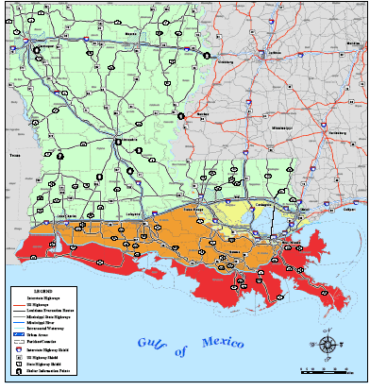
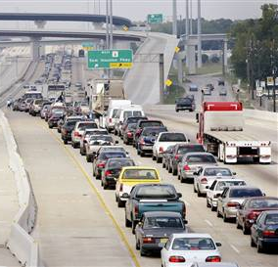
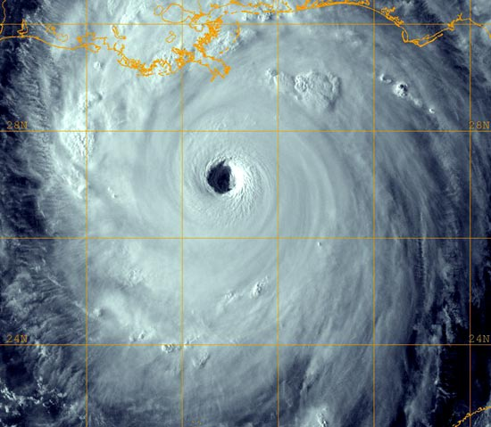
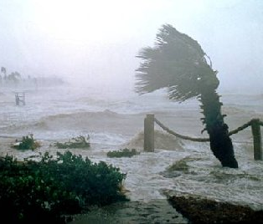
Coping with Hurricanes/Typhoons
Weather
Information
Weather
Translation
Impact
Estimation
Response
Scenarios
Weather analyses
& forecast data
Extraction of
relevant information
Placing into
situational context
Mitigation strategies
Affected population
& infrastructure,
disruption of services,
damages due to wind
& water, etc.
Hurricane track,
size, & intensity
Storm surge, flooding,
inundated areas
Implementation of
evacuation &
recovery plans

Slide 23


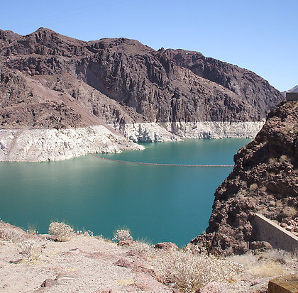
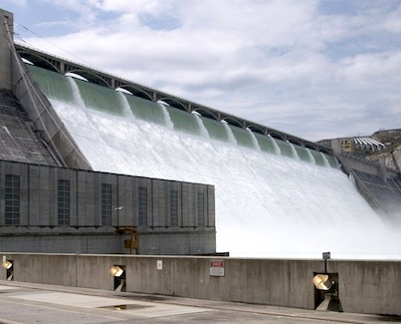

Water Resources Management
Weather
Information
Weather
Translation
Impact
Estimation
Response
Scenarios
Weather analyses
& forecast data
Extraction of
relevant information
Placing into
situational context
Mitigation strategies
Rainfall (or lack thereof)
Runoff & flow into
reservoir, water
levels behind dam
Controlled release of water
& timing thereof
Dam overflow, water
rights, or minimal
streamflow for fish

Slide 24
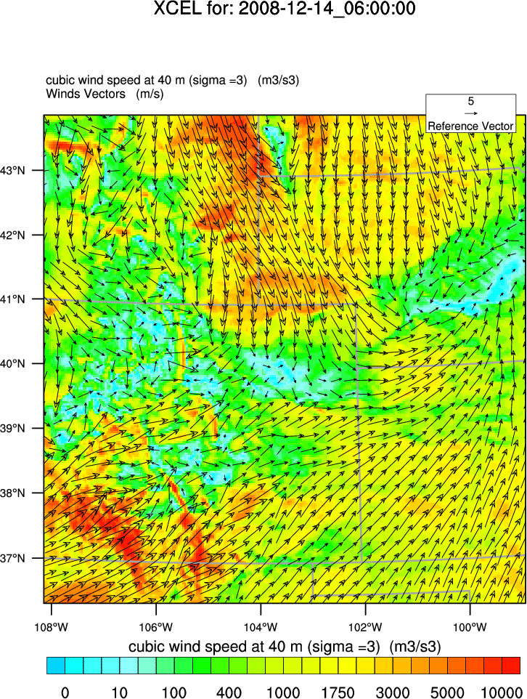


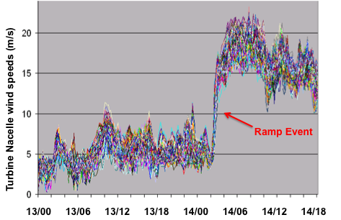
Wind Energy
Weather
Information
Weather
Translation
Impact
Estimation
Response
Scenarios
Weather analyses
& forecast data
Extraction of
relevant information
Placing into
situational context
Mitigation strategies
Wind at hub height,
min/max thresholds,
& ramp events
Energy generated
by entire windfarms
Balancing power grid using
different energy sources
Wind & variability

Slide 25
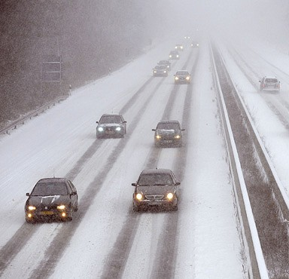
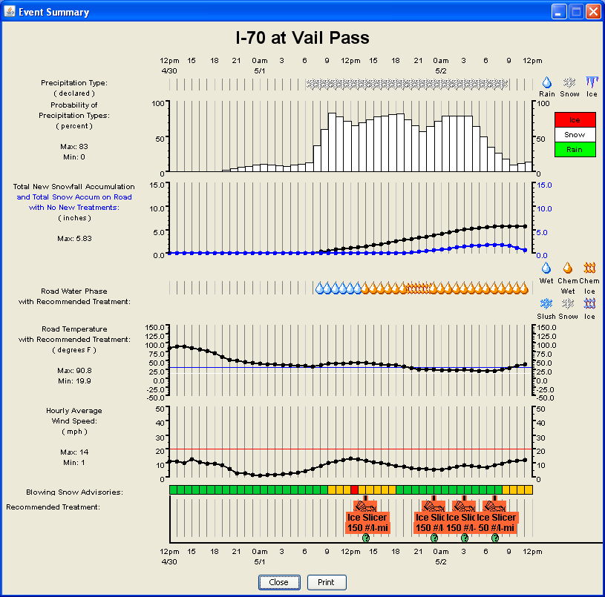


Winter Road Maintenance
Weather
Information
Weather
Translation
Impact
Estimation
Response
Scenarios
Weather analyses
& forecast data
Extraction of
relevant information
Placing into
situational context
Mitigation strategies
Temperature, relative
humidity, wind
& precipitation
Snow accumulation
along road based on
pavement temperature
Road mobility &
traffic demand
Timing of snow plows &
application of chemicals

Slide 26


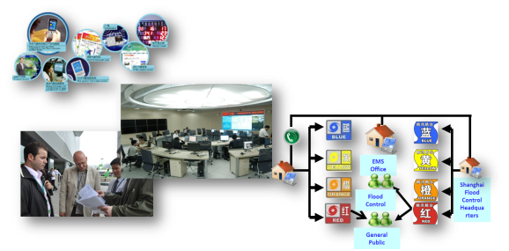
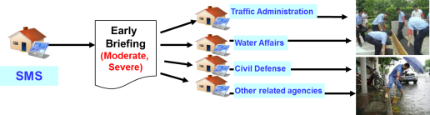
MHEWS within Shanghai Meteorological Service
Observations & NWP
Multi-Hazard Detection & Monitor
Forecasting Information Product (e.g. NWP)
Weather Information
Integrated Operational Platform
Impact information generating
Hazard Risk Analysis and Assessment
Translation &
Impact estimation
Weather Service Platform
Impact & Risk based warning
Issuing (users based situational context)
Response Scenarios
Multi-agency Coordination Mechanism
Response mechanism and decision-making support

Slide 27
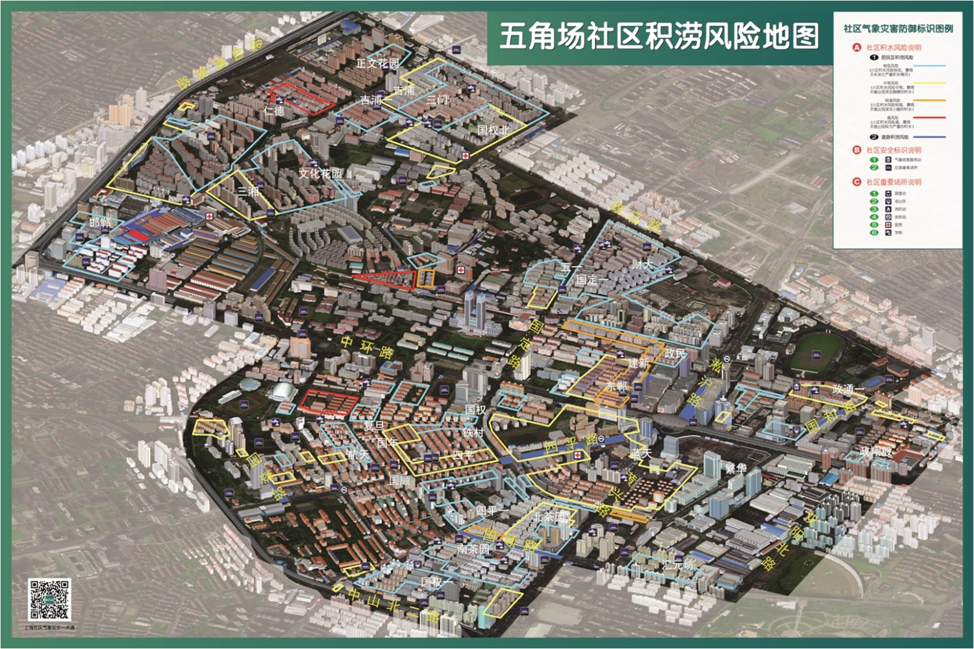
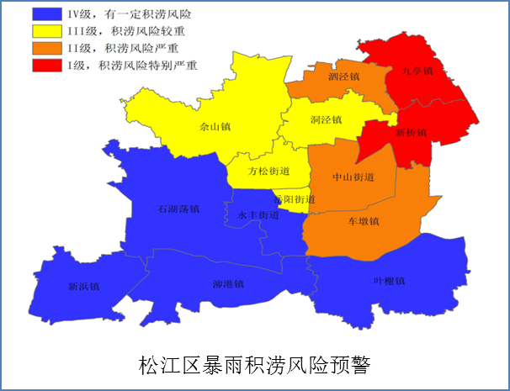
Framework of IBF&RBW for Urban Flooding
Rainfall Forecasting
Radar QPF/QPF
Rapid Refresh
HR ensemble
Observation
0-1h forecast
Every 6-min
1-12h forecast
Every 1h
12-120h forecast
Every 3h
Accumulated rainfall every 1 h
Real-time，future rainfall
Field survey of disaster and verification
Impact-based Forecasting
Urban flooding assessment Model
Community flooding risk database（residential area、roads、schools etc.）
Location or area、intensity and duration
Risk Assessment
Community flooding risk database
Risk-based Warning
Risk-based Warning Product
Flooding Risk Warning
Manual Adjustment
Multi Hazard Monitoring and Risk Warning System
Cellular
WenChat
Terminal
Large Screen
Joint Response
Joint Response
措施预防
防汛抢险
灾后救助

Slide 28
Concluding Remarks
understanding of information needs, but also communicating capabilities & limitations
Gaining as much as possible knowledge of vulnerability and exposure （often not easily accessible by meteorologists）
translation of weather into user-relevant information (extraction of relevant information from each ensemble member)
integration of weather into user’s decision making process (impact estimation & response scenarios utilizing decision support tools)
calibration of probabilities & including some measure of confidence
training for understanding & utilizing (probabilistic) forecasts
close collaboration between weather forecast providers & end users / decision makers
development of trust in translated forecasts & decision support tools
embracing change & possibly adjusting operational procedures
more ……

Slide 29
Thank You
Alice Soares
asoares@wmo.int

