Slide 1
Impact-based forecast and warning services - Tools
Alice Soares
Scientific Officer
Data-Processing and Forecasting Systems (DPFS) Division
asoares@wmo.int
Malé, Maldives, 26-28 September 2016
WMO; WDS

Slide 2
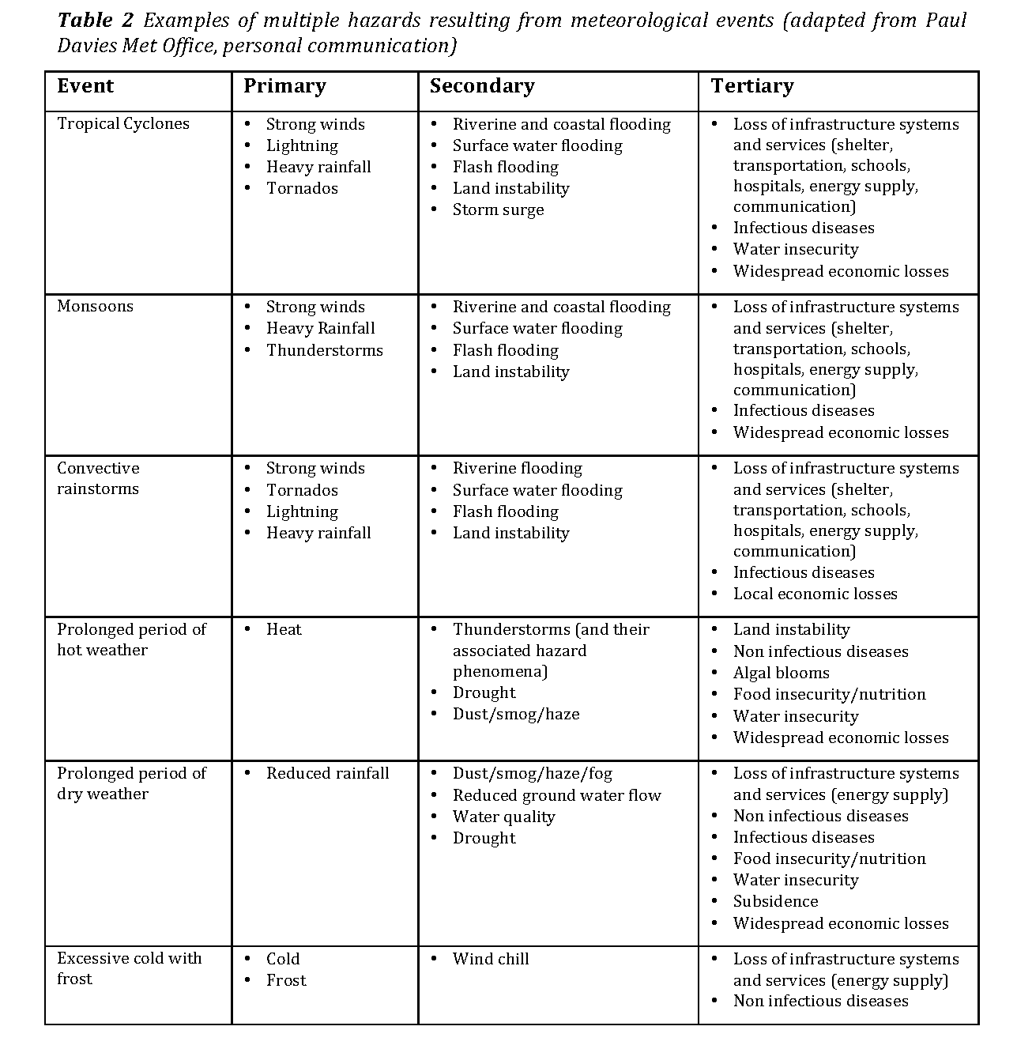
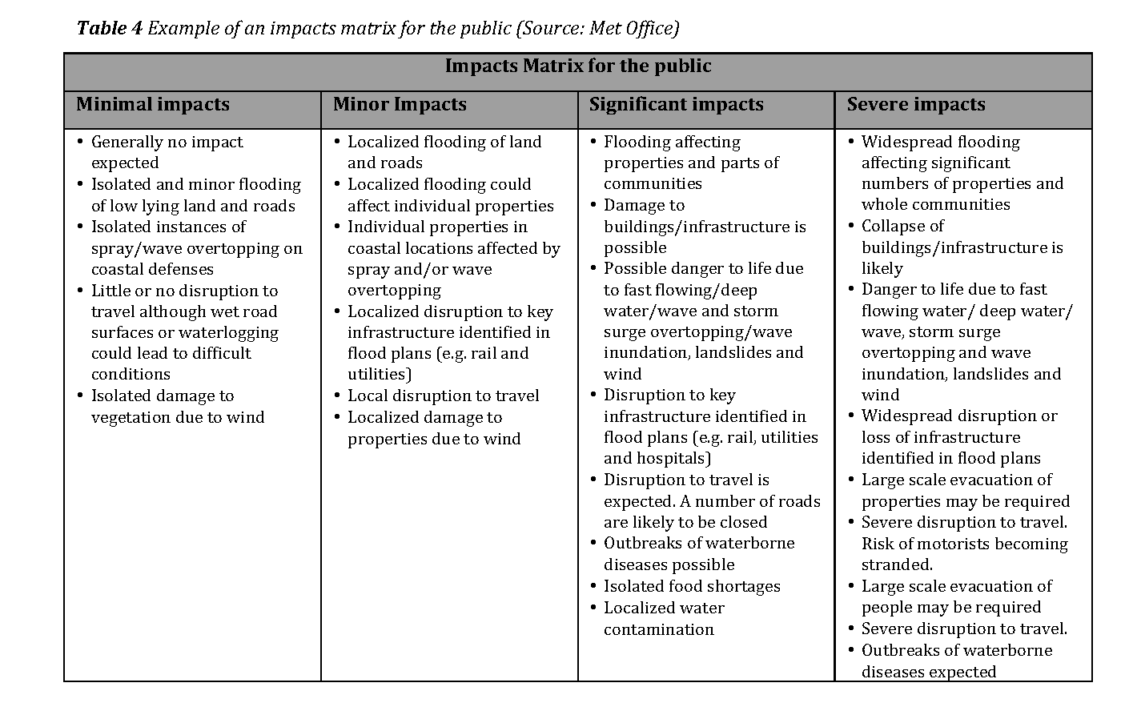
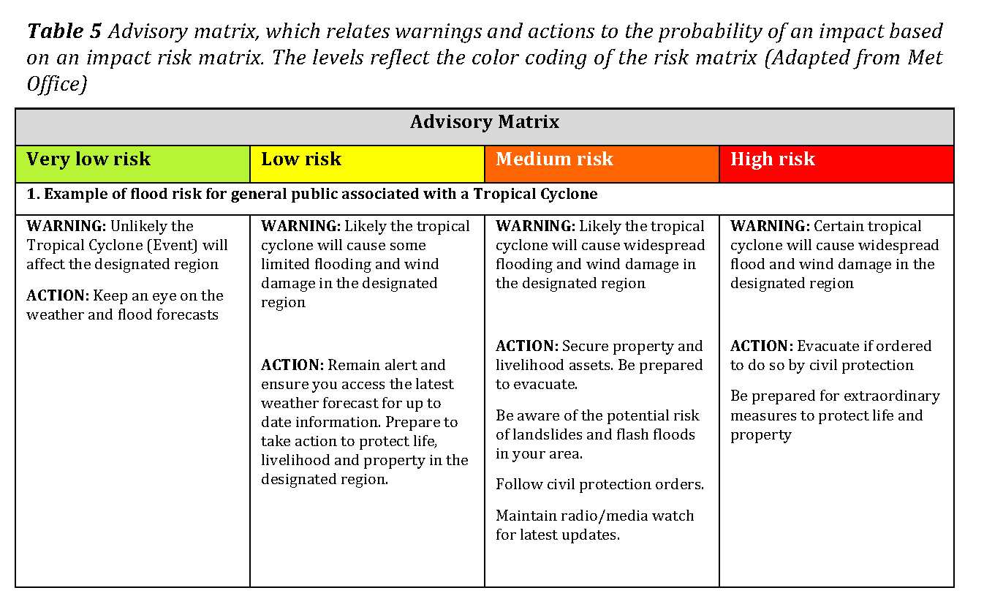
Hazard matrix
Impact matrix
Risk
matrix
Advisory matrix

Slide 3
REQUIREMENTS
Accurate and timely forecasts of the primary and secondary meteorological and or hydrological hazards
Accurate and timely forecasts of the tertiary hazards
Assessments of the vulnerability and exposure of population and assets
Understanding of the causal relationships among hazards, vulnerability and exposure to forecast the impact on people and assets
Provide early warning of the risk of hazard impacts
Want to be able to perform risk analysis for:
Scenarios to identify potential threats and to reduce vulnerability and or exposure prior to the realization of the threat
Real-time forecasting and warning system
Open source and open data

Slide 4
OPEN SOURCE AND OPEN DATA
Cost: No barrier to entry and no barrier to scale up
Capacity Building: More opportunities for capacity building
Collaboration: Opportunities to collaborate on free and open source technologies: shared investments
Customization: easily adapted to country requirements

Slide 5
Examples of open source tools
    Geonode – a web-based tool to store geospatial information
    OpenStreetMap – community of mappers – the way to build maps of vulnerable and exposed assets and people
    InaSAFE – used to build impact scenarios and can be adapted to generate warnings
    QGis – open source geospatial information system for visualizing data

Slide 6
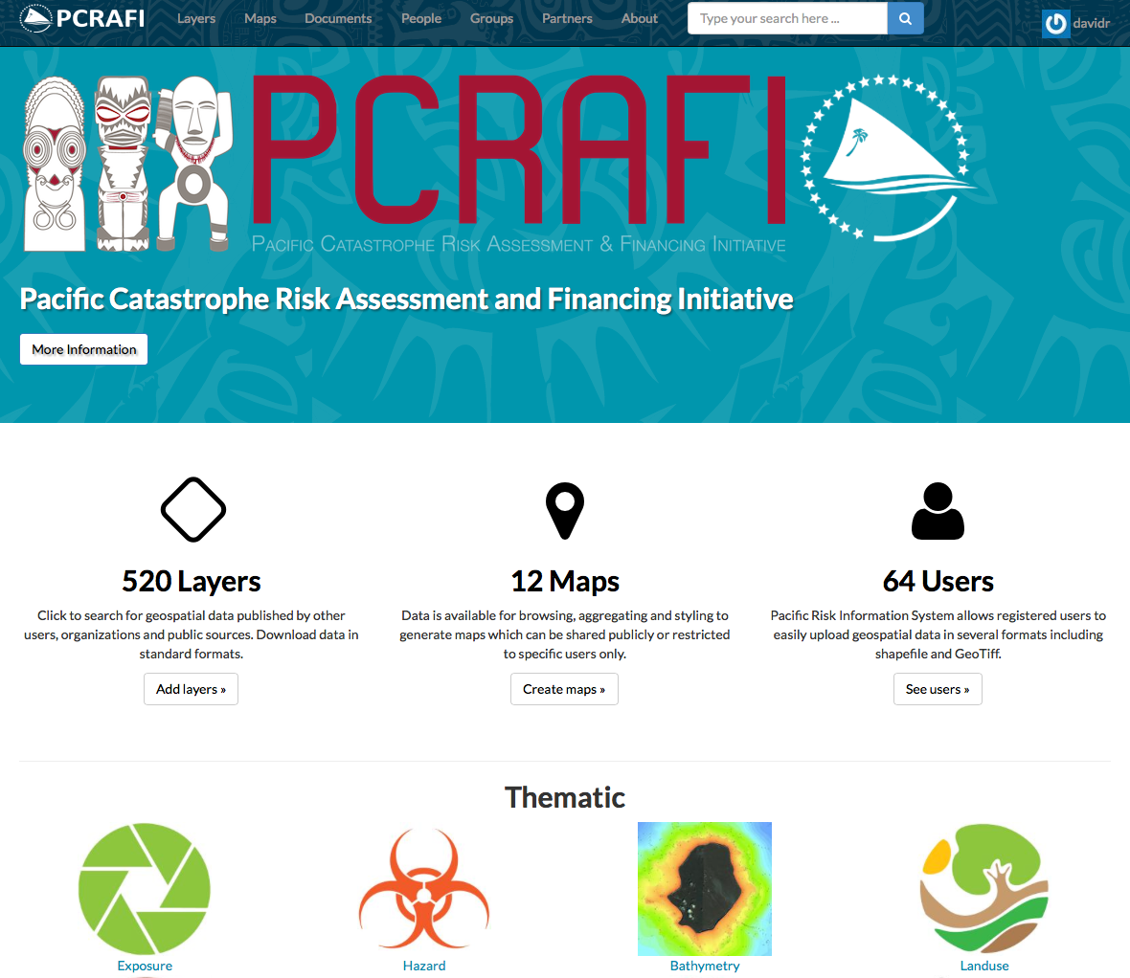
GEONODE – online geospatial data
Free and Open Source
User and Developer Community
Support
Simple online tools to:
        Search for data in catalogue
        Collaborate and share data
        Manage users and rights
        Manage metadata
        Standard compliant

Slide 7
OpenStreetMap
Access to detailed data
Open source tools for mapping
Common platform for uploading and hosting data with open access
Active global community of users
Training resources

Slide 8
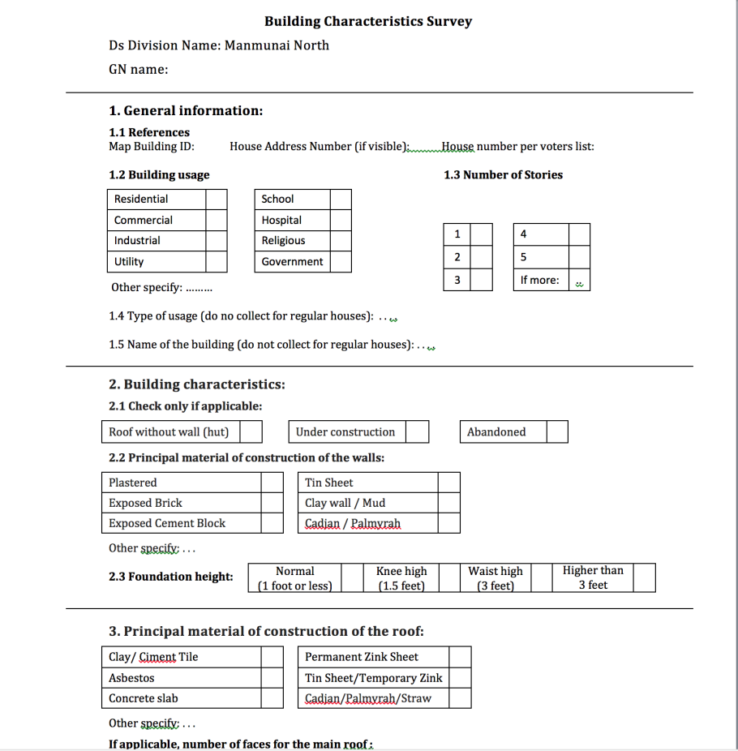
OpenStreetMap – Buildings and Roads layer

Slide 9
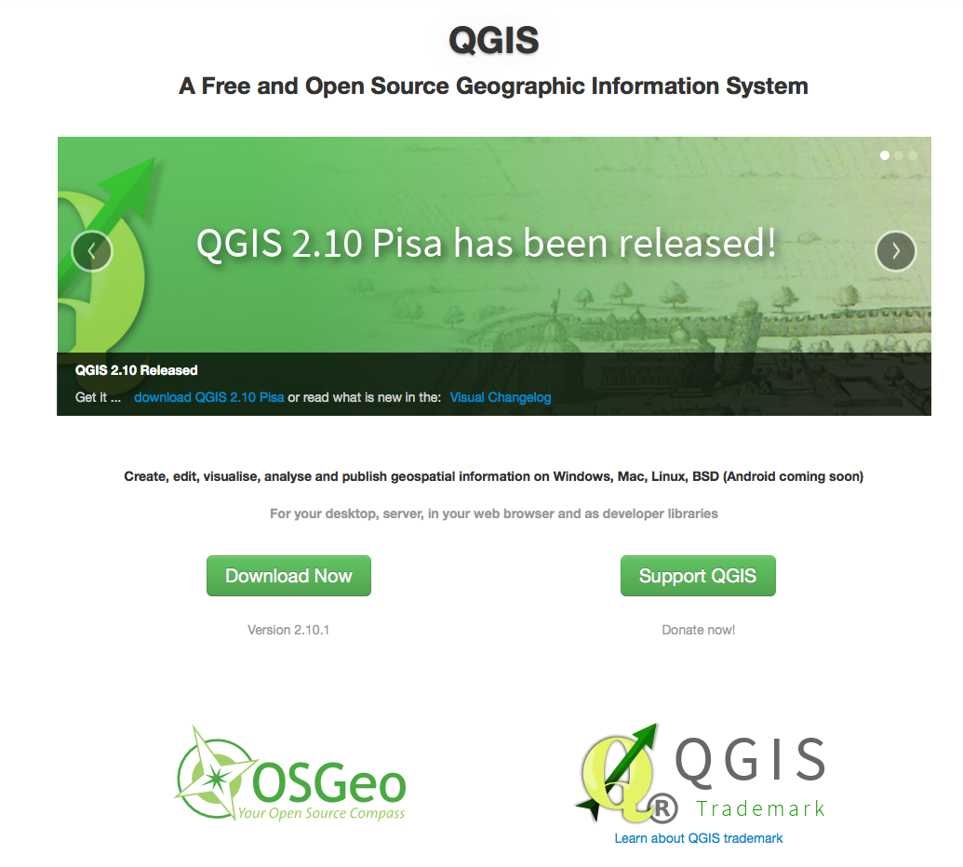
QGis
Open source geographical information system used to visualize information
Myanmar Information Management Unit

Slide 10
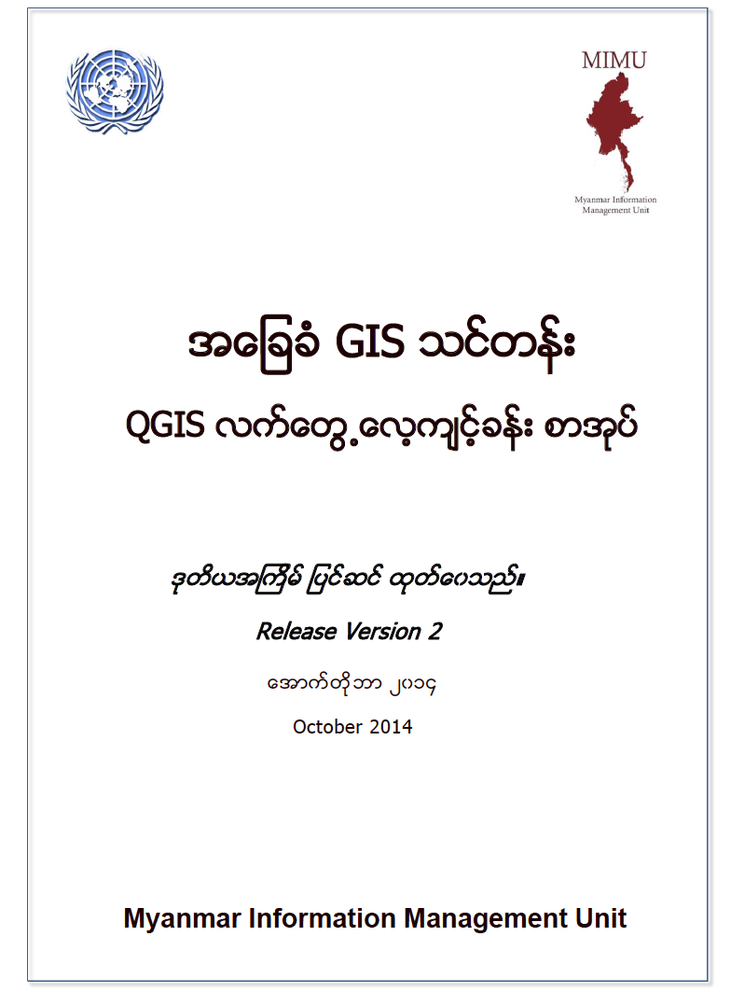
Notes:
MIMU is supported by Canada, EU and Switzerland through UN country office

Slide 11

InaSAFE (Indonesian Scenario Assessment For Emergencies)
Using Data to Inform Decisions
Makes it easier to generate realistic disaster scenarios for contingency planning
Makes it easier to generate hazard impact forecasts and warnings

Slide 12
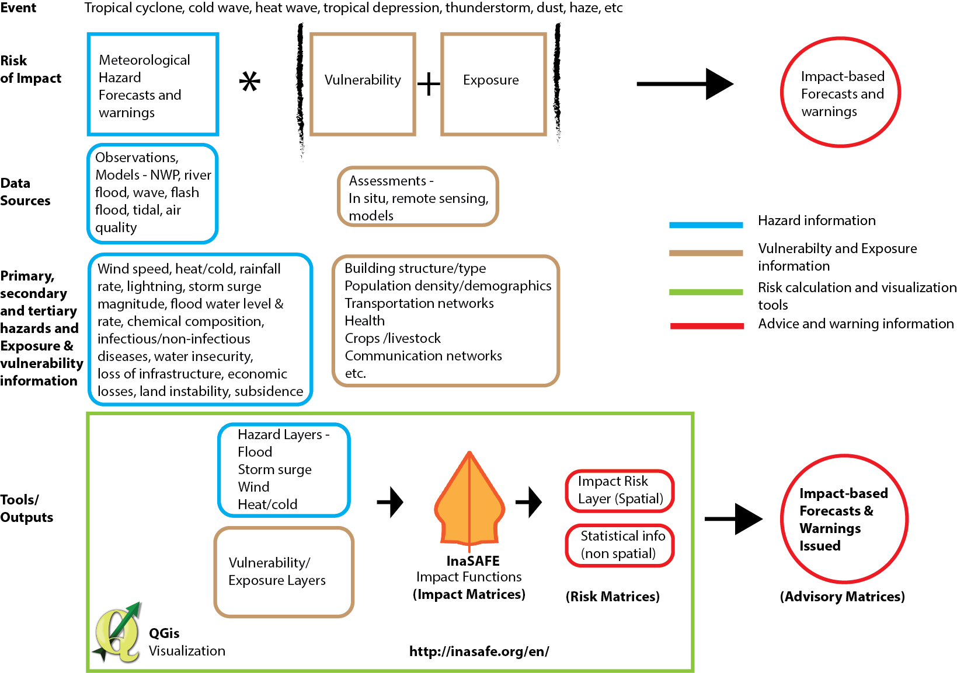

Slide 13
Thank You
Alice Soares
asoares@wmo.int

