Slide 1
SWFDP-Bay of Bengal: Regional Training- Workshop (Colombo, Sri Lanka, 6-8 December 2018) {Public Weather Services (PWS): Bhutan}
Sonam Tashi (Mr)
Weather Forecaster
Weather & Climate Services Division
National Centre for Hydrology & Meteorology
Email: sonamtashi@nchm.gov.bt

Slide 2
Outline
Weather warning dissemination
Challenges
Gaps
Conclusion

Slide 3
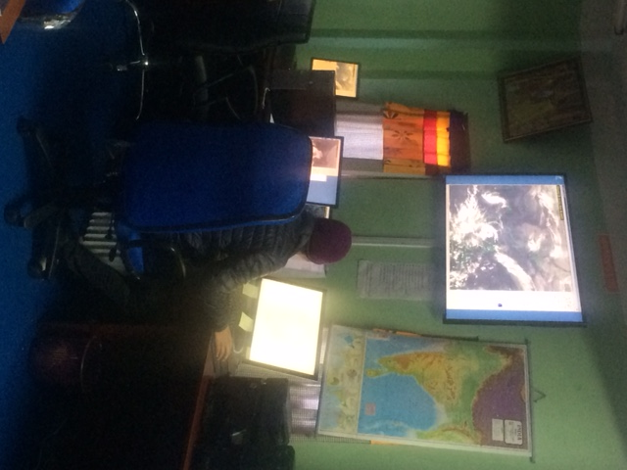
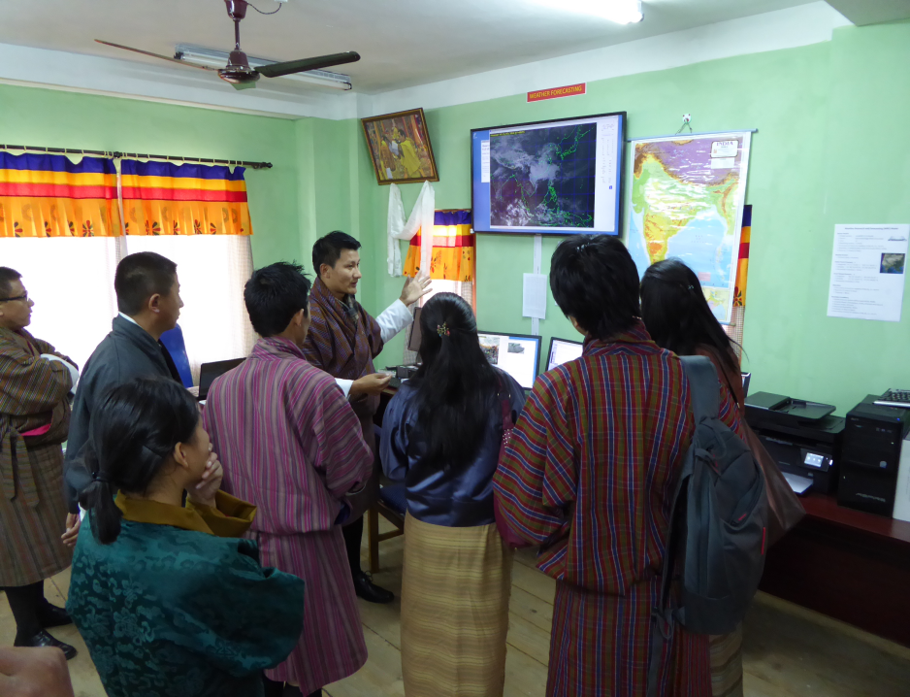
GTS and weather monitoring 24x7
Global Telecommunication System (GTS); share data to New Delhi and Bangkok (Backup) 00 &12
Weather (daily and extreme events) is monitored round the clock (24x7).
One shift have to do 8 hours and prepare weather report to PMO, HM and to media (Print media, television and others).

Slide 4
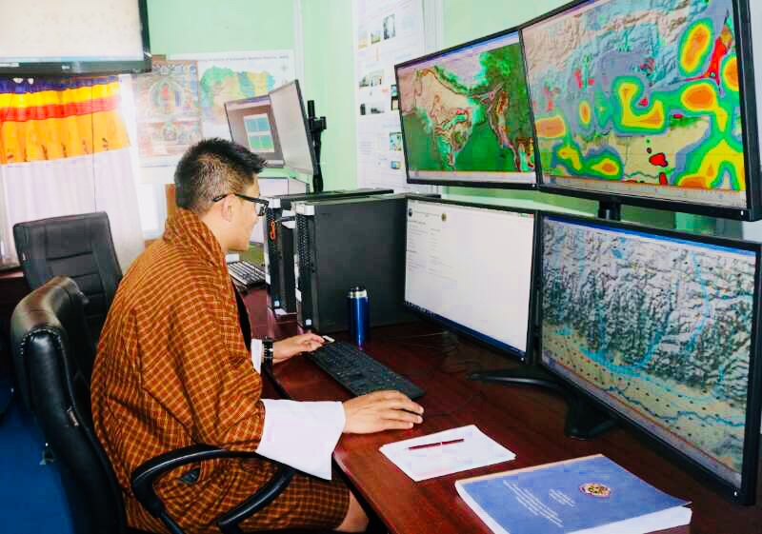
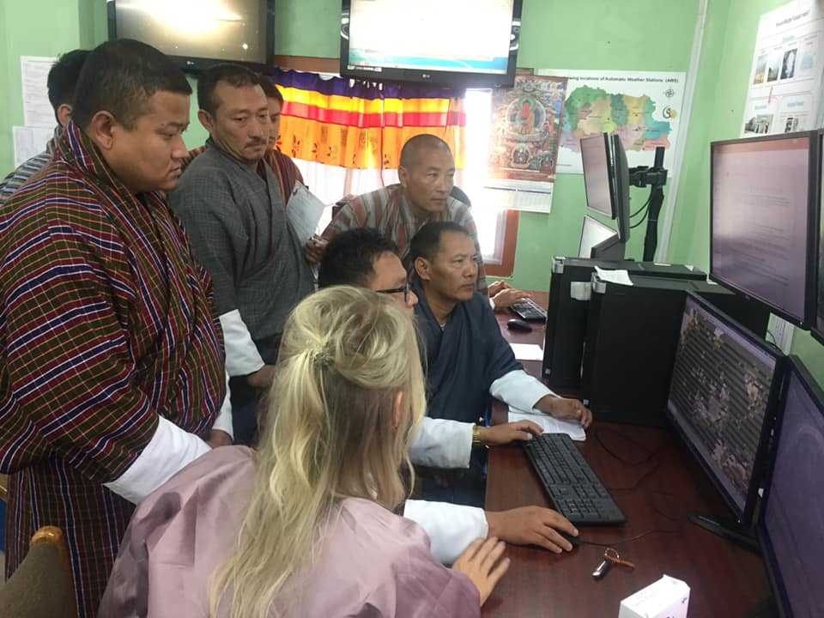
Types of warnings
Extreme warnings issue by NCHM:
Heavy rainfall
Heavy snowfall
Wind storm (Still problem in Bhutan)
Cyclone impacts…
Others…
Seasonal outlook
Monsoon outlook (June, July and August)

Slide 5
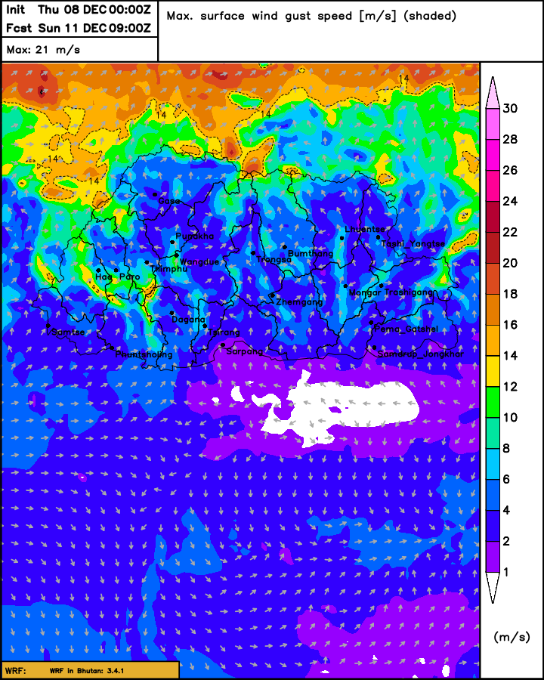
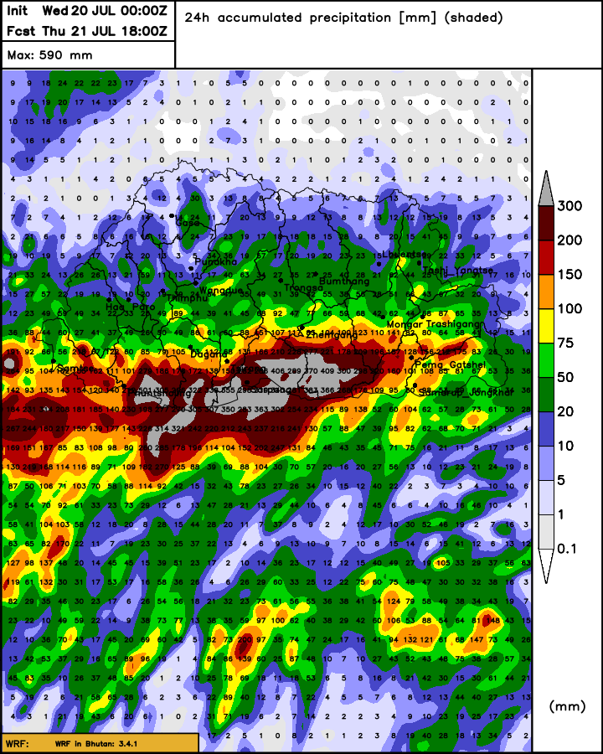
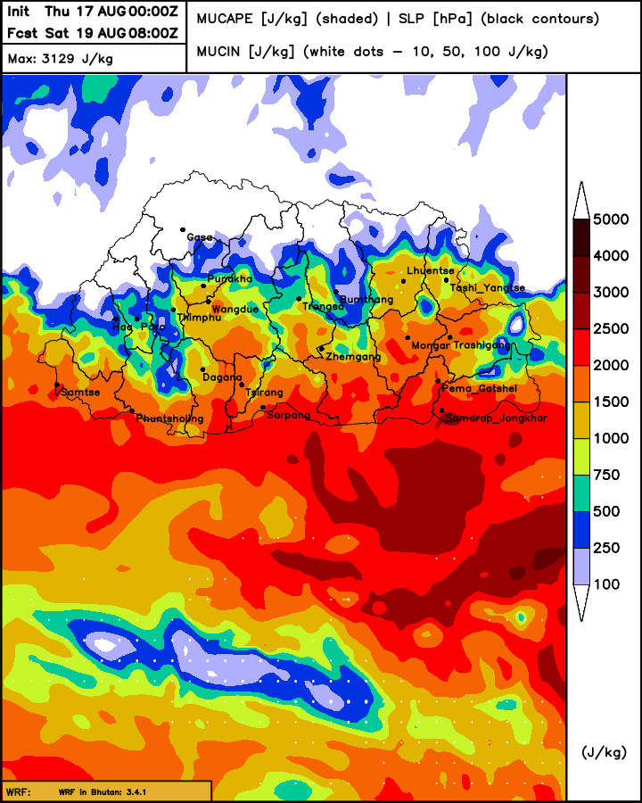
Based on WRF/NWP Model output

Slide 6
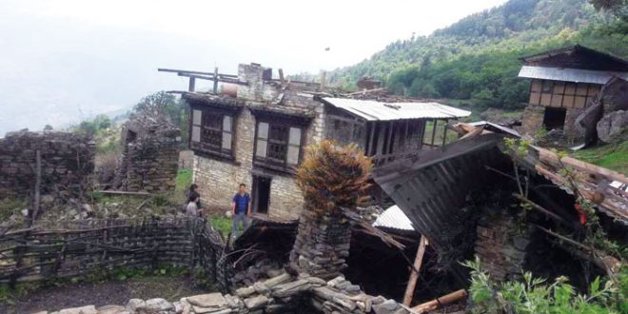
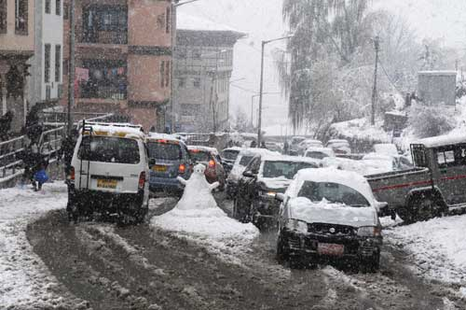
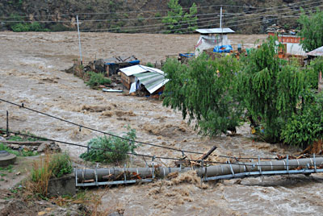
Example of disasters: Bhutan

Slide 7
Weather warning communication:DDM
1. NCHM Disaster Management 20 dzongkhags local level
2. NCHM Media/TV (Normal condition)
PMO and others
3. Extreme: Discuss (Forecasters)
Forecasting Head
Chief WCSD
Director/Action

Slide 8
Extreme weather warnings
We issue extreme weather warning through different mode of communication such as Facebook, website, mobile and press release to different media houses (Print media, radio and television).

Slide 9
Current challenges: Accuracy of forecast

Slide 10
Public media: TV and Newspapers
Scientific words related to weather and climate are miscommunicated to general public/end users…
Reporters and anchors/newscasters are not familiar to weather and climate related terminology
General public miss-understood about forecast and extreme weather warnings

Slide 11
Challenges: Believe/trust in forecast
DDM and implementation agencies have less confident in our forecast
They ask weather forecast updates after event happening only
People started believing in our weather forecast and warnings now but not 100%

Slide 12
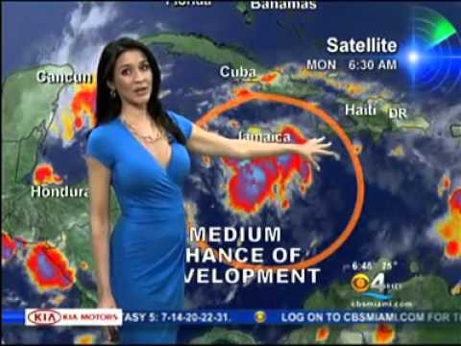
Gaps: Expert weather presenter in NCHM
People can better understand about weather forecasting better (Time scales)
Prepare day to day plans according to weather forecast-NCHM
Lack of proper training in PWS (Little improved after attending PWS course by friends…

Slide 13
Conclusion
Currently, we issue extreme weather warnings
Difficult in understand weather/Climate terminology-Simplification
Extreme weather warning- Press release through different media
Lack of experts, weathercaster and studio in NCHM
Broadcast television: 06.00-10.00 PM and Re-Broadcast only
Lack of weather and climate knowledge among peoples
Dedicated trained media focal person in NCHM, Bhutan
Proper training and improved in technological facilities- Weather accuracy increasing

Slide 14
THANK YOU......
To be interested in the changing seasons is a happier state of mind than to be hopelessly in love with spring. ~George Santayana

