Slide 1
Training Workshop on the Assessment of Social and Economic Benefits of Meteorological and Hydrological Services for Members of SADC 4th – 8th May 2015
Seychelles Meteorological Services

Slide 2
Met Office representatives
Chantale Bijoux:
Meteorologist and in charge of Public Weather Services Unit.
E-mail address: c.bijoux@meteo.gov.sc
- - - - - - - - - - - - - - - - - - - - - - - -- - - - - - - - - - - - - - - - - - - - - - - - - - - - - - - - -- - - - -
Francois Albert:
Meteorologist and in charge of Early Warning Unit
E-mail address: f.albert@meteo.gov.sc
- - - - - - - - - - - - - - - - - - - - - - - - - - - - - - - - - - - - - - - - - - - - - - - - - - - - - - - - - - - - -
Marcel Belmont
Senior Meteorological Technician in charge of Data Management
E-mail address: m.belmont@meteo.gov.sc

Slide 3
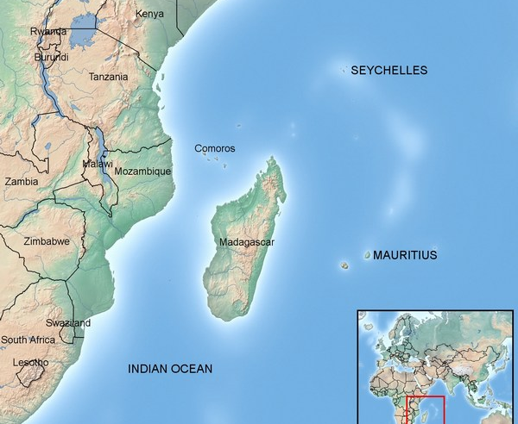
Location of Mahe
Mahe the main island in the Seychelles group is located at 4°. 40 South by 55°.31 East .

Slide 4
Some facts on the Seychelles
Population: 91650 (July estimate)
Latest annual GDP: $25,000
Composition of GDP:-(Agriculture:2%, Industry:18.7%, Serrvices:79.4%)
Main Industries: Fishing, Tourism and Beverages
Main climate: Tropical Marine, very humid. The cooler season is during the South East monsoon (May to October) and the warmer season is during the North West monsoon (November to April)
Annual Average: Max Temperature: 30.0°C
Annual Average: Min Temperature: 24.7°C
Annual Average Ordinary Temperature: 27.1°C
* Weather related hazards: Tropical Storms/Cyclones, Flooding, Landslides, Strong Winds and Drought.

Slide 5
Background on the Met Services Organization
The Seychelles National Meteorological Services falls under the division of Climate Affairs, Adaptation Information Services within the Ministry of Environment and Energy.
The SNMS provides weather and climate services for the safety and well-being of the community.
Number of Staff: 30
Annual Budget: SCR 4 million

Slide 6
Background on the Met Services Organization (continued...)
Range of products and services provided and main sectors that use them: Forecasts (Seasonal, Marine, Area, Aviation, Data)
Estimated costs
(a) Observing systems: To be discussed
(b) Forecasting: “ “ “
(c) Climatology: “ “ “
* (d) Tech support: “ “ “
* (c) Admin: “ “ “
* (d) Others: “ “ “

Slide 7
Background on the Met Services Organization (continued...)
Main sectors that use the products: Aviation, Fisheries, Insurance, Tourism, Private sector, Contractors, Educational Institutions
One sector where our organization is strong: Aviation and Seasonal Forecasts
* One sector where our organization is weak: Agriculture and Marine due to lack of human capacity.

Slide 8
Background on the Met Services Organization (continued...)
Significant funding gaps or new products/services you are seeking funding to development: New equipment and software in order to better the forecasts
*Main funding sources for operations and capital equipment (e.g. have you received support from donors or MDBs to purchase capital?) : Under projects but not on a regular basis

Slide 9
Background on the Met Services Organization (continued...)
Expectations from Workshop
From the knowledge gained in the workshop we will be able to relate our different services and products to our available resources.

Slide 10
Estimate of climate related damages (total amount in USD and/or percentage of GDP)
We do not have copies of other climate related damages for other years but we obtained a copy for that of 2013 caused by tropical cyclone ‘Felleng’ in 2013. The estimated cost amounted to 8.4 million dollars.

