Slide 1
Training organized by WMO and SWFDP-BoB)on Regional Training Workshop on Severe Weather and Impact Forecasting and Warning Services (Colombo, Sri Lanka, 6-8 December 2018)
Weather forecasting and warning Dissemination, Challenges and Gaps
by
Hussain Waheed
Maldives Meteorological Service
06 December 2018

Slide 2
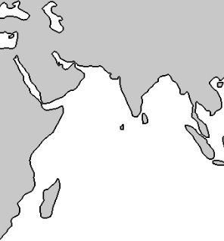
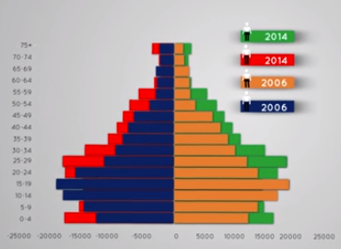
Maldives
Maldives consists of about 1,192 small, low-lying coral islands.
The population of the Maldives, according to the 2014 census is 338,434 people.
National Bureau of Statistics
Notes:
Maldives extends from the Latitude of 7° 6’ 35” N to 0° 42’ 24” S and longitude of 72° 32’ 19 E to 73° 46’ 13” E.
Maldives consists of about 1,192 small, low-lying coral islands which are grouped into 26 natural atolls.
The population is distributed in 194 islands.

Slide 3
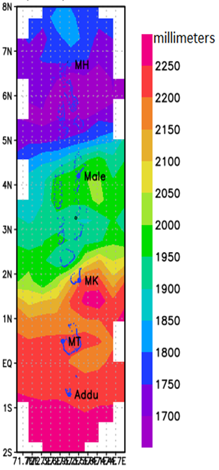
Maldives Climate
The southwest monsoon (wet-season) normally extends from mid-May to November.
The northeast monsoon (dry-season) extends from January to March.
The month of December and April are considered as the monsoon transitional periods.
Notes:
Graph: Total Annual rainfall (mm) distribution over Maldives.
Maldives experiences warm and humid climate throughout the year.

Slide 4
Meteorological and hydrological Hazards in Maldives
Heavy rain
Flood
Thunderstorms
Gust Winds
Tidal Waves
Swell Waves
Funnel Cloud (Water Spout and Tornado)
Tropical Cyclones

Slide 5
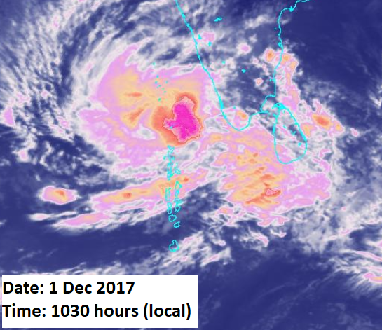
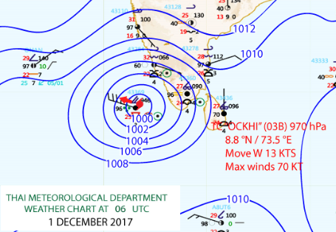
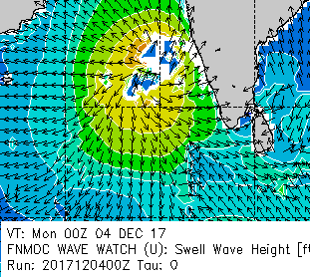
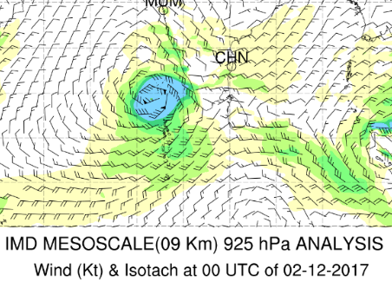
Tropical cyclone “Ockhi”
Notes:
Tropical cyclone Ockhi ( 29 Nov – 2 Dec 2017)
Depression had formed over southwest Bay of Bengal off Srilanka Coast on 29th of November.
The depression moved towards northwest and got intensified into a Deep Depression over the Comorin area on the 30th of November.
On the same day, the system had further intensified into a tropical cyclone and named “Ockhi”.
It had entered into Southeast Arabian Sea and continued to move west north westerly direction.
It had further intensified into a very sever cyclonic storm on 1st of December where it had moved to the Lakshadweep Area, parallel to Maldives longitude on the same day.
The system was close to the Maldives about 221 km north of Haa Alifu Thuraakunu.
When the system moved closer to the Maldives, torrential rain and strong winds were experienced over the widespread area in central and northern part of the country.

Slide 6
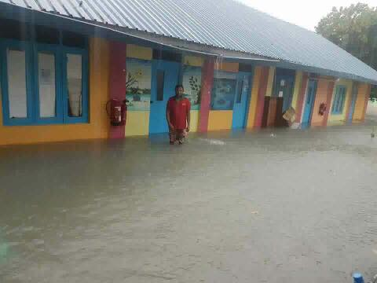
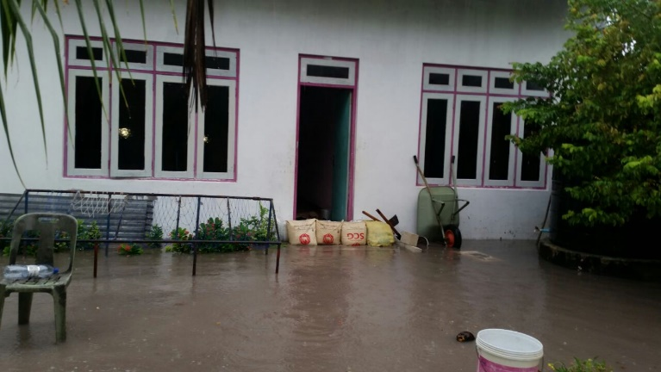
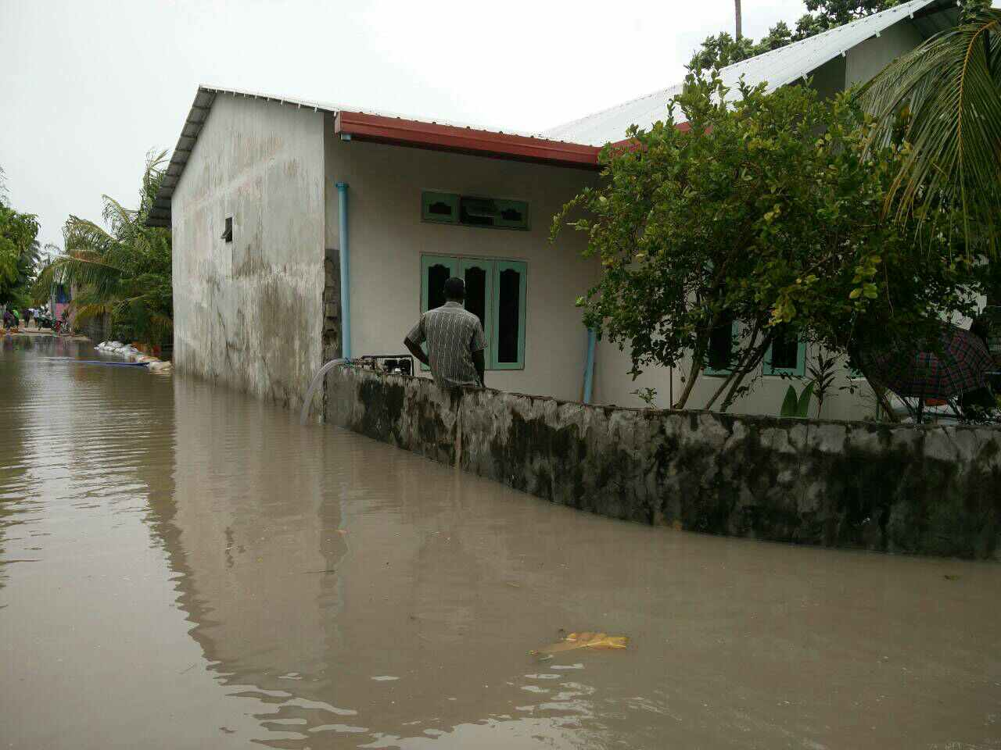
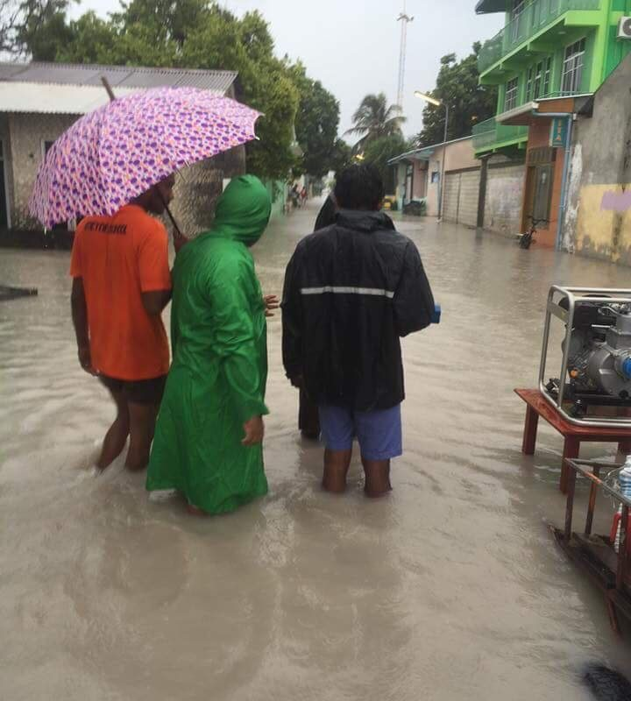
Impacts of Tropical Cyclone Ockhi
Dhaal. Meedhoo (1st Dec 2017)
Noonu.Manadhoo (1st Dec 2017)
Noonu.Manadhoo (1st Dec 2017)
Noonu Holhudhoo (1st Dec 2017)
Notes:
Total 57 islands were affected by the tropical cyclone Ockhi.
The AWS station of Raa Ifuru, had recorded the highest rainfall of 175 millimeters on 30th November.
Tthe AWS station of Alif Dhaalu Maamigili and Baa Dharavandhoo had recorded the gust winds of 56 and 54 miles per hour respectively.
The average strong winds of 20 – 30 miles per hour prevailed over the country on the 1st of December.
The strong gust winds of 59 and 51 miles per hour were also recorded at the AWS station of Alifu Dhaalu Maamingili and the National Meteorological Centre at Hulhule respectively on 1st of December.

Slide 7
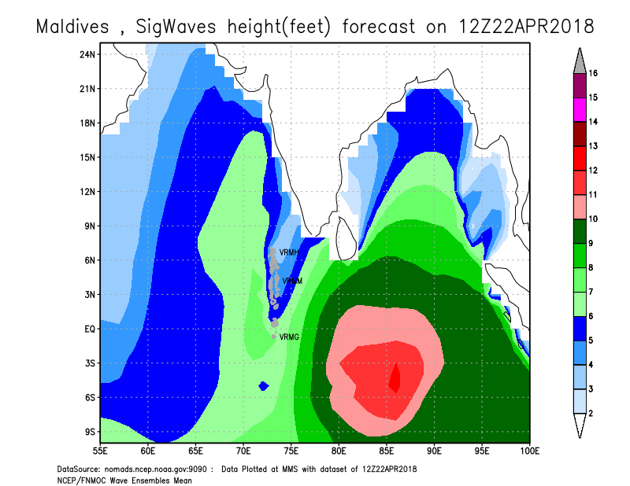
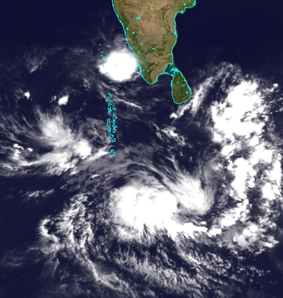
Recent Swell Surge event
On 28th of April 2018, Tropical Cyclone, “Flamboyan” situated about 2200 km south-east of Addu atoll. The high swell waves associated prior to this system caused sea surges across the country, particularly in southern atolls of Maldives on 21st and 22nd of April.
22nd April 2018, Time: 0830 hours
Notes:
The well marked low-pressure area in the south-east of Maldives had deepened in to a depression on 22nd of April which was about 1000 km from southeast of Addu atoll on 21st of April.
It had further intensified on the following day and moved south-south-easterly direction, away from Maldives.
Due to the intensification of this system, high swell waves were generated.
The high swell waves associated with this system caused sea surges across the country, particularly in southern most atolls on 21st and 22nd of April.
The swell event was coincided with the time of high tides in the Maldives.
The islands which had experienced the significant damages by this swell surges include the islands from Addu city, Fuvahmulak, Thaa atoll and Laamu atoll.
In addition, many islands from Haa Alifu, Haa Dhaalu, Shaviyani, Raa, Alifu Dhalu, Faafu, Dhaalu and Thaa atoll were impacted. It was reported from Thaa Guraidhoo and Thaa Thimarafushi that Sea surge went approx. 600ft inland and observed from all directions of the island.

Slide 8
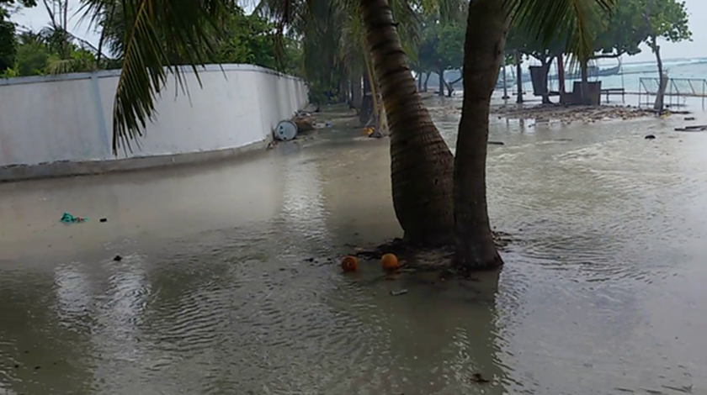
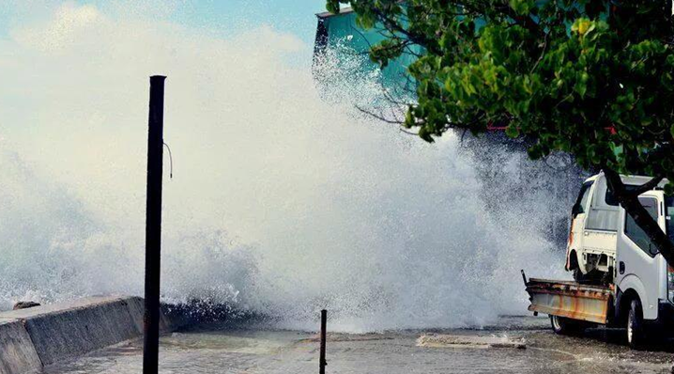
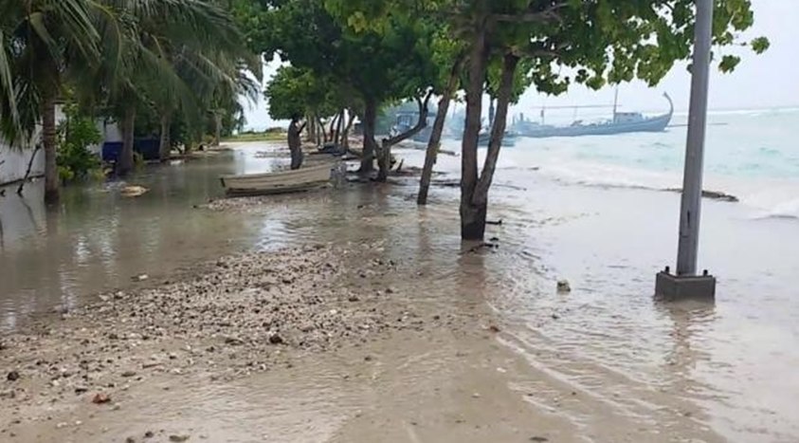
Swell Surge Impact

Slide 9
Yesterday's flash flood event in Male City
Heavy rain has caused flooding in capital city Male’ on Wednesday,05th Dec 2018.
The heavy rain that began on Wednesday morning did not cease until later in the evening.
This has caused some roads to flood up to the knees, preventing people from travel by foot and some houses and stores have also been flooded.
A record breaking amount of rainfall of 228.9 millimeters occurred in Male’ AWS during the past 24 hours.
This is the highest record of rainfall with in 24 hours period in the history of Maldives.

Slide 10
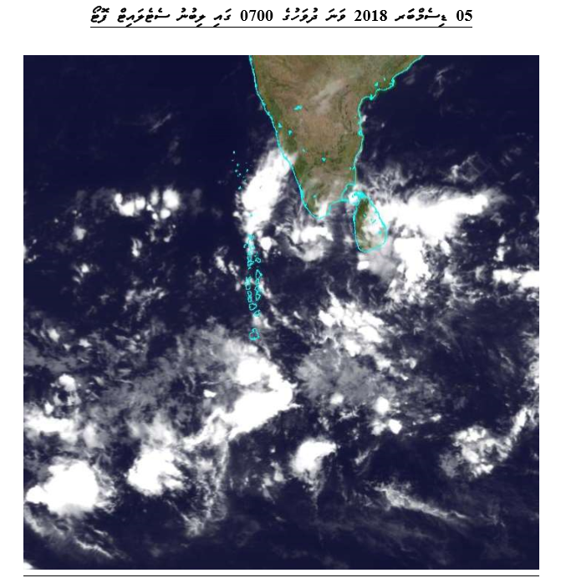
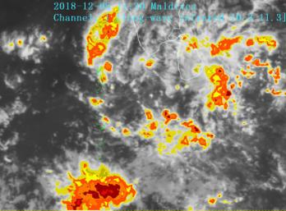
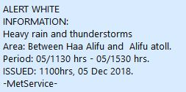
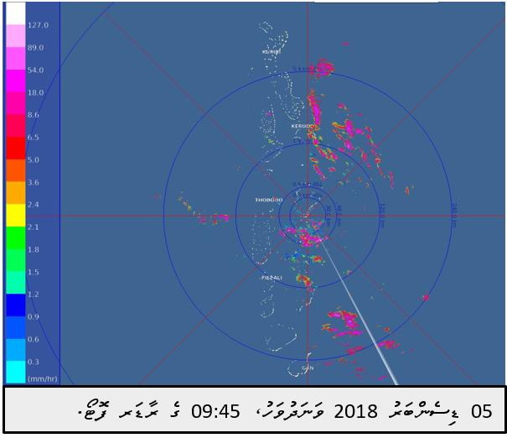
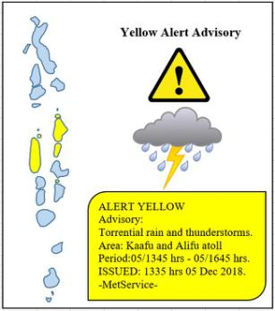
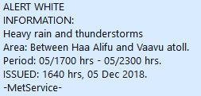
Flash flood in Male’ city on 05 Dec 2018

Slide 11
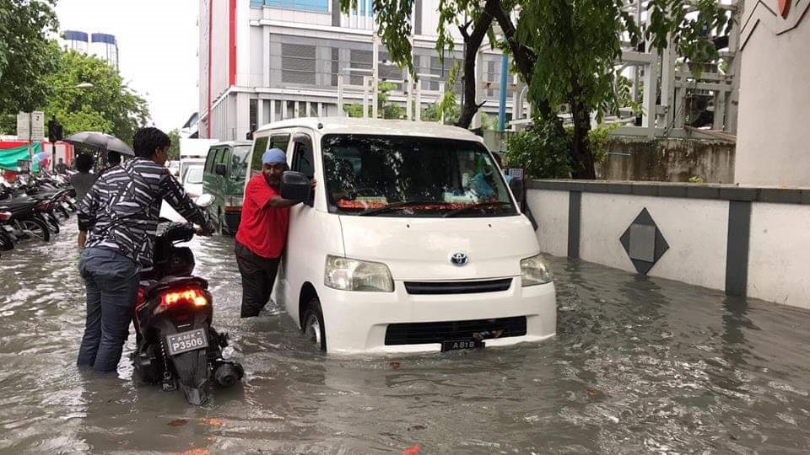
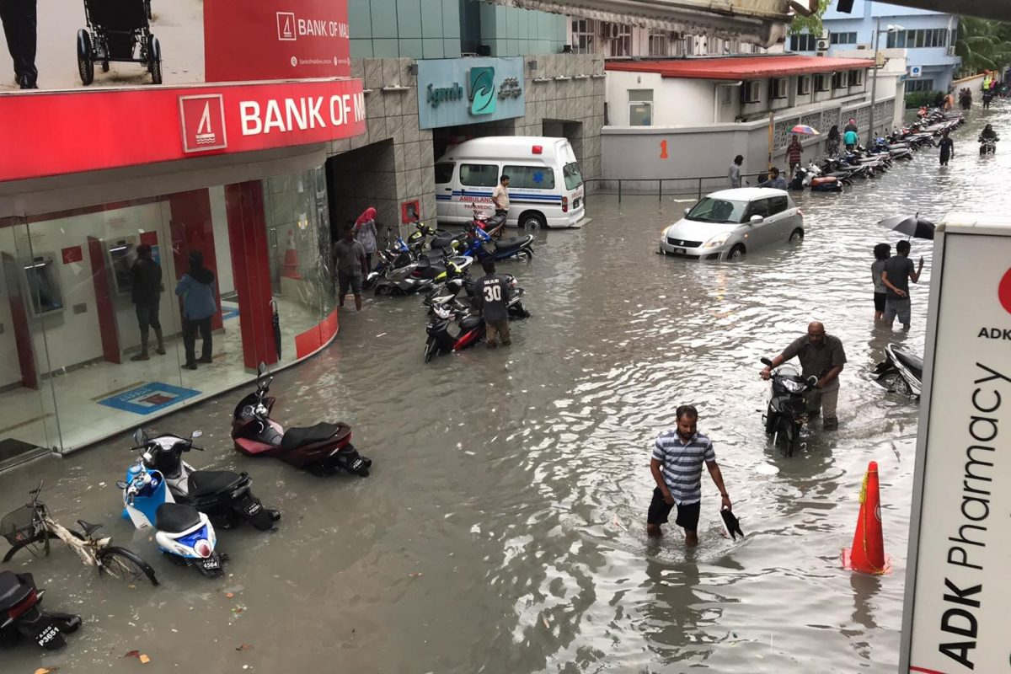
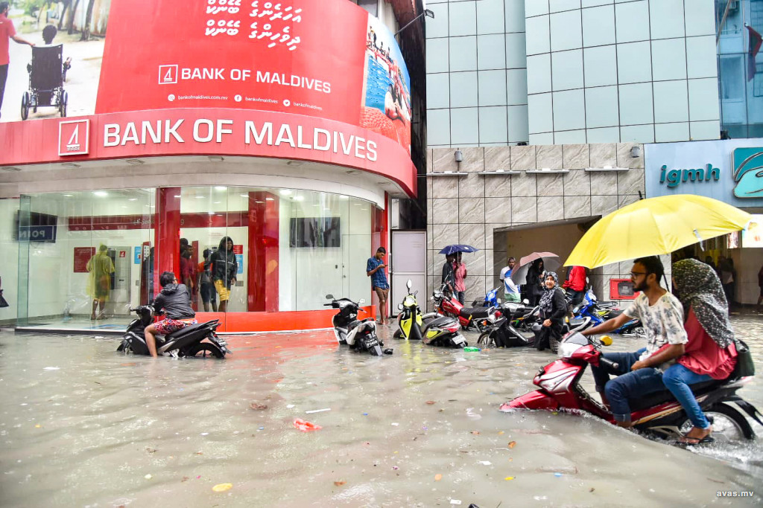
Flash flood in Male’ City

Slide 12
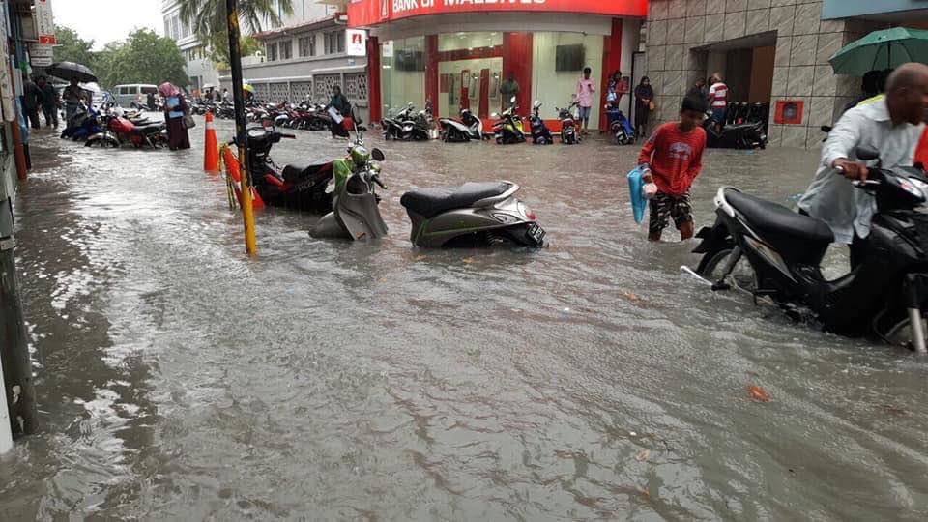
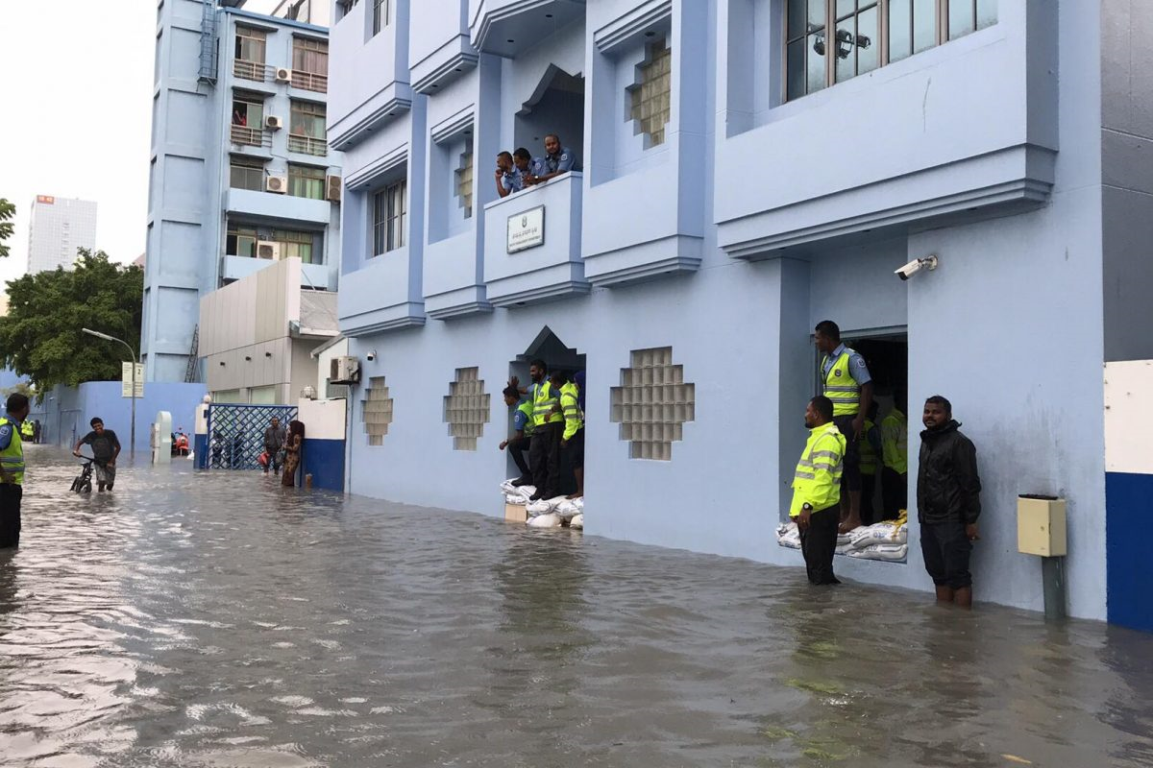
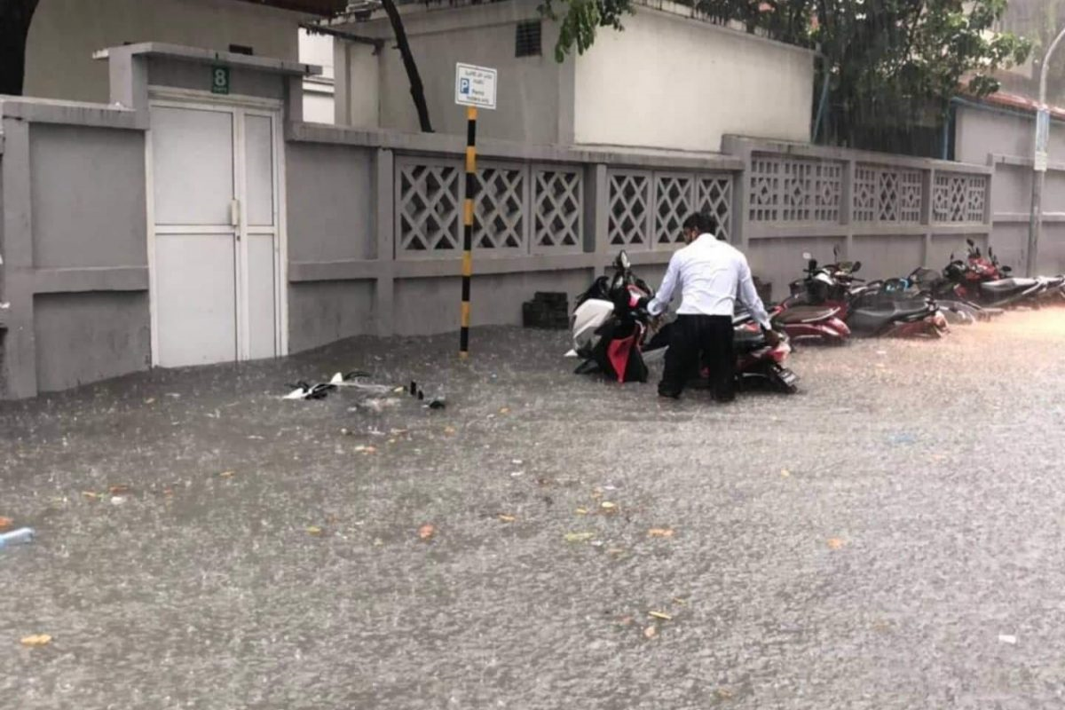
Flash flood in Male’ City

Slide 13
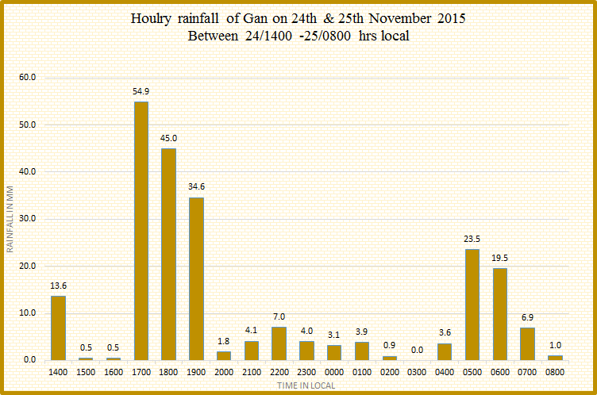
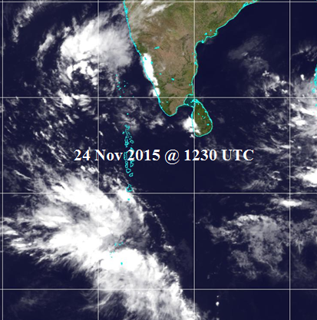
Recent flood events
Heavy downpour of 228 millimeters in 24hours was recorded at the Meteorological Office, Gan on 24th November 2015.
Notes:
Cloud cluster formed over south of Maldives brought widespread rain and very heavy showers to southern most atolls on 24th November.
Heavy downpour of 228 millimeter was recorded at the Meteorological Office, Gan, which was the highest record of rainfall within 24hours period and the heaviest Addu City, has seen in 40 years.

Slide 14
Weather Forecasting Products and Tools.

Slide 15
Forecast generation process at MMS
Observations: land and upper air observations from Maldives and neighboring countries, including satellite data are used
Numerical Weather Prediction (NWP) model outputs from various climate centers and model products from MMS; incorporation of observations into NWP models, referred to as data assimilation, improves the spatial and temporal quality of forecasts ( increased resolution for finer details )
Skillful analysis of various model outputs and in reconciling sometimes seemingly conflicting information from different sources, particularly for locally severe weather.
Finally present / provide forecast to the end user in understandable format and send to media for broadcasting.

Slide 16
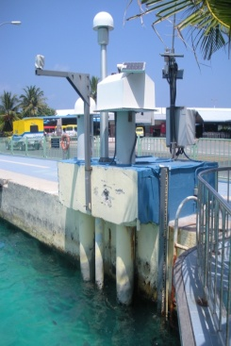
Current status of MMS
Meteorological Observatories: 5
Automatic Weather Station: 33
Upper air observation: 1
Doppler Weather Radar: 1
Seismometer: 2
Tide gauge: 3
Satellite picture receiving system: 1
Numerical Weather Prediction Models ( WRF )
Number of Staff ( technical & admin) : 105
Standby generator (Back-up electrical system):1
Draft Met Bill in progress.
Mobile App

Slide 17
Weather Satellite Image receiving station
FY2E, FY2D Satellite image.
Image receives at every 30 minutes.
Mainly 3 types of image ( Infrared, Visible and water vapor image).
Satellite Weather Application Platform (SWAP) and Meteorological Information Comprehensive Analysis and Process System (MICAPS).

Slide 18
AWS stations in the Maldives

Slide 19
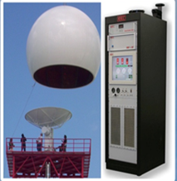
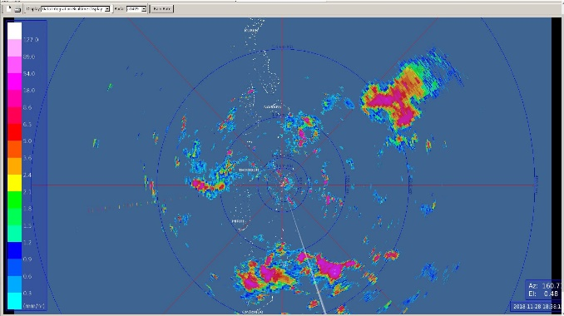
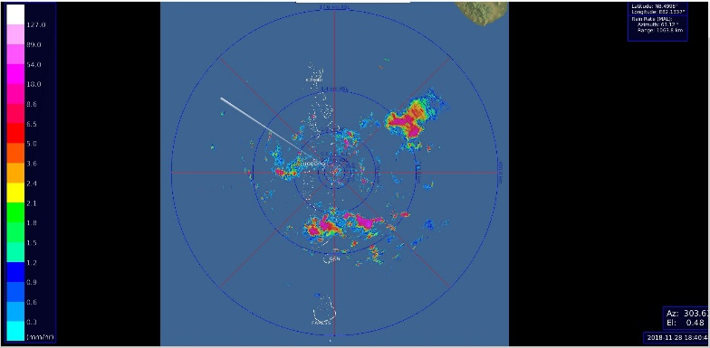
Doppler weather Radar
S- Band Doppler weather Radar made by Enterprise Electronics Cooperation (EEC), USA.
EDGE 6 from EEC software is used.
Wavelength is 10 cm.
Maximum Effective Range of Reflectivity is 240 km.

Slide 20
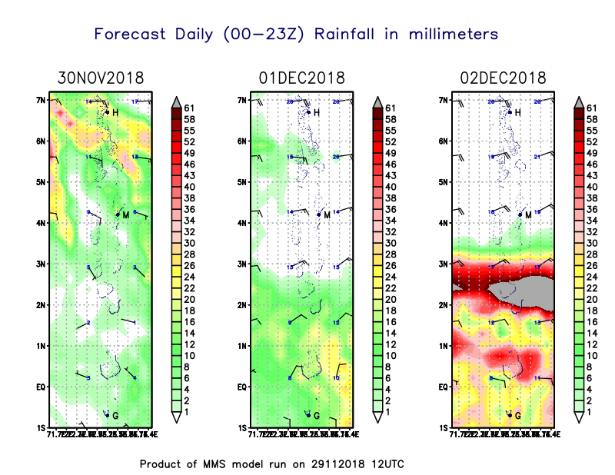
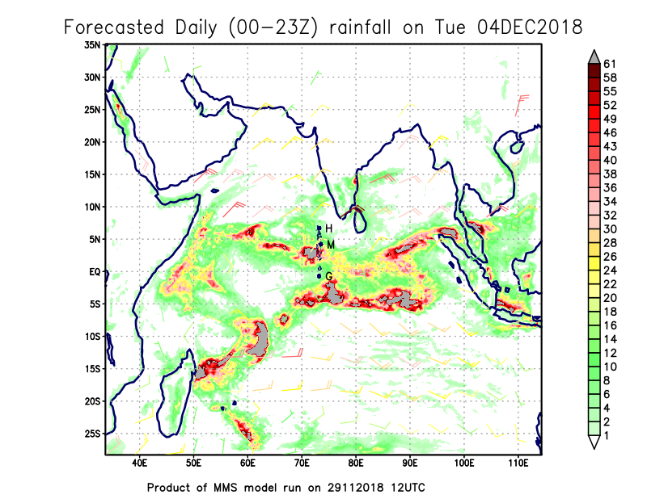
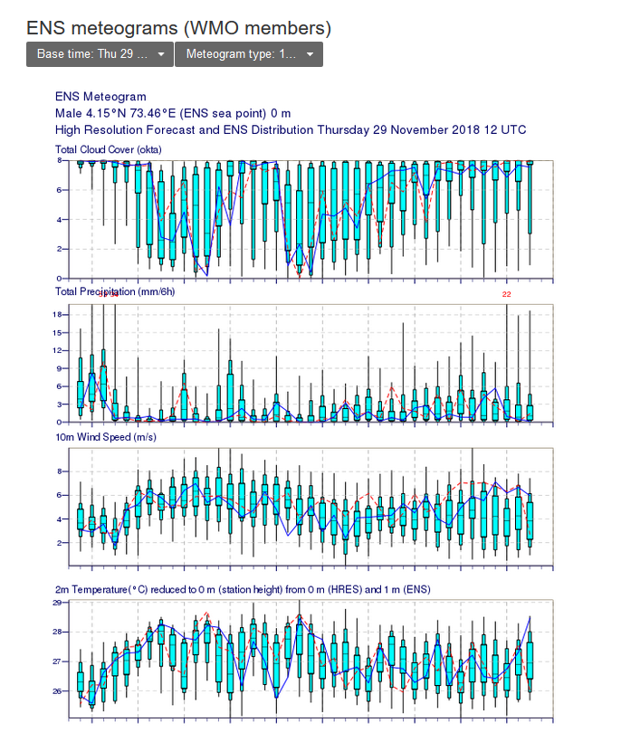
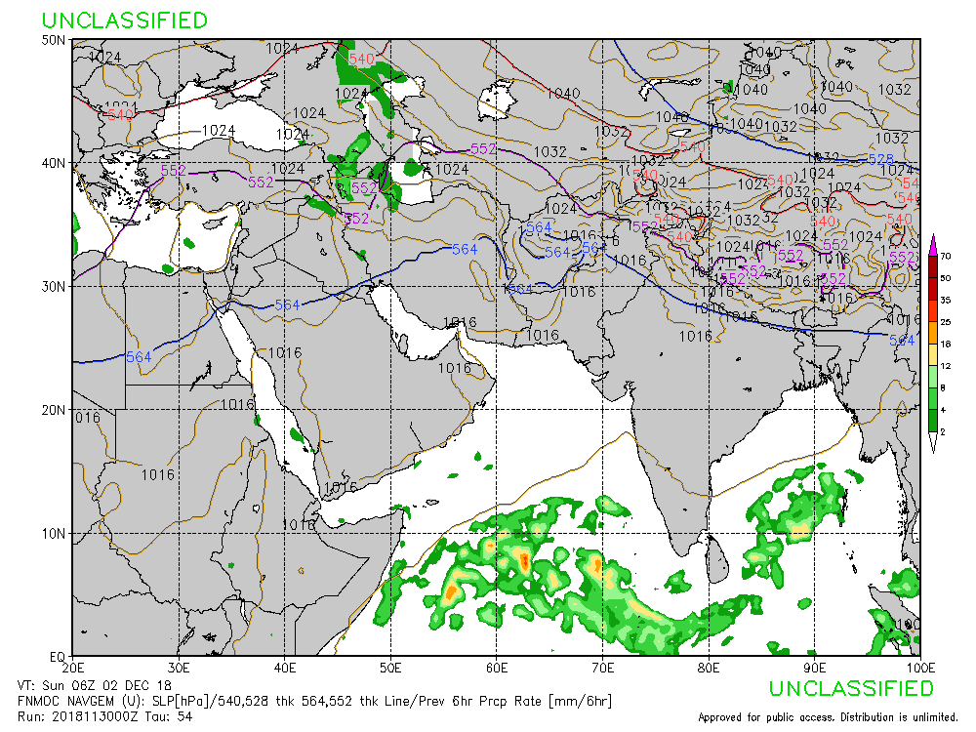
Weather Forecasting Products from Various Sources

Slide 21
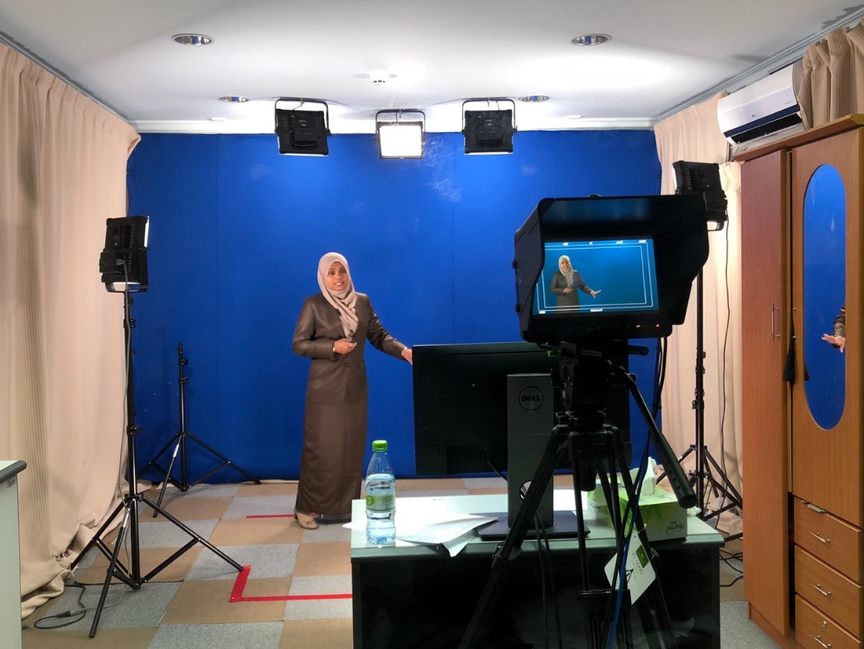
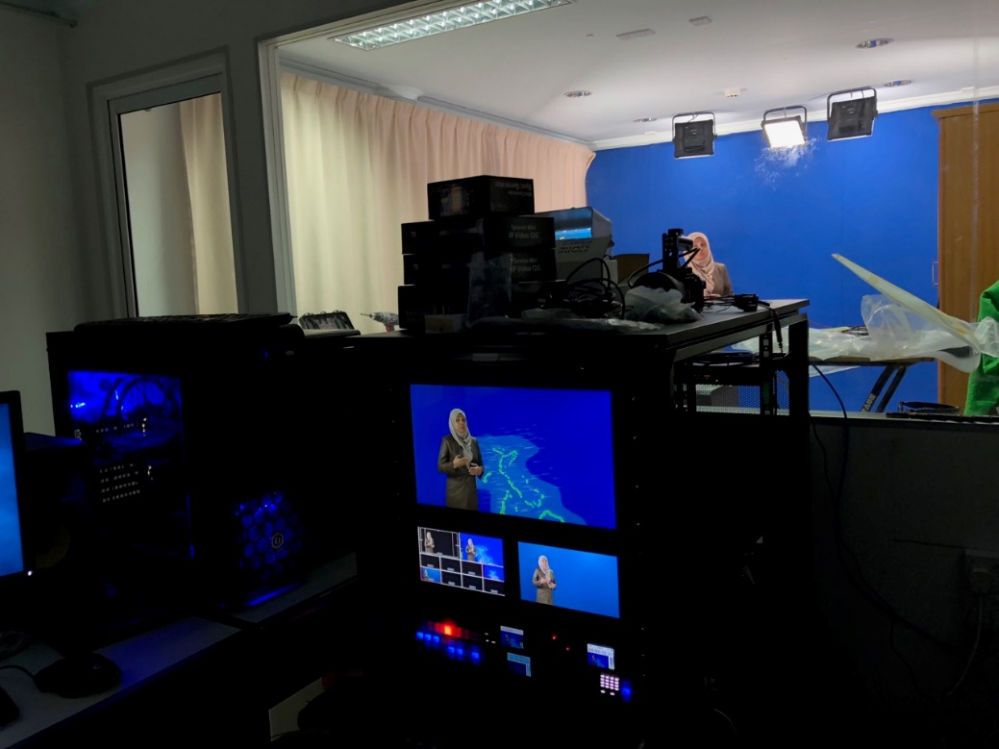
MMS Forecast Dissemination
Currently we prepare and send weather presentation video to TVM studio once a day

Slide 22
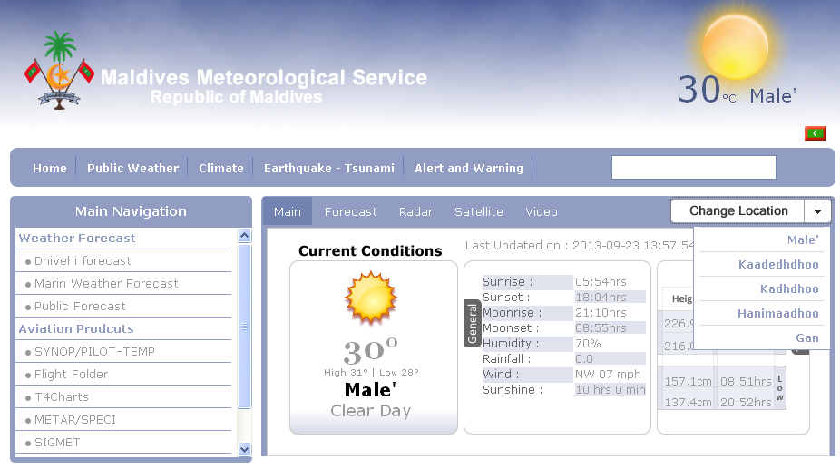
MMS Forecast Dissemination

Slide 23
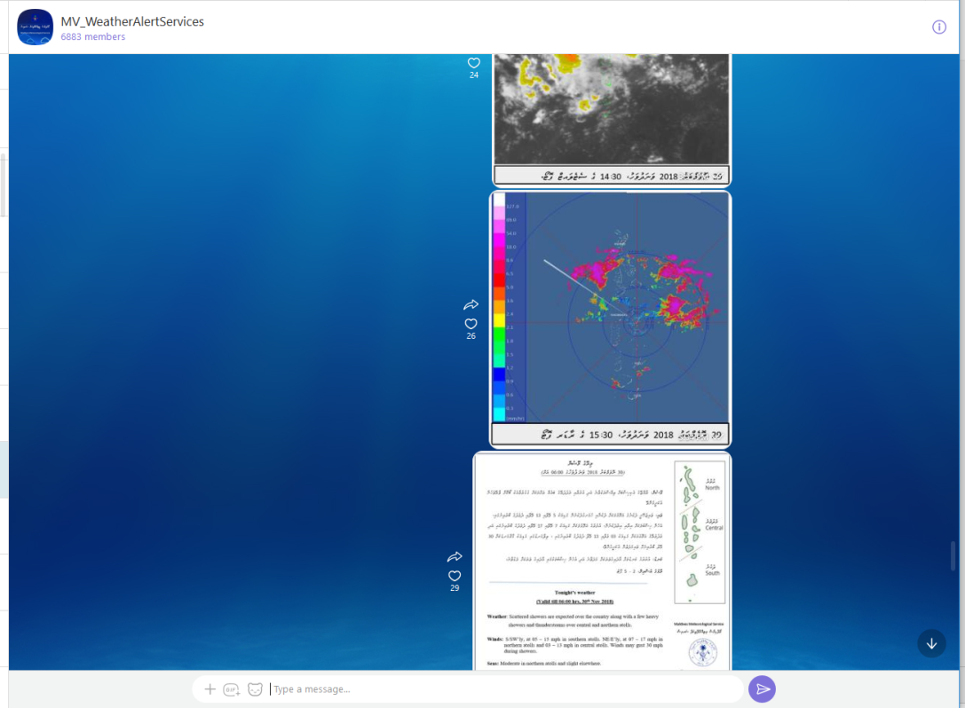
Weather information via Community Viber group

Slide 24
Early Warning Mechanism

Slide 25
Early warning Mechanism
Standard Operating Procedure - SOP
Maldives Meteorological Service
A standard operating procedure has been develop which tells what role to be played and by whom, to speed up the operation during emergencies.
It also has compulsory instruction to be followed.

Slide 26
Early warning Mechanism
Alert level 1
Alert level 2
Alert level 3
Alert level 4

Slide 27
Early warning Mechanism
Alert Level |  | Description | Action
1 | WHITE | Mean wind speed is expected or prevailed between 23 – 29 mph. Rainfall of more than 50 mm is expected to occur within 24 hours. High tidal waves are expected. | Weather Information, but no immediate threat.
2 | YELLOW | Mean wind speed is expected or prevailed between 30 – 40 mph. Torrential rain is expected and if heavy rain occurred for more than 2 hours. A severe thunderstorm is expected or experienced. Tropical Cyclone is formed within effective areas of Maldives. Significant tidal or swell waves expected or experienced. | Concern authorities and people living in the area to be on alert & be ready to take action. Travel by sea not advisable.
3 | RED | -Flash flood is expected. -A tropical Cyclone is tracked to move closer or cross Maldives islands. -Destructive tidal or swell waves or storm surge is expected or observed. | Evacuation of population from threatened areas to safer places. Prohibition of sea transportation.
4 | GREEN | The condition has improved. | Cancel warning

Slide 28
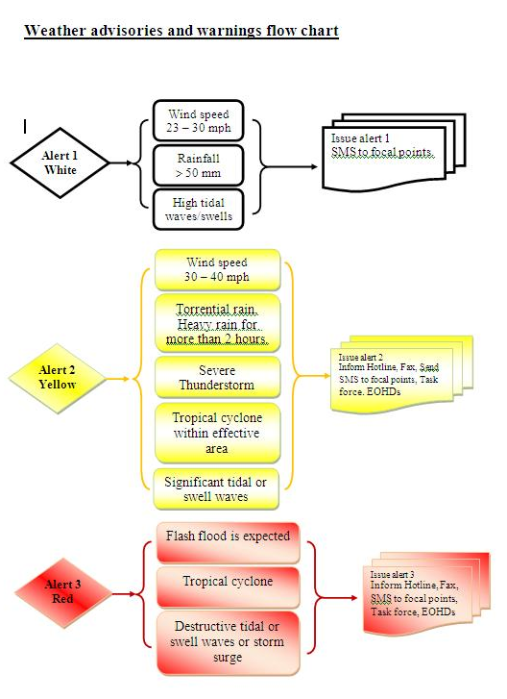
Early warning Mechanism
Weather advisories and warnings flow chart

Slide 29
Early warning Mechanism
މެޓްއޮފީހުގެ އެލާޓް ޕްރޮސީޖާ
Weather information, advisories and warnings
ALERT WHITE
INFORMATION:
Heavy rain with strong average winds of 23 - 30 mph and gust winds of 40 - 50 mph expected.
Area:Between Haa Alifu & Laamu Atoll.
PERIOD:
14/0030 - 14/0630 hrs.
ISSUED:
0022 hrs 14 May 2018.
-MetService-
ALERT YELLOW
Advisory:
Average winds of 30 - 40 mph prevailed and expected
Area: central atolls
PERIOD:
15/1730-15/1900 hrs
ISSUED:
1730 hrs 15 May 2018
-MetService-

Slide 30
Early warning Mechanism
warnings flow chart
Alert Message from Maldives Meteorological Service ( MMS )
TVM
Hotline
VOM
Hotline
NDMC
Hotline
MNDF
Hotline
MPS
Hotline
SMS
Concerned authorities and focal points
Pass the message to the public via TV and radio
Pass the message to the concerned sectors
Pass the message to the concerned Authorities.
Take necessary action

Slide 31
Challenges
No marine observation station at present.
Challenges in swell and tidal wave forecasting.
Training in Live TV weather presenting.
AWS maintenance and calibrations (frequent data gaps due to AWS failures).
Gaps in Human Resources Development (Short term Refresher training programs for Weather Observers, instrument technicians and Forecasters).
Inadequate budget for infrastructure development and maintenance cost.

Slide 32
Challenges
Current Doppler weather Radar is not covering the whole country. It is a challenge for nowcasting.
Challenges in forecasting Thunderstorm and Lightning – Currently there is no lightning detectors established in the Maldives.
Established Legal Framework.

Slide 33
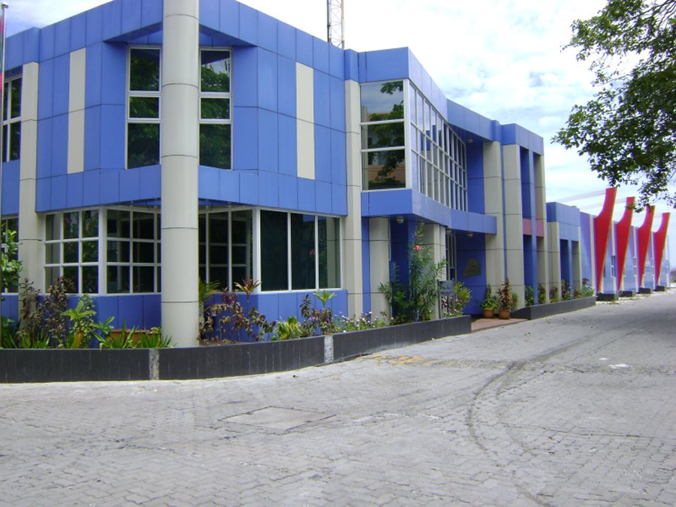
Thank You
Dial Weather : 3317171 / 171
Phone : 3323084 / 7967171
Website: www.meteorology.gov.mv
Email : admin@meteorology.gov.mv
END

