Slide 1
Severe Weather Forecasting
Demonstration Project (SWFDP)
Bay of Bengal
Alice Soares
Scientific Officer
Data-Processing and Forecasting Systems (DPFS) Division
asoares@wmo.int
Malé, Maldives, 26-28 September 2016
WMO; WDS

Slide 2

Why a project on severe weather forecasting?
Dramatic developments in weather and climate prediction science
Leading to improved alerting of hydro-meteorological hazards, at ever-increased precision, reliability, and lead-times of warnings
Developing countries, including LDCs and SIDSs, saw little progress
Increasing gap in application of advanced tools and technology in forecasting and early warnings
WMO SWFDP attempts to close this gap, by applying the ‘Cascading Forecasting Process’
?
2
Notes:
Dramatic developments in weather forecasting science over the past two decades – advances in monitoring and NWP and Ensemble Prediction Systems (EPS),
leading to improved alerting of weather hazards, at increased lead-times of warnings
Developing countries, LDCs, saw little progress due to limited budgets, failing infrastructure, inadequate guidance and expertise,
increasing gap in application of advanced technology (NWP, EPS) in early warnings
WMO SWFDP attempts to close this gap by increasing availability, and developing capacity to use existing NWP and EPS in countries where it is not effectively used. It applies the ‘Cascading Forecasting Process’ (global to regional to national to users) through regional frameworks (where a regional centre provides forecast guidance to a group of like-countries in a geographical region, with the supported by global centres).

Slide 3
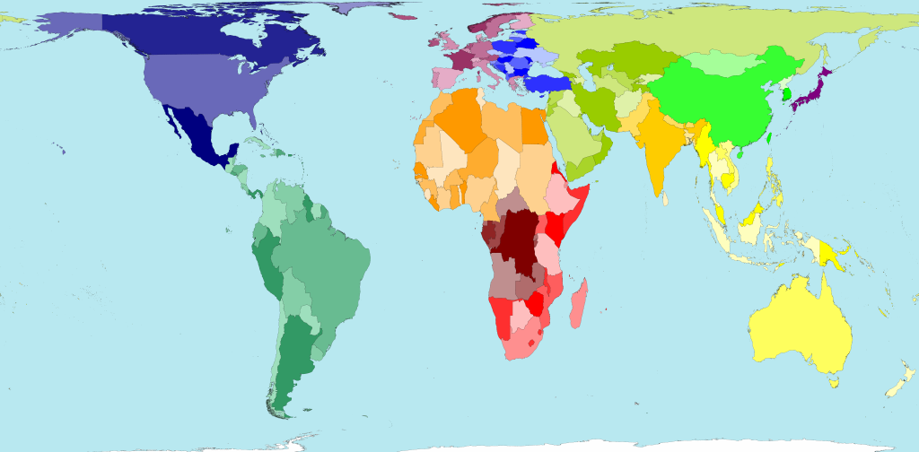
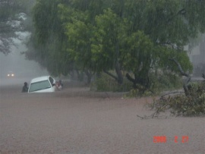
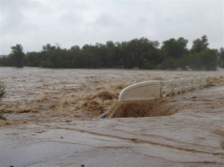
SWFDP Cascading Forecasting Process –
efficient delivery of GDPFS
Global NWP centres to provide available NWP/EPS and sat-based products, including in the form of probabilities, cut to the project window frame;
Regional centres to interpret information received from global centres, prepare daily guidance products (out to day-5) for NMCs, run limited-area model to refine products, maintain RSMC Web site, liaise with the participating NMCs;
NMCs to issue alerts, advisories, severe weather warnings; to liaise with user communities, and to contribute feedback and evaluation of the project;
NMCs have access to all products, and maintained responsibility and authority over national warnings and services.
User communities, including Disaster Management authorities
Global Centres
RSMC Pretoria
NMCs
3

Slide 4
SWFDP Main Goals
Implement the WMO’s GDPFS three-level system – the ‘Cascading Forecasting Process’
  International collaboration among operational centres at global, regional and national levels
  Improve the skill of products from WMO operational centres through feedback and forecast verification
  Continuous learning and modernization
  Address the needs of groups of “like-countries”
Improve lead-time of Warnings
Improve interaction of NMHSs with their users
Identify areas for improvement and requirements for the WMO Basic Systems
Notes:
SWFDP represents a systematic approch for buiding capacity and for transfering knowledge and skills to operational weather forecasting teams across the NMHS community
Introduction of new proven products, enhancements to the forecasting process, and provides a channel for testing relevant promising S&T outputs

Slide 5
SWFDP Strengths
Cost effectiveness;
Simplicity;
NMHSs need good internet only;
Highly operational;
Capacity development through specialized training programme
improved forecasts and lead-time of warnings

Slide 6
SWFDP: Existing projects and Future directions
Depending upon the resources, the number of developing countries and LDCs to benefit from the SWFDP may grow to over 100 in next 5 years
Green color boxes represent the domains of existing SWFDP regional subprojects. Pink and Orange color boxes signify the regions for future SWFDP subprojects which will be developed within next 1-2 years and 3-5 years respectively. Contributing Global Centres and RSMCs /RFSCs are also shown for each of the SWFDP regional subprojects.
SWFDP Strengths:
Cost effective;
Simplicity;
NMHSs need internet only;
Highly operational focus;
Capacity development with improved forecasts and lead-time of warnings

Slide 7
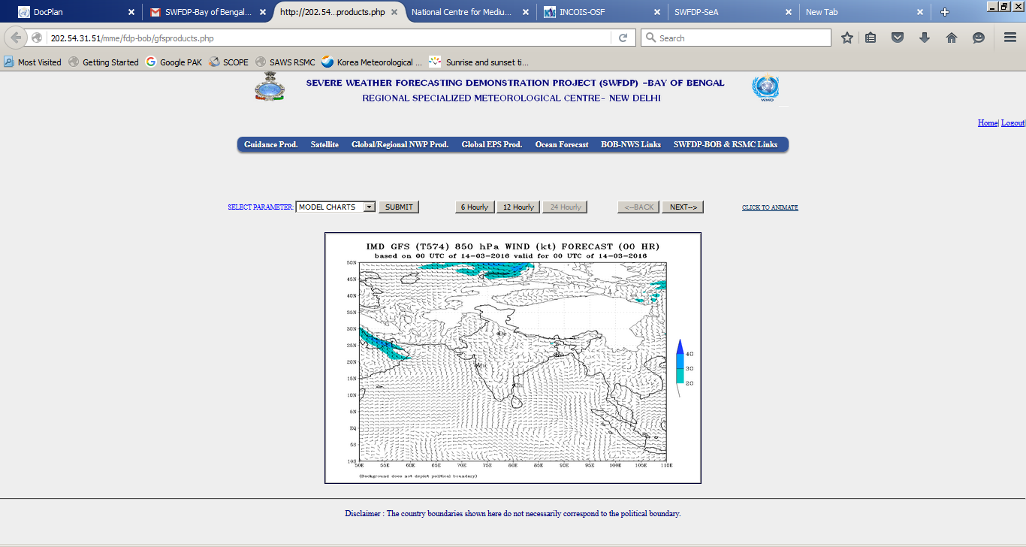
SWFDP-Bay of Bengal
http://nwp.imd.gov.in/mme/fdp-bob/login.php
RSMC New Delhi Web portal
since September 2015
    Global Centres: IMD (supported by NCMRWF, INCOIS, IITM) ECMWF, JMA, NOAA/NCEP, UKMO
    Focus on: strong winds, thunderstorm, monsoon, heavy precipitation (mainly TC-related) and associated hazards (e.g. flooding, landslides, storm surges, swell)
    Domain:
    10°S, 35°N,
    45°E, 110°E
    Global Centres:
    IMD, ECMWF, UKMO, NOAA/NCEP
    Regional Centre:
    RSMC New Delhi

Slide 8
ECMWF operational forecasting system
High resolution deterministic forecast (HRES) :
  twice per day 9 km 137 levels, to 10 days ahead
Ensemble forecast (ENS):
  twice per day 51 members, 18 km 91 levels, to 15 days ahead
  Monday/Thursday 00 UTC extended to 1 month ahead (Monthly Forecast, 18/36 km )
Seasonal forecast: once a month
  51-members, ~80 km 91 levels, to 7 months ahead
  sub-set of 15 members is run for 13 months every quarter (30 years of hindcasts)
Slide 8

Slide 9
Example products: ENS Meteograms
The Ensemble Meteogram displays the time evolution of the distribution of selected weather parameters in the ensemble forecasts (ENS) for a given location.
The ENS currently comprises 50 perturbed members, each starting from slightly different initial conditions, and an unperturbed Control forecast.
Altitude information for the site (if applicable) is extracted from the 30 arc-second global topography (GTOPO30) dataset, located at https://lta.cr.usgs.gov/GTOPO30

Slide 10
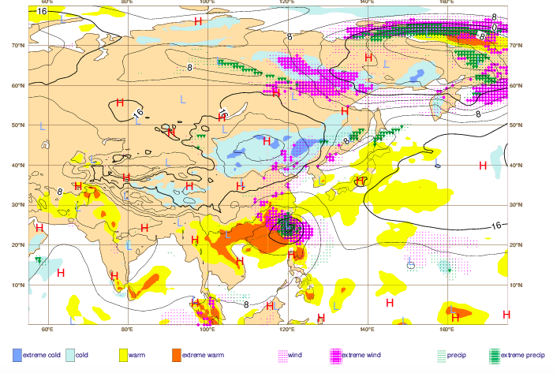
Example products: Extreme Forecast Index
The Extreme Forecast Index (EFI) is an integral measure of the difference between the ensemble forecast (ENS) distribution and the model climate distribution (M-climate, see below). This allows the abnormality of the forecast weather situation to be assessed without defining specific (space- and time-dependent) thresholds. The EFI takes values from -1 to +1. If all the ENS members forecast values above the M-climate maximum, EFI = +1; if they all forecast values below the M-climate minimum, EFI = -1.
Notes:
Experience suggests that EFI magnitudes of 0.5 - 0.8 (irrespective of sign) can be generally regarded as signifying that "unusual" weather is likely
whilst magnitudes above 0.8 usually signify that "very unusual" or extreme weather is likely. Although larger EFI values indicate that an extreme event is more likely, the values do not represent probabilities as such.

Slide 11
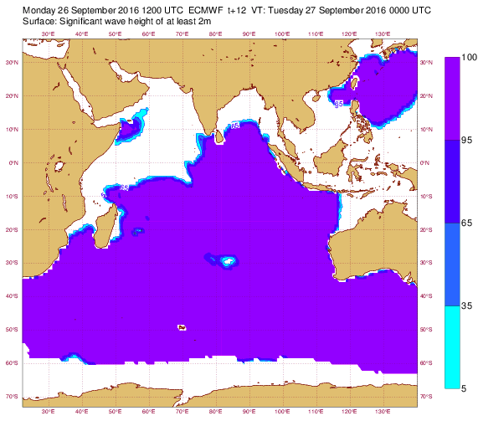
Example products: wave products

Slide 12
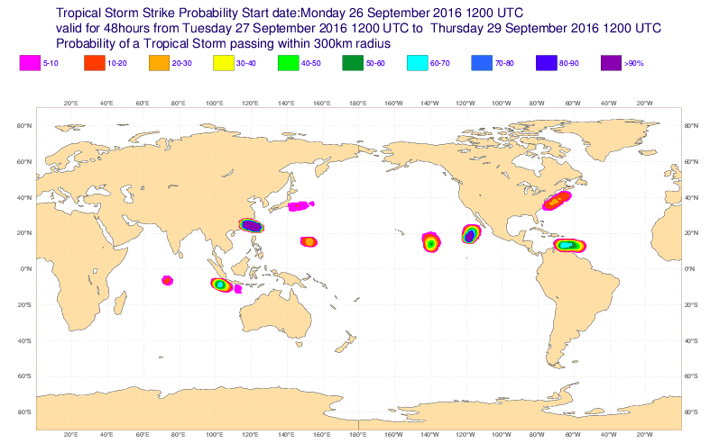
Example product: Tropical Cyclone genesis
This product shows the potential tropical cyclone activity at different time ranges during the forecast. It includes both tropical cyclones that are present at analysis time and those which may develop during the forecast. The maps show the "strike probability" based on the number of ENS members that predict a
tropical cyclone, each member having equal weight.
http://www.ecmwf.int/en/forecasts/charts/medium/tropical-cyclone-activity-including-genesis?time=2016071300,72,2016071600&intensity=Tropical%20cyclones&area=Global
Notes:
The strike probability is the probability that a tropical cyclone will pass within a 300 km radius from a given
location and within a time window of 48 hours. This provides a quick assessment of high-risk areas allowing for some uncertainty in the exact timing or
position. The strike probabilities are generated for three storm categories; tropical cyclones(> 8 m/s), tropical storms (> 17 m/s) and hurricanes/typhoons (> 32m/s).

Slide 13
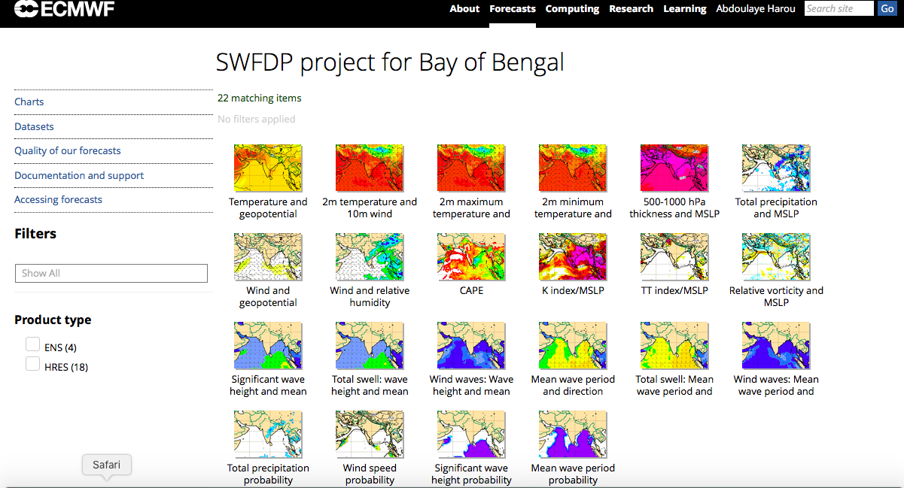

Slide 14
Thank You
Alice Soares
asoares@wmo.int

