Slide 1
seasonal prediction for Myanmar
SON 2016
05 September 2016
Prof. OH Jaiho (jjho2023@gmail.com)
Dept. Env. & Atmos. Sci., Pukyong National University, Busan, Korea

Slide 2
ICOsahedral Non-hydrostatic (ICON) model
Joint development project of DWD and Max-Plank-Institute for Meteorology for the next-generation global NWP and climate modeling system
Non-hydrostatic dynamical core on an icosahedral-triangular Arakawa C-grid
Coupled with almost full set of physics parameterizations
Two-way nesting with capability for multiple nests per nesting levels in order to replace extra process for downscaling
Full hybrid (MPI/OpenMP) parallelization
ICON

Slide 3
Preparation of Seasonal Prediction for Autumn, 2016
Initial Condition | ECMWF Operational Analysis data (2016.7.21.~7.30.)
Boundary Condition | NOAA OI Monthly Global SST data (2016.7.10.~7.16.) ECMWF Operational Analysis data for Sea ice (2016.7.13.)
Model | ICOsahedral Non-hydrostatic (ICON) MODEL
Vertical & Horizontal Resolution | 40 km/90 layers
Integration period | From 2016.07.21 to 2016.11.30
Method for Seasonal Prediction | Time-lag Method - Prediction run with daily SST forcing (10 Ensemble members) AMIP-type Present-day run - Climatology run during 1979~2008 (30years)
Presented Variables | 850hPa Temperature, Precipitation

Slide 4
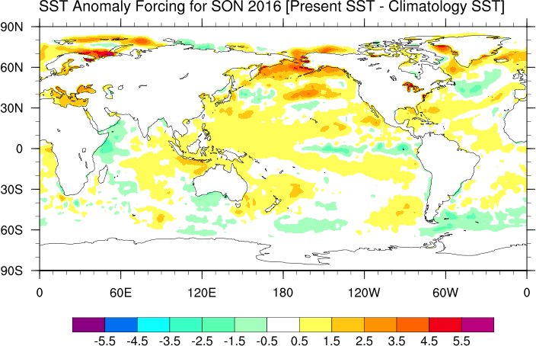
Boundary Condition
Present SST : NOAA OI Weekly SST (Jul. 10~16, 2016)
Climatology SST : NOAA OI Average year SST (1971~2000)
Positive Anomalies near the Korean Peninsula.

Slide 5
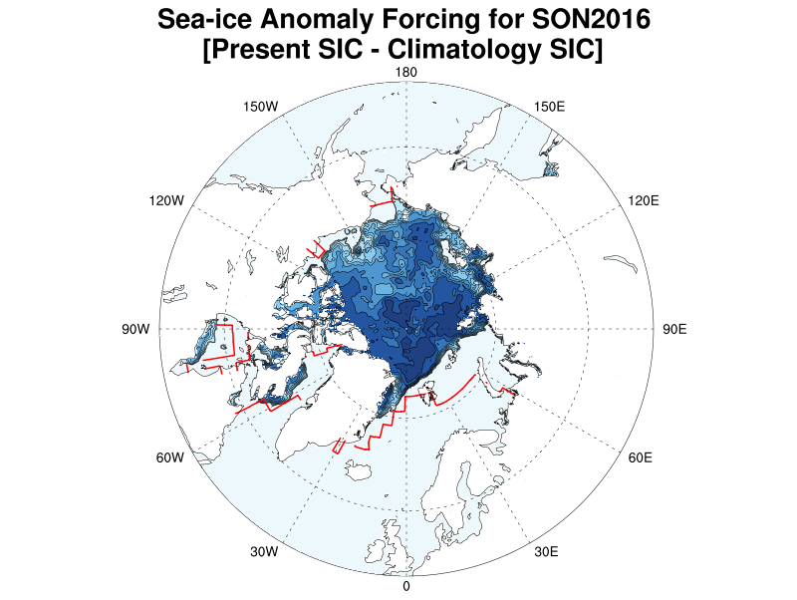
Boundary Condition
Sea Ice Extent in the Arctic (Jul. 13, 2016)
ㅡ climatology
Present Sea Ice : ECMWF Sea Ice (Jul. 13, 2016)
Climatology Sea Ice : ERA-40 Average year Sea Ice (1971~2000)

Slide 6
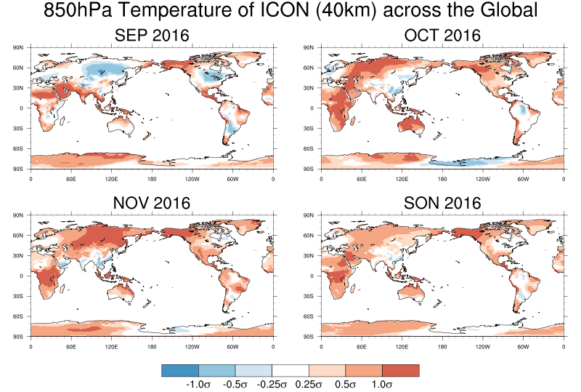
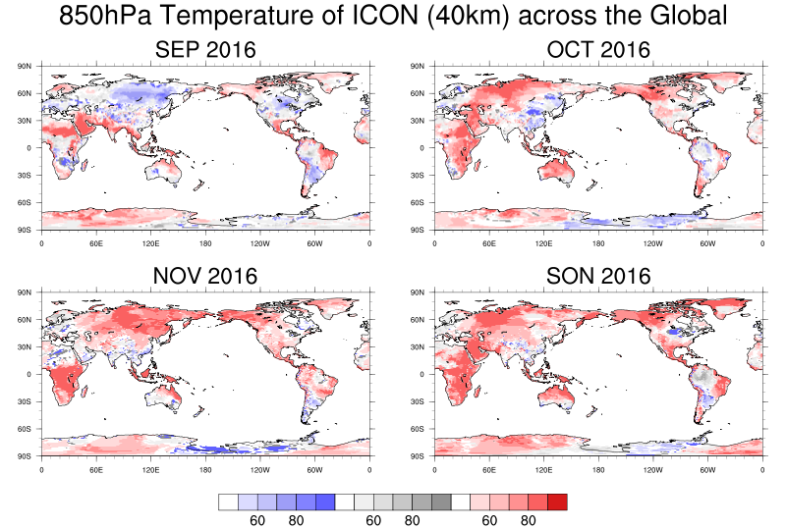
SON 2016 Outlook for the Globe
(850hPa Temperature)
Anomaly Prediction
Probability Prediction
850hPa Temperature of ICON (40km) for the Globe
850hPa Temperature of ICON (40km) for the Globe

Slide 7
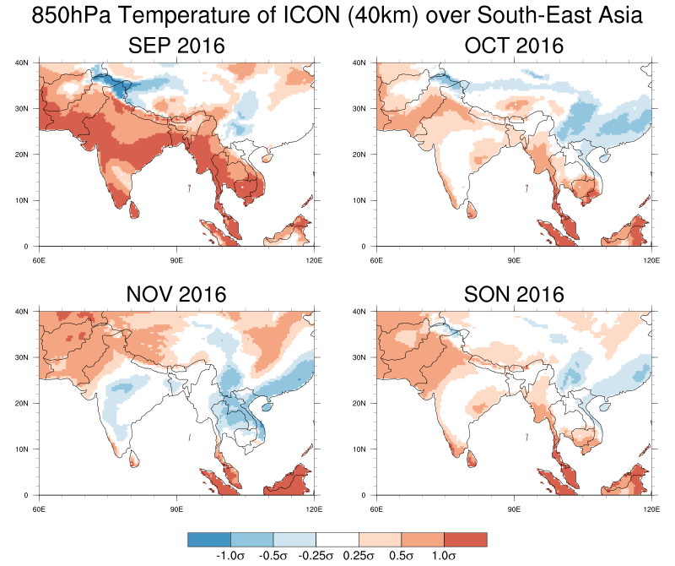
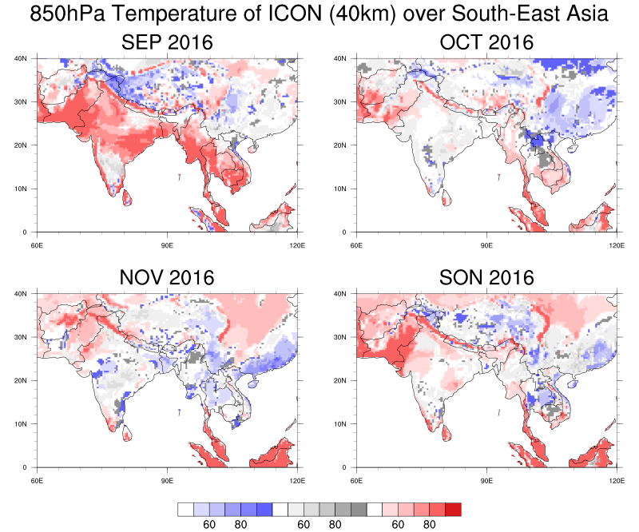
SON 2016 Outlook for Southern Asia
(850hPa Temperature)
Anomaly Prediction
Probability Prediction
850hPa Temperature of ICON (40km) for Southern Asia
850hPa Temperature of ICON (40km) for Southern Asia

Slide 8
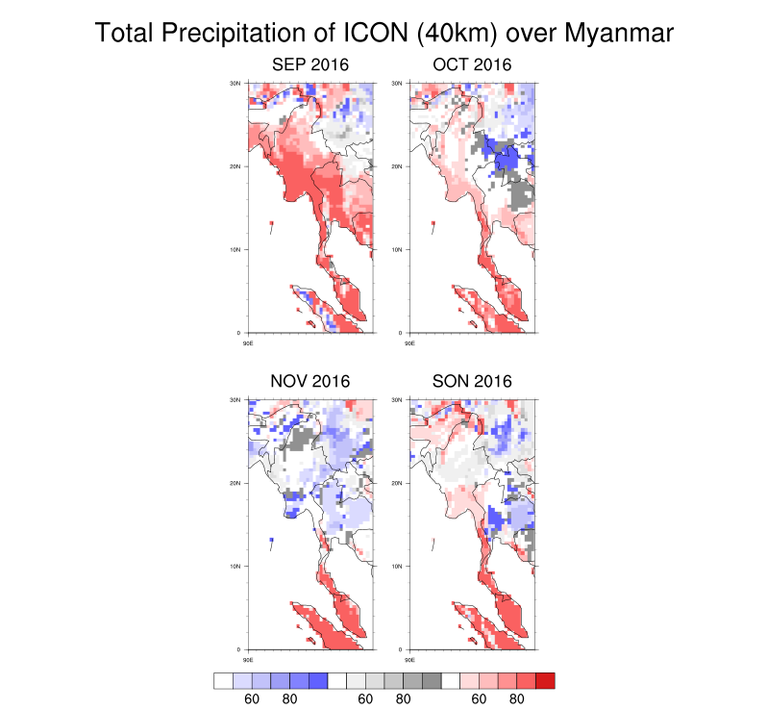
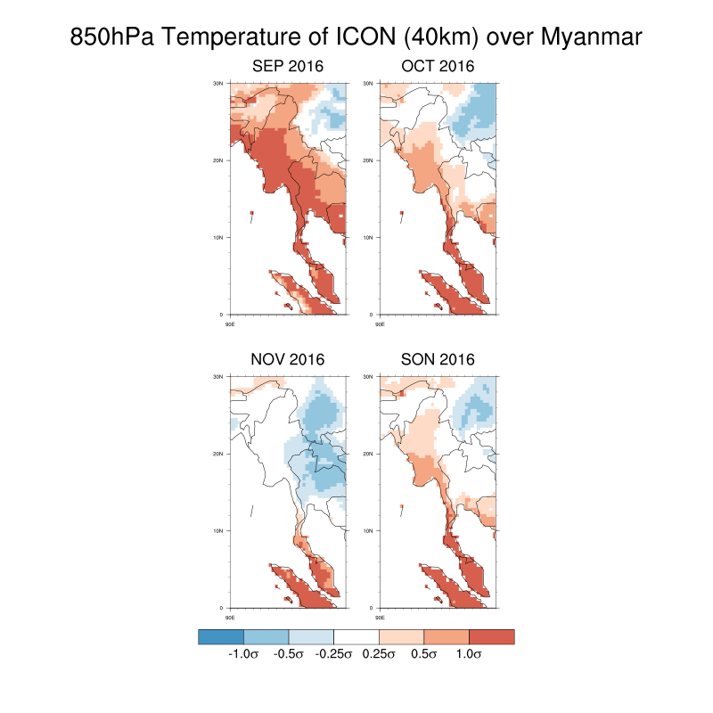
SON 2016 Outlook for Myanmar
(850hPa Temperature)
Anomaly Prediction
Probability Prediction
850hPa Temperature of ICON (40km) for Myanmar
850hPa Temperature of ICON (40km) for Myanmar

Slide 9
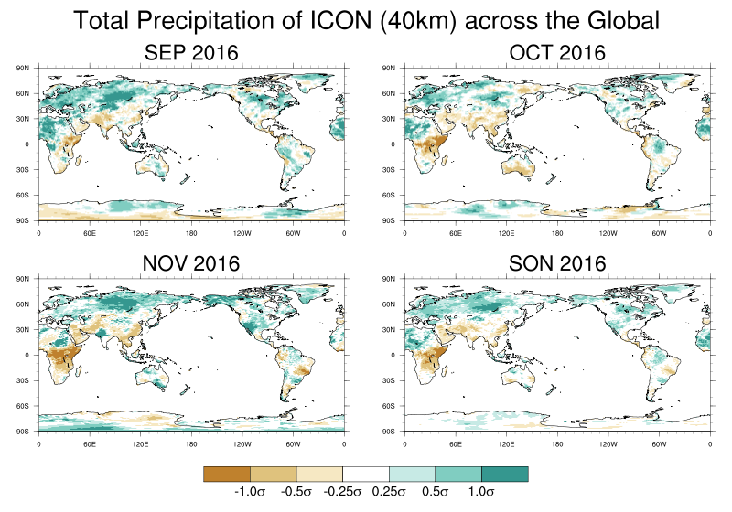
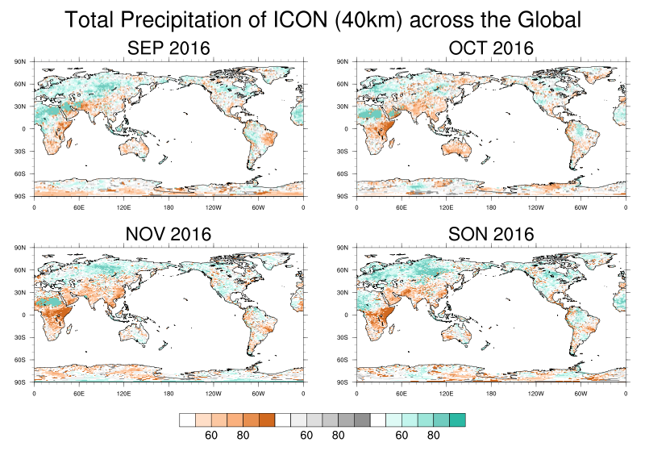
SON 2016 Outlook for the Globe
(Total Precipitation)
Anomaly Prediction
Probability Prediction
Total Precipitation of ICON (40km) for the Globe
Total Precipitation of ICON (40km) for the Globe

Slide 10
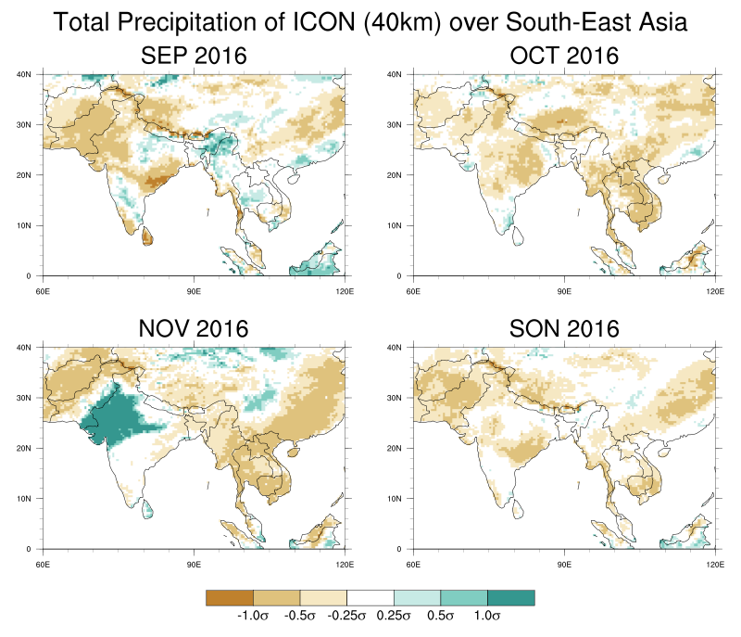
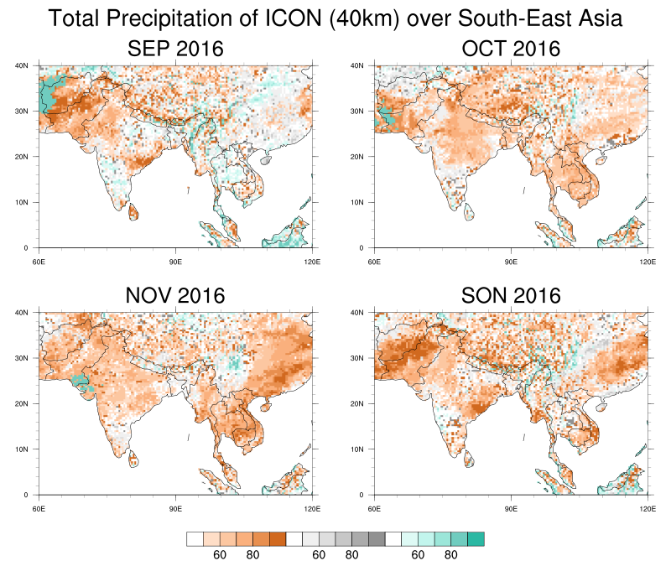
SON 2016 Outlook for Southern Asia
(Total Precipitation)
Anomaly Prediction
Probability Prediction
Total Precipitation of ICON (40km) for Southern Asia
Total Precipitation of ICON (40km) for Southern Asia

Slide 11
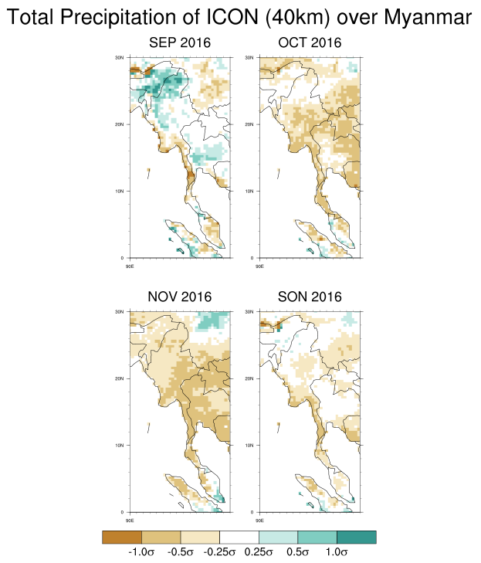
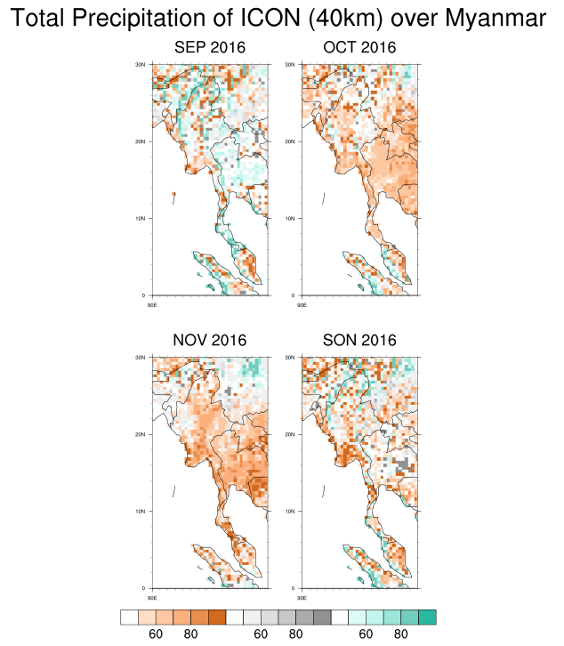
SON 2016 Outlook for Myanmar
(Total Precipitation)
Anomaly Prediction
Probability Prediction
Total Precipitation of ICON (40km) for Myanmar
Total Precipitation of ICON (40km) for Myanmar

Slide 12
Prediction Summary for Autumn, 2016
 |  | SEP | OCT | NOV | SON
Anomaly Prediction | Temp. | Warm | Warm | Normal | Warm
 | Prec. | Wet in Northern Part Dry in Southern Part | Normal | Dry | Normal
Probability Prediction | Temp. | Above Normal | Normal | Normal | Normal
 | Prec. | Normal | Below Normal | Below Normal | Below Normal

