Slide 1

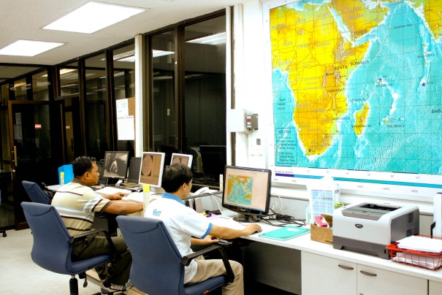
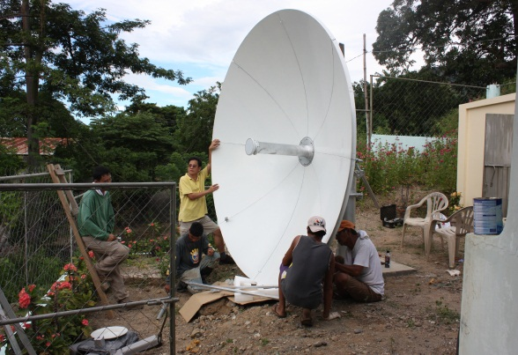
The Regional Integrated Multi-Hazard
Early Warning System for Africa and Asia
(RIMES)

Slide 2
RIMES – Background
RIMES stands for Regional Integrated Multi-Hazard Early Warning System for Africa and Asia
Owned and managed by its Member States, for the generation and application of early warning information
Established on 30 April 2009 with the signing of the RIMES Cooperation Agreement by Member States Registered with the United Nations under Article 102 on 1 July 2009.
Institutional development supported by UNESCAP Trust Fund
32 Participating Member States in Africa, Asia and Pacific
Notes:
RIMES operates from its regional early warning center located at the campus of the Asian Institute of Technology

Slide 3

RIMES Member States

Slide 4
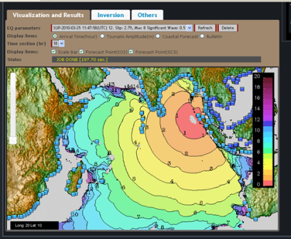
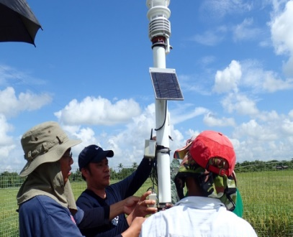
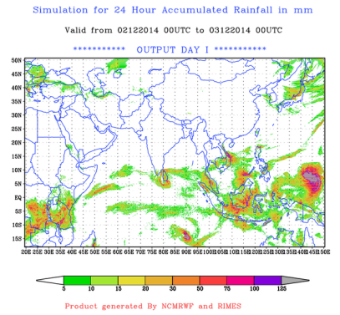
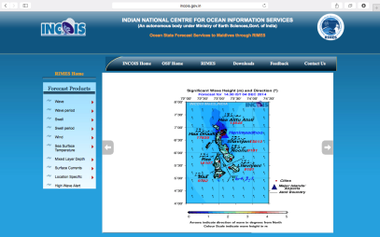
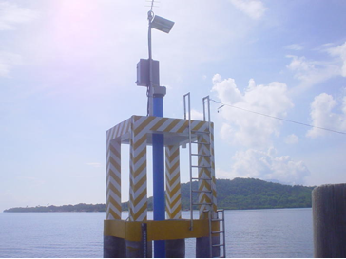
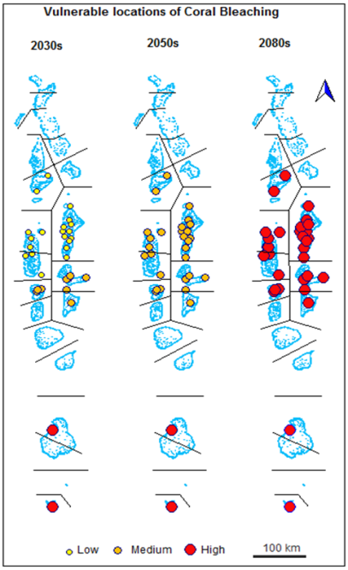
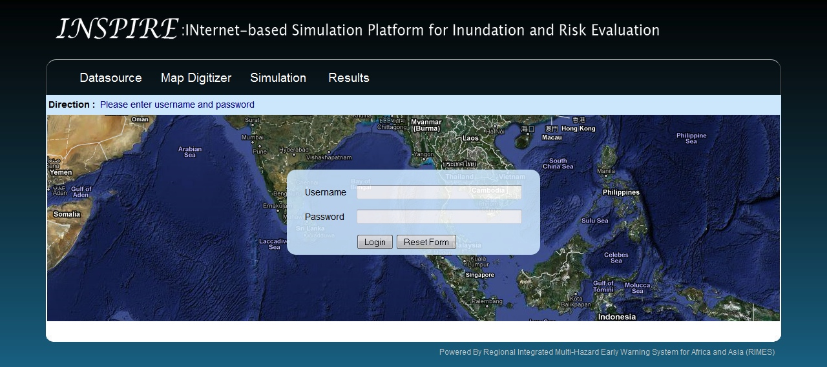
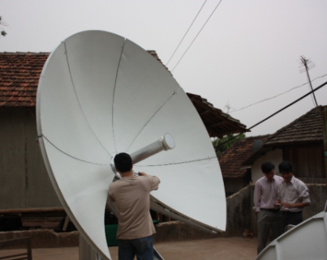
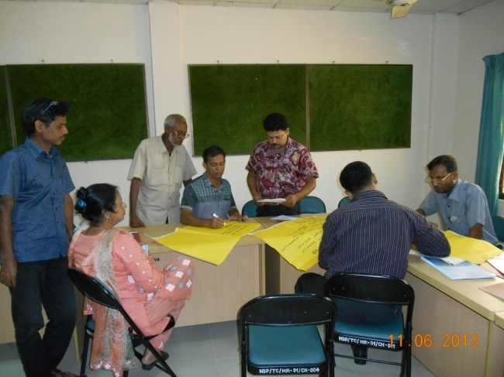
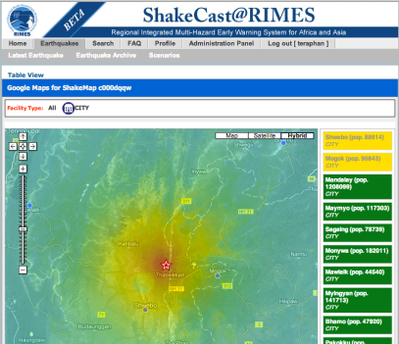
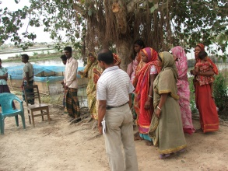
Key Services
Earthquake and tsunami services
Capacity building
Improving data availability
Weather and climate services
NMHS generates forecast
NMHS convenes the Forum
Forecast users analyze potential impacts and management options
Users report back to home agencies and finalize and implement impact management plan
Users monitor progress of the season and report actions taken, during the Forum
Monsoon Forum

Slide 5
Information Products and Key Partners
Earthquake Alert
Tsunami Bulletin
3-day weather forecast
Cyclone potential impact guidance
25-day flood forecast
Downscaled seasonal climate outlook
Downscaled climate projections
Ocean waves and swells forecast
Seasonal flood outlook
Storm surge forecast
10-day flood forecast
Flash flood forecast
Agro-advisories
IRIS
INCOIS
ESCAP
UNESCO/IOC
INCOIS
ESCAP
NCAR
NCMRWF
INCOIS
Gov of India
WMO/ESCAP
ECMWF
USAID
ESCAP
ECMWF
USAID
ESCAP
ECMWF
WMO
ESCAP
IPRC, Hawaii
IITM-CORDEX-SA
WMO
ESCAP

Slide 6
RIMES Services
EARTHQUAKE MONITORING AND TSUNAMI EARLY WARNING: Seismic observation stations
Santa, Philippines (SZP): 120 27.30E 17 33.12N
Sonla, Vietnam (SLV): 103 54.30E 21 20.03N
Sittwe, Myanmar (SIM): 092 53.11E 20 07.99N
Dalat, Vietnam (DLV): 108 28.89E 11 57.91N

Slide 7
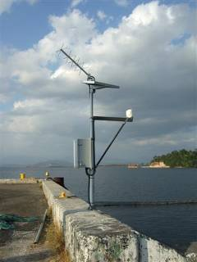
RIMES Services
EARTHQUAKE MONITORING AND TSUNAMI EARLY WARNING: Water level observation stations
Koh Taphao Noi, Thailand (KOTA): 98 25E 7 49N
Subic, Philippines (SUBI): 120 17E 14 49N
Vung Tao, Vietnam (VTAU): 107 15.264E 10 20.41N
Qui Nhon, Vietnam (QUIN): 109 15.26E 13 46.51N

Slide 8
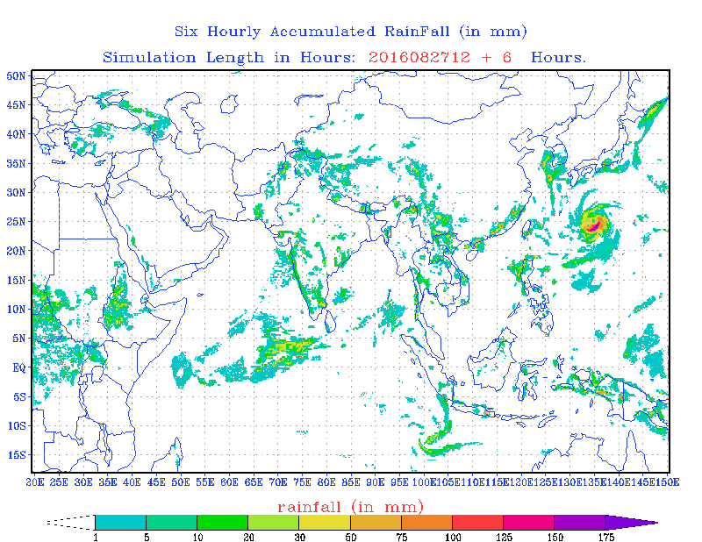
RIMES WRF model
Model domain extends from 20 ̊E to 150 ̊E and 16˚S to 50˚ N
Model forced with NCEP GFS 12 UTC cycle and rerun with NCMRWF GDAS datasets
Horizontal grid Resolution 9x9 Km (1470x870)
Micro Physics – Ferrier New Eta
  predicts changes in water vapor
Long-wave radiation – RRTM (Mlawer et al. (1997)
Noah Land Surface Model
Convective scheme - Kain and Fritsch (1990, 1993)

Slide 9
Model Performance

Slide 10
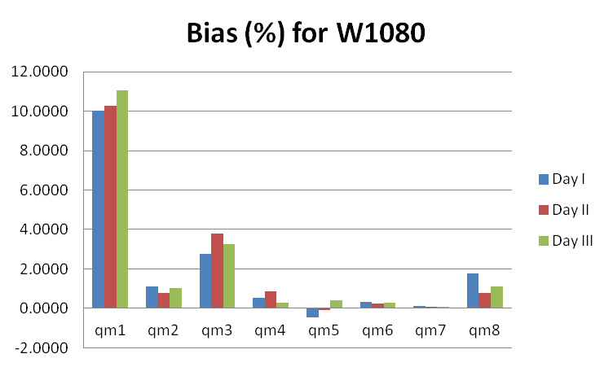
Model Performance - Myanmar

Slide 11
Model Performance – med range

Slide 12
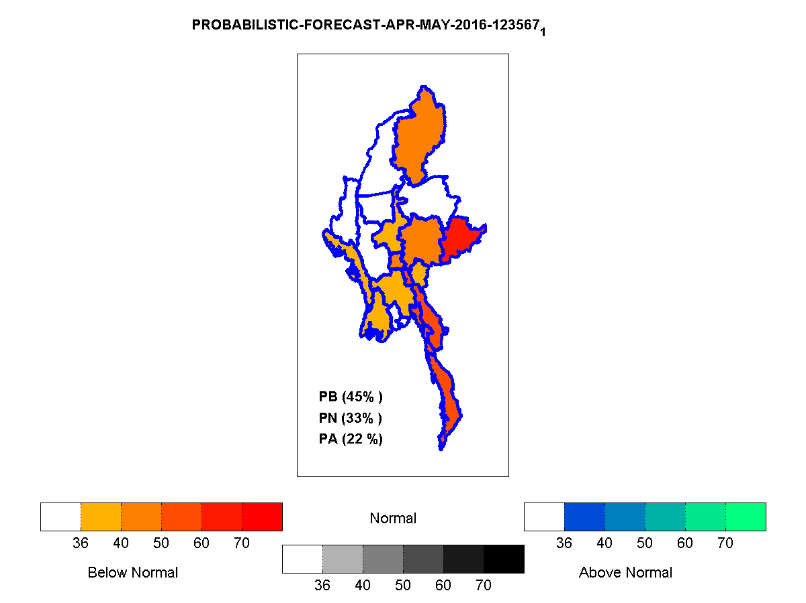
Seasonal Outlook
Monthly and Seasonal Forecast model climate zone wise
GCMs are include for multi model ensemble forecast
Developed based on statistical (empirical) method
Updated monthly

Slide 13
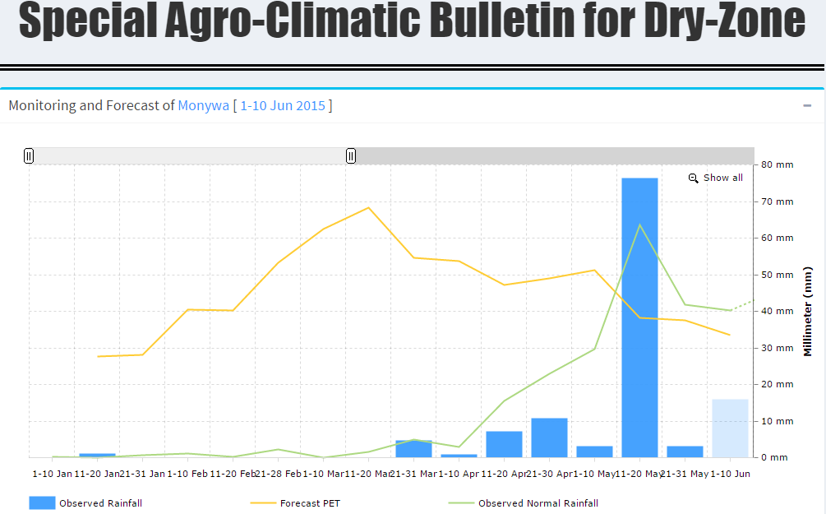
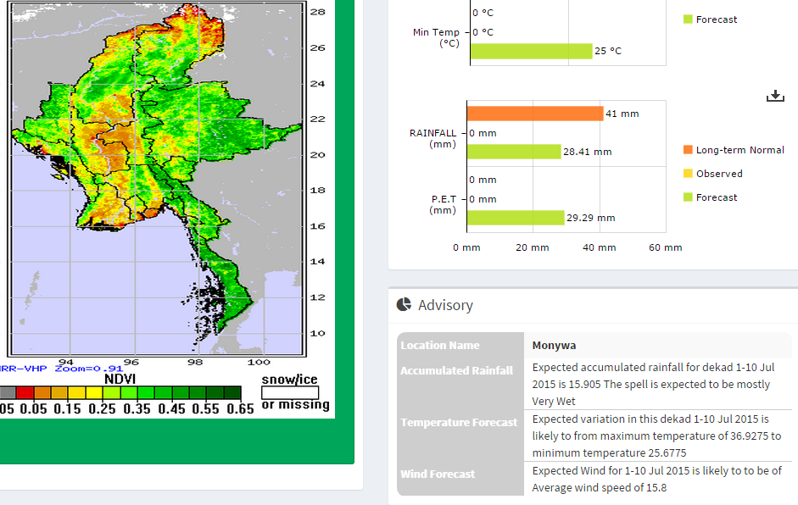
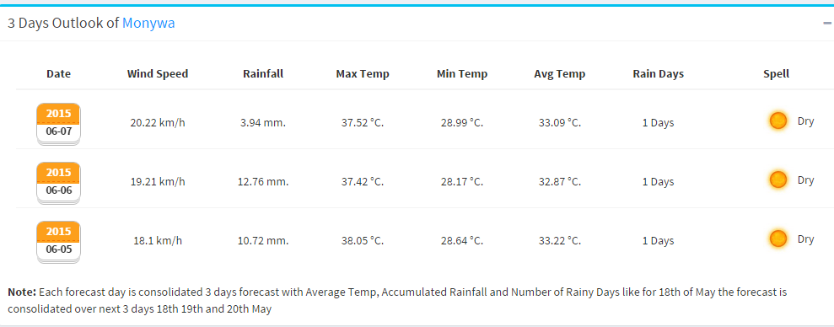
Agro-met Advisory System
Integrating both 3 days WRF and 10 days ECMWF forecast product to generate agro-climatic bulletin
Piloted in Dry zone in Myanmar – at township level with DMH and DoA collaboration

Slide 14
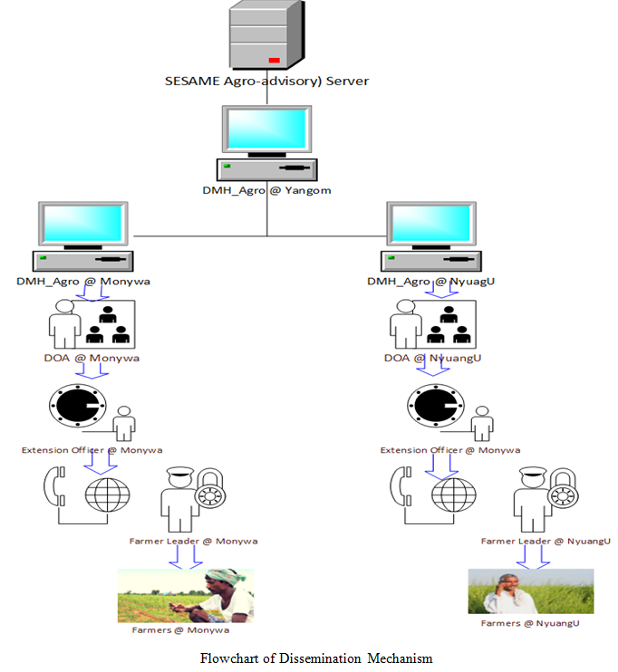
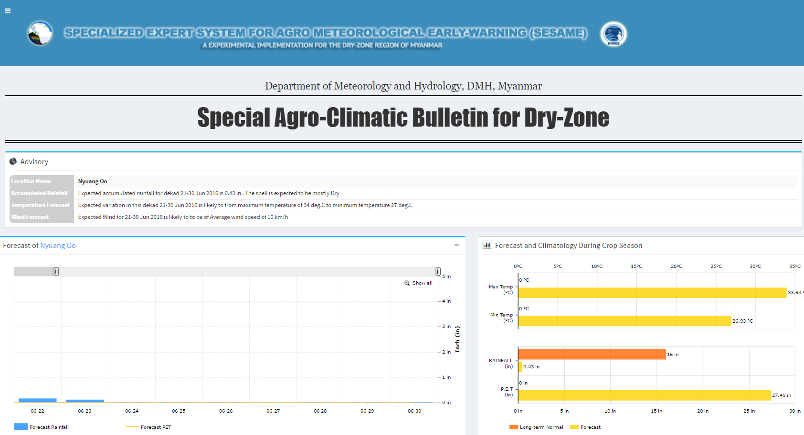

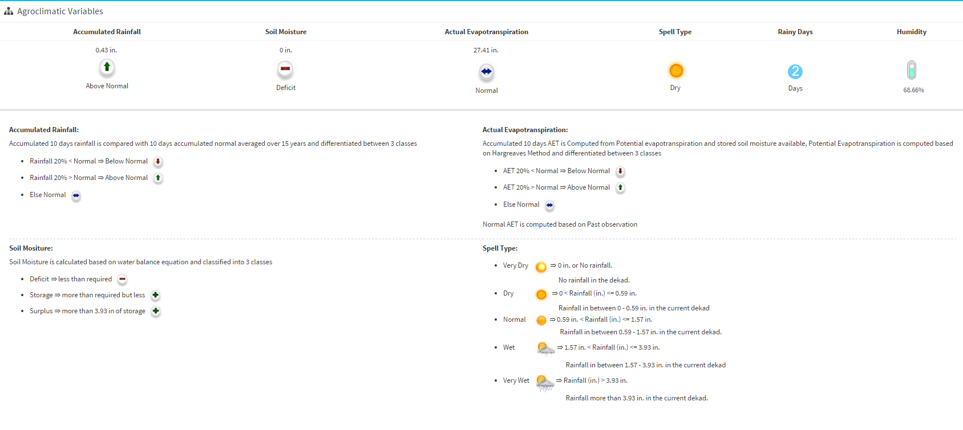


Agro-met Advisory System
4

Slide 15

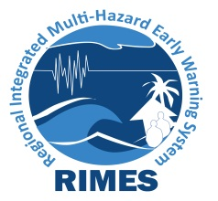
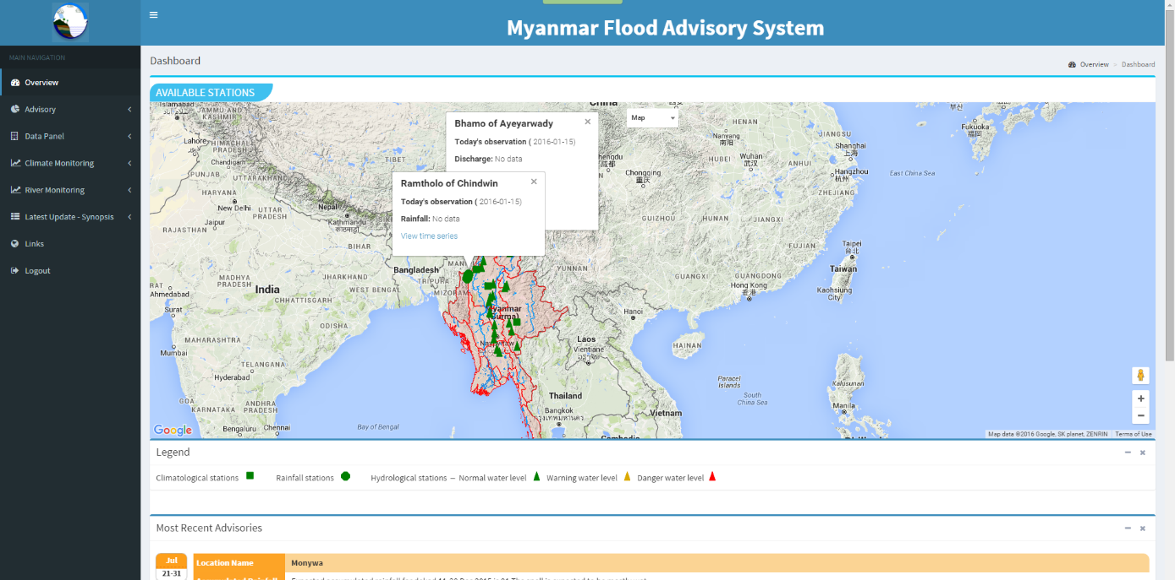
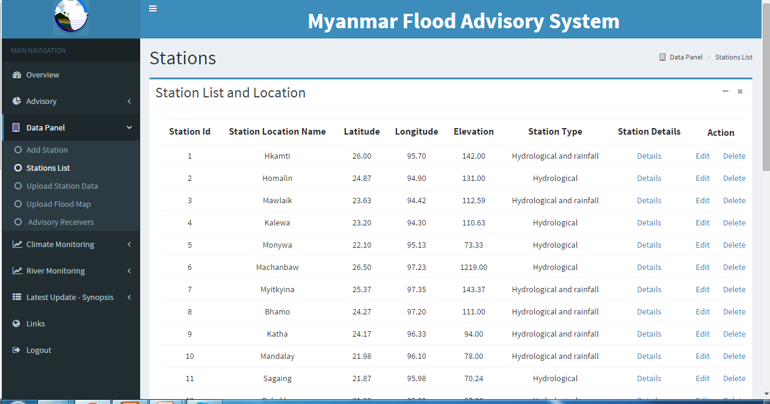
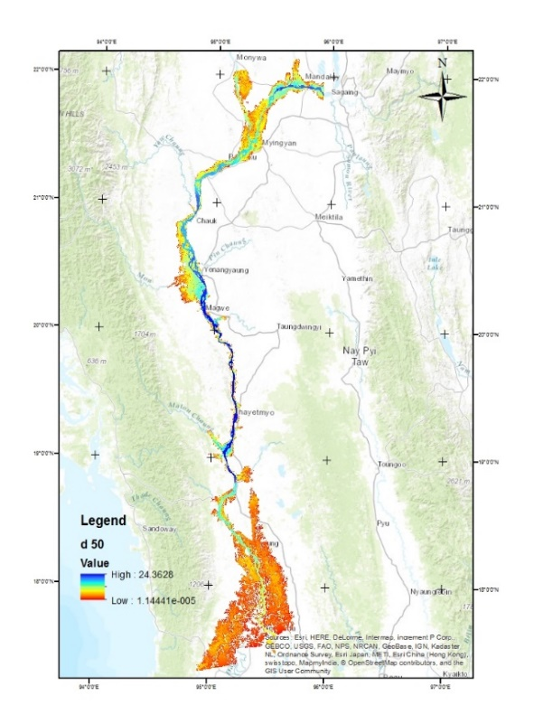
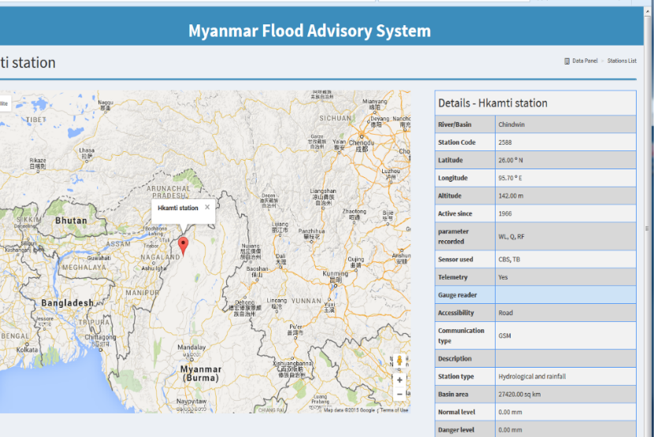
Myanmar Flood Impact Forecasting
Hazard map for 50 years return period flood

Slide 16
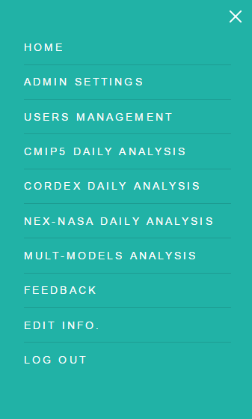
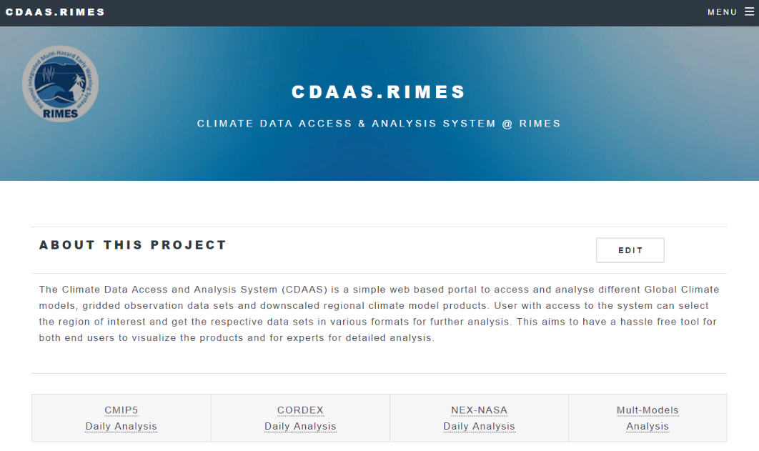
C D A A S
User friendly web based interface to access climate scenarios.

Slide 17
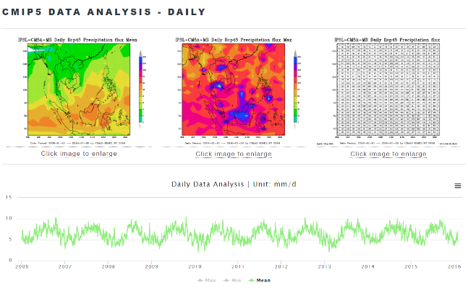
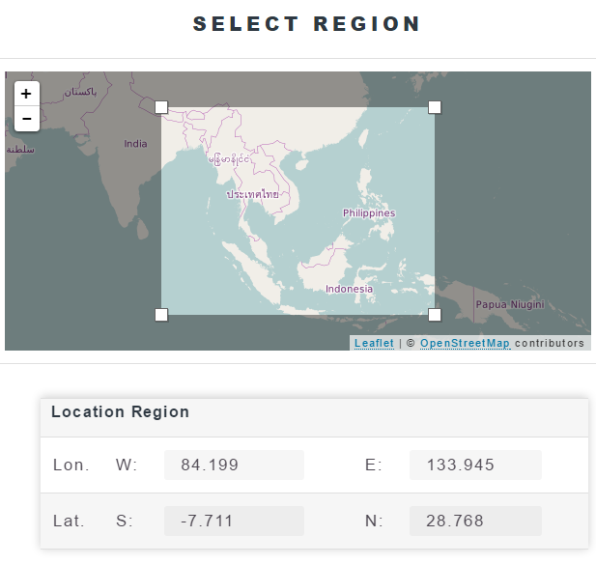
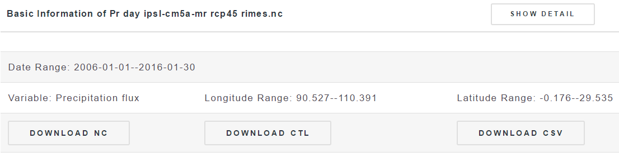
C D A A S

Slide 18
Reports

Slide 19
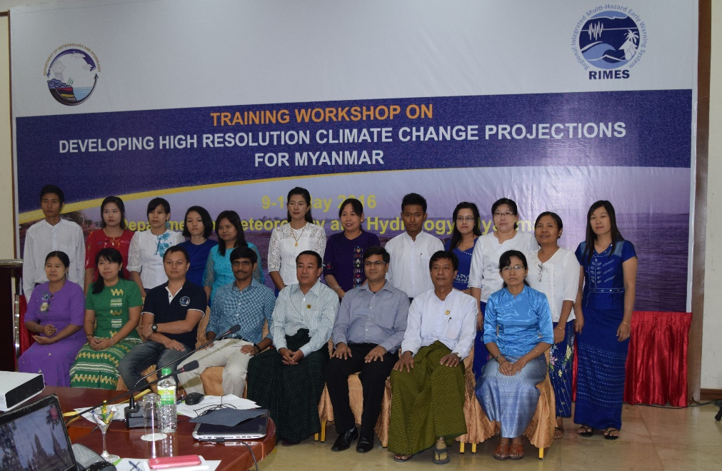
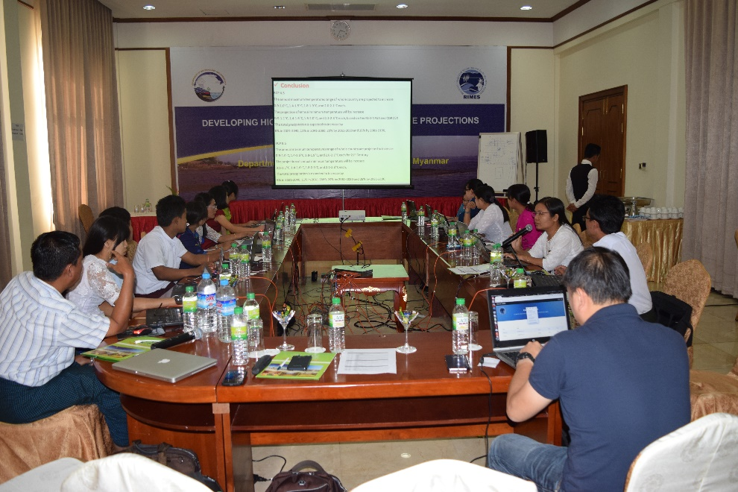
Capacity Development: Myanmar
DMH workshop, Nay Pyi Taw, Myanmar, May 9-11, 2016
Training workshops for interpretation and use of climate change scenarios for the key sectoral users
Training workshops within DMH to share analysis results

Slide 20
Needs and challenges
Integrated Data management system for effectively managing data from observation
Capacity in terms of human resources – IT skills
Maintenance of existing observation network
Establishment of upper air observation
Communication Systems

Slide 21
Thank you
Itesh Dash
RIMES
itesh@rimes.int
www.rimes.int

