Slide 1
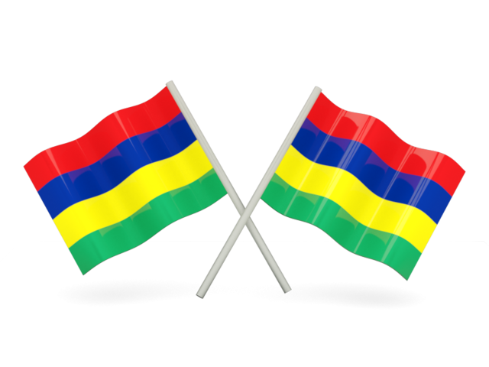
MAURITIUS FIRE AND RESCUE SERVICE
Coping with Climate Hazards
Presented By
Deputy Chief Fire Officer
D.SEESAHYE

Slide 2
MAURITIUS FIRE AND RESCUE SERVICE
The Mauritius Fire and Rescue Service Formally called Government Fire Service established during the 1954
During the recent five years the Mauritius Fire and Rescue Service has been facing many challengers and has been restructured to meet these challengers.
MAURITIUS FIRE AND RESCUE SERVICE
2

Slide 3
MAURITIUS FIRE AND RESCUE ACT
The Fire and Rescue Act 2013 No.13 of 2013 was proclaimed on 05th February 2014
The Fire Services Act dated 1954 has been repealed and consequential amendments have been brought to the:
Occupational Safety and Health Act 2005,
Central Electricity Board act,
The Central water Authority Act,
and Road Traffic Regulation 1954.
This Legislation has broadened the scope of the Service Operation.
MAURITIUS FIRE AND RESCUE SERVICE
3

Slide 4
MAURITIUS FIRE AND RESCUE SERVICE
VISION:
To render the Republic of Mauritius free from the dangers of fire and other emergency threats, and safe to live, work and visit anytime and anywhere
MAURITIUS FIRE AND RESCUE SERVICE
4

Slide 5
The mission of the Mauritius Fire and Rescue Service is to:
Protect life and property against destruction by fire in the republic of mauritius.
Render humanitarian services and to give advice on fire prevention and protection measures.
Provide supports in rescue operations during national calamities and major accidents.
Pro-contribute for the development of a sustainable republic of mauritius
MAURITIUS FIRE AND RESCUE SERVICE
5

Slide 6
MAURITIUS FIRE AND RESCUE SERVICE
Commitment :
We are dedicated to build a safer Mauritian society by:
Reducing the risk that cause emergencies
Dealing with emergencies when they happen
Building public confidence in Fire Services
Working effectively with our partners and stakeholders
Continually developing our resources to meet changing needs
MAURITIUS FIRE AND RESCUE SERVICE
6

Slide 7
MAURITIUS FIRE AND RESCUE SERVICE
7

Slide 8
MAURITIUS FIRE AND RESCUE SERVICE
Service Response Capability
The Mauritius Fire and Rescue Service is being driven and shaped like all Fire Service around the world by the rapid change taking place in its operating environment, not only in terms of nature, complexity and magnitudes of hazards and risks brought by new types of materials, industrial processes and taller, larger and more sophisticated buildings and above all the change in climatic conditions. The Mauritius Fire and Rescue Service has gradually evolved to become an All-hazard response agency.
MAURITIUS FIRE AND RESCUE SERVICE
8

Slide 9
MAURITIUS FIRE AND RESCUE SERVICE
We protect people and property from fire throughout the island.
We also protect people and property from other types of emergencies such as:
Cyclones
Floods
Landslide
Tsunami
Droughts
Industrial accidents
Chemical incidents oil spills
Aircraft incident
Road traffic accident
Technological Disasters
MAURITIUS FIRE AND RESCUE SERVICE
9

Slide 10
Human Resources
The Mauritius Fire and Rescue Service currently operates ten (10) fire stations manned by six hundred front line responders working in a four (4) shift system to provide fire and emergency cover for the whole country of about 1,255,020 population.
Approximately a firefighter to population ratio of 1 firefighter on duty for every 2100 of population
MAURITIUS FIRE AND RESCUE SERVICE
10

Slide 11
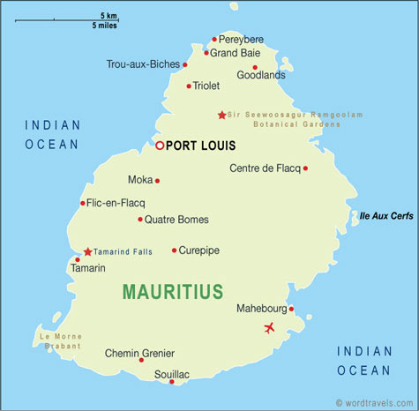
PITON F S
TRIOLET F S
PORT –LOUIS F S
COROMADEL F S
FLACQ F S
QUATRE-BORNES F S
CUREPIPE F S
TAMARIN F S
MAHEBOURG FS
ST AUBIN F S
MAURITIUS FIRE AND RESCUE SERVICE
11

Slide 12
Appliances and equipment
A fleet of 35 fire fighting vehicles are daily on the run for response to emergencies.
40 utility vehicles provide back-up supports and are used on other non-fire related incidents.
A wide range of firefighting, pumping, personal protective equipment and rescue gears is available and maintained in a high state of readiness through regular checks and standard test procedures.
MAURITIUS FIRE AND RESCUE SERVICE
12

Slide 13
Special Equipment
Flooding
At present the Mauritius Fire and Rescue Service has a wide range of equipment to perform at flooded sites. These include:-
Mobile Pumps, Portable Pumps, Submersible Pumps, Floating Pumps and associated equipments
Ropes and Lines
Lighting Equipment
MAURITIUS FIRE AND RESCUE SERVICE
13

Slide 14
Non Fire Incidents
Annually officers responded to an average 2521 non fire incidents during the period of 2010 to 2014
MAURITIUS FIRE AND RESCUE SERVICE
14

Slide 15
MFRS Involvement Cont’d
MAURITIUS FIRE AND RESCUE SERVICE
15

Slide 16
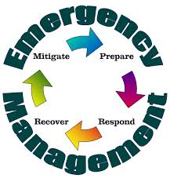
MFRS Service to Community:
Managing Natural Disaster
Four pillars of EMS:
Mitigation
Preparedness
Response
Recovery
MAURITIUS FIRE AND RESCUE SERVICE
Marine Pollution Incident
16

Slide 17
Global and National Strategies for Managing Natural and Man-Caused Disaster Risk.
MFRS has spoused the global strategies of investing in the Risk reduction from the effects of Natural and Man made calamities and preparedness at Service level as well as the Community.
Emergency preparedness for the community
Counter measures for landslide
Construction and maintenance of Drain
Consolidation of residential building /other structure
Capacity building at Service level.
Development of emergency plan.
Simulation exercises
MAURITIUS FIRE AND RESCUE SERVICE
17

Slide 18
Global and National Strategies for Managing Natural and Man-Caused Disaster Risk Cont’d
Investment in state of art, high tech equipment for early detection, alert and response.
MAURITIUS FIRE AND RESCUE SERVICE
18

Slide 19
Response:
Assist in evacuation
Carry out Search and Rescue
Pumping of flooded areas
Cleaning of Roads
MAURITIUS FIRE AND RESCUE SERVICE
19

Slide 20
Dry Seasons
Assist CWA to supply to Government Institutions.
Conduct Fire Safety / Prevention Awareness.
Formulate Forest Fire Precaution Plan.
Fight outbreak of Fires.
MAURITIUS FIRE AND RESCUE SERVICE
20

Slide 21
Non Fire Incidents
Annually officers responded to an average 2521 non fire incidents during the period of 2010 to 2014
MAURITIUS FIRE AND RESCUE SERVICE
21

Slide 22
Vegetation Fires
Annually officers responded to an average 2412 Sugar Cane Field Fires and an average of 2849 Wild Land Fires during the period of 2010 to 2014
MAURITIUS FIRE AND RESCUE SERVICE
22

Slide 23
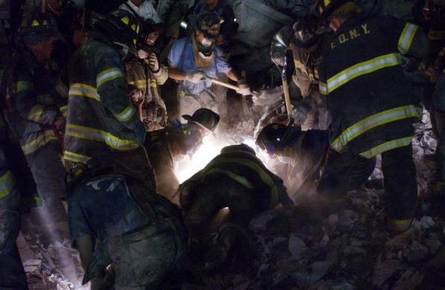
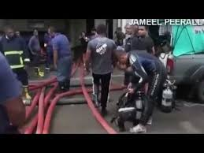
Recovery
Assist to restore essential services
MAURITIUS FIRE AND RESCUE SERVICE
23

Slide 24
Impact based forecast and Risk Based warning
Enable MFRS to ensure a high state of preparedness
Formulate preplan based on forecast
Consolidate precautionary / safety measures
MAURITIUS FIRE AND RESCUE SERVICE
24

Slide 25
Any Question?
MAURITIUS FIRE AND RESCUE SERVICE

Slide 26
Wishing that the co-operation between the Mauritius Fire and Rescue Service will flourish.
Thank You
MAURITIUS FIRE AND RESCUE SERVICE

