Slide 1
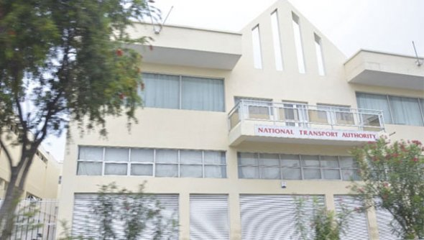
NATIONAL TRANSPORT AUTHORITY
Date: 26th October 2015
Venue: Gold Crest Hotel
Notes:
This template can be used as a starter file for presenting training materials in a group setting.
Sections
Sections can help to organize your slides or facilitate collaboration between multiple authors. On the Home tab under Slides, click Section, and then click Add Section.
Notes
Use the Notes pane for delivery notes or to provide additional details for the audience. You can see these notes in Presenter View during your presentation.
Keep in mind the font size (important for accessibility, visibility, videotaping, and online production)
Coordinated colors
Pay particular attention to the graphs, charts, and text boxes.
Consider that attendees will print in black and white or grayscale. Run a test print to make sure your colors work when printed in pure black and white and grayscale.
Graphics, tables, and graphs
Keep it simple: If possible, use consistent, non-distracting styles and colors.
Label all graphs and tables.

Slide 2
Welcome
Presented by:
Mr. Rajen Gungabissoon
Chief Road Transport Inspector

Slide 3
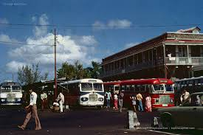
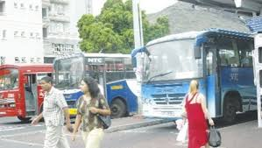
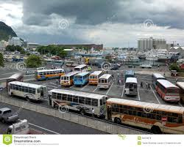
Coping with hazards that affect day to day operations and activities
Notes:
This is another option for an overview using transitions to advance through several slides.

Slide 4
Agenda
Introduction
Services
Inspectorate
Coping with hazards
Notes:
This is another option for an overview slide.

Slide 5
Introduction
The National Transport Authority (NTA) is a Department under the aegis of the Ministry of Public Infrastructure and Land Transport.It has as main responsibility the regulation and control of road transport in Mauritius and Rodrigues.

Slide 6
Introduction cont….
Vision
Mission
Objectives
Profile

Slide 7
SERVICES
Registration and Licensing of motor vehicles.
Licensing of public services vehicles, goods vehicles and petrol service stations.
Collection of Road Tax and other license fee.
Vehicle examination.
Licensing of bus conductors.
Enforcement of road transport legislation and monitoring of public transport.
Enforcement of parking regulation.
Keeping statistics of motor vehicles.
Planning of new transport services.

Slide 8
INSPECTORATE
Roles and Responsibilities
Enforcement of the relevant provisions of the Road Traffic Act and Road Traffic Regulations.
Monitoring of bus services and dedicated school services.
Attending to complaints.
Examining requests for new transport facilities.

Slide 9
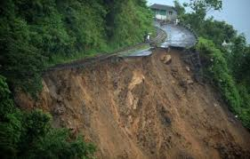
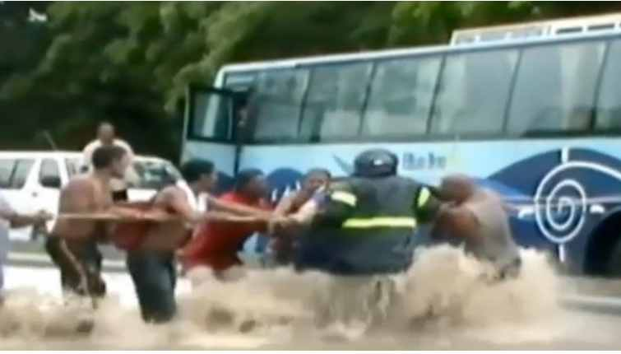
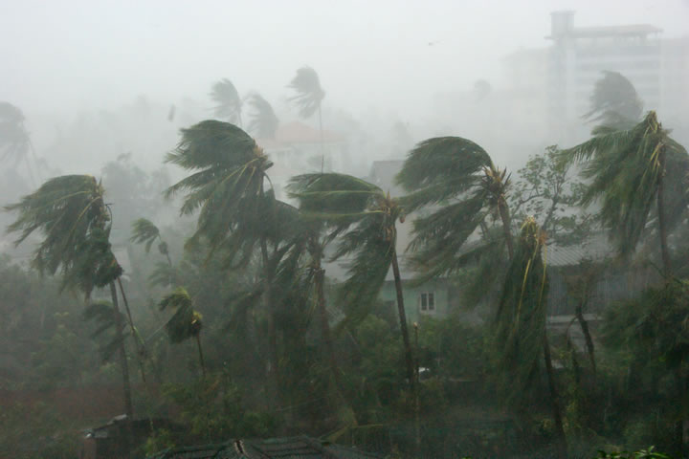
Coping with hazards
Hazards:-
Torrential rain
Cyclone
Other natural disasters

Slide 10
Coping with Torrential Rain
On the issue of torrential rain warning , programme of work for the day is cancelled.
SRTIs and RTIs should call immediately on bus stands or stations of their respective zone.
Continuous monitoring of the situation.
Reporting of the prevailing situation to the Principal Road Transport Inspectors.
Communicate information to CRTI rep. NDRRMC

Slide 11
Coping with Cyclone
Issue of Cyclone warning class II
Classes at schools dismissed.
SRTIs an RTIs to liaise with bus operators for provision of dedicated school buses.
Monitor and ensure that maximum number of buses are available on bus stations.

Slide 12
Coping with Cyclone cont….
Issue of Cyclone warning class III
SRTIs and RTIs to take stock of transport situation prevailing along all routes at bus stations falling under their responsibility.
To liaise with bus operators for the provision of maximum number of buses at major bus stations.
To report the situation on a regular basis to Principal Road Transport Inspectors.

Slide 13
Reporting
On removal of warning (any day):-
Take stock on state of roads, flooding, fallen down trees or any other obstruction.
Any damage caused to buses, bus stations, shelters, etc.
Monitor bus services.

Slide 14
Reporting cont….
SRTIs an RTIs should call to their respective sites of work within one hour.
Monitor the transport situation for at least three hours.
For any changes in routes the SRTIs an RTIs should consult the senior officer.
In case of warning removed after 17h00 monitoring to be done from 6h00 the very next day.
RTIs should remain at post until transport situation is back to normal.
SRTIs to report on the situation to PRTIs.

Slide 15
Thank You

