Slide 1
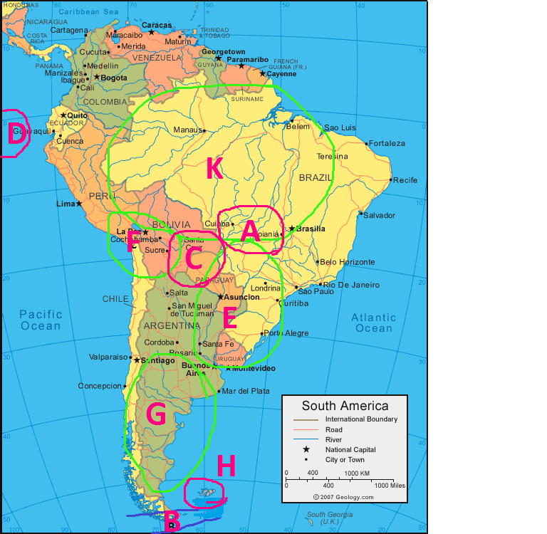
Suriname (Northeast coast of South- America)

Slide 2
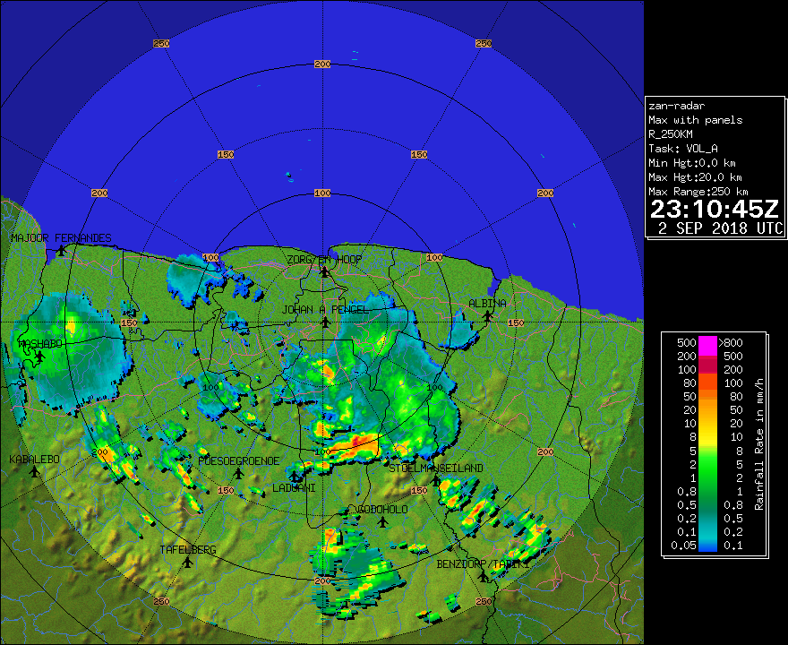
What is the status of the impact based forecast in Suriname
Suriname Government bought a doppler radar in 2015 which has proven to be a valuable tool to make better weather forecast, especially for the nowcast. This can be consider as a strong key for impact based weather forecast Weakness: staff who are responsible for rescue missions are not taking weather forecast seriously so they frequently act after impact of the weather phenomena, somewhat late.
Numerical models can’t handle small scale convection

Slide 3
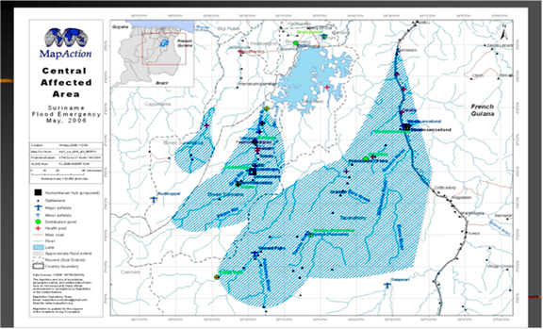
How is the decision making process of emergency agencies based on national weather information
In Suriname the national coordination Platform make decision after consultation of the minister of public affairs So the parties involve in the decision making are all government, but weather forecast are not taken too serious. Chart on the left: flooding in 2006, part of the interior 5-8 th may 2006

Slide 4
Communication between weather service and emergency agency
Step 1: weather service and emergency agency raise public awareness about weather hazard in terms of what measure to take in case of violent thunderstorm, strong gusty winds, flooding, via television interviews, ect..
Step2: weather service submit weather forecast and warning Weather forecast every 7 hours to the emergency agent, general public, warning as soon a needed and daily rainfall data. Note: emergency agent should do more at the preparation stage
Step3 : Emergency agency take measure after weather hazard Sometimes the agency encounter a lack of financial support by the government
Note: better communication between weather service and emergency agency is required e.g data exchange ect.

Slide 5
Evaluation process or reconstruction
Complain from weather service: Frequently the evaluation or reconstruction process is done with little or no input of the weather service.
The emergency agent don’t share data with the weather service e,g how many houses or buildings are damage after strong gusty winds and
What are the exact geographic locations, ect

Slide 6
Weather product user oriented? Communication channels?
For our nowcast products we recently start to use colours for warning type e,g
=Warning of the highest alert. Take immediate action due to weather hazard possible consequences: flooding, lightningstrike,strong gusty winds
= be aware of weather phenomena in the area with 50% chance of appearance
= Lowest alert with 40% chance of appearance of weather phenomena
Communication channels: website, radio, television interviews, newspaper

