Slide 1
DEFINITION OF LANDSLIDE AND THE PROCEDURES OF THE EARLY WARNING SYSTEM AT DESIGNATED SITES
PRESENTED BY
M.K.MOSAHEB
Engineer/Senior Engineer
Ministry of Public Infrastructure and Land Transport
26 October 2015

Slide 2
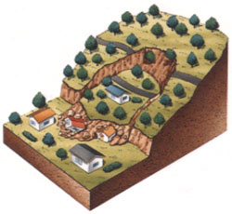
What is Landslide?
A landslide is a phenomenon where a mass of soil moves down on a slope.
This is triggered by heavy rain, earthquakes, volcanic eruptions, river erosion and earthworks.
Compared to slope failure, landslides are generally on a larger scale and occur on gentler slopes (about 5-30deg).

Slide 3
Major Landslide Disasters in Mauritius (sources: JET & MPI)
Year | Landslide Disasters/Countermeasures
1986 | A large scale landslide occurred in the La Butte area (1500 houses were damaged, 4 main water pipes and high voltage power lines were broken).
1989 | JICA’s Port Louis City Landslide Countermeasure Planning Study began (−1990).
1994 | JICA’s Port Louis City Landslide Protection Project was approved (completed in 1998).
2005 | A large scale landslide occurred in Chitrakoot (54 houses were damaged). A landslide occurred in Quatre Soeurs (11 houses were affected).
2006 | A landslide reoccurred in Chitrakoot (14 houses more were damaged)
2007 | A school in the landslide hazard area in Chitrakoot was damaged.
2008 | Landslides reoccurred in Chitrakoot and Quatre Soeurs (monitoring began).
2008 | Landslide occurred in Vallee Pitot.
2009 | The Cyclone and Other Natural Disasters Scheme was established. Landslide Management Unit (LMU) was established at the MPI.
2013 | Landslide occurred in Camp Chapelon.
2014 | Rockfall at Maconde Baie du Cap

Slide 4
Nature of Disasters
Slope Disasters
There are normally four types of slope disasters namely:
Landslide
Rock fall
Slope failure
Debris Flow

Slide 6
Classified Landslide Sites
Presently, there are three classified landslide sites as per the National Disaster Scheme namely:
Chitrakoot Upper Vallée des Prètres
Vallée Pitot near Eidgah
Quatre Soeurs at Marie Jeanne, Jhummah Street, Old Grand Port

Slide 7
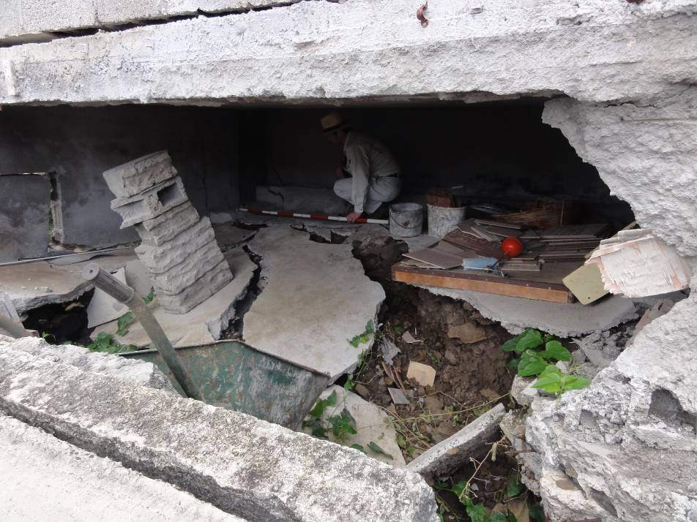
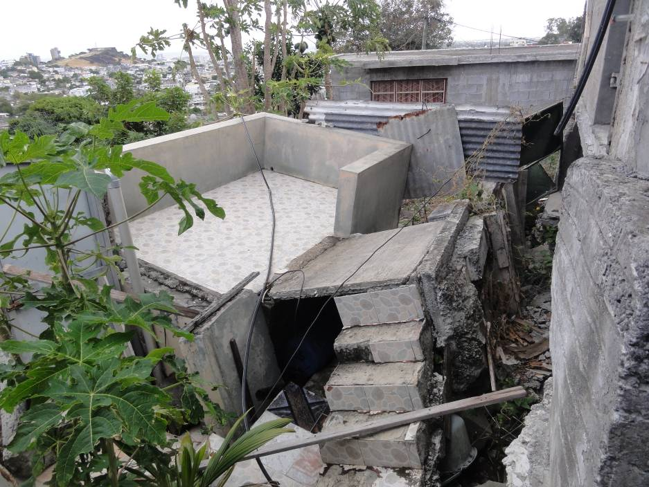
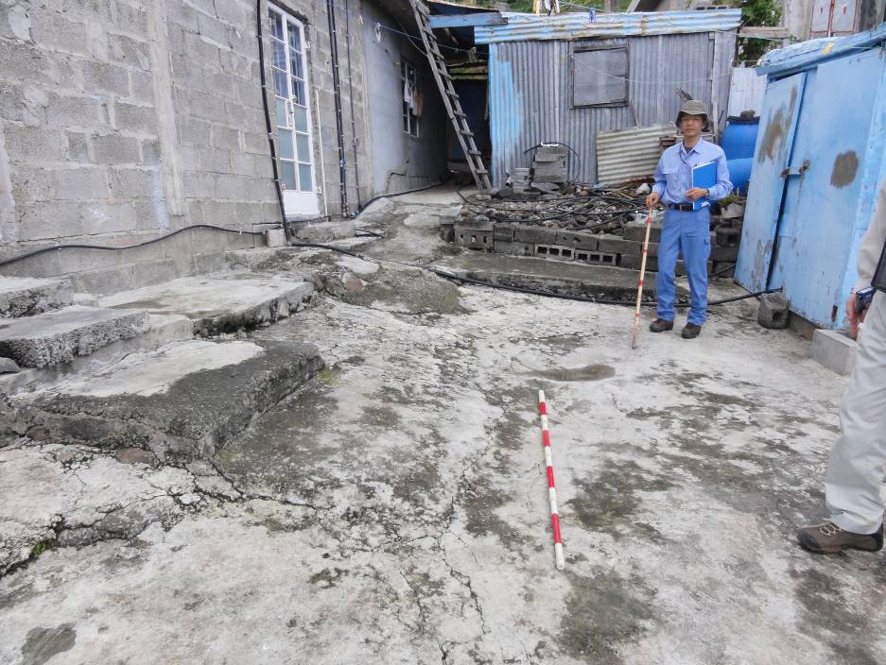
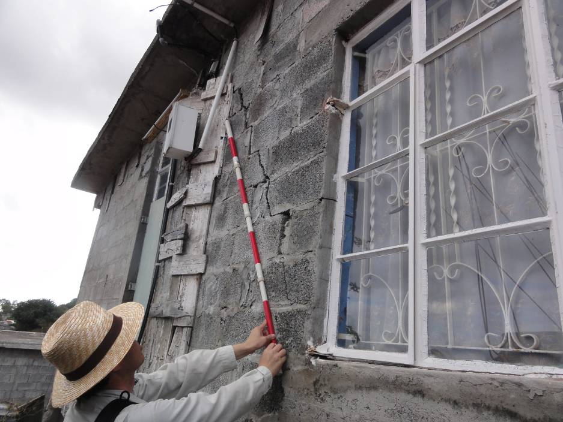
Large scale landslide sites: Vallee Pitot
Main scarp
The broken steps
The observed cracks
Damage on house

Slide 8
Vallée Pitot near Eidgah
Actions Taken:
Contract awarded for in-depth investigation :
Drilling of Boreholes
Installation of Landslide Monitoring Equipment
Monitoring and Maintenance of Landslide Devices
Countermeasure works will be designed based upon the results of the in-depth investigation after relocation of some houses.

Slide 9
Management of Landslide Activities
Structural measures
Non-Structural Measures

Slide 10
Actions to be undertaken prior to establish Non-Structural Measures
Create awareness of landslide issues among the local people
Underline the importance of landslide through an intensive education campaign to the local people
Get the participation of the inhabitants through stakeholder meetings

Slide 11
Establishment of an Early Warning System
Early Warning is governed by
Precipitation using Rain Gauge (to be provided by the Meteorological Services)
Ground Surface Deformation (Extensometer readings)
Damages on existing structures

Slide 12
Establishment of an Early Warning System
The Early Warning System consists of three stages as follows: -
Warning Stage
Evacuation Stage
Termination Stage

Slide 13
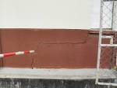
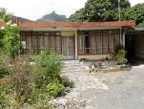
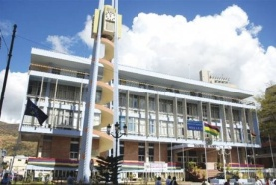
WARNING STAGE
EXTENSOMETER
RAIN GAUGE
OBSERVATION
- DAMAGES on structures -
10mm/day
cracks
or
or
Yellow
Beacon
at EV1
75 mm
deformation
MPI
Police /Special Mobile Force (SMF)/NDRRMC
Issue of
Warning Stage
Municipality of Port Louis
Inhabitants

Slide 14
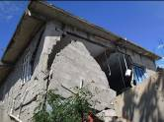
EVACUATION STAGE
EXTENSOMETER
RAIN GAUGE
OBSERVATION
- HEAVY DAMAGE -
20mm/day
Red Beacon + Alarm Sound (Siren)
at EV1
or
100 mm
or
Police / SMF/NDRRMC
Inhabitants
Evacuation Order
(Self) Evacuation
Safe Area
(Out of
the Landslide)
Do not wait the Evacuation Order

Slide 15
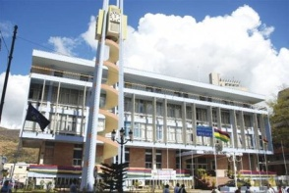
TERMINATION
Municipality of Port Louis
MPI
EXTENSOMETER
0 mm /day
(RAIN GAUGE)
No rainfall for 3 days
and
and
Observe the site condition
Police / SMF/NDRRMC
Announcement of
Termination
Inhabitants

Slide 16
Thank you

