Slide 1
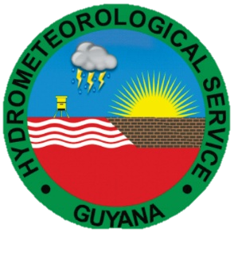
Meteorologist Lyndon Alves Weather Forecaster Eron McPherson
Hydrometeorological Service- Guyana

Slide 2
The Hydrometeorological Service is a Department attached to Ministry of Agriculture. It was established on 5th October, 1965 by Cabinet of Guyana.
The Department’s responsibility is to monitor and evaluate the weather and water resources in Guyana and to actively support the government in disaster risk management and aviation, water, agriculture, engineering and other agencies for the socio-economic development of the country.
It is the official provider of weather, water and climate information and related products and services for Guyana.

Slide 3
STATUS OF IMPACT BASED FORECASTS
The Hydrometeorological services produces the forecast and sends same to; sectorial agencies, public and other bodies:
Health
Agriculture
Drainage and irrigation
City council
NDC and RDC
Ministry of Public infrastructure.

Slide 4
INSTANCES OF ARTICULATION
National Disaster Risk management Protocol
The agencies are separate
The DRM platform : Hydromet, CDC, Red Cross, Police, Fire fighters, Drainage and irrigation, Agriculture, Health, etc.
Hydromet in the Secretariat for the EWS Subcommittee of the National Disaster Risk Reduction Platform
Hydromet feeds the platform with information in all phases of an emergency

Slide 5
WEAKNESSES AND STRENGTHS
* Warning and Alerts sometimes get out late due to the dissemination chain.
* Due to the process, the message is sometimes changed/sensationalized.
Good monitoring capabilities
Responsible agencies know what the situation on the ground is and how they are to respond in the case of each disaster.
DRMs meets periodically to assess the needs, concerns, plans, etc.
CDC is ready to act to address any situation.

Slide 6
PRODUCTS AND THEIR DISSEMINATION

Slide 7
PRODUCTS AND THEIR DISSEMINATION
Webpage
Mailing lists
Radio
TV

Slide 8
Thank you

