Slide 1
Shanghai Forecast Office

Slide 2
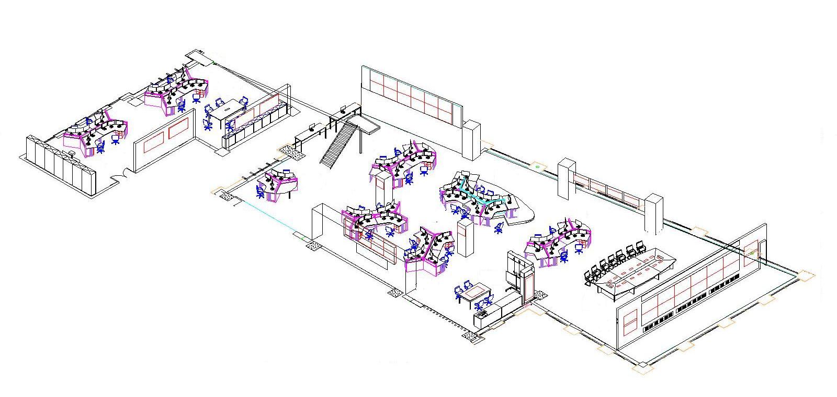
Forecast Area
F-1: Forecast Planning & Organization
Focus on high impact weather:
F-2: Multi-scale Weather Analysis and Forecast
F-3: Refined Urban Weather Forecast and Early Warning based on Vulnerability
F-7: Typhoon Early Warning
Focus on weather impact on critical locations:
F-3: Refined Urban Weather Forecast and Early Warning based on Vulnerability
F-5: Regional Weather Forecast, Warning and Joint Preparedness
F-7: Refined Marine Weather Forecast
Weather Briefing
Supporting sub-sections:
F-6: Weather and Environment Analysis based on Satellite Remote Sensing
F-8: Regional NWP Application
F-9: Subtropical Circulation & Abnormal Characteristic Analysis
Focus on weather impact on users:
F-4: Weather Impact Forecast Based on Ensemble NWP Analysis

Slide 3
Subtropical Circulation & Abnormal Characteristic Analysis
Focus on High Impact Weather System
1 ) Basic Weather System
2 ) Severe Convective Weather
3 ) Tropical Cyclone
NWP products
Uncertainty and maximum possibility analysis of NWP
Sensitivity parallel run
Forecast Area
TC Location and Intensity Estimation
Weather system dynamic analysis
Tropical Early Warning
Multi-scale Wea Analysis & Fcst
Severe Convective Weather
F-1: Forecast Planning & Organization
F-2: Multi-scale Weather Analysis and Forecast
F-3: Refined Urban Weather Forecast and Early Warning based on Vulnerability
F-4: Weather Impact Forecast Based on Ensemble NWP Analysis
F-5: Regional Weather Forecast，Warning and Joint Preparedness
F-6: Weather and Environment Dynamic Analysis based on Satellite Remote Sensing
F-7: Typhoon Early Warning & Refined Marine Weather Forecast
F-8: Regional NWP Application
F-9: Subtropical Circulation & Abnormal Characteristic Analysis

Slide 4
Environmental Remote Sensing Monitoring and Analysis
Weather system dynamic analysis
Focus on critical locations
1) Shanghai, a megacity
2 ) Marine and costal areas
3 ) East China Region and Lake Taihu Basin
Ensemble PoP
Sea wave model product
Hydro-meteorological coupled model
Forecast Area
Multi-scale weather analysis and Seamless Forecast
Refined marine weather forecast
1.Urban Refined Forecast
2.Early warning based on Vulnerability
Lake Taihu basin hydro-meteorology
regional weather guidance & jointly preparedness
F-1: Forecast Planning & Organization
F-2: Multi-scale Weather Analysis and Forecast
F-3: Refined Urban Weather Forecast and Early Warning based on Vulnerability
F-4: Weather Impact Forecast Based on Ensemble NWP Analysis
F-5: Regional Weather Forecast，Warning and Joint Preparedness
F-6: Weather and Environment Dynamic Analysis based on Satellite Remote Sensing
F-7: Typhoon Early Warning & Refined Marine Weather Forecast
F-8: Regional NWP Application
F-9: Subtropical Circulation & Abnormal Characteristic Analysis

Slide 5
Environmental Remote Sensing Monitoring and Analysis
Weather system dynamic analysis
Focus on high sensitive users
1) Impact on natural environment (storm surge , haze)
2) Impact on urban infrastructure (power supply, transportation)
3) Impact on Public health (COPD, heat exhaustion)
Reliability analysis and verification of NWP
Ensemble NWP products and analysis
Forecast Area
TC wind and rain fcst
Multi-scale weather analysis and Seamless Forecast
Urban refined forecast
F-1: Forecast Planning & Organization
F-2: Multi-scale Weather Analysis and Forecast
F-3: Refined Urban Weather Forecast and Early Warning based on Vulnerability
F-4: Weather Impact Forecast Based on Ensemble NWP Analysis
F-5: Regional Weather Forecast，Warning and Joint Preparedness
F-6: Weather and Environment Dynamic Analysis based on Satellite Remote Sensing
F-7: Typhoon Early Warning & Refined Marine Weather Forecast
F-8: Regional NWP Application
F-9: Subtropical Circulation & Abnormal Characteristic Analysis
Synoptic mapping & forecasting for weather impact
Probabilistic weather impact forecast based on EP

