Slide 1
THE
PWSD
PROGRAMME

Slide 2
World Weather Information Service
(WWIS)

Slide 3
Participation of Members in WWIS
169 Members providing weather and climatological information for cities 2152 cities

Slide 4
WWIS in Eleven Languages
Arabic
Chinese
English
French
German
Italian
Korean
Polish
Portuguese
Russian
Spanish
The 5th Meeting of WWIS Language Hosts (Lisbon, Portugal, 2015)

Slide 5
The WMO World Weather Information Service (WWIS)
Hosted and coordinated by Hong Kong Observatory (HKO)
Objectives
source of official weather by NMHSs
To enhance visibility of NMHSs, especially those of developing countries
Links to the NMHS's websites

Slide 6
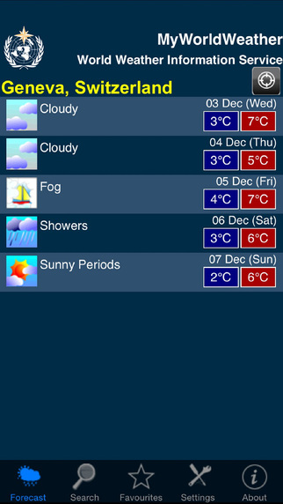
The WMO World Weather Information Service (WWIS)
Available in website and mobile phone versions (Android and Apple platforms)
A weather widget is available for Members to include on their websites
The WWIS Widget

Slide 7
Future of WWIS
WMO taking steps to increase participation of NMHSs and to include modern features in WWIS
Challenge of competation with private weather forecast providers especially on mobile phone platforms (view WWIS here)

Slide 8
Request to Members in order to address challenges
To increase number of cities for which they provide forecast and climate information
To provide forecasts for at least 5 days
To provide a link to WWIS from the Website of the NMHSs
To enable local media, tourist companies, hotels and the public to use WWIS
To include the WWIS widget on the website of NMHSs

Slide 9
Thank you
Merci

