Slide 1

THE
PWSD
PROGRAMME

Slide 2

Common Alerting Protocol
(CAP)

Slide 3
Learning Objectives
On completion of this session, you should understand :
1. what CAP is
why CAP is needed
the expected benefits of CAP
the role of the WMO Register of Alerting Authorities
3. the WMO Alert Hub
Notes:
Here are the Learning Objectives for this introductory session.

Slide 4
Presentation Outline
1 What is CAP
2 Benefits of CAP
3 Features of a CAP Message
4 Alerting Authorities
WMO Alert Hub
Opportunities for implementing CAP
Notes:
These are the major topics I will cover in this presentation.
The first topic is "Opportunity and Challenge".

Slide 5
What is CAP?
The Common Alerting Protocol (CAP) is a standard message format
Notes:
CAP was developed to address the challenge of alerting by standardizing the content of alerting messages.
CAP provides a format designed for any media, to communicate information about any kind of hazard situation.
And, the message can be targeted to: the public at large; certain designated groups such as civic authorities or responders; or to specific individuals as needed.

Slide 6
The CAP Format
Event Categories
Urgency
Severity
Certainty
Notes:
Recall that CAP has a variety of “coded values”. These include:
Event Categories (Geo, Met, Safety, Security,
Rescue, Fire, Health, Env, Transport, Infra, Other)
Urgency: Timeframe for responsive action
Severity: Level of threat to life or property
Certainty: Probability of occurrence

Slide 7
The CAP Format
Event Categories
(Meteorological, Fire, Health, Transport, etc)
Urgency: (Immediate, Expected, Future, Past, Unknown)
Severity: (Extreme, Severe, Moderate, Minor, Unknown)
Certainty: (Very Likely, Likely, Possible, Unlikely, Unknown)
Notes:
Recall that CAP has a variety of “coded values”. These include:
Event Categories (Geo, Met, Safety, Security,
Rescue, Fire, Health, Env, Transport, Infra, Other)
Urgency: Timeframe for responsive action
Severity: Level of threat to life or property
Certainty: Probability of occurrence

Slide 8
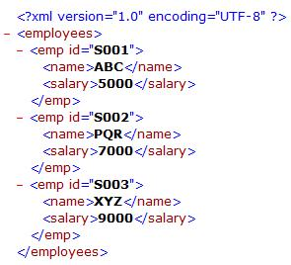

The Common Alerting Protocol (CAP)
An XML-based data format

Slide 9





All-Hazards, All-Media
CAP
Notes:
CAP can supplement or replace single-purpose interfaces between alert sources and dissemination media. So, CAP can be viewed as
a kind of "universal adaptor" for alert messages.
I like to think of CAP as a standard form, carried on a clipboard. People involved in all kinds of hazard situations all have this same form. Standardized information in the items on that CAP form can be communicated to all who need it--across all kinds of systems and media.

Slide 10

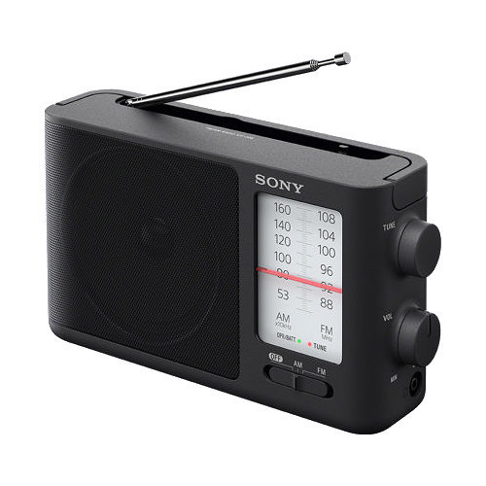

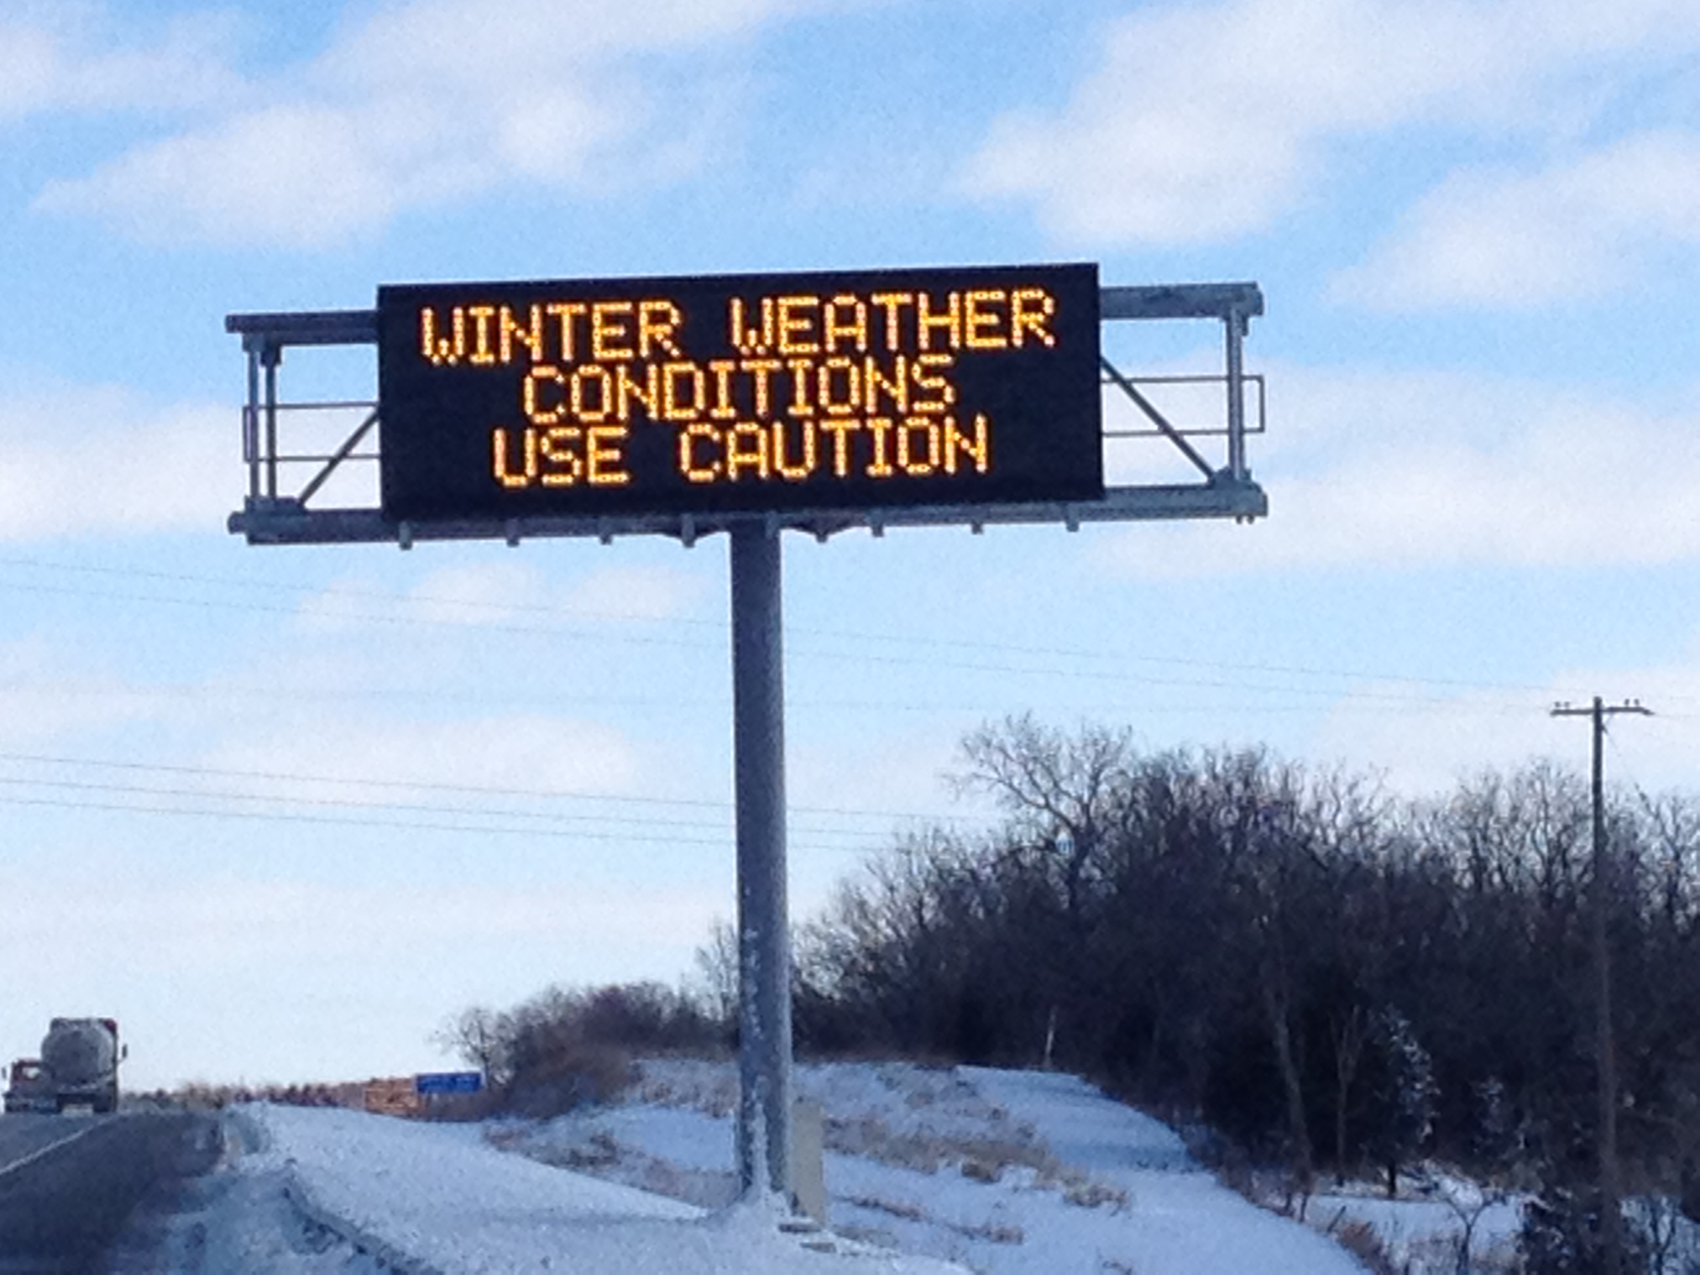
The Common Alerting Protocol (CAP)
CAP warning disseminated simultaneously over many warning channels
(e.g. TV, radio, internet, mobile phones, digital road signs … etc)
CAP warning

Slide 11
Some Basics About CAP
To make a CAP alert easier for a human to read, a “Stylesheet” transforms the XML document into HTML.

Slide 12
Structure of a CAP Message
Text for humans to read
Coded values for machines useful for filtering, routing, and automated translation
to human languages
Notes:
This is a critically important feature of CAP messages.
CAP Messages contain various text values for human readers,
such as "area description", "headline", and "instruction".
But, CAP messages also contain coded values that are necessary
for filtering, routing, and display of messages.
Coded values are also very useful for automated translation to human languages.

Slide 13
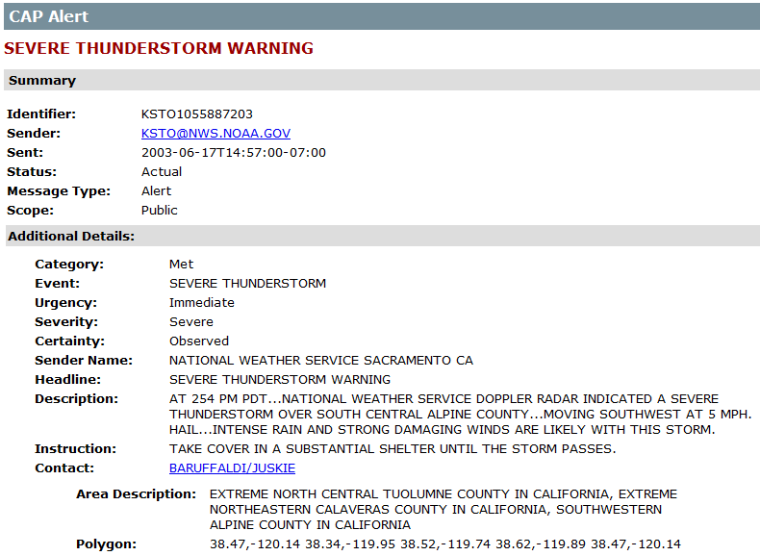
Alert with Stylesheet
Example: Text for human to read
Notes:
To make a CAP alert easier for a human visitor to read, a “Stylesheet” transforms the XML document into HTML. Yet, the XML representation is still there so it can used by other processes, such as alert aggregators, text-to-speech processors, and so on.

Slide 14
Example CAP Message
Example: Coded values for machines
Notes:
First we’ll look at Learning Some Basics About CAP
The most fundamental technical feature of CAP is that it defines
its standard message format using eXtensible Markup Language (XML).

Slide 15
WMO Register of Alerting Authorities
Purpose: To provide an authoritative register of organizations authorized to issue alerts in each country
PRs nominate editors to maintain respective country register pages

Slide 16
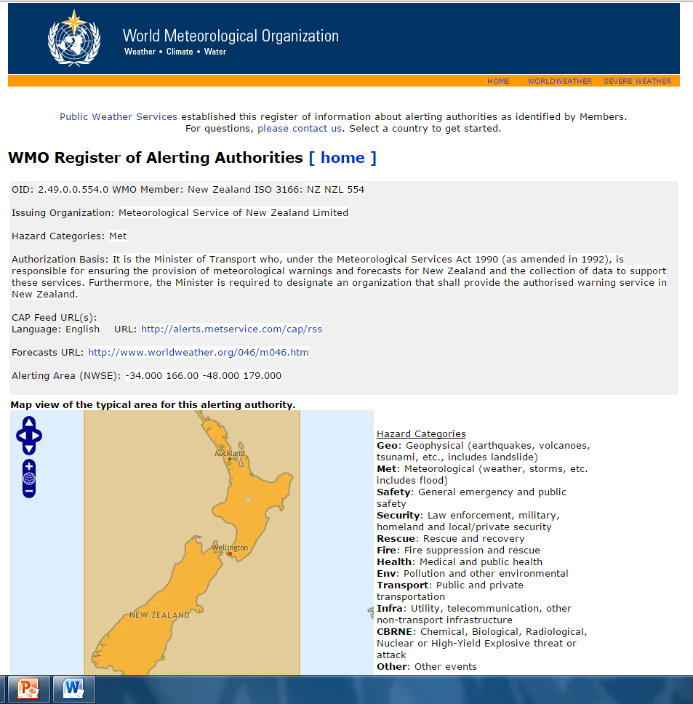
Example
The Register page for the Meteorological Service of New Zealand

Slide 17
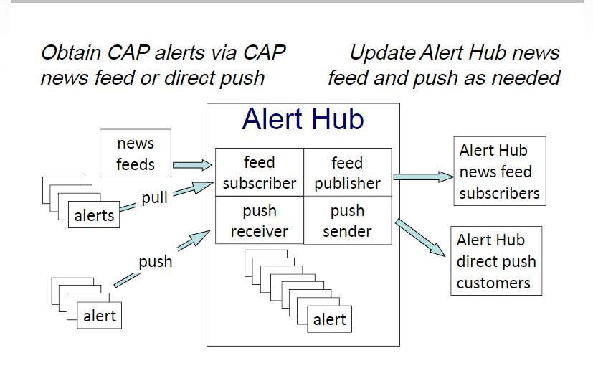
The W MO Alert Hub
WMO planning on developing an alert hub for all alerts from Members
Hub planned to provide one-stop platform for alerts provided by authorized agencies/institutions
Courtesy: Eliot Christian

Slide 18
WMO Alert Hub
Planned for free service collecting alerts and other emergency information,
Can push updates to all subscribers
WMO Alert Hub to carry only alerts from official sources, per Register of Alerting Authorities
Benefits :
  Speed
  Scale (performance, reliability, availability)
  Redundancy
  Security and Authenticity
  Analytics
Other collectors: Google, The Weather Company (TWC), etc
Notes:
An Alert Hub is a site that aggregates CAP alert news feeds in
one location, on the global cloud infrastructure. The WMO Alert
Hub aggregates alerts only from alerting authorities registered in
the International Register of Alerting Authorities.
The idea here is that official alert publishers can push alerts and related emergency information here, as soon as it is posted online. The push action assures that dissemination is as rapid as possible, usually within a second.
The benefits of the WMO Alert Hub are:
Speed - Dissemination time is crucial for sudden-onset events
such as earthquakes, tsunami, and tornadoes
Scale - Global scale dissemination infrastructure that is mostly independent of the local alerting infrastructure and provides high performance, high reliability, and high availability
Redundancy - An additional copy of alert messages elsewhere
from the originator
Security and Authenticity
Analytics - A centralized aggregator simplifies analysis and
enables optimization of alert dissemination
It is important to emphasize that the WMO Alert Hub provides only a copy of the alert; it does not play the role of an alert originator.

Slide 19

Implementation of CAP
WMO through PWSD programme assists Members through the «CAP Jump-start» arrangement
    Experts visit NMHSs and provide training and freeware
    LDCs and developing countries are supported
There is a need for resources for advancing implementation of CAP
WMO CAP Jump-start
(Link to more information)

Slide 20
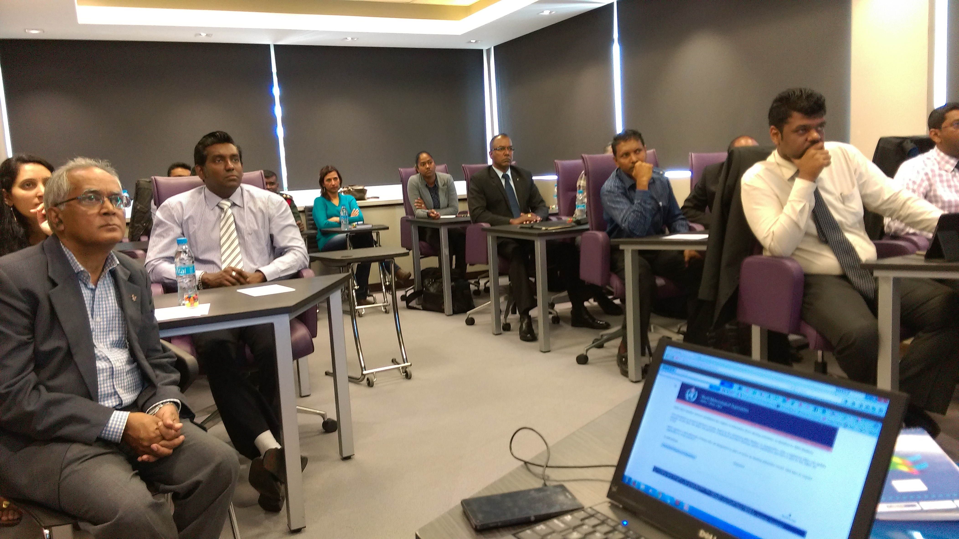
CAP Jump-Start Workshop, Vacoas, Mauritius, 31 August – 4 September 2015
WMO Organized 16 CAP-Jump Start workshops by PWSD Programme

Slide 21
Presentation Outline
1 What is CAP
2 Benefits of CAP
3 Features of a CAP Message
4 Alerting Authorities
WMO Alert Hub
Opportunities for implementing CAP
Notes:
These are the major topics I will cover in this presentation.
The first topic is "Opportunity and Challenge".

Slide 22

Thank you
Merci

