Slide 1


Benefit Cost Analysis
Jeffrey K .Lazo, PhD
Director – Societal Impacts Program
National Center for Atmospheric Research
Zagreb, Croatia
Wednesday, 1 July 2015
1400-1430

Slide 2
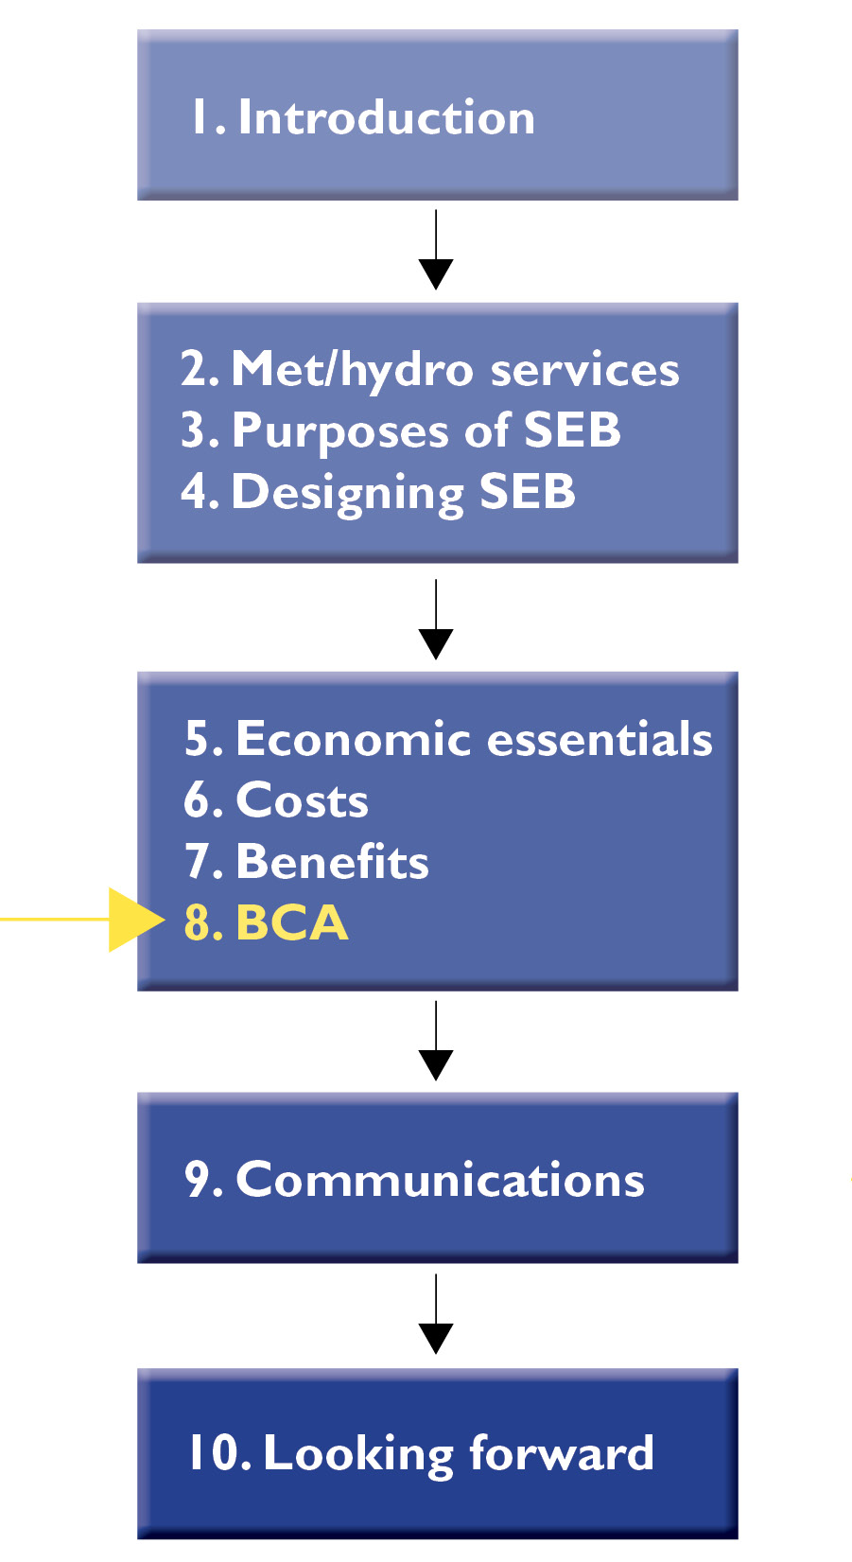
Purpose and Desired Outcome
Purpose
Combine measurement of benefits and costs to evaluate economic viability of a project using benefit-cost analysis (BCA)
Desired Outcome
Understand the purpose and uses of benefit-cost analysis
Understand how to “read” a BCA study

Slide 3
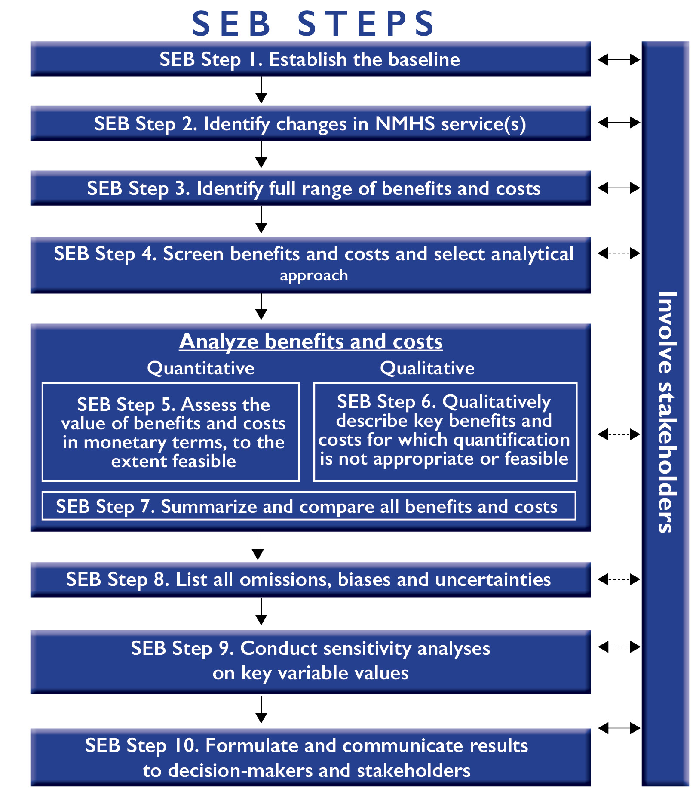
Outline
Introduction
BCA concepts
  BCA decision criteria – net societal benefit
  Selecting the discount rate
Step 7: Summarize and compare all benefits and costs
  Net present value and project decision criteria
  Reporting qualitative benefit and cost information
  Distributional issues
Step 8: List all omissions, biases and uncertainties
Step 9: Conduct sensitivity analyses on key variable values
Conclusion

Slide 4
Introduction
Why Benefit-Cost Analysis (BCA)?
Can we justify purchasing a new supercomputer for research to improve weather forecasts – with no change in forecast quality until 10 years from now.
Is it a good idea to build a new observation system?
Should we broadcast additional weather forecasts?
Would we be better off spending additional money on modeling for weather forecasting?
Should we spend the money on weather forecasting or education or crime control or health care?
Each of these should be addressed by doing a proper cost benefit analysis.

Slide 5
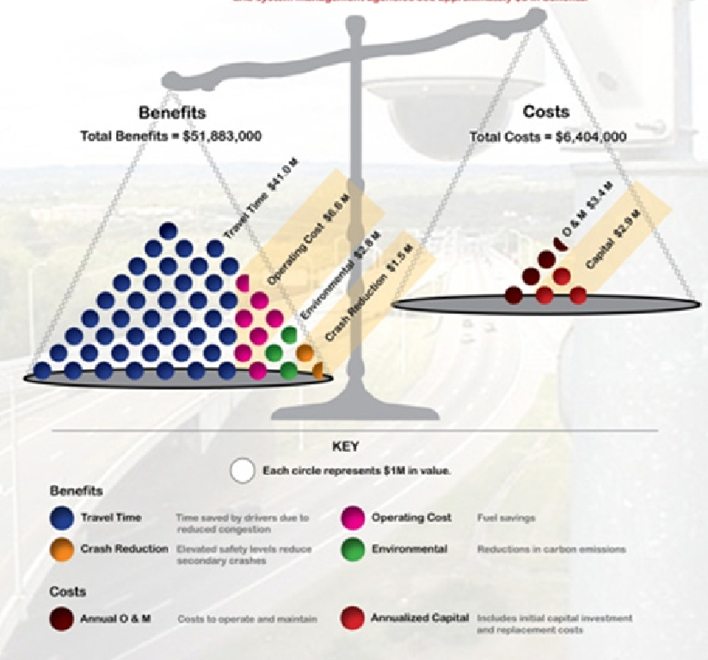
BCA concepts - decision criteria
Net benefit = benefits minus costs
  If benefits > costs → worth doing the program
  If benefits < costs → not worth doing the program
Benefit-cost ratio:
  If benefits / costs > 1 → YES
  If benefits / costs < 1 → NO
Internal rate of return (IRR)
  Rate of interest in a net present analysis that makes the benefits equal to or greater than the costs.
  If IRR > rate of discount → YES
  If IRR < rate of discount → NO

Slide 6
BCA concepts - discount rate
Projects generate costs and benefits over a period of time, with costs and benefits often occurring in different time periods.
  a dollar of costs or benefits ten years from today not directly comparable to a dollar of costs or benefits today.
  investor prefers to receive a payment of a fixed amount of money today, rather than an equal amount in the future
Discounting is used to express all future costs and benefits in their present value equivalent.
Costs and benefits are discounted in each future time period and summing them to arrive at a present value.
Some costs that occur far into the future may be given too little weight in traditional cost-benefit analysis
  climate change impacts
  extinction of species

Slide 7
BCA concepts - discount rate
The Economics of Climate Change: The Stern Review, Nicolas Stern (2007) - discount rate of just 0.1%
Zhuang et al. (2007) surveyed discount rates used for public projects
  2-3% in developed nations such as the United States and Germany
  12-15% in developing countries such as Pakistan and the Philippines
Multilateral development banks (MDBs)
  The World Bank guidance - Handbook on Economic Analysis of Investment Operations (Belli et al., 1998)
    notional discount rate of 10-12%
    task managers may use a rate outside this range as long if justified in the Country Assistance Strategy
  Asian Development Bank (ADB) specifies discount rate policy - Guidelines for the Economic Analysis of Projects (ADB, 1997)
    tend to be 10-12% at minimum
  InterAmerican Development Bank, African Development Bank and European Bank for Reconstruction and Development
    tend to use rates in the range of 10-12%

Slide 8
BCA concepts - discount rate
PV Benefits =
PV Costs =
NPV = PV Benefits-PV Costs =
Total NPV = sum of all PV Benefits-PV Costs =

Slide 9
BCA concepts - discount rate
Example - $50 benefit to be received in two years with 3% discount rate
 | Discount rate= 0.0% | Discount rate = 3.0%
Year | Benefits | PV Benefits
2 | 50.00 | 47.13
PV Benefits = = = = 47.13

Slide 10
BCA concepts - discount rate
 | Discount rate= 0.0% |  | Discount rate = 3.0% |  | Discount rate= 7.0%
Year | Benefits | Costs | PV Benefits | PV Costs | PV Benefits | PV Costs
0 | 0.00 | 100.00 | 0.00 | 100.00 | 0.00 | 100.00
1 | 25.00 | 50.00 | 24.27 | 48.54 | 22.68 | 45.37
2 | 50.00 | 10.00 | 47.13 | 9.43 | 41.16 | 8.23
3 | 50.00 | 10.00 | 45.76 | 9.15 | 37.35 | 7.47
4 | 50.00 | 10.00 | 44.42 | 8.88 | 33.89 | 6.78
5 | 50.00 | 10.00 | 43.13 | 8.63 | 30.75 | 6.15
Total PV | 225.00 | 190.00 | 204.71 | 184.63 | 165.84 | 174.00
NPV |  | 35.00 |  | 20.08 |  | -8.16

Slide 11
Outline
Introduction
BCA concepts
  BCA decision criteria – net societal benefit
  Selecting the discount rate
Step 7: Summarize and compare all benefits and costs
  Net present value and project decision criteria
  Reporting qualitative benefit and cost information
  Distributional issues
Step 8: List all omissions, biases and uncertainties
Step 9: Conduct sensitivity analyses on key variable values
Conclusion

Slide 12
Step 7: Summarize and Compare All Benefits and Costs
If possible, discount quantitative benefit or cost projections over time (from Step 6) to PV at an appropriate discount rate.
Summarize net monetized benefits and costs (either annual or present value) in one location, along with the listing and ranking of those benefits that can be described only qualitatively (from Step 6).
Summary table must include:
  the monetized benefits and costs
  a listing and qualitative assessment of the non-quantified benefits and costs

Slide 13
Step 8: List All Omissions, Biases, and Uncertainties
Explicitly document all omissions, biases, and uncertainties associated with the estimated benefits and costs.
The impact that these may have on the final outcome of the analysis should be noted.
  e.g., in terms of their likelihood of increasing or decreasing net benefits, or an uncertain direction of change in net benefits

Slide 14



Distributional Issues
Costs
Benefits

Slide 15
Distributional Issues
Distribution between:
Different groups or individuals
  one versus many
Different geographic areas
  countries
  regions / states
Gender
Ethnicity
Age groups
Income groups

Slide 16
Distributional Issues
How does benefit cost analysis deal with distributional issues?
Pareto principle: project is worthwhile if it makes one person off while making no-one else worse off
Potential Pareto principle (Kaldor-Hicks Principle): could arrange sufficient compensation from those that are made better off to those that are made worse off so that all would end up no worse off than before.
How to do this “right” – be transparent and specific about distributional issues?

Slide 17
Step 9: Conduct Sensitivity Analyses on Key Variable Values
Conduct sensitivity analyses on key variables or benefit and cost estimates
  with the aim of exploring and communicating the impact of assumptions, uncertainties, or natural variability.
Sensitivity analyses is used to identify which assumptions or uncertainties have the largest impact on the outcome of the analysis
  to identify which assumptions might change the net benefits of an option from positive to negative or to alter the ranking of options in terms of their relative net benefits.

Slide 18
Conclusion
BCA concepts
  BCA decision criteria – net societal benefit
  Selecting the discount rate
Step 7: Summarize and compare all benefits and costs
  Net present value and project decision criteria
  Reporting qualitative benefit and cost information
  Distributional issues
Step 8: List all omissions, biases and uncertainties
Step 9: Conduct sensitivity analyses on key variable values

Slide 19
Exercise 10: Benefit-Cost Analysis
Objectives | Understand and apply calculation of net present value is undertaken and understand how to use the results for project evaluation. Understand and apply key concepts in benefit cost analysis such as discounting, net present value, and benefit cost ratio. Understand sensitivity analysis.

Slide 20



Example 1: Calculating a Present Value
For a Benefit of $50 (B=$50) that will occur 5 years from now (t=5) using a 3% discount rate (r=.03).

