Slide 1

Defining and Measuring Costs
Glen Anderson, Chief of Party, CCRD
Zagreb, Croatia
July 1, 2015

Slide 2
Cost Definitions
Cost – the value of the inputs needed to produce any good or service, measured in some units or numeraire, generally money
  Labor
  Purchased goods and services
  Use of goods from inventory
  Capital equipment
Expenditures refer to actual payments made with respect to the production of a good or service during a certain time span

Slide 3
Cost Definitions
Capital costs – expenditures on goods in one year that have a limited lifetime and are depreciated over time
  If the lifetime of a capital good is 10 years, it is typically represented in cost calculations as depreciation costs where annual depreciation cost is 1/10th of the cost of the capital good
Losses –unintended costs, e.g., in case of damage to equipment or buildings
  As we will see when we discuss benefits, met/hydro services often provide benefits in the form of avoided losses

Slide 4
Costs in the context of economic studies
Benefit-cost analysis
  Determining the social value of met/hydro services compared to the costs to provide them
  Net benefits = benefits minus costs
  Benefit/cost ratios = benefits divided by costs
Cost-effectiveness analysis
  Used to compare alternatives for providing a specific product or service, e.g.,
    Automated versus manual observation system
    Developing remote sensing capacity versus purchasing remote sensing data

Slide 5
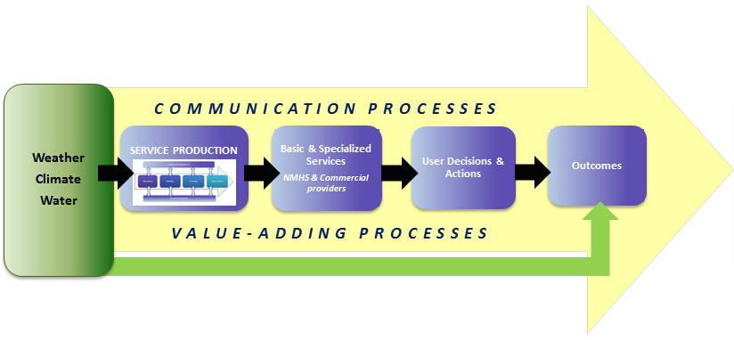
Costs Associated with the Value Chain

Slide 6
Annual Cost Statement – Royal Netherlands Meteorological Institute

Slide 7
Preliminary costs to modernize Nepal Department of Hydrology and Meteorology (Millions of Nepalese rupees)

