Slide 1
National Institute of Meteorology and Hydrology, Bulgaria
Anastasiya Stoycheva
Head of “Meteorological forecasts“
Forecaster on duty
anastassia.stoycheva@meteo.bg

Slide 2
Content:
Our duties and products;
Our main stakeholders;
How the stakeholders get the information from NIMH in Bulgaria;
How the different sectors are impacted by the weather;
The improvements after different stakeholder requirements – future plans.

Slide 3
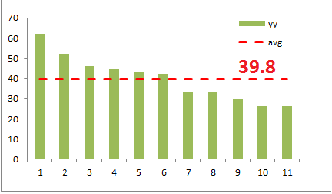
Our duties, forecasts and MSI
24/7; 8- и 12-h duties;
11 weather forecasters;
Main type of forecasts:
Short-range: 24-48 h;
Warnings (METEOALARM);
Middle-range: 3- to 7-day;
15-day and monthly forecasts;
Marine forecasts;
Seasonal forecasts.
Main sources of information:
Operational meteorological information: regular observation (NIMH), satellite inf. (EUMETSAT), radar inf. (Agency of hail suppression, BULATSA);
Numerical models: ECMWF (9 km), ARPEGGE (7.5-37 km), ALADIN (7 km), GFS (28 km), etc.
Average of forecasters team

Slide 4
Main stakeholders:
Government
Media
Private sector
President;
Bulgarian national radio;
Bulgarian national TV;
Private TV’s and radio stations;
Information agencies / electronic sites;
Newspapers.
Ministries of:
Prime Minister;
Environment and Water,
Education,
Regional Development;
Bulgarian Academy of Science.
Agricultural companies;
Energy companies;
Market research companies;
Insurance companies;
Car’s dealerships;
Advertising companies;
Movie productions.
Builders;
Civil Protection Agency;
Transport,
General public

Slide 5
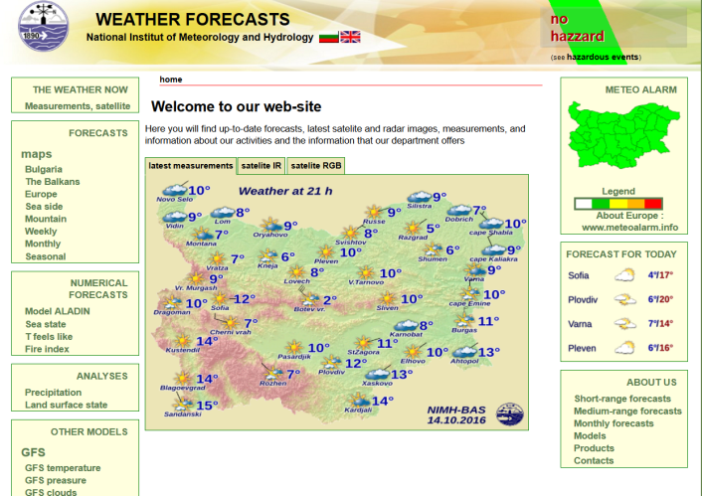
How do the stakeholders get the information from NIMH in Bulgaria?
By mail;
By web-based system – individual logins and passwords (preferred);
By phone;
By NIMH’s web pages:
www.meteo.bg
www.weather.bg
By official documents, received from the NIMH administration desk;
By a live-signal cabin for weather forecasts.

Slide 6
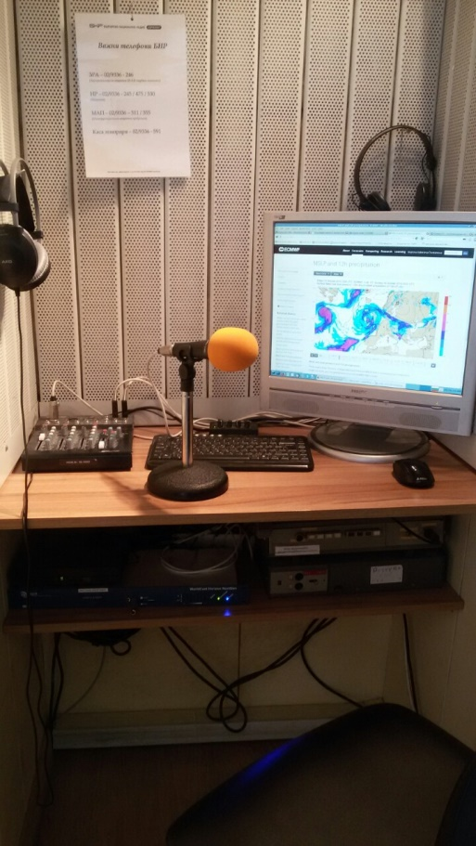
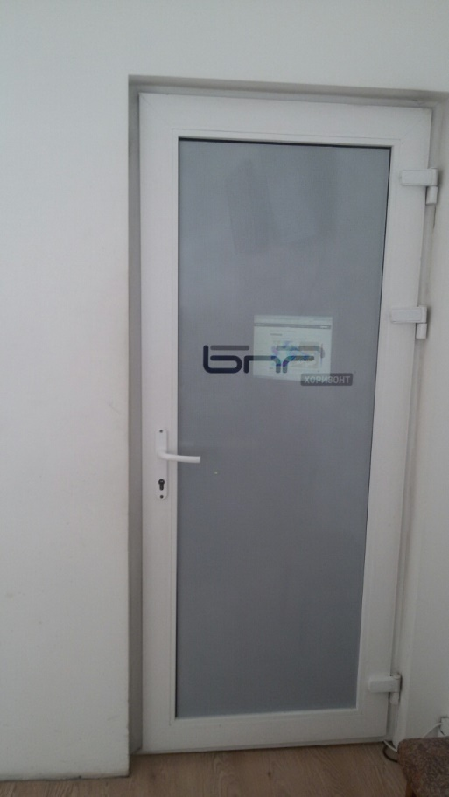
National Radio cabin – broadcast live
Next to the forecasters’ working place
Soundproofed fully equipped small studio

Slide 7
How is the sector impacted by the weather?
There is no human activity or business untouched by the weather – an undeniable fact;
A qualitative answer so far:
For the media – the time/minutes around the weather forecasts is/are the most expensive for advertising;
For energy companies – our small experience (∼10 month) shows 20-30% improvement in specialized energy planning forecasts;
A representative of our main user - my colleague from our National Radio:
Mrs. Maria Yanakieva

Slide 8
What improvements in NIMH’s work do the stakeholders require?
We send letters for checking the users’ opinions, we will collect the answers and in the near future we are going to prepare some improvements on the base of these requirements;
I give opportunity to my colleague from Bulgarian National radio to give some feedback.

Slide 9
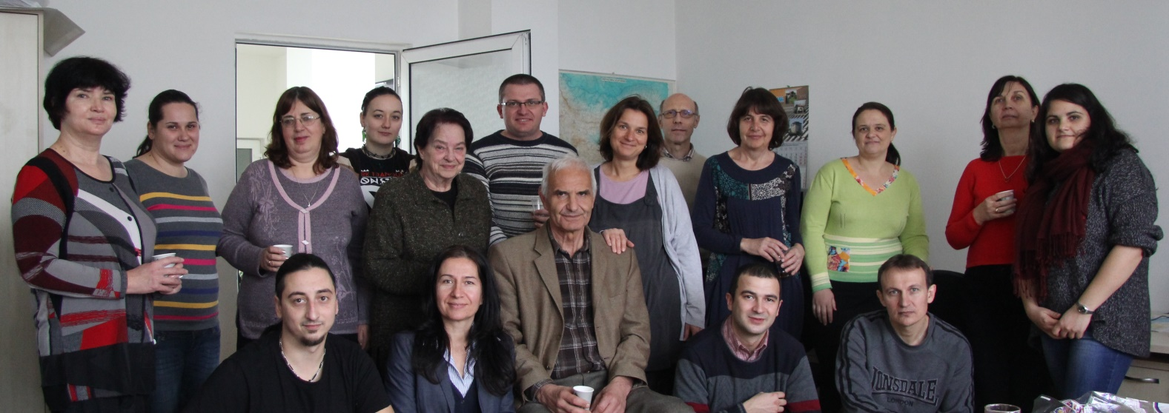
Anastasiya Spasova Stoycheva, Ph.D.
Iliana
Denica
Krasi
Christo
Mariana
Daniela
Asiya
Anna
Boriana
Milena
Lubka
Thank you for
your attention!
Martin
Orlin
Georgy
Hristo
Evgenia
NIMH - BAS 66 Tsarigradsko chausee, blvd.
1784 Sofia, Bulgaria tel: (+359) 2 974 44 09, mobile: (+359) 887 94 20 24 e-mail: anastassia.stoycheva@meteo.bg

