Slide 1

National Disaster Risk Reduction and Management Centre
(NDRRMC)
P. Booneeady & R. Luximon
NDRRMC
Impact-Based Forecasting, Mauritius 26-30 October 2015

Slide 2
Outline
Few hazards affecting Mauritius
History of Disaster Management in Mauritius
NDRRMC
NEOC
Challenges

Slide 3
Few Hazards affecting
Mauritius

Slide 4
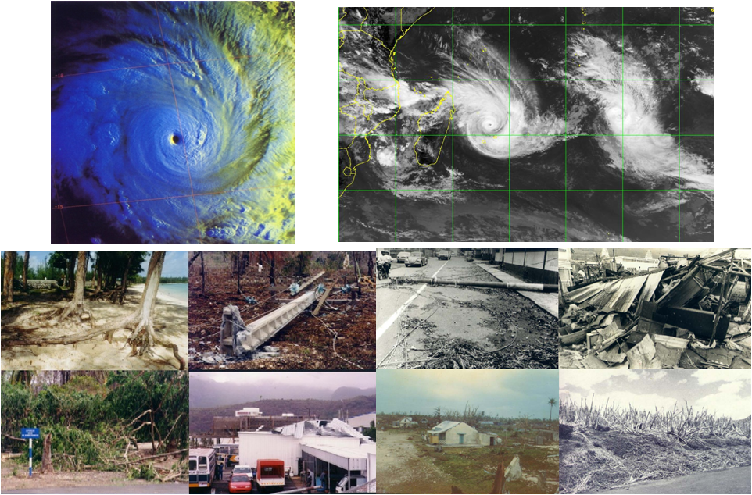
Tropical Cyclones

Slide 5
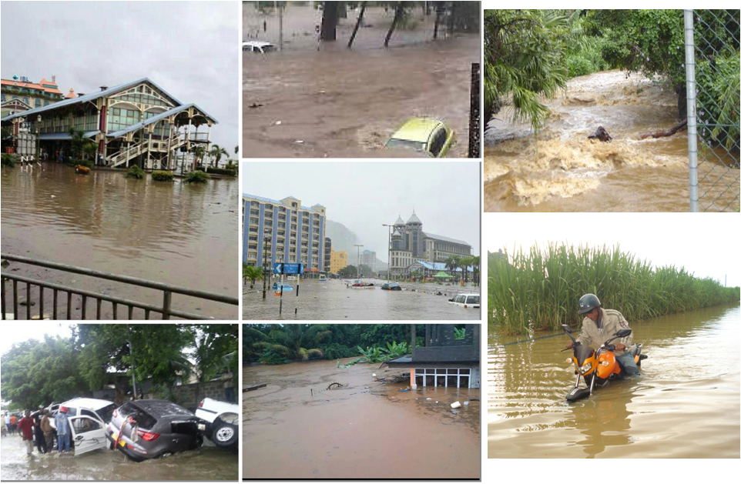
Flash flood

Slide 6
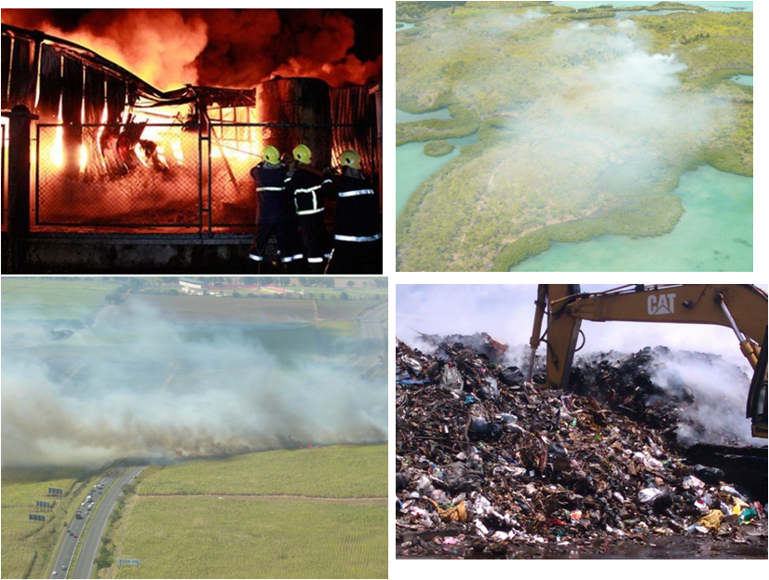
Fire outbreak

Slide 7
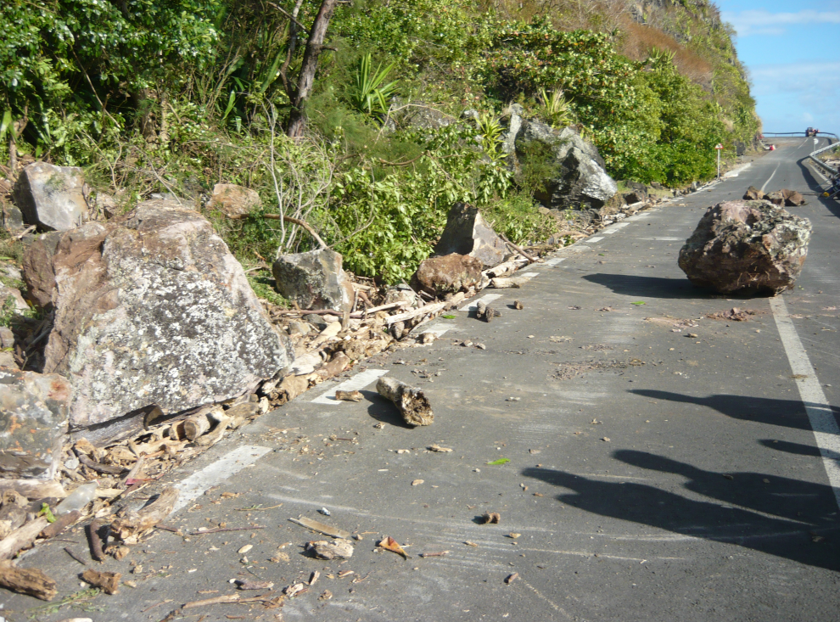
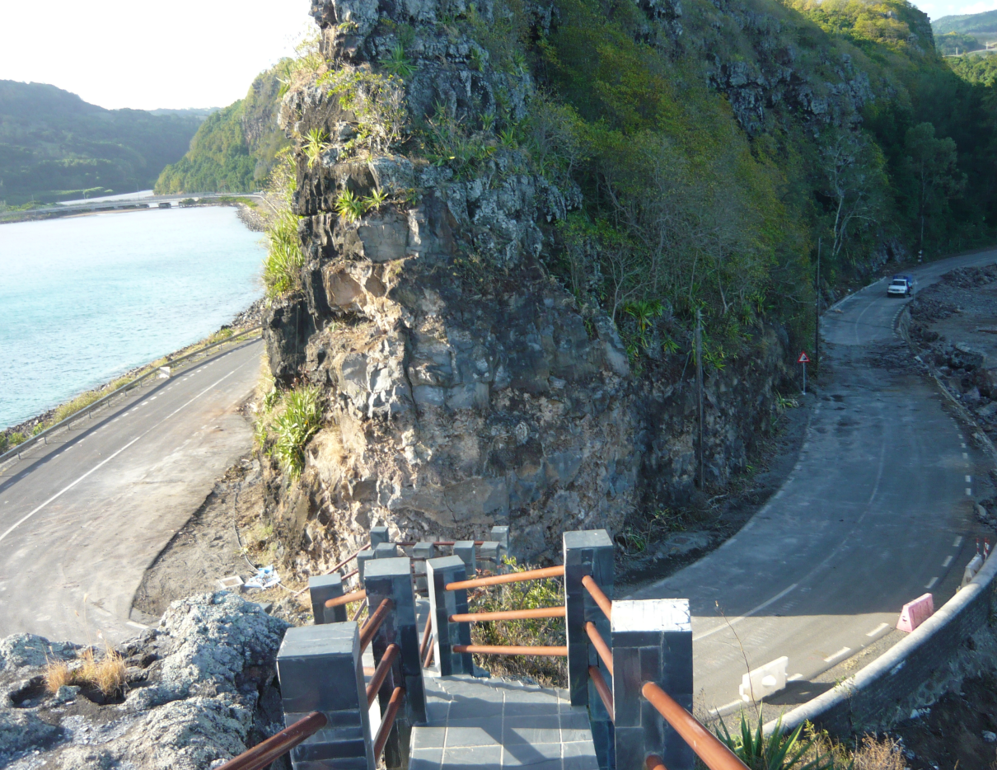
Rock Fall

Slide 8
Few hazards (cont)
Landslide
Torrential rain
High waves (tidal/storm surges)
Earthquakes
Tsunami
Water crisis

Slide 9
Disaster Management in Mauritius
Initially, Disasters were mainly known to be caused by hydro-meteorological events (cyclones)– DM under Prime Minister’s Office
Setting up of Cyclone and Other Natural Disasters Committee
  Implement Disaster Risk Reduction Strategy and Action Plan in line with Hygo Framework for Action (2005-2015)
  Manage all disasters affecting Republic of Mauritius
National Disasters Operations Coordination Centre (NDOCC) -2010 –lead Commissioner of Police -PIOR (ex-Lola flood event)

Slide 10
Disaster Management in Mauritius (cont)
30 March 2013 flood event : Need for a National Disaster Risk Reduction & Management Programme for the Republic of Mauritius to provide a safety from disaster caused by natural and man-made hazards emphasizing on all stages of disaster risk management, including prevention and protection, preparedness, response, and recovery.
Cabinet Decision in August 2013
  National Disaster Risk Reduction & Management Council,
  National Disaster Risk Reduction and Management Centre (NDRRMC),
  Local Disaster Risk Reduction and Management Committee,
  Council and Centre for Rodrigues, and
  Disaster Management Coordinators in Agalega and St Brandon.

Slide 11
National Disaster Risk Reduction and Management Centre
(NDRRMC)

Slide 12
NDRRMC
Recognition at national level of need to move from agency response focus towards a strategic, coordinated, multi-stakeholder pro-active approach which prevents or reduces risk, providing greater public safety and economic stability
Building on the work done previously to ensure well-coordinated, strategic and effective preparation for, response to and recovery from identified threats
NDRRMC was set up on 24 October 2013 under PMO
Since Dec 2014 - Under Ministry of Environment, Sustainable Development, and Disaster & Beach Management

Slide 13
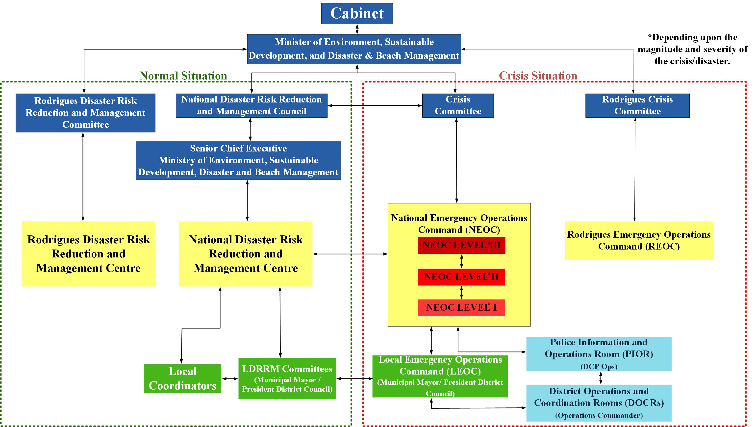

Slide 14
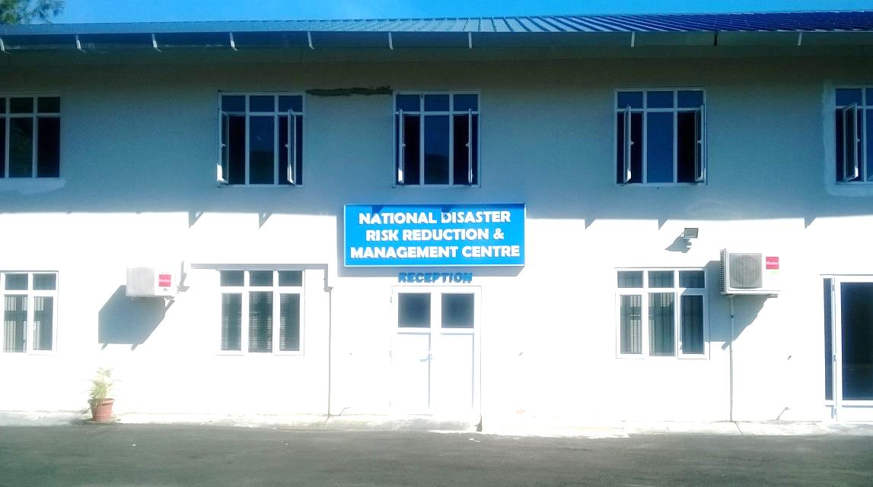
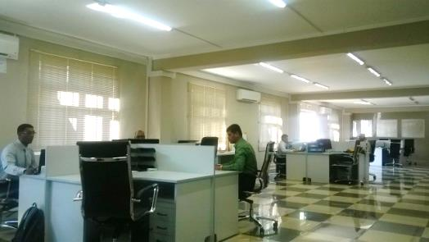
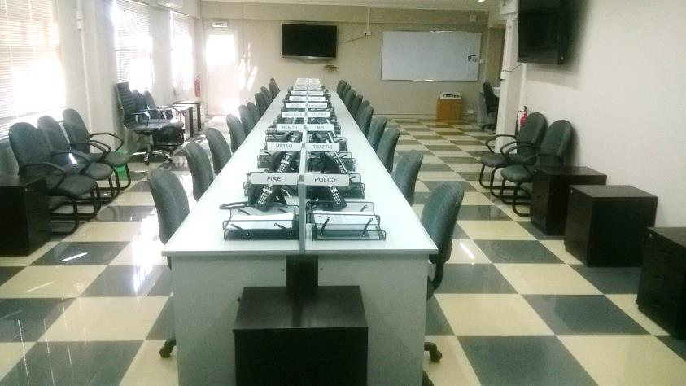
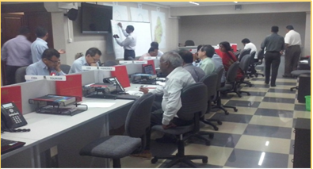
Ministry of Environment, Sustainable Development, and Disaster and Beach Management
National Disaster Risks Reduction & Management Centre
National Emergency Operations Command(NEOC)

Slide 15
NDRRMC
New Approach to Disaster Risk Reduction and Management
  Disasters will occur when least expected
  Pro-active all-hazards, multi-agency approach to risk management
  Place the country’s approach in alignment with regional and international best practice (SFDRR), adapted to the local context
  Integrate risk reduction into development plans at all levels and across all sectors
  Engagement of all residents of Mauritius, Rodrigues, St Brandon and Agalega in the disaster risk management process
  Establish the Government’s policy, roles and responsibilities in national disaster management

Slide 16
Elements coordinated through NDRRMC
Policy and Governance
Risk Assessment
Risk Mapping
Mitigation
Preparedness
Public Awareness and Education
Response
Relief
Recovery and Rehabilitation
Post Impact Evaluation

Slide 17
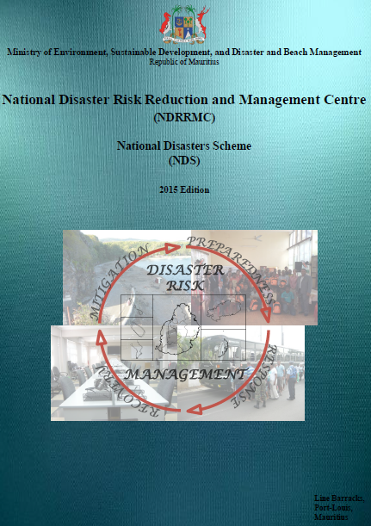
Policy & Governance -
National Disasters Scheme
(2015 edition)
Functional document to support agencies and stakeholders in understanding and undertaking their roles, responsibilities and actions in emergencies.
SCHEMES
  Cyclone Emergency Scheme
  Heavy Rainfall, Torrential Rain and Flooding Emergency Scheme
  Tsunami Emergency Scheme
  High Waves Emergency Scheme
  Water Crisis Emergency Scheme
  Earthquake Emergency Scheme
  Landslide Emergency Scheme
  Port Louis Flood Response Plan

Slide 18

Republic of Mauritius
Republic of Mauritius
Development of Inundation, Flooding and Landslide Maps and DRR Strategic Framework and Action Plan for the Republic of Mauritius
(2013)

Slide 19
DRR Report 2013
Reduce risk in areas prone to high risk
Implement National DRR Platform
Adopt sound development strategy
Preserve healthy natural environment
Embrace culture of resilience (capacity building, community sensitization, research)
Sound Spatial Data infrastructure
Early Warning and Alerting System
Capacity Building for Emergency Response
Emergency Fund and Insurance Scheme

Slide 20
Action Plan
Development of Coastal Inundation, Flooding and Landslide Maps
Implementation of DRR Policies, Strategic Framework and Action Plan
Developing Early Warning System
Developing Disaster Cluster Groups
Building Capacity for Community Disaster Response Teams
Risk Transfer Mechanism
GIS Mapping of Resources

Slide 21
Data Availability

Slide 22
National Disaster Risk Reduction and Management Centre
NDRRMC
Mitigate
Prepare
Disaster
Respond
Relief
Recover
Spatial Data Use

Slide 23
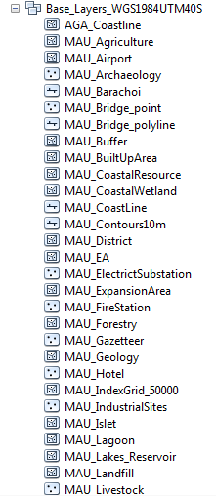
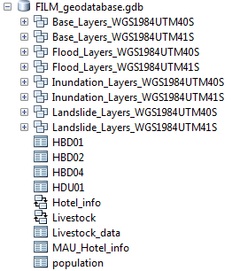
Existing GIS vector data:
Development of Inundation, Flooding and Landslide Maps and DRR Strategic Framework and Action Plan for the Republic of Mauritius (2013)

Slide 24
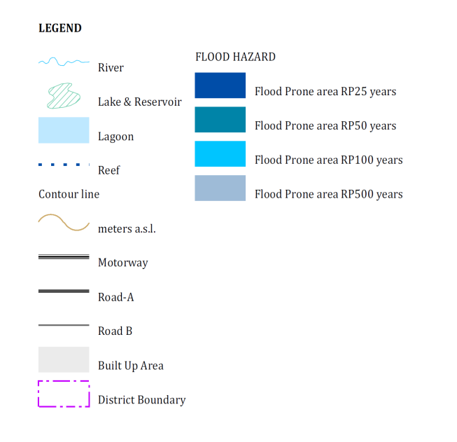
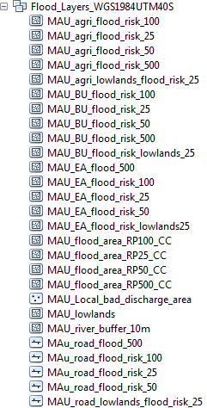
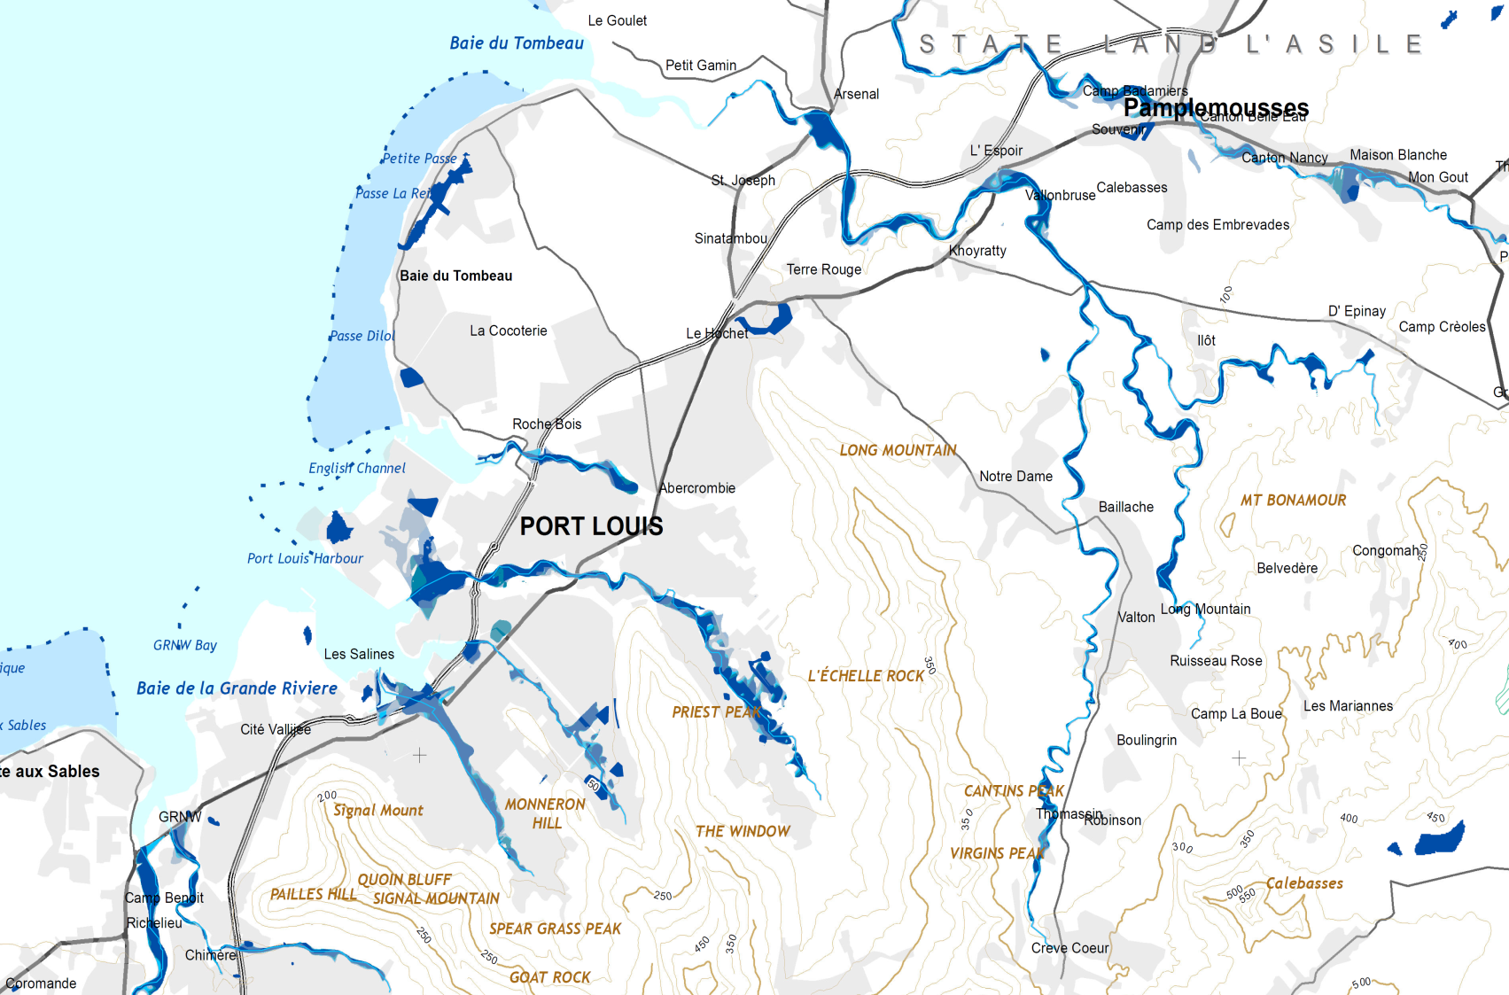
Flood

Slide 25
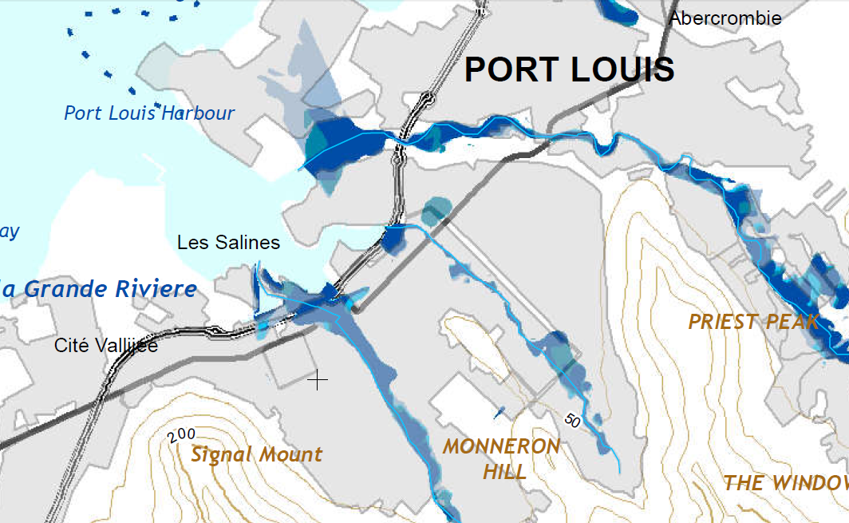
Flood
(continued…)

Slide 26
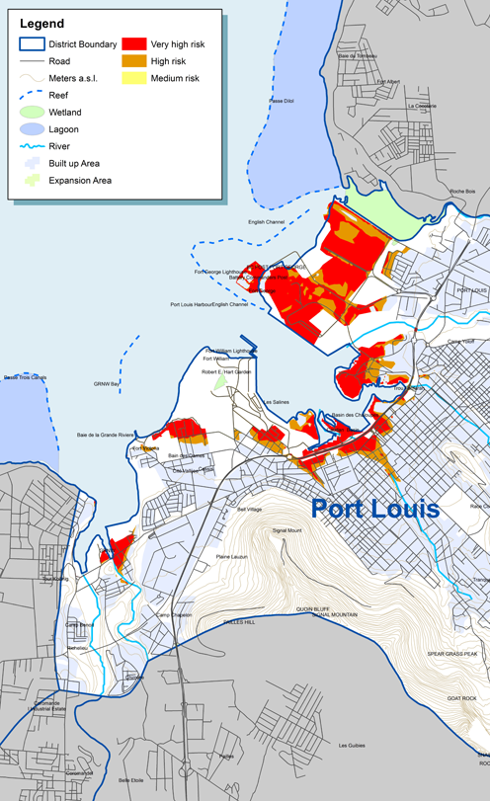
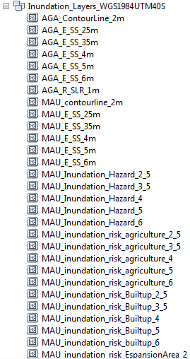
  Coastal Inundation

Slide 27
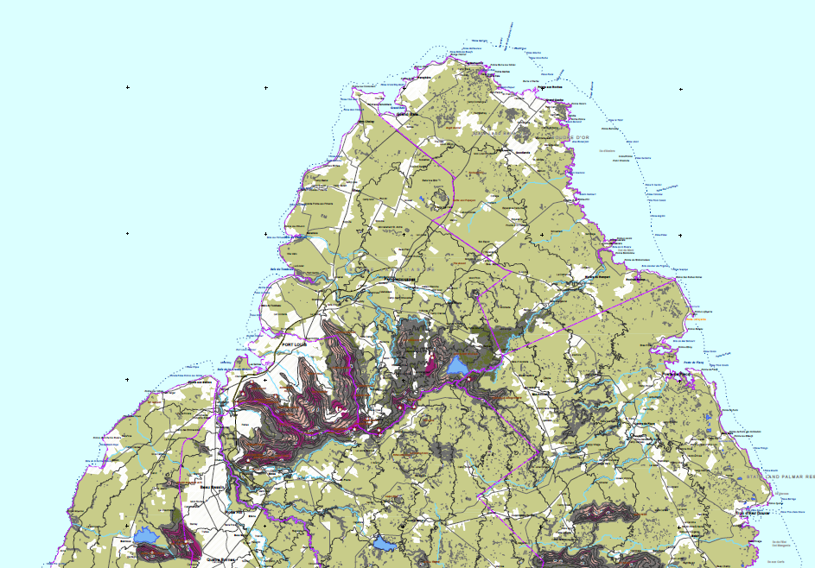
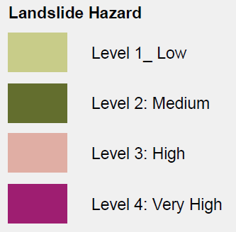
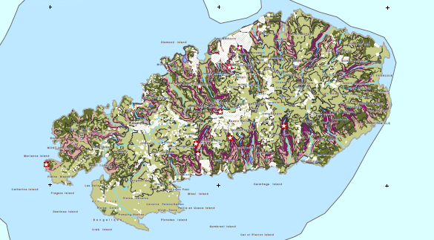
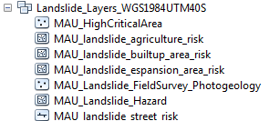
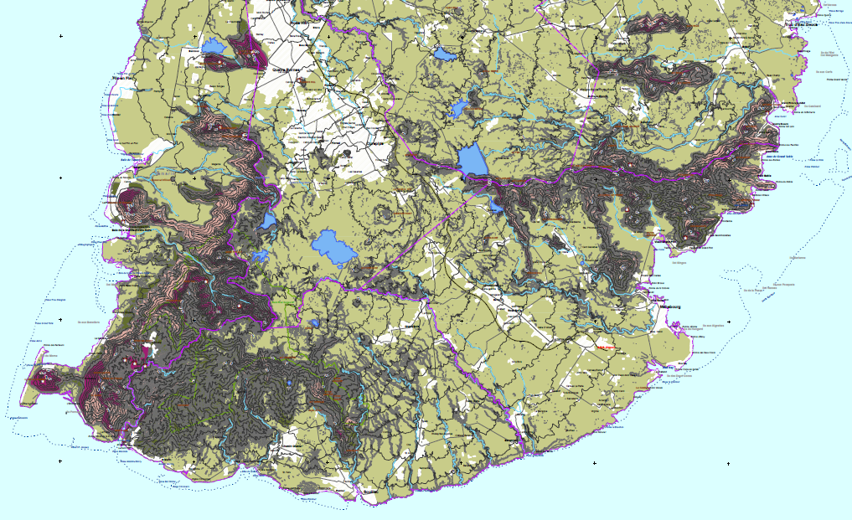
Landslide

Slide 28
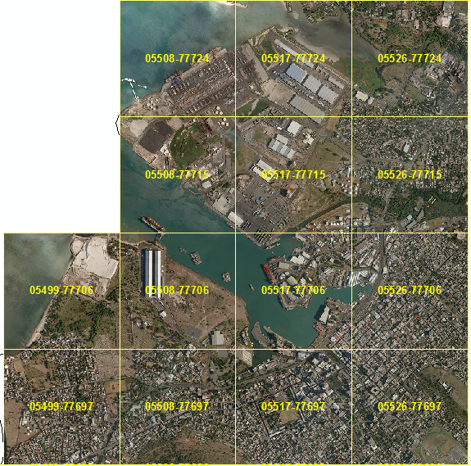
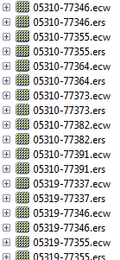
Rasters data
Data from MHL (Roads with names, buildings, LAVIMS 2008 aerial images)

Slide 29
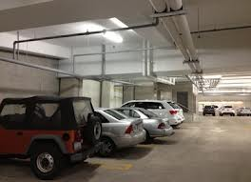

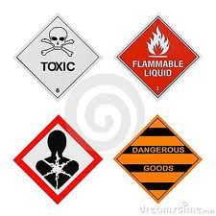
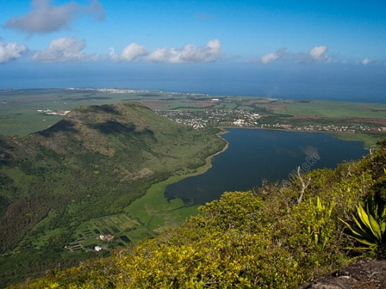
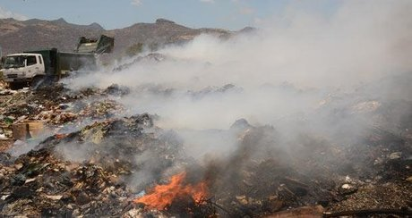
New GIS vector data:
Emergency shelters
Underground parkings
Industrial hazard
Dams
Dumping sites
Ongoing mapping activities:
Schools
Hotels
Health centres
….

Slide 30
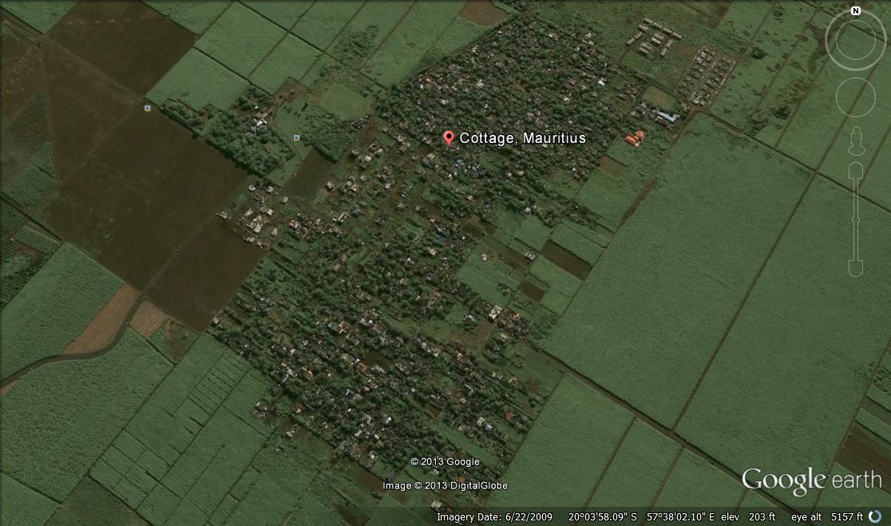
Unexpected flood impact

Slide 31
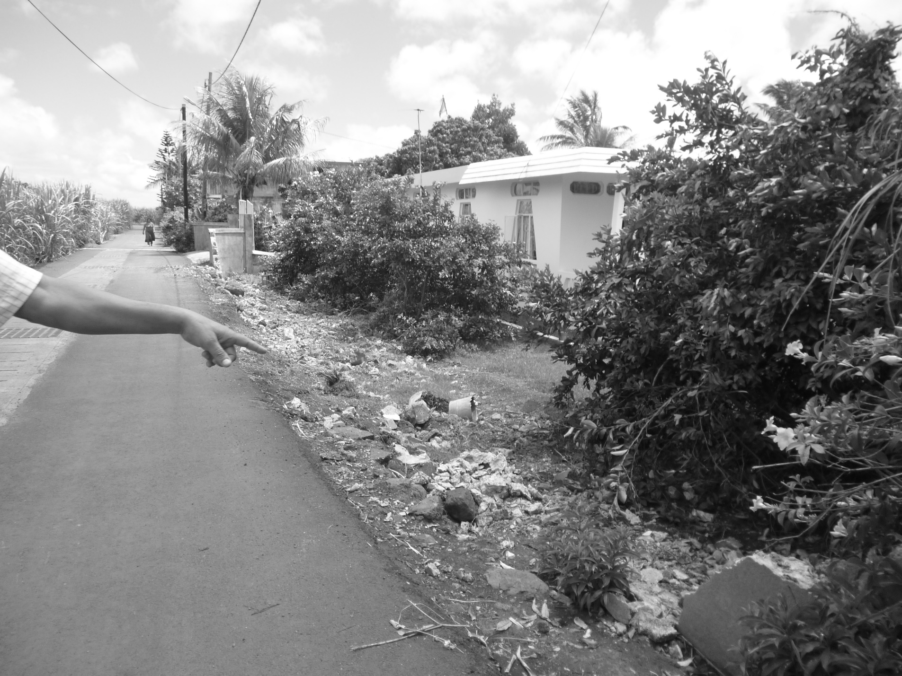
8 fencing walls were destroyed at Cottage in March 2013

Slide 32
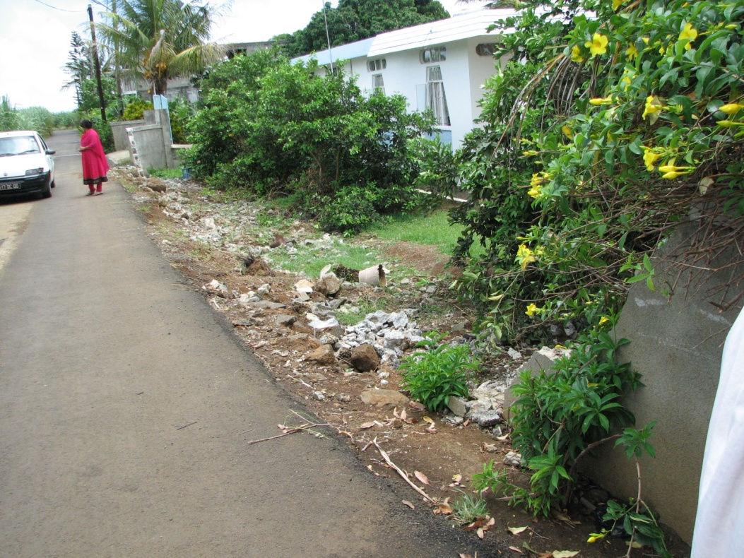

Slide 33
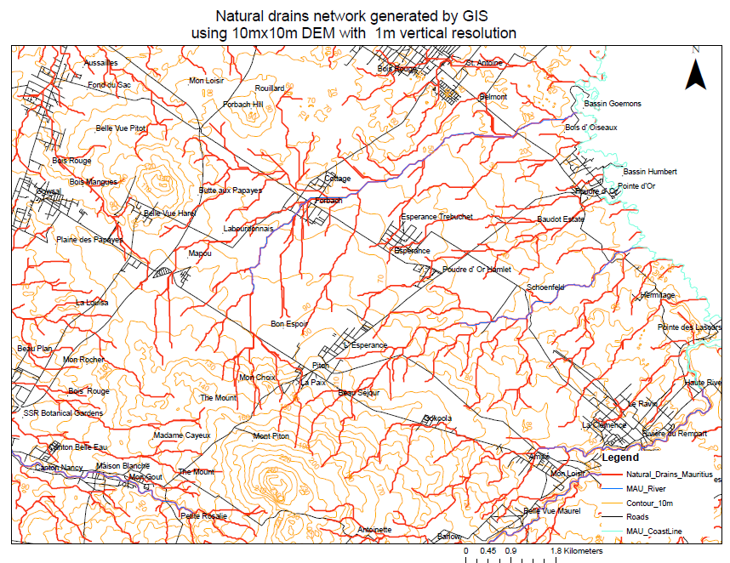

Slide 34
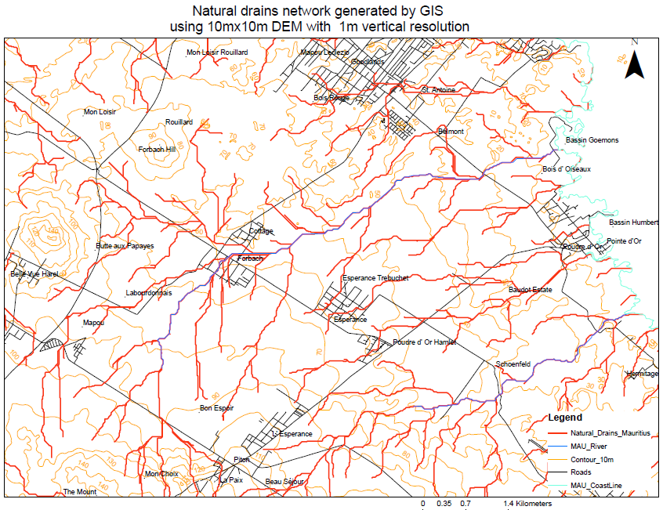

Slide 35
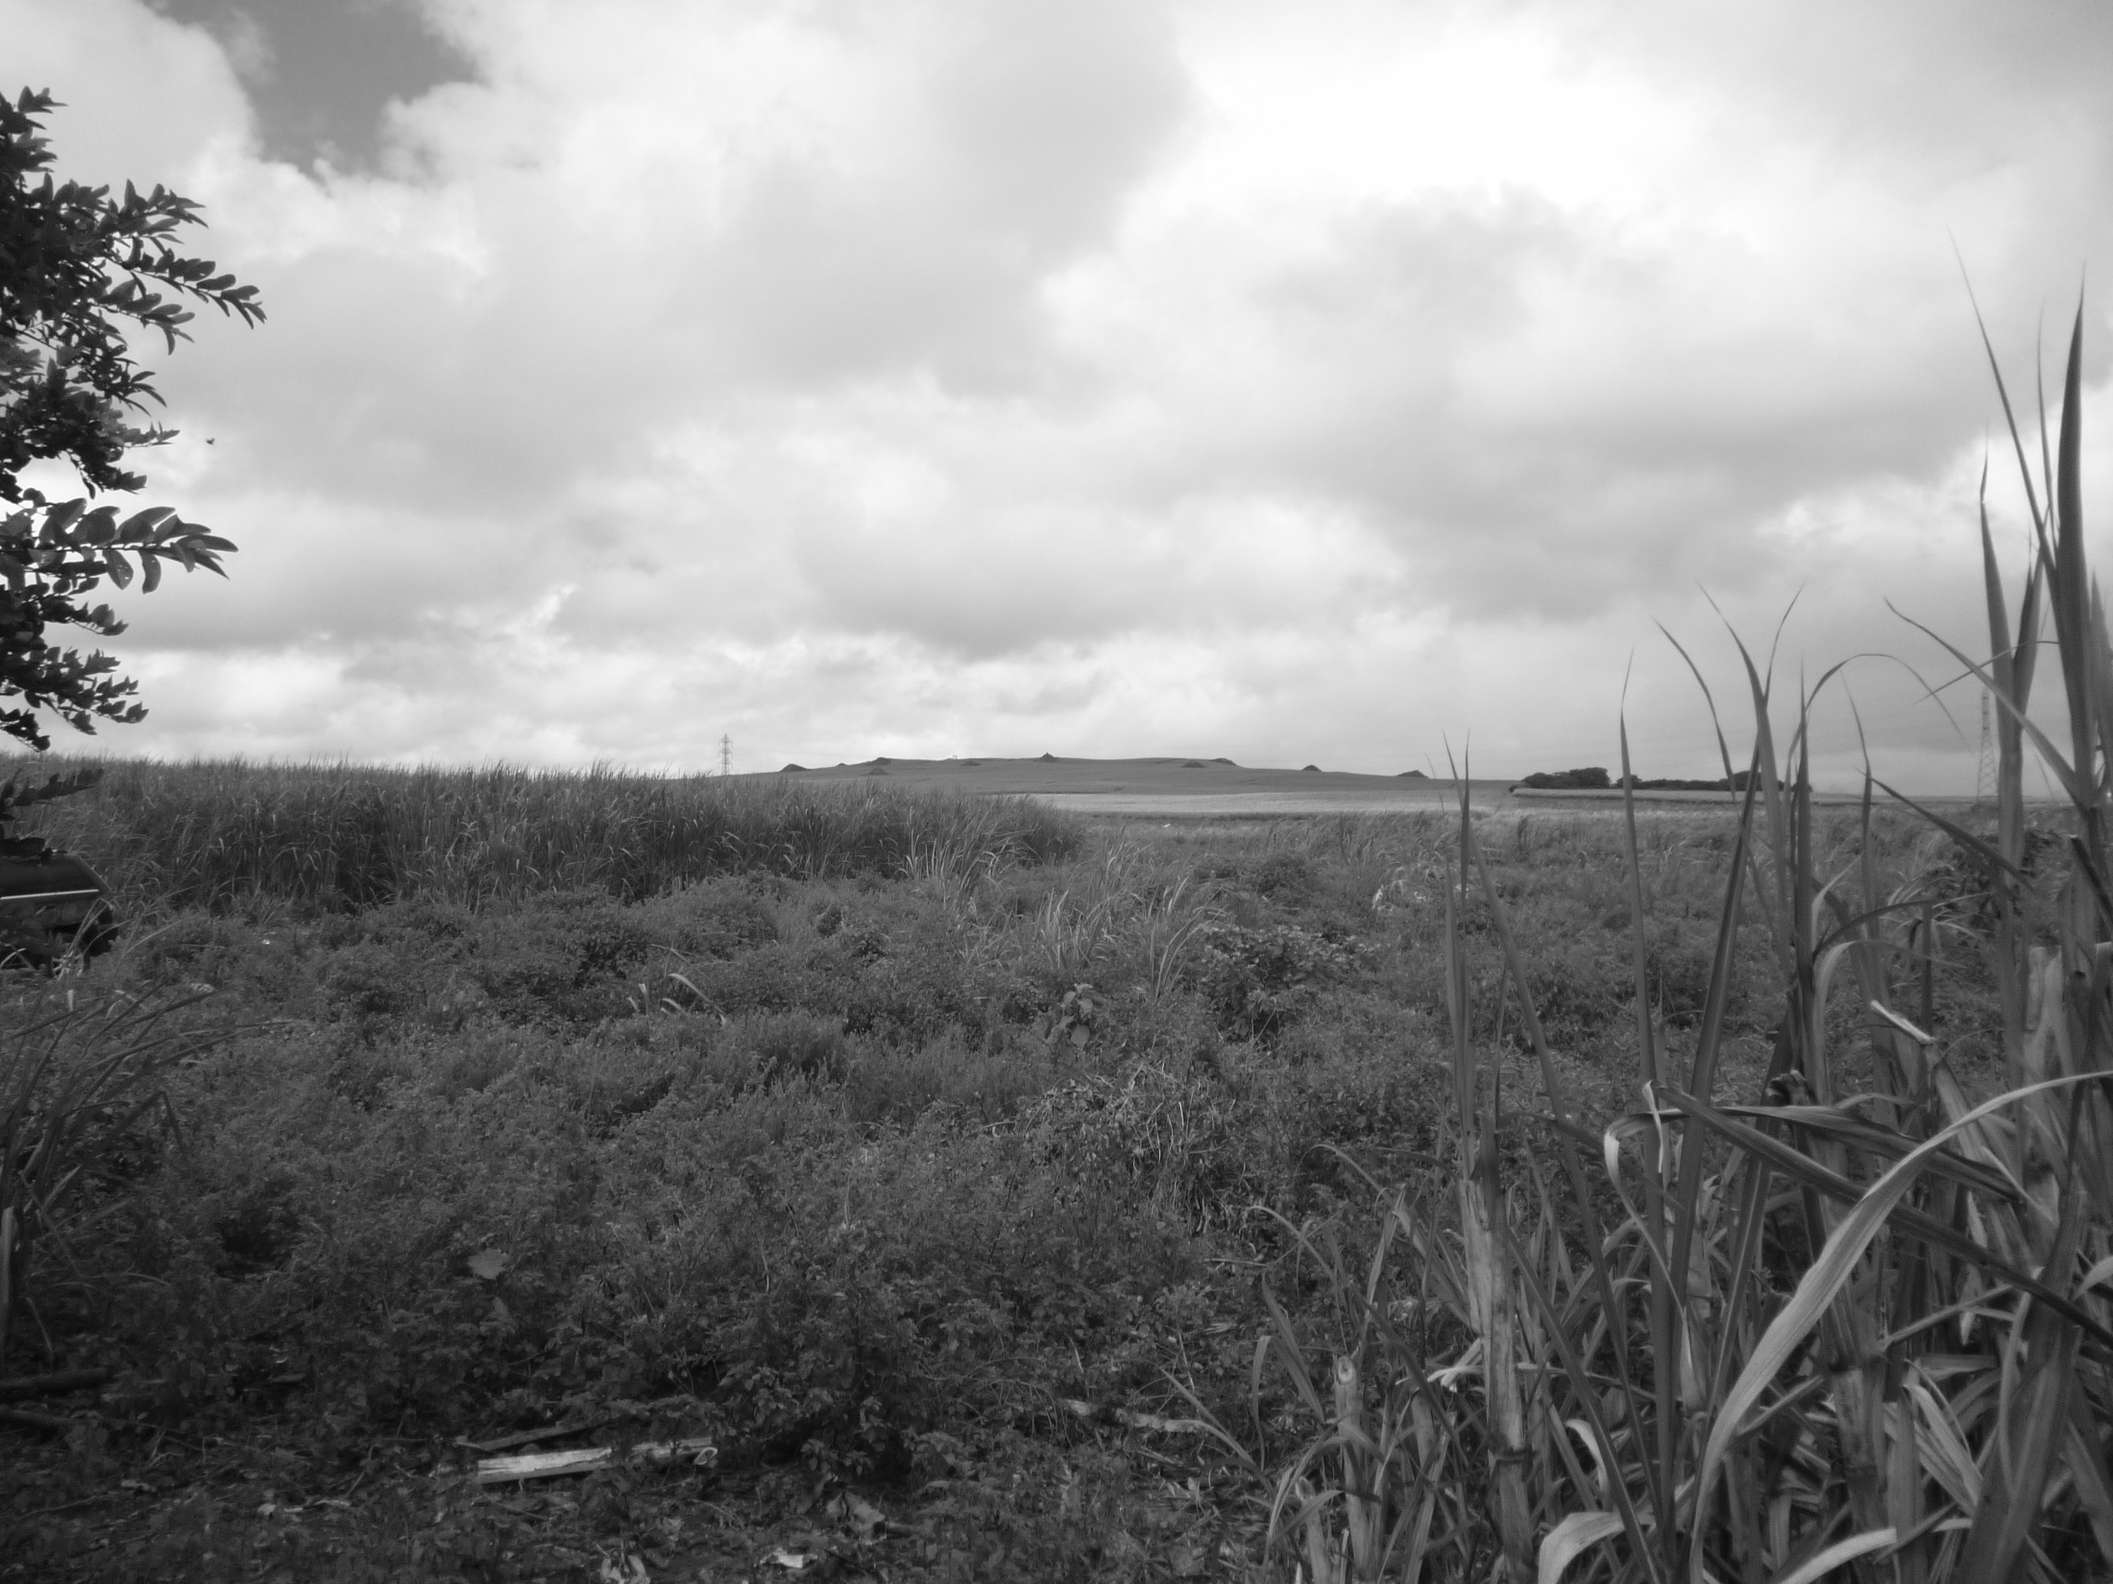
Mont Piton

Slide 36
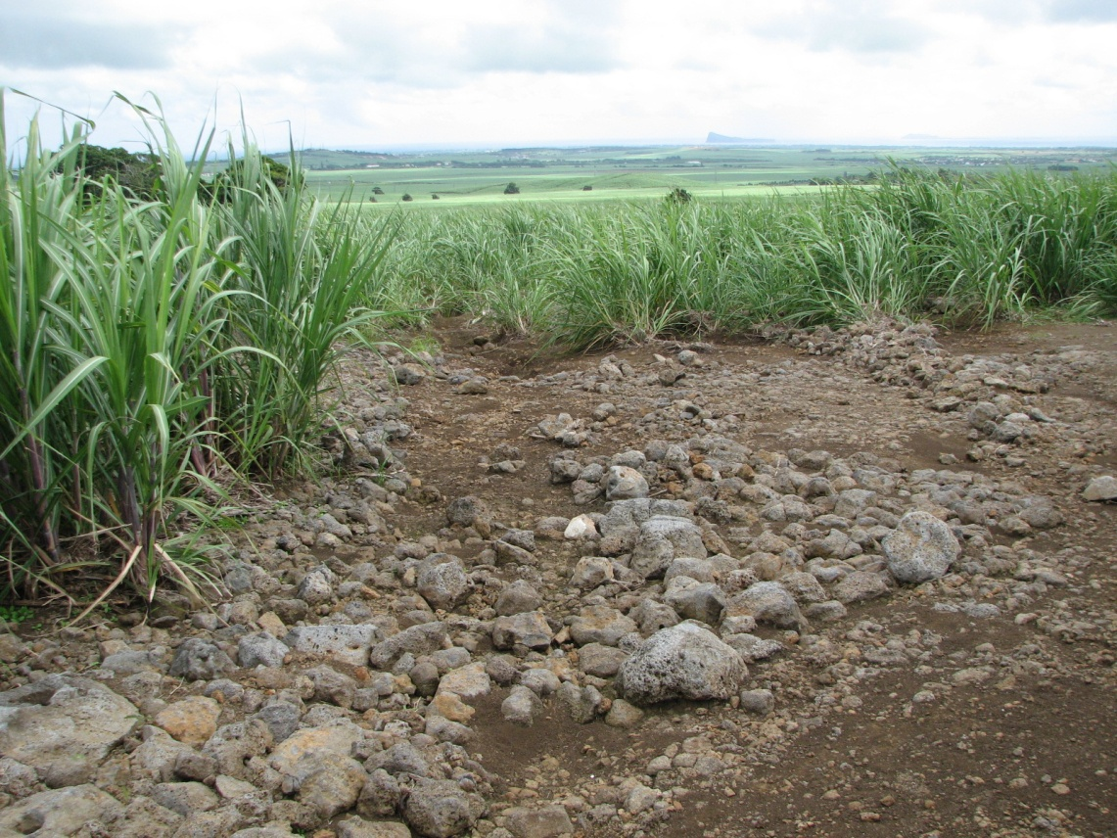
On top of Mont Piton

Slide 37
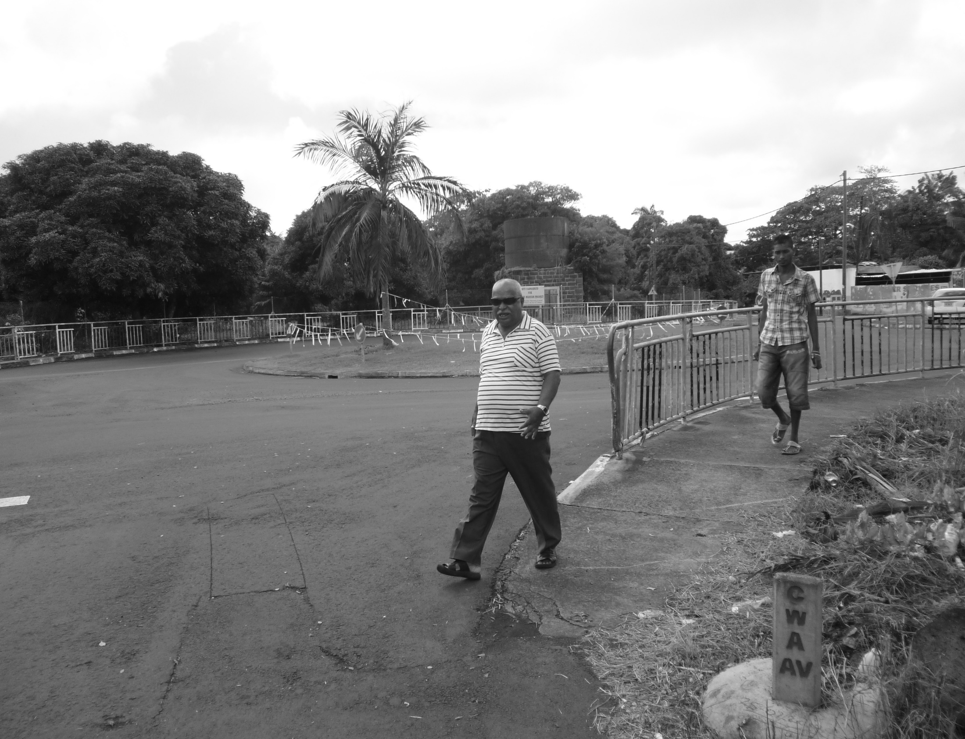
Mapou round about

Slide 39
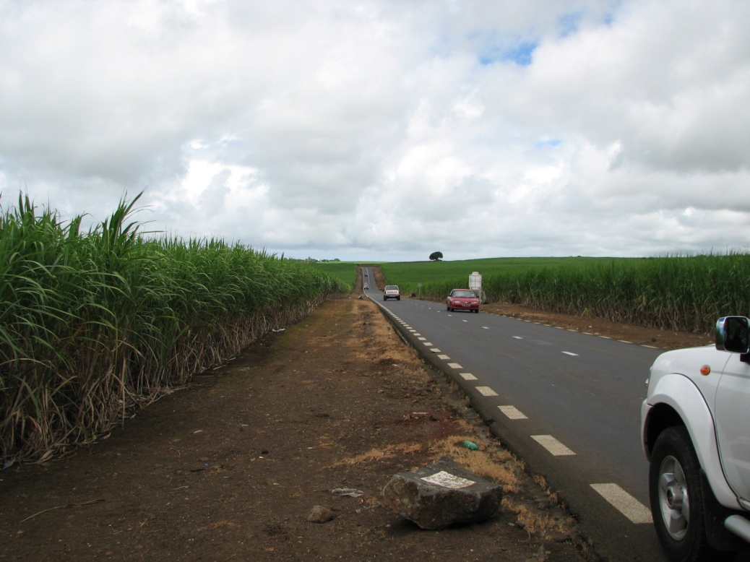
Beau Sejour

Slide 40
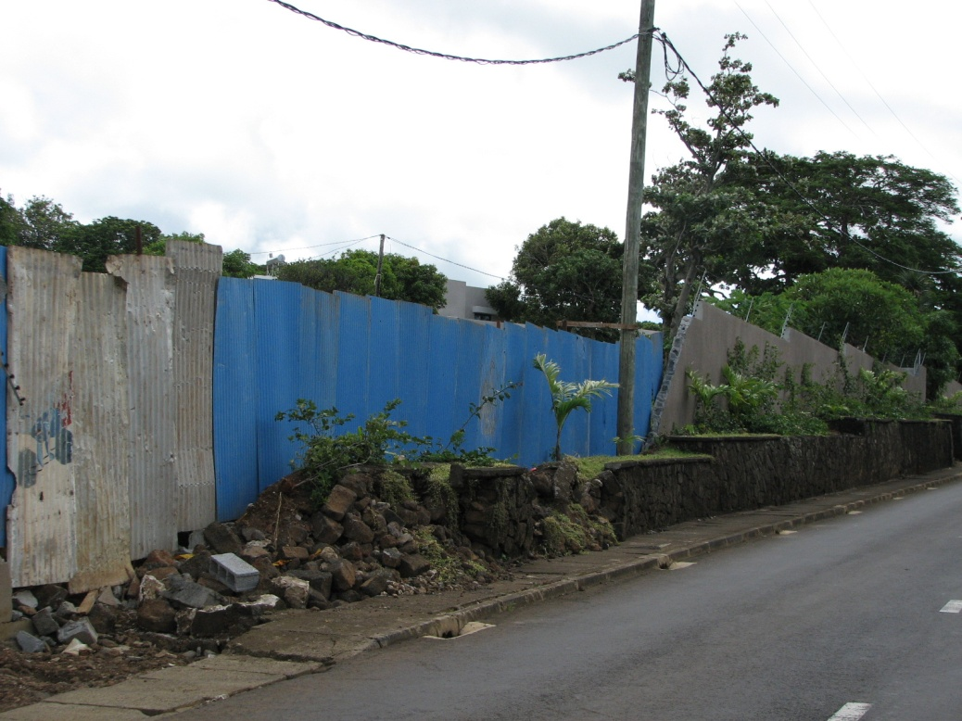
Beau Sejour

Slide 41
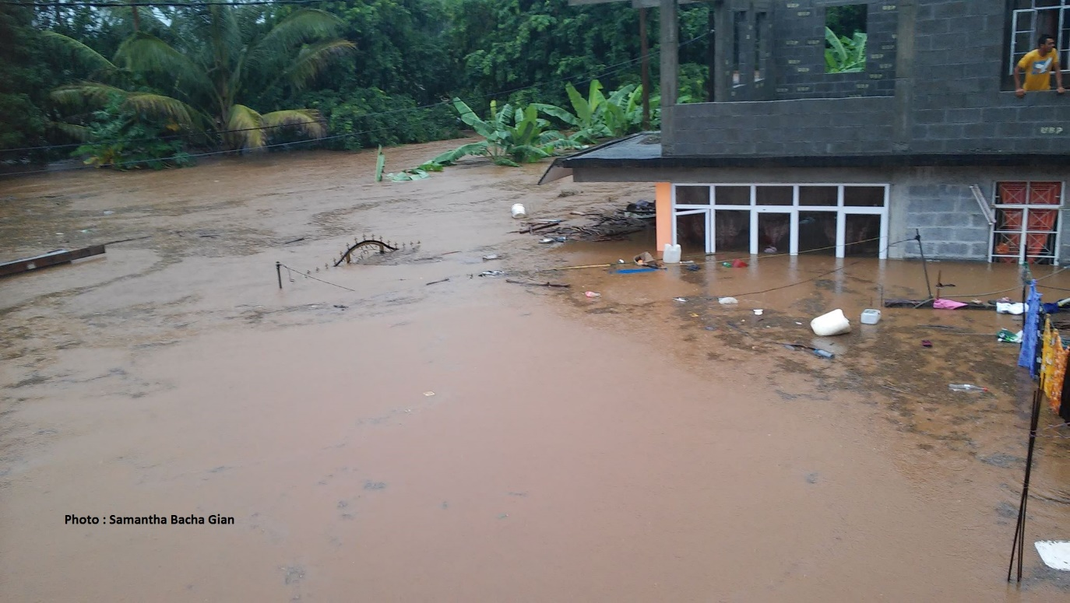
Disaster Risk Mapping
Virahsawmy Lane, Surinam, March 2015

Slide 42
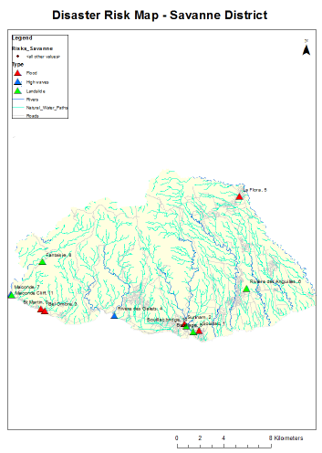
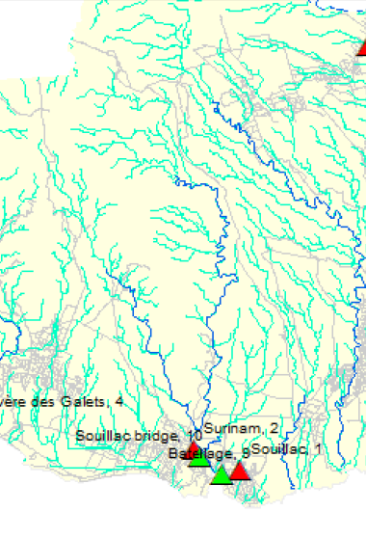
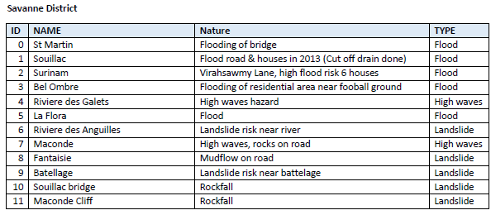

Slide 43
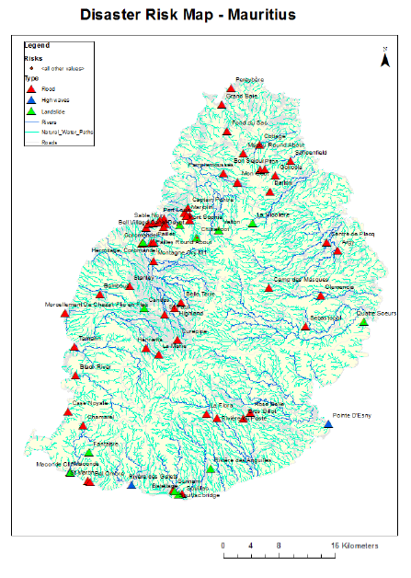

Slide 44
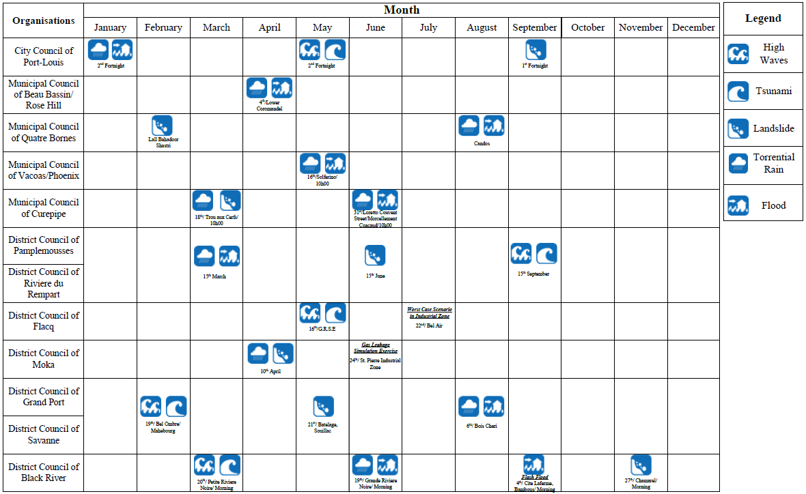
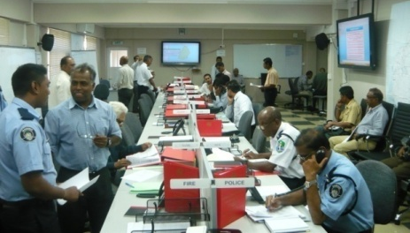
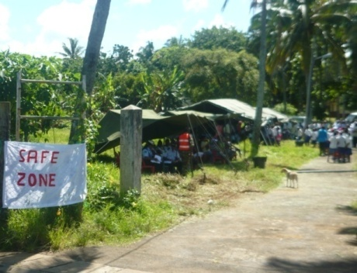
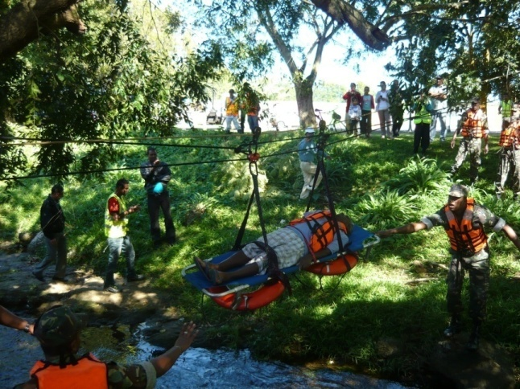
Simulation Exercises
Simulation
Calendar

Slide 45
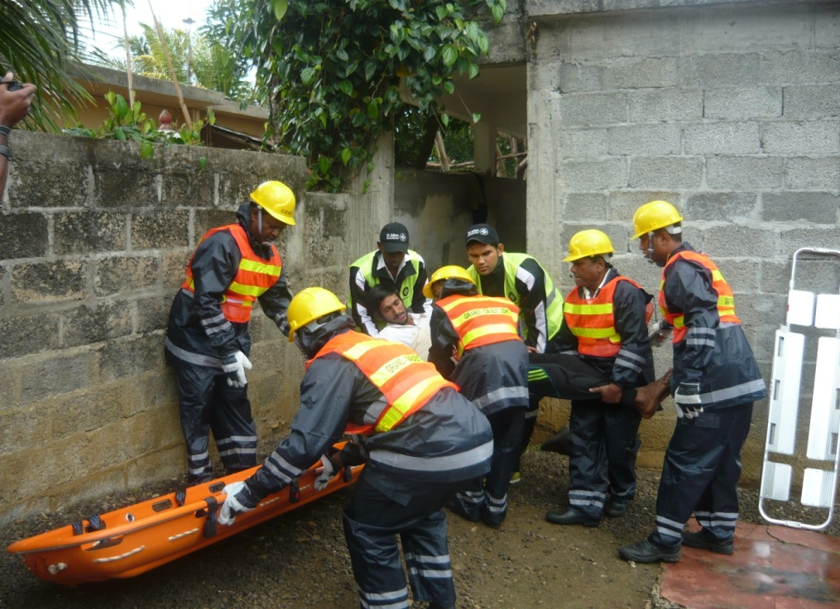



Community Disaster Response Team - CDRT

Slide 46

Community Sensitisation Programme

Slide 47


Education Programme
Sensitisation in Secondary Institutions
Sensitisation in Primary Institutions

Slide 48


Education Programme
Sensitisation in Elderly Care Homes
Sensitisation in Community Forums

Slide 49
Few Challenges

Slide 50
To work in line with the 4 priorities of SFDRR
  Understanding disaster risk
  Strengthening disaster risk governance to manage disaster risk
  Investing in disaster risk reduction for resilience
  Enhancing disaster preparedness for effective response and to build back better in recovery, rehabilitation and reconstruction
Improve current disaster management practices
  Promote the culture of mitigation & preparedness
  Capacity Building (include First Responders & volunteers)
  Prompt response of all stakeholders including First Responders
  Ensure proper recovery through participation of all
  Vulnerability assessment – in depth all-hazard risk mapping, etc
Enhance the planning, organising, coordinating and monitoring role of the NDRRMC

Slide 51

Challenges (cont)
Disasters are increasingly exacerbated by CC (Frequent hydro-meteorological extremes) and geological events
→ Understanding the significant overlap between DRR and CCA for Sustainable Development

Slide 52
Republic of Mauritius
Republic of
Contact Us
National Disaster Risk Reduction and Management Centre,
Line Barracks,
Port-Louis, Republic of Mauritius.
Tel: +230 2073900
Fax: +230 2073927
Website: Under construction
Email: disaster@govmu.org

Slide 53
THANK YOU

