Slide 1
NATIONAL COAST GUARD
COPING WITH HAZARDS
BY
ASP-REDDY LUTHMOODOO
Notes:
1

Slide 2
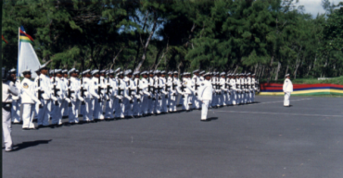
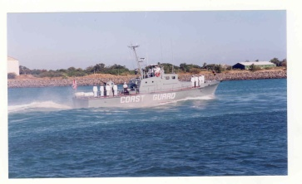
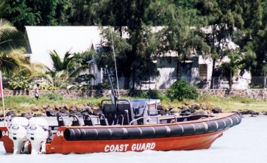
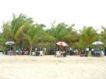
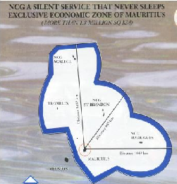
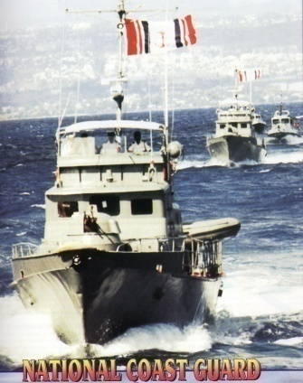
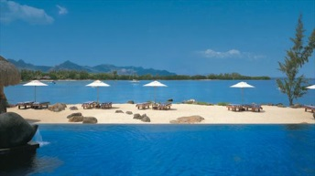
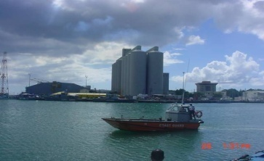
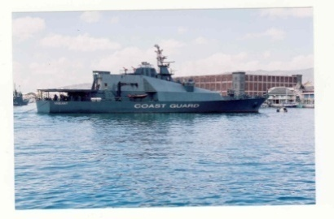
NATIONAL COAST GUARD
Notes:
2

Slide 3
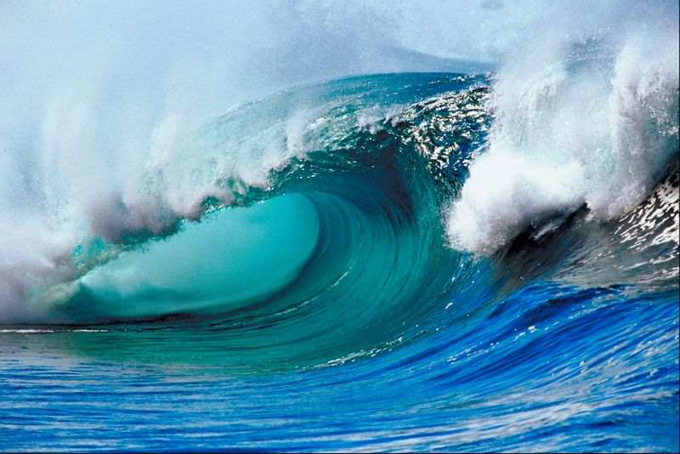
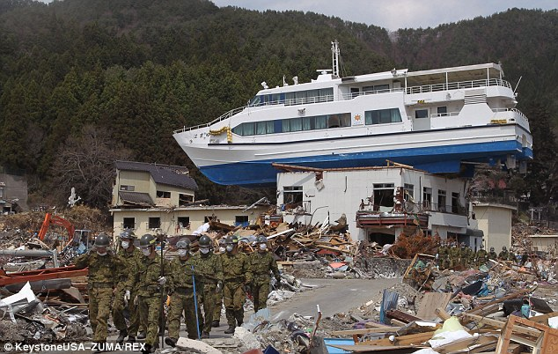
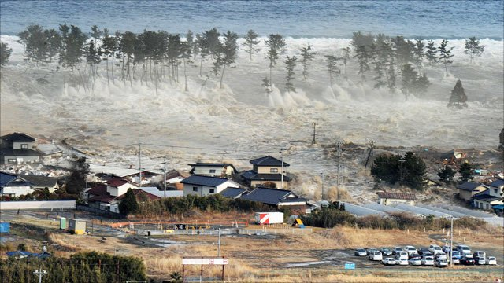
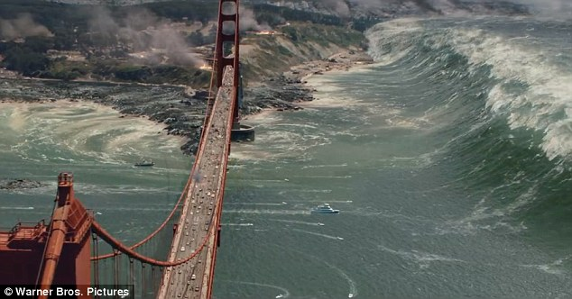
TSUNAMI

Slide 4
TSUNAMI WARNING
AFLOAT PATROL/FOOT PATROL/ MOBILE PATROL TO CAST OFF IMMEDIATELY TAKING ALONG LOUDHAILERS, SIRENS OR ANY MEANS OF COMMUNICATION SUITABLE TO WARN MEMBERS OF THE PUBLIC OF TSUNAMI ALERT.

Slide 5
AFLOAT PATROL
WARN THE FOLLOWING TO RETURN ASHORE :
FISHERMEN
BOAT OWNERS
SKIPPERS OF PLEASURE CRAFT
PICNICKERS
SANITIZE ALL ISLETS IN THE DIVISION

Slide 6
FOOT & MOBILE PATROL ON BEACHES AND ALONG THE COAST
INFORM MEMBERS OF THE PUBLIC, BY THE USE OF TSUNAMI ALARM WARNING/SIRENS FITTED IN VEHICLES/LOUDHAILERS, NOT TO VENTURE AT SEA.
TO VACATE THE AREA TO HIGHER GROUNDS.
INFORM HOTELS MANAGEMENT TO ASSEMBLE THEIR CLIENTS AT HIGHER GROUNDS.(ALREADY IDENTIFIED IN EACH COASTAL AREAS )
INFORM PLEASURE CRAFTS’ OWNERS/ FISHING BOAT OWNERS TO BRING THEIR BOATS/ CRAFTS TO A SAFER PLACE.

Slide 7
ONE HOUR BEFORE TSUNAMI WAVE REACHES THE COASTAL AREAS
ALL COAST GUARD PERSONNEL ON PATROL TO CALL AT POST AFTER EVACUATION OF SEA AND BEACH USERS.
I/C POST TO MUSTER HIS MEN.
TO SECURE CRAFTS , LOCK THE POST AND EVACUATE.

Slide 8
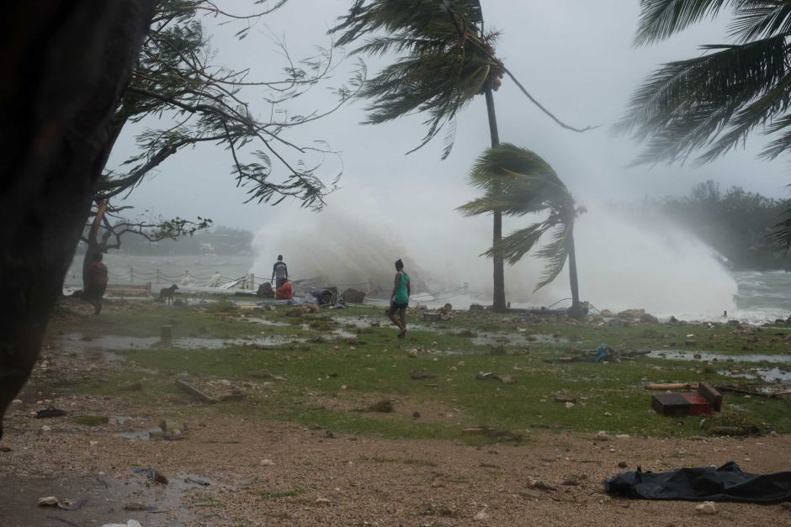
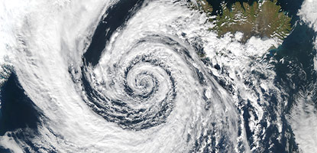
CYCLONE

Slide 9
CYCLE CLASS I
.
Inform hotels, sea farers, fishermen, boat owners and tour operators in the Division.
All Islets to be santized.

Slide 10
CYCLE CLASS II
ADVISE OPERATORS OF CRAFTS NOT TO VENTURE OUT AT SEA.
RENDER ASSISTANCE TO VESSEL/CRAFT IN DISTRESS.
RENDER ALL POSSIBLE ASSISTANCE TO OTHER DEPARTMENT OF THE POLICE, CIVIL SERVICE AND THE PUBLIC.

Slide 11
CYCLE CLASS III AND IV
ALL SMALL CRAFT TO BE HOISTED IN SAFE PLACE.
AFTERMATH
ALL POST ARE TO ASSESS DAMAGE CAUSED IN RESPECTIVE AREA AND REPORT TO POLICE HEADQUATERS.

Slide 12
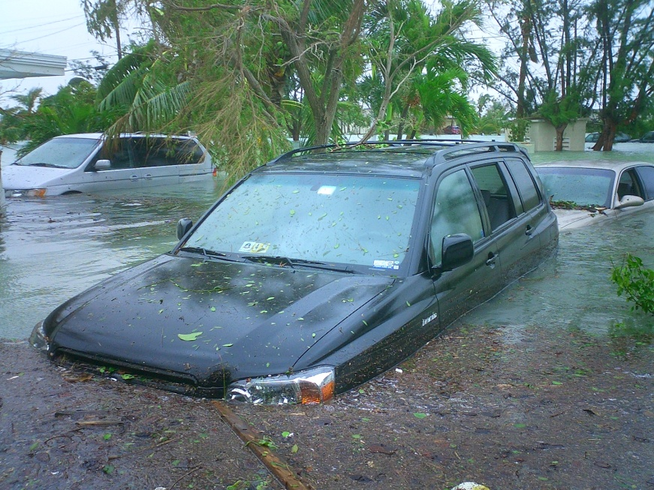
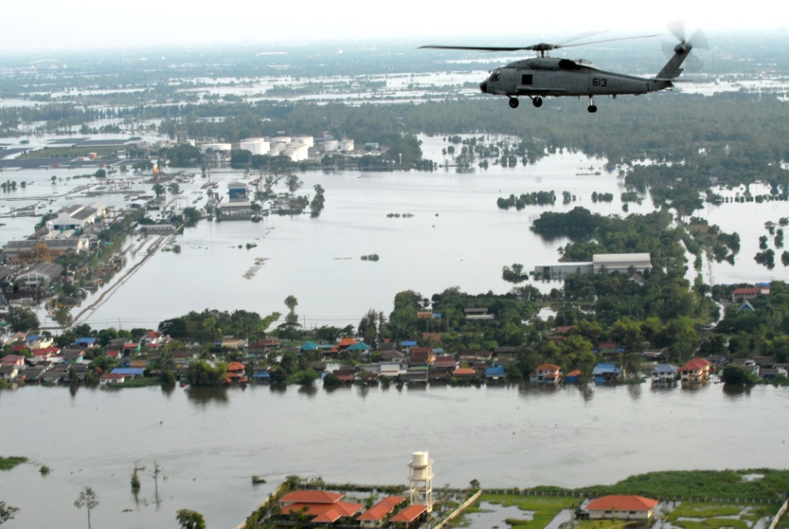
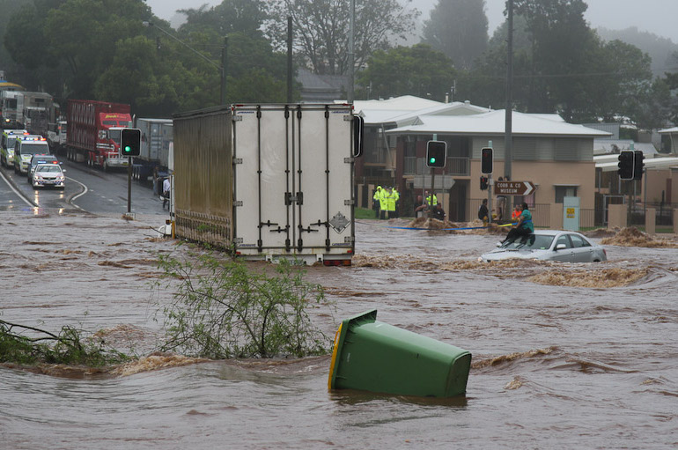
FLOODING

Slide 13
COAST GUARD JOIN OTHER RESCUE SERVICES TO EVACUATE THE PUBLIC TO A SAFER PLACE BY MEANS OF AFLOAT CRAFTS.
ENGAGED IN DIVING TO SEARCH FOR PERSONS TRAPPED IN BUILDING
OR REMOVE DEAD BODIES.

Slide 14
TIDAL WAVES

Slide 15
WARNING OF TIDAL WAVES
INFORM ALL SEA USERS NOT TO VENTURE AT SEA.
OWNERS OF FISHING BOATS, PLEASURE CRAFTS, BOAT HOUSES ARE INFORMED TO KEEP THEIR VESSELS IN SAFE PLACE.
PICNICKERS AND SWIMMERS ARE INFORMED TO TAKE MAXIMUM PRECAUTION.

Slide 16
THANK YOU

