Slide 1
Seamless Water Forecasting to support Flood Forecasting and Warning
Dr Dasarath (Jaya) Jayasuriya
DMH at Nay Pyi Taw
8 September 2016

Slide 2
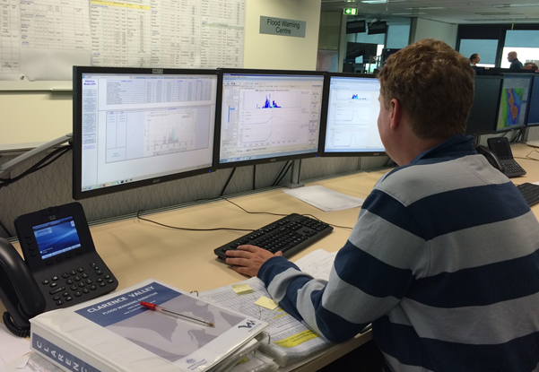
Overview
Flood Forecasting and Warning Vision
Seamless water forecasting approach
Total Flood Warning System
Bureau's experience
Recent advances – product dissemination and end user engagement
The 7 Day Flow flood guidance
Opportunities for DMH

Slide 3

Flood Forecasting and Warning
Vision Statement
The Flood Forecasting and Warning Branch harness the skills of our people, potential of our technology and the strength of our processes to deliver user-focused, resilient, responsive and flexible services to meet the changing needs of our endusers

Slide 4
What we do
Perspective
Situational awareness
Foresight
PAST
PRESENT
FUTURE
DECADES
YEARS
WEEKS
DAYS
DAYS
WEEKS
YEARS
DECADES
National water account
Long-term trends
Water balance reporting
Water market website
Seasonal Forecasts
Flood and short-range forecasts
Notes:
Looking back to the future
Forecasting is the Bureau's DNA – weather and climate, and also flood for over 50 years
Seamless approach to water forecasting
From flood – and more recently to short-term – seasonal and long term

Slide 5
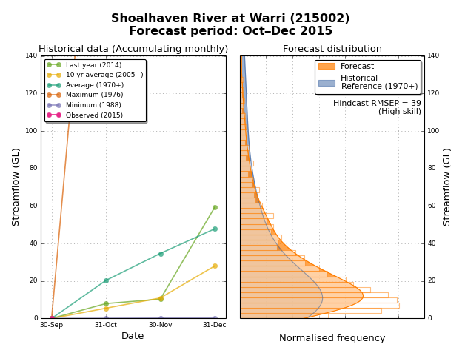
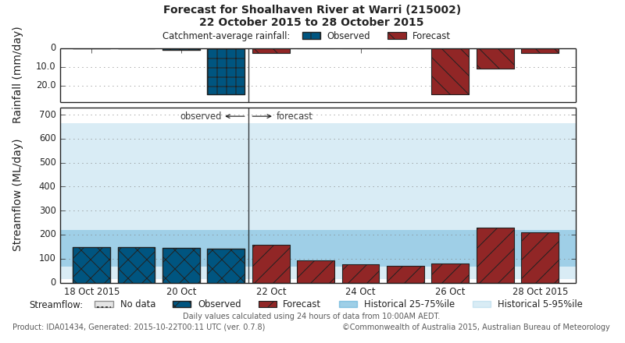
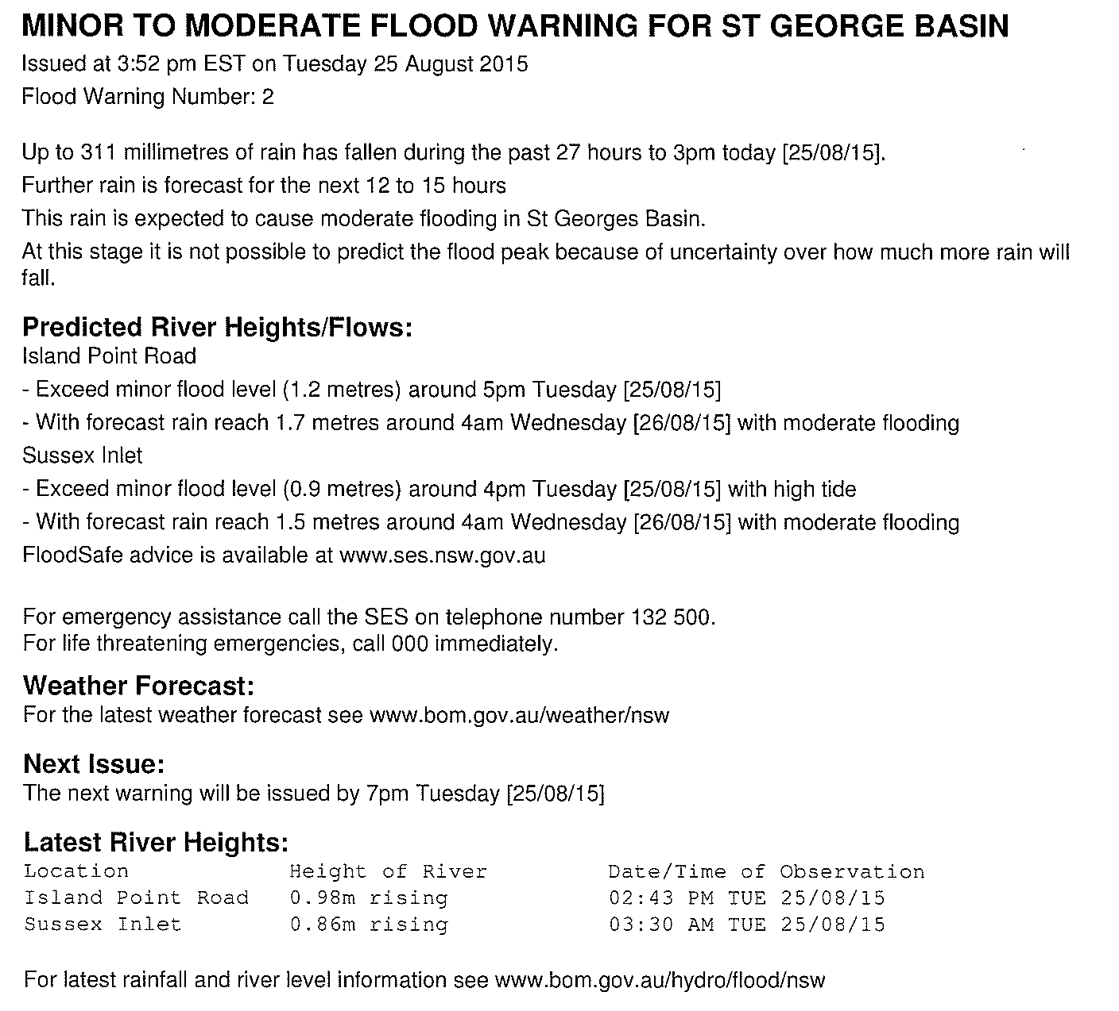
Flood forecasting warnings and services
Seasonal forecasts
7-day streamflow forecasts
Flood warning service
The seasonal forecasting service commenced in 2010
The 7- day forecasts commenced in September 2015 and was the first service using forecasts provided by HyFS
The Bureau has been providing flood warnings for over 50 years. HyFS became fully operational for flood forecasting in December 2015

Slide 6
Adding value to water information
Forecasting
Rare
Precious
National reporting
Analysis
Data » Information » Insight
INCREASING VALUE
Modelling
Uncommon
Very high value
Integration
Sharing
Local reporting
Archiving
Quality assurance
Monitoring
Common
High value

Slide 7
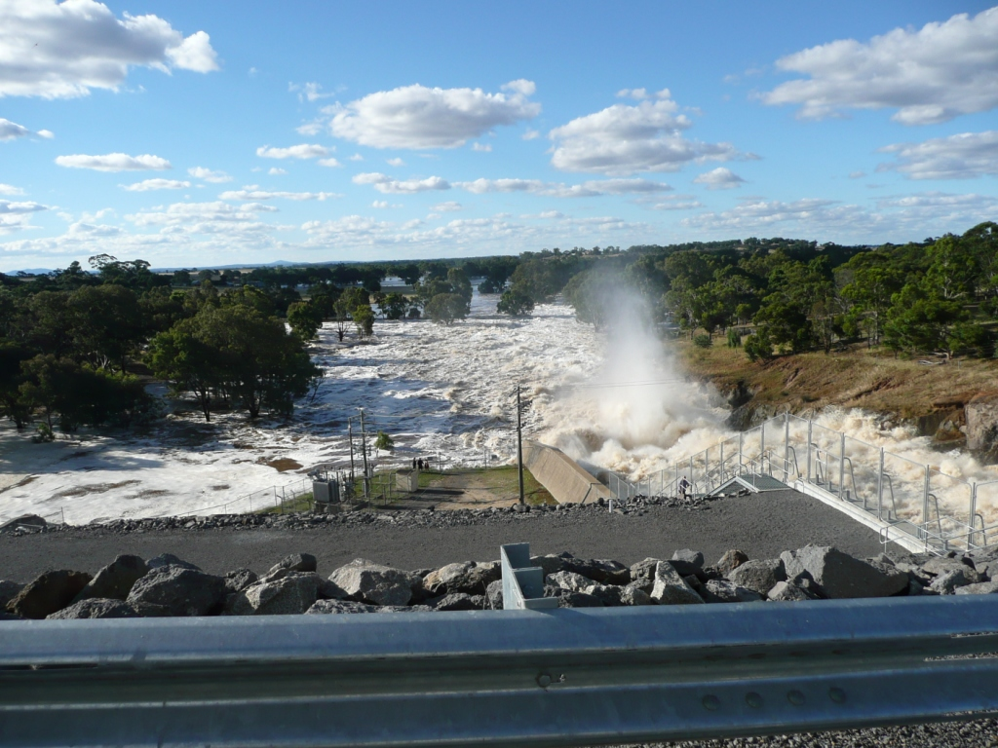
Flood Forecasting and Warning Service

Slide 8
Total flood warning process

Slide 9
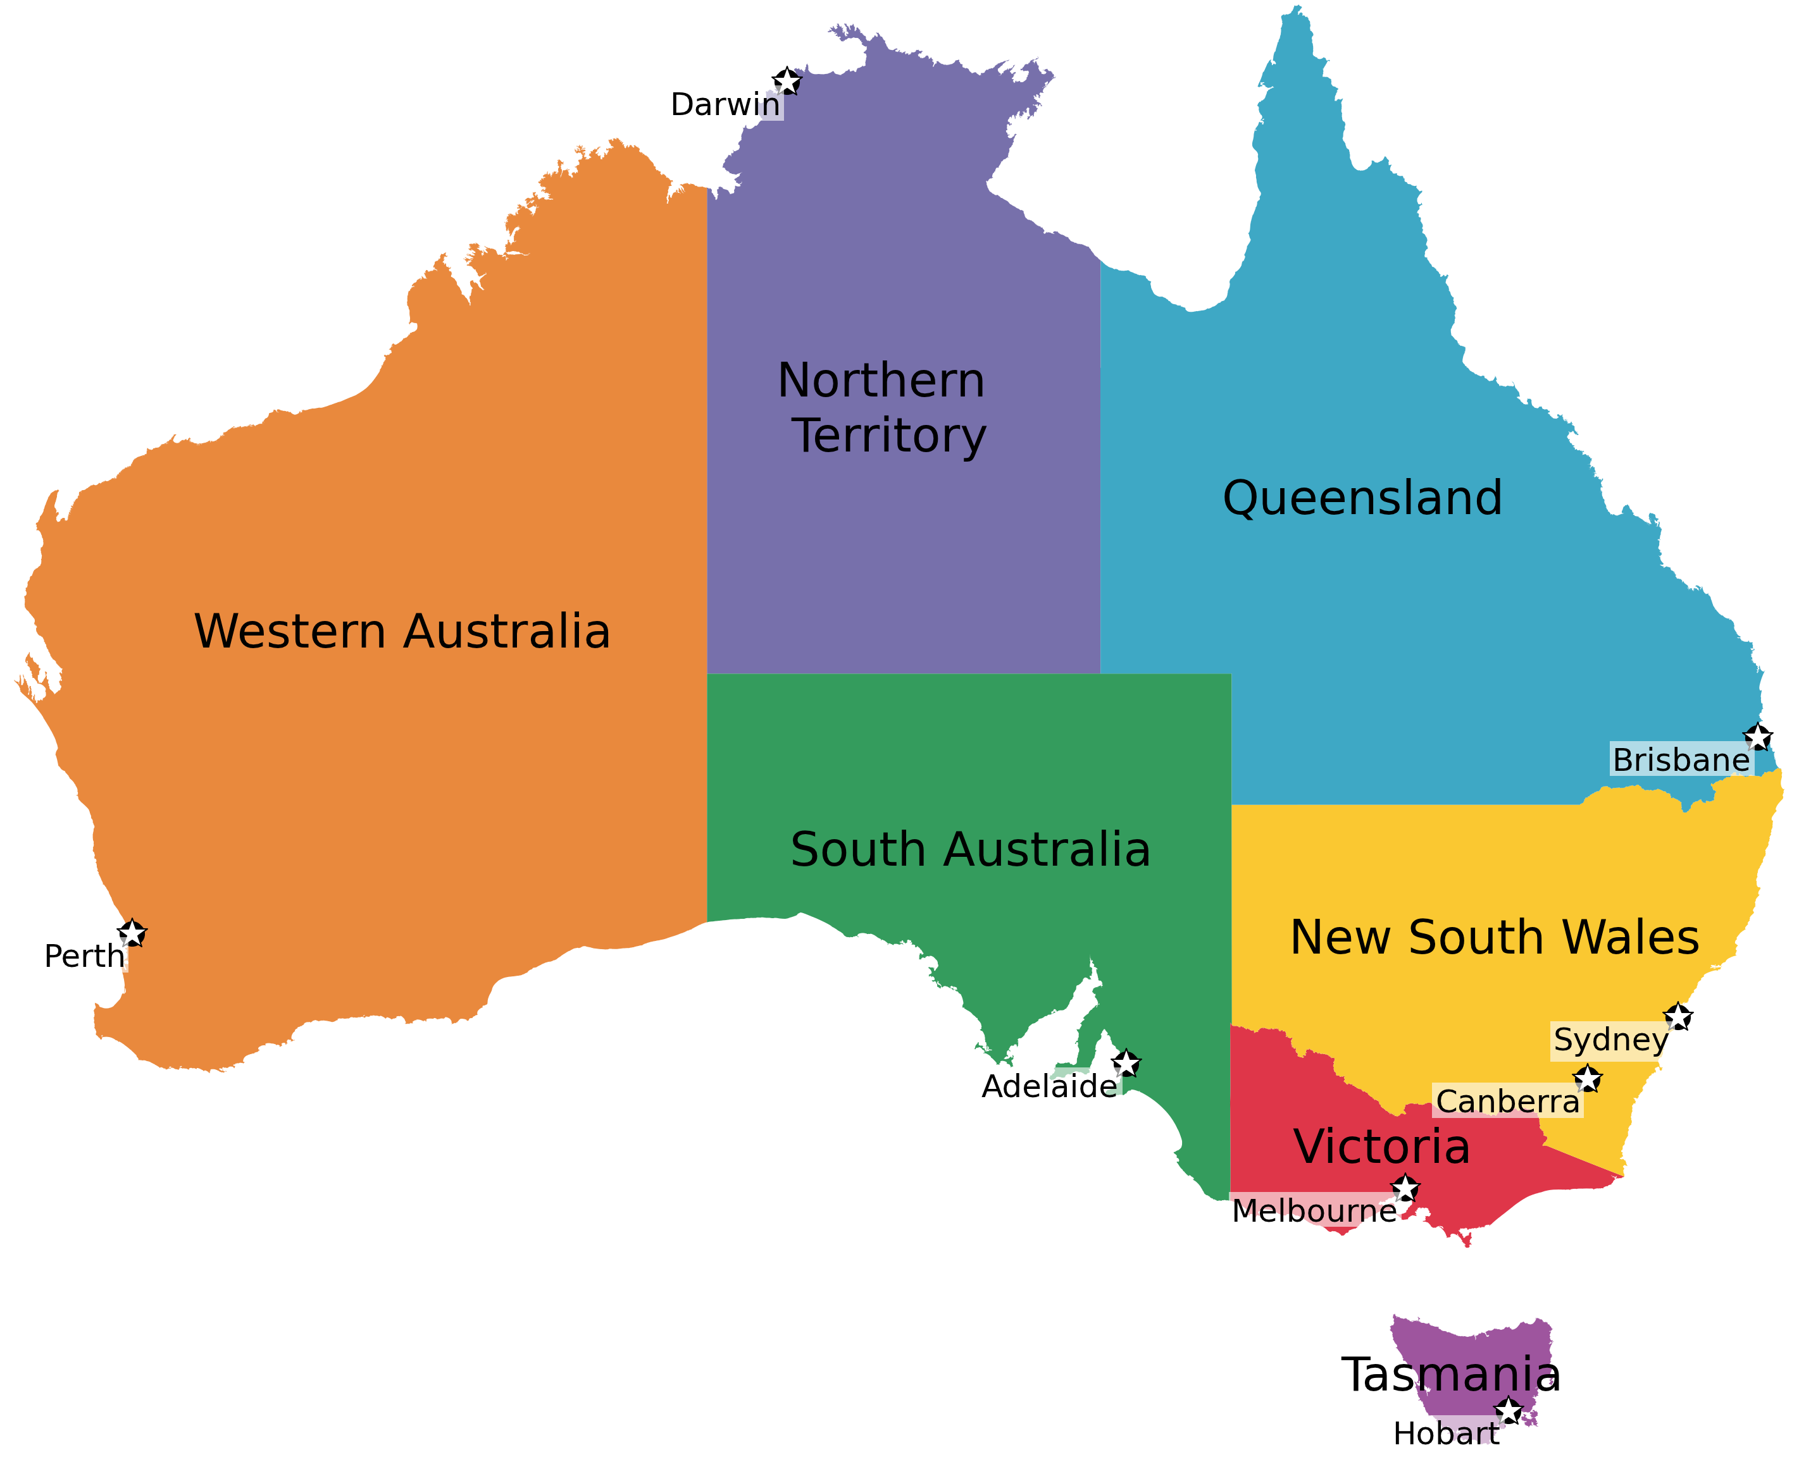
Flood risks and activity
Properties affected by
1 in 100 year flood
(Leigh and Gissing, 2006)
Flood warnings issued
in last ten years
State | Number | % of total
Queensland | 62 130 | 36%
New South Wales | 55 677 | 33%
Victoria | 42 376 | 25%
Western Australia | 1142 | 1%
South Australia | 6582 | 4%
Northern Territory | 990 | 1%
Tasmania | 723 | <0.5%
Total | 169 620 | 100%
95
6106
831
159
5541
3814
2144

Slide 10
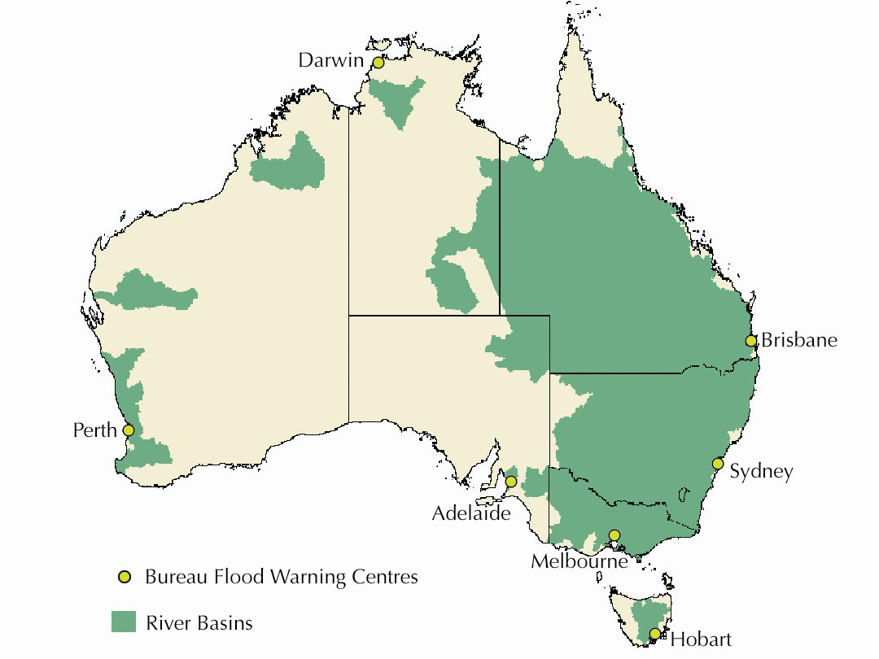
Flood forecasting in Australia

Slide 11
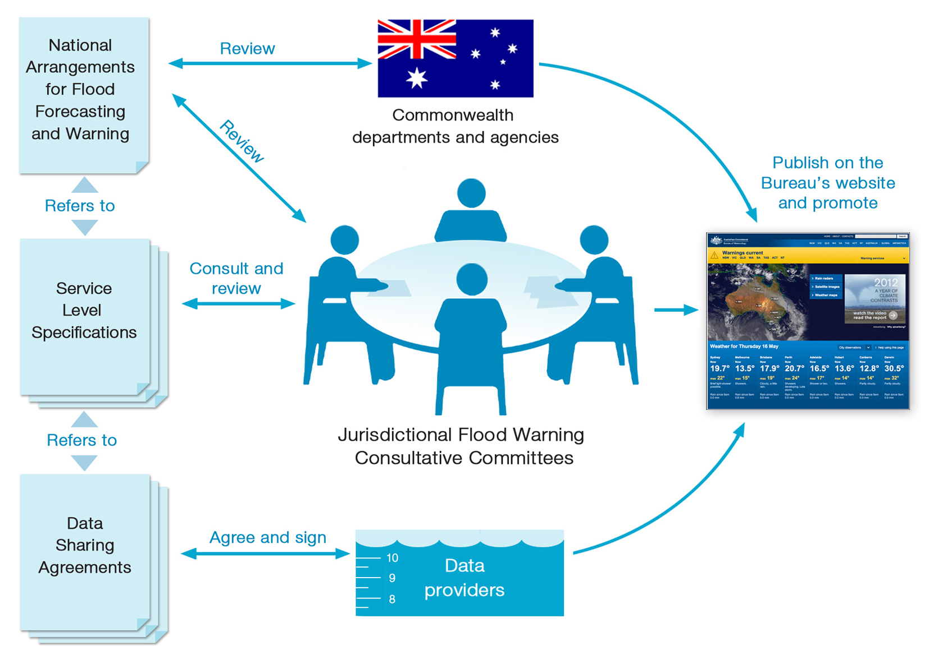
Flood forecasting and warnings
Collect, store and publish river height and
rainfall data
Develop flood forecasting models
Prepare watches, warnings and predictions
Deliver briefings to government, emergency services and media
Maintain historical flood intelligence

Slide 12
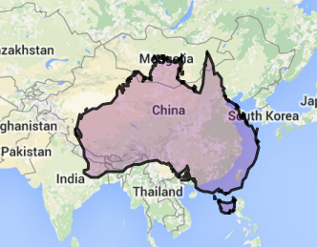
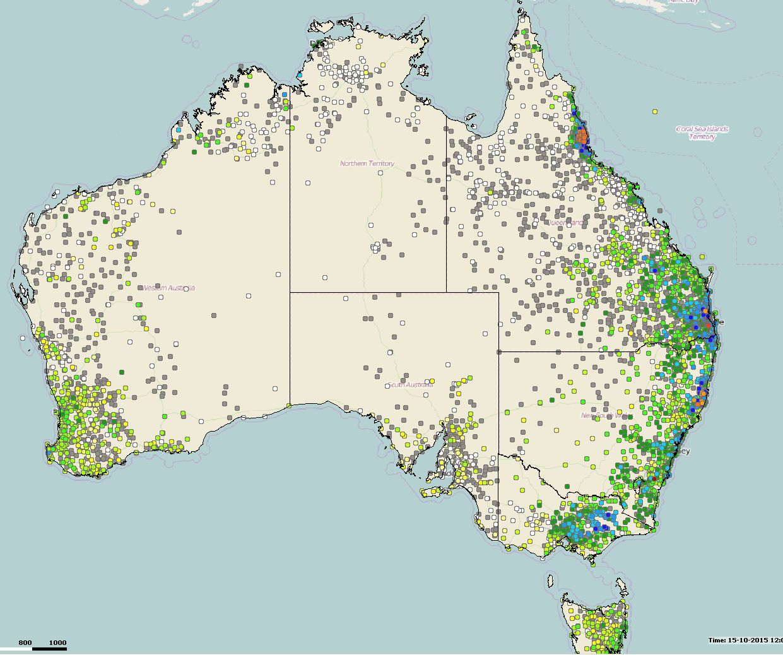
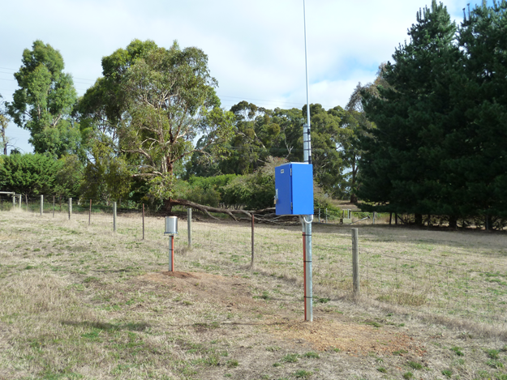
Australian flood warning data network
Rain gauges ~ 4100 (50% Bureau)
River gauges ~ 2600 (5% Bureau)
Size of
China

Slide 13
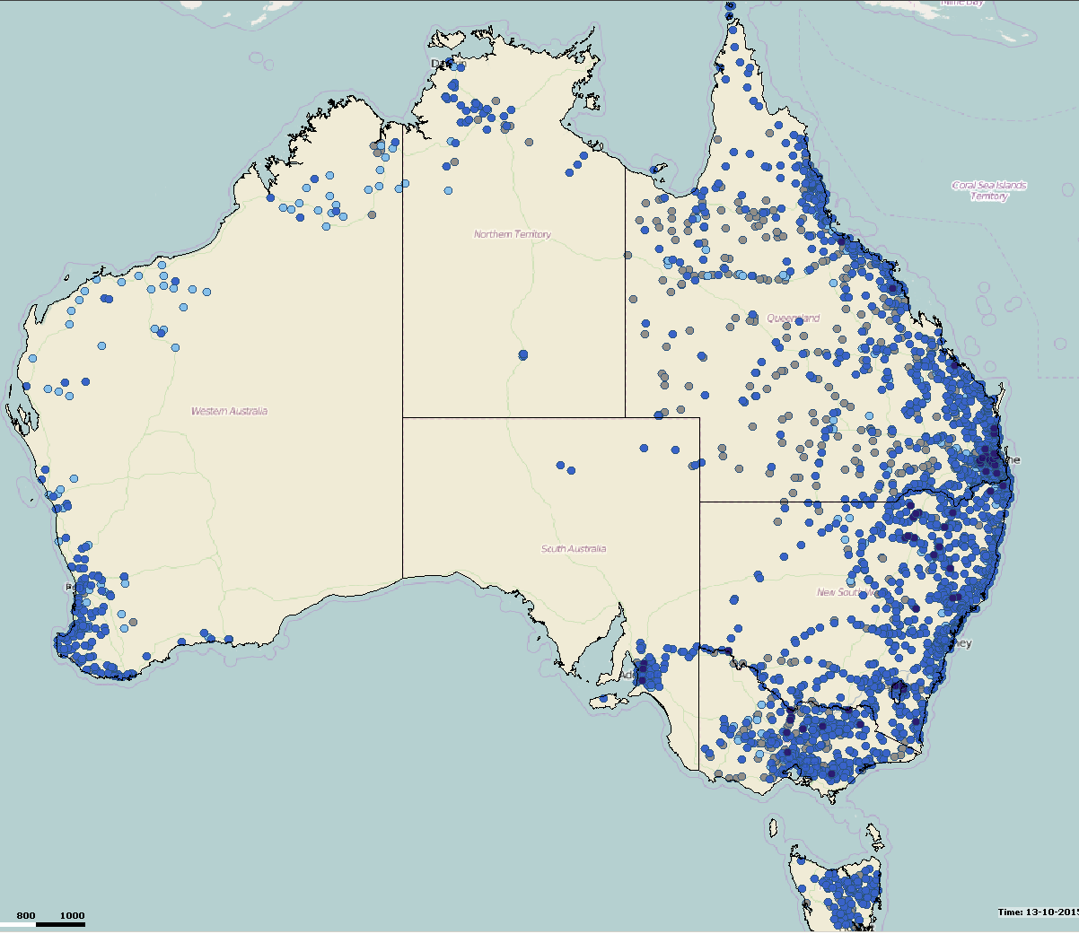
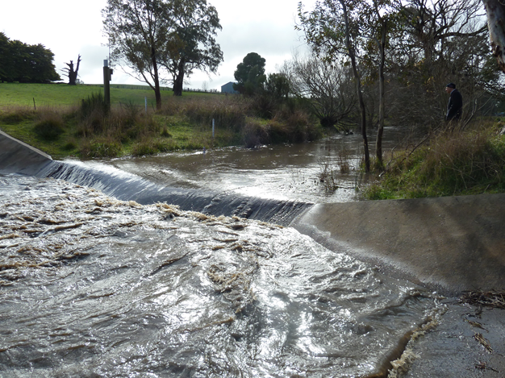

Australian flood warning data network
Rain gauges ~ 4100 (50% Bureau)
River gauges ~ 2600 (5% Bureau)
Size of
China

Slide 14
Bureau's flood warning system
Real Time Data Collection
Online Database
Automated Products
Product Delivery
Clients
  Maps
  Bulletins
  Plots
  Warnings
  Alerts
  Warnings
  Website/Web services
  Fax
  FTP
  Public
  SES
  Local Government
  Stat Government
  Other
  Pre-processing
  Quality Control
  Metadata
  Data Management
  Radio Telemetry
  Polled Telemetry
  Automatic Weather Station
  Local Agency Data
  External Agency Data
  Internet Transfer
Analysis & Modelling
Hydromet Inputs
  Data Viewing
  Flood Risk Assessment
  Hydrological Modelling
  Prepare Warning Products
  Radar
  NWP
  Meteorologists

Slide 15
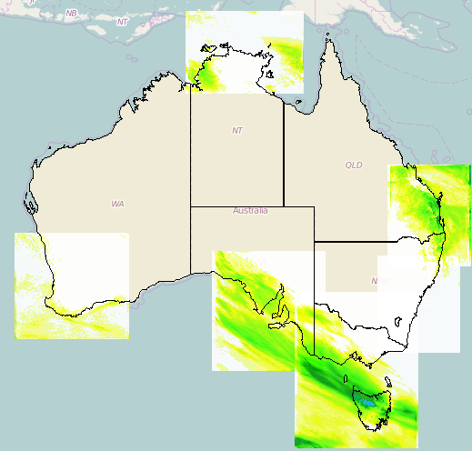
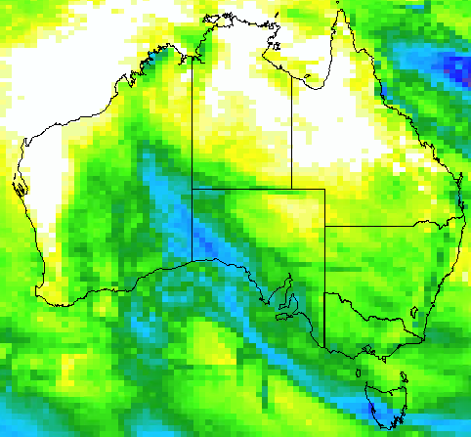
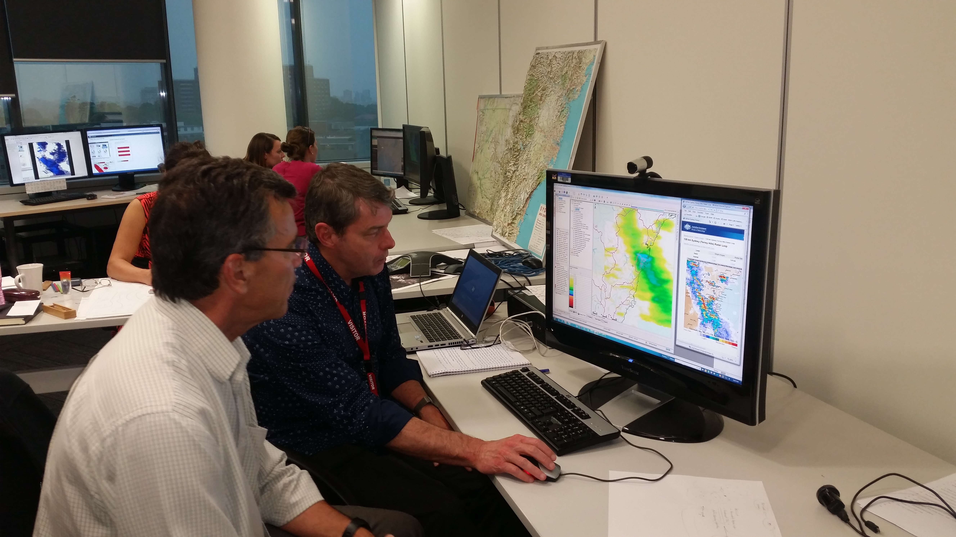
Rainfall forecasts
Numerical Weather Predictions
Australian, International
High/low resolution/leadtime
Multi-model combination
Meteorologists

Slide 16
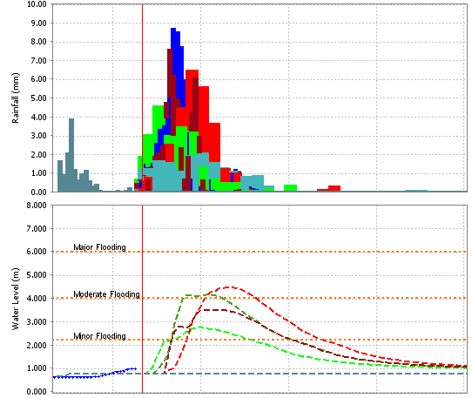
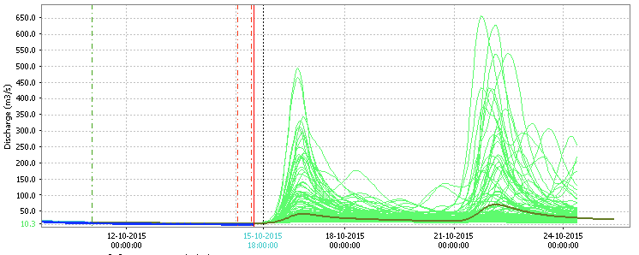
Rainfall forecasts
Numerical Weather Predictions
Australian, International
High/low resolution/leadtime
Multi-model combination
Meteorologists
Many
models
Ensemble forecasts:
River level Rainfall
One
model,
many
scenarios

Slide 17
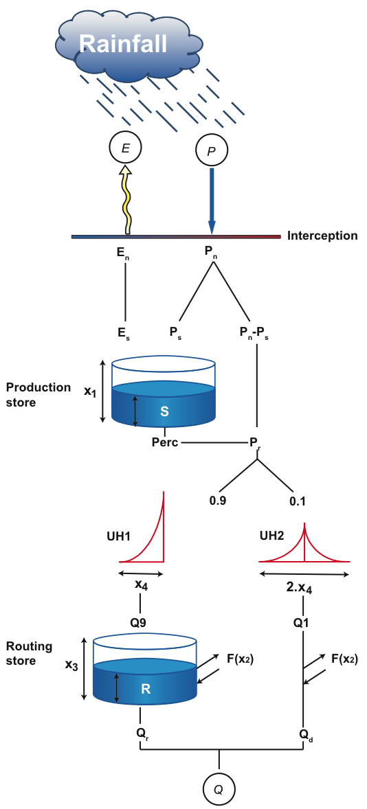
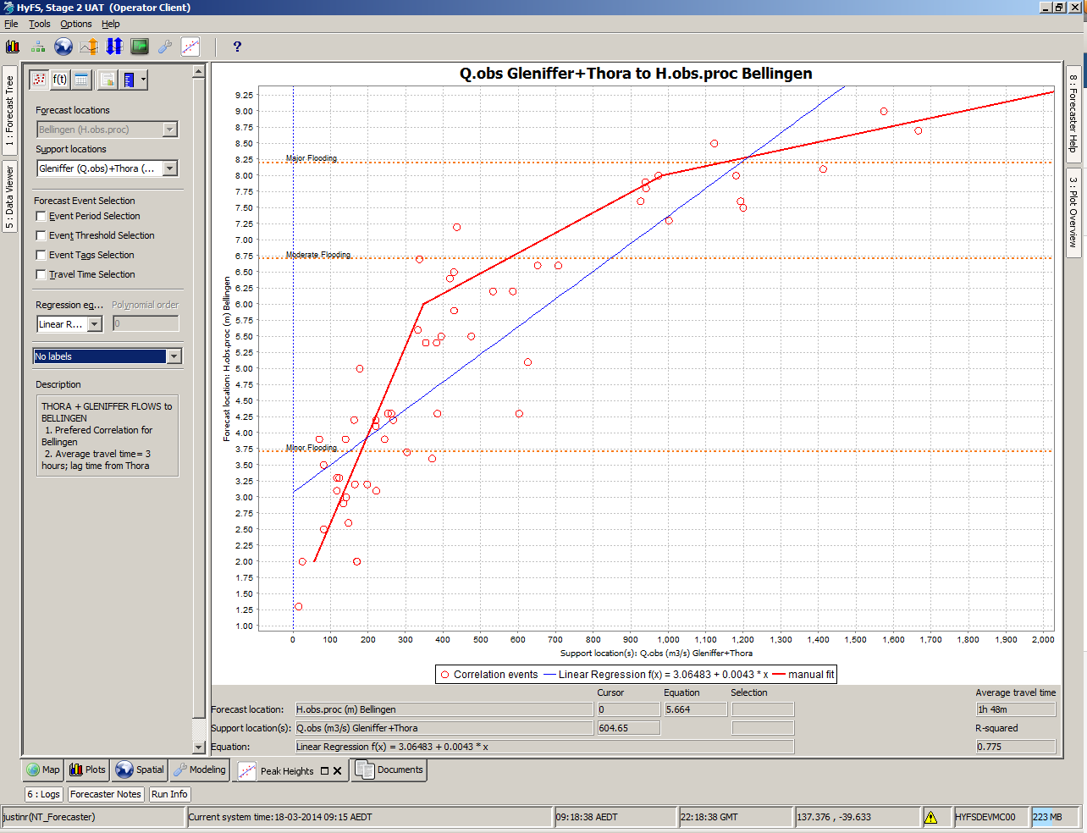
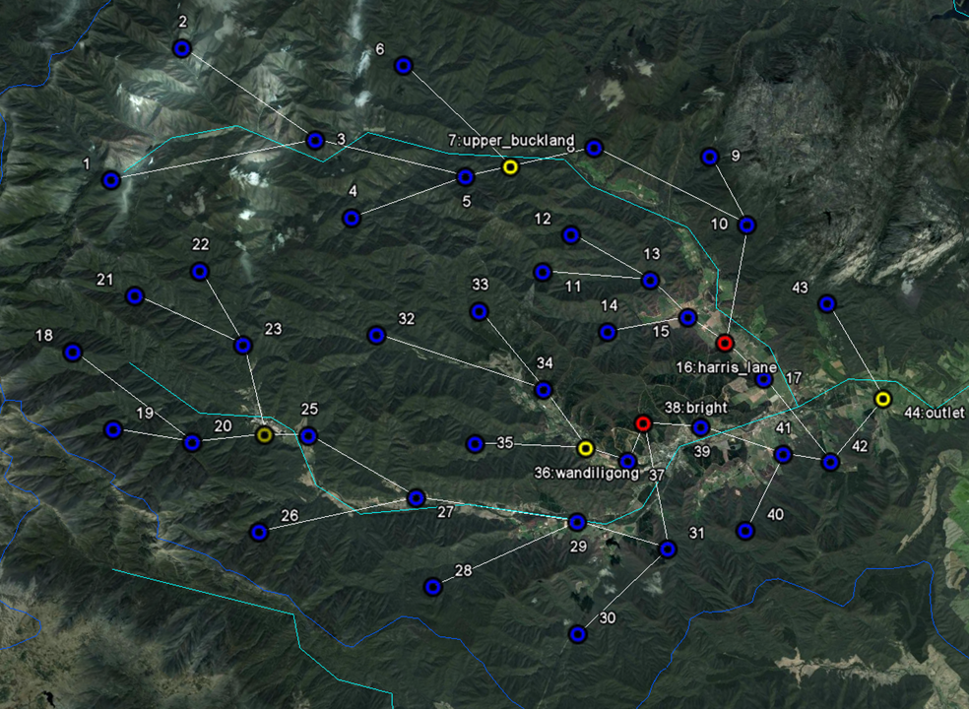
Hydrologic models
  Continuous models GR4J
  URBS (same as Mekong River)
  Event-based, semi-distributed
  Muskingum routing
  Statistical forecasts
Notes:
Runoff flows to nodes
Streamflow flows from one node to the next
Parameters can be uniform or varying in space
URBS, however, there are catchments, sub-catchments and subareas

Slide 18
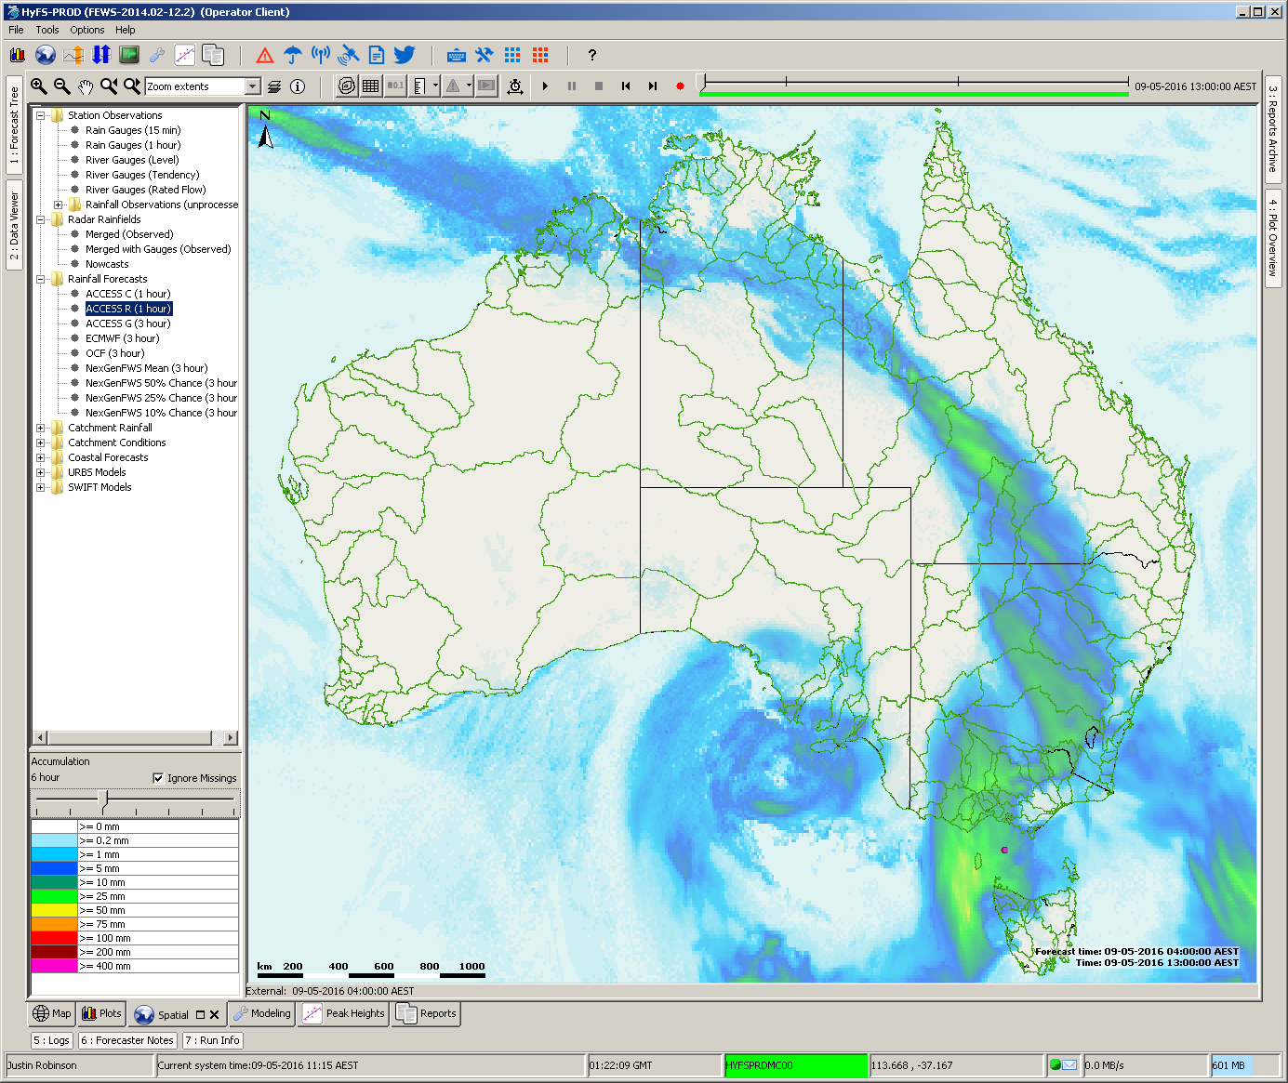
Next Generation Hydrological Forecasting System (HyFS)
The Bureau's Next Generation Hydrological Forecasting System (HyFS) is a state of the art national forecasting system with full disaster recovery
Brings the latest advances in hydrological and weather forecasting to operations and services
National system that allows forecasting from any office and enables greater surge capacity
Realises benefits from investment in R&D
Supports collaboration with forecasting agencies in Australia and overseas

Slide 19
Bureau's flood warning products
Flood Watch
Qualitative, high uncertainty, uses forecast rainfall
Outlook for an area
Flood Warning
Quantitative, usually based on observed rainfall or combination of observed and forecast rainfall, aided by observed flow
Predictions for individual locations

Slide 20
The Bureau's Products
Significant threat
1 – 6 hours
Severe Weather Warning
Significant threat
1-24 hours
Severe Thunderstorm warning
Storm Tide Advice
Outer harbour level >3.5m
+24 hours
SMS Alerts
Flood Warning
Flood Watch
now
Point specific
Rainfall/river level
For emergency managers
6 – 24 hours
Magnitude, location & timing
1-4 days ahead
Large areas
Possibility of flooding
Notes:
Go Through each of the Flood Warning products
Reference other bureau products
All published on our website

Slide 21
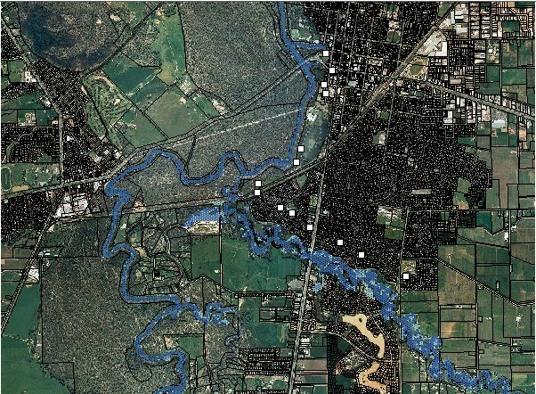
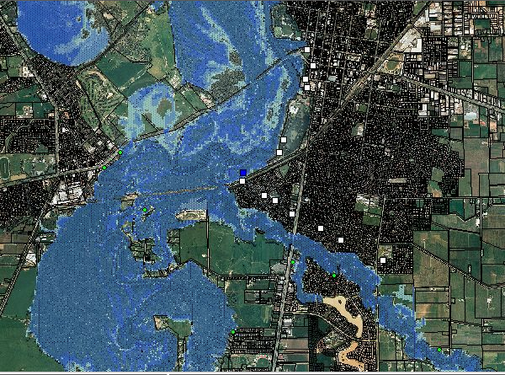
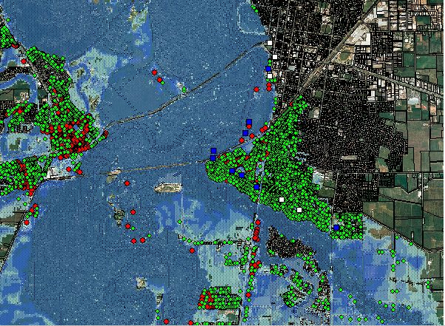

Flood classes are impact-based
Minor: Causes inconvenience. Low-lying areas next to watercourses are inundated which may require removal of stock and equipment. Minor roads may be closed and low level bridges submerged.
Moderate: The evacuation of some houses may be required. Main traffic routes may be covered. The area of inundation is substantial in rural areas and requiring the removal of stock.
Major: Extensive rural areas and/or urban areas are inundated. Properties and towns are likely to be isolated and major traffic routes likely to be closed. Evacuation of people from flood affected areas may be required.

Slide 22
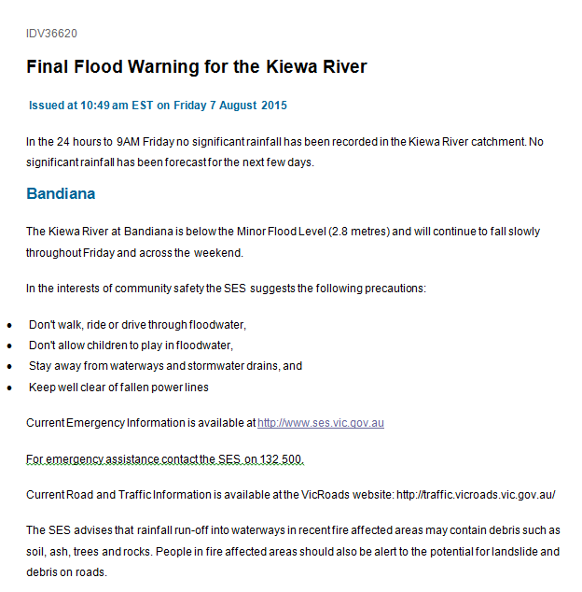
Flood Products:
Watches
Warnings
Issued as needed
Talking with media,
emergency managers
Title
Summary
River level forecast
What to do

Slide 23
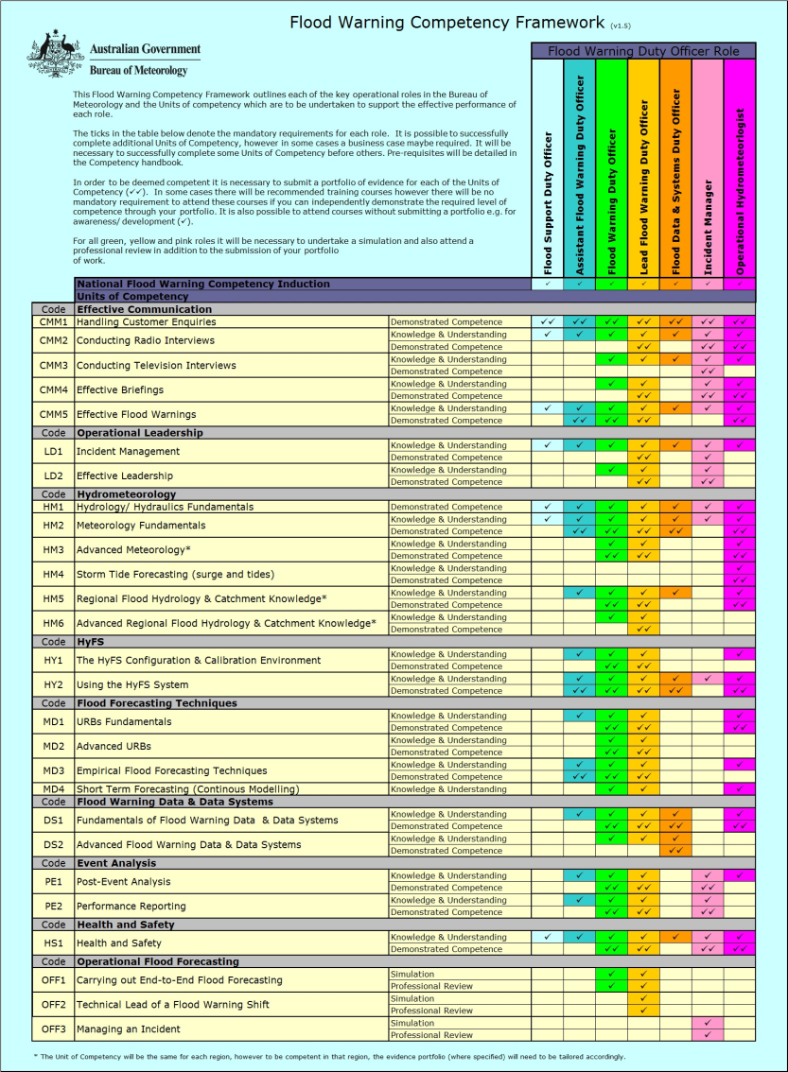
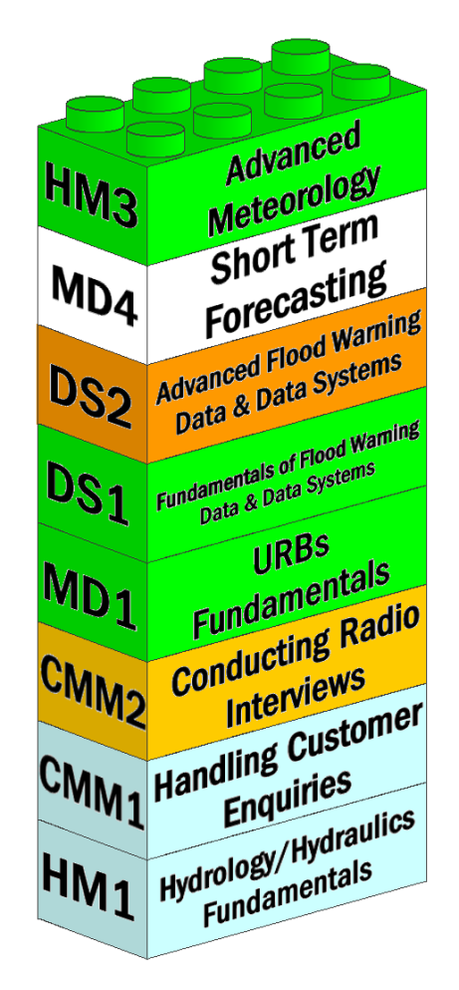
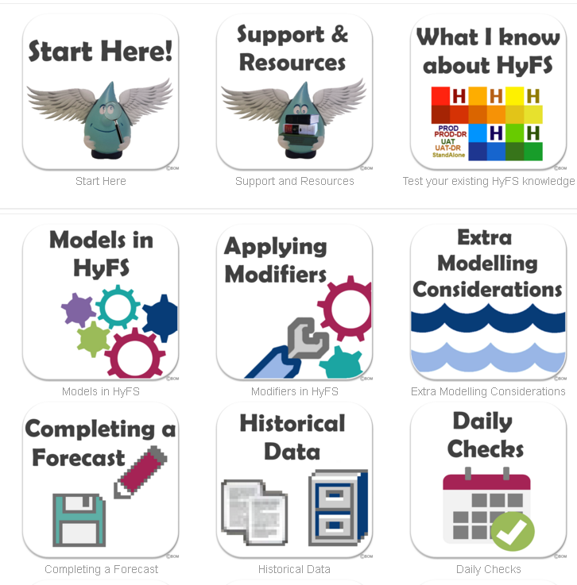
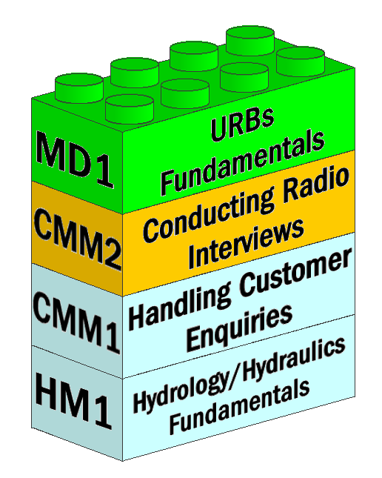
Advanced training and competency assessment
Structured training and assessment
Roles-based operations
Teaches best practice, ensures consistent capability of qualified staff
Enables greater staff mobility and cross-region operational support
Building Blocks for Operational Roles

Slide 24
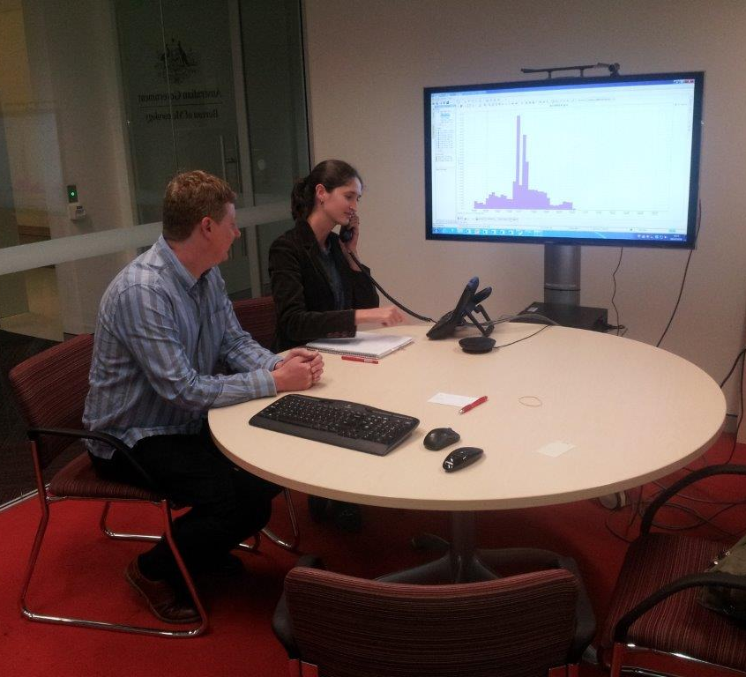
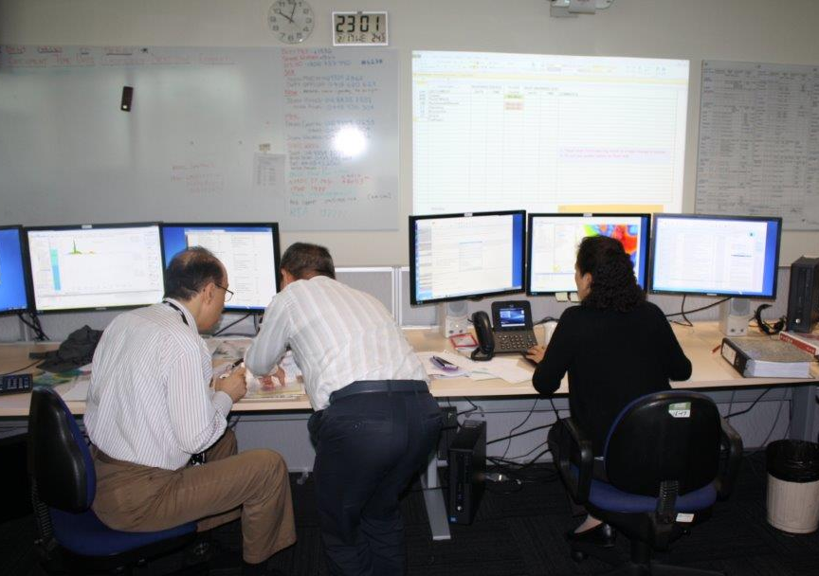
HyFS Collaboration Lab creates real flood scenarios
WaterCoach Command Centre
Flood Warning Centre
1st group in the command centre, who take the role of SES, Media, Water Agencies making calls to the flood desk.
2nd group in the flood warning centre
Develop media and SES briefing skills
End-to-end forecasting capability
Ability to work with other agencies
Notes:
Photos – Hugh Bruist (NSW Regional Office)

Slide 25
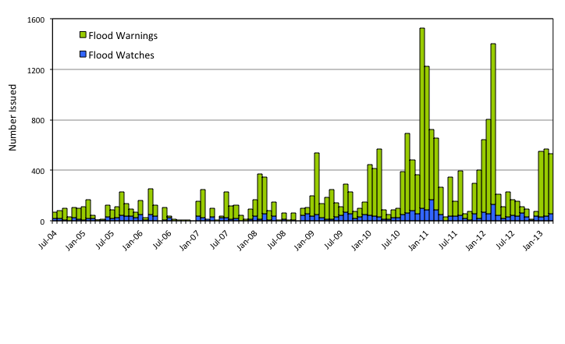
Record numbers of flood services
Notes:
2012/13 Year to date overview:
> A total of 2265 flood warnings and watches have been issued since July 2012.
The busiest months were January, February and March 2013 with over 500 warnings and watches issued in each of these months.
New approach to support proven with staff from the National Team (head office) and other regional flood forecasting units (clusters)
Contributing over 40 shifts to operational FWCs in QLD, NSW, WA and VIC (so far)
During TC Oswald in the Queensland Flood Warning Centre:
Cost of operations in the critical 11 days of the event (23 Jan – 2 Feb, 2013) was the equivalent of 25 weeks of ordinary salary
More than 100 briefings provided to State and Local Disaster Management Groups, key water agencies and the media
Telephone – 697 call over the 11 days totalling 25 hours of talk time (Average of 63 calls per day)
Peak call rates:
peak daily rate of 164 on 28 Jan (41 calls per line for the day)
Peak hourly rate of 23 calls, equalling a call every 4 minutes (5-6pm on 28th Jan)

Slide 27
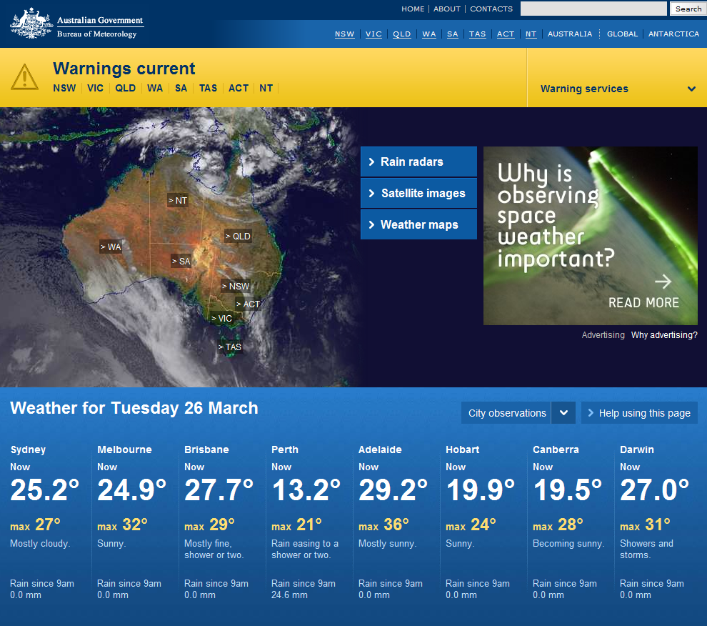

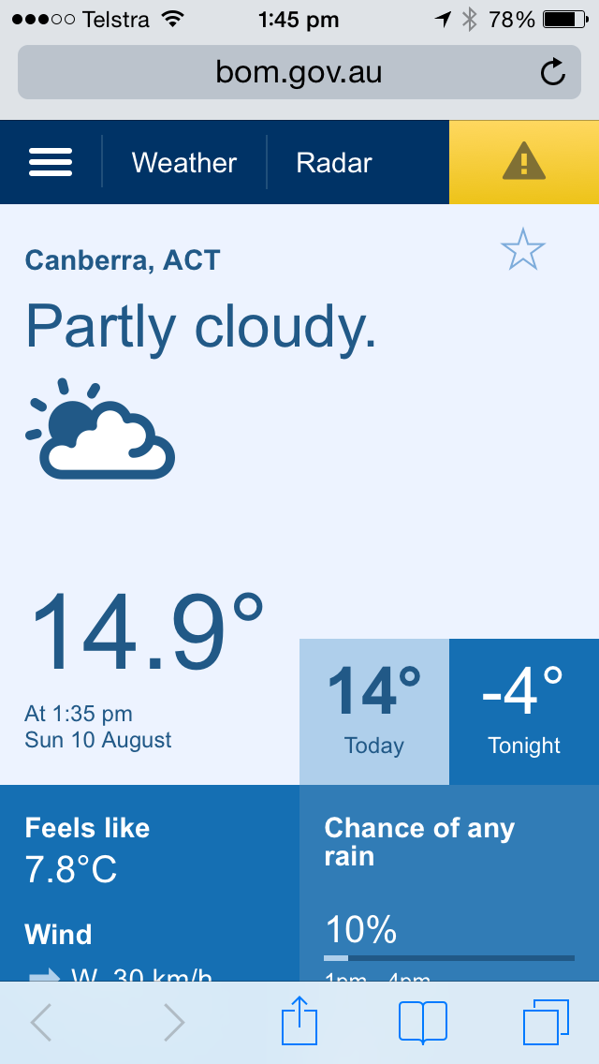
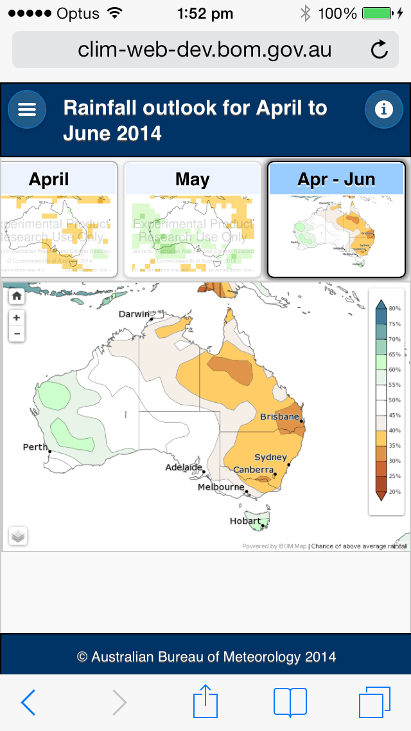
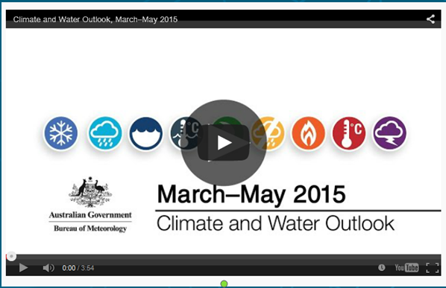
Digital delivery
Website: www.bom.gov.au
  In the internet Top 20
  542 million visits in 2013-14 and 2.97 billion pages served
Mobile: m.bom.gov.au
  Over 50 per cent of users now access the Bureau through mobile devices
  Mobile website introduced in May 2014
  Native apps coming
Videos
  Monthly outlooks
  Explainers
Blog

Slide 28
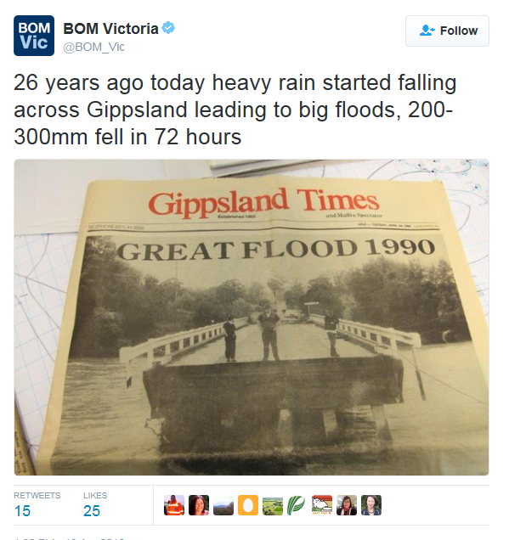
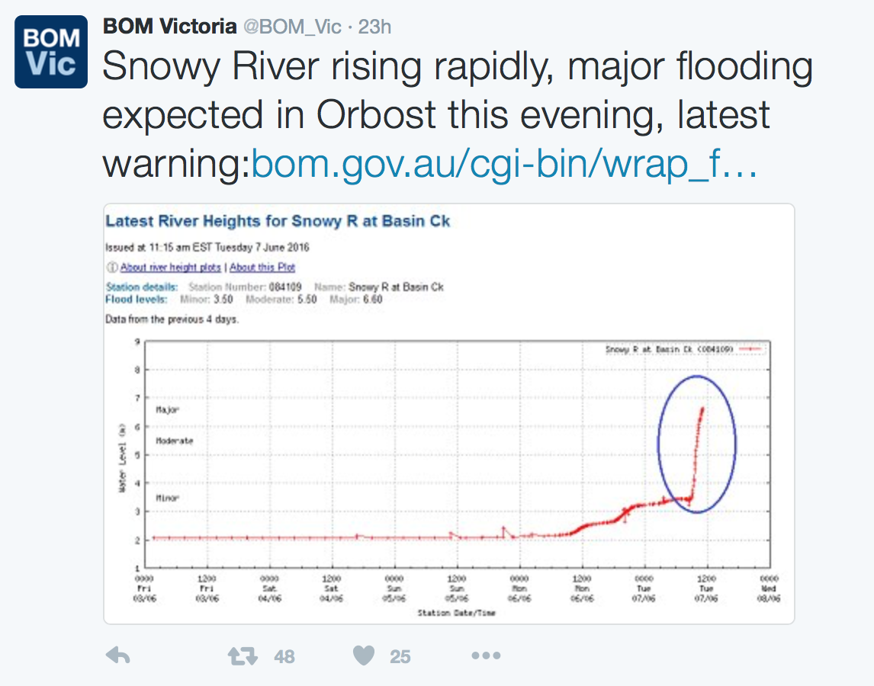
Social Media - Twitter

Slide 29
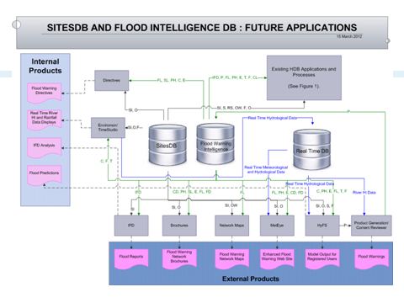
Flood Intelligence System
Staff
Standards
Systems
Objective:
a system that enables flood intelligence
to be gathered efficiently and accessed readily,
that drives consistency and supports best practice
leading to optimally informed decisions and enriched flood services
Some intelligence components:
  Flood affects
  Flood Class Levels
  Peak heights
  Service levels
  Hydrologic parameters
  Stakeholder contacts
  Forecast verification

Slide 30
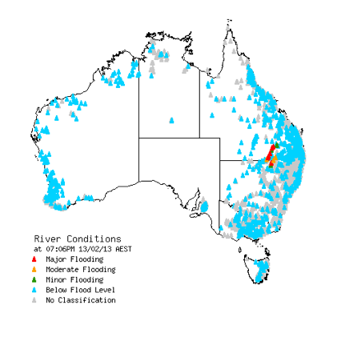
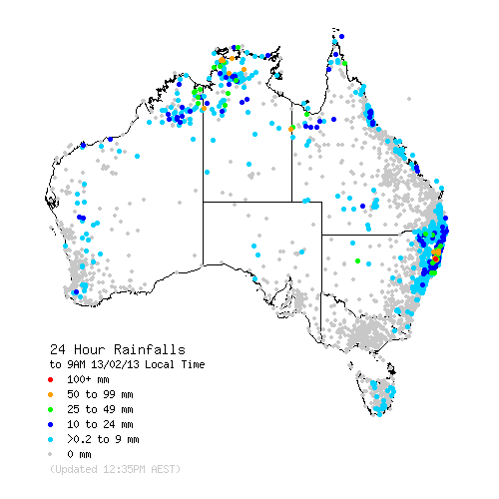
Flood Dashboard
Staff
Standards
Systems
FROM: “River and Rainfall Information”
TO: "Flood Dashboard"
  Dynamic mapping and charting > views not tied to state boundaries
  National product consistency: Flood Watch > Flood Warning
  Warnings spatially enabled and shown with data
  Mobile platform friendly (HTML5) AND able meet peak demand

Slide 31
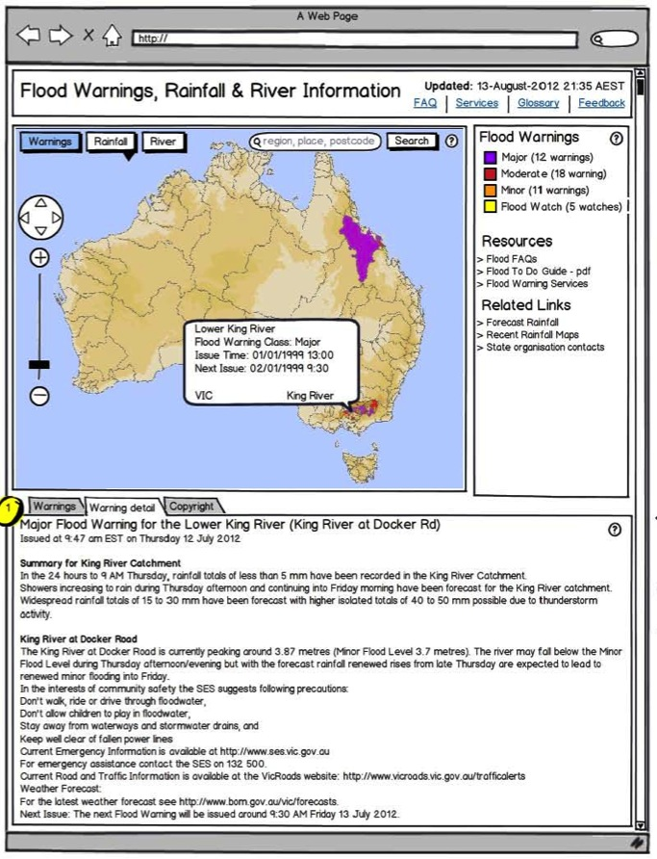
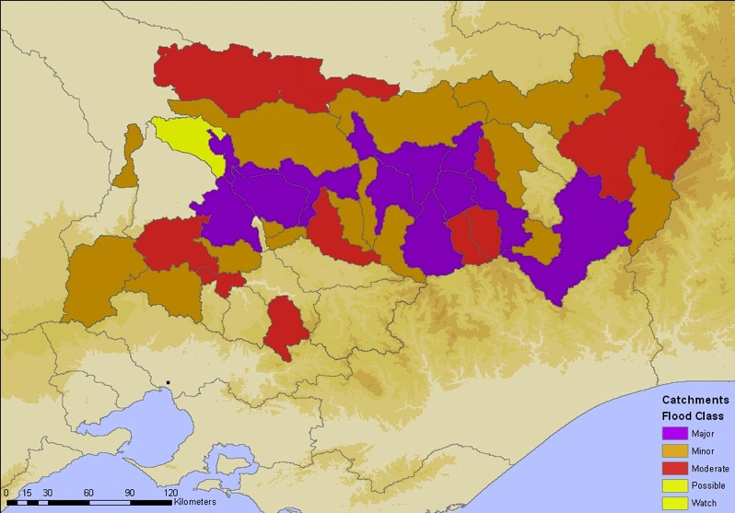
Spatially Enabled Warnings
Staff
Standards
Systems
Sub-catchment warning display

Slide 32
Flood Products:
Watches
Warnings
Issued as needed
Talking with media,
emergency managers
Title
Summary
River level forecast
What to do

Slide 33
Short range forecasts
Flood and 7-day forecasts

Slide 34
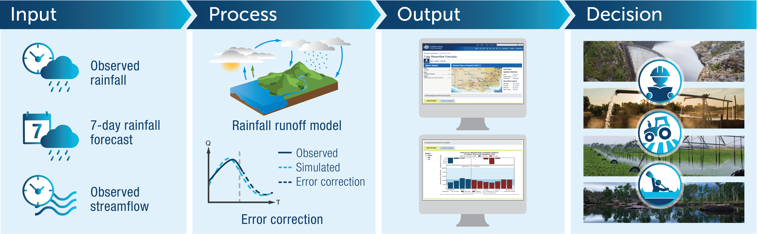
7 Day streamflow forecast service
http://www.bom.gov.au/water/7daystreamflow

Slide 35
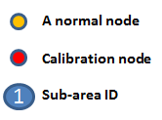
Semi-distributed node-link representation
Sub-area
  A hydrological model applied to
Sub-catchment
  Same parameter set is applied to all sub-areas
Catchment
  Combination of sub-catchments
Delineation
  Use Geofabric layers
1
Sub-area
4
1
3
5
5
Sub-catchment
4
3
2
6
2

Slide 36
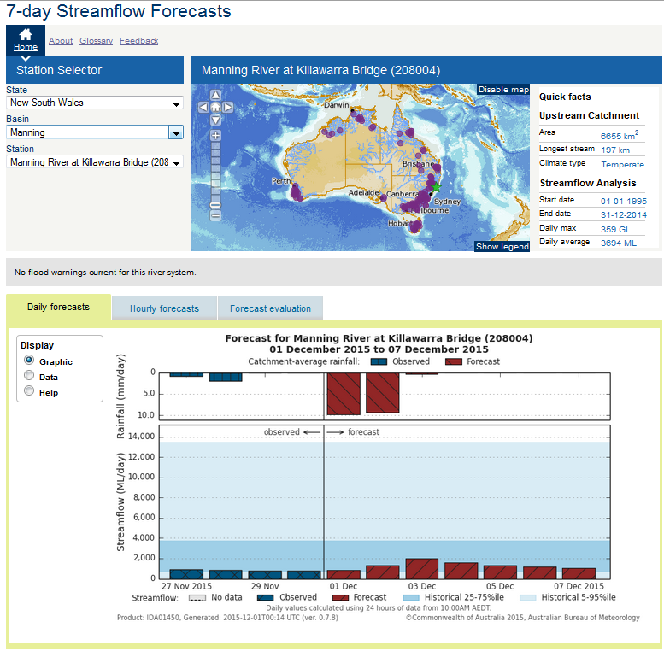
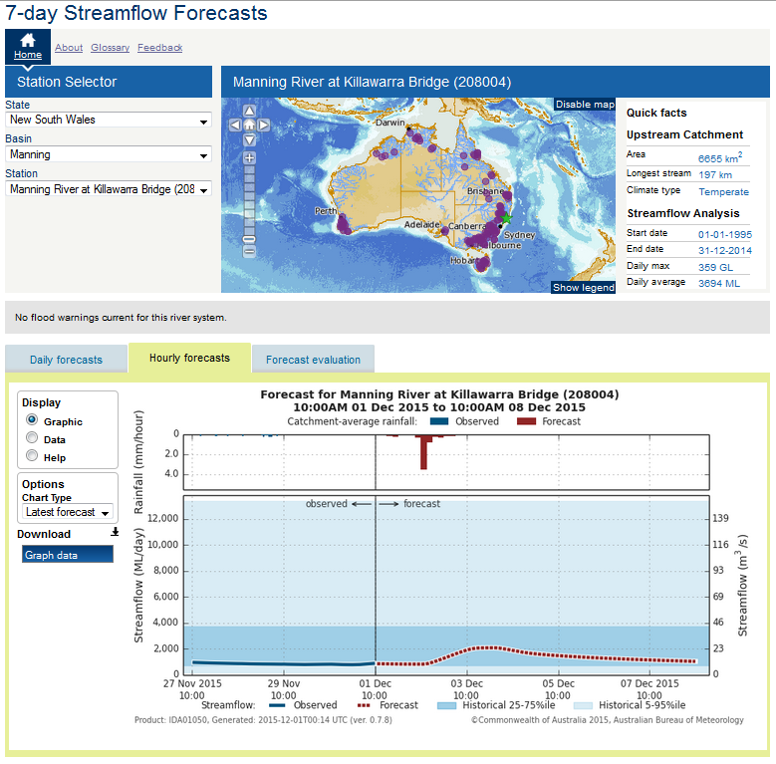
7 Day Streamflow Forecast Service
Public product (daily) – 103 sites
Registered user product (hourly) – 126 sites
http://www.bom.gov.au/water/7daystreamflow
http://reg.bom.gov.au/water/reg/stf

Slide 37
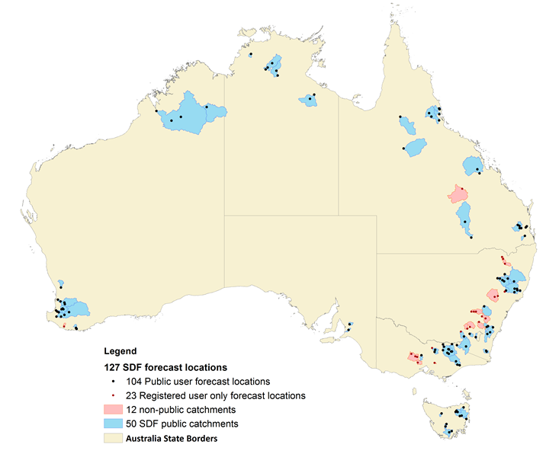
Current status
In September 2015 the publicly available service was launched
There are 62 catchments with 127 forecast locations
Of those there are 50 catchments with 104 forecast locations available to the public
Deterministic approach gradually moving to ensemble mode during 2016-18

Slide 38
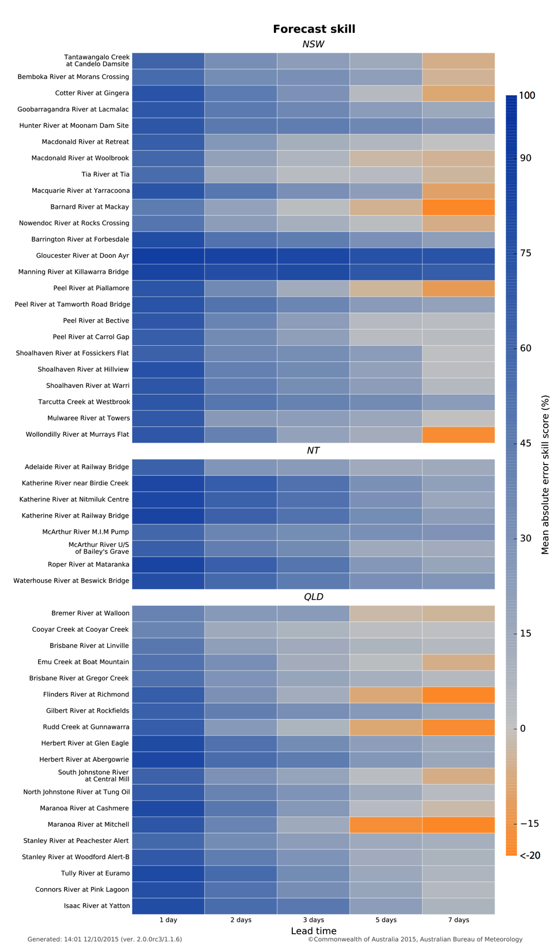

Forecast performance across Australia
(MAE skill score)
1 day
2 days
3 days
5 days
7 days
1 day
2 days
3 days
5 days
7 days

Slide 39
Water information services (http://www.bom.gov.au/water/)

Slide 40
Opportunities for DHM
Fit for purpose data
  Quality assured archiving
  National sharing
  Standardised quality
One model may not meet all needs (complex is always not better)
Concept of severe weather desk and its mobilisation
Integrated forecasting centre with hydrologists and meteorologists collaborating during floods
Active end user engagement for riverine and flash flooding

Slide 41


Thank you
Jaya
d.jayasuriya@bom.gov.au
Questions?
Notes:
Photo: Eildon spillway(Alison Pouliot)

Slide 42



What does the Bureau do?
Measures rainfall data (and some river heights)
Collect and publish real-time rainfall and river height data
Run flood models
  Simple peak flood height correlations
  150 basins and 700+ calibrated and operational semi-distributed hydrologic models
Issue flood watches, warnings and river height predictions
Deliver briefings to Government, emergency services and media
Maintain historical flood intelligence
Answer public queries
Manage field work/network and assist other agencies

