Slide 1

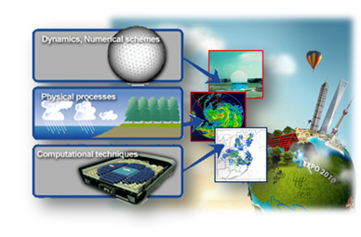
Operational High-resolution Numerical
Weather Prediction and support for Impact-based Forecast in SMS
Baode Chen
Shanghai Meteorological Service(SMS)
Shanghai Typhoon Institute of CMA
6-9, September, 2016, DMH, Myanmar

Slide 2
OUTLINE
Background
An overview of regional NWP in SMS
NWP products made for applications
Impact based forecast and Risk warning
Q&A

Slide 3

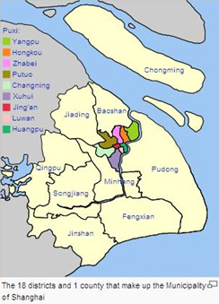
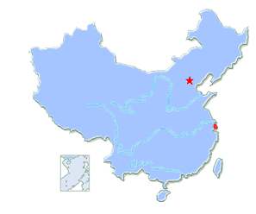
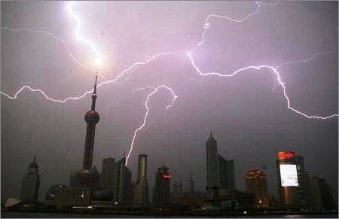

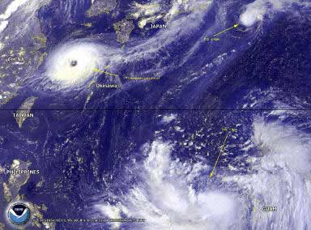
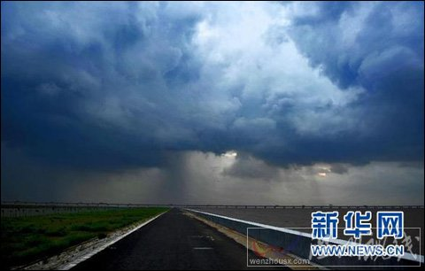
Shanghai is the largest Chinese city by population, with a population of more than 24 million as of 2014. It is a global financial center and a transport hub with the world's busiest container port. Located in the Yangtze River Delta in East China, Shanghai sits on the south edge of the mouth of the Yangtze in the middle portion of the Chinese coast.
Due to its unique geographical location, Shanghai is frequently affected by weather hazards such as typhoon, thunderstorm, lightning, heavy fog, haze, severe convective activity and so on, accurate weather forecasts are essential to prevent loss of people’s life and property, high-resolution meso-scale model is a major forecasting tool.

Slide 4
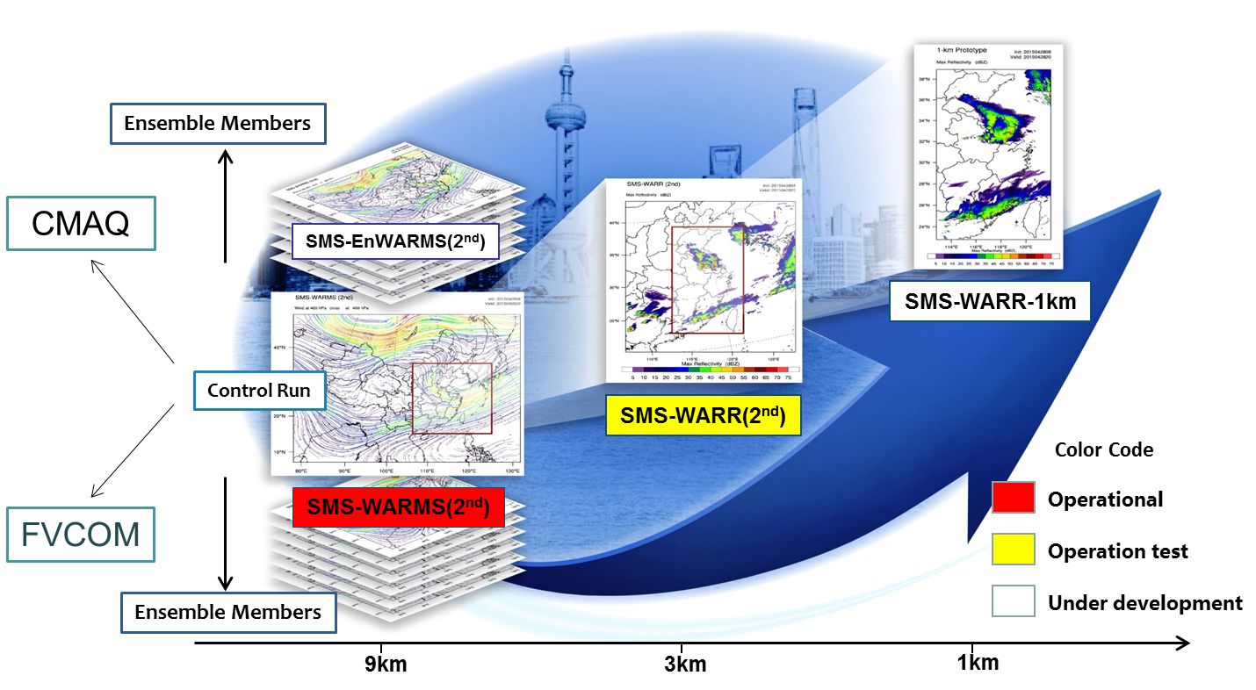
The 2nd Generation of Operational NWP in SMS
SPPT and SKEBS
Holistic Multi-scale Regional High-resolution Assimilation and Model Framework
SPPT：Stochastic Perturbed Physics Tendency

Slide 5

International Advisory Committee
Chair：Jimy Dudhia (NCAR)
Members: Jian-Wen Bao (ESRL/NOAA), Geoge Grell (ESRL/NOAA),
Songyou Hong (Kiaps/Korea), Haraldur Olafsson (Burgen School of Meteorology),
Vijay Tallapragada (EMC/NOAA)，沈学顺(CMA)，Martin Kohler (DWD),
Anna Ghell (ECMWF)，John Michalakes (EMC/NOAA)

Slide 6

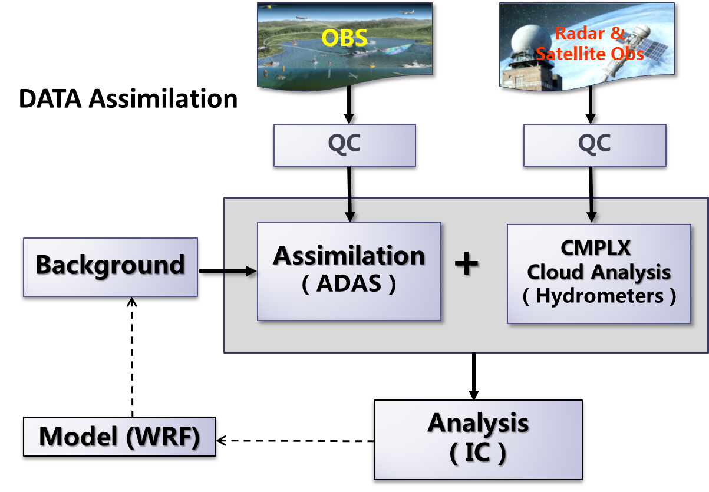
ADAS uses a successive correction scheme, known as the Bratseth method, which is basically a local data analysis system.
OBS used in 1-h Cycle
Type | Frequency
SYNOP | 1h
METAR | 1h
SHIP | 1h
AWS | 1h (5min)
AMDAR | 1h
Radiosonde | 12h
PILOT | 12h
CINRAD | 1h(6min)
FY2C IR&VIS | 1h(30min)

Slide 7
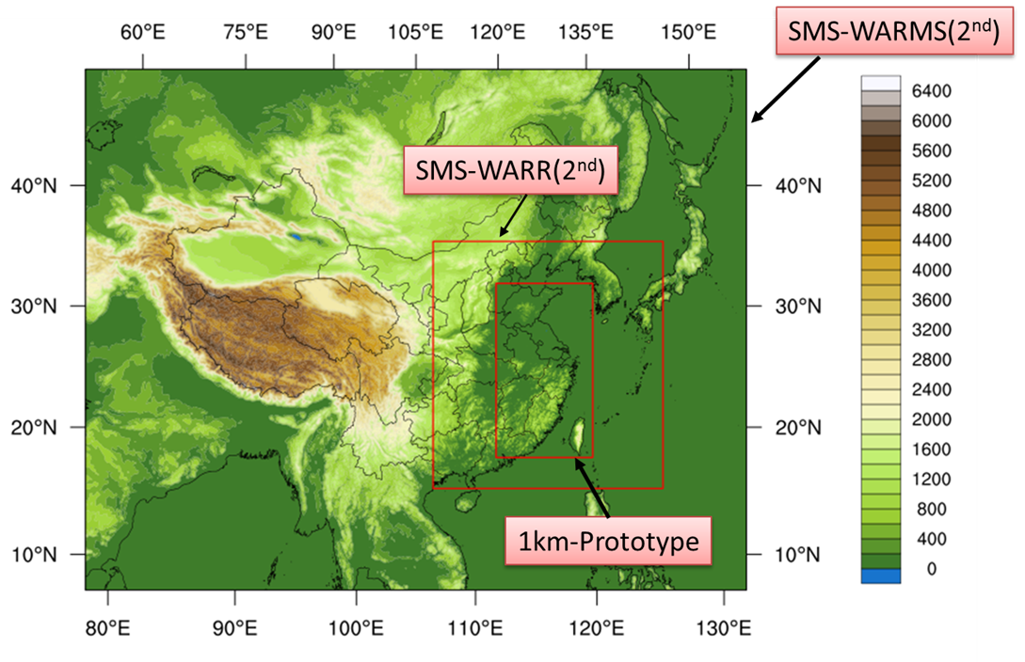
SMS-WARMS-2(WRF-ADAS REALTIME MODELING SYSTEM)
9-km Resolution: 760X600 grid points, 51 levels
SMS-WRF 3.5.1+SMS-ADAS 5.3.3
Initialized at 00 and 12 UTC and 72-hour prediction
GFS background error variance intensively tuned;
GFS upper level RH adjusted to liquid surface;
Modified WRF initialization module to take initial values of hydrometers from the complex cloud analysis package of the ADAS;
Improvement for cumulus parameterization and microphysics;
Substantial enhancement for computing efficiency
New Post-Processing Package

Slide 8
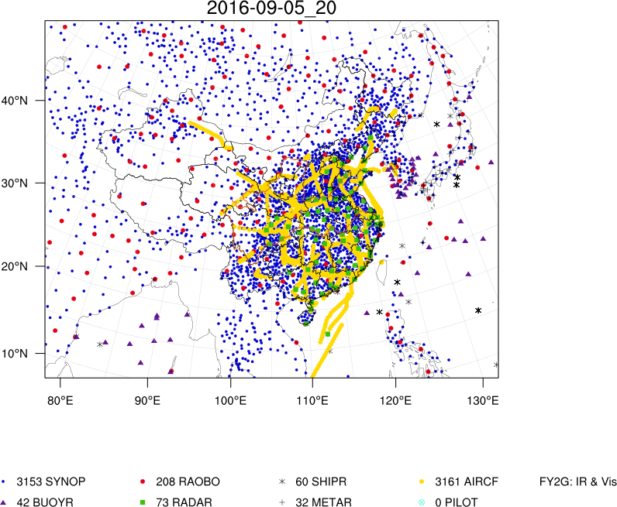
OBS used in one forecast

Slide 9
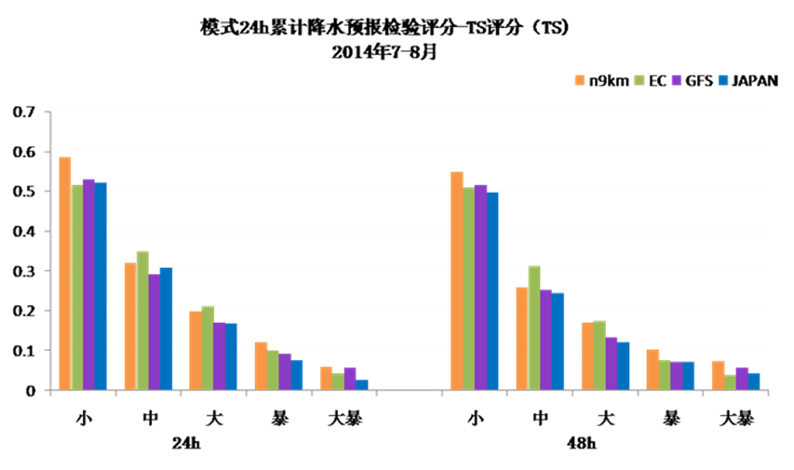
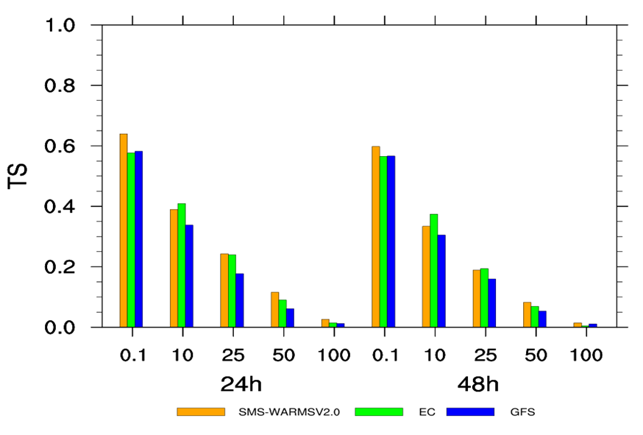
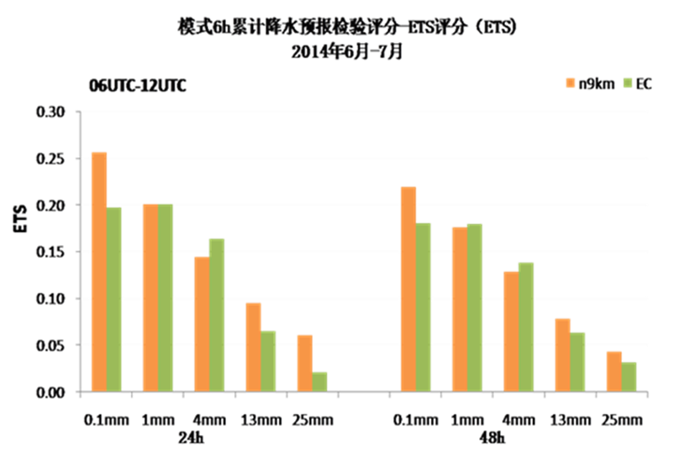
April-June, 2016

Slide 10
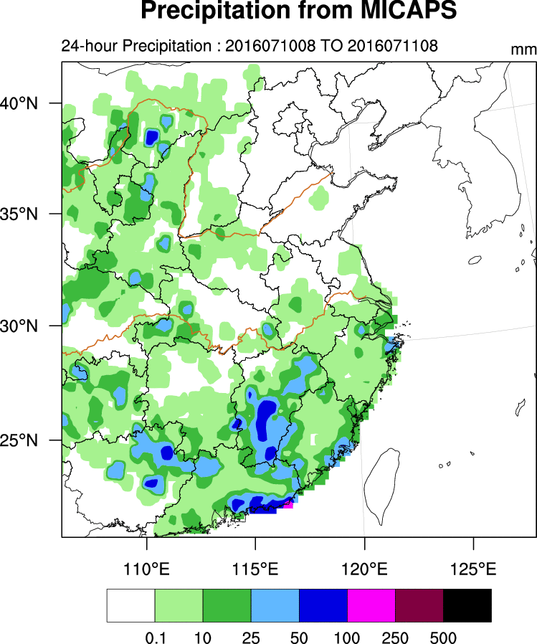
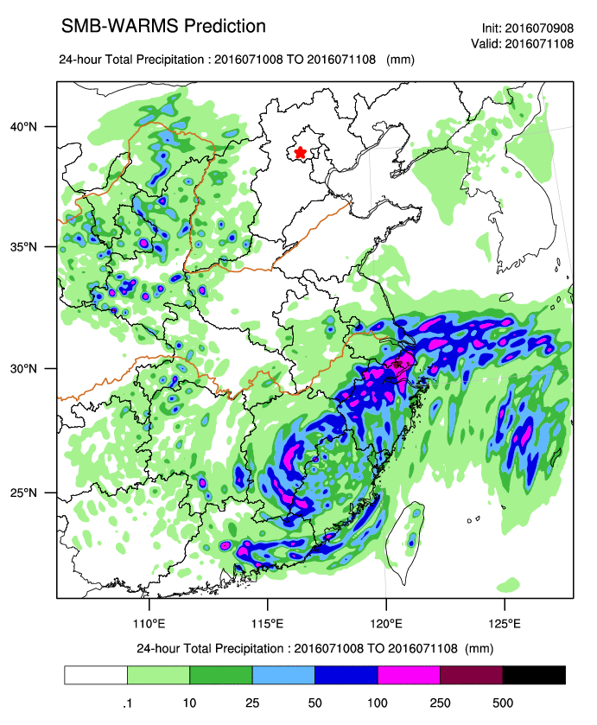
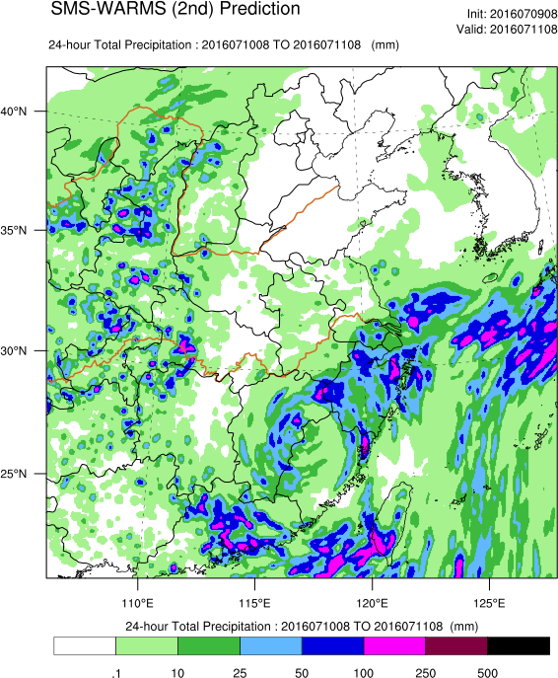
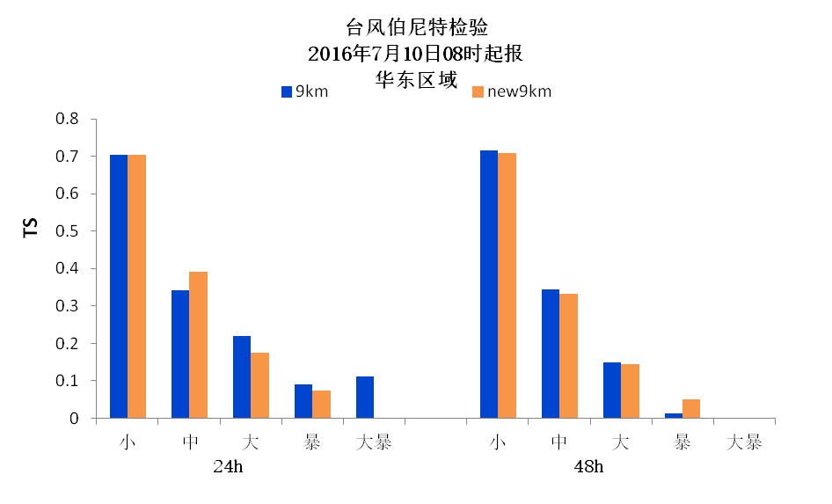
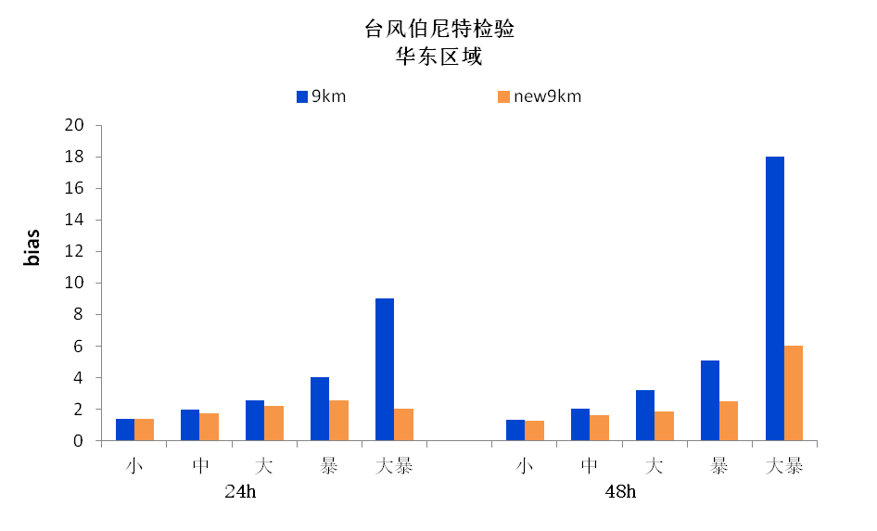
TS score
Bias
Typhoon Nepartak related rainfall

Slide 11
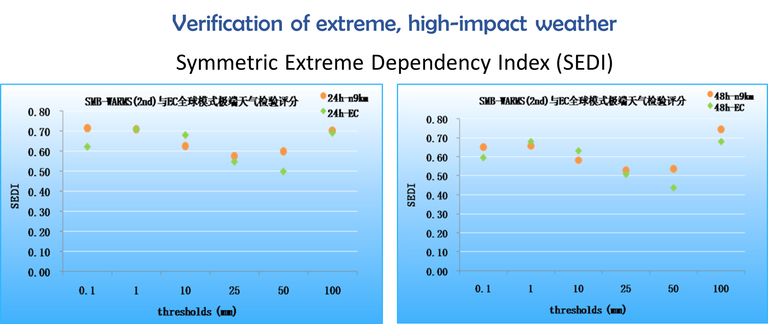

Slide 12

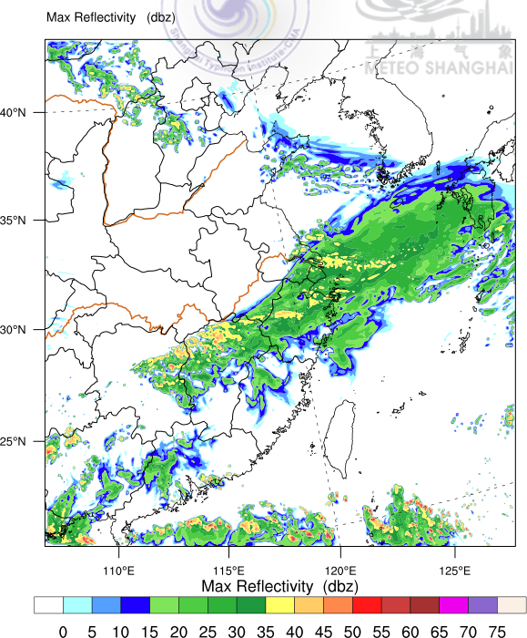
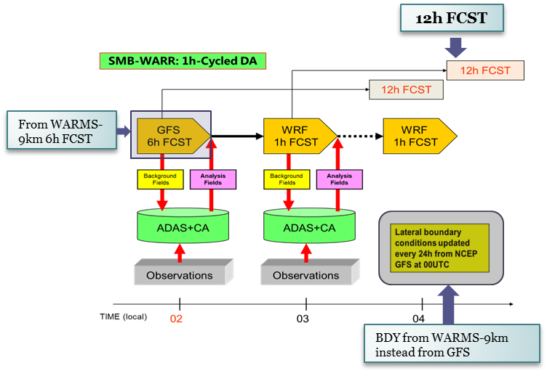
SMS-WARR : WRF_ADAS Rapid Refresh System
3-km resolution, 51 level, Cold starting at 02 am (local time) data assimilating every hour, and making 12-hour prediction
Key Techniques in Rapid Refresh Assimilation and Forecast¹⁾
绝热与非绝热数字滤波初始化技术
冷启动（Cold Start）、暖启动（Warm Start）和热启动（Hot Start）技术
循环同化设计（如何配置不同的启动）
云分析技术（雷达、闪电、卫星资料应用）
近地面资料同化技术
同化频率与资料空间分辨率
^{1）}陈葆德、王晓峰、李泓和张 蕾：《快速更新同化预报的关键技术综述》 Advances in Meteorological Science and Technology 气象科技进展 3（2）- 2013

Slide 13
ADAS Analysis (Initialization)
Background:
The ADAS analysis program (Brewster 1996) was developed by the University of Oklahoma to assimilate a variety of observed data that could then be initialized by the ARPS NWP model. ADAS interpolates observations onto the ARPS grid by combining the observed field with a background field. The background field is generally supplied by a larger national- or regional-scale model.
Description
A Bratseth objective analysis scheme was employed that evaluates pressure, wind, potential temperature, and specific humidity. In this scheme, an analysis is created from a background or first-guess grid, which is generally supplied by a larger-scale NWP model and the observed data. The analysis is created by modifying the background values of variables at specific grid points based on observational data located within a specified distance from the grid point. Each observation that influences a specific grid point is assigned a weight that is inversely proportional to its distance from the grid point.
a 3-D cloud analysis scheme is designed to create consistency with all data and the typical meteorology of clouds by using surface observations of cloud cover and height, satellite data, and radar data to determine the cloud cover, cloud liquid and ice water, cloud type, rain/snow/hail mixing ratios, icing severity, in-cloud vertical velocity, cloud base and top, and cloud ceiling (Case et al. 2002; Zhang et al. 1998; Brewster 2002).

Slide 14
Data and Data assimilation
OBS used in 1-h Cycle
Type | Frequency
SYNOP | 1h
METAR | 1h
SHIP | 1h
AWS | 1h (5min)
AMDAR | 1h
Radiosonde | 12h
PILOT | 12h
CINRAD | 1h(6min)
FY2C IR&VIS | 1h(30min)

Slide 15
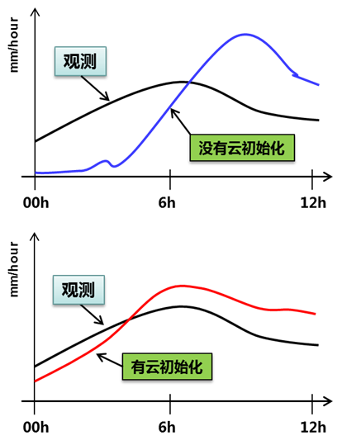
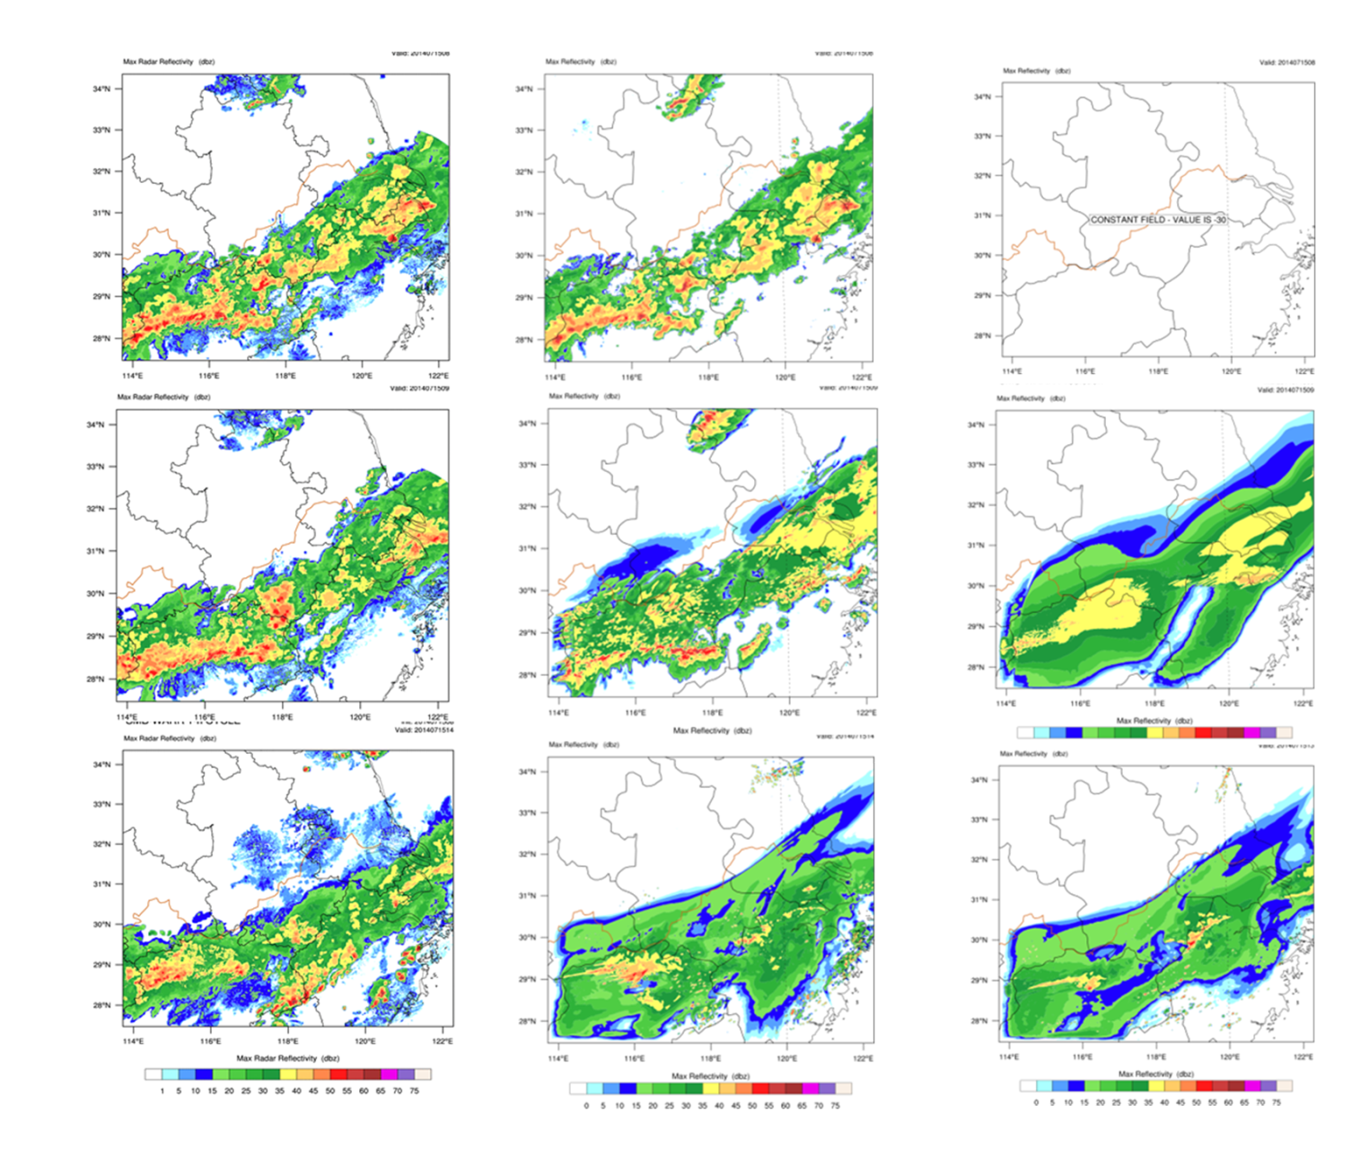
OBS
w/ cloud Init.
w/o Init
0h
1h
6h

Slide 16
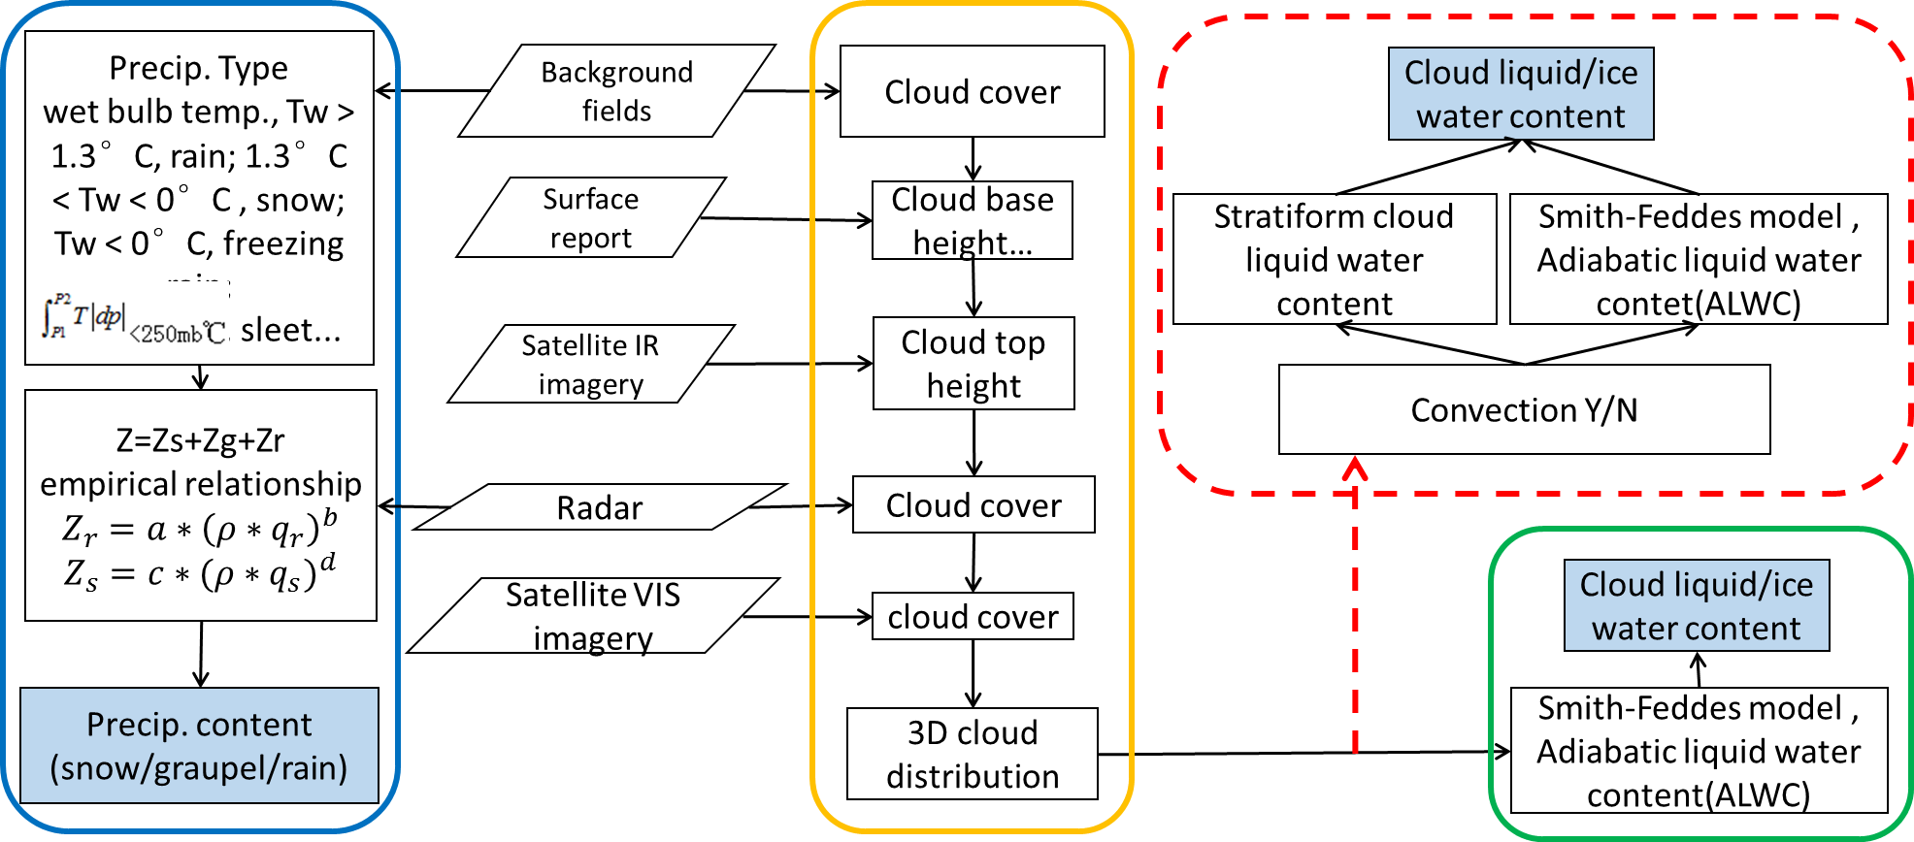
Schematic of Cloud Analysis
OBSERVATION
Updated
Precipitation
Cloud
Scale Aware

Slide 17
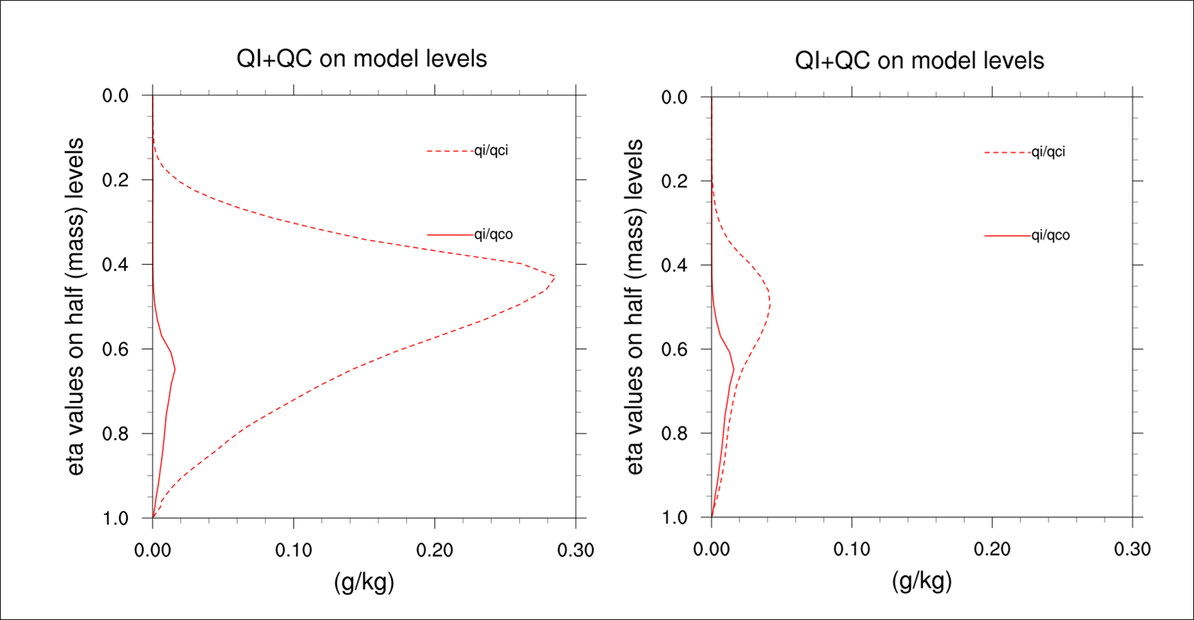
Updated One
Baseline
Baseline
OLD Scheme

Slide 18

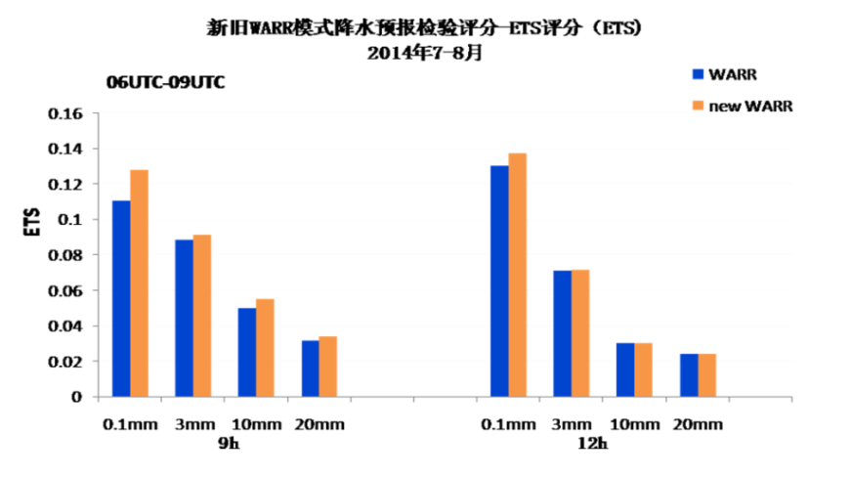
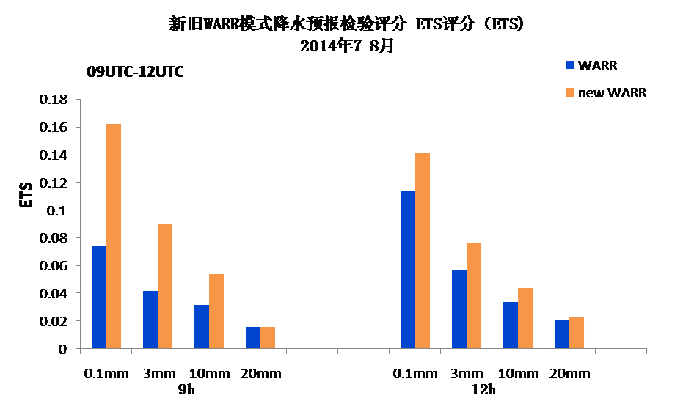
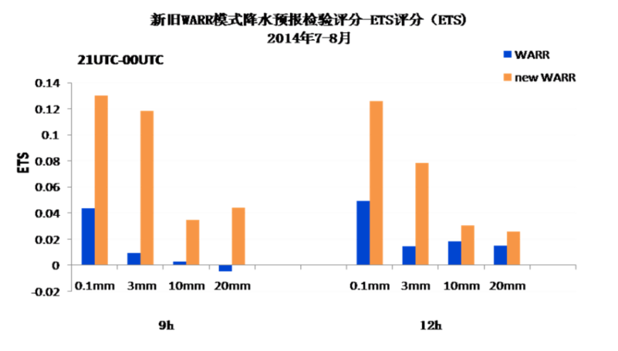
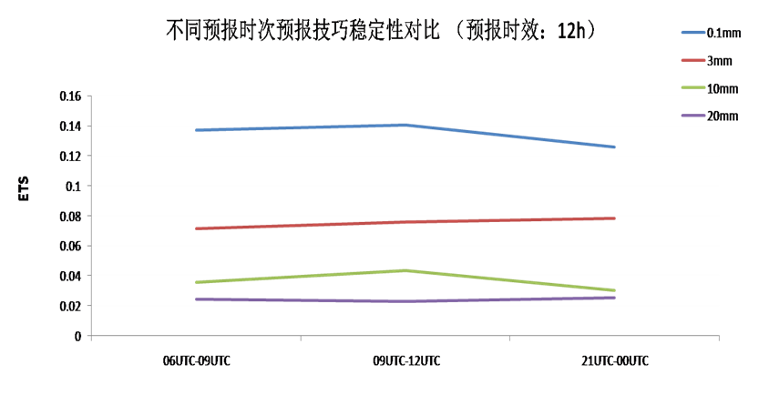
3h accumulated rainfall verification
14-17h
17-20h
Upgraded SMS-WARR-2 is much better than its predecessor
NWP for nowcasting in SMS : from some kind of reference to practical use in daily operation
05-08h

Slide 19

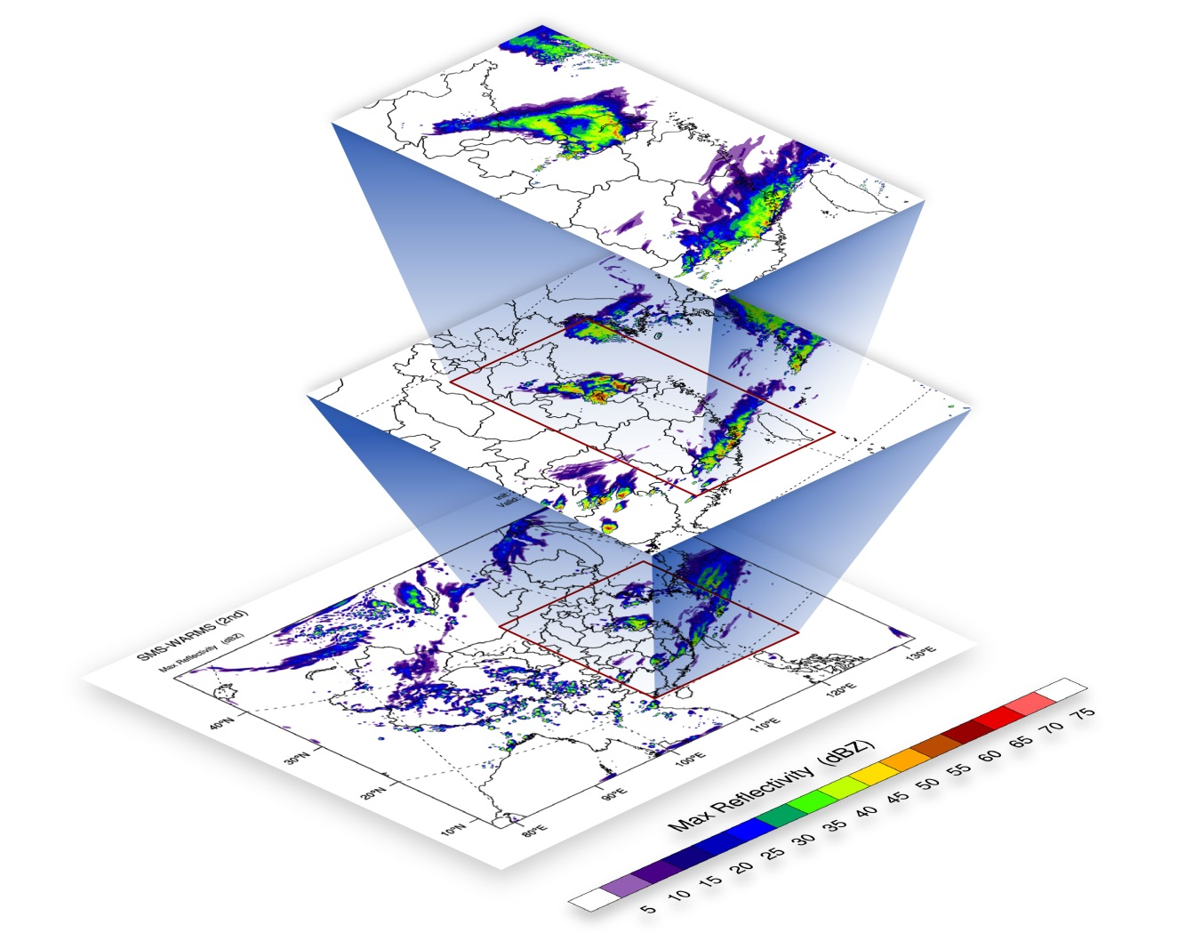
1-km prototype model
1km
Downscaling from 3km
3km
1h cycle (warm start)
Cool start at 02 am
9km
Assimilation + cool start
Start at 08 am, 20pm
72 hours forecast

Slide 20

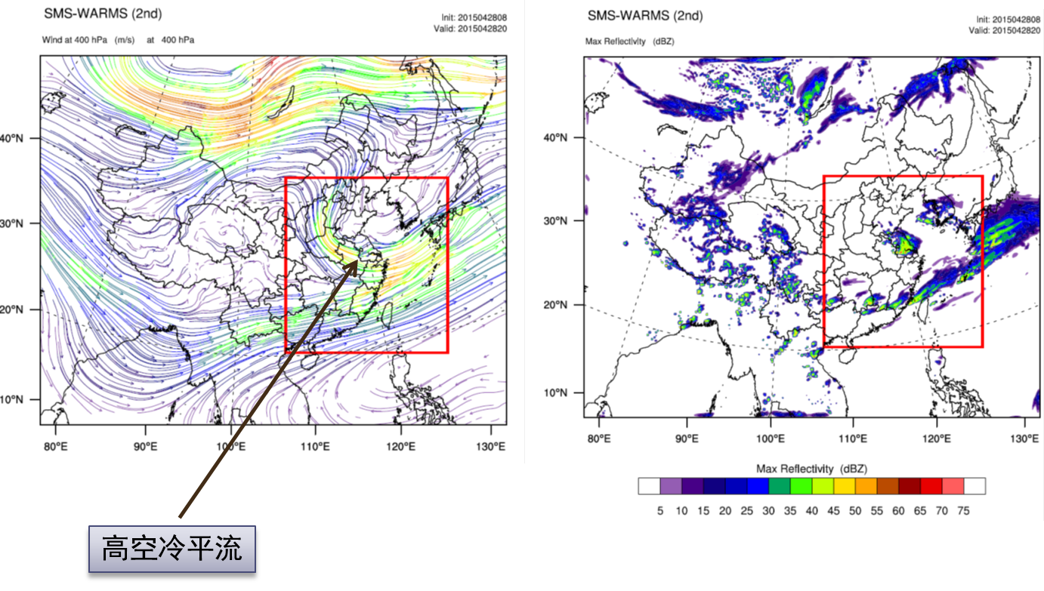
1-km prototype model : Case study

Slide 21

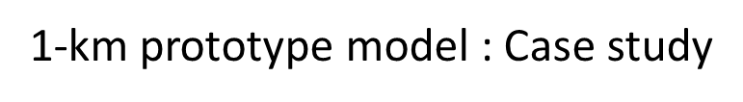
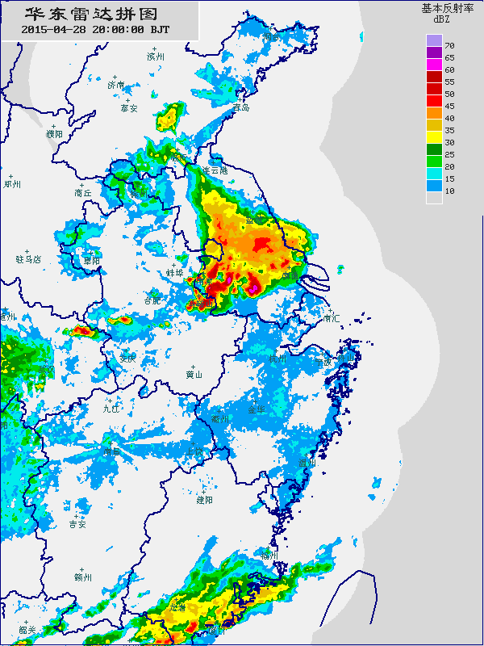
1km
OBS
3km

Slide 22
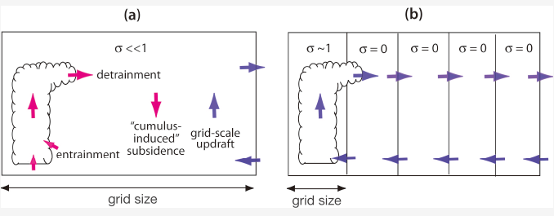
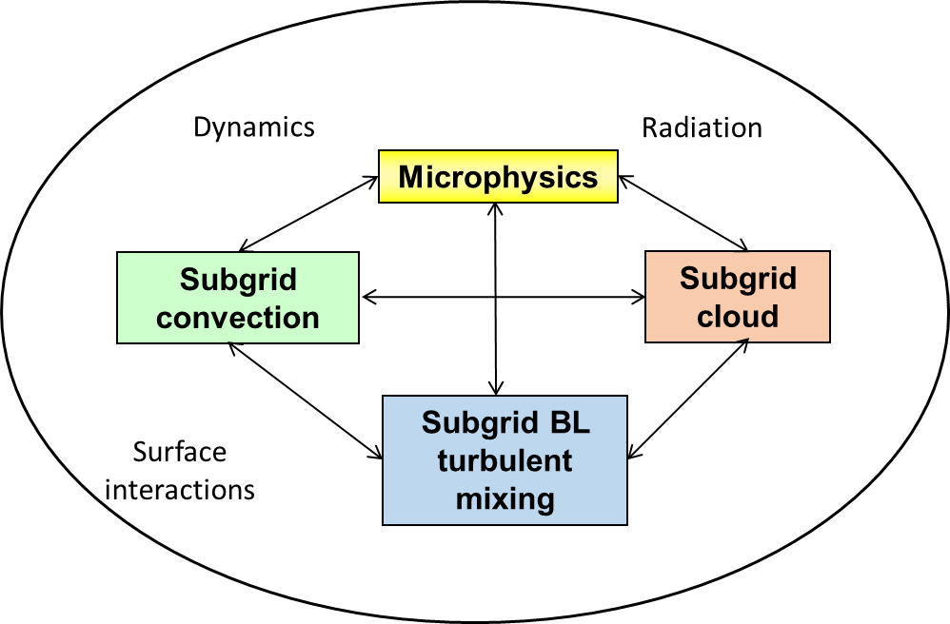
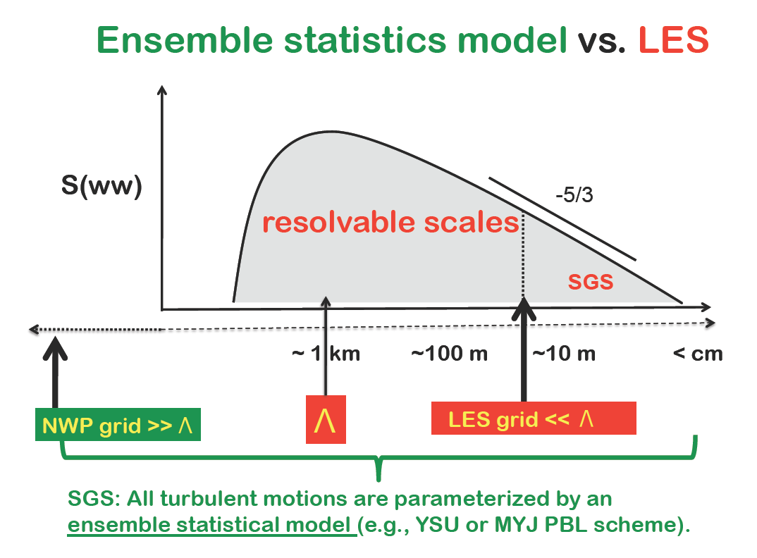
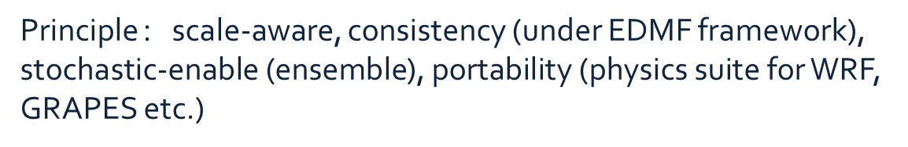
Related Research work
Moisture physics in gray zone
Sub-grid mixing processes in gray zone
Physical (cloud) initialization with radar and satellite observations
Field experiment

Slide 23
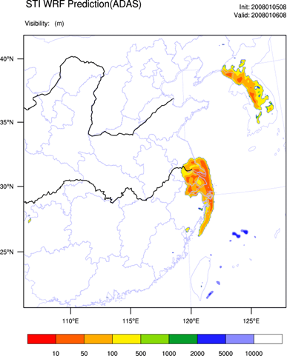
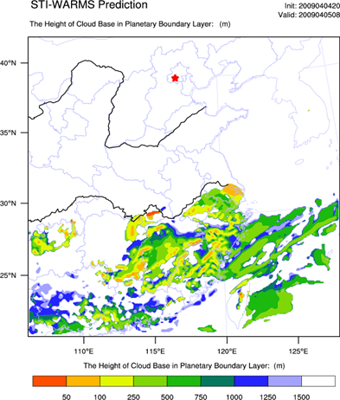
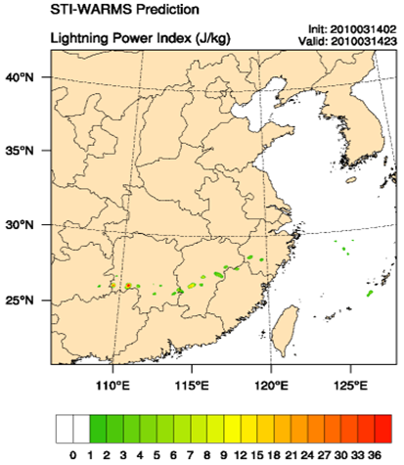
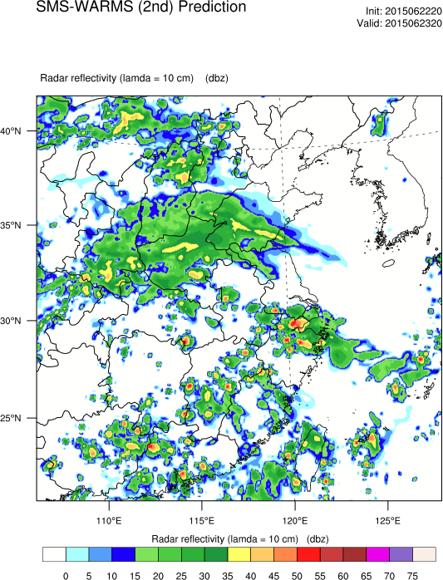
NWP Products Made for Various Applications
Visibility
Ceiling
Lightning Power Index
Radar Reflectivity

Slide 24

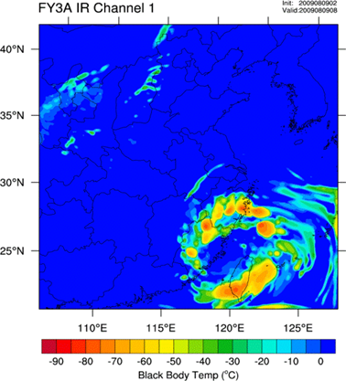
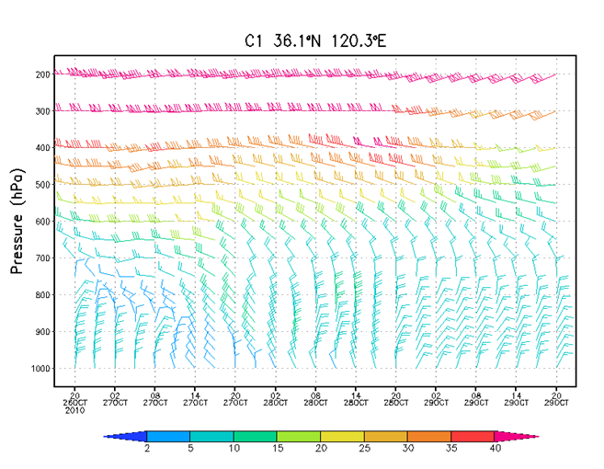
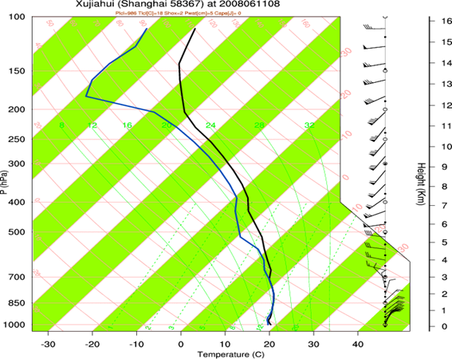
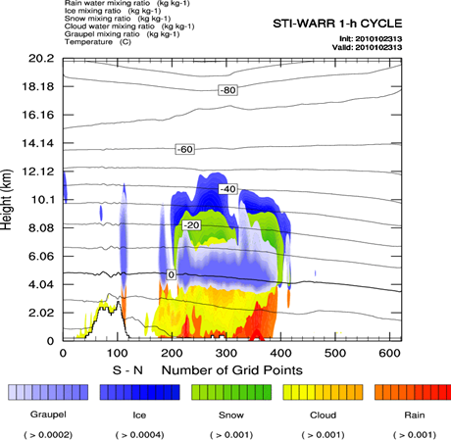
Some other tailored products could be provided, for example
Aviation applications
1. Low Level Wind Shear
2. In-flight icing condition
According to S. Silberberg, Icing happens in following situation:
-22C < T < 0C
RH > 70 %
Ascent air and Equivalent Potential Vorticity (EPV) < 0
Cloud water if SLD (super cooled large droplet)
3. Clear Air Turbulence Index
Ellrod Algorithm (Gary P. Ellrod: Wea. and Forecast,1992) and Ri number suggested by S. Silberberg of AWC. Light: CAT = 1; Middle: CAT = 2, Severe: CAT = 3, No CAT: CAT = 0
4. flight condition restriction
Depending on ceiling and/or visibility to classify flight condition at airport
Also, with meso-scale ensemble forecast available, uncertainty information could be estimated.

Slide 25
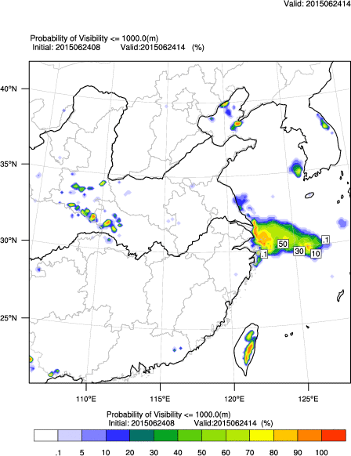
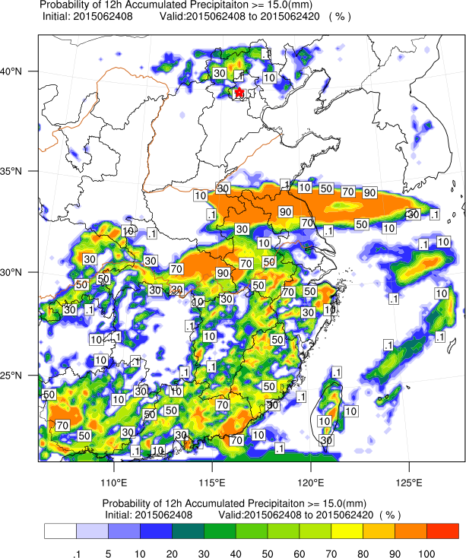
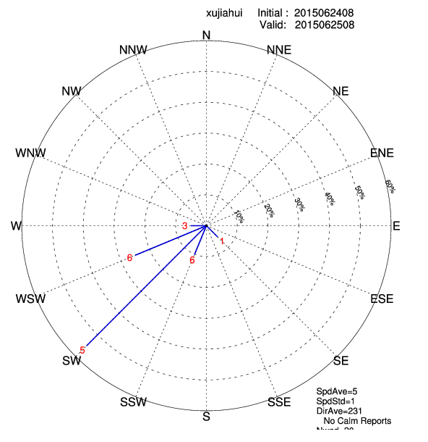
Probabilistic Products

Slide 26
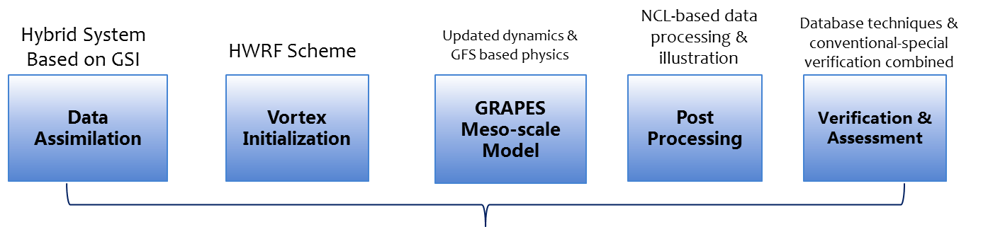

Tropical cyclone: GRAPES-TCM

Slide 27
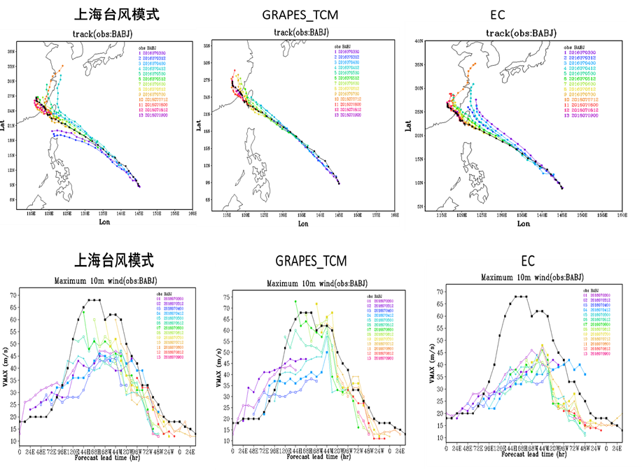

2016
Typhoon Nepartak

Slide 28
Impact based forecasts and Warning
National Meteorological and Hydrological Services (primary responsibility): to provide timely and accurate forecasts and warnings of hydrometeorological hazards and events.
  Governments and Public: to use forecasting and warning information and take effective action.
BUT even good forecasts are not always well used because they do not respond to the requirements of the users (e.g., emergency managers) in way that they can be of real use in decision-making and actions.

Slide 29
Operation Shifts needed
Phenomenon-Based Forecasts
Impact-Based Forecasts
Products-Based Services
Decision Support Services
Meteorological Threshold-Based Warning
Impact Threshold-Based Warning (Risk based warning)
Deterministic (best forecast)
Probabilistic (uncertainty range)
underway
Notes:
So , we need some operation shifts：
That is,
Phenomenon-based forecast to impacted-based forecast
Product-based service to decision support services
Meteorological threshold based warning to impact threshold based warning or risk-based warning
Currently, in the operational community, more and more probabilistic forecasts products are generated,
There is a transition from deterministic (best guess) to probabilistic forecasts (ensemble forecast) taking place.
This provides a good opportunity to generate impact-related information by using ensemble forecasts.

Slide 30

Impact-based forecast: Weather Translation
Curtsey of Dr. Matthias Steiner of NCAR

Slide 32


Impact-based :Added Value to NWP
NWP center should provide products and TOOLs for various users to add values to NWP for their own interests and applications (Impact-based)
DATA Service：NWP+

Slide 33
To make better use of NWP products
The way that the atmosphere works
The way that a NWP model works
The way that works as forecasters (or others in the field other than model builders ) are thinking
The way that works as users are thinking

Slide 34
The way that the atmosphere works
Newton’s laws of motions
Law of conservation of energy
Equation of radiative transfer

Slide 35
The way that a NWP model works
Grid + Sub-grid
3D
1D
时间顺序
DA（decoupled？）
OBS
模式

Slide 36
The way that works as forecasters (or others in the field other than model builders ) are thinking

Slide 37

过程１： 4月20日
[数字： 20日08时-21日08时实况]
[等值线：NMC主观QPF 24小时预报]
主要预报误差：
广西、湖南暴雨严重空报！

Slide 38

EC模式预报：
广西、湖南暴雨严重空报！

Slide 39


黄色区域内暴雨预报理由
（1）低空急流
（2）切变辐合
（3）水汽、不稳定条件

Slide 40

20日08时-21日08时 组合反射率拼图
暖区对流活跃，主系统移入后对流迅速减弱

Slide 41
The way that works as users are thinking
Related to impact-based forecast

Slide 42
Q&A
Thank you for your attention !

