Slide 1
Mauritius Meteorological Services
Sandhya Devi Dindyal
Metoerologist
sandhyadindyal@yahoo.com
St Paul Road, Vacoas. Mauritius
Tel. (230) 686 1031, fax (230) 6861033
Email: meteo@intnet.mu
Web: http://metservice.intnet.mu

Slide 2
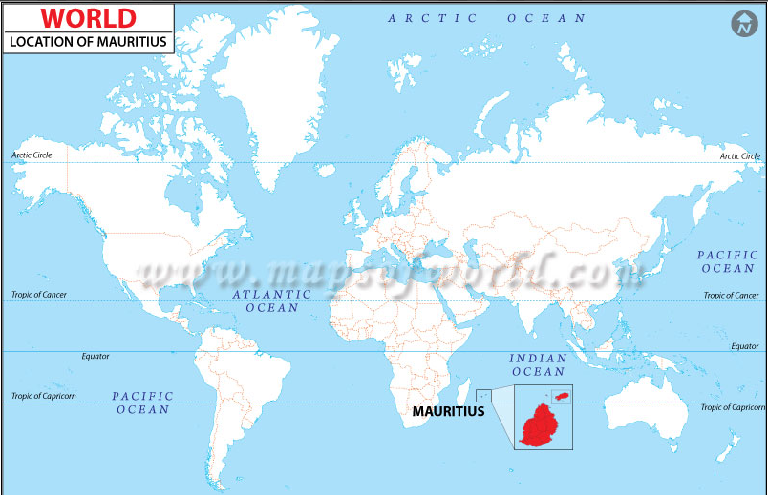
Mauritius Meteorological Services

Slide 3
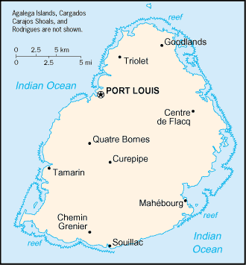
Mauritius Meteorological Services
Indian Ocean, about 800 km (500 mi) east of Madagascar
Geographic coordinates:
20 17 S,57 33 E
Area:
Total: 2,040 sq km
Note: includes Agalega Islands, Cargados Carajos Shoals (Saint Brandon), and Rodrigues

Slide 4
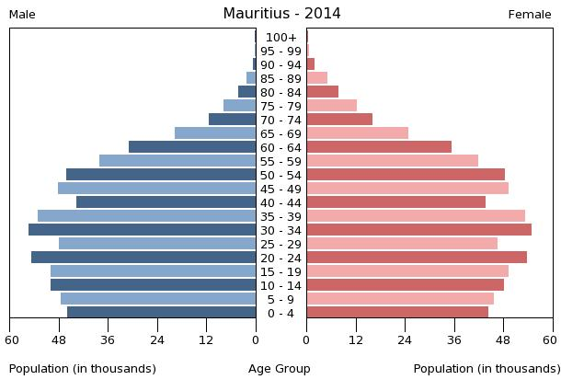
Mauritius Meteorological Services
Population:
1,331,155 (July 2014 est.)

Slide 5
Mauritius Meteorological Services
Latest annual GDP:
$23.42 billion (2014 est.)
$22.67 billion (2013 est.)
$21.97 billion (2012 est.)
note: data are in 2014 US dollars
Composition of GDP: Agriculture: 4.5%
Industry: 22.4%
Services: 73.2% (2014 est.)

Slide 6
Mauritius Meteorological Services
Agriculture:
sugarcane, tea, corn, potatoes, bananas, pulses; cattle, goats; fish
Industries:
food processing (largely sugar milling), textiles, clothing, mining, chemicals, metal products, transport equipment, nonelectrical machinery, tourism

Slide 7
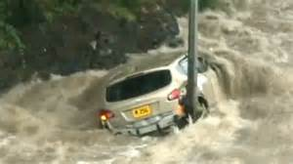
Mauritius Meteorological Services
Main climate and weather related hazards
Flash flood
Cyclones
Heavy Rainfall
Landslide
High waves
Drought
Thunderstorms

Slide 8
Introduction
The Mauritius Meteorological Services is a Government Service established and operated primarily at public expense for the purpose of carrying out those meteorological and related functions which the Government recognizes as a responsibility of the State in support of the safety, security and general welfare of the citizens and in fulfilment of their international obligations under the Convention of the World Meteorological Organization.

Slide 9
Mauritius Meteorological Services
The general functions of the Meteorological Services are: -
Provision of Meteorological Services to:-
Government Ministries, Departments, local authorities, the media and the general public, agricultural and industrial interests and tourism,
Maritime and Aeronautical navigation.
Organization of meteorological observations in the Republic of Mauritius, including Rodrigues, Agalega and St Brandon and over adjacent parts of the Indian Ocean.
Collection, processing and publication of meteorological observations.
Provision of a tropical cyclone warning service for Mauritius, Rodrigues, Agalega and St Brandon and for ships, aircrafts and for the information of neighboring countries.
Provision of Tsunami warnings, as and when the event occurs in the Indian Ocean.
Issue of warning for the protection of life and property during adverse weather conditions.
Participation in the activities of appropriate international organizations, particularly the World Meteorological Organization.
Research and investigation related to weather and climate.

Slide 10
Who Are Our Customers

Slide 11
Mauritius Meteorological Services
Staff of the MMS
Director | 1
Deputy Director | 2
Divisional Meteorologist | 3
Meteorologist | 12
Chief Meteorological Technician | 1
Principal Meteorological Technician | 10
Senior Meteorological Technician | 33
Senior Meteorological Observer | 3
Meteorological Technician | 17
Meteorological Observer | 8
Trainee Meteorological Technician | 10
Chief Electronic Technician | 1
Principal Electronic Technician | 4
Senior Electronic Technician | 7
Trainee Electronic Technician | 2
Senior Human Resource Officer | 1
Senior Officer | 2
Officer | 4
Confidential Secretary | 1
Word Processing Operator | 2
Financial Operations Officer | 1
Assistant Manager (Procurement & Supply) | 1
Procurement & Supply Officer | 1
Receptionist/Telephone Operator | 1
Officers of Junior Rank | 14

Slide 12
Mauritius Meteorological Services
Statement of expenditure
Details | Actual Expenditure Rs
Compensation of Employees | 46,393,712.49
Personal Emoluments | 40,761,408.95
Overtime and other staff costs | 5,632,303.54
Goods and Services | 6,805,008.64
Cost of Utilities | 1,613,392.39
Fuel and oil | 231,001.72
Office Equipment and Furniture | 152,508.01
Office Expences | 196,275.01
Maintenance of Buildings | 1,376,614.73
Publications | 212,515.89
Fees | 274,592.00
Scientific Equipment and Support | 2,483,311.05
Other Goods and Services | 495,799.56
Grants | 727,494.10
International Organisations | 727,494.10
World Meteorological Organisation (Regular) | 375,000.00
World Meteorological Organisation (VCP) | 46,650.00
World Meteorological Organisation (IPCC) | 94,350.00
World Meteorological Organisation (ACMAD) | 211,494.10
Acquisition of Non-Financial Assets | 3,612,172.30
Residential Buildings | 0.00
Construction of Government Head Quarters | 0.00
Acquisition of Vehicles | 1,224,375.00
Acquisition of Machinery | 2,387,797.30
TOTAL | 57,769,389.25

Slide 13
Mauritius Meteorological Services
Vision
To be a proactive, highly efficient and effective institution
Mission
To provide accurate and timely weather information and meteorological products and information related to natural disasters for the general welfare of the citizens of the Republic
Quality Objective
Our objective is to attain excellence in the timely delivery of effective and quality service in an equitable manner so as to optimize customer satisfaction

Slide 14
Mauritius Meteorological Services
Our Values
Working for the citizens of the Republic of Mauritius with full dedication and in total transparency
Keeping abreast with technology
Team Spirit and timeliness
Uniformity and Consistency
Integrity and striving for excellence

Slide 15
Mauritius Meteorological Services
Desired Outcomes
To provide weather information to the citizens of the Republic of Mauritius daily
To provide weather forecast to fishermen in Mauritius, Rodrigues, St Brandon and Agalega
To provide a five day weather forecast to the agricultural community
To report on rainfall distribution over Mauritius and Rodrigues every fortnight
To make a seasonal forecast and updates when necessary
To provide cyclone warnings at regular intervals of six hours for class I and class II, three hours for class III and more frequently, after receipt of latest information, during class IV
To provide timely information and warnings about occurrences of extreme weather events including tidal surge and torrential rain
To provide advisories to ensure the protection and safety of aircrafts and ships
To issue tsunami alert bulletin in the event of the occurrence of a potential destructive Indian Ocean-wide tsunami
To provide any other related weather and climate information for the general welfare of the citizens of Mauritius

Slide 16
Mauritius Meteorological Services
Strategic Planning
Increased use of IT to enhance quality of observation, both surface and upper air, to better inform the population and develop resilience towards natural disasters and reduce lost is life and property.
Continued monitoring of rainfall network stations and provide monthly and seasonal rainfall forecast for a better water resources management as to ensure sustainable socio-economic development.
Continued provision of weather and climate information to the farming community for a sustainable and economically viable agriculture
To increase the network of sea level monitoring stations in the exclusive economic zone of the Republic of Mauritius; to install wave rider buoy off the coast of the main land and the outer Island of Rodrigues as to monitor wave heights and timely inform the fishermen of abnormal sea condition thus ensuring safety of life and property at sea.
To work in closer collaboration with the World Meteorological Organization and the neighbouring countries in the region to monitor natural hazards like cyclones, earthquakes, tsunami, and volcanoes as to ensure safety of life and property in the region

Slide 17
Mauritius Meteorological Services
Funding required for:
Capacity building in flash flood forecasting
Short range radar
River gauges to monitor river levels

Slide 18
Mauritius Meteorological Services
Expectations:
More efficient communication with stake holders
Setting - up of SMS to communicate early warning

