Slide 1
Developing Impact-based Framework
Liz Page
WMO Public Weather Services Training Workshop on Impact Based Forecast and Warning Services

Slide 2
Matrix Development
Hazards
Impacts
Response/Advise

Slide 3
Hazards are categorized according to the stages in which they appear following an event and whether they are directly attributed to the hazard source, or indirectly through a combination of other hazards.
Primary Hazard Phenomena occur as a result of the process itself. For example, ground shaking during an earthquake. These lead to Primary Hazard Impacts, such as building collapse and utility pipeline rupture.
Secondary Hazard Phenomena occur only because primary Phenomena has caused them. For example, soil liquefaction as a result of earthquake ground shaking, drought as a result of prolonged periods of hot weather or pest infestation as a result of prolonged or seasonal rainfall. Secondary impacts may include infrastructure damage (flood impacted bridges and potholes following a cold spell), lack of irrigation for crops, and reduced crop harvests induced by pest swarms.
Tertiary Hazard Phenomena occur as a result of Primary and Secondary Phenomena. Often these exhibit long term effects. These include things like loss of habitat caused by a flood, permanent changes in the position of river channel caused by flood, crop failure caused by a pest infestation, induced by prolonged or seasonal rainfall etc. Impacts associated with tertiary hazards are often harder to quantify and have significant duration. Examples include, food chain disruption and loss of species due to habitat reduction, increased long term probabilities of flooding associated with geometry and course alterations and famine.

Slide 4
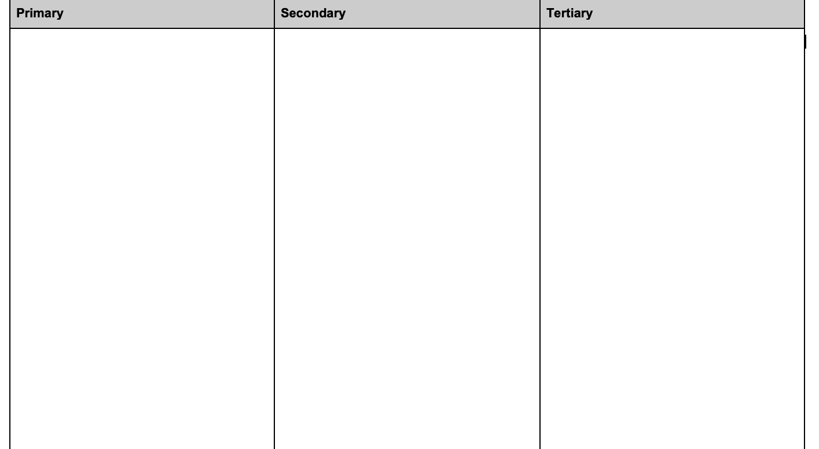
Hazard Matrix

Slide 5
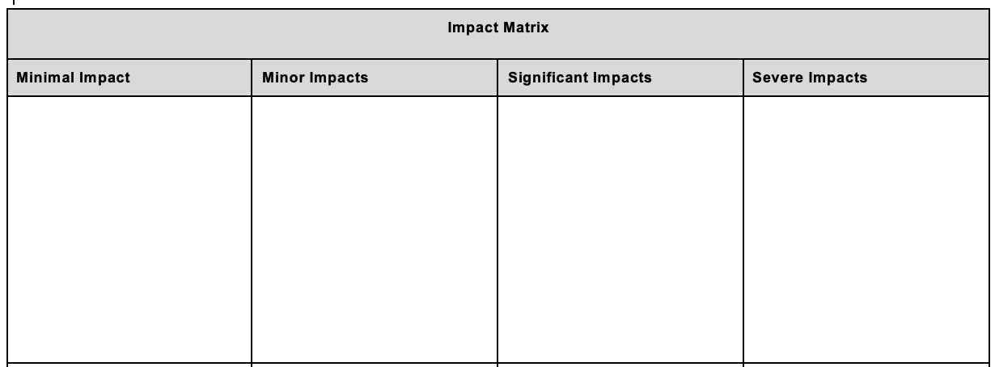

Slide 6
