Slide 1

Matrix Development
Curacao, October 2016
Haleh Kootval
Chief, PWS

Slide 2
Why do we need a Hazard Matrix?
All-hazards approach helps to better coordinate emergency preparedness and response
Hazards also include potential for subsequent or secondary emergencies
Hazards can have primary, secondary and tertiary effects

Slide 3
Hazard definitions
Hazard: a meteorological or geophysical event which has the potential to negatively impact on humans, animals or the environment.
Primary: occur as a result of the process itself. E.g., Ground shaking during earthquake
Secondary: occur because primary hazard has caused them. E.g. Soil liquifaction.
Tertiary: Occur as a result of primary and secondary hazards and often have long term effects. E.g. Land instability.

Slide 4
Hazard definitions
Event: Tropical Cyclone/typhoon/hurricane
Primary: Strong wind and heavy rain
Secondary: floods (flash, riverine, coastal), storm surges
Tertiary: infrastructure damage, water and food shortage

Slide 5
Hazard Matrix Example
Source | Primary Hazard | Secondary Hazard | Tertiary Hazard
Monsoon | Strong winds Heavy rainfall Thunderstorms | River and coastal flooding Surface water flooding Land instability | Disease

Slide 6
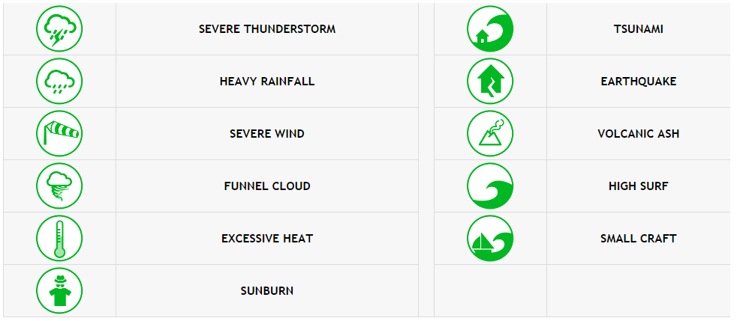
Type of Hazards

Slide 7
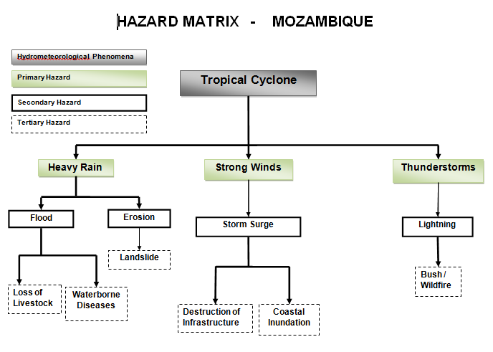
Alternative Hazard Matrix

Slide 8
Introduction to Impact Matrices
Impact matrix allows organisations to decide where on the risk matrix an event lies for a specific event
Is the bad weather expected during a rush hour?
In the area of concern are there any local “hot-spots” i.e. areas prone to the particular weather hazard (wind, snow, fog, flooding etc.)
Are there any significant outdoor events at which large numbers of people could be adversely affected?
Are there “politically” sensitive areas e.g. areas which have flooded badly recently?

Slide 9
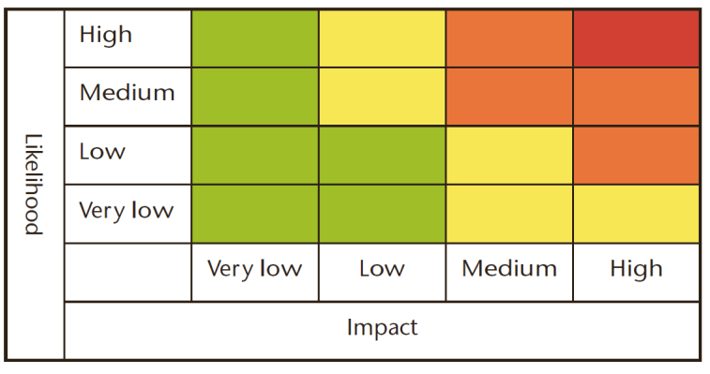
Where is the tick?
YELLOW
✓
High Likelihood - Low Impact
The public should be aware that some minor disruption is highly likely.
Low Likelihood - High Impact
Some very severe conditions are possible with major disruption to daily life (particularly to…) and the public should be prepared.
✓

Slide 10
Methodology
For each identified hazard, each sector should determine the impacts
Impacts should be categorised into very low, low, medium, high

Slide 11
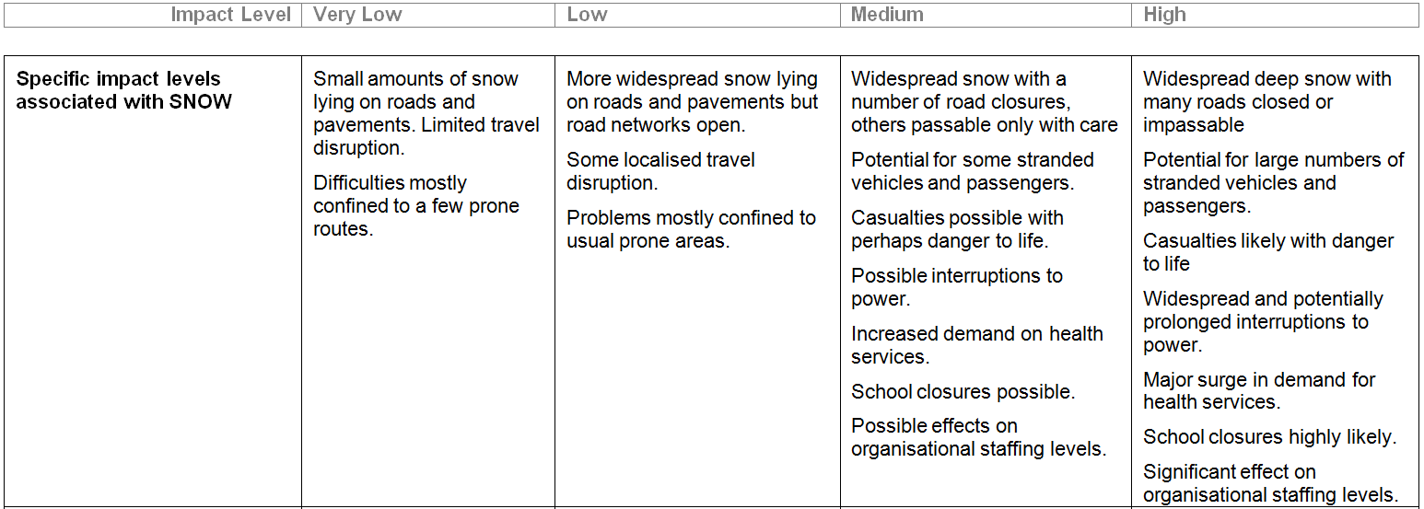
Impact Matrix Example
Hazard: Snow

Slide 12
Mitigation Advice Matrix
We Know Impact level as well as likelihood – gives us a Risk level
But what now?
Advice matrix for each hazard with advice on what actions need to be taken in order to reduce impact
Separate into Risk levels: Very Low, Low, Medium, High

Slide 13
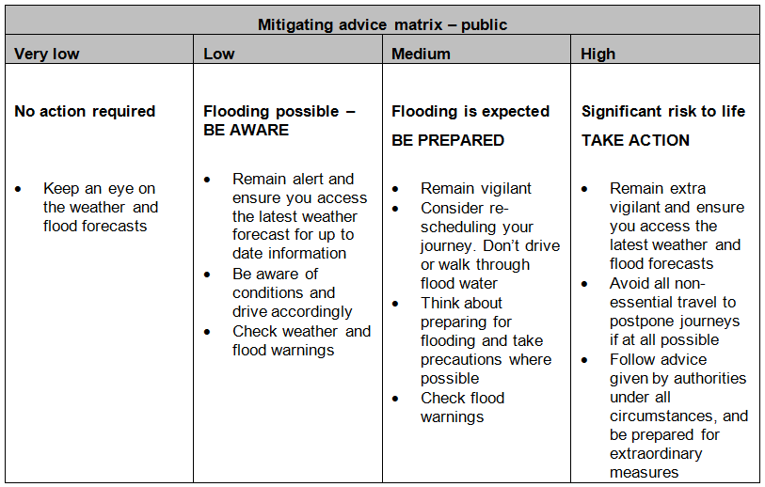
Mitigation Advice Matrix: Floods

Slide 14

Thank you
hkootval@wmo.int

