Slide 1
TRAINING WORKSHOP FOR NATIONAL METEOROLOGICAL AND HYDROLOGICAL SERVICES (NMHSS) ON DESIGNING SOCIO-ECONOMIC BENEFITS STUDIES OF METEOROLOGICAL AND HYDROLOGICAL SERVICES AND PRODUCTS FOR MEMBERS OF THE SOUTHERN AFRICAN DEVELOPMENT COMMUNITY (SADC)” MAHé, SEYCHELLES, 4-8 MAY 2015
Lucy Mtilatila
Deputy Director (Forecasting and Observations)
Department of Climate Change and Meteorological Services -

Slide 2
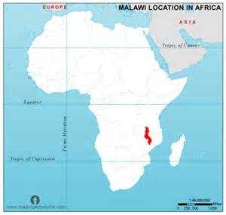
Location
Malawi located in Southern Malawi
Over 15 million people
Area 118,484 sq km
GDP: $13.76 billion (2014 est.)
GDP relies much on agriculture

Slide 3
Malawi climate
Malawi has a sub-tropical climate.
warm-wet season stretches from November to April, during which 95% of the annual precipitation takes place.
Annual average rainfall varies from 725mm to 2,500mm
Extreme conditions include the drought (prolonged dry spells) that occurred in 1991/92 season and 2004/2005.
Floods are taking place almost every year. The low-lying areas such as Lower Shire Valley and some localities in Salima and Karonga are more vulnerable to floods than higher grounds.
On average, Malawi loses US$9 million or 0.7% of the GDP each year

Slide 4
Department of Climate Change and Meteorological services
Our Mission: to provide reliable, responsive and high quality weather and climate services to meet national, regional and international obligations through timely dissemination of accurate and up to-date data and information for socio-economic development
Vision
"Towards reliable, responsive and high quality weather and climate services for a resilient nation to climate change"

Slide 5
Services and advisories by MET Services
Daily forecasts
Five day forecasts
10-day agromet bulletins
Seasonal forecasts
Data
Warnings
Strong winds on Lake Malawi (Mwera warnings)
Heavy rainfall
Thunderstorms
Crop yield estimates
Flush flood guidance

Slide 6
Dissemination channel
Radios
TV
Newspapers
Emails
website

Slide 7
Main Clients/sectors
Aviation
Agriculture
Disaster risk affairs
Water services
Tourism
Insurance
Building and Construction industries

Slide 8
Some challenges
Low understanding and uptake of weather information
Inadequate equipment and tools
Limited human capacity- Vacancy level - 42%.

Slide 9
Thank you
Zikomo
www.metmalawi.com
lucyngombe@yahoo.com

