Slide 1
Training Workshop
on Designing SEB studies
of Met/Hydro Services and Products
Mahé, Seychelles, 4-8 may 2015
Zo RABEFITIA
MADAGASCAR

Slide 2
MADAGASCAR REPRESENTATIVE
Name : RABEFITIA Zoaharimalala
Organization: Direction Générale de la Météorologie (DGM)
Current role: Director of Applied Meteorology Department (DMA)
Backgroung:
Engineer degree in meteorology
MSc.in geophysics
PhD in atmospheric physics

Slide 3
MADAGASCAR
Madagascar is the world's fourth biggest island
Population: 22 Millions
GDP:10.8 Billion USD, GDP increase: 2.4%
Inflation 6.1%
Composition of GDP (2014 est.)
Agriculture: 28.1% industry: 17.4%
services: 54.5%
sources of growth: Agriculture, tourism, and the extractive industries

Slide 4
CLIMATE
Madagascar has a hot and subtropical climate
colder temperatures in the central Highland (Tmin < 10°C in june-july).
Seasons mainly divided into two main periods: Rainy season from November to March and the dry season from April to October. average annual precipitation varying from 280 mm to 3,250 mm
Hazards: Tropical Cyclones (74%), Drought (8%), flood (10%). ( ): average annual losses
Average: 4 Tropical Cyclones /year

Slide 5
The DGM
The DGM is the authority on Met, climate and Hydro
Divided in 3 departments: Forecast, Applied Met, Research
Number of staff: 230 (20 engineers, 70 technicians)
Annual budget: 400,000 USD
services provided: weather forecasting, climate information, applied met and hydro information
We are strong in: Agriculture and Tourism assistance
weakness : providing local climate information
Main funding needs in Building capacity of met observation networks including basic infrastruscures, Radars)

Slide 6
. Expectations from this workshop
It is well known that met and climate services have important return in socio-economic benefits
But in Madagascar it is only in the theoretical field and SEB of met services are not yet quantifiable.
I expect the workshop to provide:
clear demonstration of how to evaluate SEB of Met and climate services
practical tools and methodologies to evaluate SEB
Implementation plan for SEB Studies (Log frame, funding)

Slide 7
. Importance of SEB study in Madagascar
SEB of met services are very important, it will demonstrate and justify the importance of investments to support the level of meteorological services expected by the Malagasy government and decision makers.
Near future works
application of methodologies learned during this workshop for evaluating SEB in Madagascar.
communication results of SEB studies to policy end decision-makers.

Slide 8
. THANK YOU

Slide 9
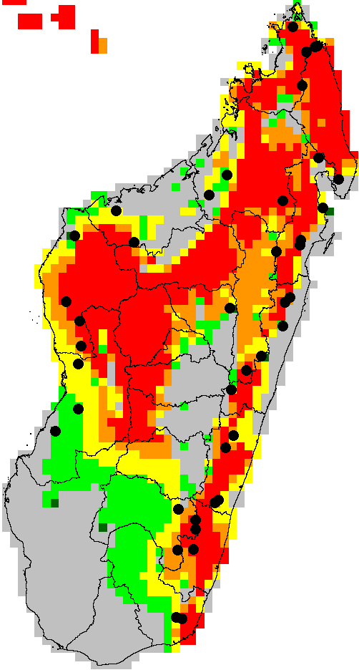
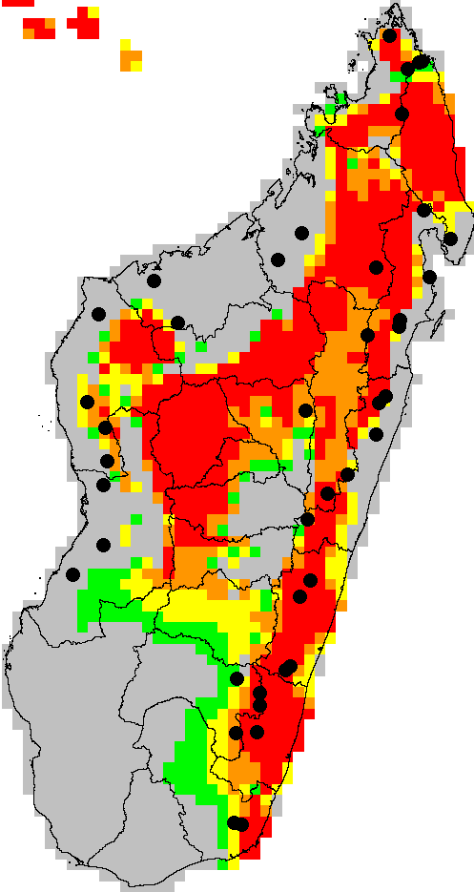
E
SUITABLE HABITAT FOR LEMURIESS
Currently
in 2020
Position des Lémuriens

Slide 10
AGRO METEOROLOGICAL MAPS
PLUIES ANNUELLES
Températures ANNUELLES

