Slide 1


Cooperation between DMH Myanmar and MET Norway on Capacity Building
In collaboration with Asian Disaster Preparedness Center (ADPC)
Tor Ivar Mathisen
Workshop, 6.-9. September 2016, Nay Pyi Taw

Slide 2



Key figures…
Funded by the Norwegian Ministry of Foreign Affairs (MFA)
Project inception 2012/2013
Budget: 180.000 USD per year
Cooperation with Asian Disaster Preparedness Center (ADPC) in Bangkok
A part of the MoU between DMH and ADPC
Coordinated with the activity carried out by Norwegian Water Resources and Energy Directorate (NVE)

Slide 3
Key figures…
Focus on building human and institutional capacity
  «Disaster Risk Reduction» (DRR) through handling «Early Warning System» (EWS) and (GFCS)
  Preparing for climate services (GFCS)
Basically no investment in equipment

Slide 4
Domains of GFCS vs. our focus
Global
Regional
National
NHMS

Slide 5
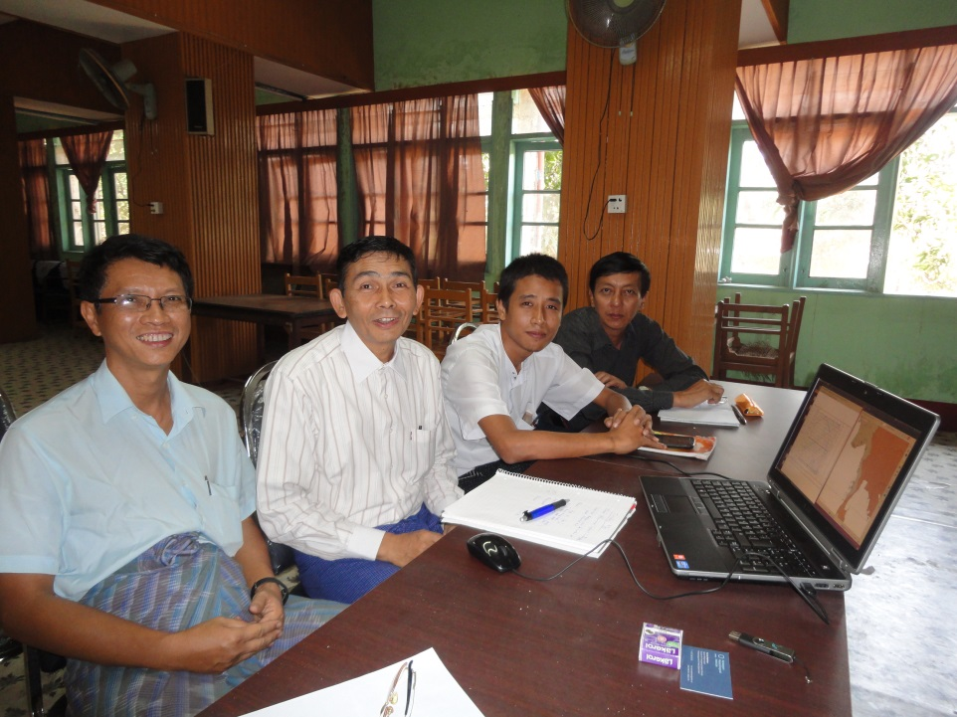
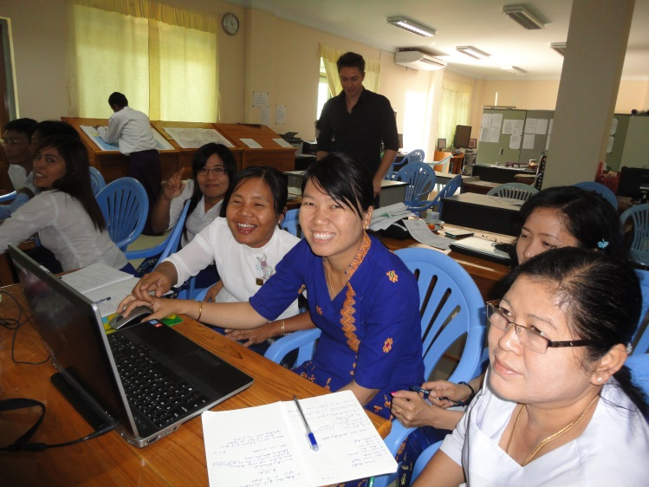
“Building the institution by building the people”
Build relationships, cooperation with colleagues
  trust and mutual respect
Establishment of a common project team
Listen, understand - then propose
Based on DMH’s available capacity and resources
DMH ownership
Overall Goal:
Make DMH (not Met Norway) visible for the users and independent of us

Slide 6
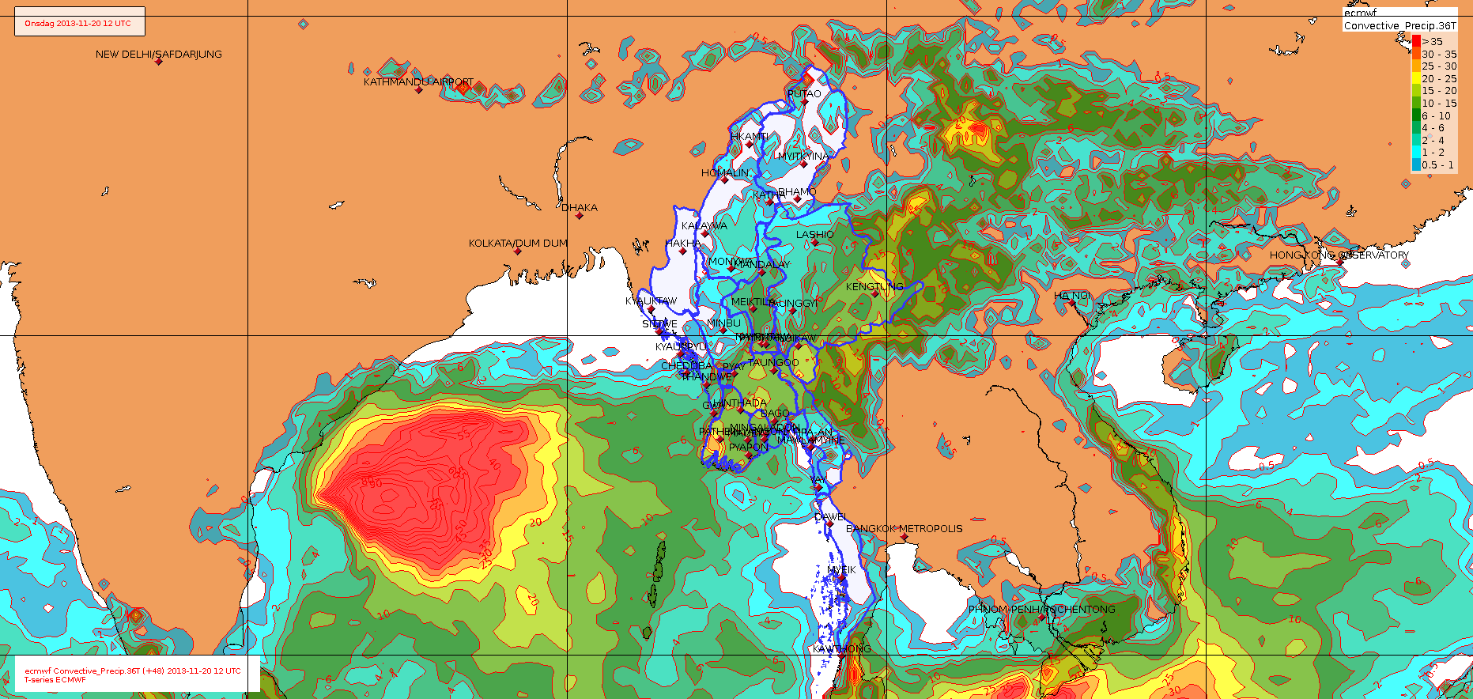
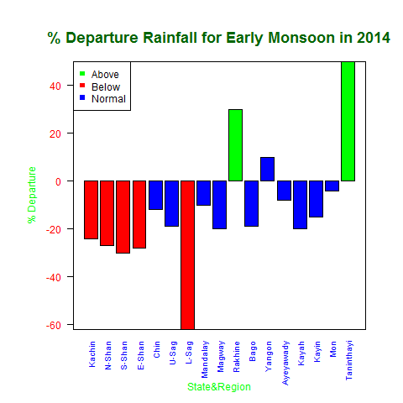
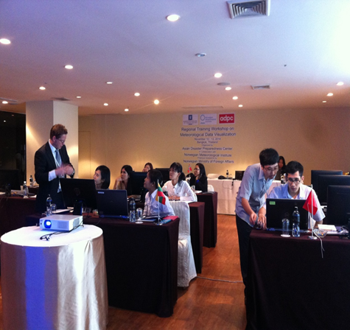
What are we doing?
Strengthen EWS (decision making):
Integrated forecasting tools developed at Met Norway (free, open source software) – hands-on-training
NWP model outputs: WRF (ADPC), ECMWF (Met Norway), GFS, GSM
Observations, satellite images, (radar)
NWP model/forecast verification
Climate services:
Digitizing and QC of historical observation data (ADPC/Met Norway)
Climate data base and Climate Data Portal (ADPC)
Analysis and products
National Climate Report – understanding current and future climate
Identify synergies between countries in the region (Vietnam and Bangladesh)
Learn from each other
Enhance the relationship between the institutions

Slide 7
Further plans
"We need to listen, understand and then propose”
Focus areas:
Strengthening the EWS (forecasting decision making), and with a special focus on extreme weather incidents
Medium range weather forecasting (ensembles, probability)
Marine forecasting
Aviation weather forecasting
Improving the experience on model verification
Improving DMH understanding of current and future climate, to prepare for the future and able to adapt the national infrastructure
Independence:
Still focus at support and hand-on-training, to help DMH become more robust and independent

Slide 8
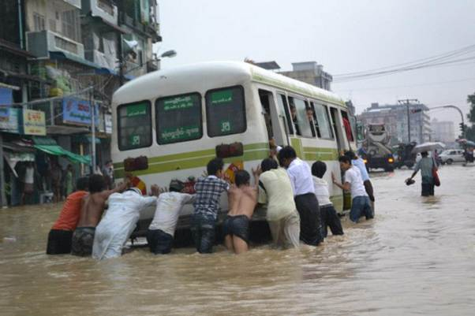
Coordination and collaboration between donors
to ensure sustainability
Build block by block (no “black boxes”)
  Use open standards/formats
  Try to use free, open software systems
Balance between:
  The new technology and the
  human/institutional technical skill and capacity at DMH
Avoid:
  Duplication of activities
  Overload of the human resources (key experts) at DMH
"The work needs to be meaningful both for DMH and Met Norway”

