Slide 1
Regional Training on Severe Weather Forecasting and Warning Services: Workshop on Public Weather Services 26-30 March 2018. Hanoi, Vietnam
WMO
Country Report on
Public Weather Services in Lao PDR
Miss. Phetlasy SOMCHANMAVONG.
Weather Forecasting Division and Early warning Division.
Department of Meteorology and Hydrology (DMH)
Ministry of Natural resources and Environment (MONRE)

Slide 2
Outline
DMH`s role and responsibity disaster Management.
Current weather Warning Dissemination Systems.
- Warning criteria.
Dissemination.
Challenges.
Concerns.
III. Gape in Warning Production
- Gaps in dissemination
Gaps in collaboration with main SWFDP

Slide 3
I. The role of the Department of Meteorology and Hydrology
The Department of Meteorology and Hydrology: "Hattha" is a science department that is incorporated into the structure of the organization.
Creating and expanding the meteorological station - hydrology; Collect meteorological and hydrological data across the whole range
A member of the World Meteorological Organization
Provides meteorological and hydrological information to air forecasting, water forecasting and socio-economic development across the country.
Manage and provide disaster information
Train
Forecasting meteorological and hydrological precautions
To prevent and reduce the damage to life and property of the nation and parents from natural disasters Nationality

Slide 4
II.Current Weather Warning Dissemination System
Heavy rainfall
Local Storm (Strong wind)
Flash Flood
Landslides
Drought
Floods
Typhoon
Cold weather
Hot weather

Slide 5
Hazard | Description | Warning Criteria | Notes
Drought | During Dry Season (From Nov-Feb) | There is no rain | General public
Drought-Dry Spell | Dry spell often occurs for about two weeks from the end of June to the beginning of July | No rain during two weeks | General public
Local Storm (Strong Wind) | From March to April is a hottest of the year, local storm always occurs at late afternoon to evening, caused strong wind, hail and lightning | 13 - 15 m/s | General public
Heavy rain | During the summer monsoon, especially from July to September, the southwest monsoon is more active, resulted, heavy rainfall occurs over the Lao PDR | 80 – 90 mm/day | General public

Slide 6
Hazard | Description | Warning Criteria | Notes
Flash Flood | Heavy rainfall in the hills and mountainous areas | 100 mm/day | General public
Landslide | Heavy rainfall occurs during 2 or 3 days in the hills and mountainous areas. | 100 mm/day | General public
Tropical Storm | On the average, there are 2 or 3 tropical storms per year passed over Lao PDR after making landfall in Vietnam. | Far warning: TS is located between 115 to 120 deg. East Near warning: TS is located 110 to 115 deg. East Urgent warning: TS is located west of 110 deg. East | General public

Slide 7
Hazard | Description | Warning Criteria | Notes
Flood | On the average, floods occur every 1.4 years and large floods occur every 5.7 years, from August to September | Flood advisory: water level is expected to be 0.50 meters below warning level. Flood warning: water level is expected to exceed warning level. Flood announcement: water level is expected to be 0.50 meters below dangerous level and heavy rain is forecasted exceeding 100 mm per next 24 hours. | General public
Cold weather | From December to January is coldest period of the year. In some years, the temperature drop into negative values. | Northern part: less than 10 deg. C lasted 5 days. Central and Southern parts: 10 – 12 deg. C lasted 5 days | General public
Hot weather | From March to April is a hottest period of the year. In some years, the temperature reached to 40 deg. C or greater. | Northern part: 34 - 36 deg. C lasted more than 5 days. Central and Southern parts: >= 37 deg. C lasted more than 5 days | General public

Slide 8
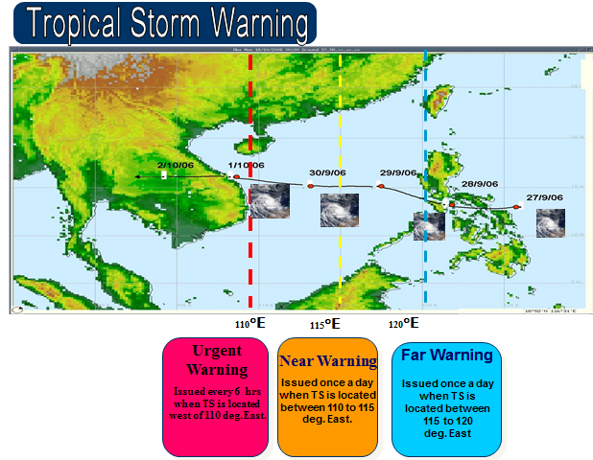
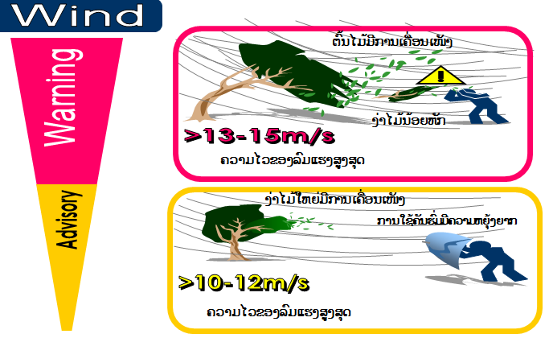
Warning Criteria

Slide 9
Dissemination System in Lao PDR
Department of Meteorology & Hydrology
http://dmhlao.etllao.com
WMO
GTS Network
LNMC
Prime Minister’s Office
MAF
Mass Media TV Radio News
Provincial Hydro – Meteo Stations
Provincial TV Radio
MONRE
Aviation.
Intl. Airport
NDMC ( NDMO) Line ministries concerned
Local Authorities
Electricity Hydro– power
Provincial Agriculture and Forestry Services
PDMC
People in affecting areas
M I H
DDMC
Districts & villages affected areas
Private companies
Village Disaster Prevention

Slide 10
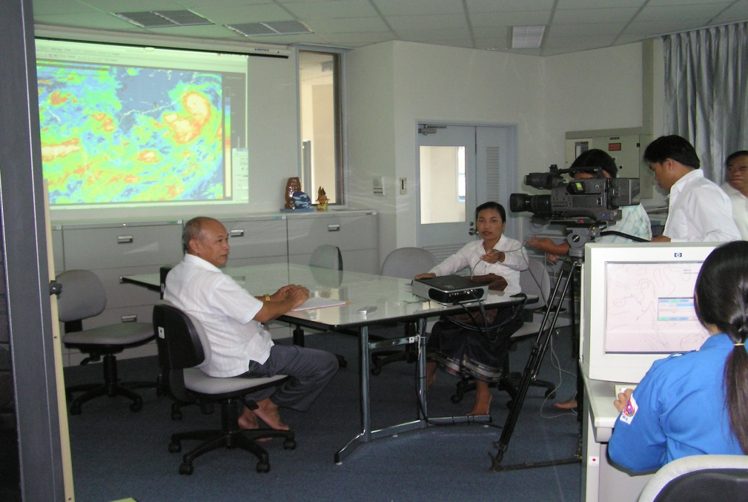
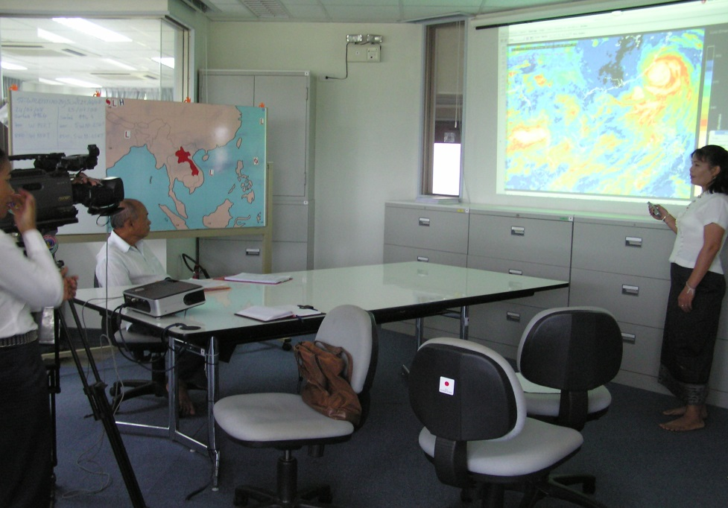
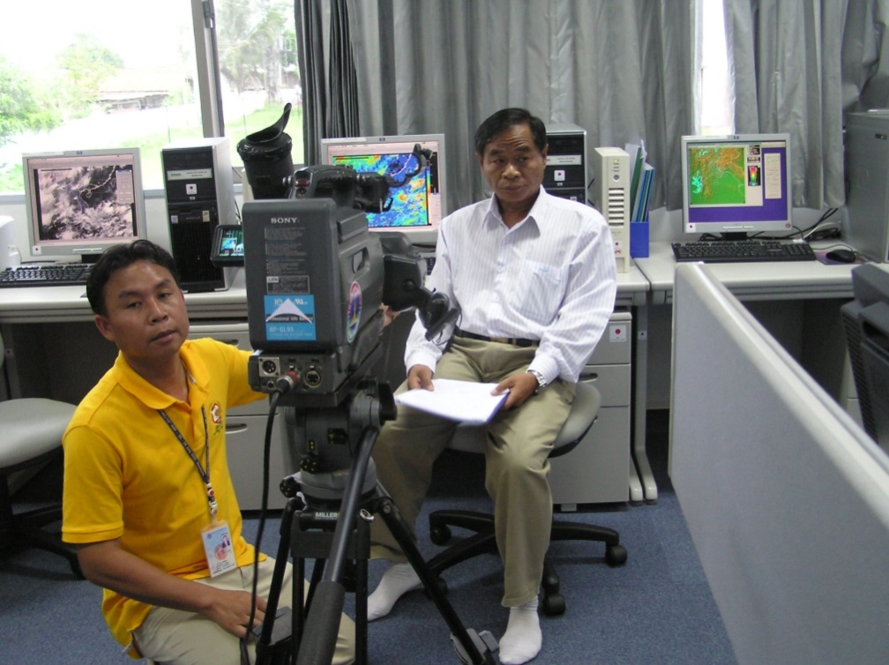
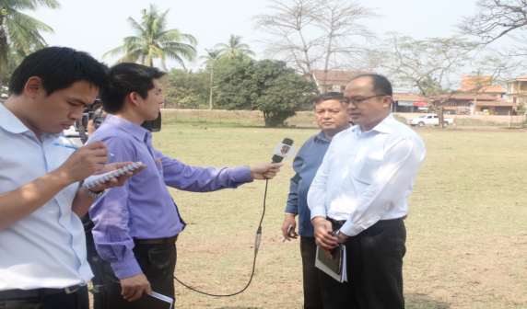
Inter view

Slide 11
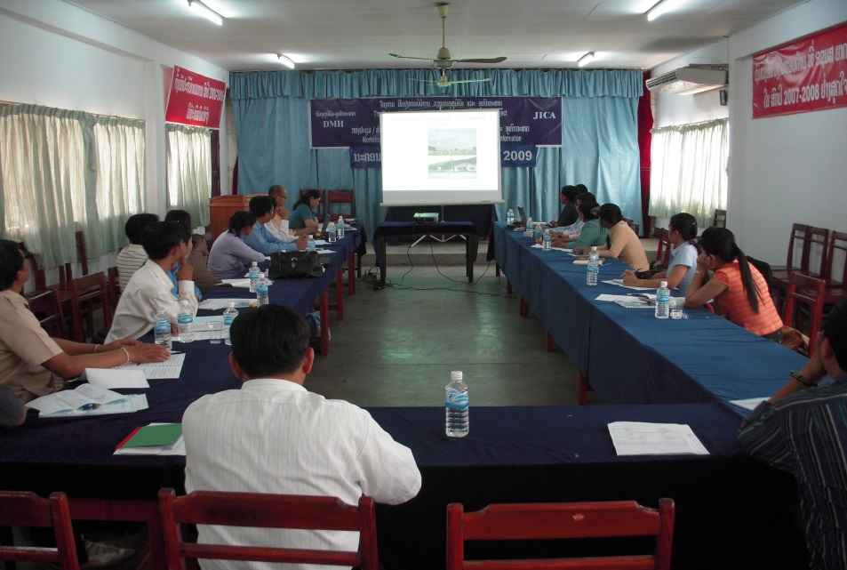
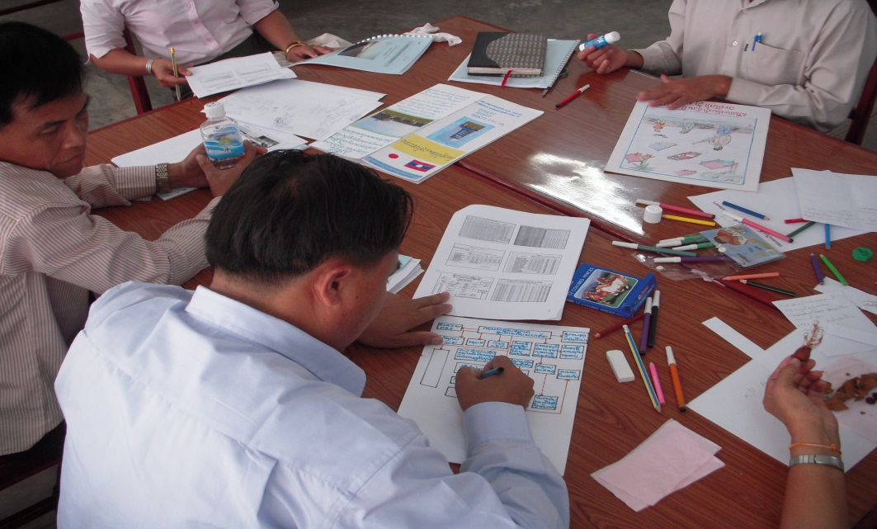
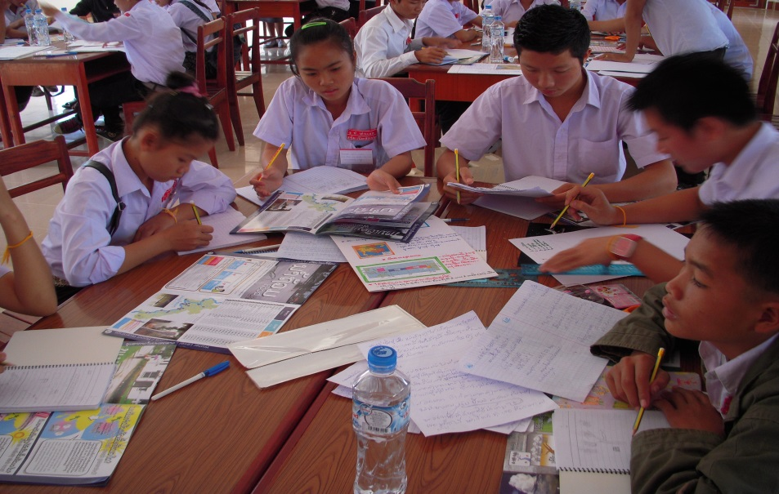
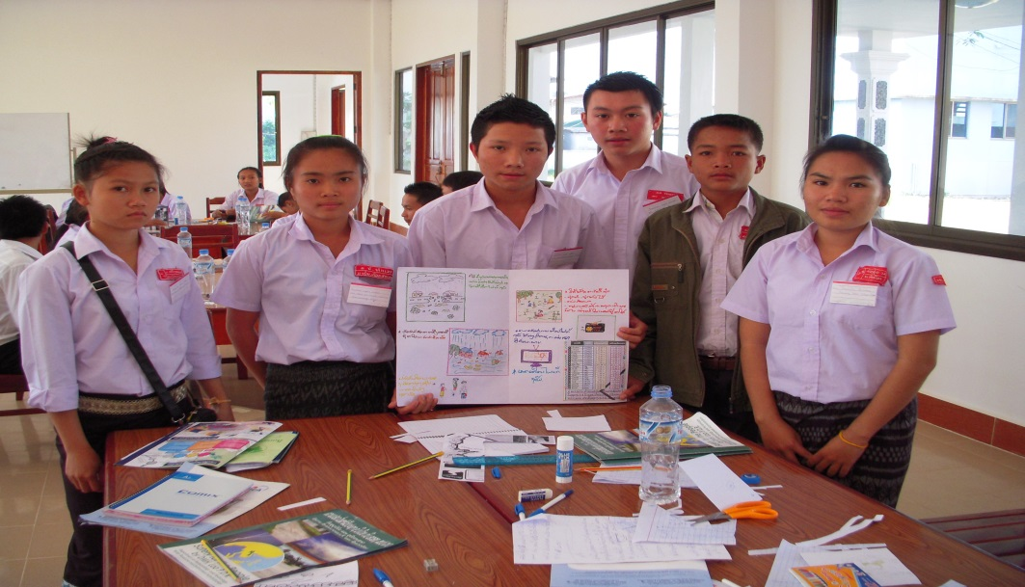
Training to mass media, public and student

Slide 12
Challenges
Communication is also cumbersome, some areas have a hard time communicating.
Sometimes Weather Forecast are wrong because can not access the models in time because the internet has problem, a power outage.

Slide 13
pressures
Forecasting is sometime also an error in notification.
Sometimes Forecasters are wrong because can not access the models in time because the internet has problem
concerns
Notifications are sometimes delayed sometimes people do not understand do not believe in forecasting alerts, so disaster happen and can not resolved it affect the people.

Slide 14
III. Gape in Warning Production
Gaps in dissemination
When the alert was issued, people did not believe in alert, caused a disaster and could not be resolved in time.

Slide 15
Gape in Collaboration with main SWFDP
All models are not accessible to all models.
The data in the Forecaster model is not yet certain to see Which country models are accurate.

Slide 16
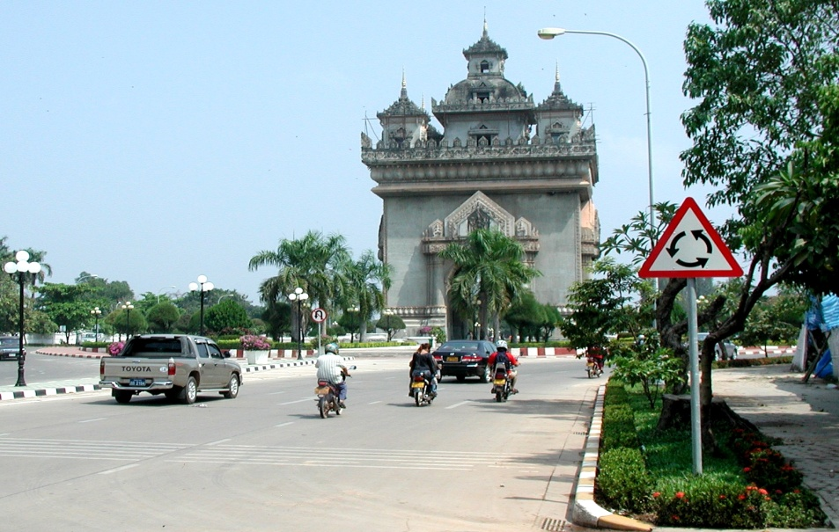
Thank you for your kind attention !

