Slide 1
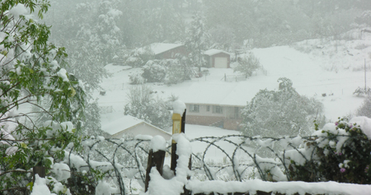
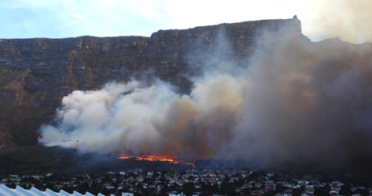
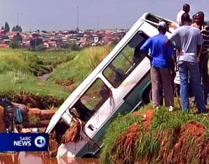
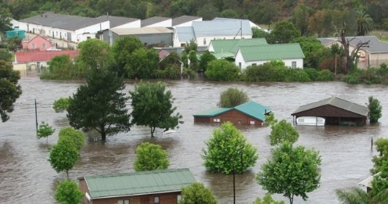
Weather Ready Nations: Impact-Based Forecast and Warning Process
Paul Kucera, Ph.D.
COMET
Boulder, CO USA
December 2018

Slide 2
Weather Ready Nations (WRNs) program is implementing an Impact-based forecast system following the WMO guidelines
Reorient Focus from what the weather Will be TO what the weather will do

Slide 3
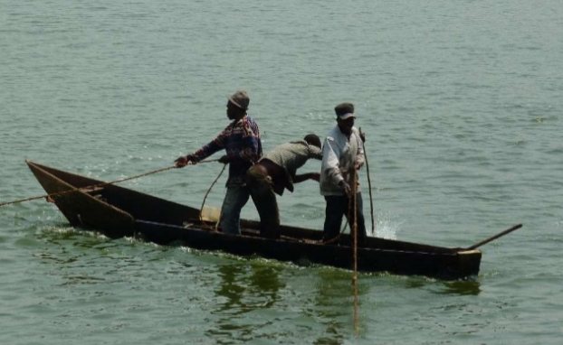
Why Impact-based Forecasting?
Stakeholders make decisions based on weather impacts on their activities
Forecasters focus on the needs and concerns of stakeholders
Decision makers use weather information as one input

Slide 4
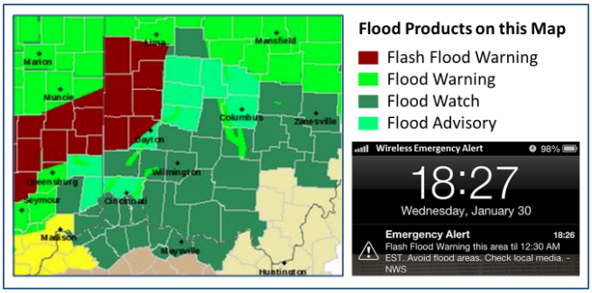
Weather Ready Nations addresses impact-based forecasts and warnings
Improve products and services for decision-making
Deliver potential impact of forecast weather
Warnings based on impact severity levels
Work together with disaster management agencies and other stakeholders

Slide 5
Transition Towards Impact-based Forecasting
National Meteorological and Hydromet Services (NMHS) are responsible for timely and accurate forecasts and warnings
Stakeholders make decisions based on impact on lives, livelihood, property, and the economy
Need more than statements about hydrometeorological events
Need information on disaster risk and forecasting impact beyond the traditional forecast
Forecasting high-impact hydrometeorological is a global challenge

Slide 6
Disaster Management Survey
Needs:
Clear and concise information on the weather impacts
Communication that enables effective decision making
“Tell the decision makers what is going to happen, when, where, and how serious it will be”

Slide 7
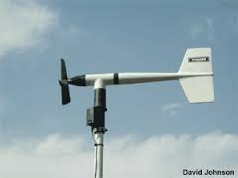
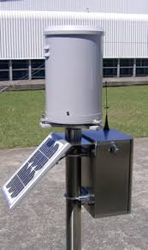
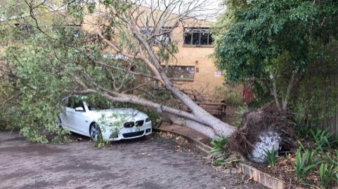
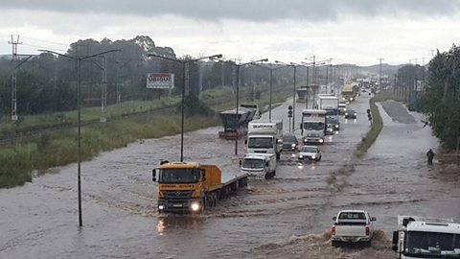
Impact-Based Forecasting
Move from
Towards
What the weather will be:
- 50mm in 24 hours
- 35 knot winds
What the weather will do: - Roads flooded - Communities cut off
Observations
Impacts

Slide 8
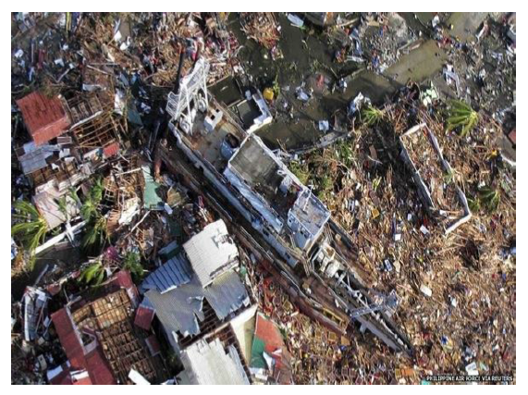
Moving Towards Impact based Forecasting
What causes hazards to become human disasters?
How does a good forecast, become a bad outcome?

Slide 9
How does an Impact-based Forecast System Work?
Assessing Risks
Are the hazards and the vulnerabilities well known?
Are risk maps and data widely available?
Monitoring and Early Warning
Develop hazard monitoring and early warning services
Are the right parameters being monitored?
Can accurate and timely warnings be generated?
Dissemination and Communication
Communicating risks and early warnings
Do warnings reach those at risk?
Is the warning information clear and actionable?
Response Capability
Build national and community response capabilities
Are response plans up to date and tested?
Are people prepared and ready to react to warnings?

Slide 10
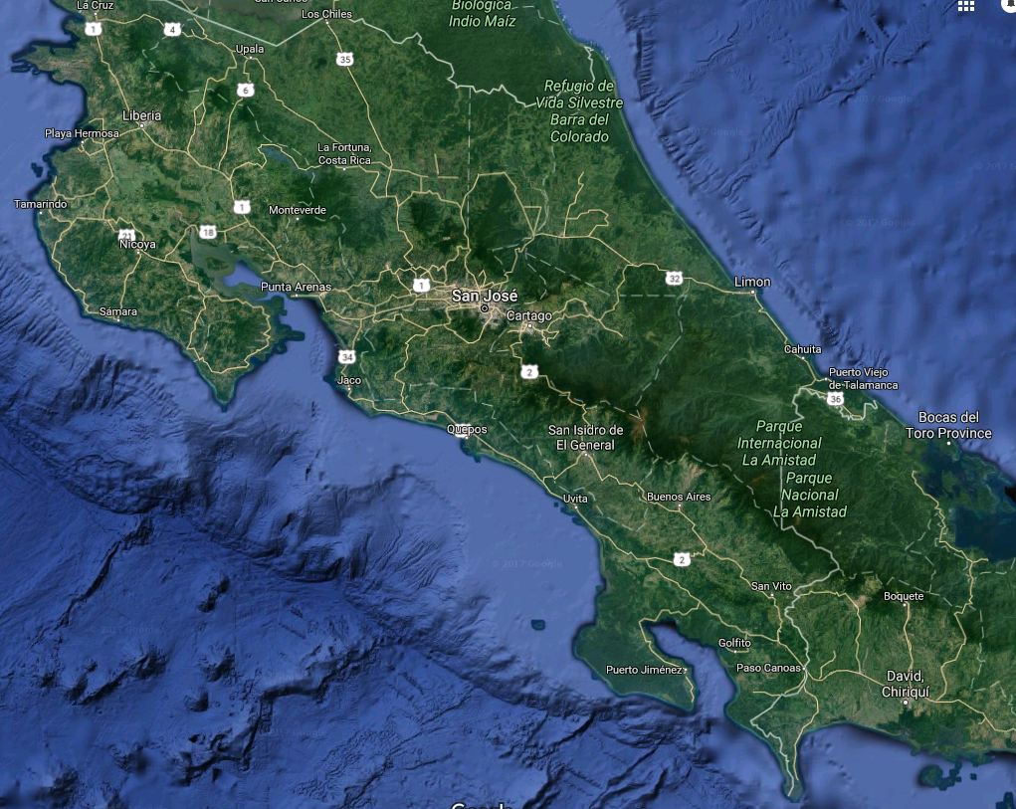
Warning: Heavy rain of more than 100 mm in 24 hours is expected
The goal is to change from this type of forecast …
So??
What does it mean to me?

Slide 11
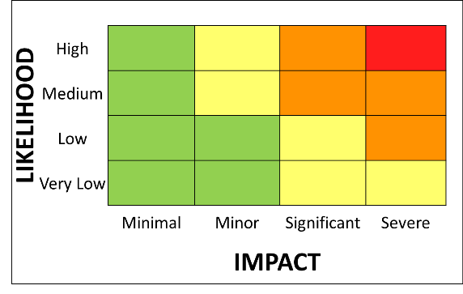
Impact Warning: 1. Orange warning for rain with a medium likelihood of significant impacts 2. Yellow warning for rain with a high likelihood of minor impacts
To an Impact-based Early Warning Forecast System
2
1
2
1

Slide 12
Barbados Example - Hazard Matrix
Primary | Secondary | Tertiary
High Winds | High Seas and Surf, Gale and Small Craft Impacts | Wind Shear and Flight Hazards hindering safe flight operations, Small Boats and high surf impact the health and safety of populations.
Severe Convection | Heavy Rain, Lightning, Wind Gusts, Flooding and Flash Flooding | Health and Safety of the Populations, potential evacuations of persons needed.
Heavy Rain Events | Flooding and Flash Flooding | Roads flooded, homes destroyed, evacuation of persons needed. Possible landslide hazards, crop failure. Health and Safety of Population.
Tropical Cyclones | Strong Winds, Heavy Rains, Storm Surge, Flooding and Inundation. | Structural damage, damaged infrastructure. Health and Safety of Population

Slide 13
Impact-based Forecast System Development
Impact tables define the different levels of impact
Impact level depends on vulnerability of the region
Disaster management agencies provide input to the tables
General description of different impact levels
Minimal | Minor | Significant | Severe
Day to day activities not affected but some small scale impacts occur | Some local incidents, minor disruptions, 'business as usual' for emergency responders | Disruption to day to day routines and activities, mostly localised. Short-term strain on emergency responder organisations | Widespread, Prolonged disruption to day to day routines and activities Prolonged strain on emergency responder organisations

Slide 14
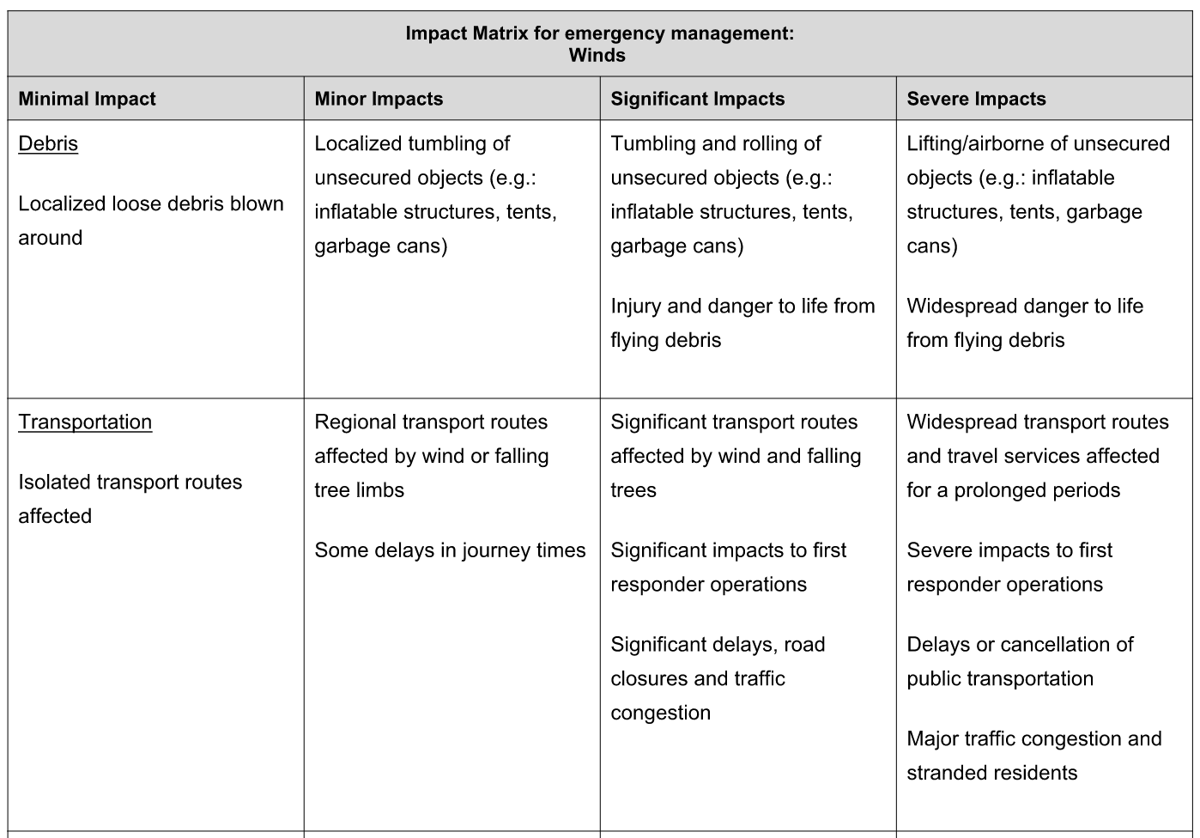
Barbados Example - Impact Matrix

Slide 15
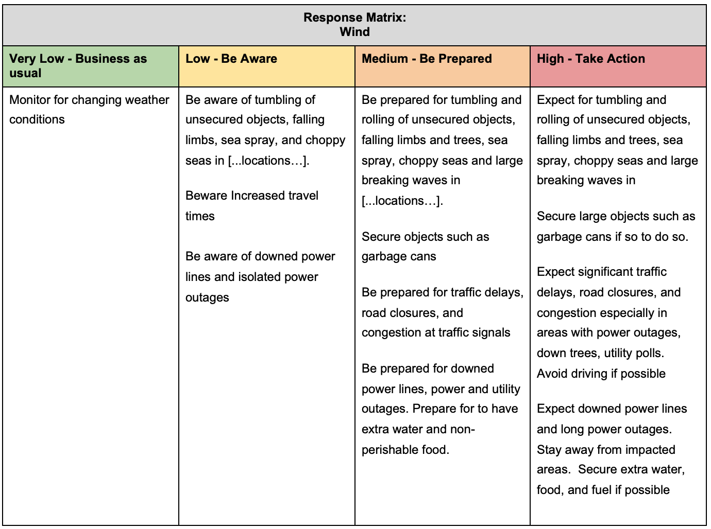
Barbados Example - Response Matrix

Slide 16
Risk and Response Matrix
Combine Likelihood and Potential Impacts to Determine Risk and Response

Slide 17
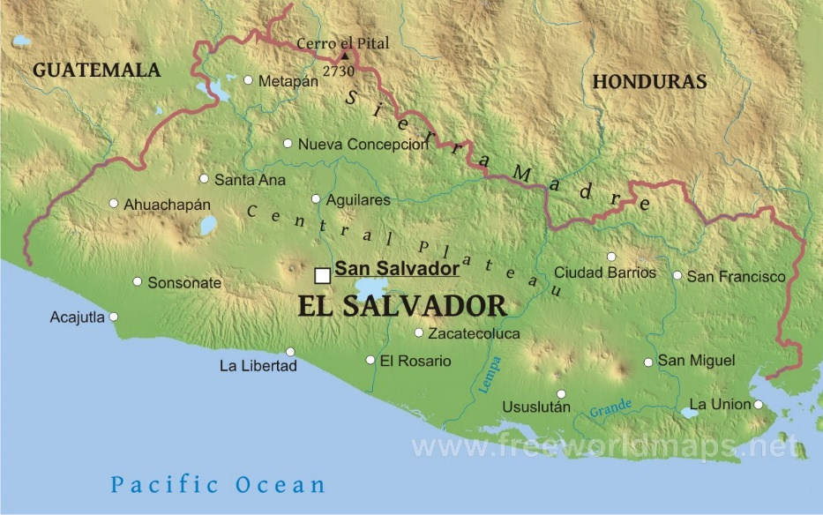
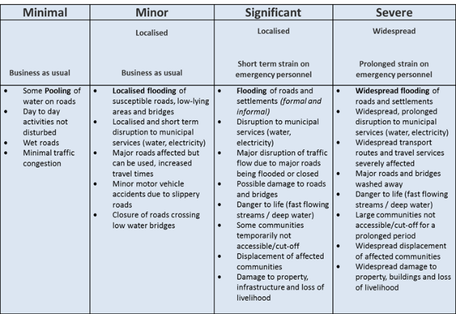
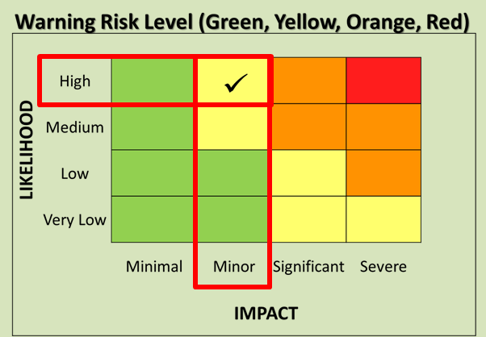
Example - Using a Risk Matrix
Forecasters identify a region where rainfall could result in adverse impacts
The most appropriate impact level is identified for an area
The expected likelihood of these impacts to occur is determined
Then the appropriate warning risk level (color) is established

Slide 18
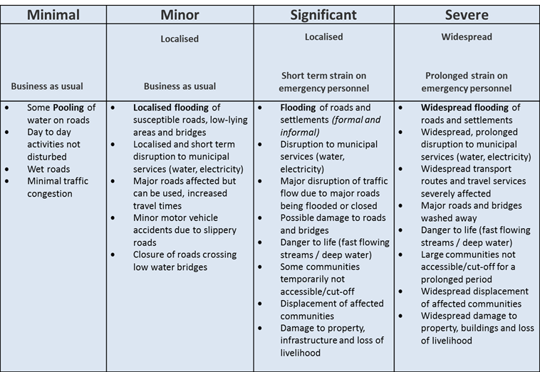
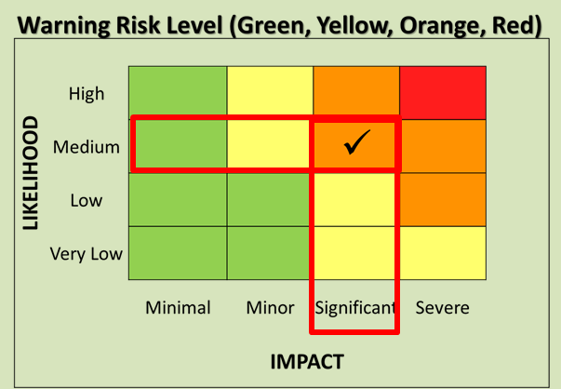
Example - Using a Risk Matrix
The same is done for areas with higher vulnerability

Slide 19
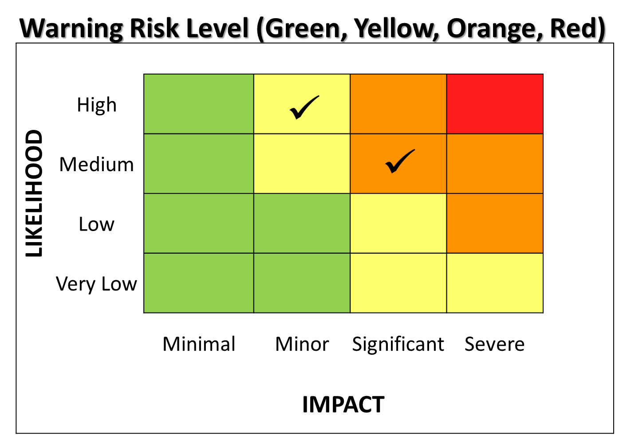
Example - Using a Risk Matrix
Important to note the difference in impact and likelihood of the yellow and orange warnings
These warnings require a different response from disaster management

Slide 20
Warning Template Example
Date Issued | 18-Oct-2017
Date Valid | 18-Oct-2017 to 19-Oct-2017
Time Valid | 1100hr 18-Oct to 23oohr 19-Oct
Warning (SMS) | Yellow Warning of Rain Be aware that some low level disruption looks likely to occur
Discussion | High rain fall amounts have already been recorded therefore the ground is likely saturated. Flooding has already been reported in flood prone areas. Any further rainfall could result in previous areas flooding again. There is a higher likelihood of minor impacts occurring over central San Salvador due to the amount of rainfall expected to occur over the area.
Date Issued | 18-Oct-2017
Date Valid | 18-Oct-2017 to 19-Oct-2017
Time Valid | 1100hr 18-Oct to 23oohr 19-Oct
Warning (SMS) | Orange Warning of Rain Be prepared for moderate level disruption to normal daily life
Discussion | Rain fall already occurring with rainfall amounts already recorded across San Salvador causing flooding. There is an indication that ore than 100mm more rainfall is possible. Areas prone to flooding need to be closely monitored over this period. Please be aware that flooding of roads is possible, disruption of municipal services, disruptions of traffic on major roads because of flooded roads and significant reduced visibility due to rainfall, possible damage to roads and bridges due to flooding.
x
x

Slide 21
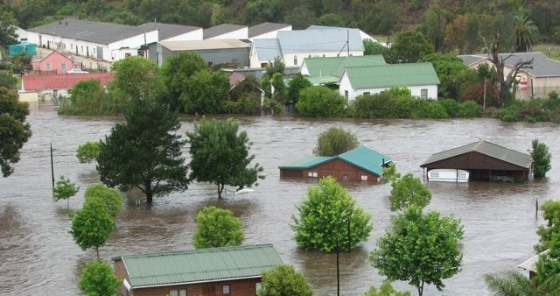
Partnerships and Collaboration
Main challenge: NMHSs and Civil protection need to work in partnership with other government agencies and stakeholders (emergency response, mapping agencies, transport, public, etc.)
Development of Information and Services - data sharing among different agencies and departments is vital (demographic, GIS mapping, economic information, etc.)

Slide 22
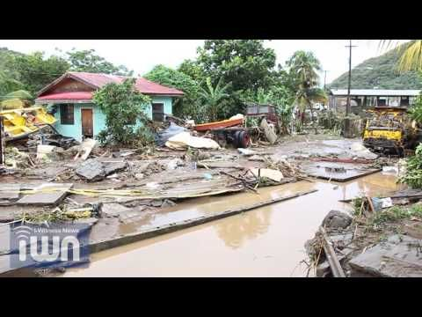
Development of an Impact-based Forecast System
Phase One: Collect Data and Develop Hazard, Risk, and Response Matrices
Workshop 1: Analyze available data and tools for developing matrices
Workshop 2: Draft Hazard and Response Matrices
Workshop 3: Finalize Hazard and Response Matrices

Slide 23
Example of combined Heavy Rainfall: Impact, Hazard and Response Matrix developed by forecasters, hydrologists, and disaster managers
Minimal | Minor | Significant | Severe
Business as Usual | Localized = Single District Municipality affected Business as usual | Localized = Single District Municipality affected Short term strain on emergency personnel | Widespread = Multiple Districts affected Prolonged strain on emergency personnel
Some pooling of water on roads or in rural settlements Day to day activities not disturbed Wet roads Minimal traffic congestion Isolated mudslides and rock falls | Localized flooding of susceptible informal settlements or roads, low lying areas and bridges Localized and short term disruption to municipal services (water, electricity, etc.) Major roads affected but can be used, increased travel times Minor motor vehicle accidents due to slippery roads Closure of roads crossing low water bridges Localized mudslides and rock falls | Flooding of roads and settlements (formal and informal) Disruption to municipal services (water, electricity, etc.) Major disruption of traffic flow due to major roads being flooded or closed Possible damage to roads and bridges Danger to life (fast flowing streams I deep water) Some communities temporarily not accessible/ cut-off Displacement of affected communities Damage to property, infrastructure and loss of livelihood Mudslides and rock falls | Widespread flooding of roads and settlements Widespread, prolonged disruption to municipal services (water, electricity, etc.) Widespread transport routes and travel services severely affected Major roads and bridges damaged or washed away Danger to life (fast flowing streams I deep water) Large communities not accessible/cut-off for a prolonged period Widespread displacement of affected communities Widespread damage to property, buildings and loss of livelihoods Widespread mudslides and rock falls

Slide 24
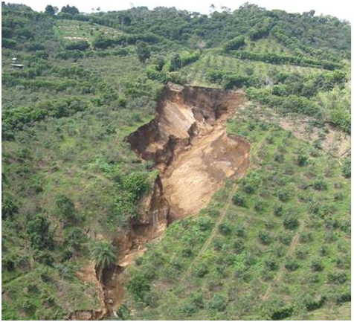
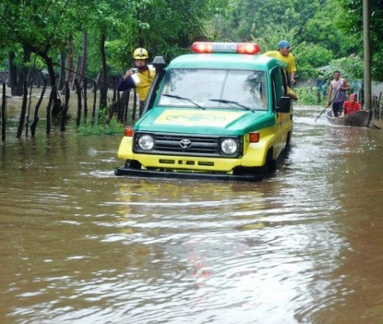
Development of an Impact-based Forecast System
Phase Two: Expand Stakeholder Participation
Workshop 1: Draft sector specific matrices (e.g. health, public works, transportation, and other key partners)
Workshop 2: Finalize sector specific matrices

Slide 25
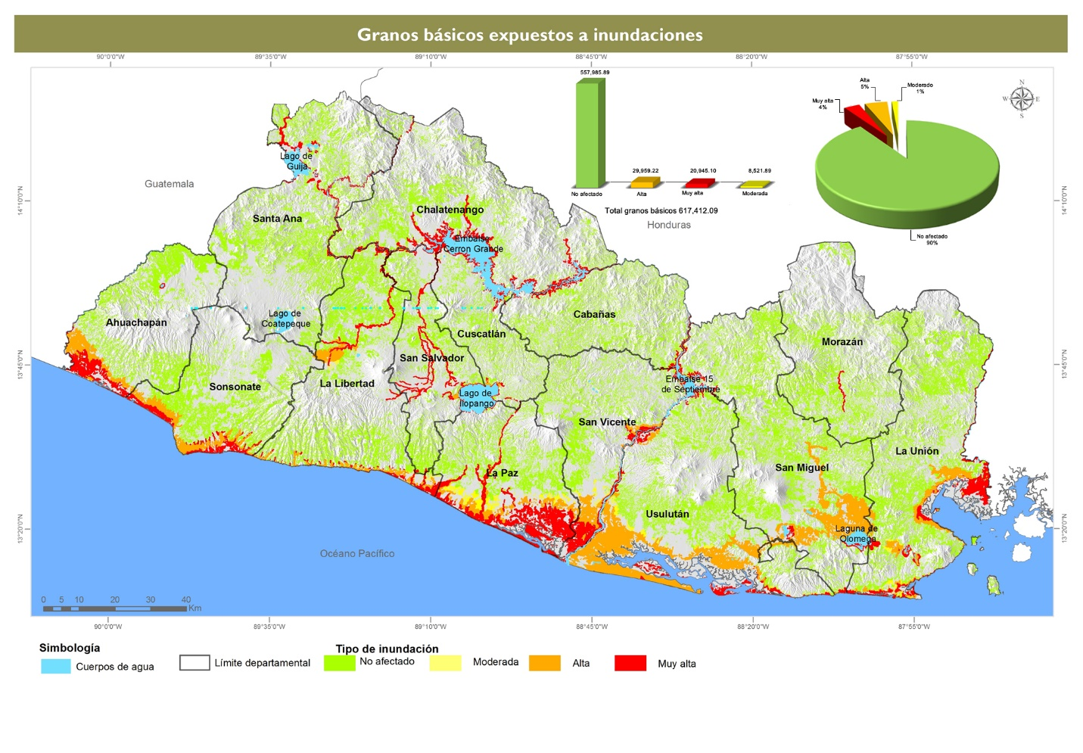
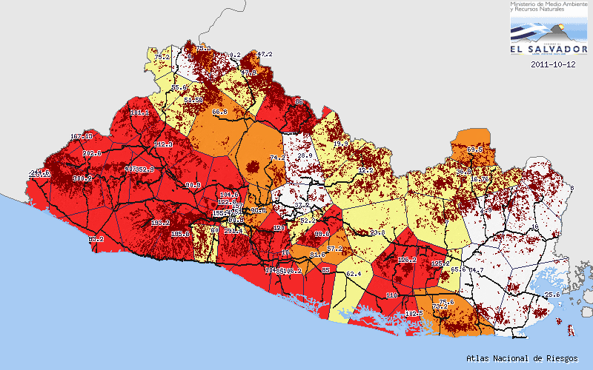
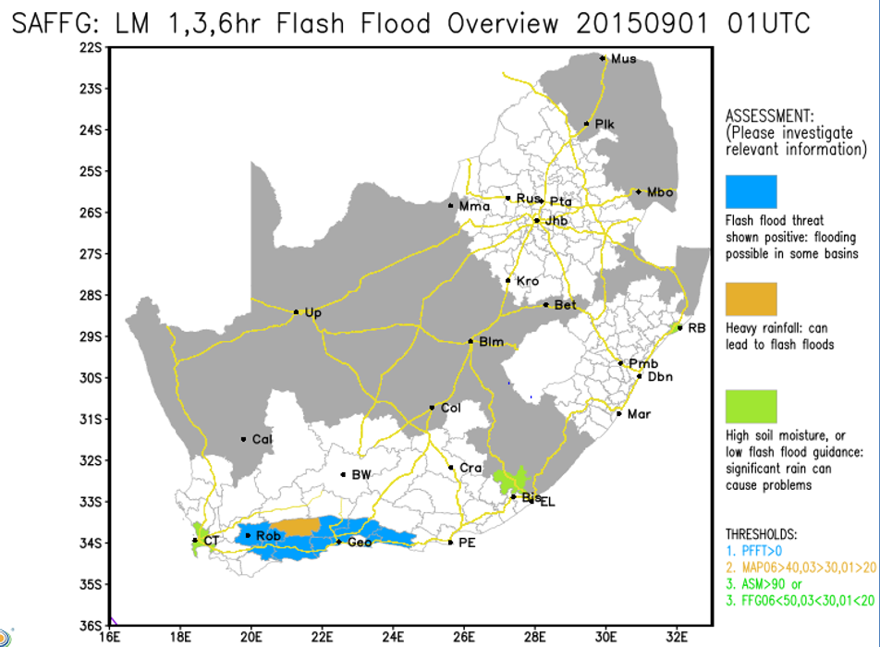
Phase Three: Forecaster and Disaster Management Interface
Workshop: Develop display system to share information between forecasters and disaster managers

Slide 26
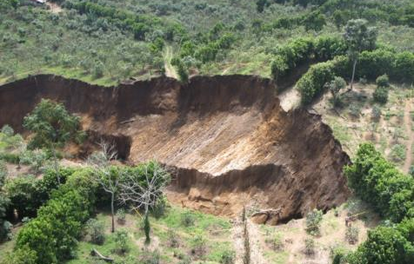
Phase Four: Develop Standard Operating Procedures (SOP)
Workshop 1: Draft the Standard Operating Procedures
Workshop 2: Finalize Standard Operating Procedures

Slide 27
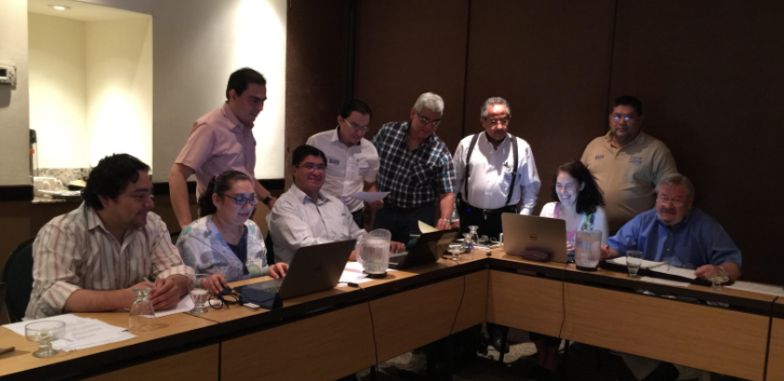
Phase Five: Impact-based Forecasting Demonstration
Workshop 1: Train Forecast and Civil Protection Staff
Workshop 2: Train the media and other stakeholders
Workshop 3: Simulation test in conjunction with civil protection and NMHSs

Slide 28
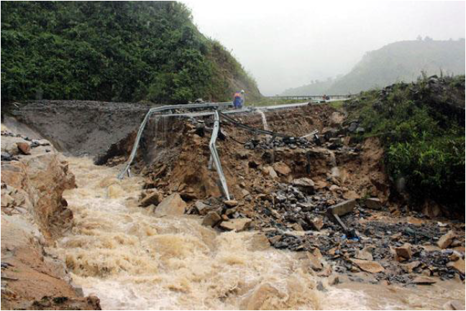
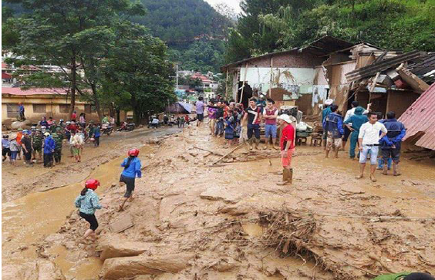
Phase Six: Public Awareness and Outreach
Workshop: Develop outreach material and raise public awareness to recruit volunteers to assist with communication and mitigation efforts

Slide 29
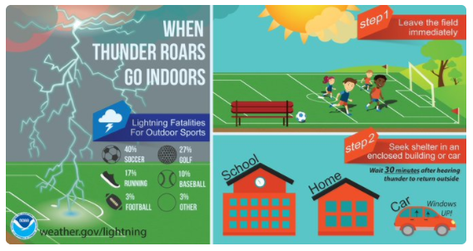
Challenges
NMHS forecasters and civil protection commit to paradigm shift to impact-based forecasts and warning
NMHS and civil protection needs to build staffing skills to create and use impact-based forecasts
NMHS and civil protection needs to incorporate social science principles in operations
NMHS and civil protection collect and analyze data to develop the impacts, hazard, and response matrices

Slide 30
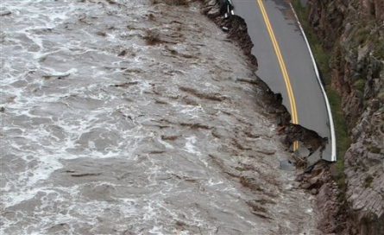
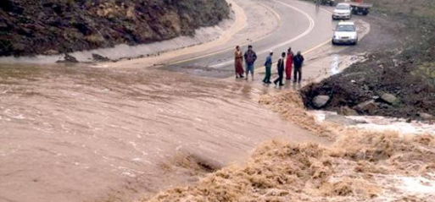
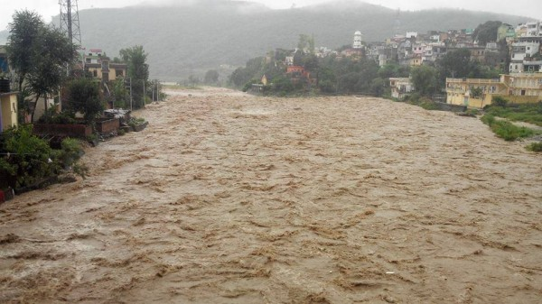
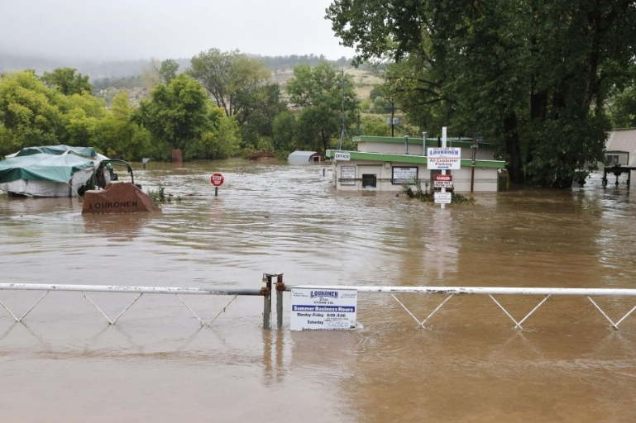
Thank you – Questions?

