Slide 1
Coping with hazards and disasters
Khishma Modoosoodun
26 October 2015

Slide 2
OUTLINE
AMESD wave data buoy
MESA wave and surge monitoring
MESA SADC THEMA on flood
MESA coastal monitoring
Tsunami Inundation map for Mauritius

Slide 3
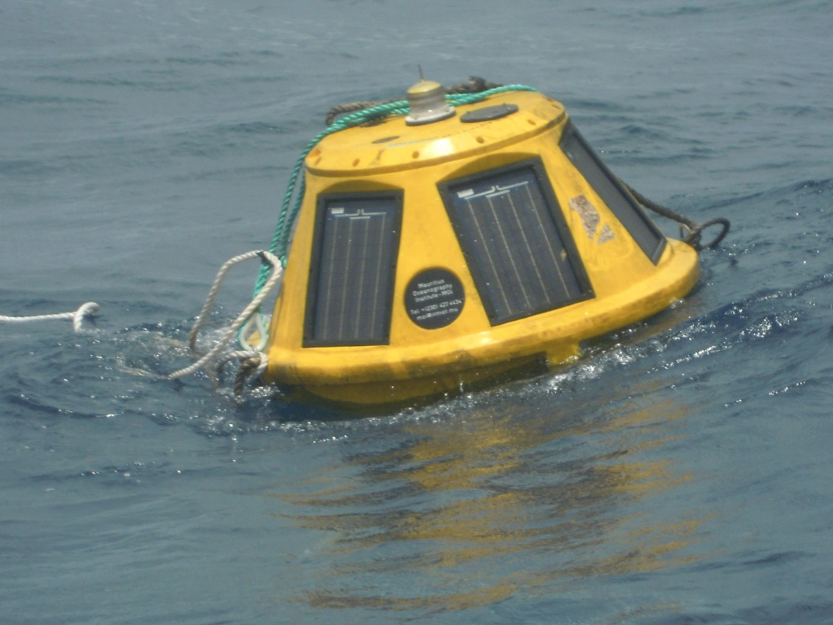
AMESD wave data buoy
Data: Near-Real Time wave data (30 min-interval) transmitted to MMS used to validate forecasting models.
Period: 2012-2014
End-users: fishermen
venturing at sea

Slide 4
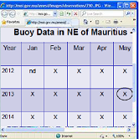
AMESD wave data buoy
Buoy
Configuration
Software
Satellite/GSM/Radio
Communication
Communication
Hardware
Communication
Software
PC
Receiving Station
Database
Central Repository
Data Monitoring/Presentation
Software
Data Visualisation via
Web-based Interface

Slide 5
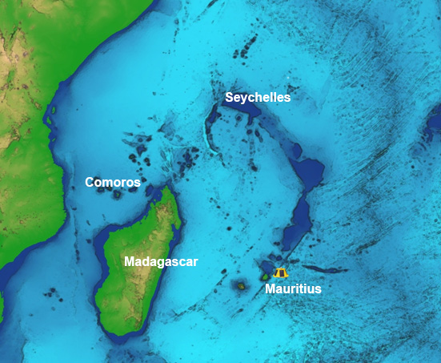
MESA wave and surge monitoring
Acquire operational marine information to allow monitoring, evaluation, prevision and mitigation of ocean risks.
Setting up of a small network of wave buoys - IOC Member states

Slide 6
MESA wave and surge monitoring

Slide 7
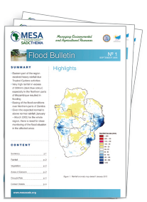
MESA SADC THEMA on flood
The MESA SADC Flood Service is designed to assist help the ministries and departments of water resources and disaster management offices mandated with flood monitoring and disaster management in SADC Member States monitoring.
Active participation of the MOI in the set up of the SADC flood service in Mauritius
Notes:
After receiving the earth observation satellite data, the estimated rainfall will have to be processed using GIS and remote sensing, together with other data such as Digital Elevation Model, Soil Type, Built up areas and Curve Number in view to estimate the storm water run-off in a particular water catchment area and to produce flood maps and hydrographs;
-working with UOM & NDRRMC

Slide 8
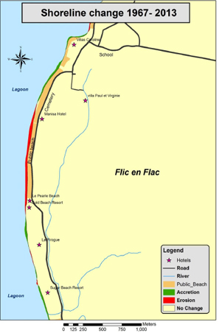
Shoreline Change
Determining the Coastal Vulnerability Index (CVI)
Acquisition of satellite/aerial images
Digitalize aerial photos
Geo-reference and rectify images using GIS software
Calculating shoreline change
Acquisition of satellite/aerial images
Digitalise aerial photos
Geo-reference and rectify images using GIS software
Calculating shoreline change

Slide 10
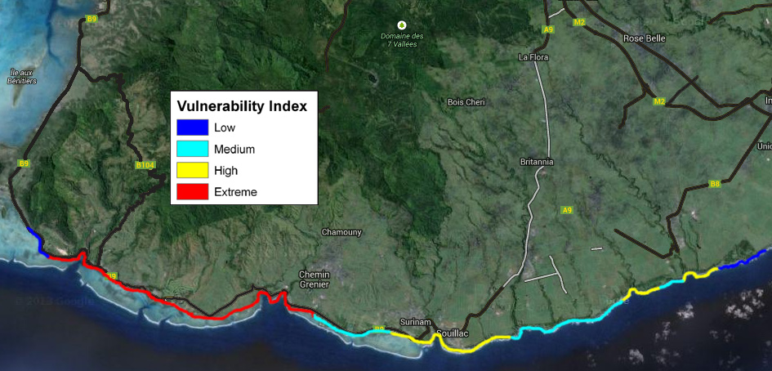
Eventual CVI Output
Rough example for the coast of Mauritius
Identify sites more prone to coastal hazard
Shortlist affected sites
Come up with a monitoring protocol to generate maps of shoreline changes

Slide 11
Tsunami Inundation map for NDRRMC
The MOI has had an active participation in the setting up of an early warning system for Mauritius.
In 2007, MOI came up with a Tsunami preparedness map for the National Disaster Risk Reduction Management Centre.

Slide 12
Thank you…
Contact:
Mr. Bheenesh Motah
bmotah@moi.intnet.mu
Dr. Daniel Marie
director@moi.intnet.mu
https://s-media-cache-ak0.pinimg.com/originals/3f/5a/52/3f5a527646b64c78a893ea6f589f2ee6.gif

Slide 13
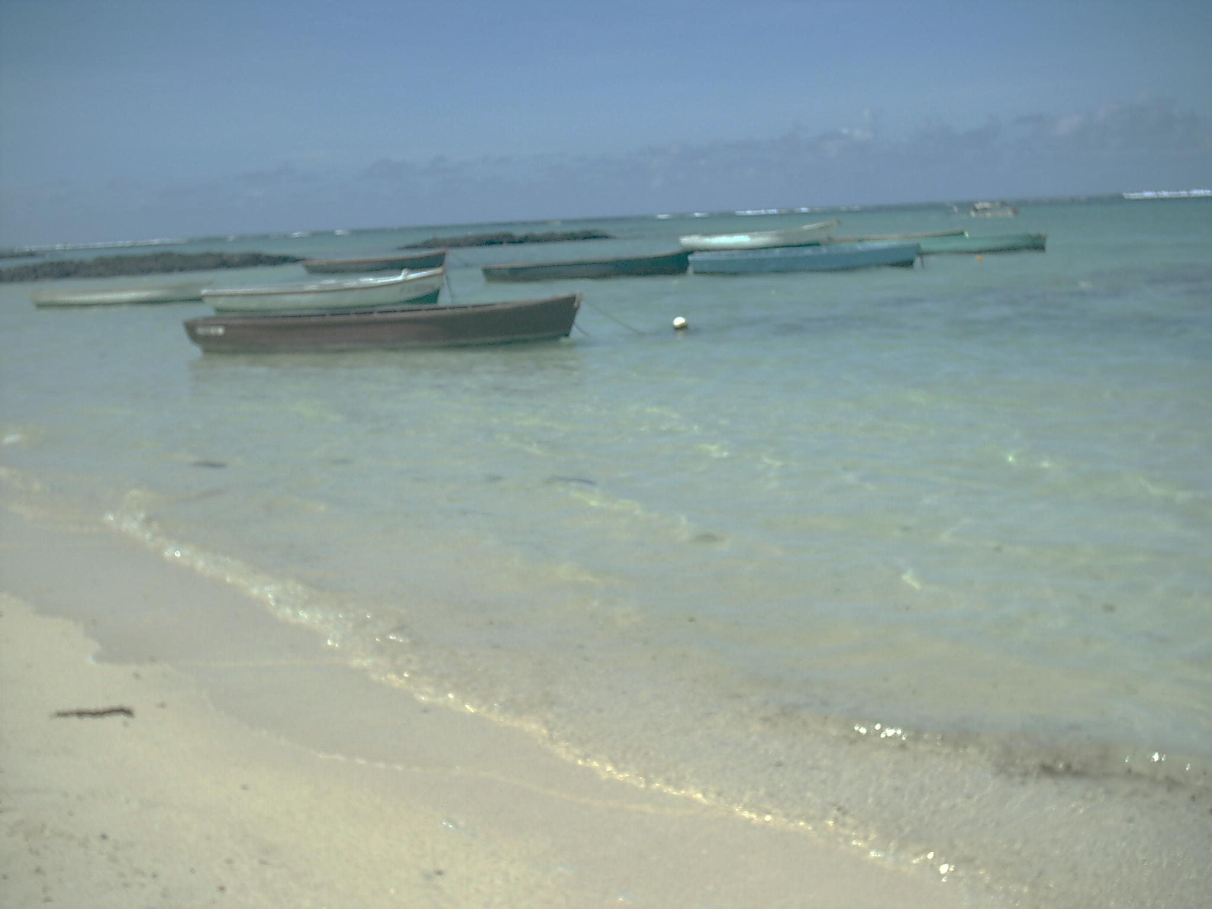
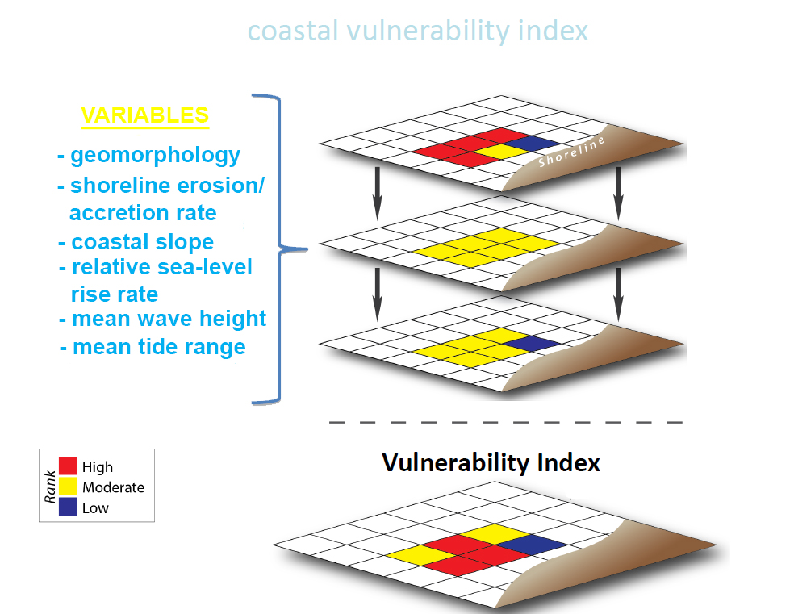
Determining the Coastal Vulnerability Index
Variables
Shoreline type
Shoreline change Rate
Coastal Slope
Mean tidal Range
IOC THEMA Countries: Comoros, Kenya, Madagascar, Mauritius, Mozambique, Reunion Island, Seychelles and Tanzania

