Slide 1
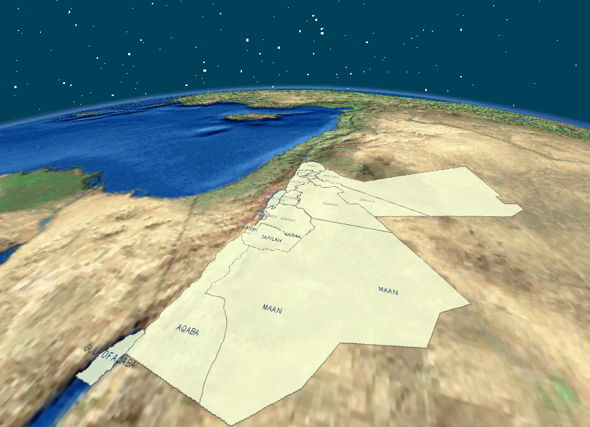
Jordan Meteorological Department
JMD
Training Workshop for National Meteorological and Hydrological Services (NMHSs) on Designing Socio-Economic Benefits Studies of Meteorological/Hydrological Services and Products for Members of Regional Association VI (Europe) 29 June - 3 July 2015 Zagreb, Croatia the Congress Centre of Kraš
Mohammad Samawi
Deputy Director General
Jordan Meteorological Department (JMD)

Slide 2
Jordan Meteorological Department
JMD
RAED RAFID.
Jordan Meteorological Department.
National Forecasting Cernter (NFC) /Head Of Forecasting Division.
raedrafid@yahoo.com
AHMAD AL-HALLAJ.
Jordan Meteorolgical Department.
Internal Control Unit (ICU) / Internal Auditor.
kaa_jometeo@hotmail.com
Jordan Meteorological Department (JMD)

Slide 3
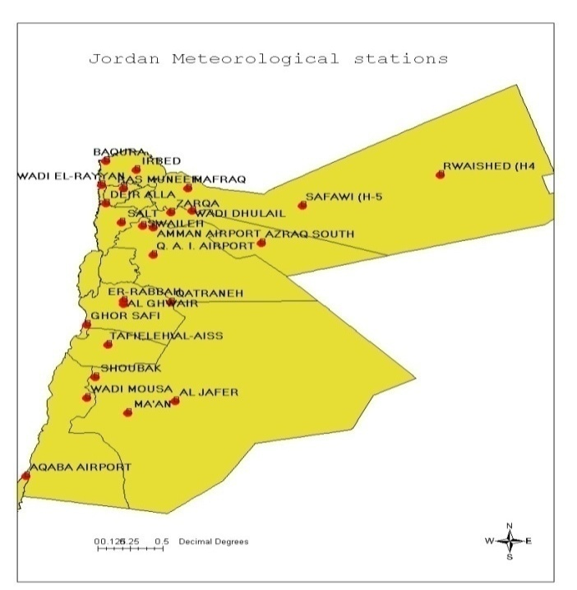
Jordan Meteorological Department
JMD
Location: Middle East, northwest of Saudi Arabia, between Israel (to the west), Iraq (to the east) and syria (to the north).
Population: around 8 Millions. note: increased estimate reflects revised assumptions about the net migration rate due to the increased flow of Syrian refugees (July 2014 est.)
Jordan Meteorological Department (JMD)

Slide 4
Jordan Meteorological Department
JMD
Gross Domestic Product (GDP): around $ 80 billion (2014 est.).
Composition of GDP:
agriculture: 3%
industry: 30%
services: 70% (2014 est.)
Main industries and services:
tourism,
information technology,
clothing,
fertilizers,
potash, phosphate mining,
pharmaceuticals,
petroleum refining,
cement,
inorganic chemicals,
light manufacturing
Jordan Meteorological Department (JMD)

Slide 5
Jordan Meteorological Department
JMD
Jordan Meteorological Department (JMD)

Slide 6
Jordan Meteorological Department
JMD
Jordan Meteorological Department (JMD)

Slide 7
JMD Brief Outline
JMD was established ¹⁹⁵¹ as part of the Civil Aviation Authority
Set up on ¹⁹⁶⁷ as independent entity/MOT
World Meteorological Organization member since ¹⁹⁵⁵.
Arab league member since ¹⁹⁵⁵
Jordan Meteorological Department (JMD)

Slide 8
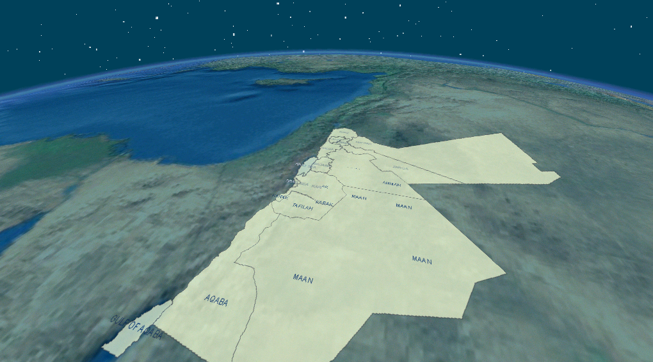
Role of JMD
Establishment of observations network and forecast offices
^{“ weather & climate”} warnings and forecasts
services to transport , agriculture , hydrology and other economic sectors
climate data bank
Establishment of a rapid communications system for national and international data and products exchange
Promote research and training in the different fields of meteorology.
Jordan Meteorological Department (JMD)

Slide 9
Organization
Jordan Meteorological Department (JMD)

Slide 10
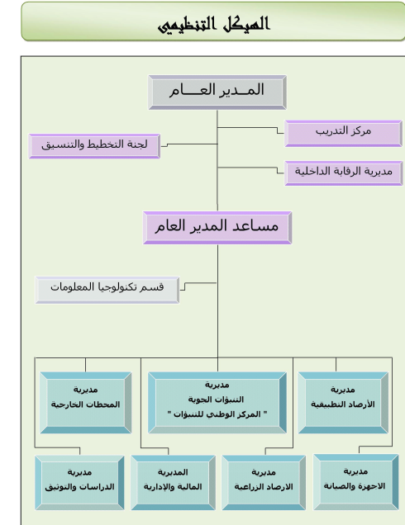
Director General
Training Centre
Planning Committee
Entire Control
Instruments
&
Maintenance
FORECASTING
Applied meteorology
NFC
C & CC
Agro Metrology
Administration
&
Finance
Studies
&
Documentation
Observing Stations
Jordan Meteorological Department (JMD)

Slide 11
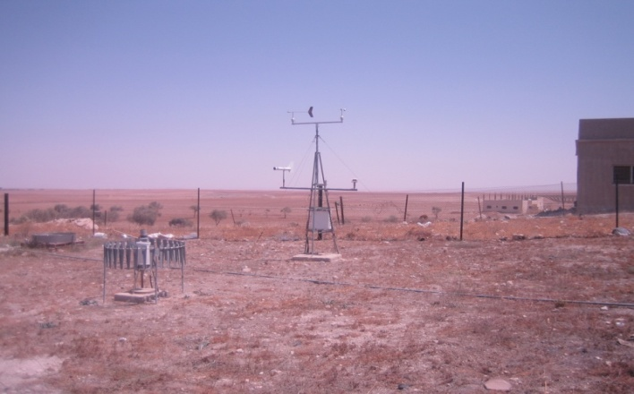
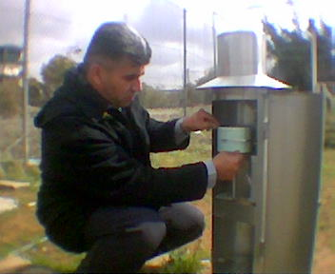
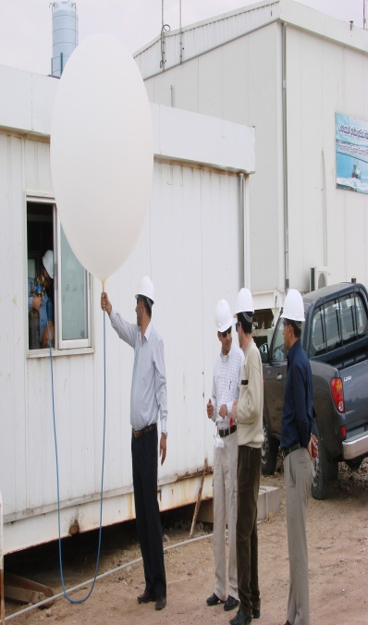
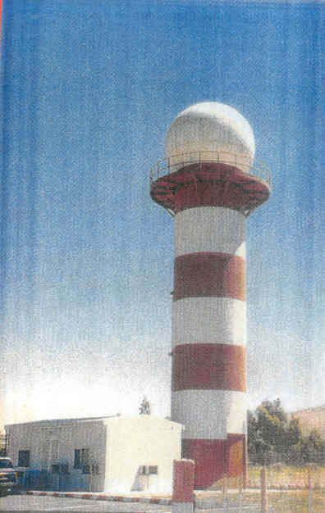
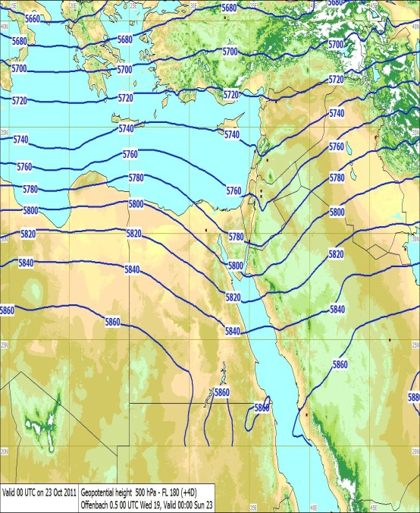
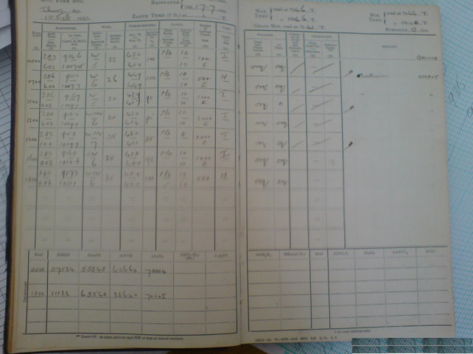
Budget
Annual budget :1.8 M ^{JD} ≈ 2.5 M $
Capital Fund = (25%) of the total budget
Jordan Meteorological Department (JMD)

Slide 12
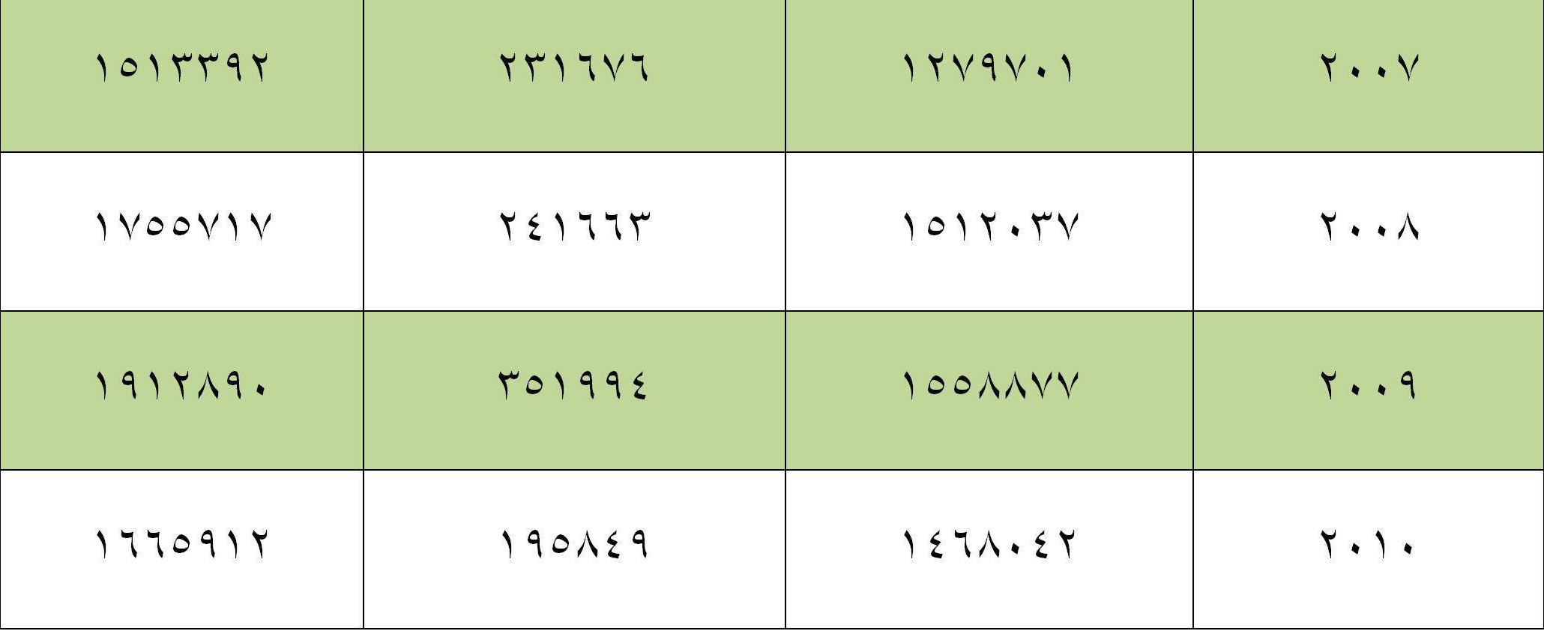
Jordan Meteorological Department (JMD

Slide 13
Infrastructure :
It was developed over the years to fulfill the national and international requirements .
Operational components
Observation Network
Forecasting Facilities
Telecommunication sys.
Climate Data Bank
Admin.
Jordan Meteorological Department (JMD)

Slide 14
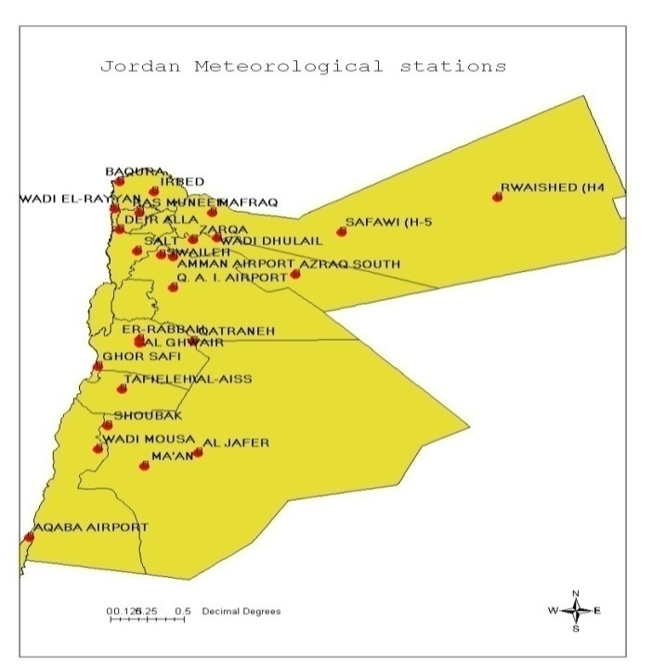
JMD Operational components
Observation Network ^{32 Stations}
Main stations: 16
Climate Stations:25
Ago-climate-stations:8
Total : 49
Main stations: 18
Climate Stations:4
Ago-climate-stations:10
Total : 32
Jordan Meteorological Department (JMD)

Slide 15
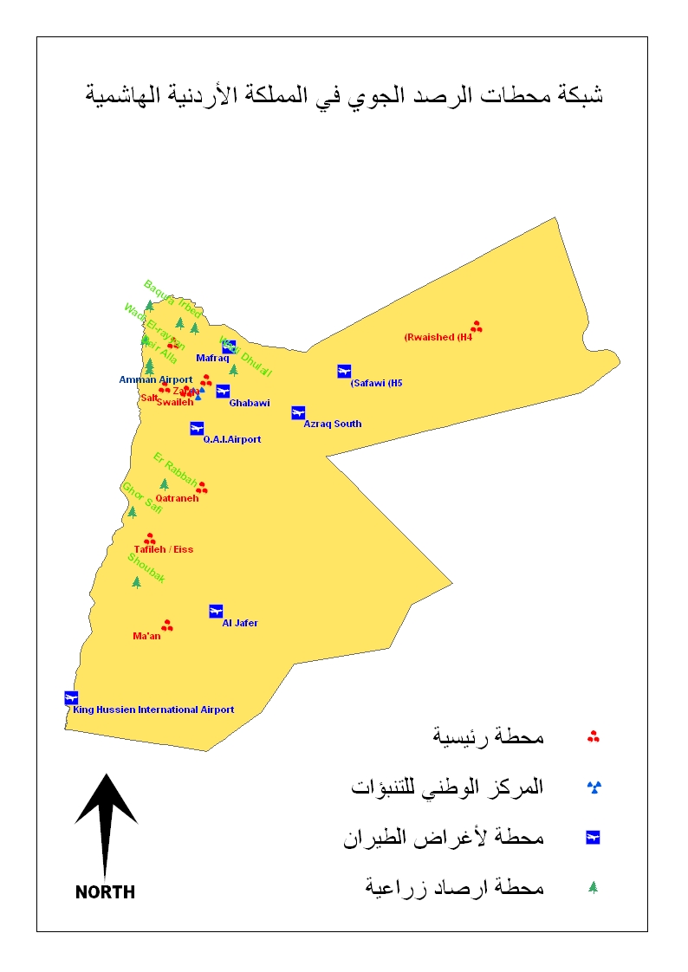
الصفاوي
الروسشد
الأزرق
المفرق
الزرقاء
وادي الضليل
اربد
راس منبف
صما
الرمثا
الغباوي
الباقوره
وادي الريان
دير علا
مزرعة الجامعة
البحر الميت غور الصافي
الغور
Valley
الشمال والشرقNorth-East
الجغر
الشوبك
معان
الربة
القطرانة
العقبة
مطار عمان
مطار الملكة علياء
وادي القطار
السلط
صويلح
الجامعة الأردنية
تل الرمان
الوسط Center
الجنوب والجنوب الشرقي
South-South East
Jordan Meteorological Department (JMD)

Slide 16
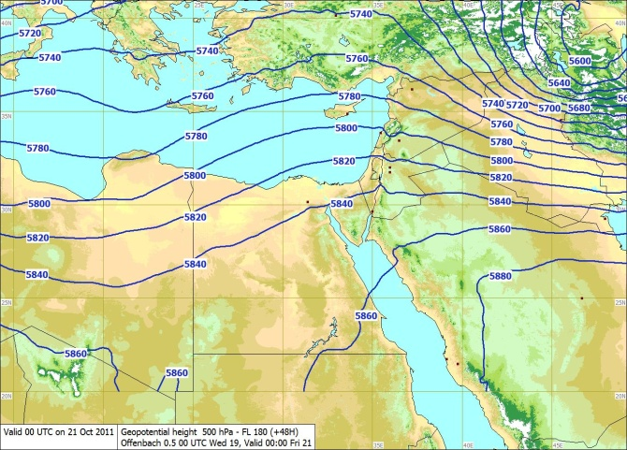
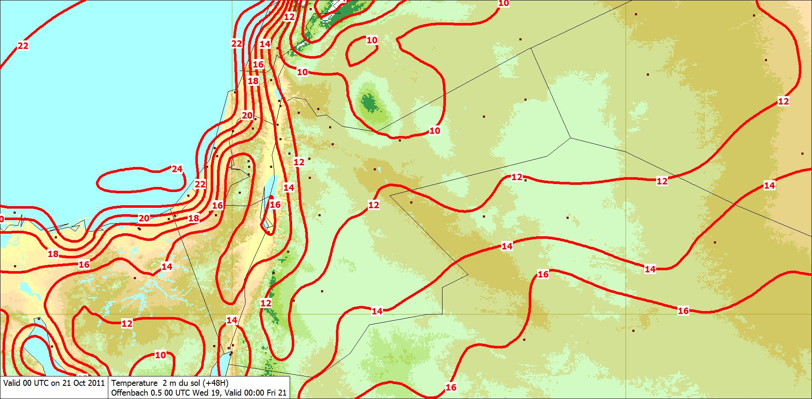
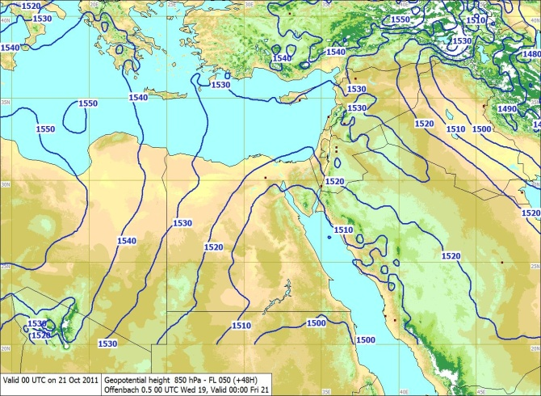
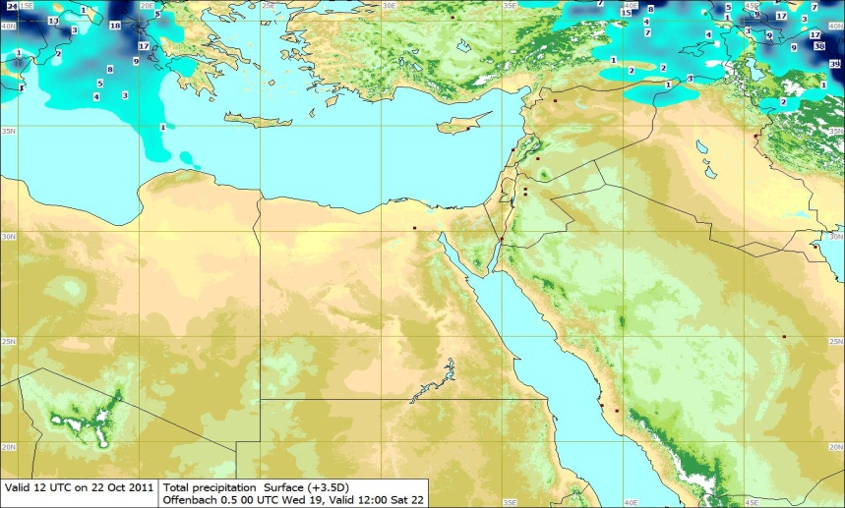
JMD Operational components
Forecasting Facilities
(1 Main Forecasting Center and 6 Class ² Forecasting offices)
The raw data and products ( GRID, GRIB, T4 ) are received from Global and Regional centers ( Offenbach, Toulouse, Braknell ...)
and from JRM (HRM) regional model (new)
Data Processing
Jordan Meteorological Department (JMD )

Slide 17
JMD Operational components
Telecommunication sys ^{@ NFC}
SDUS, PDUS ,HRPT,SADIS,MDD (old)
MESSIR :Communication and processing data systems( AMSS / RETIM )
MSG-1 reception station (new)
Data Processing
Telecommunication sys ^{@ HQ}
Leased lines :-(2^{MB}) ^{head quarter} , (1^{MB}) ^{NFC}
Networking :
Archiving Network.
Climate Network.
Intranet.
Internet.
A-VPN:
10 Stations.
IP-VPN:
One line.
Operating Systems:
Windows.
Linux.
Applications:
Oracle Application Server.
Oracle Data base 9i /10g
RegCM
R
Web Site Hosting.
Anti-virus Software.
IVR
Jordan Meteorological Department (JMD)

Slide 18
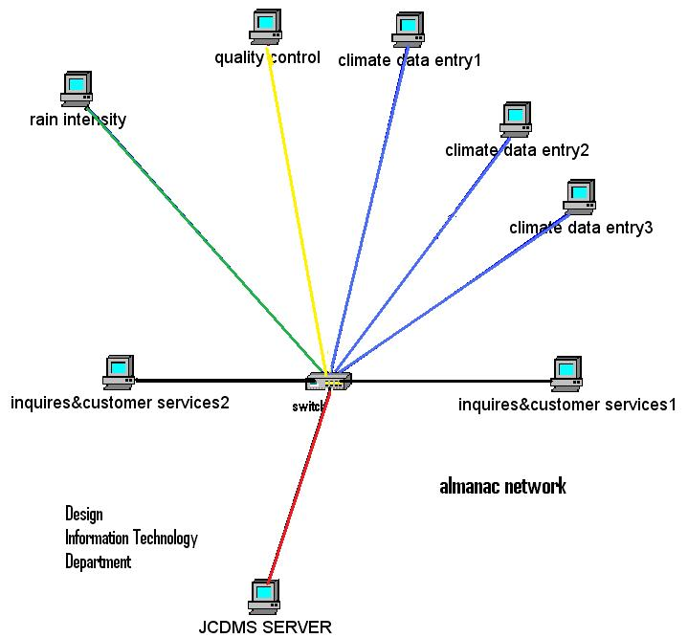
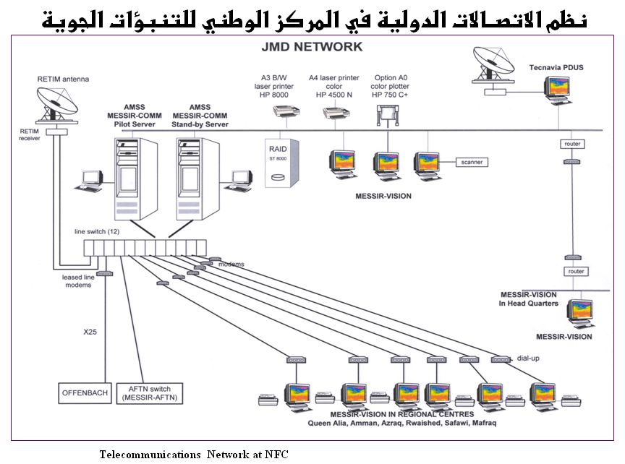
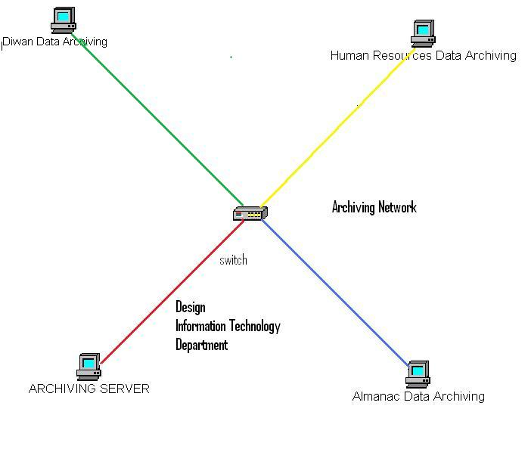
Climate Data
Archiving network

Slide 19
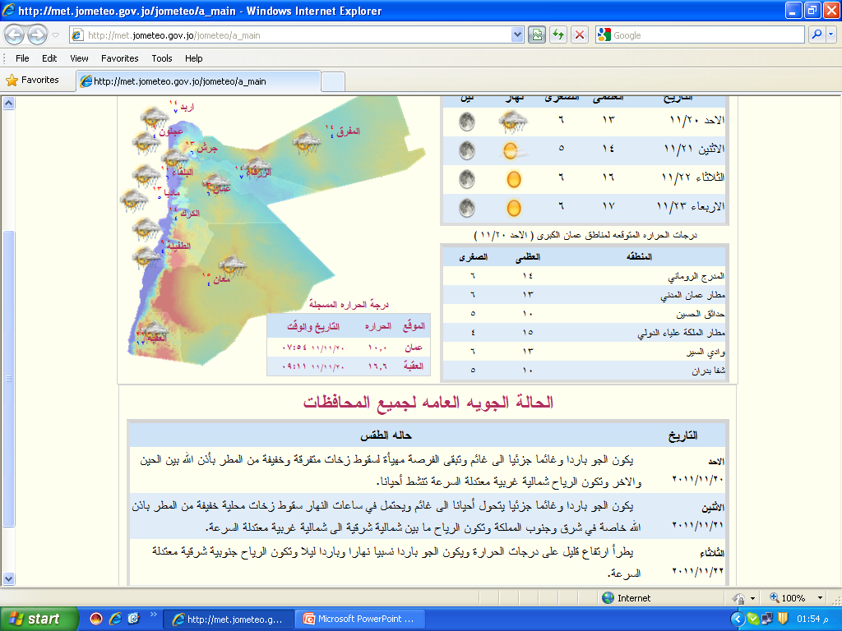
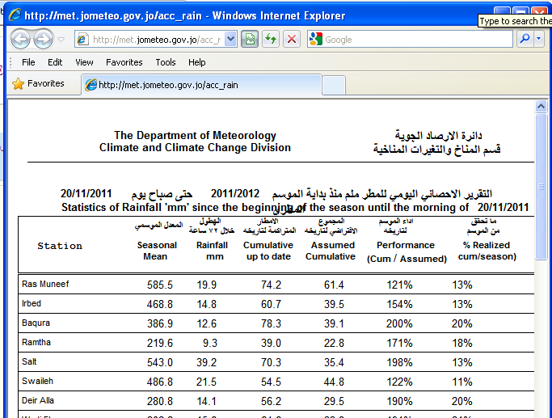
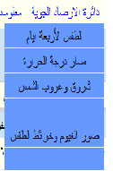
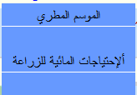
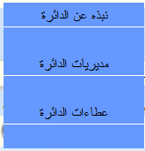
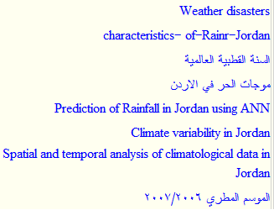
JMD ^{Home Page}
http://www.jometeo.gov.jo

Slide 20
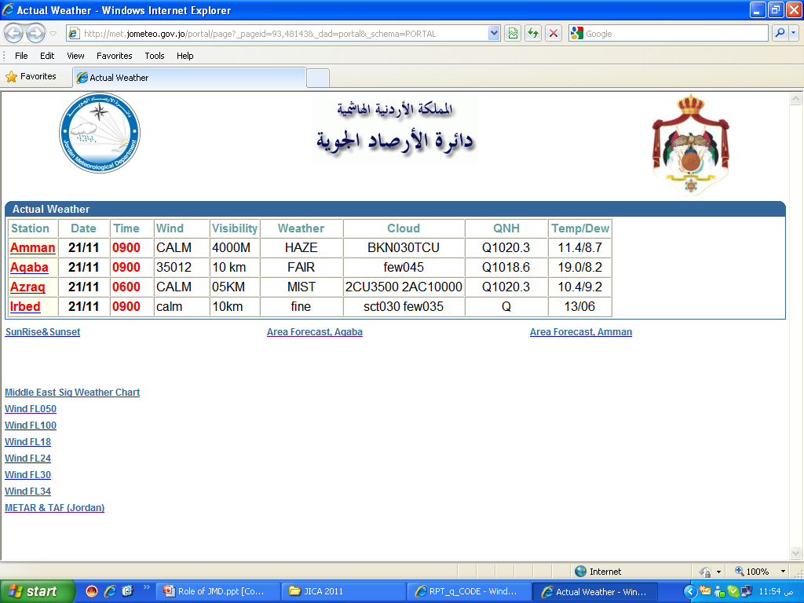

Slide 21
JMD Operational components
Climate Data Bank ^{@C & CC}
“JCDM”“
checking
Readable format
QC-procedures
database
Data archiving
Data retrieval
Data Analysis
Quality control
Data and information Representation
Data Processing
precipitation
clouds
Sun duration
evaporation
radiation
dew
Temp (max,min,dry &wet temp,
Grass temp,soil temp at 1,5,10,50,100 cm)
pressure
Relatively humidity
wind
Measured Data
Climate Division
Forecasting Center
Jordan Meteorological Department (JMD)

Slide 22
Measured Data
Forecasting Center
Climate Division
history
Earliest Data Record: 1923
Data archiving and retrieval
Data processing (statistics, display,..)
Quality control
Climatological Data:
actual data
Daily
Synoptic
Upper air data
Derived data
Monthly
Normals
Extremes
JCDMS Oracle
Jordan Meteorological Department (JMD)

Slide 23
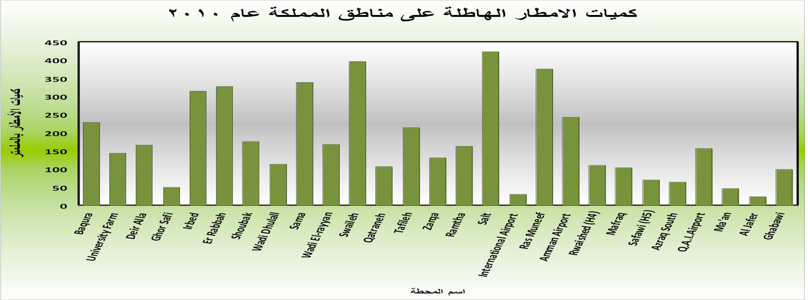

Slide 24
Observation Network
Forecasting Facilities
Telecommunication sys.
Climate Data Bank
Admin.
Staff administration & observers @ field
@ Field | @ Head Quarter | Staff #
6 | 5 | 1st U Degree
44 | 17 | 2nd U Degree
35 | 17 | Diploma
61 | 8 | High school
31 | 31 | others
2011 | 2010 | 2009 | year
252 | 261 | 256 | Staff #
3 | 10 | 14 | Retirement
- | 2 | 6 | Resignation
- | 1 | 3 | Loss function
3 | 13 | 23 | Sum
Jordan Meteorological Department (JMD)

Slide 25
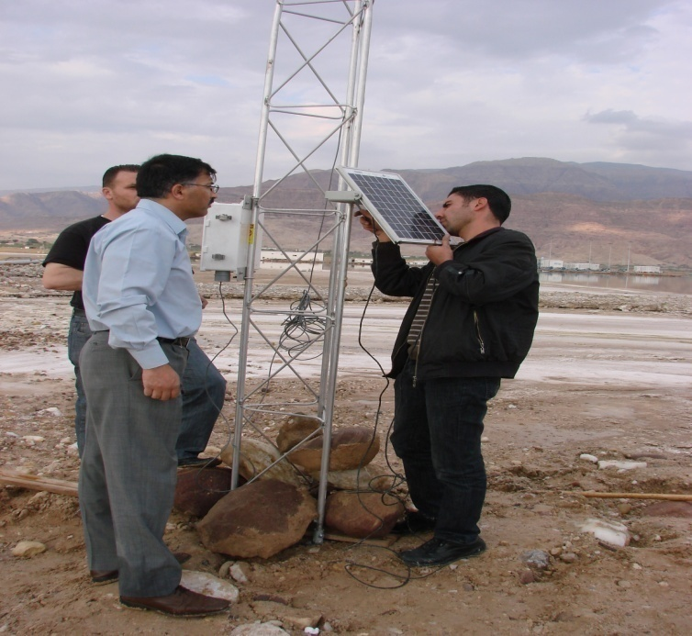
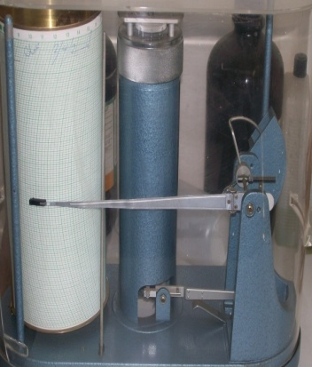
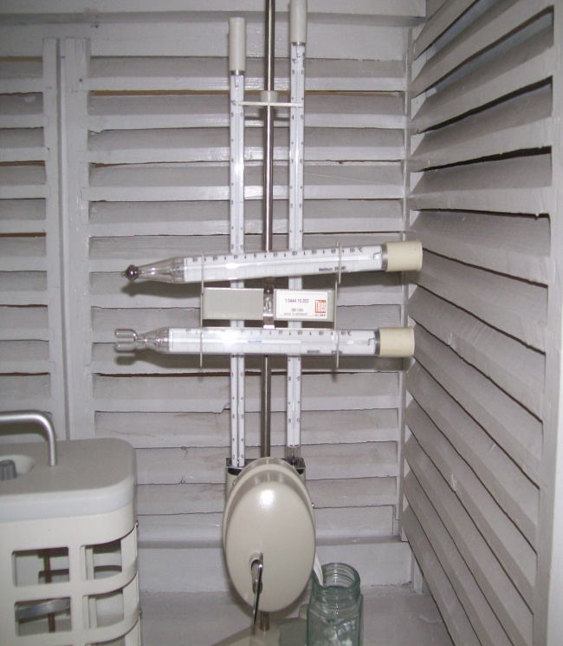
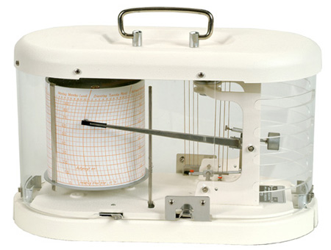
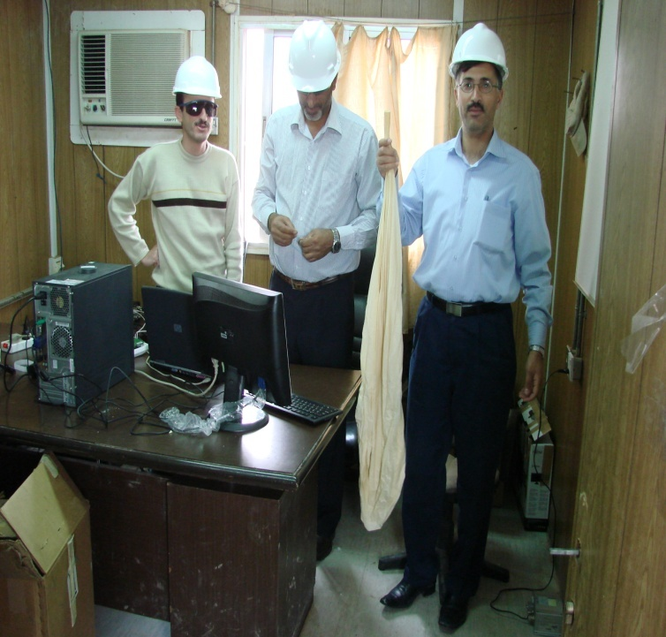
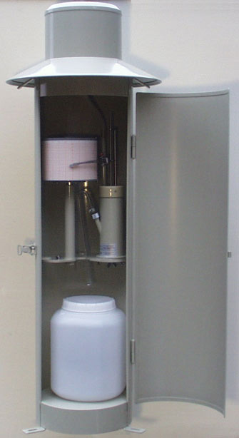
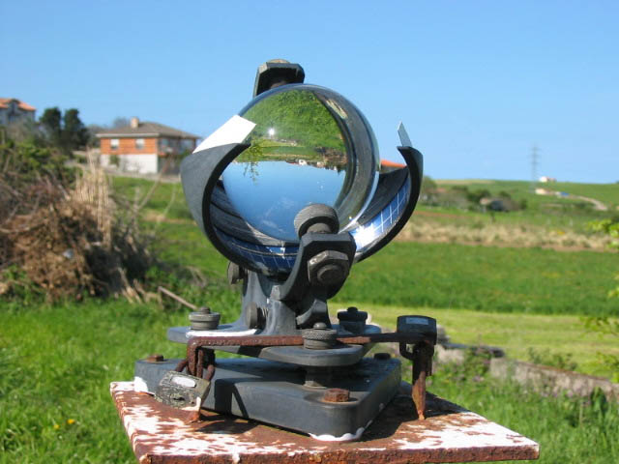
Calibration and Maintenance lab
Instruments
&
Maintenance
Instruments specification
Instruments installing
Instrument calibration
Software and Hardware maintenance
Infrastructure Maintenance

Slide 26
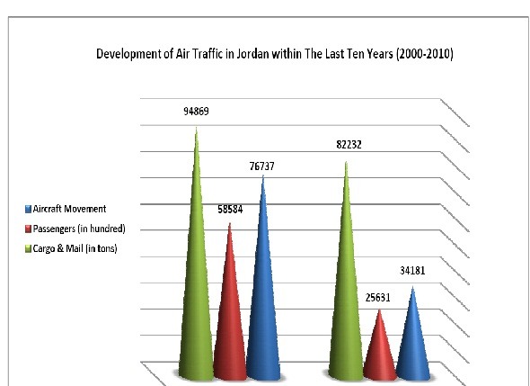
Our Strategy
Jordan Meteorological Department (JMD)

Slide 27
Services
Jordan Meteorological Department (JMD)

Slide 28
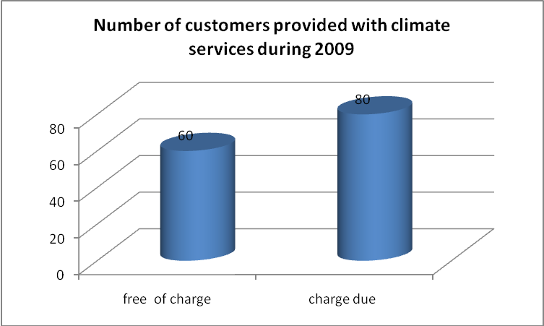
Climate Services
Jordan Meteorological Department (JMD)

Slide 29
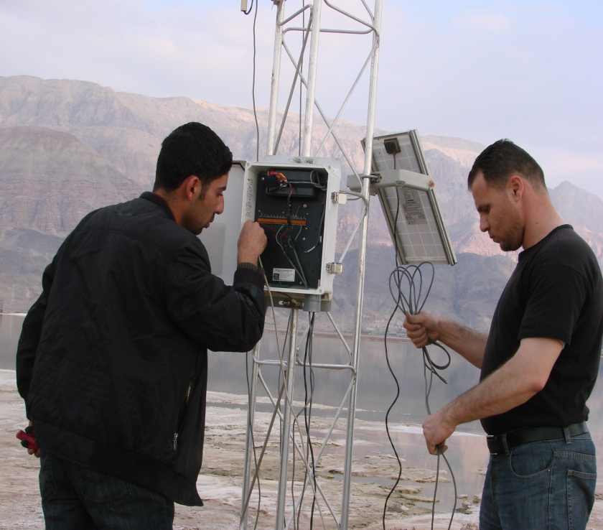
Achievements @National and international levels
commitment with WMO
MOU
Ministry of Water and irrigation
^{Arab Potash Company}
^{Central} ^{Electricity Generation Co.}
Japan International Cooperation Agency
Jordan Meteorological Department (JMD)

Slide 30
On-Going Activities
Advanced training, rehabilitation or construction of flow measurement, monitoring and climate stations.
Purchase and installation of measuring and transmission equipment, additional equipment, and laboratory equipment.
Improvement of measurement networks in selected areas (pilot projects).
Database enhancement, extension of decision support systems for climate and climate change.
updating the WEB site
Updating dept. legisliation System
GIS Data Portal
Rainfall Enhancement projects
Climate Change Modeling
Seasonal forecast
Jordan Meteorological Department (JMD)

Slide 31
Challenges and Future Perspectives
Contribute to the advancement and application of atmospheric and hydrological sciences and new technologies
Assist and train Staff in strengthening their capacity to meet national, regional and global needs
Ensure coordination in meteorology and operational hydrology at the national level and support similar efforts by other involved services at the national level
Contribute to addressing socio-economic sustainable development challenges
Jordan Meteorological Department (JMD)

Slide 32
Thanks
V
Your Attention
Jordan Meteorological Department (JMD)

