Slide 1

Impact-based Forecast and Warning Services
Curacao, October 2016
Haleh Kootval
Chief, Public Weather Services

Slide 2
The Presentation Will Cover
The case for Impact-based Forecasting
Why good forecasts result in a poor response?
Forecasting impacts
Risk Matrix
Recommended elements of Impact Forecast and Warning Services
WMO actions
Conclusions
2

Slide 3
The Case for Impact-based Forecasting
Traditionally, NMHSs focus is on what the weather will be, not what the weather will do
NMHSs produce reliable, accurate and timely warnings in support of safety of life, livelihood and property
Yet, many people still die, losses continue to rise
  In part due to lack of understanding of impacts of hazards
Governments and public: need to know impact of hazards on lives, livelihood, property and economy
How should WMO Members solve this problem?
CBS directed the WMO PWSP to initiate addressing the issue
Notes:
I have altered the indenting a bit here…

Slide 4
Why good forecasts result in a poor response?
Numerous examples of good forecasts but underestimated impacts and inadequate response
Super-typhoon Haiyan (Yolanda): Philippines - >6000 fatalities, >28000 injured, >1700 missing, >1.6 million affected and >US$ 827 million damage to agriculture and infrastructure
Accurate warnings issued (rain, wind)
Good indication of storm surge
Not enough knowledge of storm surge impacts

Slide 5
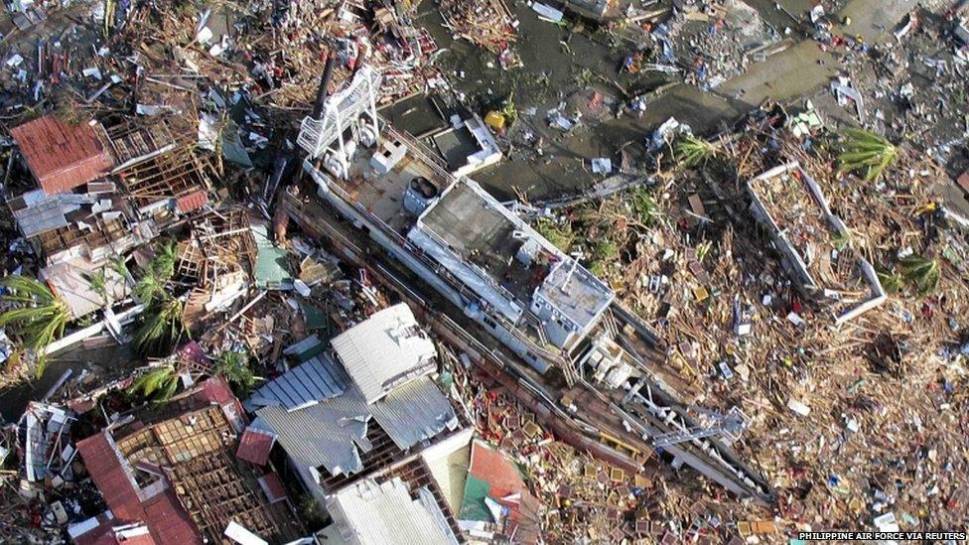
Typhoon Haiyan

Slide 6
What worked, what didn’t?
Good track and intensity forecasts well in advance
Warnings issued at provincial level
Government was engaged and committed
Coordination at local level ok
NDRRMC embeds PAGASA staff (2 days before landfall)
Good policies and laws guide DRM and PAGASA
Good observing network
First responders in place in advance
Warnings not understood; did not trigger life saving actions
Risk of storm surge not understood or underestimated
Inundation distance 1-2 km; people needed several hours in poor weather conditions to evacuate – many didn’t
Emergency preparedness is decentralized – Local Gov. Units receive same info. but act differently
Bulletins were made manually and prone to errors and delays
Weather models and other hazard models not coupled
Notes:
Note one island successfully evacuated all 1000 residents because they were well prepared thanks to local government.

Slide 7
What worked, what didn’t?
Good track and intensity forecasts well in advance
Warnings issued at provincial level
Government was engaged and committed
Coordination at local level ok
NDRRMC embeds PAGASA staff (2 days before landfall)
Good policies and laws guide DRM and PAGASA
Good observing network
First responders in place in advance
Lack of scientific and technical capacity to translate hazard information into impacts – therefore, impacts underestimated
Lack of appreciation and utilization of available hazard maps at local level for extremely severe storm surge resulted in evacuation to unsafe shelters that got destroyed
Inconsistency in interpretation of information from different sources delivered through multiple channels contributed to public and responder confusion

Slide 8
What worked, what didn’t?
Good track and intensity forecasts well in advance
Warnings issued at provincial level
Government was engaged and committed
Coordination at local level ok
NDRRMC embeds PAGASA staff (2 days before landfall)
Good policies and laws guide DRM and PAGASA
Good observing network
First responders in place in advance
UN system did not sufficiently preposition resources
Delayed effective response due to slow deployment of army and police
Cultural habits and beliefs may have contributed to inadequate response by public
Lack of engagement of social sciences to understand behaviors and decision making by public
Limited and inadequate shelters resulted in people refusing to evacuate
Loss of communication resulted in underreporting loss of life and injuries

Slide 9
Storm surge - existing limitations
Lessons learned
  Storm surge hazard maps and inundation information was of low resolution
  Limited capacity and capability to forecast the extent and speed of the storm surge
  People didn’t understand what a storm surge was, were caught unaware by the severity of the surge and struggled to protect themselves against the impact
  Communication and dissemination systems, networks and processes failed in places during and after Haiyan
  Some people chose to ignore warnings for fear of losing properties to looters and some chose to take action by evacuating to safe centres that were not resilient to the storm surge.

Slide 10
Why good forecasts result in a poor response?
  An accurate and timely weather warning does not guarantee safety of life or prevent major economic disruption
  Weather models and other hazards models not coupled (landslides, storm surge)
  Lack of scientific and technical capacity to translate hazard information into impacts – therefore impacts underestimated
  Inadequate communication channels, which can fail during the event
  Lack of appreciation and utilization of available vulnerability information (Maps) at local level; not shared / not routinely updated and not digital
  No effective decision support system

Slide 11
How can science deliver the last mile?
Institutional strengthening and improving observing and forecasting systems are necessary but not sufficient prerequisite to reduce impacts
Need to understand why people do not move to safety when a warning is issued?
Is it because:
  They do not know of the danger?
  They know it but choose to ignore it?
  They do not understand the scientific language?

Slide 12
Forecasting Impacts
12
Forecasting impact is more important than pure met forecasts: they are more readily understood by:
  Those at risk and;
  Those responsible for mitigating those risks
Meteorologists often are reluctant to, or cannot, forecast impacts due to lack of vulnerability or exposure data
  Extensive knowledge of vulnerability and exposure are needed but often not easily accessible by meteorologists
Without this knowledge impact forecasting is not possible
  Example - Flood forecasting: additional data required
    Ground cover, run off, topography, roads and infrastructures, time of day and traffic conditions, crowd sourced information
  The data allows risks of impact to be forecast and warnings issued targeting those exposed to hazard
  Authorities can take specific actions: safe routes, closing schools and offices etc.
Notes:
May be need to add cannot forecast impacts. If they don’t have the vulnerability and exposure data…

Slide 13
Risk Matrix
Identify likelihood of event and potential impact
Likelihood relates to uncertainty (location or severity of event)
Impact relates to vulnerability and exposure
13

Slide 14


Risk Matrix
 | HIGH
 | MED
 | LOW |  |  | X
 | VERY LOW
 |  | VERY LOW | LOW | MEDIUM | HIGH
 | IMPACT
LIKELIHOOD
Green: No severe hydrometeorological hazard is expected
Yellow: Be aware
Orange: Be prepared
Red: Take action
Assign a colour to the warning which is a combination of potential impact and likelihood (source: Met Office)
14

Slide 15
Recommended Elements of Impact-based Forecasts and Warnings
1. Partnerships
  Main key and also challenge: NMHSs need to work in partnership with other government agencies,(emergency response, mapping agencies, transport), international bodies, scientific institutions, NGOs, and local communities
  Data sharing among different agencies and departments vital (demographic, GIS and mapping, economic etc)

Slide 16
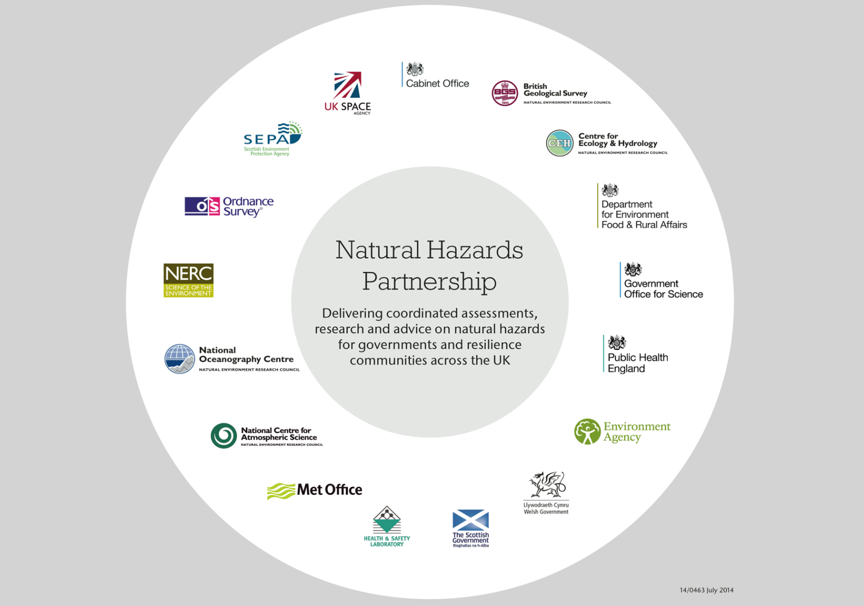
Partnerships
Example:
Natural Hazards
Partnership (UK)

Slide 17
Recommended Elements of Impact-based Forecasts and Warnings
2. Development of Information and Services
  Jointly design and develop an impact-focused framework
    Link historical hydromet events with vulnerability, exposure and recorded impacts
  Develop an end-to-end approach to observing, modeling, and predicting severe weather and consequent natural hazards, through to impact
    Requires a multi-disciplinary, integrated endeavor to translate hazard risk into impact services and a validation process to assess benefits

Slide 18
Recommended Elements of Impact-based Forecasts and Warnings
3. Developing Capacity of NMHS staff and partners
  Identifying required competencies and skills
  Cross-training on requirements and procedures
  Educating users on the use of impact information

Slide 19
Recommended Elements of Impact Forecast and Warning Services
4. Validation
  Not only objective verification but assessing performance of an impact forecasting and warning system and services
  Agreed upon by all partners
  Systematic for significant events
  Regular meetings with stakeholders for comprehensive analysis of events (warnings to actions)
  Planned, trialed and operationalized improvements according to evaluation and feedback

Slide 20
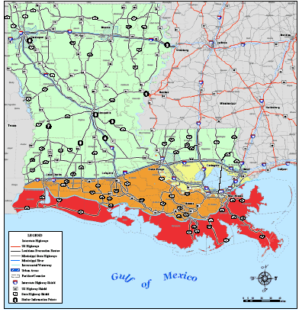
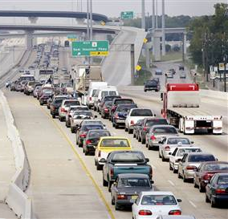
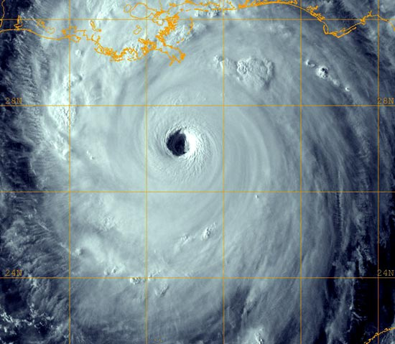
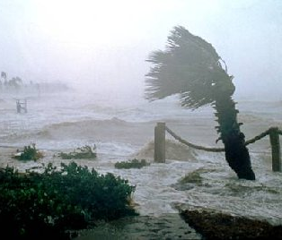
Coping with Hurricanes/Typhoons
Weather and
climate extremes
Weather
Translation to
hazards
Impact
Estimation
Reducing risk &
response
scenarios
Weather analyses
& forecast data
Extraction of
relevant information
to predict hazards
Placing into
situational context
Mitigation strategies
Affected population
& infrastructure,
disruption of services,
damages due to wind
& water, etc.
Hurricane track,
size, & intensity
Storm surge, flooding,
inundated areas
Implementation of
evacuation &
recovery plans

Slide 21
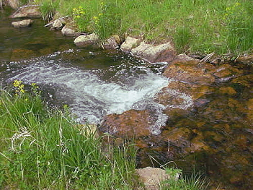

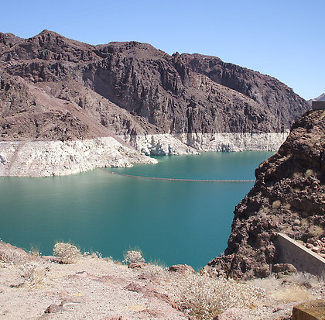
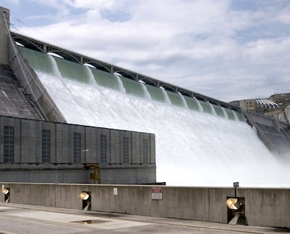
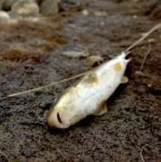
Water Resources Management
Weather and
climate extremes
Weather
Translation to
hazards
Impact
Estimation
Reducing risk &
Response
Scenarios
Weather analyses
& forecast data
Extraction of
relevant information
to predict hazards
Placing into
situational context
Mitigation strategies
Rainfall (or lack thereof)
Runoff & flow into
reservoir, water
levels behind dam
Controlled release of water
& timing thereof
Dam overflow, water
rights, or minimal
streamflow for fish

Slide 22

WMO Actions
CBS/OPAG-PWS produced in 2014
“WMO Guidelines on Multi-hazard Impact-based Forecast and Warning Services” publication (WMO-No. 1150)
Notes:
Notes
WMO, through the PWS programme, has published the “WMO Guidelines on Multi-hazard Impact-based Forecast and Warning Services”. Members are strongly encouraged to make use of this publication as a tool to enable them develop and provide impact-based forecasts and warning services.

Slide 23
WMO Actions
Over the past two years introduction to impact-based forecasting have been made at various PWS Stakeholder Workshops, based on the Guidelines
Some regions or individual NMHSs more receptive than others
Projects on Impact-Based Forecasting piloted in Mozambique, Myanmar and Mauritius since 2014

Slide 24
WMO Actions
Future pilots 2016: Maldives, Curacao
PWS ET/IMPACT established under CBS
Main task: Preparations of an implementation strategy based on the WMO Guide to help Members on practical steps
Integration of social sciences
Engagement of stakeholders to establish concrete requirements
Two-way collaboration between research, technology and science communities
Review of PWS Competency Framework

Slide 25
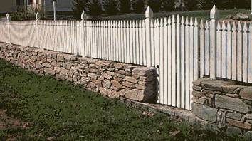

Throwing over Fence
Weather
User
Public Safety
Recreation
Transportation
Utilities
Construction
Agriculture
Emergency
etc.
Forecast Products
Decision to be made
Effective forecasts have to be tailored to specific user needs
Curtsey of Dr. Matthias Steiner of NCAR
Notes:
What is solution ？
Of course, throwing forecast over fence (or putting it on website) isn’t solution.
One solution fits all needs doesn’t exist,
Forecat should fit each user application (i.e., extract what matters to decision making process)

Slide 26
Operational Shifts needed
Phenomenon-Based Forecasts
Impact-Based Forecasts
Products-Based Services
Decision Support Services
Meteorological Threshold-Based Warning
Impact Threshold-Based Warning (Risk based warning)
Deterministic (best forecast)
Probabilistic (uncertainty range)
underway
Notes:
So , we need some operation shifts：
That is,
Phenomenon-based forecast to impacted-based forecast
Product-based service to decision support services
Meteorological threshold based warning to impact threshold based warning or risk-based warning
Currently, in the operational community, more and more probabilistic forecasts products are generated,
There is a transition from deterministic (best guess) to probabilistic forecasts (ensemble forecast) taking place.
This provides a good opportunity to generate impact-related information by using ensemble forecasts.

Slide 27
Next Steps for WMO
  Issues for impact-based forecasting varied and complex: require planning on many levels, and are not an easy option
Not enough to sell the concept to practitioners
Need to bring on board and convince the top management
Need to conduct more training and stakeholder workshops at country level
Initiate new pilots in more countries and regionsfor practical demonstration of the concept
Help mainstream the pilots into operational routine

Slide 28


Slide 29
Conclusions
Despite our best efforts natural hazards often become human disasters
Why?
          Inability to communicate warning information
          Warning information is not sufficiently specific – in time, space and impact
Need
          Better observations of small scale events
          More specific forecasts of small scale events
          Detailed dynamic exposure and vulnerability information –space and in situ observations
          Closer operational ties between NMHSs and DRR agencies
          Multi hazard warning systems
          Impact forecasts

Slide 30
An accurate and timely warning does not guarantee safety of life or prevent major economic disruption

Slide 31

Thank you
Merci

Slide 32
Users want to know – as precisely and as early as possible – the future course of the weather
Our main goal is to fulfill this task as best as we can…
…but we will never be perfect!
The knowledge about shortcomings / uncertainties can be of great value
To know what you know and to know what you do not know, that is real knowledge, Confucius (The Analects) 知之为知之，不知为不知，是知也.
The communication of uncertainties can mitigate negative impacts…
…but only if users know how to incorporate this information!
A big gap between potential and actual value of forecast information, and an even bigger gap between potential and actual value of uncertainty information

Slide 33
Weather Translation & Integration Concept
Weather Information
Weather Translation
Impact Estimation
Response Scenarios
Weather analysis
& forecast data
Extraction of relevant information
Placing into situational context
Mitigation strategies
Weather-impacted user
Weather Information provider
Some examples:
Airport operation | Ceiling & visibility (flight categories) | Reduced capacity (arrival rates) | Ground delay programs
Dam operation | Precipitation & runoff (water level) | Overflow or breaking, minimal discharge | Controlled release of water
Power plant operation | Winds below/above critical thresholds | Reduced power generation | Balancing grid with other power sources
Curtesy of Dr. Matthias Steiner of NCAR
Notes:
This shows a schematic plot of weather translation & integration concept proposed by Dr. Steiner.
First of all, you have weather information such as analysis and ensemble forecast data
Then extract relevant information from each ensemble (for example, ceiling & visibility for airport operation,
Precipitation and runoff for Dam operation, winds below/above critical thresholds for power plant operation )
Third, put the relevant information into situational context to estimate impact (for example reduced fight arrival capacity in terms of percentage),
Last, carry out mitigation strategies based on estimated impact information (e.g., ground delay programs etc.)
During whole process, as indicated by these two triangles, the impact of weather information provider becomes smaller and smaller, and the one of user becomes larger and larger, but the most of part is a jointed effort of both forecasters and users.

Slide 34
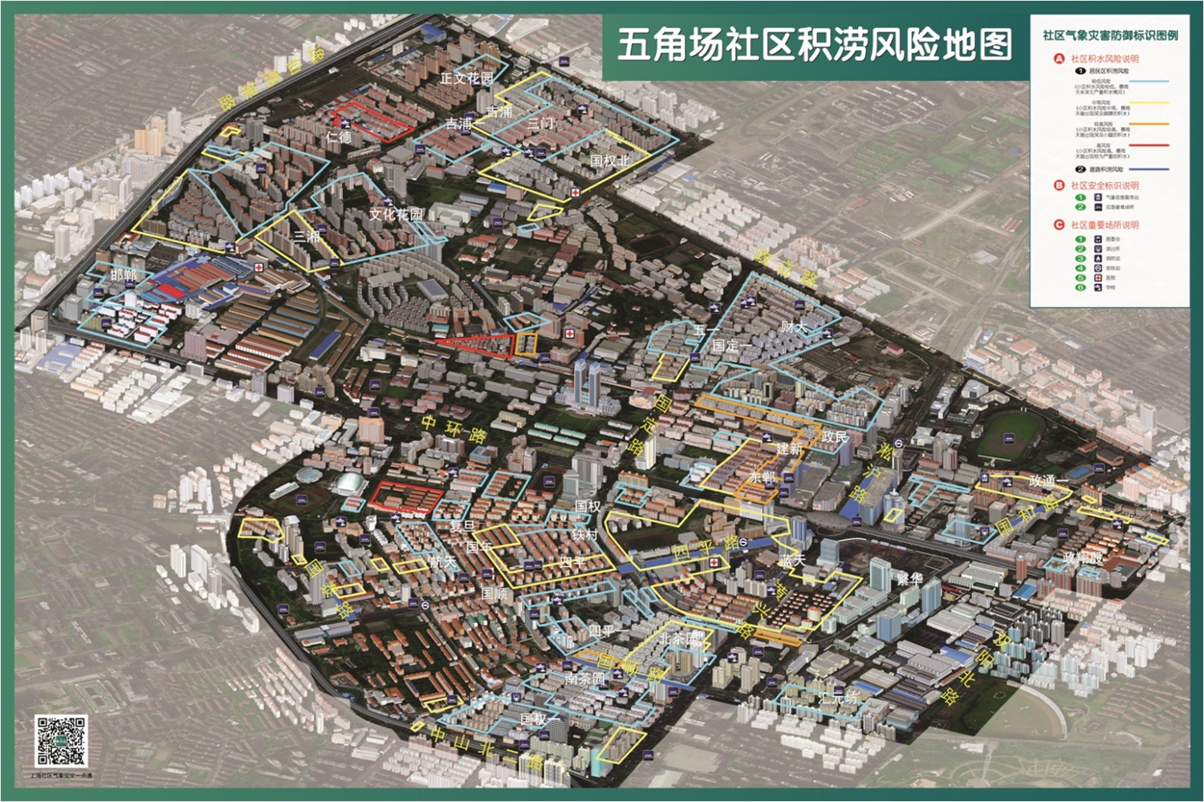
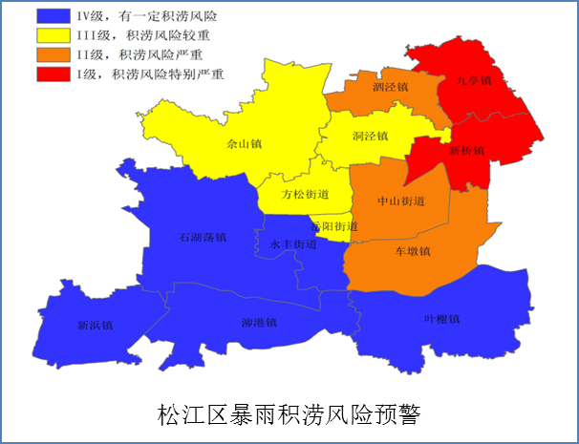
Framework of IBF&RBW for Urban Flooding
Rainfall Forecasting
Radar QPF/QPF
Rapid Refresh
HR ensemble
Observation
0-1h forecast
Every 6-min
1-12h forecast
Every 1h
12-120h forecast
Every 3h
Accumulated rainfall every 1 h
Real-time，future rainfall
Field survey of disaster and verification
Impact-based Forecasting
Urban flooding assessment Model
Community flooding risk database（residential area、roads、schools etc.）
Location or area、intensity and duration
Risk Assessment
Community flooding risk database
Risk-based Warning
Risk-based Warning Product
Flooding Risk Warning
Manual Adjustment
Multi Hazard Monitoring and Risk Warning System
Cellular
WenChat
Terminal
Large Screen
Joint Response
Joint Response
措施预防
防汛抢险
灾后救助

