Slide 1

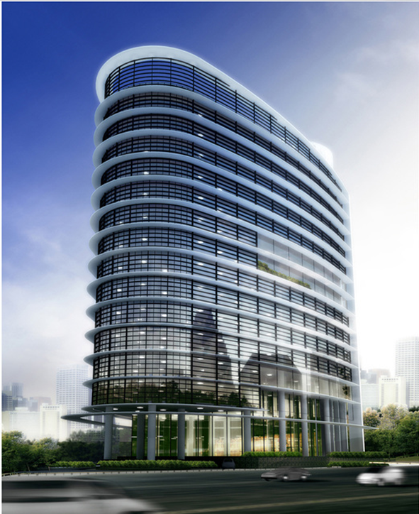
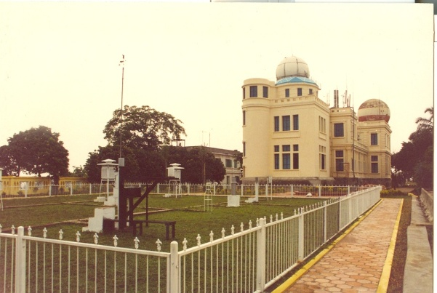
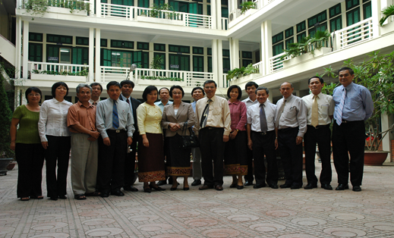
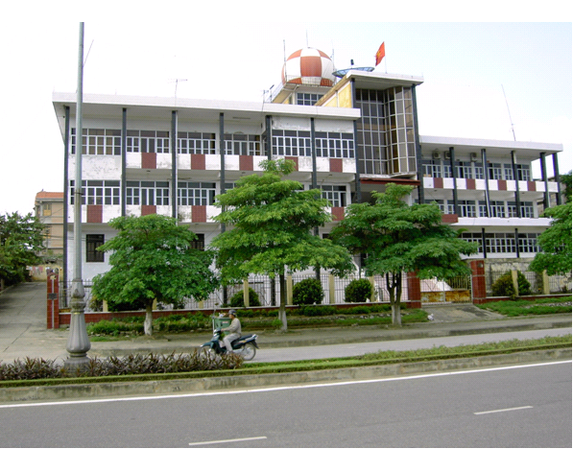
Viet Nam Meteorological and Hydrological Administration on weather warning dissemination activities
Vientiane, 25 February, 2019

Slide 2
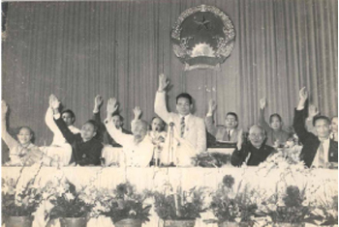
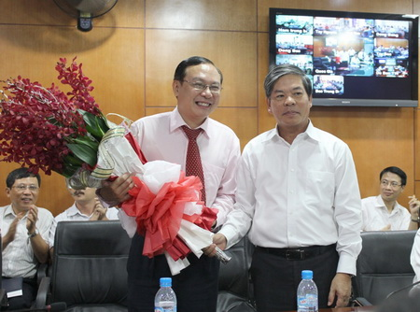

1956
23 Jan. 2018
11 Nov. 2002
5 Jun. 1956
14 Oct. 1975
18 Apr. 1891
16 Sep. 1902
Established the MONRE, rename to HMS
Re-established VNMHA, under the MONRE.
Re-established HMA from MA and Hydro. Dept., Ministry of Water Resources.
HMA established, directly under the PM office
Indochina observatory at Phu Lien, Hai Phong city
First Met. Station established in Nam Dinh province.
2018
1902
Notes:
New building: pp working, centres functioning

Slide 3
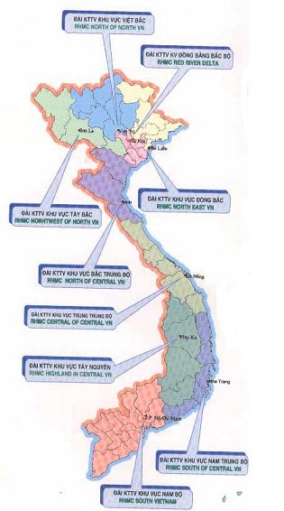
ADMINISTRATION
MONRE
9 Regional Centers
Assistant Offices
VNHMA
Administration
Finance and planning
Personnel
S&T and International cooperation
Network Management
Forecasting Management
Institutional units
National Centre for Hydro-Met. Forecasting
Hydro-meteorological Network Center
Hydro-meteorological Data and Information Center
Project Management Office
Aero-Meteorological observatory
Center for Application of Hydro-Met. Technology
Hydro-Meteorology Survey Detachment
Notes:
3038 pp over the whole country
* More than 600 forecasters,

Slide 4
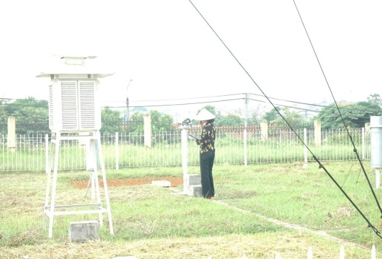
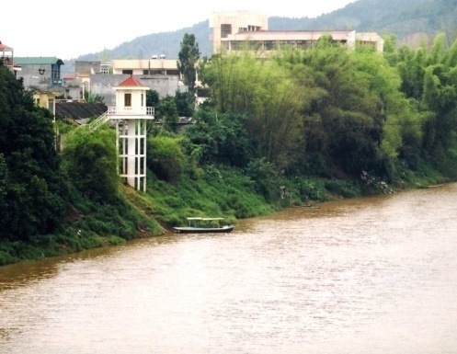
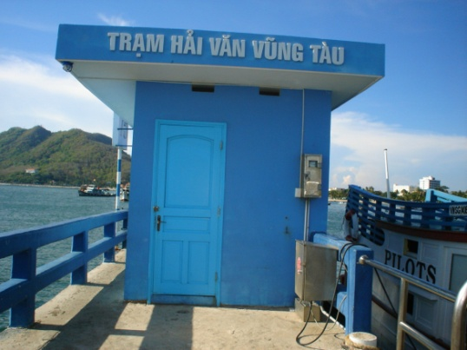
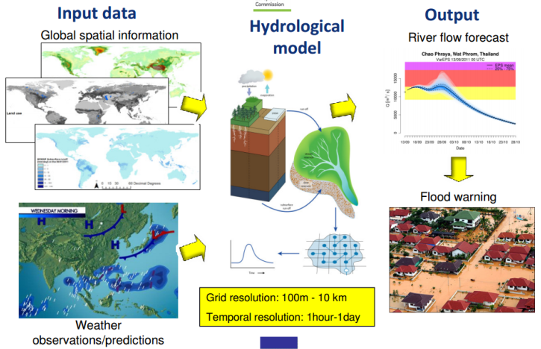
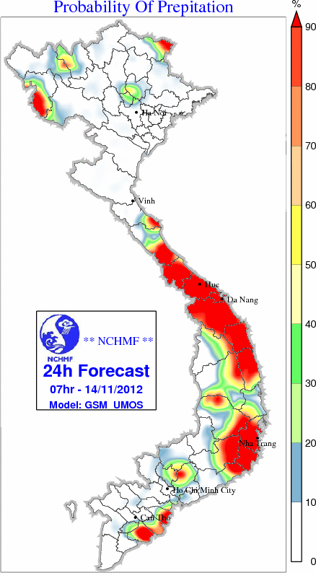
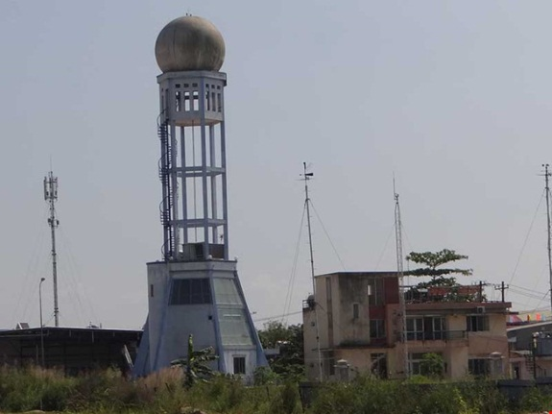
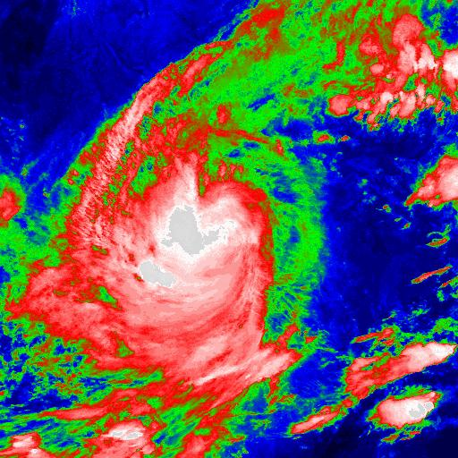
OUR MAIN MISSIONS
State management and Implementing the Law
Managing, exploiting the national Hydro-Met station networks
Carrying out observations on air and water environment, lightning detection, Climate change
Natural Hazard
Forecasting and warning
Supply the public and private services
Notes:
is the organisation chart of HMA and NCHMF of Vietnam

Slide 5
FORECASTING AND WARNING
Forecasting system
3 Levels
Natural Hazard
Forecasting and warning
Information Distribution
National Centre
Supply the public and private services such as
Disaster management agencies
Central/local Government Org.
Media (TV, radio)
Website/ SMS
Community
Tropical cyclone
Heavy rainfall
Thunderstorm
Hail, Gust wind
Extreme hot/cold
Flood, Flash flood, landslide
Drought, salinity intrusion
Storm surge
Dry spell
9 Regional Centres
54 Provincial Centres

Slide 6
HYDRO-MET WARNING DISSEMINATION
- As regulation on: Law of natural disaster prevention and preparedness (approved in 2013); Law of hydro-meteorological (approved in 2015), VNMHA (MONRE) to provide the hydro-meteorological, marine forecasts and warning to promote the natural disaster prevention and preparedness, social-economic development, national security and defense as follow:
1. The hazardous weather warnings are transmitted to Central Steering committee for natural disaster prevention and preparedness and government authority
Notes:
1. Example for the hazardous weather as tropical cyclones, heavy-rain, cold surge; storm surge,..→ Steering to organize the meeting and to make the standardization of forecast warnings and transfer to the ministries and provincial level for Steering committee for natural disaster prevention and preparedness, national committee for emergency rescue and response by fax, dispatch or via the national disaster information center belong to MARD to the general public by internal chanel

Slide 7
HYDRO-MET WARNING DISSEMINATION
2. The hazardous weather, hydro-meteorological forecast and warning are broadcasted on the mass media:
- Public Media (Viet Nam Television; The Voice of Viet Nam, VoV news etc..) ➔ preparing the broadcast; news, video, live interview;
- Website and newspaper of government and others:
bulletin, publication, …
- Website of VNMHA (http://www.kttvqg.gov.vn) and NCHMF(http://www.nchmf.gov.vn/web/vi-VN/43/Default.aspx)
Notes:
Email to media
Telephone; Video call
Telegram for marine activities
Fax

Slide 8
HYDRO-MET WARNINGS DISSEMINATION
3. The hydro-meteorological forecasts and warning to provide the relevant social-economic sectors for specialized requirements.
➔Methods to transmit the hydro-meteorological forecasts and warning, via:
- Official letter;
Email;
Telephone; Video call;
Telegram for marine activities;
Fax;
TV Interview;
SMS
Notes:
Email to media
Telephone; Video call
Telegram for marine activities
Fax

Slide 9
HYDRO-MET WARNING DISSEMINATION CHALLANGES
1. The coordination mechanism among relevant ministries has not been linked, timely and overlapped sometimes;
2. Lack of synchronization of infrastructure in mountainous areas.
3. Unofficial resources of Forecasts and warnings by other website, journal agency;
4. Lack of government in budget for hydro-met and other activities;
5. Lack of the infrastructure for hydro-met activities.
Notes:
The coordination mechanism among relevant ministries has not been linked, timely and overlapped sometimes such as for transfer to public we have many meetings between MARD, MONRE, MOIT
2. such as the Internet, television system limited in the mountainous where the heavy-rain fall; flashflood, thunderstorm it seem as nomarly operation than other areas

Slide 10
HYDRO-MET WARNING DISSEMINATION GAPS
1. Lack of People's awareness and knowledge related to weather forecasts, warning role;
2. The quality of forecasts, warnings should to be enhancement and more accurateness;
3. Infrastructure server for the hydro-met warnings dissemination have not been synchronized and modernized
Notes:
2. , not really accurate because new technologies have not been applied in the short-term rain forecasting: nowcasting, rainfall;

Slide 11
HYDRO-MET WARNINGS DISSEMINATION GAPS
4. Technical language should to be reduced
5. The weather broadcast from mass media need to enhance the diversification and popularization.
6. Human resources need to be further developed.
7. Establishment the studio for VNMHA very necessary
Notes:
4. To make the common language of news before public to the community
5. For example, using common language, for newsletters to ethnic minority people, it is necessary to compile and interpret a variety of translations through local television channels. such as TV, vov ... need to build forecasts, alerts with easy-to-understand, specific illustrations, graphics or languages ​​to transfer to the users.

Slide 12
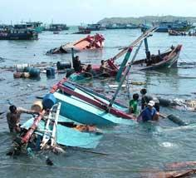

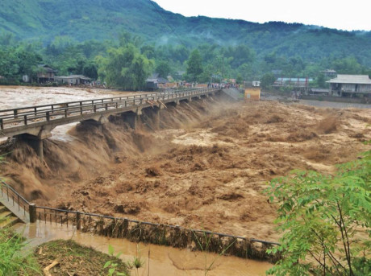
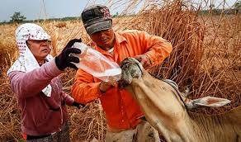
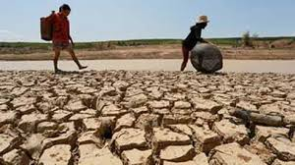
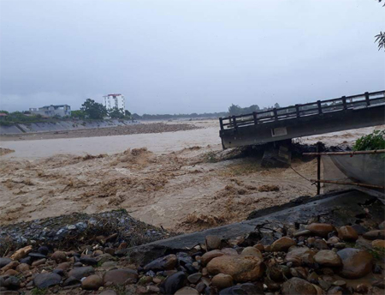


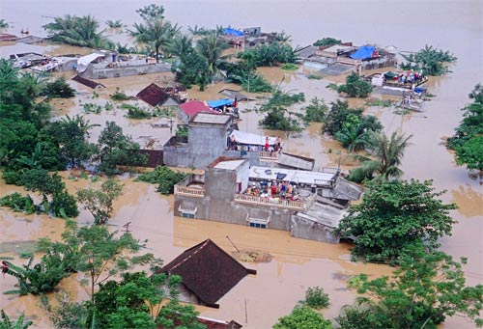
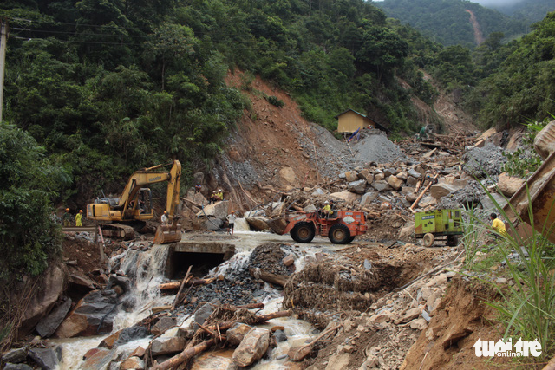
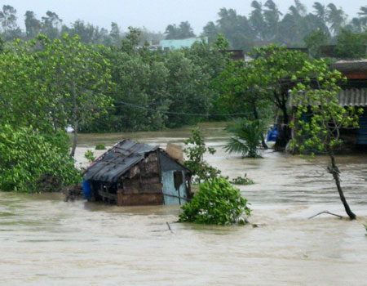
Thank you

