Slide 1
Impact Based Forecasting
Steps of Impact Based Forecasting
Delivered by Issa Lele Mouhamadou -
consultant to the Met Office under the ASPIRE
project

Slide 2

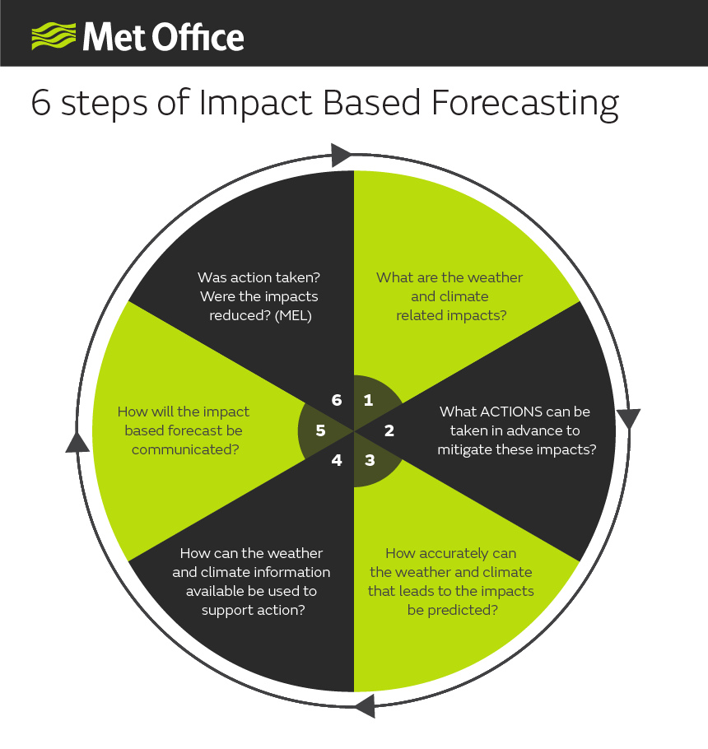
Quels sont les impacts liés au temps et au climat
Est-ce que les actions ont été menées? les impacts ont-ils été réduits?
quelles mesures peuvent être prises en amont pour atténuer ces impacts
Comment communiquer les prévisions basées sur les impacts ?
Avec quelle précision le temps et le climat qui engendrent ces impacts peuvent-ils être prédits?
Comment les informations météorologiques et climatiques disponibles peuvent-elles être utilisées pour prendre une action?
© Crown copyright 2018, Met Office

Slide 3
Impact Based Forecasting – Step 1
What are the impacts of severe weather?
What weather or hazard is associated with these?

Slide 4
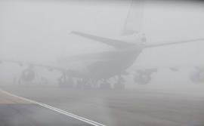
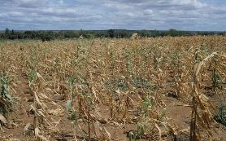
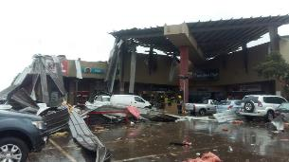
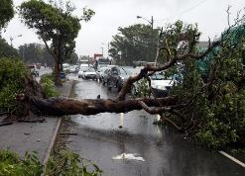
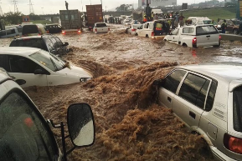
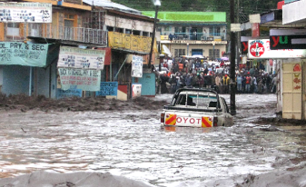
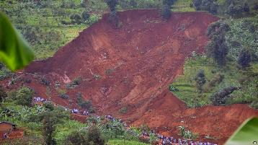
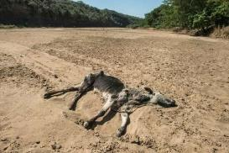
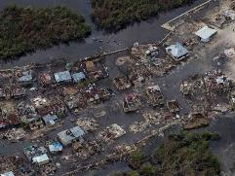

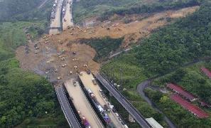
Historical data
Engage with users
Define Key Hazards

Slide 5
Identify focus stakeholders/
geography for
the IBF: whole country or just one region?
Understanding what other factors lead to impact (e.g. type of livelihood)
Collecting impact data - qualitative and quantitative
Engaging with stakeholders who understand impact
© Crown copyright 2018, Met Office

Slide 6
Exercise
Agree on a severe weather events that have happened in last 5 years in Niger and work in groups to create an impacts table (1 event each group). 30 mins

Slide 7
About the hazard (e.g. ‘flood):
Low impacts | Medium impacts | High impacts

Slide 8
Questions on exercise
Who would you need to engage with to get richer information/insight on the impacts?
2. What data sets are available on the impacts?
3. Apart from the weather, what other factors led to the impacts?

Slide 9
Impact Based Forecasting – Step 2
What is the potential to reduce these impacts (given perfect forecast information)?

Slide 10
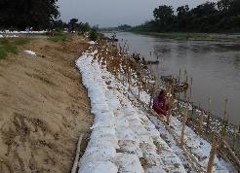
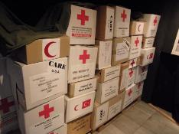
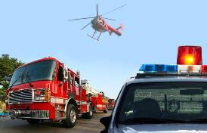
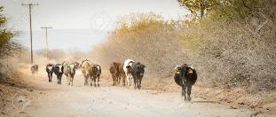
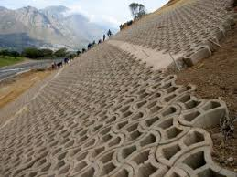
Who is responsible/mandated to take the action? E.g.. Government actors/NGOs/households?
How much lead time is needed to take the action?
What are the consequences of “acting in vain”?
What cooperation is needed between agencies to support action?

Slide 11
Exercise (in groups) 30 mins
Each group choose a different hazard (flood, drought, bush fire)
Think about what action could be taken in advance to reduce the impacts of the hazard
Who would take this action
How do they currently work with DMN?

Slide 12
Impact Based Forecasting – Step 3
How well can the hazard be forecast?

Slide 13
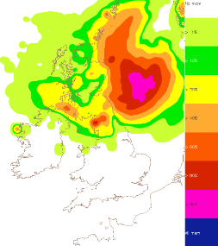
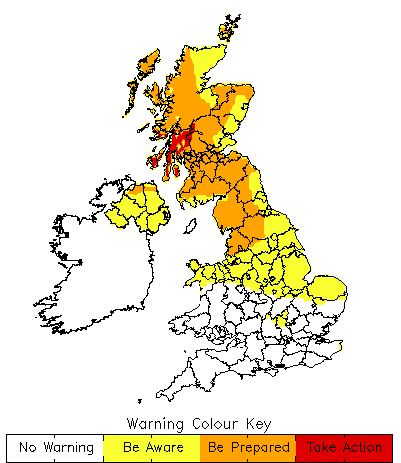
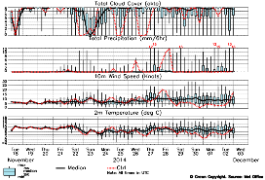
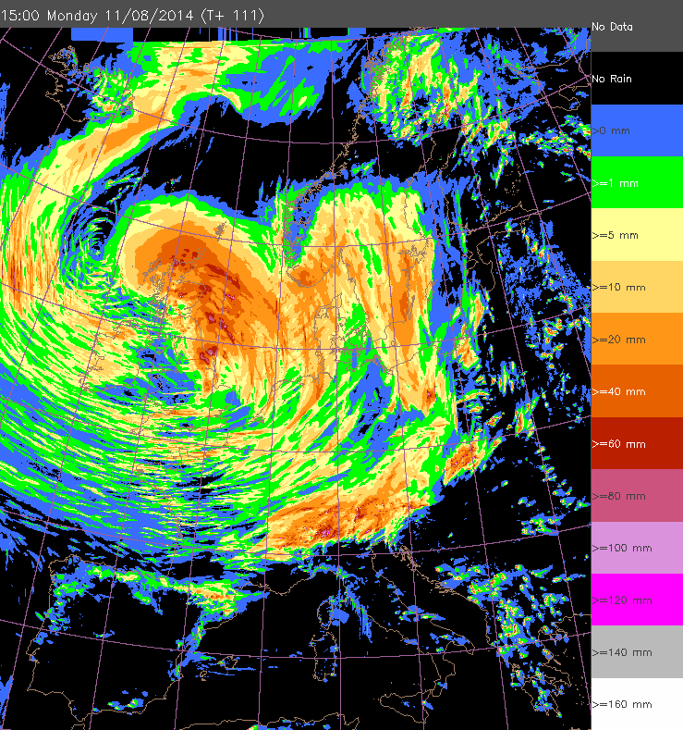
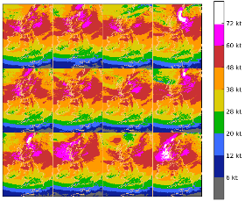
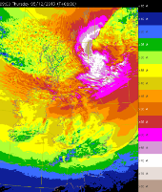
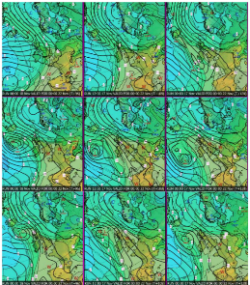
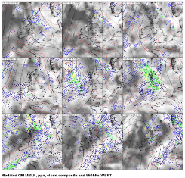
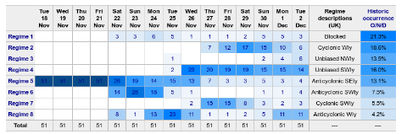
What services provided by NMS?
How accurate/
reliable are the forecasts?
Trust and Reliability
Research and Development
Cross-learning
What other forecast information are users accessing (e.g. FEWSNET etc)
What improvements are needed to the forecast ?
*NSWWS: National Severe Weather Warning Service
Notes:
In order to assess the likelihood of an event the Met Office uses a variety of numerical models including the Met Office’s Global Model, GFS and ECMWF’s global model as well as ensembles, first guess warning systems and regime analyses. The science of weather forecasting is mature, the models are skillful and verify well...

Slide 14
Discussion - probabilities (30 mins)
Do you use probabilities now? If so how do you decide on them?
Do customers understand probabilities/likelihood?
How does it add value to the forecast?

Slide 15
Discussion – accuracy & trust (30 mins)
What is known about the accuracy of DMN services? Has any verification work been undertaken?
What are levels of trust in DMN information among users/public?
What other sources of forecast information do people use?

Slide 16
Impact Based Forecasting – Step 4
How can this forecast information be used to support action?

Slide 17
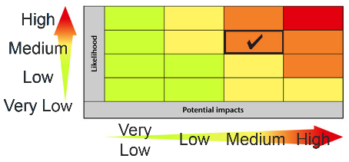
Agreeing IBF forecast frequency/update
Agreeing SOPs for actions linked to matrix
Developing impact matrixes

Slide 18
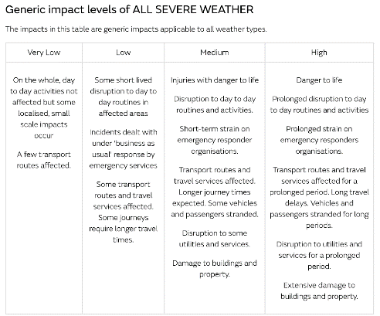
Risk Matrix – Impact Based Warnings

Slide 19
Impact Based Forecasting – Step 5
How can forecasts be disseminated and/or communicated?

Slide 20
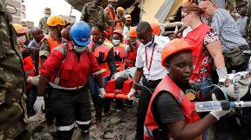

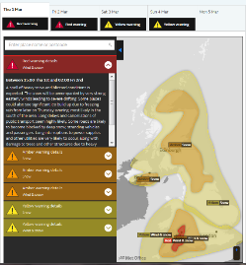
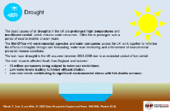
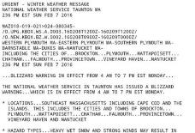
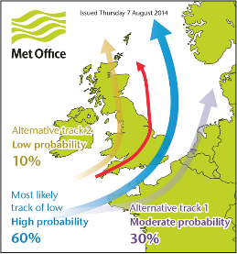
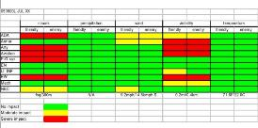
Engage and Understand Users
How do responders want to receive information (email/text/briefing)?
(for public) How will the IBF be communicated at the household level? (radio/sms/community briefing/flags)
What time of day do they need the information?
At community level, how will indigenous knowledge and communication support the forecast?

Slide 21
Impact Based Forecasting – Step 6
What action was taken based on the forecast?
What did it achieve?

Slide 22
What was the observed forecast accuracy?
For those who received the forecast, was action taken?
Did the action make a difference?
How can the value of the difference be measured?
How can the forecast/process be improved?

Slide 23
How IBF can help FbF
IBF can be applied to any hazard, any service, any lead time, any area, any asset.
Using the 6 Steps for IBF provides a formal framework for discussions with everyone – Met Services, Disaster Mangers, Public etc.
Increases understanding of hazards, impacts and what can be done with resource available.

