Slide 1
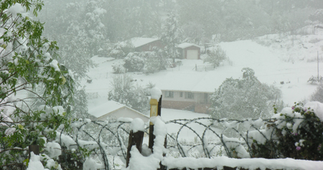
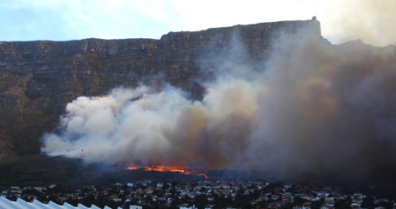
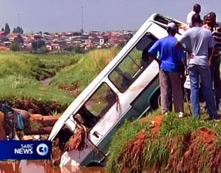
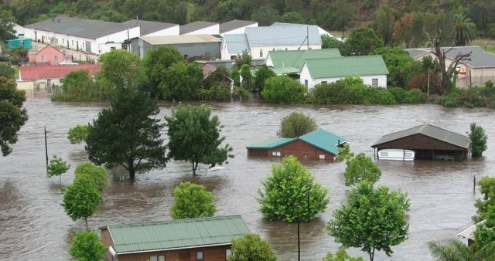
Introduction to Impact-Based Forecast and Warning Process Dr. Elizabeth Page Director, The COMET Program

Slide 2
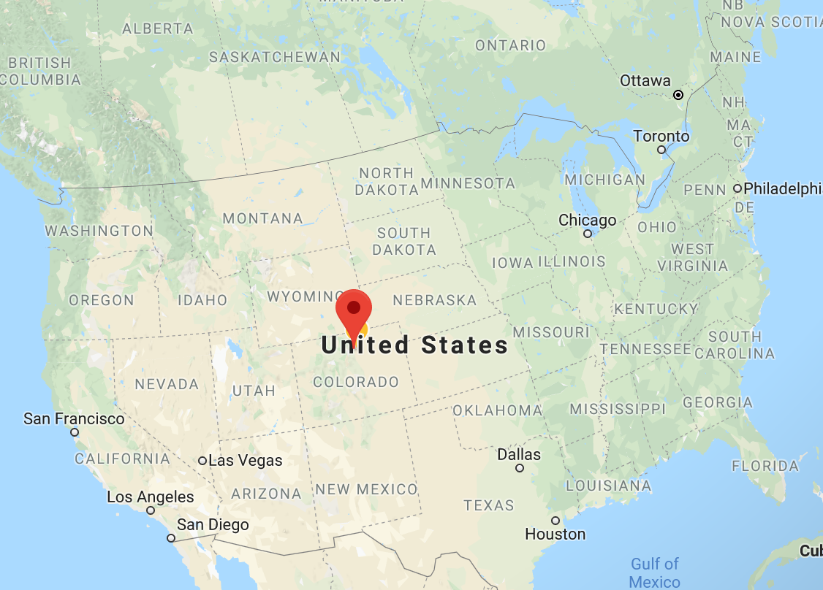
My Background
Education and Training
National Weather Service USA
Impact-based Forecast experience
Fire Weather
Agricultural Weather
Coordinating WeatherReady Nations Program for USA
www.meted.ucar.edu

Slide 3
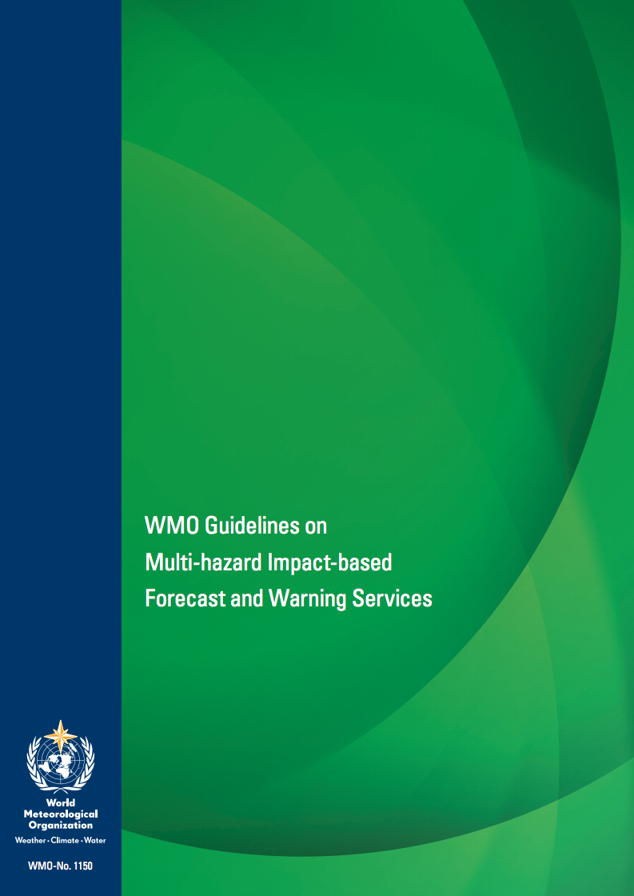
Severe hydrometeorological events profoundly impact people worldwide.
Reorient Focus from what the weather Will be what the weather will do.

Slide 4
Why Impact-based Forecasting?
Stakeholders make decisions based on weather impacts on their activities
Forecasters focus on the needs and concerns of stakeholders
Decision makers use weather information as one input

Slide 5
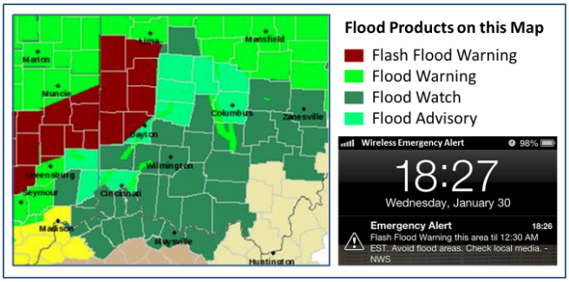
Impact-based forecasts and warnings
Improve products and services for decision-making
Deliver potential effects of forecast weather on your stakeholders
Warnings based on impact severity levels
Inclusive effort with disaster management agencies and other stakeholders

Slide 6
Partnership with Stakeholders
Protecting life and property
Helping people take action by working with emergency managers and the media
Support economic decisions
Learning what information is needed
Successful impact-based forecasting requires collaboration

Slide 7
Moving Towards Impact-based Forecasting
In Summary
NMHS responsible for timely and accurate forecasts and warnings
Great effort is put into getting the forecast right
Stakeholders make decisions based on impact on lives, livelihood, property and economy
Need more than statements about hydrometeorological events
Information on disaster risk and forecasting impact
Challenge worldwide

Slide 8
International Developments?
WMO: Disconnect between warning of hydromet events, and the understanding of their impacts
‘Weather warnings need to be more tailored towards the end-user’ (KNMI)
‘Weather warnings should only be issued if severe weather is expected to have an impact’ (UK)
IMPACT-BASED WARNINGS
UK implemented in 2011
WMO Guidelines (latest version 2015)
Europe, USA, Australia in various versions
WRNs efforts

Slide 9
Disaster Management Survey
Needs:
Matter-of-fact information
Communication that enables effective decision making
“Just tell me what is going to happen, when, where and how serious it will be”

Slide 10
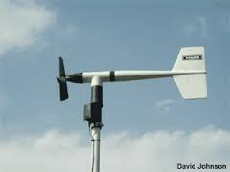
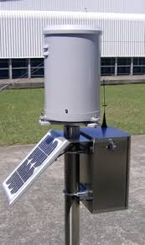
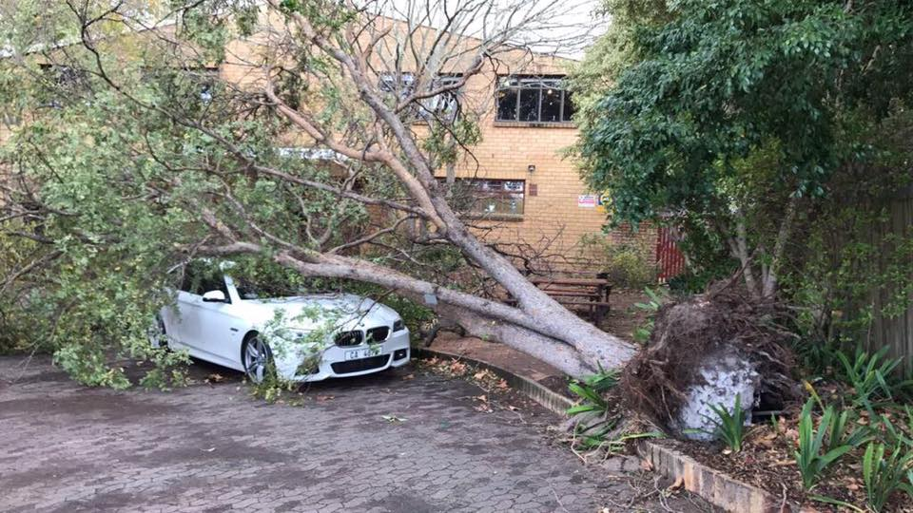
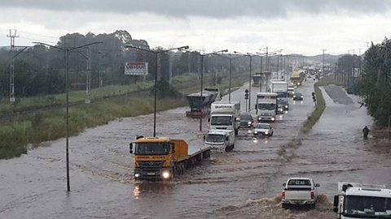
What the weather will do: - Roads flooded - Communities cut off
Impact-Based forecasting
To:
Moving from:
What the weather will be:
- 50mm in 24 hours
- 35 knot winds

Slide 11
Key Concepts for IBF
Hazard
Forecast uncertainty
Exposure
Vulnerability
Risk
Partnerships

Slide 12
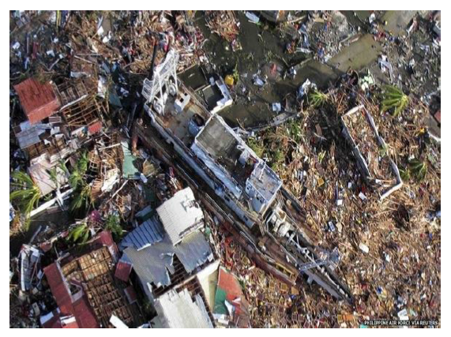
Moving Towards Impact based Forecasting
What causes hazards to become human disasters?
How does a good forecast, become a bad outcome?

Slide 13
Case Study – India
Event: Flooding
Place Uttarakhand, India
Date: 14-17 June, 2013
Synopsis:
A convective storm brings 340 mm of rainfall
375% of the daily normal during monsoon season
Devastating floods and landslides
Impact:
Over 5700 fatalities, 4200 villages affected

Slide 14
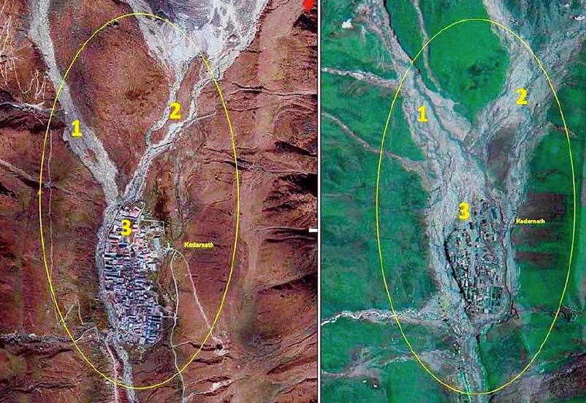
Region before and after flooding

Slide 15
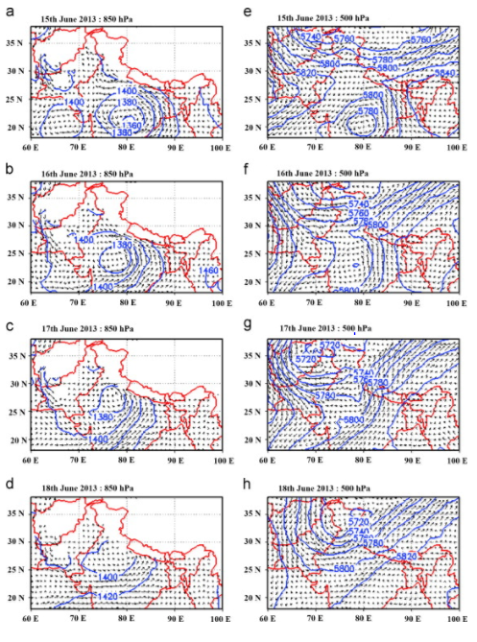
What worked
Forecasts of heavy rainfall three days ahead of event
Weather warnings were issued
Media reported the forecasted heavy rainfall

Slide 16
What did not work?
Warning information was not fully understood by state government
Local preparedness for this magnitude of hazard was inadequate
Late response resulted in hazards to responders during rescue operations
Poor communication between central government and state disaster management agencies

Slide 17
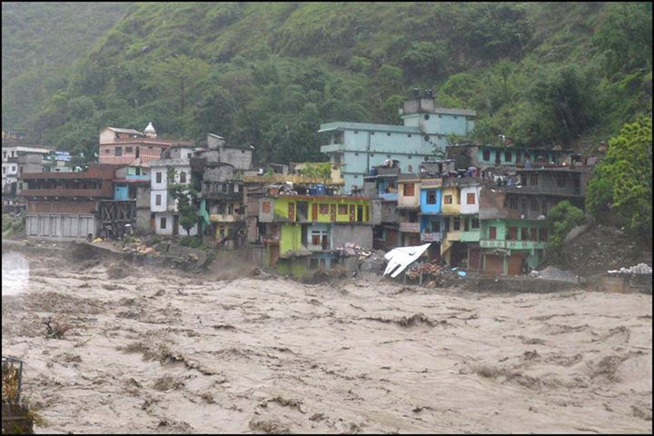
What did not work?
Weather models and hazard models not coupled
Hazard information not translated to impacts
Communication channels failed
Hazard maps not properly utilized
Observation network inadequate to forecast on the scale required for the state

Slide 18
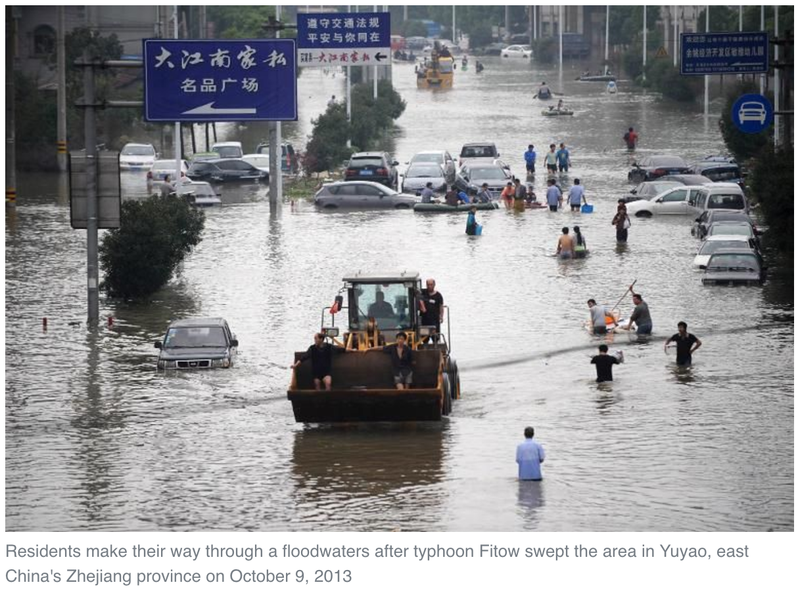
Case Study – China
Event: Tropical Cyclone Fitow
Place: China
Date: 06-08 October, 2013
Synopsis:
156 mm of precipitation, the most rainfall in 18 hours recorded since 1961
Impacts:
97 roads and 900 communities were flooded
1.2 million people directly affected
12 deaths
https://sg.news.yahoo.com/typhoon-fitow-kills-10-east-china-province-171952703.html

Slide 19
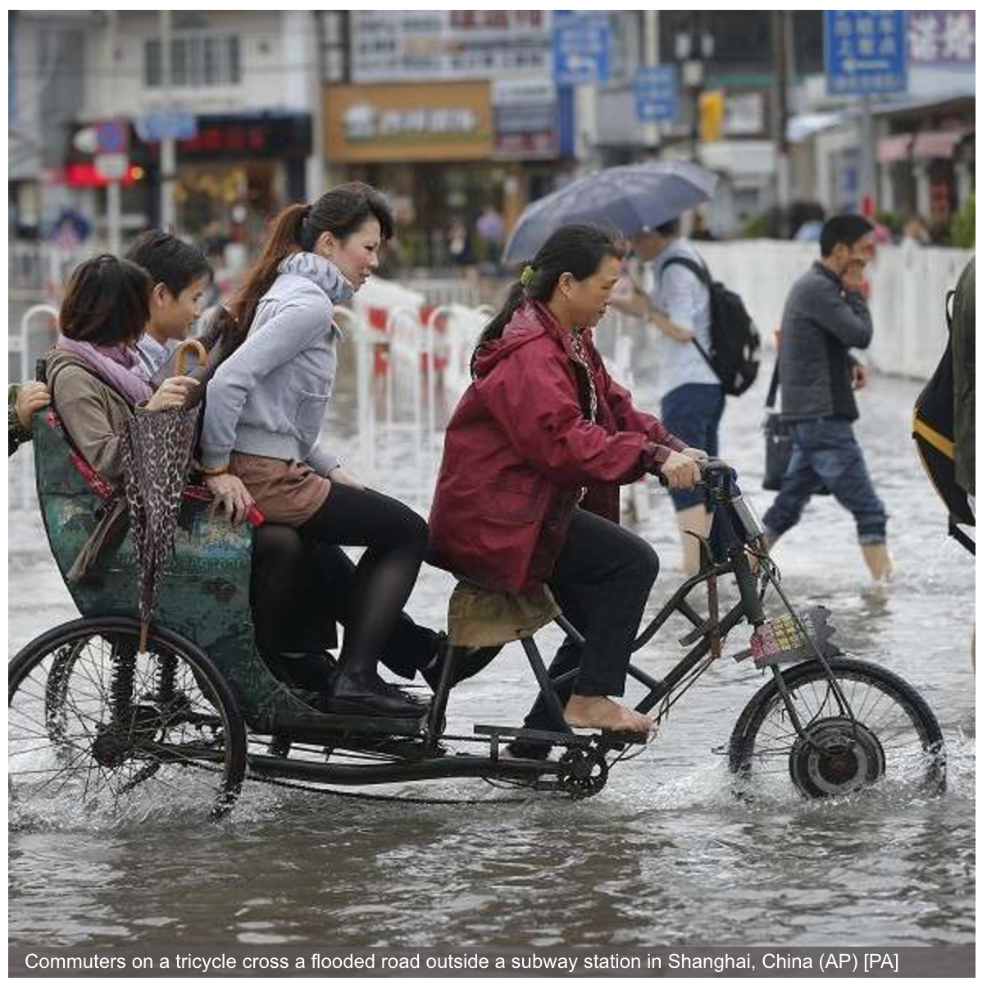
Other factors
Using thresholds is limited
Specific guidance for the circumstance
Consider the vulnerability and exposure to the hazard.
Timing of an event
First day of school and work after the Chinese national holiday.
Highest alerts released while people were going to work
https://www.express.co.uk/news/world/435222/China-hit-by-flooding-after-typhoon
Notes:
Accurate warnings were issued by the Philippine meteorological agency (PAGASA) – for heavy rain and winds in time, and the government deployed planes and helicopters to the regions most likely to be affected.

Slide 20
Risk Information
Assess Risks
Are the hazards and the vulnerabilities well known?
Are risk maps and data widely available?
Monitoring and Early Warning
Develop hazard monitoring and early warning services
Are the right parameters being monitored?
Can accurate and timely warnings be generated?
Dissemination and Communication
Communicating risks and early warnings
Do warnings reach those at risk?
Is the warning information clear and actionable?
Response Capability
Build national and community response capabilities
Are response plans up to date and tested?
Are people prepared and ready to react to warnings?
How does it work?

Slide 21
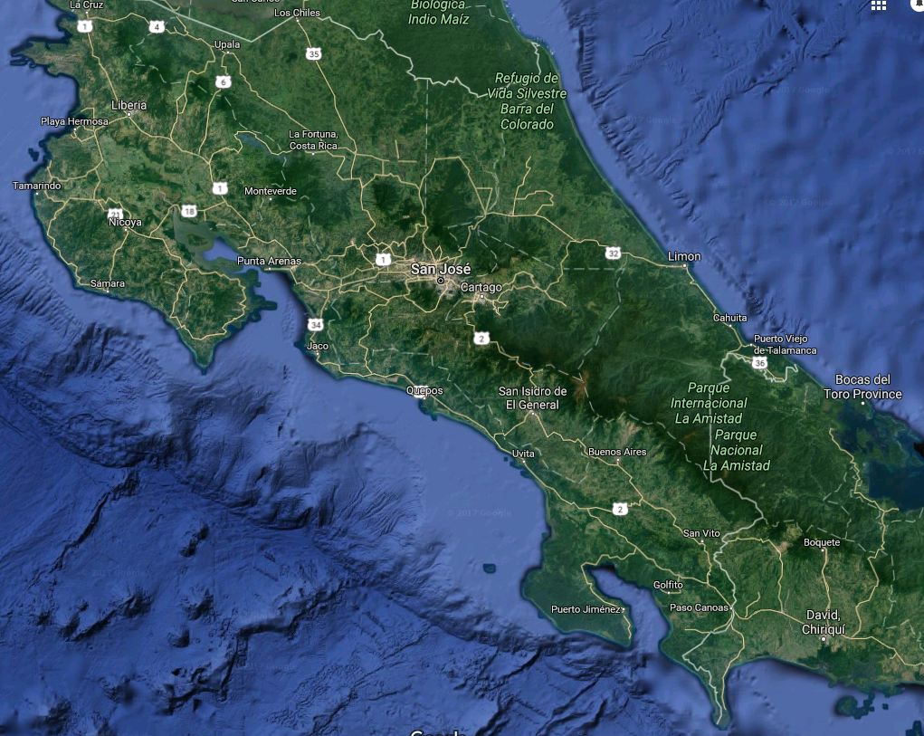
Warning: Heavy rain of more than 100mm in 24 hours is expected
We need to change from this…
So??
What does it mean to me?

Slide 22
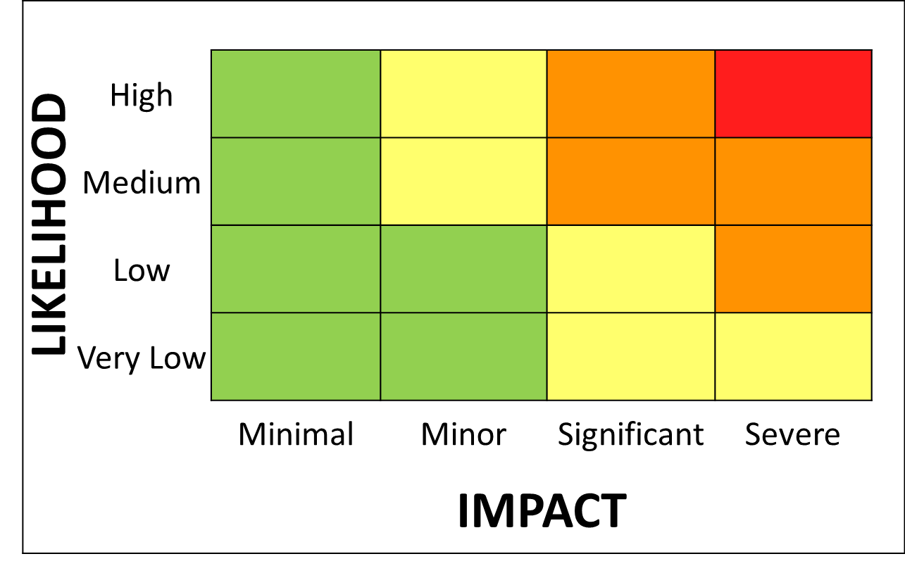
Warning: 1. Orange warning for rain with a medium likelihood of significant impacts 2. Yellow warning for rain with a high likelihood of minor impacts
To an impact-based Early Warning System
2
1
2
1

Slide 23
Barbados Hazard Matrix
Primary | Secondary | Tertiary
High Winds | High Seas and Surf, Gale and Small Craft Impacts | Wind Shear and Flight Hazards hindering safe flight operations, Small Boats and high surf impact the health and safety of populations.
Severe Convection | Heavy Rain, Lightning, Wind Gusts, Flooding and Flash Flooding | Health and Safety of the Populations, potential evacuations of persons needed.
Heavy Rain Events | Flooding and Flash Flooding | Roads flooded, homes destroyed, evacuation of persons needed. Possible landslide hazards, crop failure. Health and Safety of Population.
Tropical Cyclones | Strong Winds, Heavy Rains, Storm Surge, Flooding and Inundation. | Structural damage, damaged infrastructure. Health and Safety of Population

Slide 24
So, how does it work?
Impact tables define the different levels of impact
Impact level depends on vulnerability of the region
Disaster management agencies give input to the tables
General description of different impact levels
Minimal | Minor | Significant | Severe
Day to day activities not affected but some small scale impacts occur | Some local incidents, minor disruptions, 'business as usual' for emergency responders | Disruption to day to day routines and activities, mostly localised. Short-term strain on emergency responder organisations | Widespread, Prolonged disruption to day to day routines and activities Prolonged strain on emergency responder organisations

Slide 25
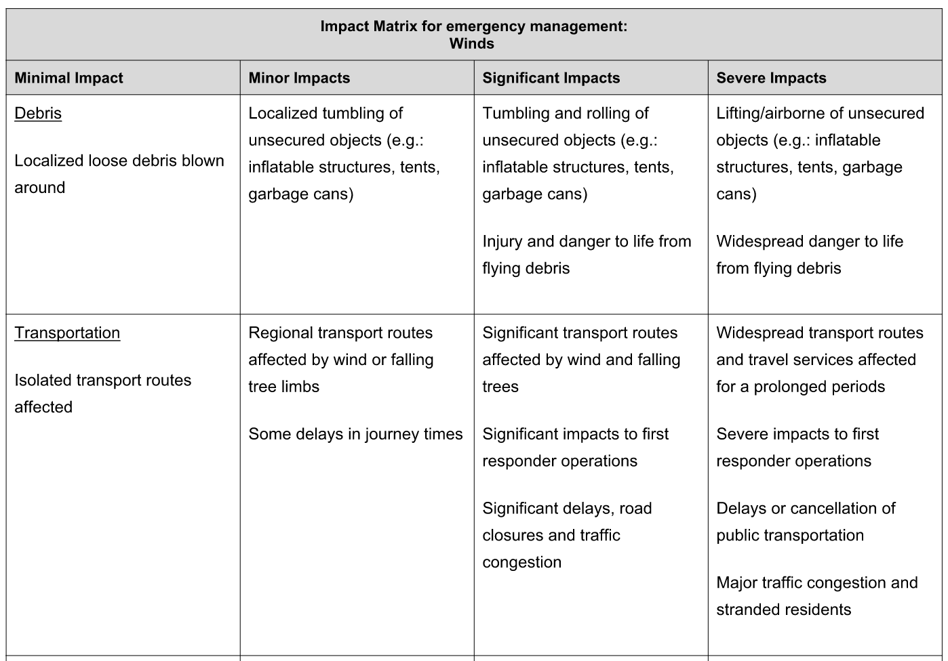

Slide 26
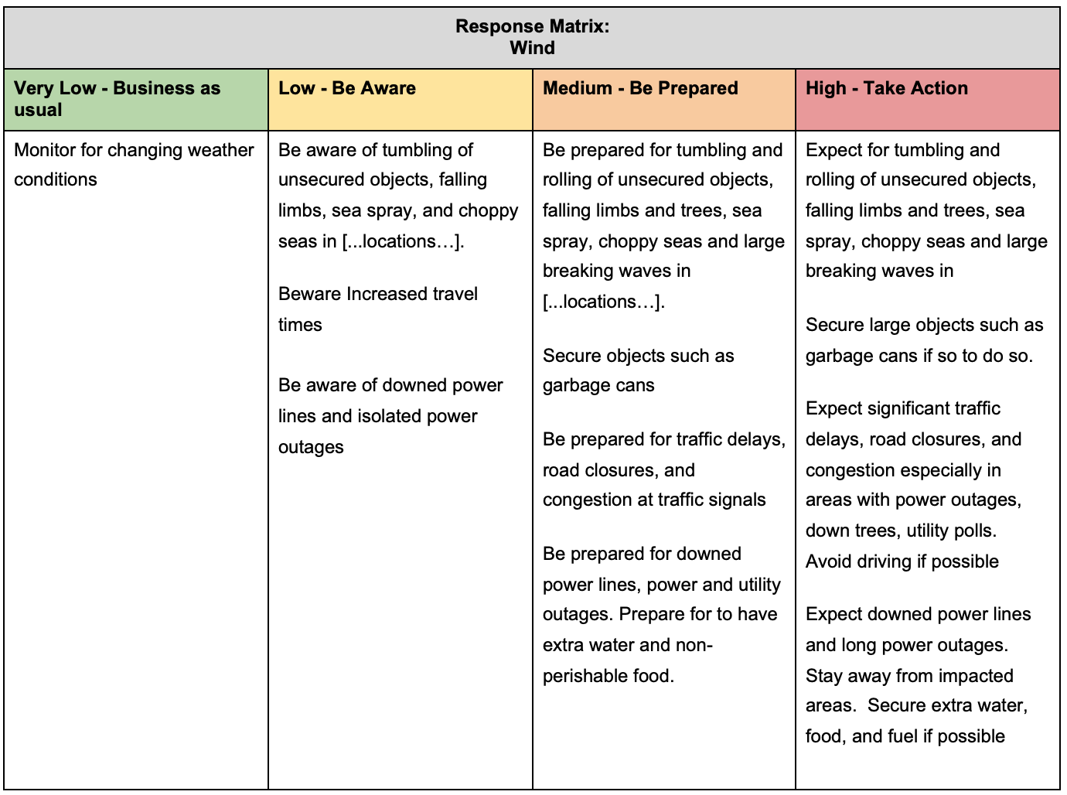

Slide 27
Combine Likelihood and Potential Impacts to Determine Risk and Response

Slide 28
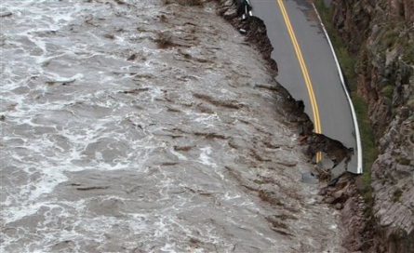
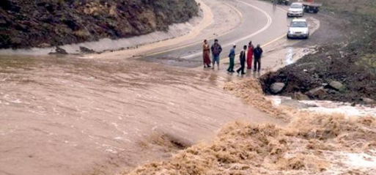
Thank you
Questions?

